Slide 1
MET workshop 180131
Talal Osman
Mechanical Engineer
www.europeanspallationsource.se
26 January, 2018

Slide 2
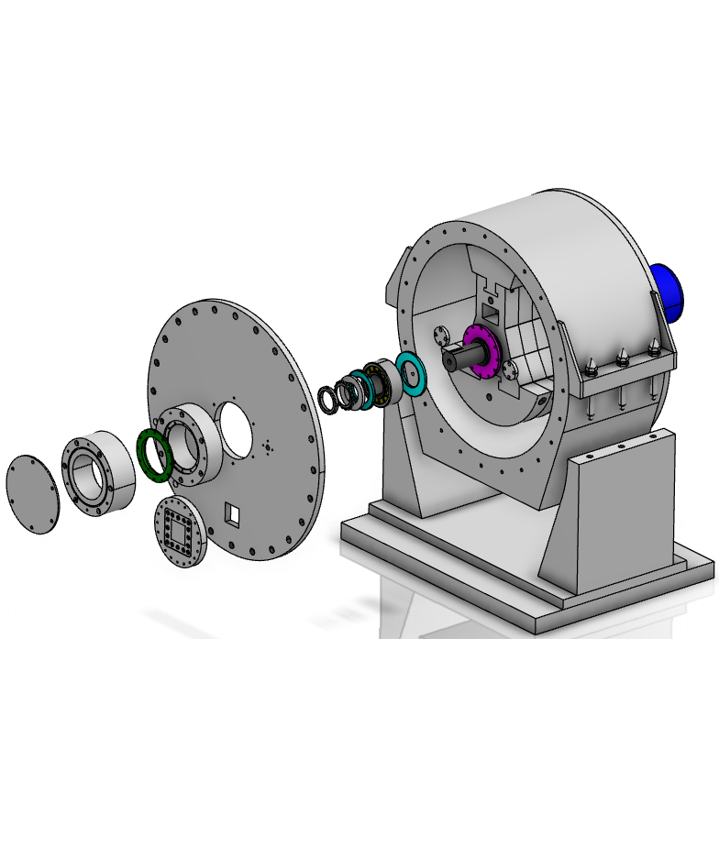
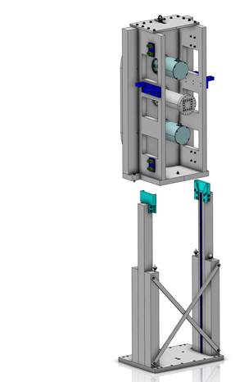
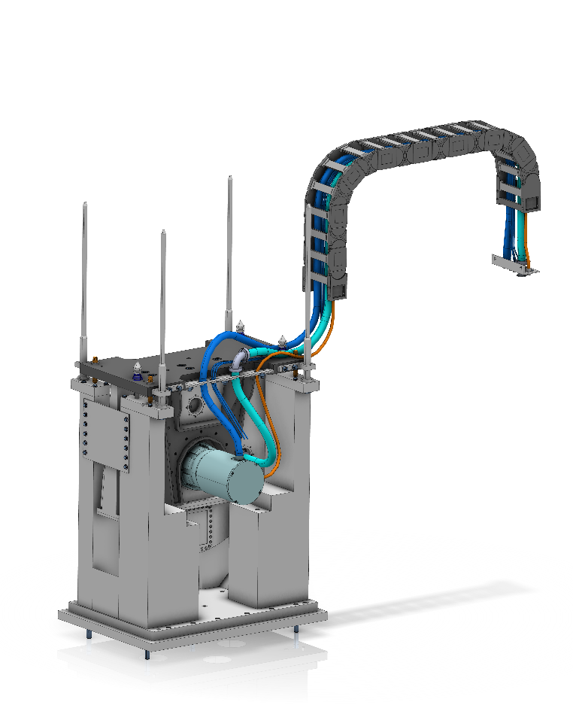
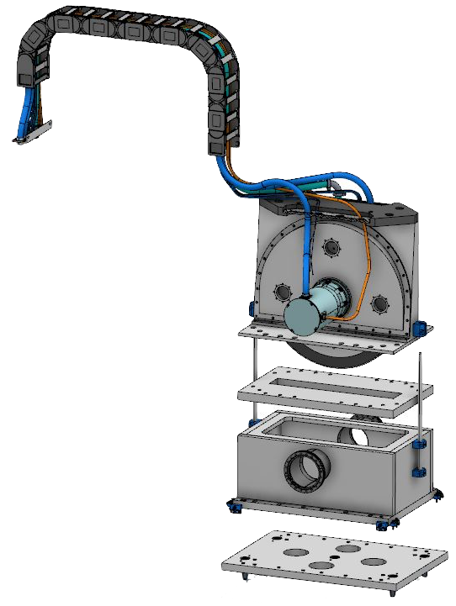
Tasks and responsibilities
  Choppers (201508-201712)
    Design
      Pillar Variant
      Horizontal split
      Over & under
      T0
    Requirements specification Document
  Remote handling (2017)
    Remote handling Bolts
    Remote handling design on Choppers
  Bunker (2016 & 2018)
    Heavy shutter
    Feed through
    Piping and cable routing
  NBOA
    The first 3,5m guide of each
    instrument

Slide 3
Expectations on MET
CAD methodology
CAD standard parts
CAD standard materials
Review process
  Purpose
    Manufacturing / Function / Fulfil ESS Standards
  Who
    Define who can review
      Mechanically
      Welding
      Analyse
      Shielding
      QA/QC

