Slide 1
Stig Jörstad
www.europeanspallationsource.se
18-01-30

Slide 2
Work Experiance:
  Working for Target Section since Nov 2015
  35 years experiance from Mechanical Design, Installation, Testing, FAT (Fabrication Acceptance Test), On Site Work, Supplier followup, etc.

Slide 3
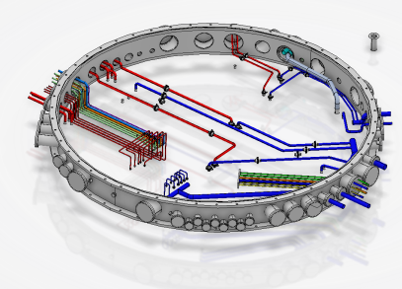
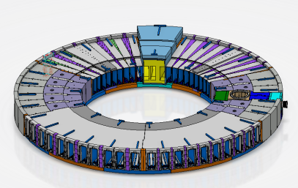
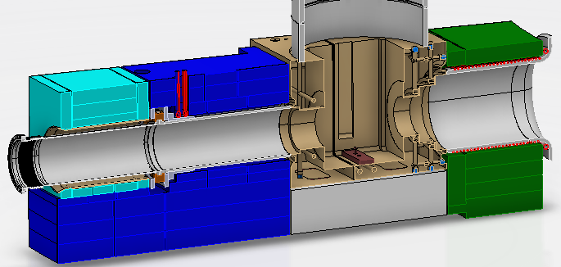
Overview some tasks
Concept design Connection Ring- Water Cooling.
Concept design Monolith Port Block.
Concept and detail design Proton Beam Window - Port Block. Water cooling loop, Main Port Block for Production.

Slide 4
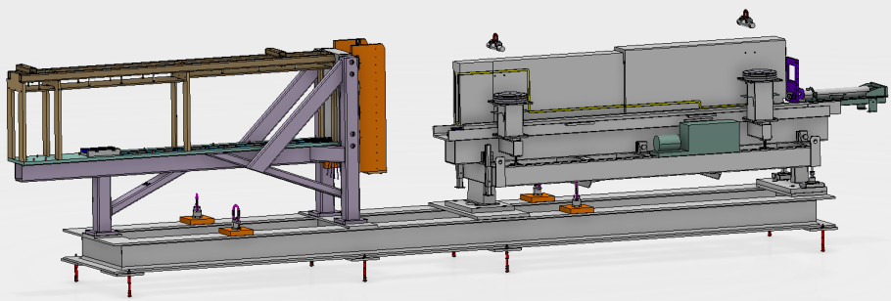
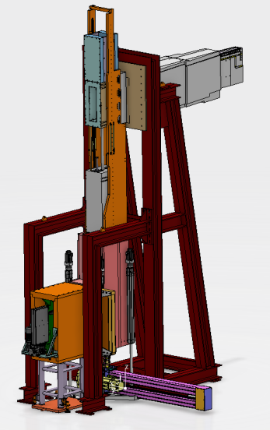
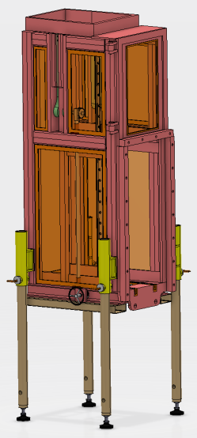
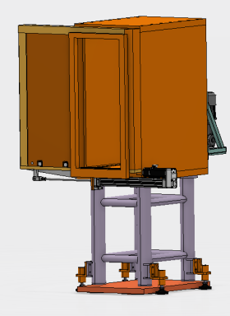
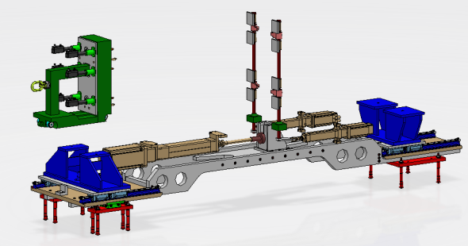
NBEX Concept and detail Design
  Test stand for Mockup Jigg and IET tool
  NBEX Insert Extration Tool
  Light Shutter Cask
  VHTS Vertical Handeling test Stand
  Lower Extration Installation Tool

