Slide 1
STUB installation
Mats Pålsson
www.europeanspallationsource.se
18-01-31

Slide 2
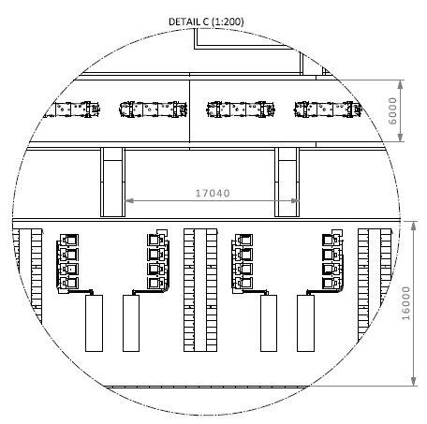
STUB data
How many STUBS
2 Warm Linac
3 Spoke
1 Spoke/Medium Beta
4 Medium Beta
10,5 High Beta
6,5 Contingency
27 STUBS in total
STUB

Slide 3
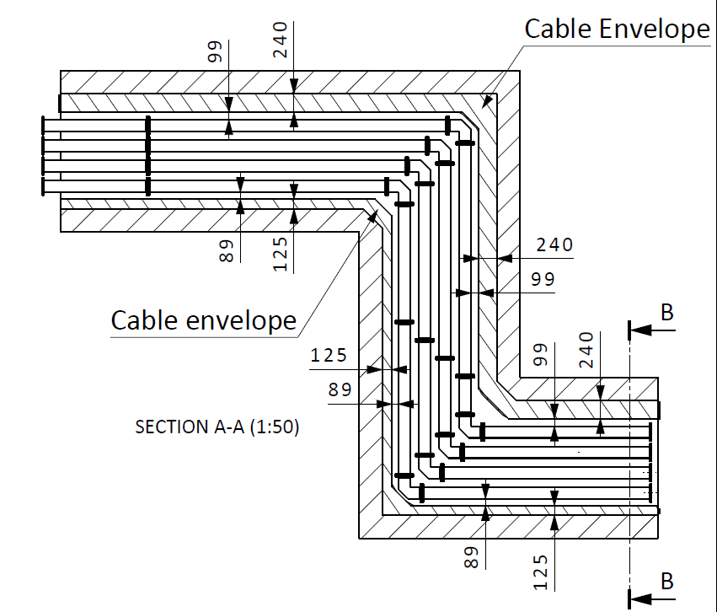
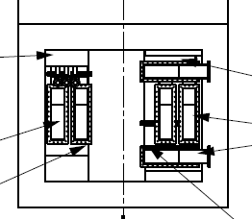
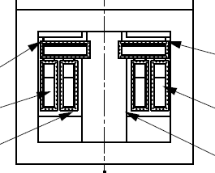
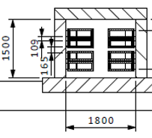
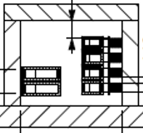
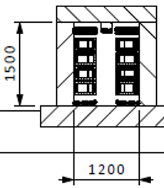
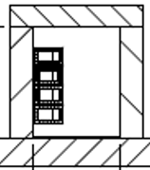
STUB data
Dimensions of STUBS
6 STUB: section W=1800mm, H=1500mm
21 STUB : section W= 1200mm, H=1500mm
Bilbao
Bilbao

Slide 4
STUB data
Content in STUBS
Waveguides for RF distribution
Cables for Power and Signals
PSS sampling pipe
Cassette for Beam Instrumentation components
Radiation shielding
Fire sealing
Cooling system to handle heat load from WG and Power Cables (design tbd, probably air cooling applied outside the STUB at the gallery side)

Slide 5
STUB data
Content in STUBS
Waveguides for RF distribution
Number of waveguides: 158
Total length of WG in STUBS: approx. 1800 meter

Slide 6
STUB data
Content in STUBS
Cables for Power and Signals
Max number of cables in one STUB: approx. 550
Total number of cables running through the STUBS: approx. 10.000

Slide 7
STUB data
Content in STUBS
Fire sealing
60 minutes fire resistance in both upper and lower end of STUB

Slide 8
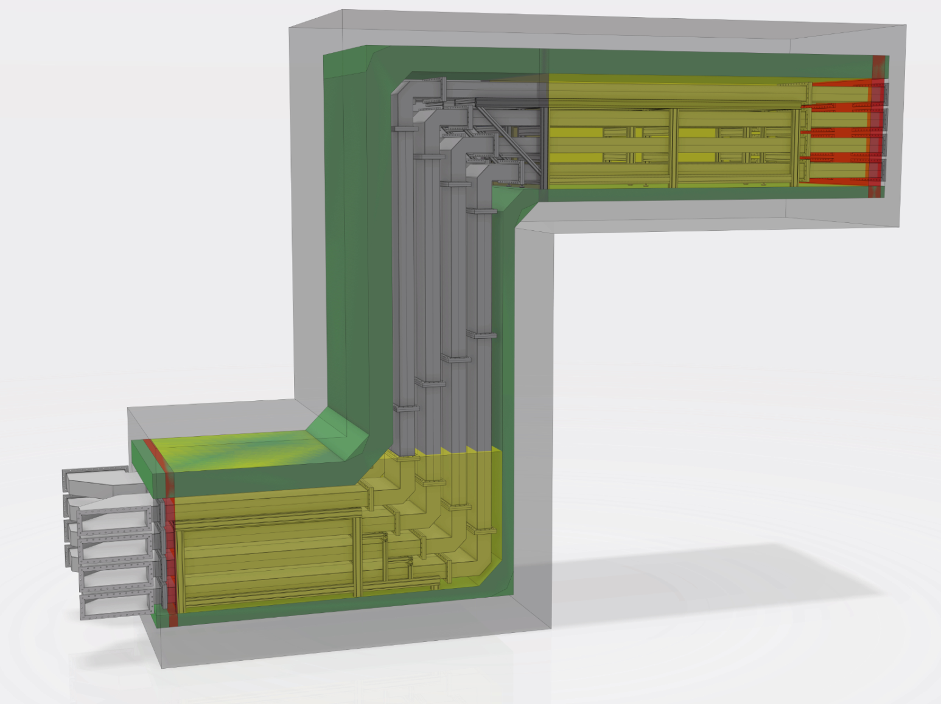
STUB installation

Slide 9
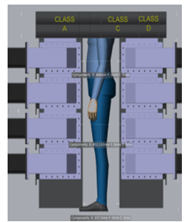
STUB installation
Installation sequence
Cables and cable ducts/trays for signal and control cables in the upper part of the STUB

Slide 10
STUB installation
Installation sequence
Wave guides

Slide 11
STUB installation
Installation sequence
Power cables in the lower part of the STUB

Slide 12
STUB installation
Installation sequence
Installation of BI cassette

Slide 13
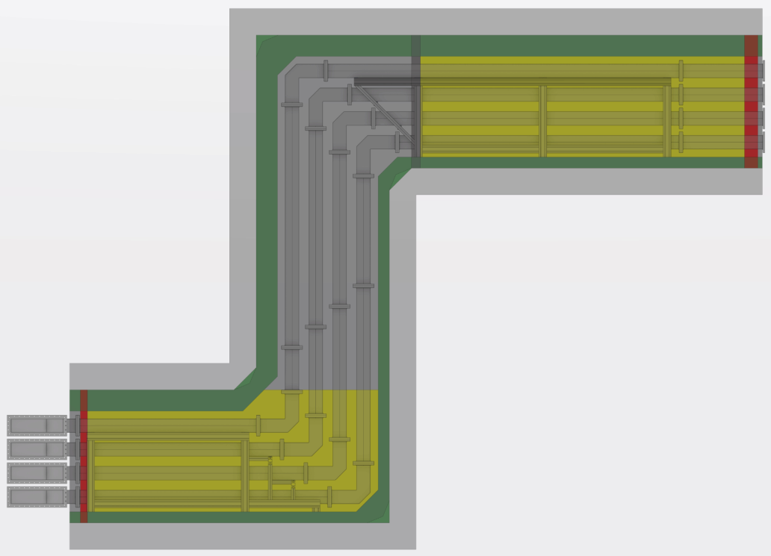
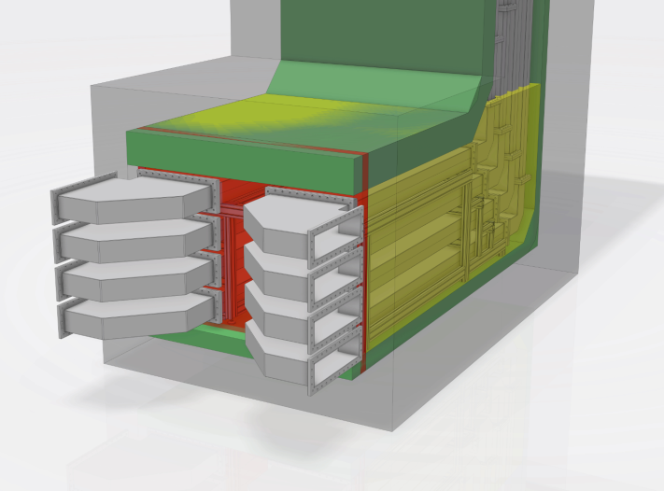
STUB installation
Installation sequence
Installation of Fire sealing

Slide 14
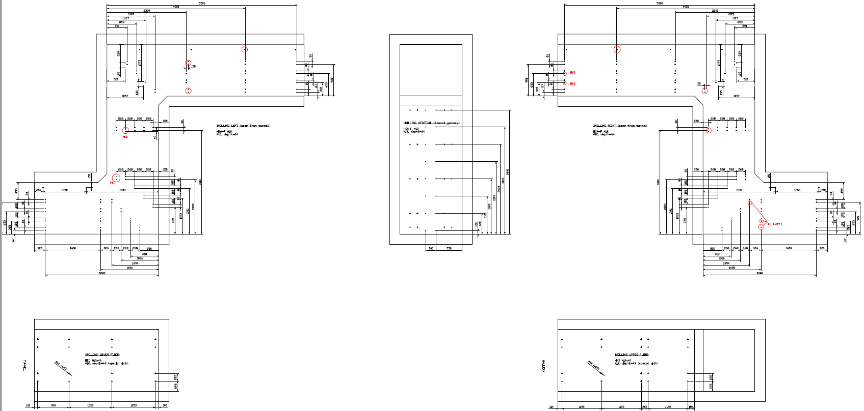
STUB test installation
Marking and drilling
Drilling plan (“as built”)

Slide 15
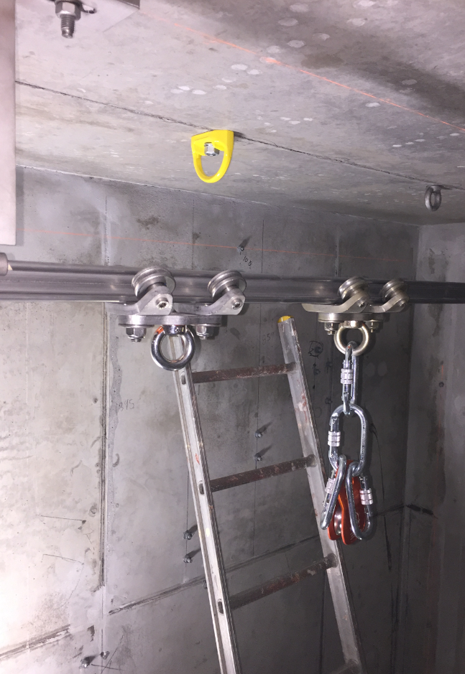
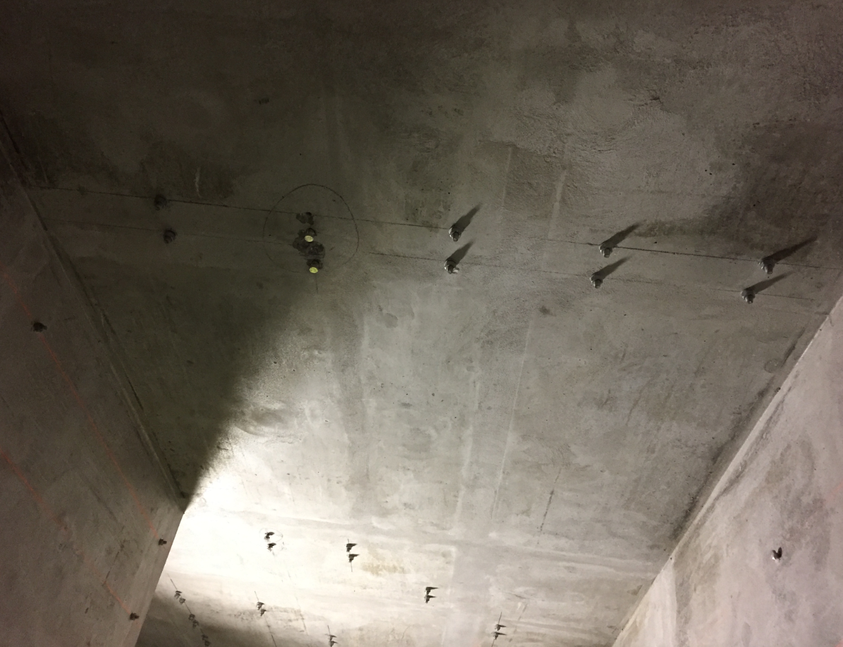
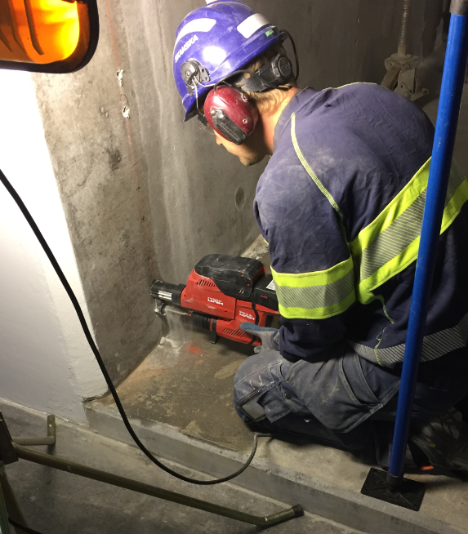
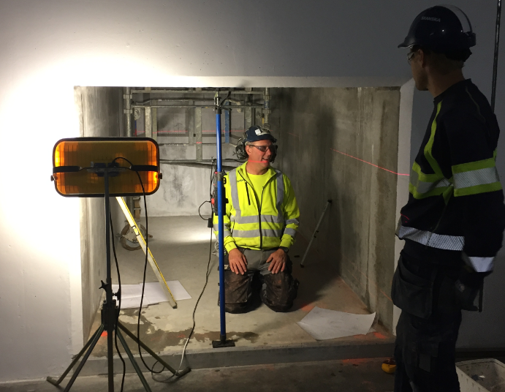
STUB test installation
Marking and drilling
~320 holes
3 types of fasteners
Safety fix points first

Slide 16
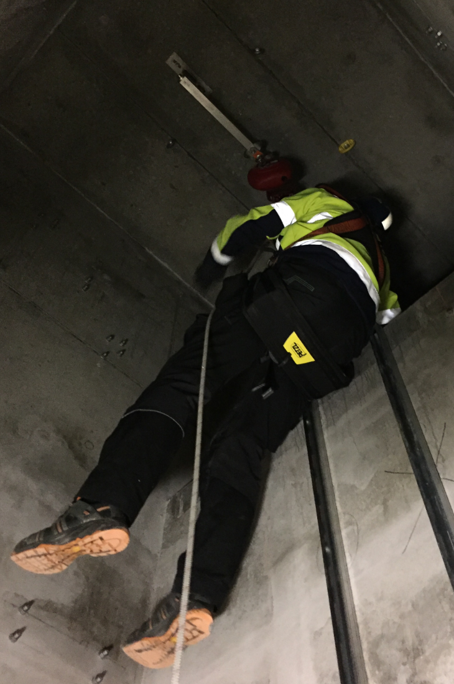
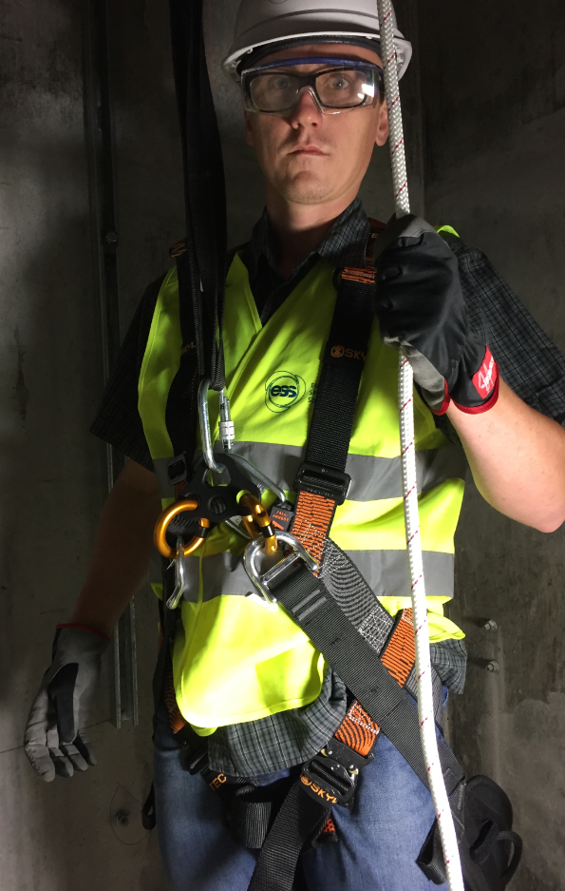
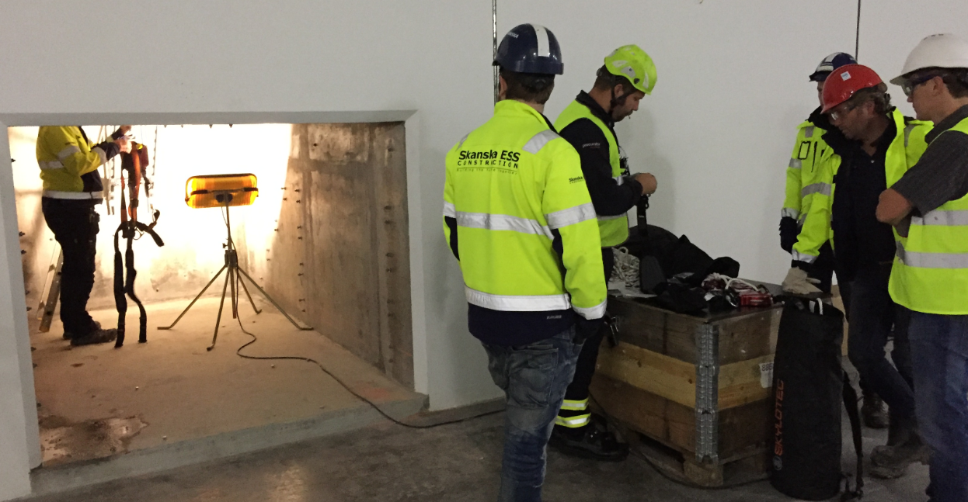
STUB test installation
Safety training
Learning specific equipment for this task

Slide 17
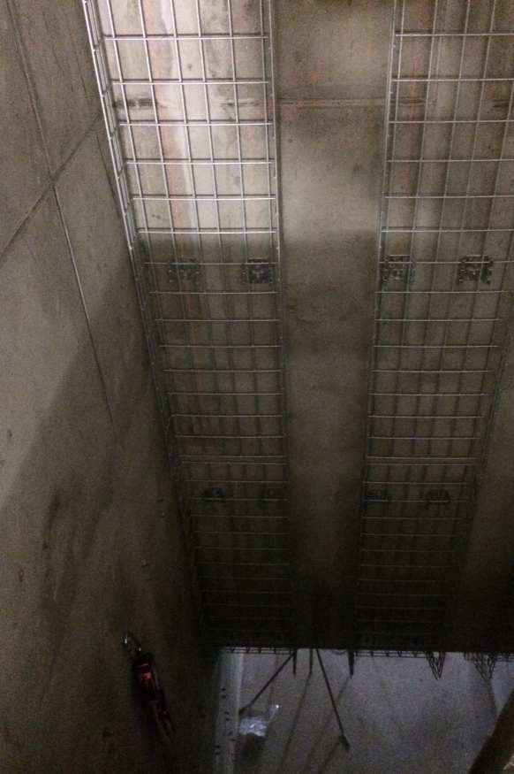
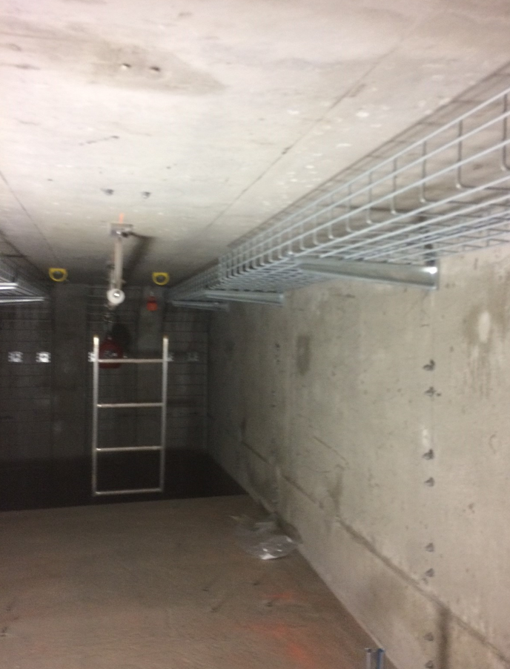
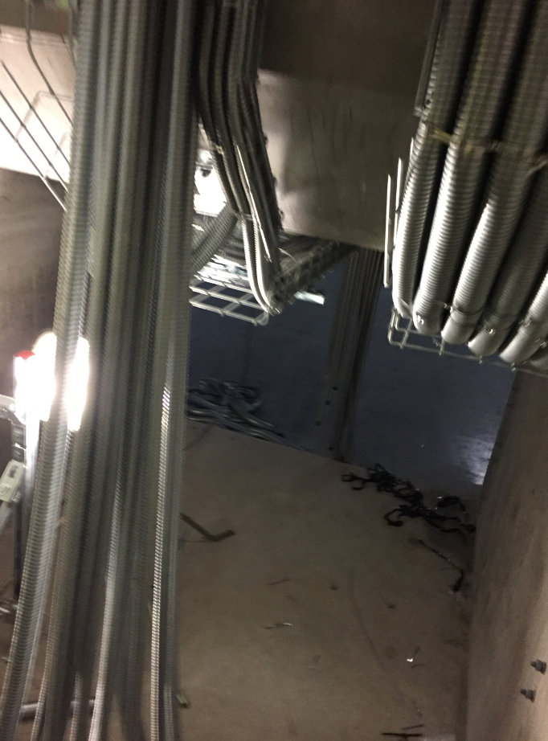
STUB test installation
Cable ways
Basket trays
Flexible metallic conduits

Slide 18
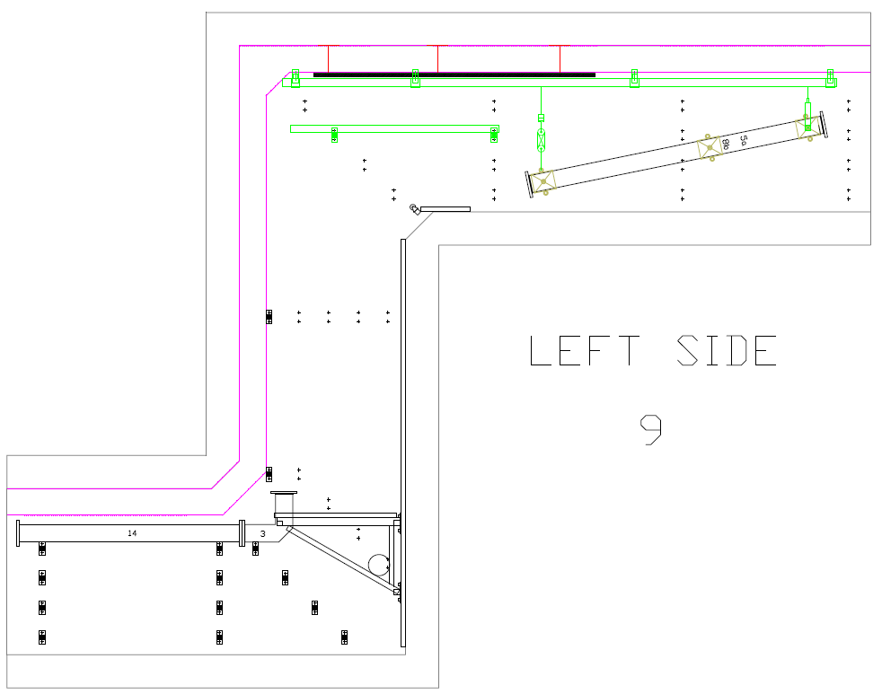
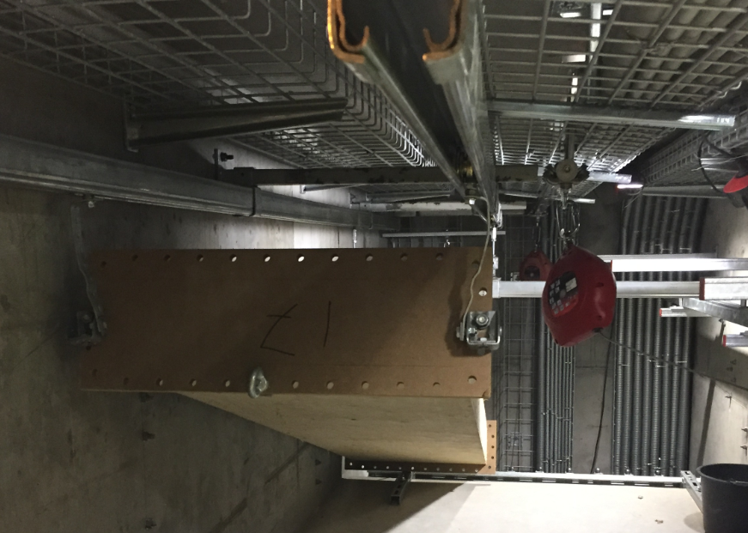
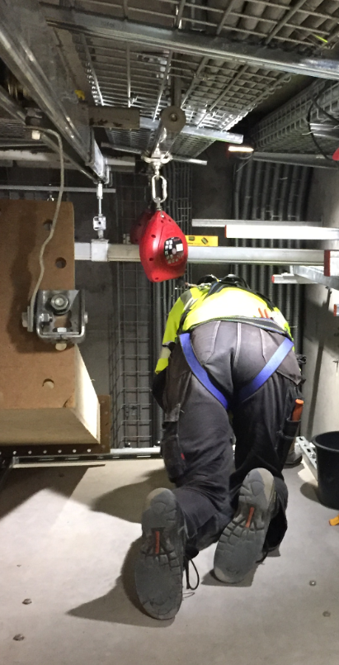
STUB test installation
Waveguides

Slide 19
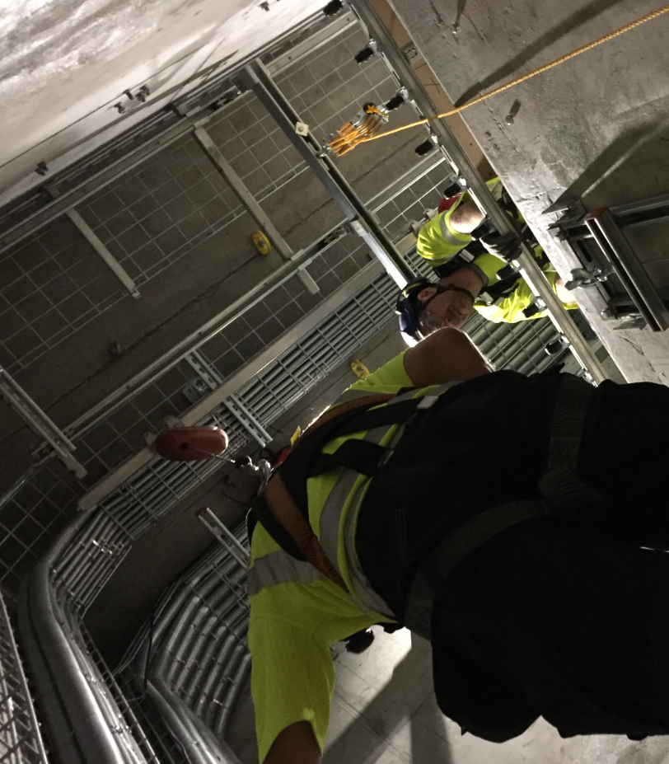
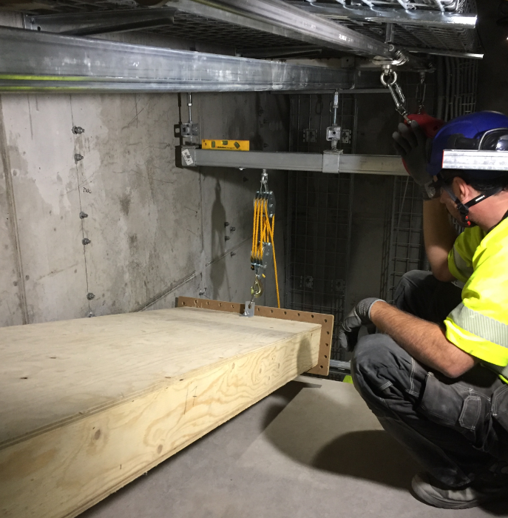
STUB test installation
Waveguides

Slide 20
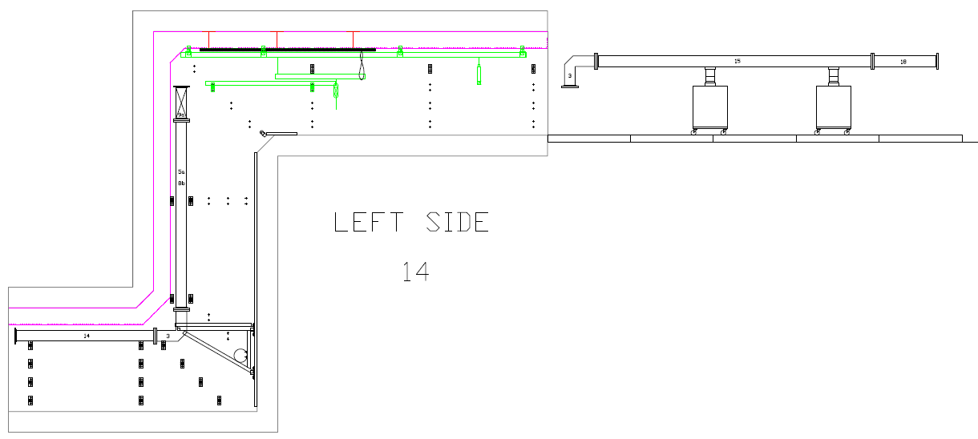
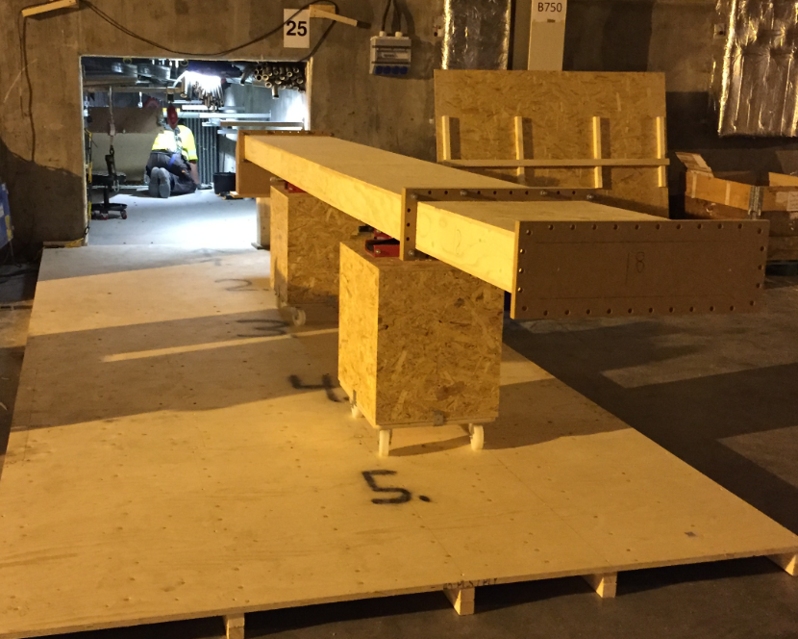
STUB test installation
Waveguides

Slide 21
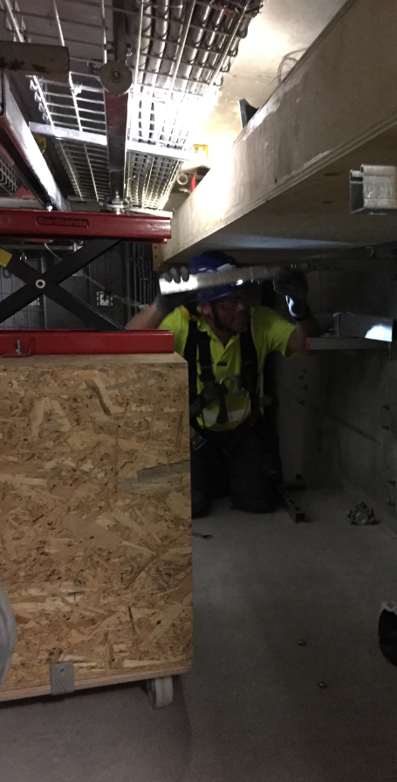
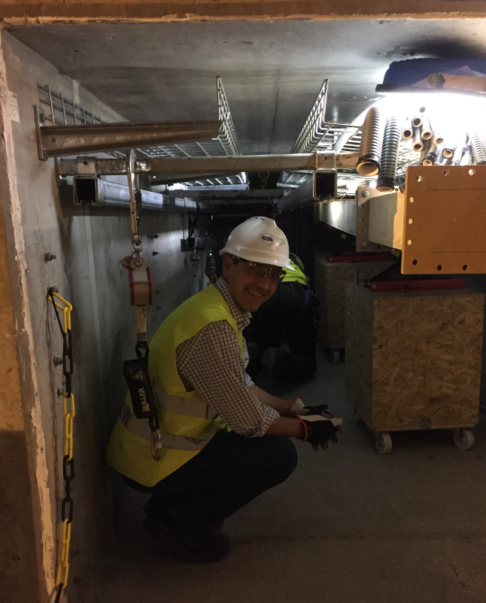
STUB test installation
Waveguides

Slide 22
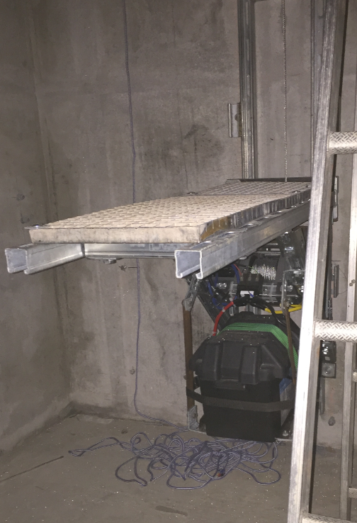
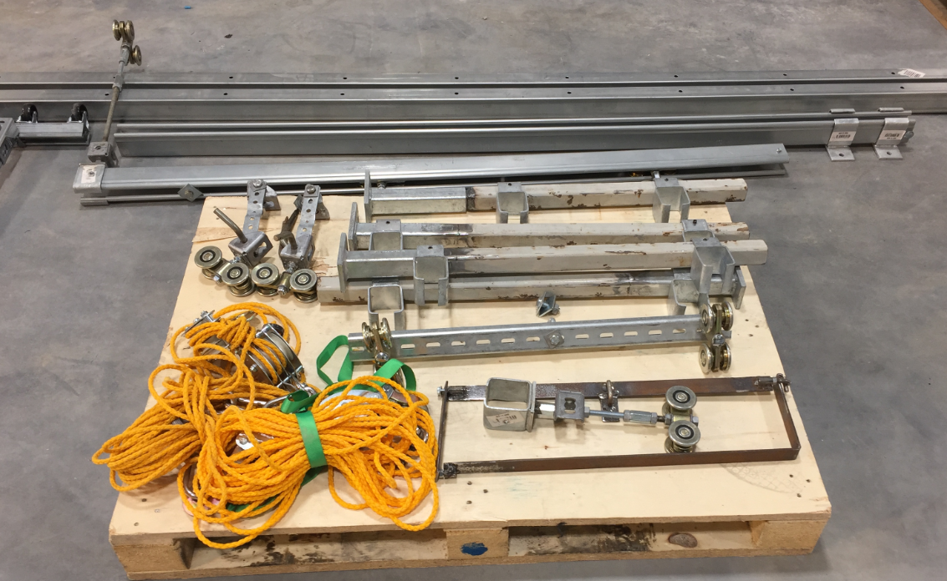
STUB test installation
Waveguides (prototypes)

Slide 23
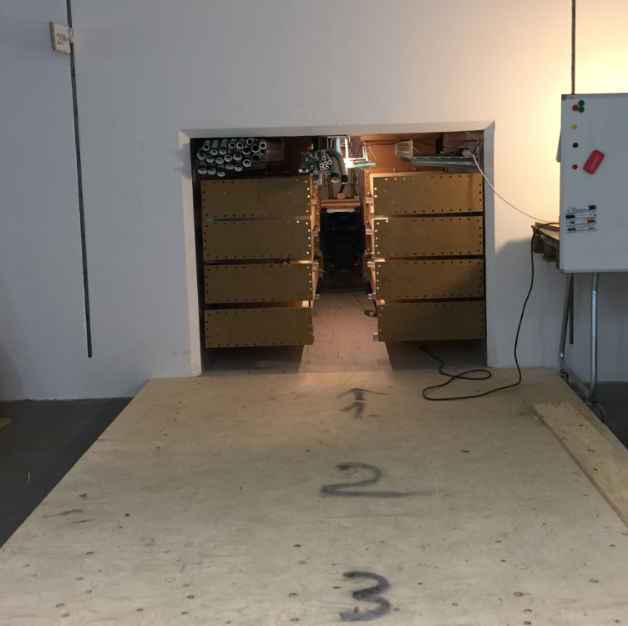
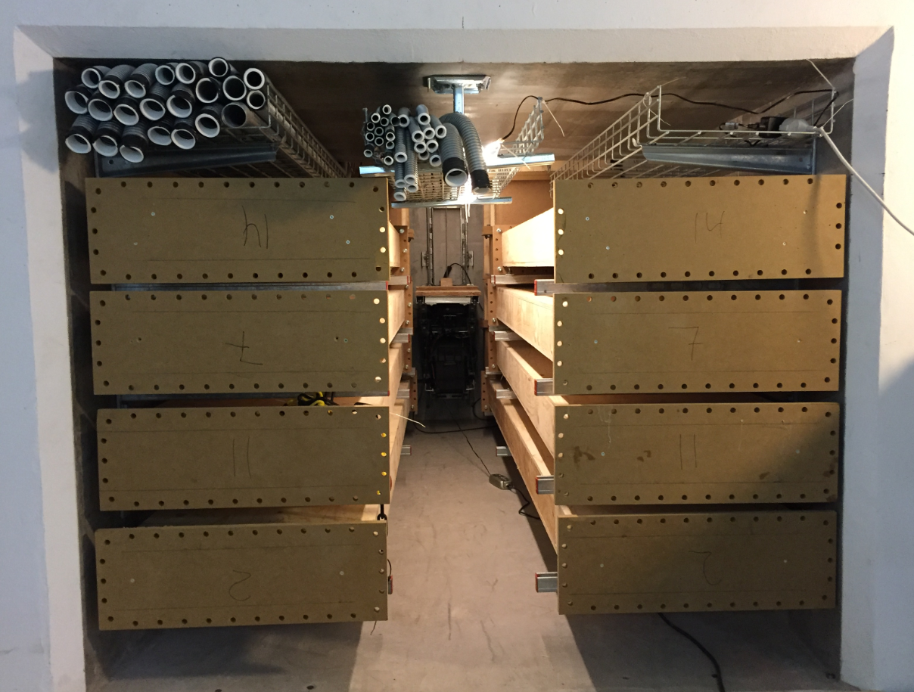
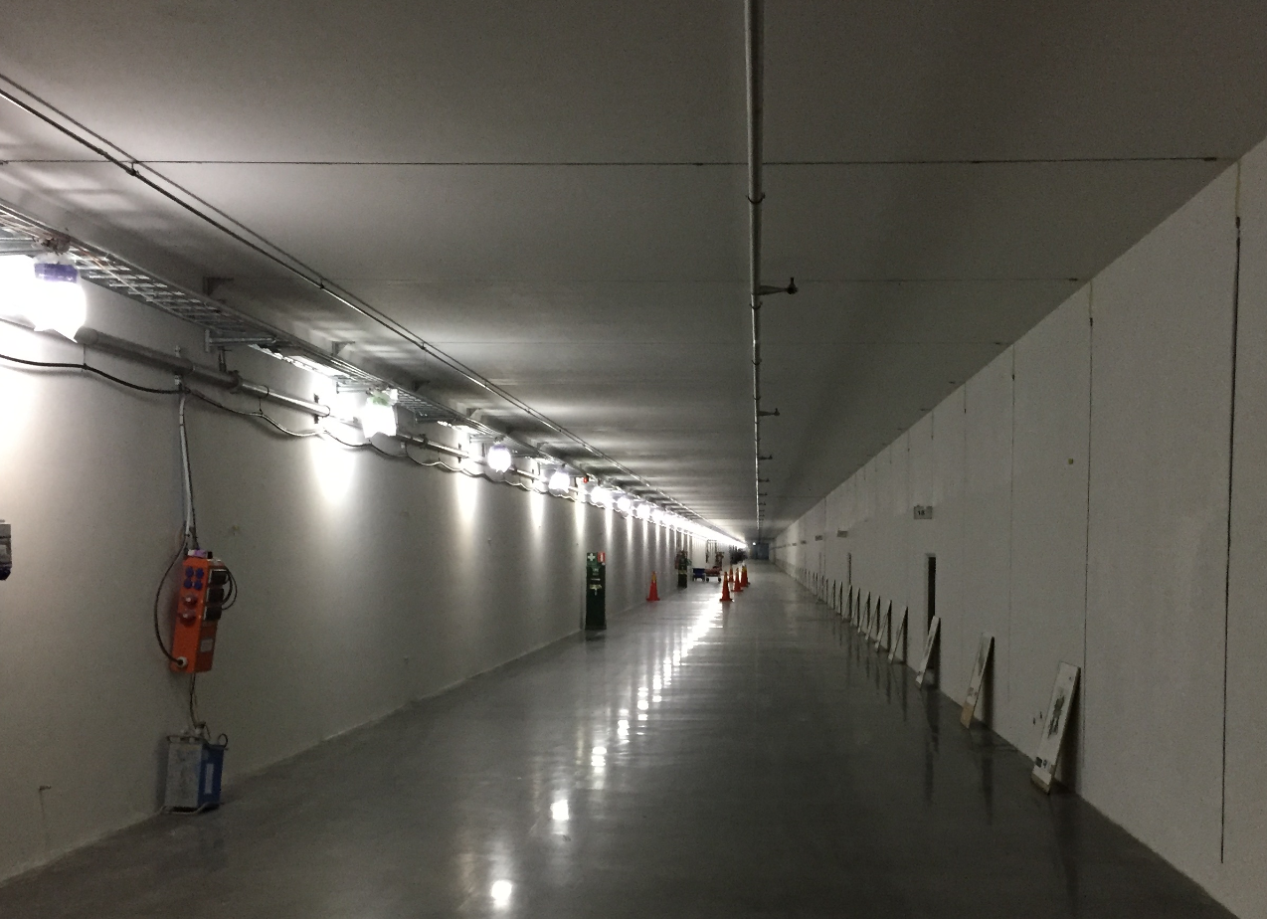
STUB test installation
Waveguides G01 Tunnel side

Slide 24
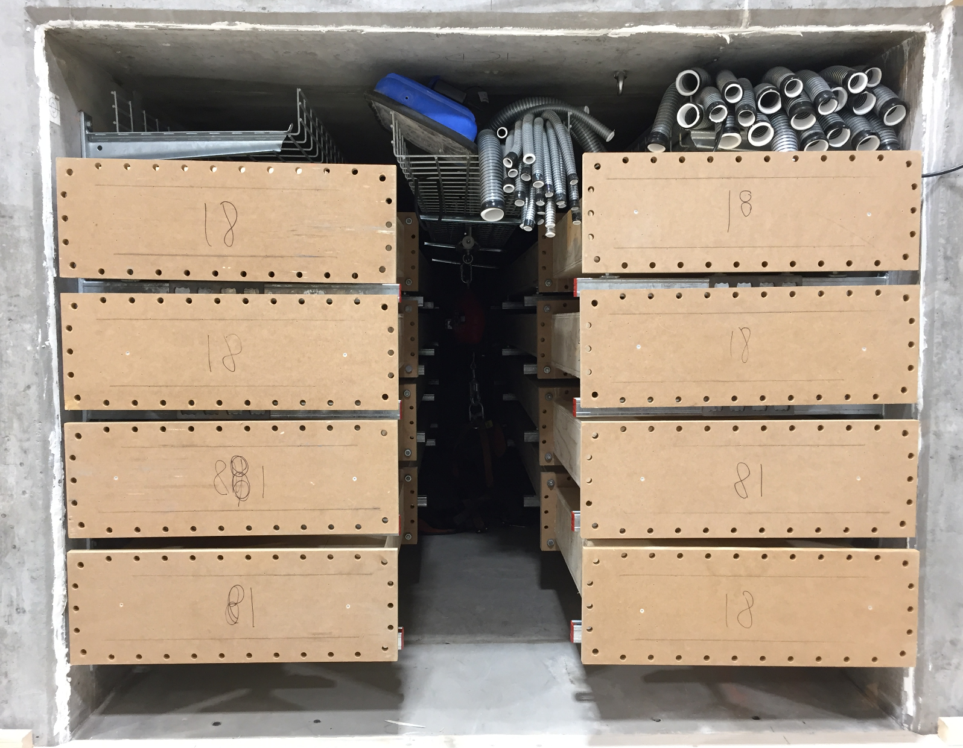
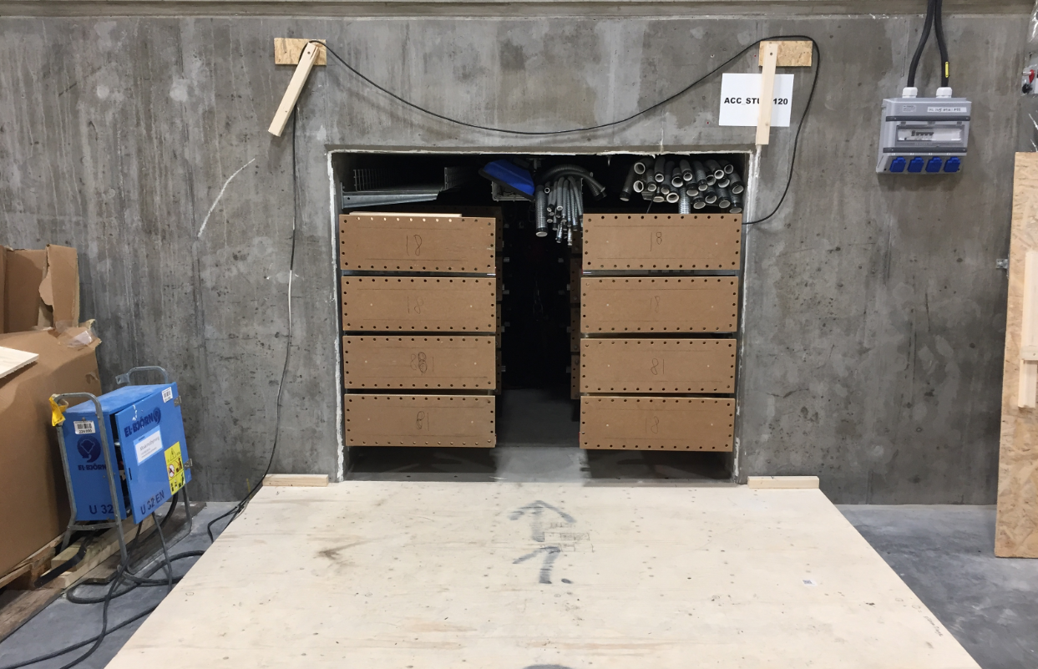
STUB test installation
Waveguides G02 Gallery side

Slide 25
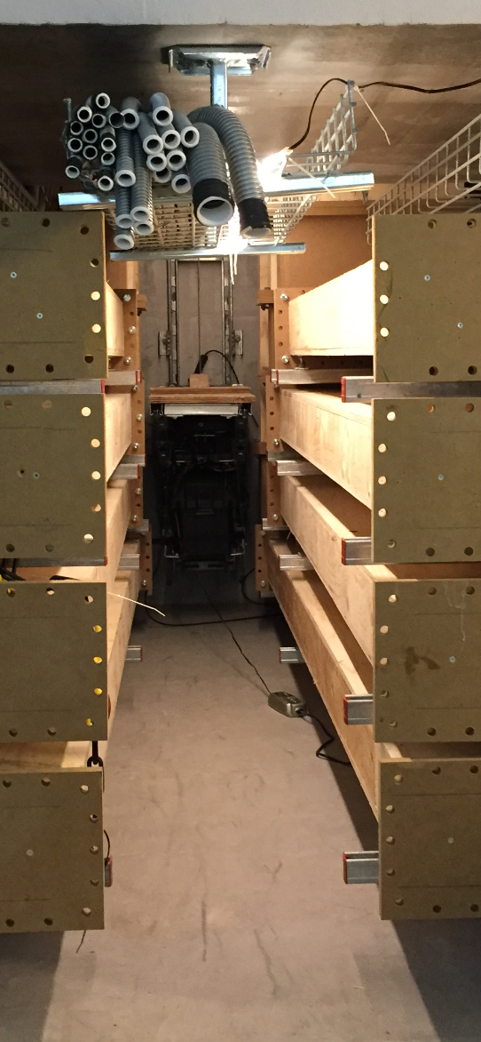
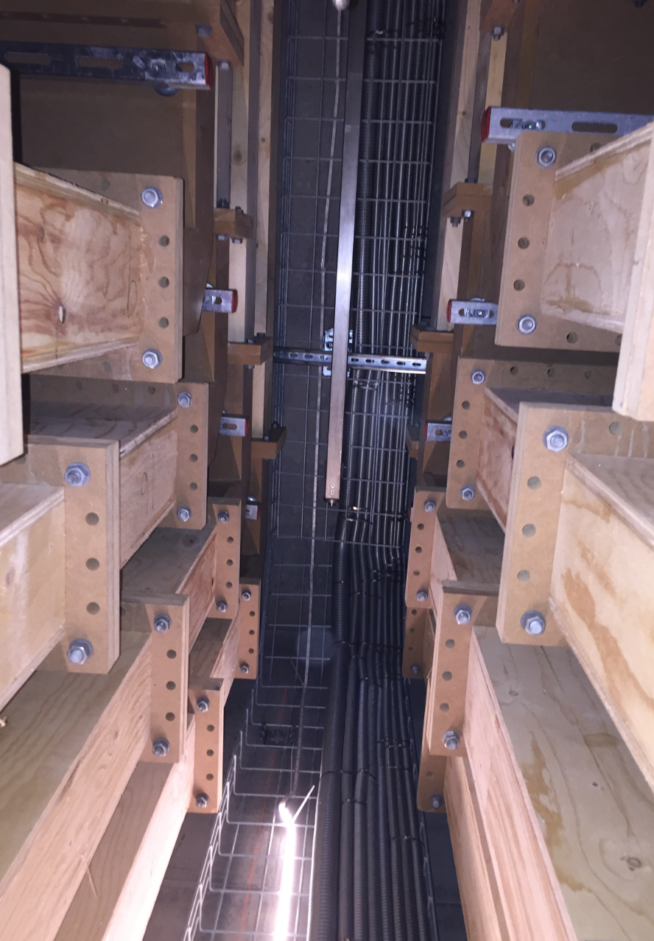
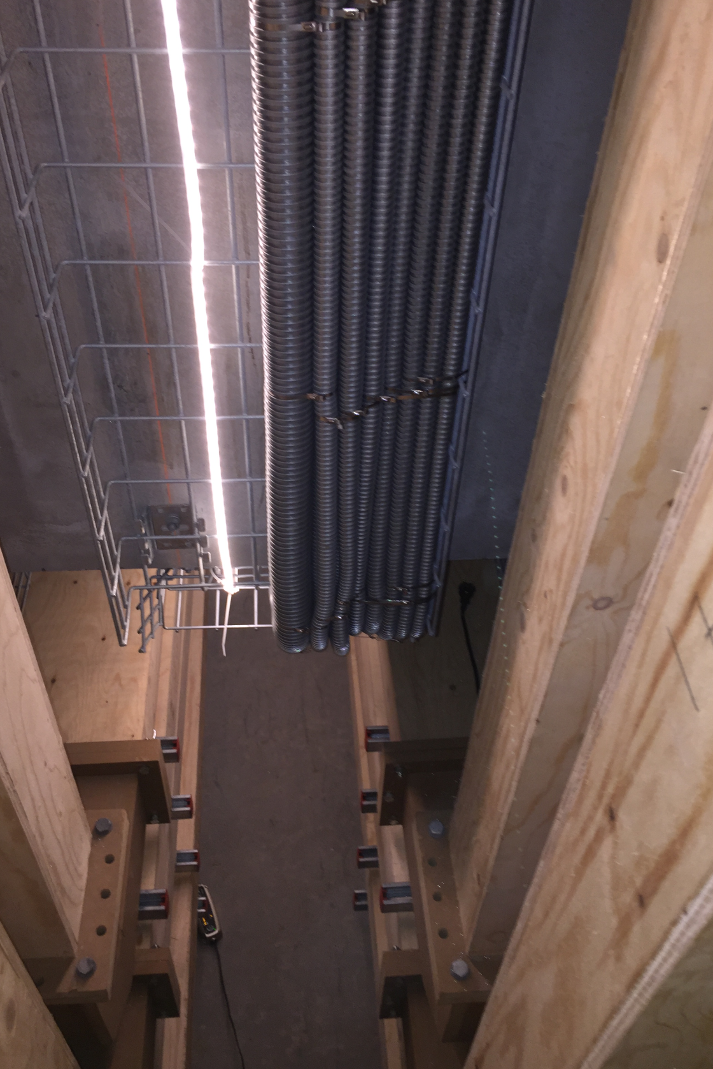
STUB test installation
Waveguides

Slide 26
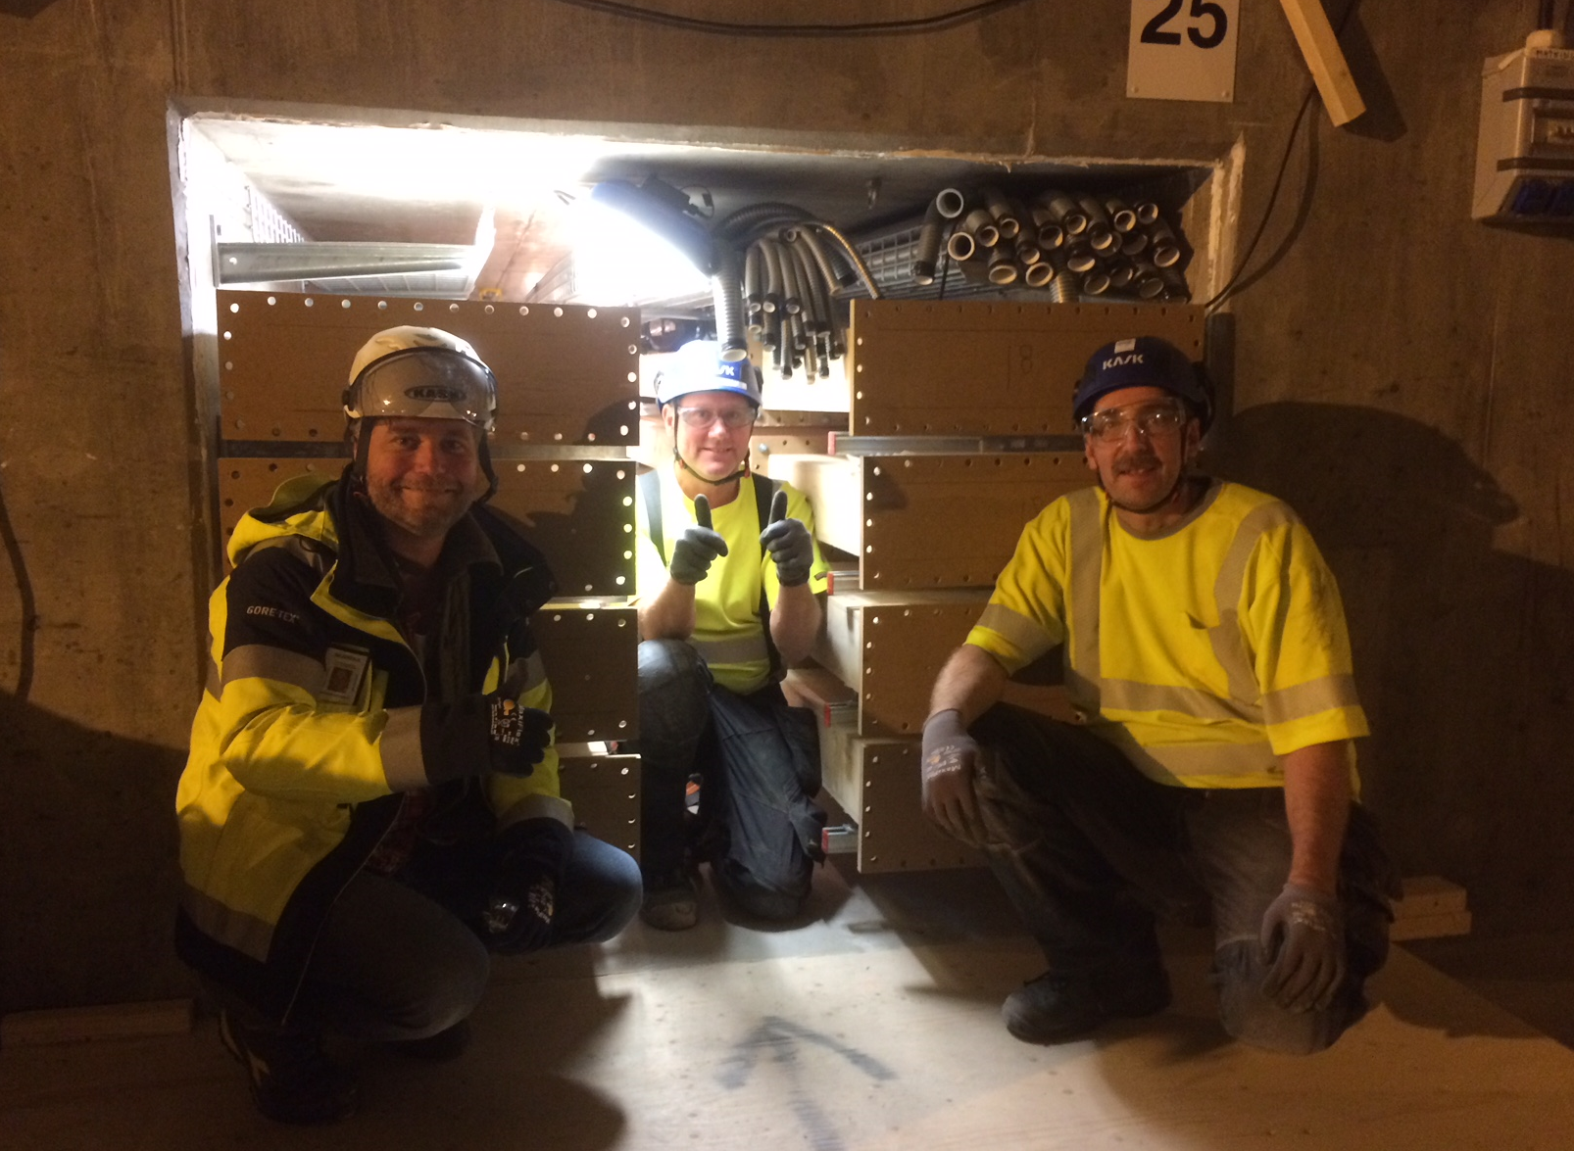
STUB test installation
Waveguides – Happy WG installation team!

Slide 27
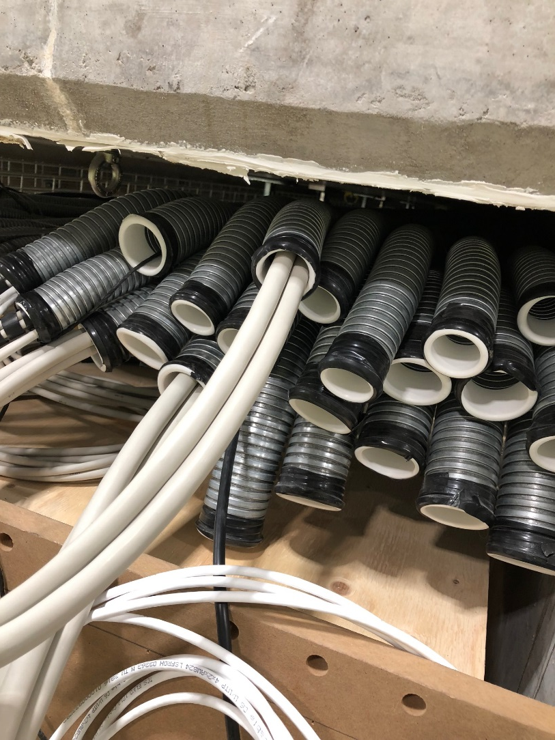
STUB test installation
Cables pulled in test Stub

Slide 28
STUB test installation
Right now out polish colleagues are working with optimization of tools and handling equipment for the Waveguides installation in the Stub test.

Slide 29
STUB installation
Cables pulled in test stub
Filling grade not so efficient as expected
Detail of “conduits design” may be changed
The amount and types of cables is not known right now!
PSS sample lines
Details to be decided than we will test install this
Beam Instrumentation Cassette
Design not ready
Power Cables
Conceptual design exist
Resource for detail design of conduits and trays starts next week
Radiation Shielding
Resource for detail design now available
Result from Radiation calculations not finished
Fire sealing
Design TBD, depend on cable detail design

Slide 30
STUB installation
NEEDS
Cables
Cable data base to be “complete” - each WP fill in CDB and someone to evaluate the info
Cable trays/conduits
Detail design – Designer detail design and routing work together, can start working next week
PSS/MPS sample lines and cables
Details to be decided – WP will get their own detail designer, starting?
Beam Instrumentation Cassette
Design not ready – is someone working with this design?
Power Cables
Conceptual design exist– Designer detail design and routing work together

Slide 31
STUB installation
NEEDS
Radiation Shielding (outside stub in G02)
Resource for detail design now available – resource for the radiation calculation needed
Fire sealing
Design TBD, depend on cable detail design – Detail designer?
Mechanical
Design of working lift/platform in Stub – Detail designer?
Design of handling equipment in Stub – Detail designer?
Design of tools for Stub installation – Detail designer?
Radiation Shielding (others)
FEB “Green walls” - on hold
FEB Penetrations
FEB Labyrinth sliding wall
Commissioning walls DTL and Shielding FC
Drop hatch
……

Slide 32
STUB installation
Challenges
Some parts does not belongs to any WP i.e. not in anyone's scope
Many WP seems not to be aware of the needs of Detail design and therefor there is no budget
Hard to get PCC when it is not clear who shall pay
Impossible to procure anything without PCC
Lack of resources and the lead time to get a new one is very long
No workshop
Complicated to get things done at site
How to perform work: Procedures, work permit etc.

