Slide 1

Charge and Agenda
of the 17th TAC meeting
11-13 April 2018, Lund
Roland Garoby
https://indico.esss.lu.se/event/985

Slide 2
TAC #17 – ESS context
The ESS construction project is now more than 43% complete, as visible with the progress in Conventional Facilities, with the amount of equipment delivered on site and with the advances in installation.
Ion source and LEBT from INFN Catania are in place in the tunnel and installation of the support equipment in the Front End building is actively progressing although at a slightly slower pace than initially foreseen. Lessons have been learnt and a new organization is being set-up for installation of utilities and for preparing installation of more components which start arriving at a high pace.
Because of the delayed access to the Target building and the delayed delivery dates of multiple in-kind contributions, a schedule re-baselining exercise is underway which will be reviewed by external experts in May 2018. Our goal is to minimize impact on the high-level goals of starting initial operations in 2019 and user science programme in 2023.

Slide 3
Questions to the TAC for its 17th meeting
- Accelerator -
a1) Are there unaddressed technical issues in the main accelerator systems?
a2) Is the schedule to complete manufacturing, testing and commissioning realistic? Proposals for mitigating technical and schedule risks would be highly appreciated.
a3) Comment on the new plan to install klystrons instead of IOTs for the first 44 cavities of the high beta linac. Is the decision properly motivated? Do you agree?
a4) Comment on the continuation of IOT development with existing hardware to prepare for a decision after 2026 between IOTs and klystrons for the second half of the high beta linac. Do you agree or not? Why?

Slide 4
Questions to the TAC for its 17th meeting
- Target (1/2)-
t1) Concerning Process controls and joint plan with ICS:
Is there a clear integration strategy that accounts for installation, verification and validation of the integrated system?
Do integration plans have specific margins and a flexible approach in order to control progress and handle unforeseen events?
Are integration activities planned and performed at an appropriate level of detail?
Are the available people, tools and procedures sufficient and appropriate to support the foreseen integration activities?
t2) Concerning Target monolith and instrument bunker interface:
Does the design satisfy the functional and performance requirements?
Are the Radiological Safety Aspects adequately addressed?
Are the Operation and Maintenance sequences for Port Inserts adequate?
t3) Concerning Waste management and the Active Cells Facility:
Is the ESS approach to waste management robust and thorough
Is the current division of responsibility sound?
Do you recommend changing some interfaces?
Would a change of interfaces now save/cost money/schedule?

Slide 5
Questions to the TAC for its 17th meeting
- Target (2/2) -
t4) Concerning Worker Radiation Safety Strategy and Policy:
Is the current strategy and policy for worker radiation safety appropriate and reasonable?
Is the risk matrix for radiation hazards for workers in reasonable balance to other conventional hazards?
Are the defined dose limits for workers appropriate?
Are the ESS General Safety Objectives, classification methodology for disciplines, PSAR coherent with regards to worker safety?
t5) Concerning TOAST experimental results and impact on licensing:
Is the response to the higher ARF adequately addressed?
Are the changes to AA3 sufficiently supported and justified?
Are the existing SSC’s being credited properly?
t6) Concerning Helium filter:
Does the helium filter design seem adequate?
Is the approach for remote maintenance of helium filters sound and appropriate?

Slide 6
Questions to the TAC for its 17th meeting
- ICS -
c1) Concerning ICS organization:
Is the competence mix appropriate for the coming project phases?
Is the employee/consultant balance appropriate?
Is the organization properly adapted for a transition to Initial Operations?
c2) Concerning the planning for NSS controls integration:
Is the prioritization of deliveries from ICS to NSS technologies groups appropriate?
Is the balance between workload and available resources cost-efficient for integration?
c3) Concerning the handover of control systems infrastructure:
Is the strategy for connecting devices to the technical network clear and well communicated?
Is the plan for using virtual machines for IOC well defined?
c4) Concerning accelerator controls:
How do we best migrate to a single hardware standard?
Comment upon the foreseen interfaces between ICS and Accelerator for the different systems. What are the risks? Would a change of interfaces now save/cost money/schedule?

Slide 7
TAC #17 – Additional information
The Committee is encouraged to provide also suggestions/comments and recommendations on any other subject it would find relevant. Feedback on the follow-up of former TAC recommendations is welcome.
A preliminary version of the TAC report is expected during the close-out session in the afternoon of Friday 13, April. The final report is expected before the end of April. The Chairman will orally present the TAC#17 report to the ESS Council on June 4-5.

Slide 8
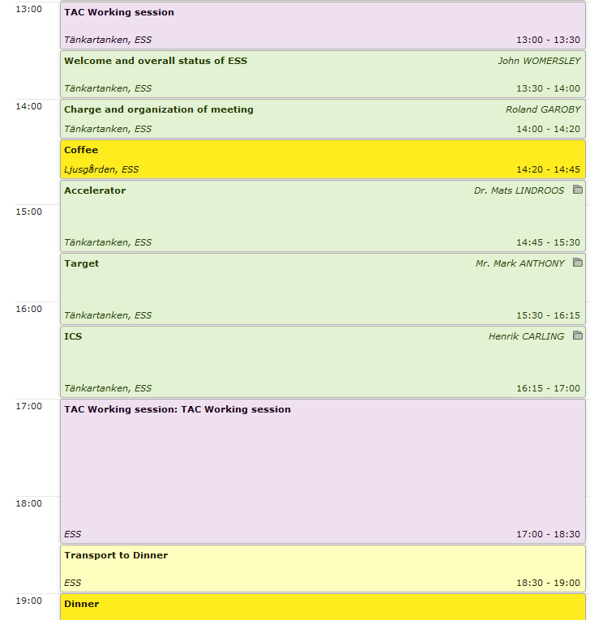
Agenda TAC#17
Wednesday 11 April 2018
TAC initial session
Plenary session
TAC session
Dinner

Slide 9
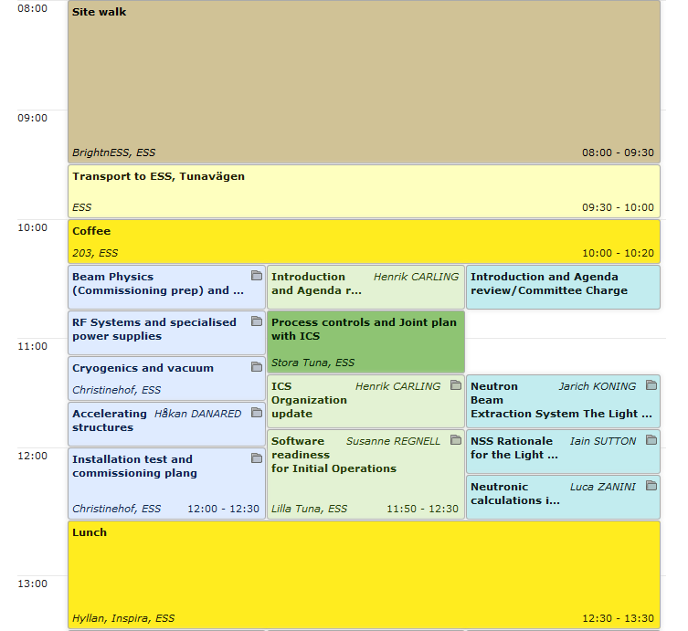
Agenda TAC#17
Thursday 12 April 2018 (am)
Site visit
(2 groups)
Joint session Target + ICS
Parallel sessions

Slide 10
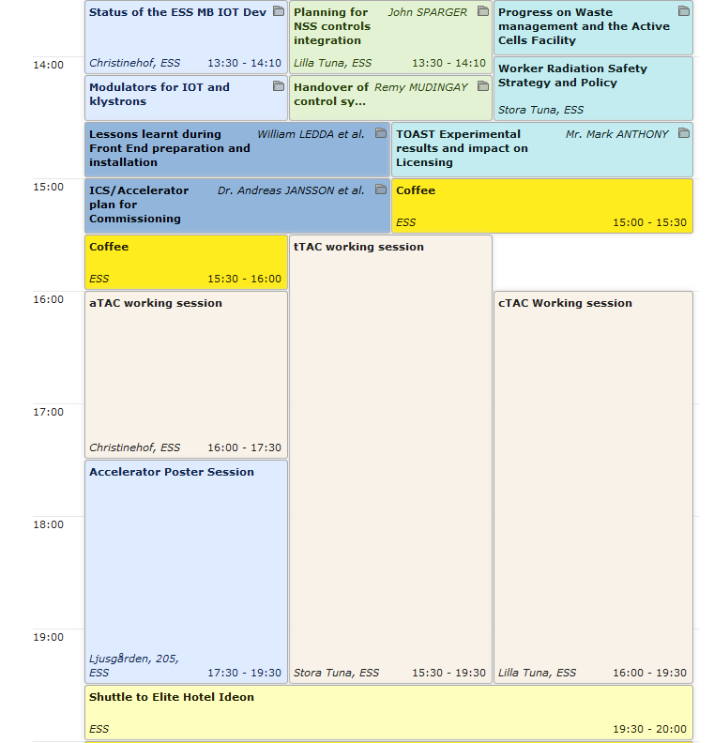
Agenda TAC#17
Thursday 12 April 2018 (pm)
Parallel sessions
Joint session Accel. + ICS
aTAC, tTAC, cTAC sessions

Slide 11
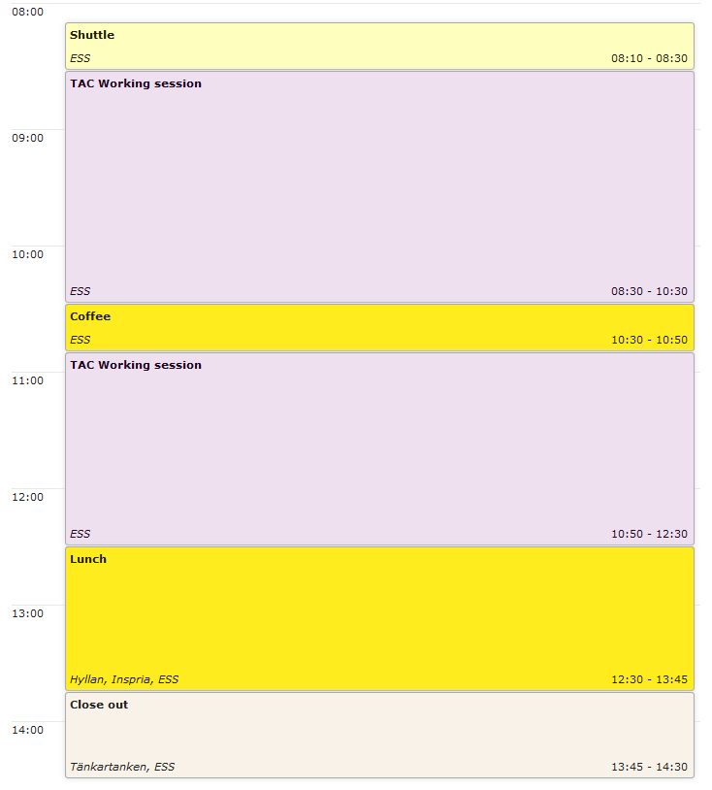
Agenda TAC#17
Friday 13 April 2018
TAC sessions
Public close-out

Slide 12
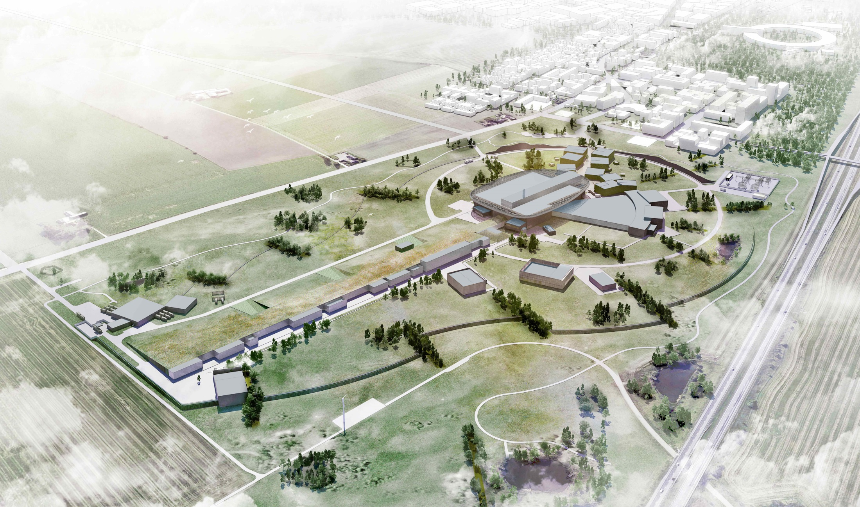
Thank you for being here.
We look forward to your advice!

