Slide 1
ESS Status Report
John Womersley
TAC
www.europeanspallationsource.se
April 2018

Slide 2
Highlights of ESS Goals and plan for 2018
Full list discussed to Council in February
Submit to SSM the application for the trial operations of the Warm Linac
Move ESS Lund organisation to site
A detailed plan for first two years (2019 & 2020) of Initial Operations
Start of commissioning of ion source and LEBT, temporary control room operational
Complete manufacturing and Factory Acceptance Tests of Moderator plug, Cryo-Moderator System and Cryoplant.
All instruments start Tollgate 3 process and begun procurement
First joint user meeting with the ILL
Secure Spain as an ERIC member
Work with ILL to establish a neutron initiative recognised by the European commission in their planning for FP9

Slide 3
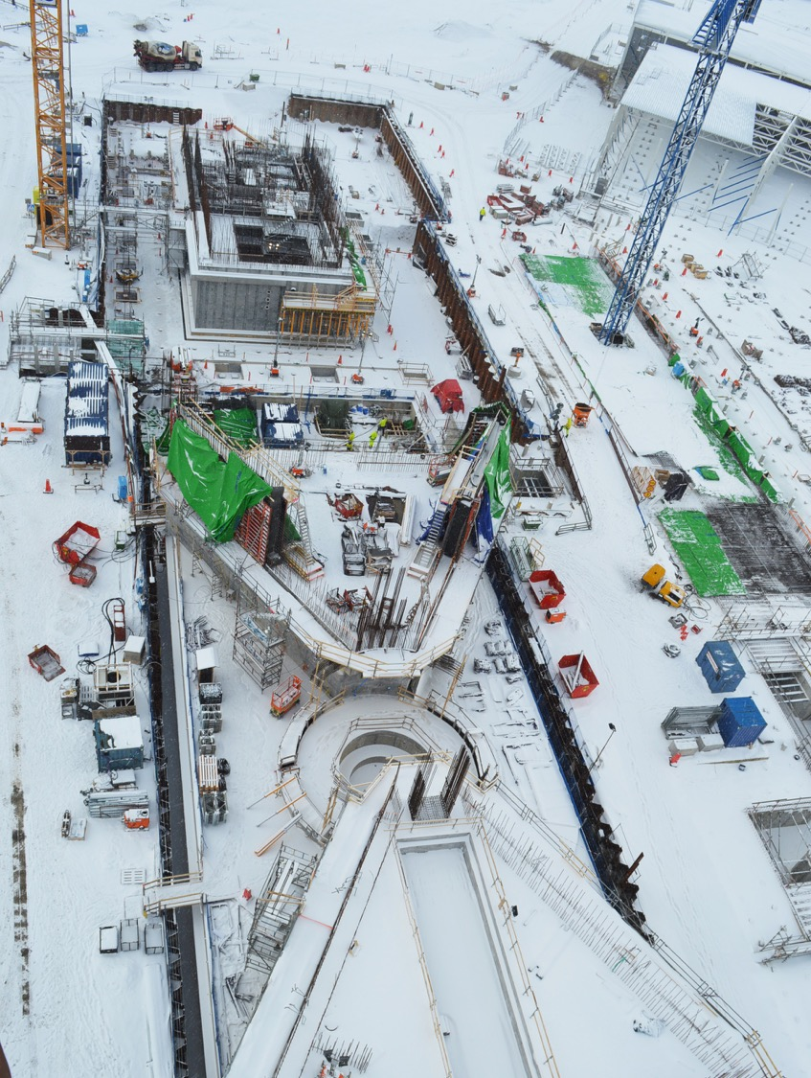
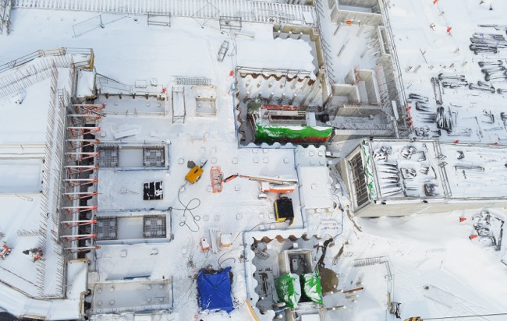
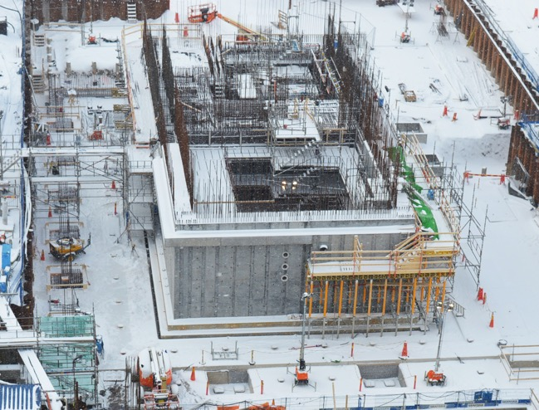
TARGET BUILDING
March 2018
A2T
ACTIVE CELLS

Slide 4
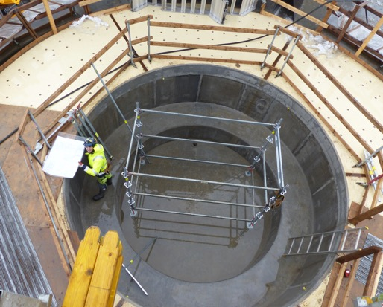
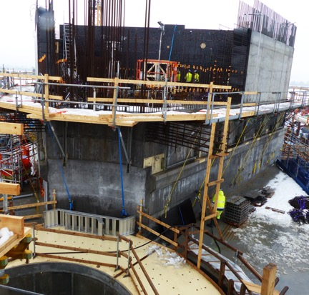
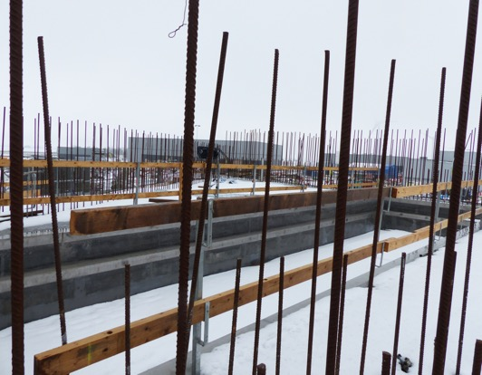
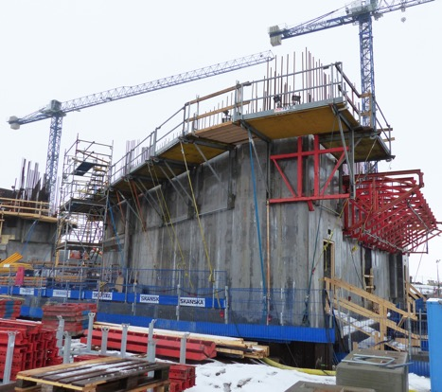
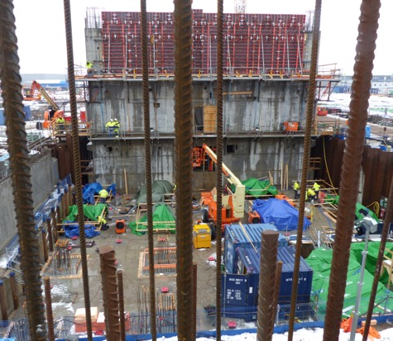
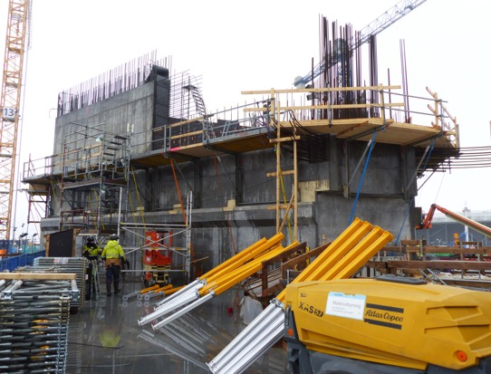
Monolith

Slide 5
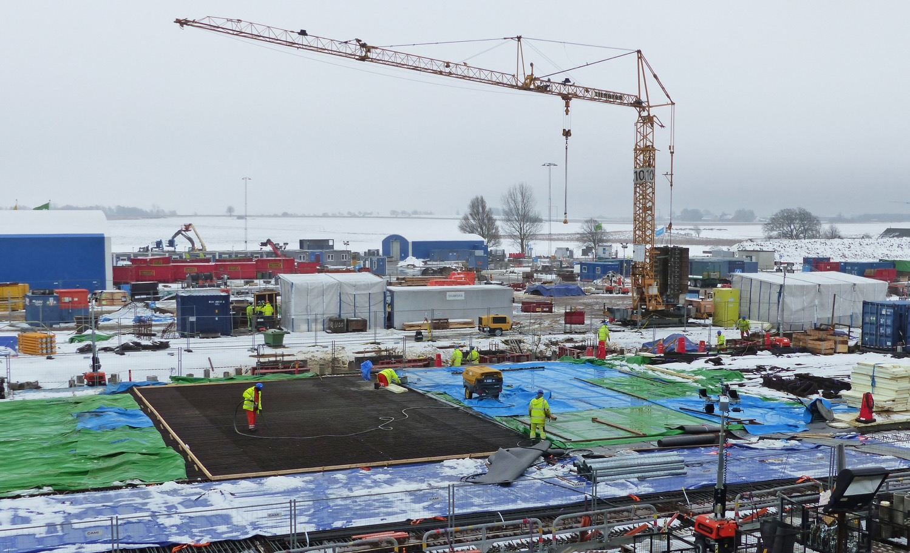
D01, base slab for Exp. Hall 1
First bottom slab casting 07/03/2018

Slide 6
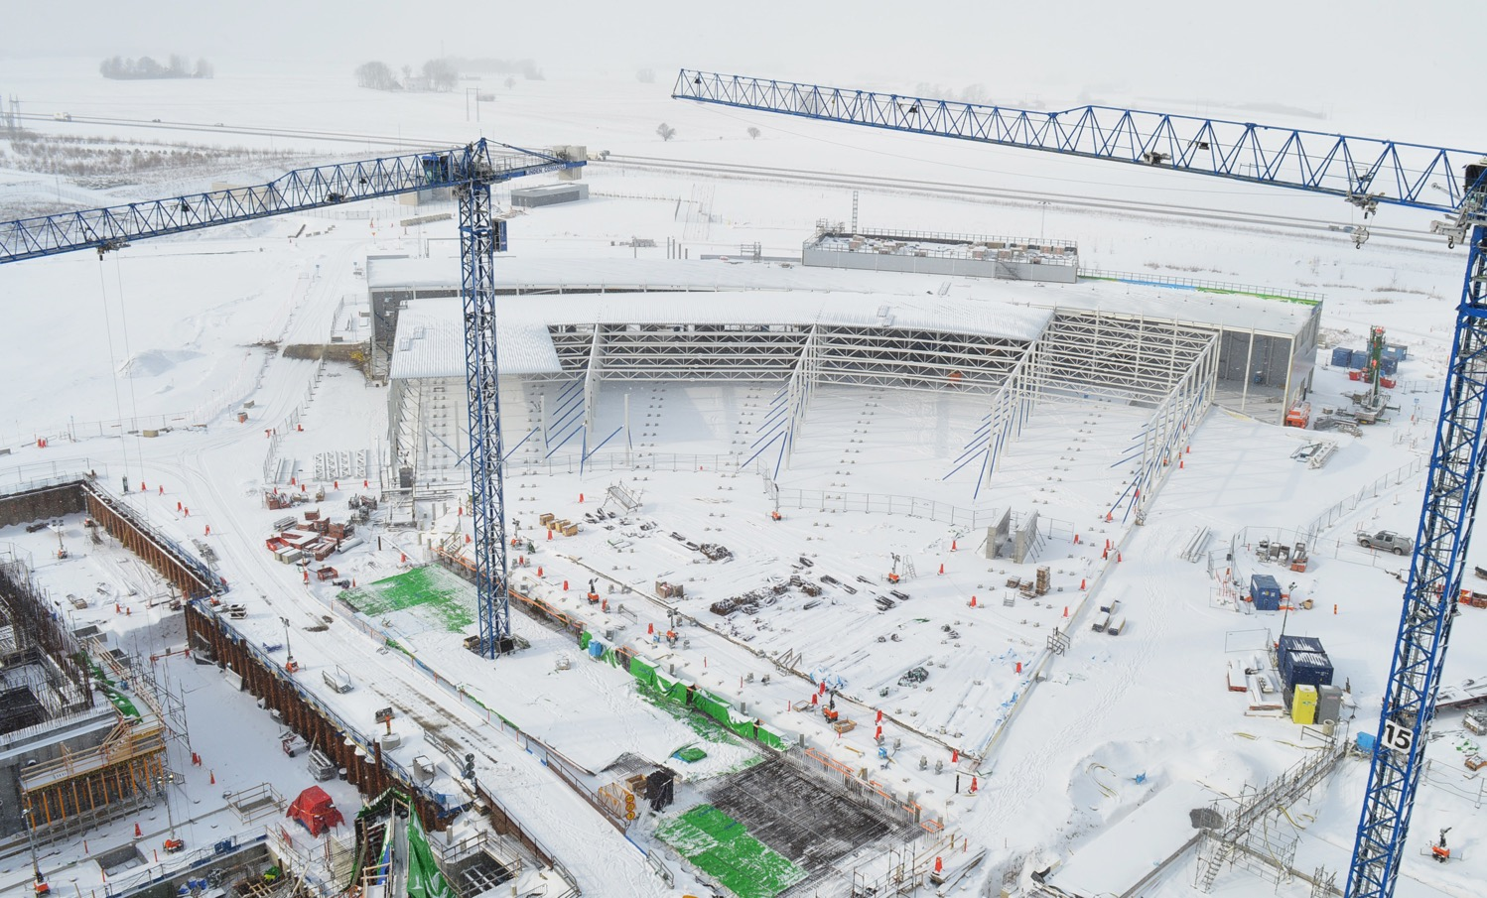
E-buildings and D03 base slab (Exp. Hall 2)
March 2018

Slide 7
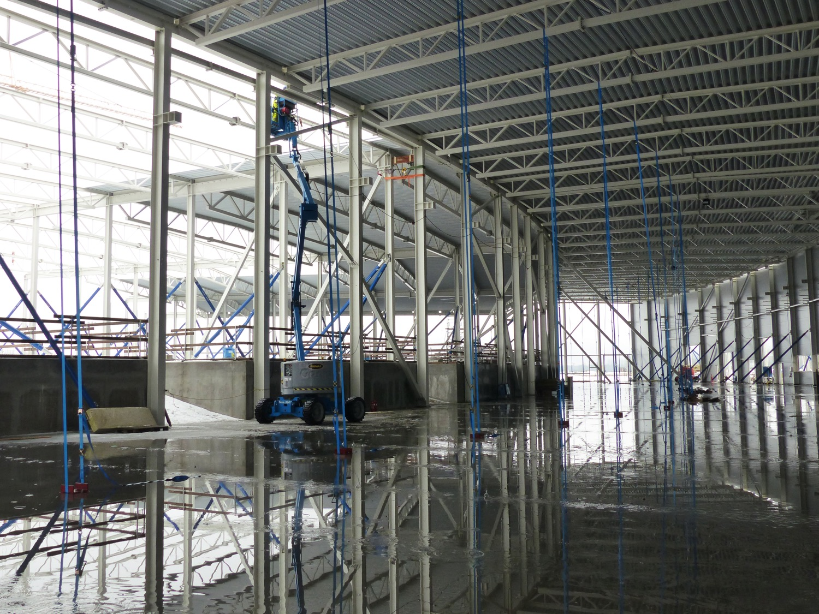
E-buildings, Superstructure
E01

Slide 8
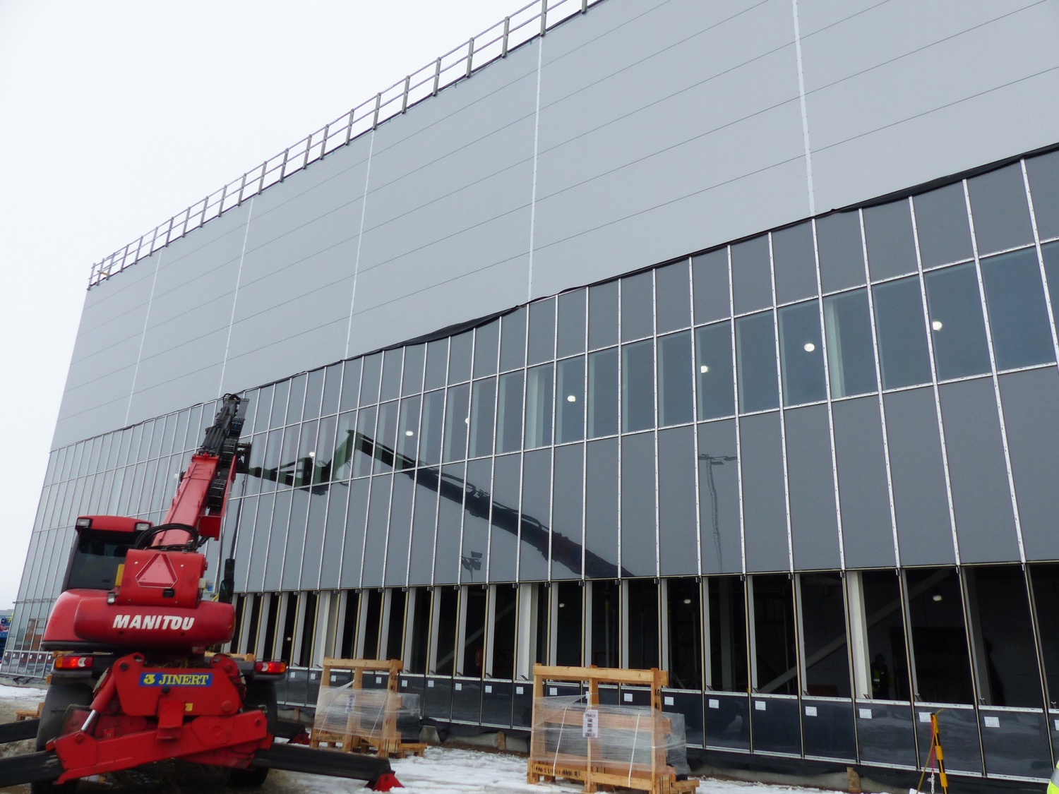
E-buildings
Facades E04

Slide 9
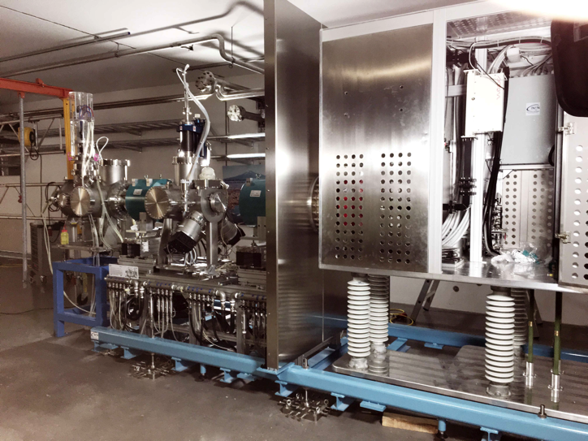
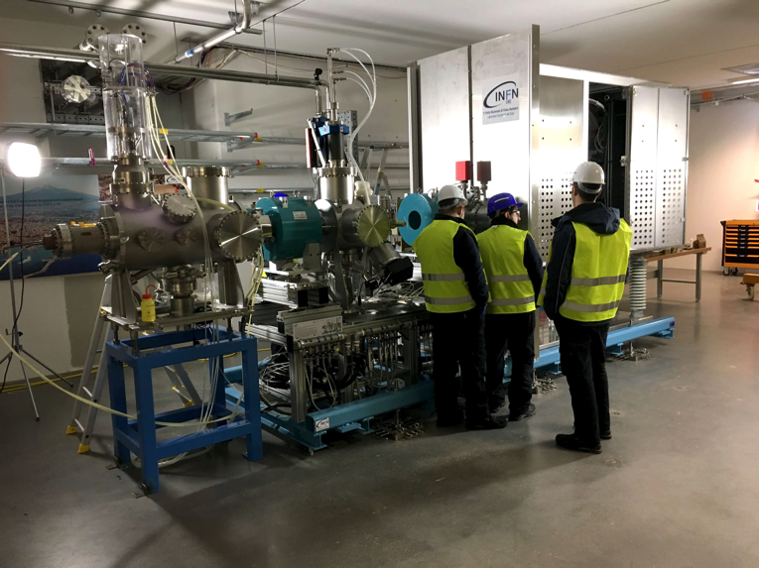
Installation of IS-LEBT in Tunnel

Slide 10

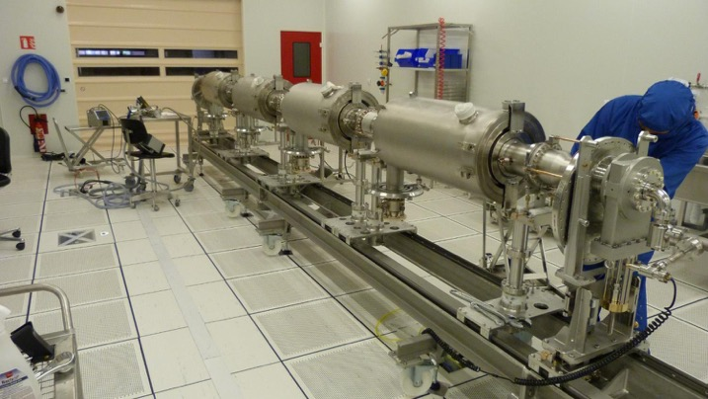
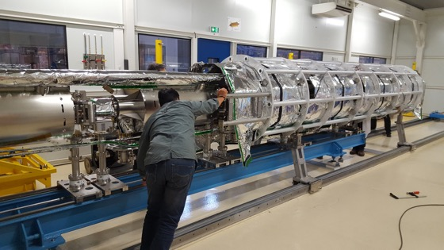
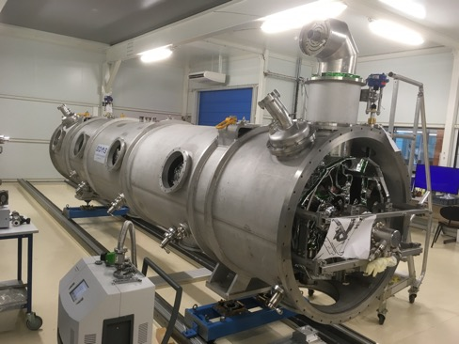
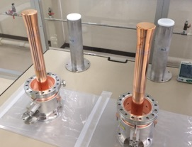
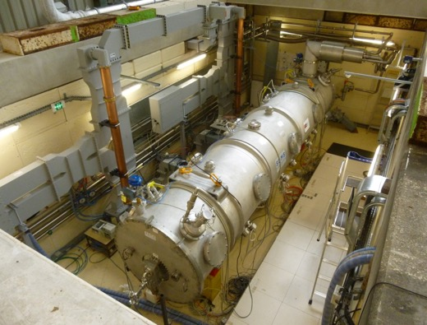
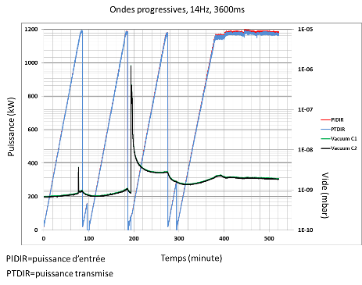
CEA – MB Prototype Cryomodule
March 2017
May 2017
July 2017
Assembly in ISO4 CEA CR
4 medium β 6 cell elliptical SRF cavities (1 LASA/3 CEA)
Cooldown at CEA test stand in Sept 2017
  No RF operation due to accidental rupture of coupler ceramic
10 couplers at nominal specs

Slide 11

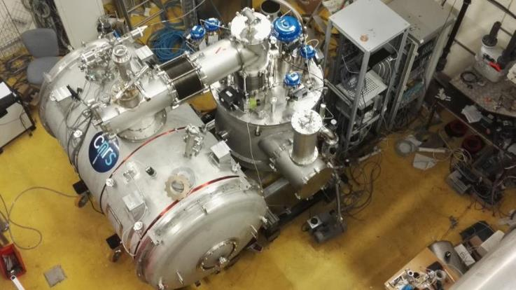
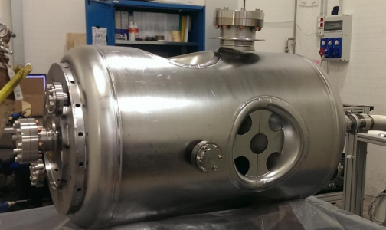
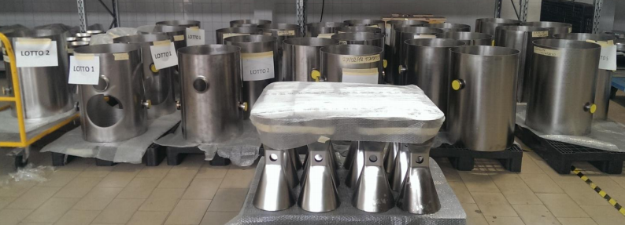
Spoke components (CNRS – IPNO)
Proto Cryomodule and
Valve Box in final cryo
validation stages at IPNO
  Assemble with 2 cavities
  @ FREIA in May RF High Power
Series cavities fabrication
  In full swing (but power coupler and vacuum vessels in critical path)
  First 4 cavities at IPNO May, then test and release of full series

Slide 12
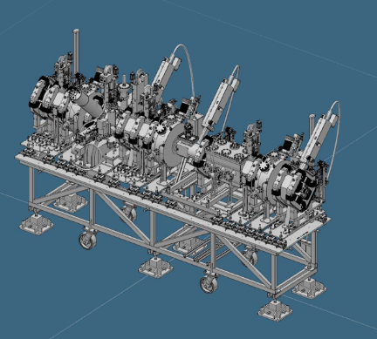
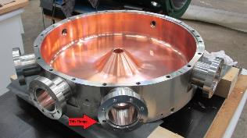
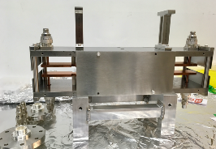
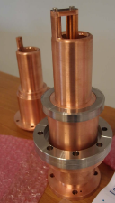
MEBT (ESS-Bilbao)
Quadrupoles 11
Buncher cavities 3
Scrapers 2 (+2)
Choppers 1
Total length 3.8 m
Several types of beam instrumentation
Quadrupole #1 under FAT at Danfysik, front view
Side view
Buncher cavity copper-plated at GSI
Chopper
3D model of MEBT
Power couplers for buncher cavity

Slide 13
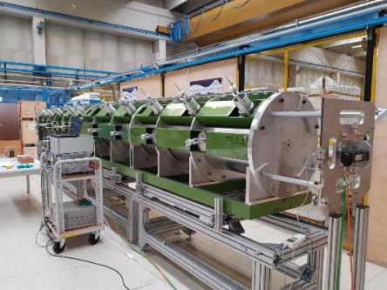
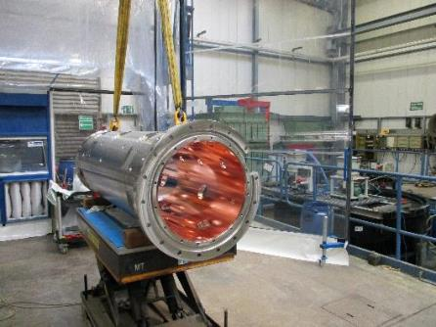
DTL (INFN – Legnaro)
Main parameters
Input energy 3.6 MeV
Output energy 90 MeV
Number of tanks 5
Sections per tank 4
Length 39 m
Weight 34 tons
Mock-up of tank, for bead-pull tests etc.
DTL schedule
Tank # | BPM's ready | DT EB welded (except BPM) | DT RFI (BPM's included) | RFI (forecast)
T4 | 2018-09-30 | 2018-06-30 | 2018-11-30 | 2019-01-01
T1 | 2018-09-30 | 2018-07-31 | 2018-11-30 | 2019-02-10
T3 | 2018-09-30 | 2018-09-30 | 2019-01-10 | 2019-03-15
T2 | 2018-09-30 | 2019-05-30 | 2019-05-30 | 2019-06-05
T5 | 2018-09-30 | 2019-05-30 | 2019-05-30 | 2019-09-30
Copper plated tank section #4-1 at GSI

Slide 14


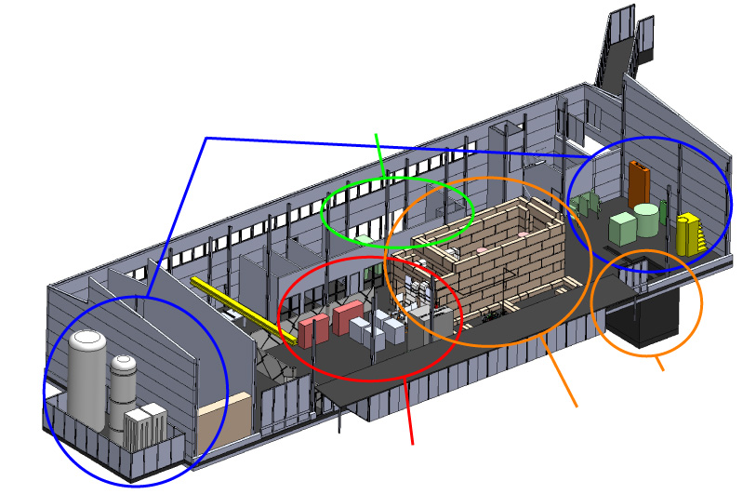

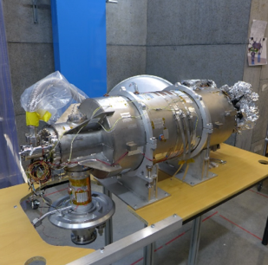
UU - FREIA Infrastructure for Spokes
Several Spoke prototypes tested in HNOSS
Preparation of HB validation test (>March)
Preparation of Spoke Prototype test (>May)
State-of-the-art Equipment
cryogenics
- liquid helium
- liquid nitrogen
control room
- equipment controls
- data acquisition
Romea in HNOSS
HB package at FREIA
vertical cryostat
3 bunkers
with test stands
horizontal cryostat
radio-frequency (RF) power sources

Slide 15
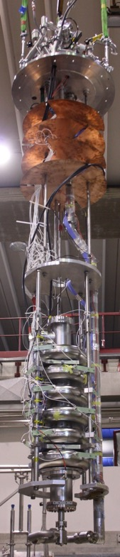
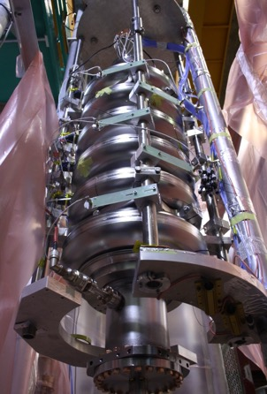
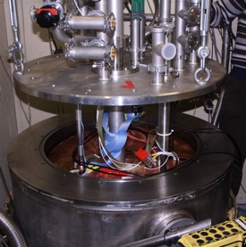
Elliptical MB cavities (INFN – LASA)
Vertical Test-stand
Medium-β cavities from INFN tested at DESY
  in the AMTF infrastructure, insert for two cavities
LASA MB test-stand for prototype validation
  single cavity insert, 4 m x Ø 0.7 m
  w or w/o helium tank
  refurbishment during Summer 2018
    decrease residual magnetic field < 8mG
  down to 1.6 K
    50W at 2K
  650W RF
Second Sound Sensors
Fast Thermometry

Slide 16

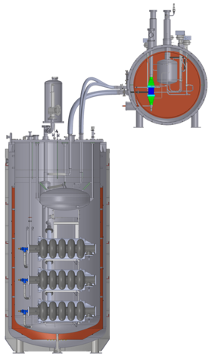
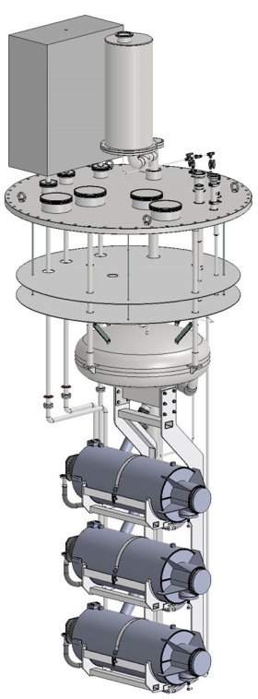
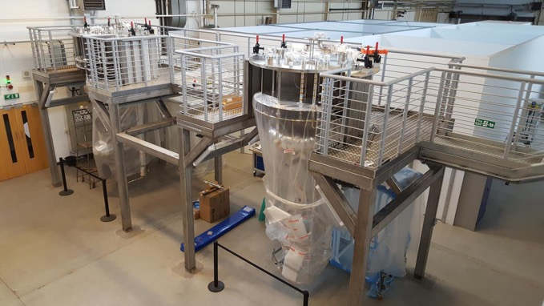
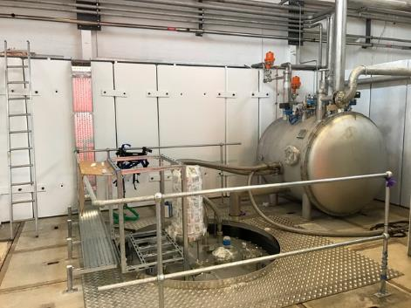
Elliptical HB cavities (STFC – Daresbury)
Vertical Test-stand
Dimensions: 3650mm x Ø 1692mm internal
  3 ESS cavities, beam axis horizontal
  LHe only in cavity helium tanks
  2 inserts fabricated
Commissioning schedule
  Q1 2018: Final installation
  Q2 2018: Start of commissioning
  Q4 2018: Benchmarking
  2019: Ready for qualification testing
Modular cleanrooms being assembled for ISO 4 connections to the cavity. End of March 2018
Top of cryostat and 2 K box

Slide 17
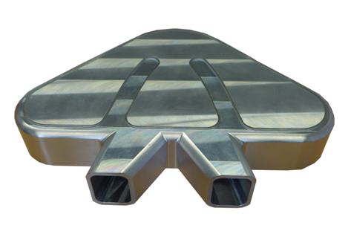
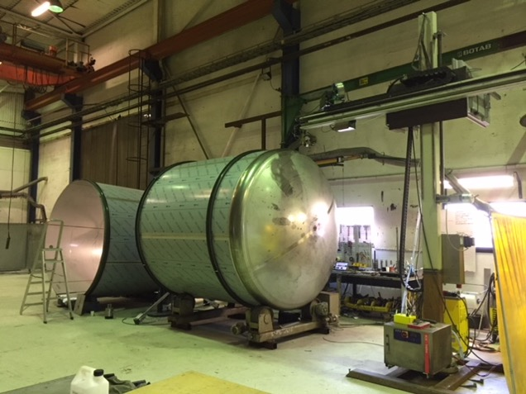
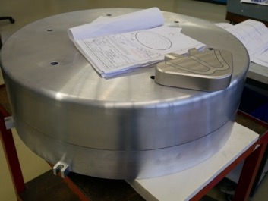
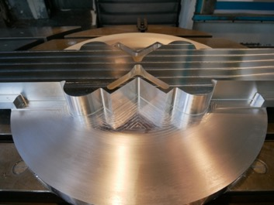
Target components are in construction
AFC.07.0X
Cryogenic moderator prototype
Drain tanks for contaminated water
Reflector Vessel & Cold Moderator
Thermal Moderator
17

Slide 18
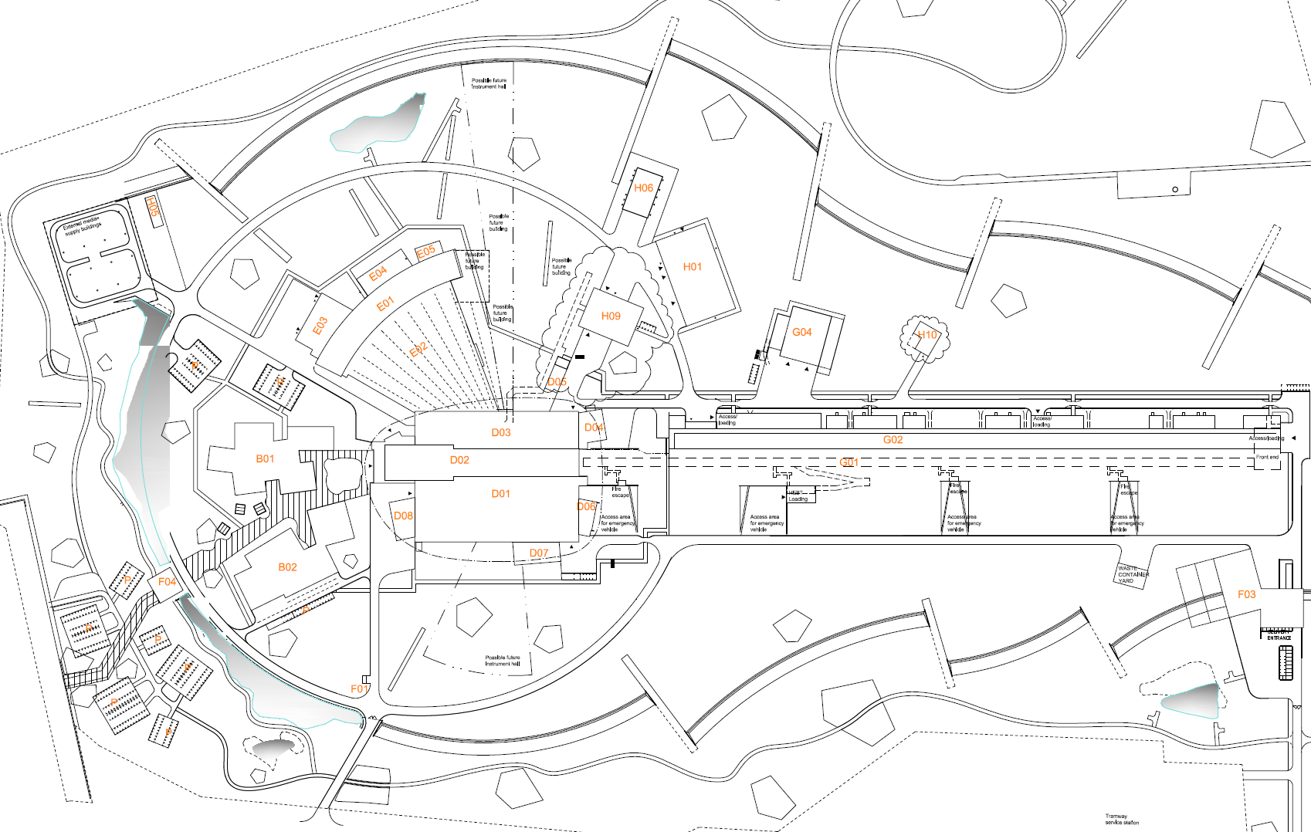
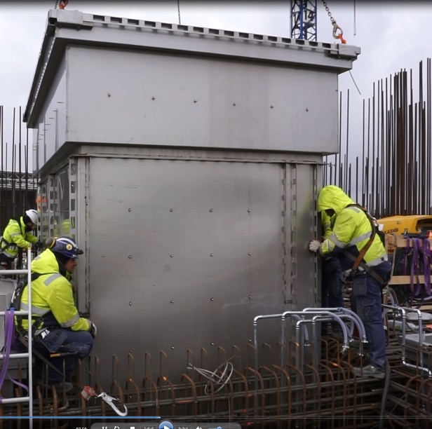
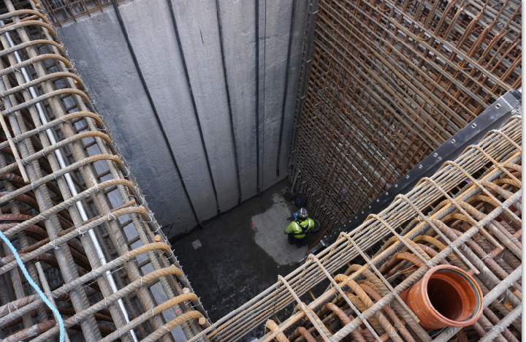
Storage pits have been installed in Active Cell Facility
Active cell
Hole before storage pit installation
Lowering of pit A3 into place

Slide 19
Licensing
Delivered updated source term to SSM for emergency preparedness zone, as scheduled on April 3rd
Focused now on permit for operation of warm linac
Management is committed to ensure that timeliness and improved quality of licensing deliveries is a high priority for ESS

Slide 20
Installation
Infrastructure Steering Group
Infrastructure Design and Installation Leader
- Manage and direct Infrastructure Design and Installation work
- Participate in regular meetings with Working Group
- Report progress, plans, and issues to Steering Group
Accelerator Baseline
(IAcc Div)
ICS Baseline
(ICS Div)
Detailed Design
(EIS Div)
Installation
(SEC)
Infrastructure Working Group
- Coordinate staff resource allocations
- Resolve issues whenever possible
- Support Infrastructure Design and
Installation Leader in executing work
- Report to Steering Group representative
Mikael Jakobsson
Installation Manager
chairs
Executing Organization
Peo Gustavsson
Customer Organizations
Set overall design concept (CAD model) and requirements
Approve Detailed Design Drawings
Approve field (installation) changes
Establish design plan
Create detailed design models and assembly and installation drawings
Approve field (installation) changes
Create as-built models
Establish installation plan
Perform installation work
Provide buildability input to Detailed Design team
Installation and Commissioning Work is proceeding safely

Slide 21

Decision-making timeline
AFC.07.05.a
AFC.07
Budget Plan 19/20 (R)
Indicative Plan 21-25 (I)
Construction Budget 2019 (I)
Political decision-making
Minister level
Schedule Review
8 Feb
10-11 Apr
Focus on re-baselining
Will mostly impact indicative plan 21-25
Council.12
Workshop
Budget plan 19/20 (I)
Indicative plan 21-25 (I)
High-Level Document (D)
Sharing Policy (D)
22-24 May
Council.14
Constr. budget 2019 (A)
Init ops budget 2019 (A)
Indicative plan 2021-2025 (A)
Commitments from Members for 2021-2025
Commitments from Members to completion of construction
Council.13
4-5 June
Budget Plan 19/20 (A)
Indicative Plan 21-25 (I)
Commitments from Members for 2019/20
initial ops funding
AFC.08
Constr. budget 2019 (R)
Init ops budget 2019 (R)
Indicative planning 2021-2025 (R)
Annual Review
Sep
Project review
30-31 Oct
3-4 Dec

Slide 22
Move of offices and technical labs
One site, One ESS
Move from Medicon Village starting end of May
Approx. 10.000 m2 offices and technical labs in 3 floors
Open area offices & conference rooms
Approx. 600 workstations
Separate ESS Reception welcoming visitors and guests
Temporary offices and technical labs
on ESS construction site
ESS offices at Medicon Village

Slide 23
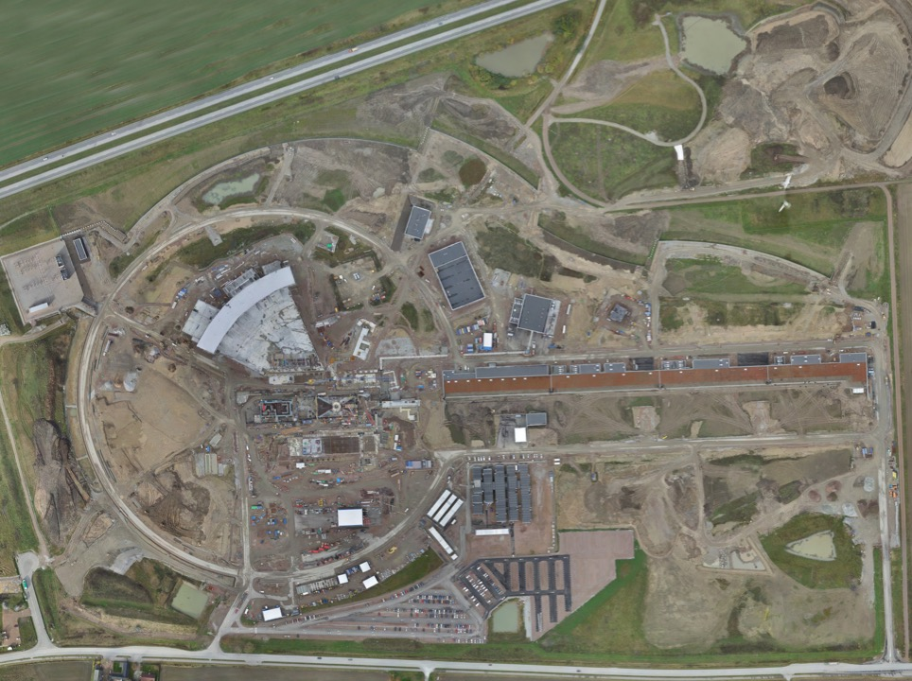
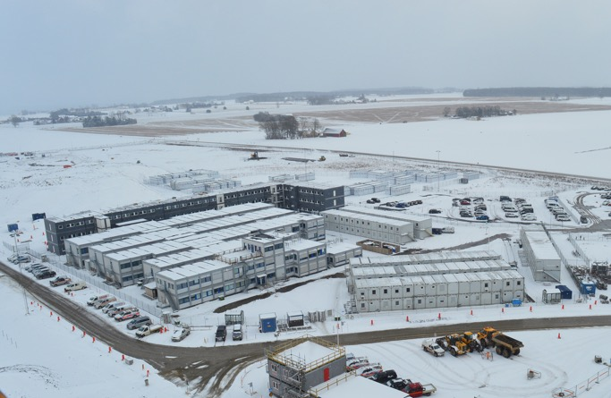
Permanent
Office Campus
2021
New 2018 ESS offices for all staff
New Bus Stop
Lund Tramway Depot

Slide 24
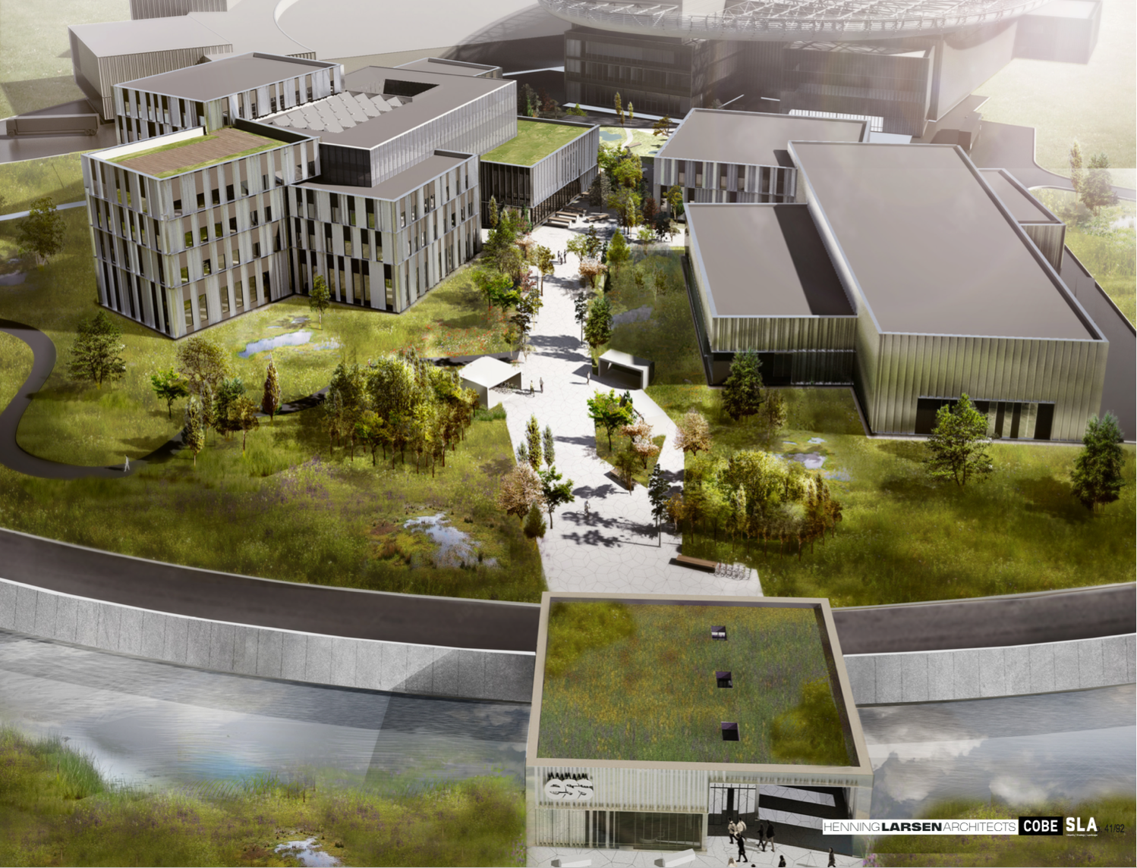
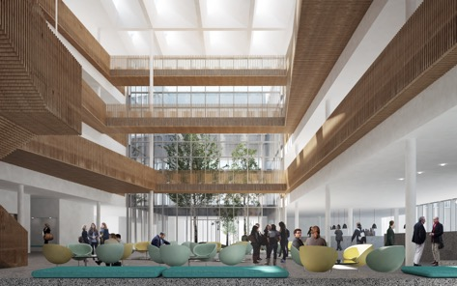
Campus
Offices, auditorium canteen
Labs and Workshops
Signed construction and financing agreements in February
Now in detailed design before target cost is agreed
Cost of the lease is included in the operations costs
Entrance Building

Slide 25




Big Science Business Forum 2018

Slide 26

ILL – ESS European Neutron User meeting
Methodological focus: user feedback on ILL New instruments Endurance 2 and ESS Instruments: Next 7 / Completions / Suite 15 / First 8.
Start series of ‘European Neutron User Meeting’ or ‘Meeting for Users of European Neutron Facilities’
Periodicity every 2 years (even years e/o ecns/icns) oscillate ILL / ESS.
200+100 participants, initial location WTC Grenoble, France
Include satellite events with scientific focus
Date: 10 – 12 Oct. 2018

Slide 27
Senior recruitments underway
In discussion with preferred candidates for each of
  Associate Director for Strategy
  Head of Communications
Recruitment for
  Deputy Technical Director

Slide 28
ESS in the Operations Phase
Initial thoughts on the high level structure
DG
Three Directors
  Science plus Deputy focused on Operations
  Technical plus Deputy focused on Operations
  Administration plus Deputy
Two Associate Directors
  ESH&Q
  Strategy
Matrixed engineering and support

Slide 29

Strategy for Rebaselining
NSS (Instrument Program)
EOC
Building
occupancy
In-kind deliveries
SOUP
Beam Comm.
First instruments
Critical Path
CF + Target + NSS (Bunker+TBL) + ICS
BOT
We have focused on keeping the Start of User Programme (SOUP) milestone as close as possible to our original goal in 2023
Target Building
In-kind deliveries
Accelerator + ICS
RBOT
BOD – Beam on Dump
RBOT – Ready for Beam On Target
BOT – Beam On Target
SOUP – Start Of User Program
EOC – End of Construction
TBL – Test Beam Line
In-kind deliveries
BOD

Slide 30
Thank you!

