Slide 1
Target Overview
TAC 17
Mark Anthony
www.europeanspallationsource.se
October 4, 2017

Slide 2
Outline
Target Project Performance
Staffing Update
In-kind Status and Issues
Technical Progress of Work Packages
License Application update
Issues
Concluding Remarks

Slide 3
Target Project is 34% complete
Current budget at completion for the ESS Target
Sub-project is 184M€
  Whereof secured in-kind contributions add up to 73M€
Earned value as of 28 February 2018 is 60.8M€
  Cumulated Schedule Performance Index is 0.93, corresponding to 3 months delay however SPI for February is 0.42 , Rebasline is in progress.
  Actual cost spent as of 28 February 2018 is 63.5M€
Preliminary Design Phase is essentially completed
  Beam drift room placement of shutoff valve is challenge
  Monolith pressure relief system and impacts with TOAST values, AA3
  Light Shutter System and Bridge-beam guides are re-questioned
Final Design (CDR’s) is well underway for most systems, 34 left of 79
Installation started
  Tuning beam dump shielding
  Active Cells Facility – electrical conduits, liner beams, floor anchors and storage pits
  TSS cable pipes installed in FEB for connections to ion source and RFQ

Slide 4
Current Target Organization

Slide 5
Forming a New Group

Slide 6
Group Responsibilities
  Prepare and better support operation licenses applications
  Update documentation to as-commissioned state following end of construction
  System Turnover, ensure satisfactory commissioning and integrated test
  Hot commission all target systems
  Enforce formality of operations (Conduct of Operations)
    Start-up and train remote handling and operations team
    Operate all target systems and remote handling facilities.
    Document and treat non-conformances
  Establish, test and improve operation and maintenance procedures
  Procure critical spares and replacement components, Build-up spares inventory

Slide 7
Installation Planning

Slide 8
In-Kind Collaboration

Slide 9










ESS Target Station Collaborators

Slide 10
Status of Target Sub-Project In-Kind Packages
Target Sub-Project has 21
in-kind work elements
  TA or CA signed for 10 work elements
  Partner selected for another 4 work elements
  N/A
  Preparation to self-perform 6 work elements

Slide 11
Target In-Kind Issues
Failure to secure in-kind partner for 5 large work elements, requires ESS to self perform
  Target Monitoring Plug
  Monolith Shielding & Port Blocks
  Monolith Atmosphere
  Internal Casks & handling Devices
  Remote Handling Support
ESS Bilbao significant delays due to funding
  Tungsten Procurement 7 months
  Monolith Vessel 12-18 months
  Target Wheel 12 months
UKAEA significant delays on ACF, increased cost

Slide 12
Progress by Work Package

Slide 13
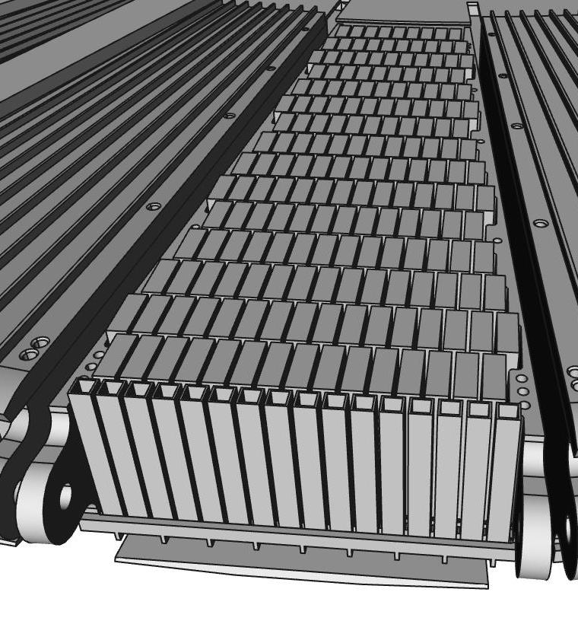
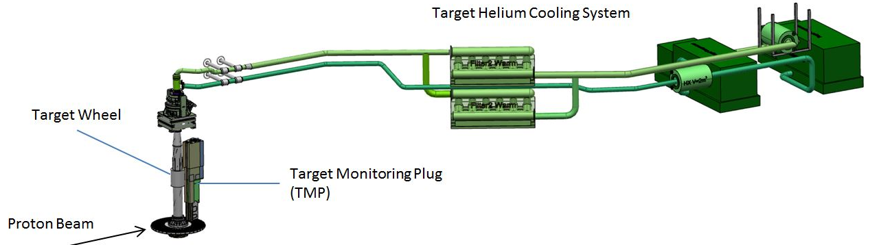
Technical Progress:
WP2 Target Systems 1(2)
Target wheel and drive unit
Manufacturing of cassettes and spallation material in progress
CDR Target Drive Unit 23 April.
Manufacturing of the target wheel prototype close to be finalized. Lessons learned to be used for the final Target Wheel
CDR for Target Wheel and Shaft postponed to Sept 2018. However, early procurement of material in progress
Complete Target Wheel Drive & Shaft delivery on site November 2019
Target Helium Cooling System
Manufacturing of the Helium Circulators in progress
CDR Target Helium Cooling System performed. Piping in the Connection Cell needs to be redesigned and remote handling of the helium filters elaborated
Target monitoring
PDR for the Target Monitoring Plug performed. Discussions with possible In Kind partner started
Tungsten Bricks in Cassette

Slide 14
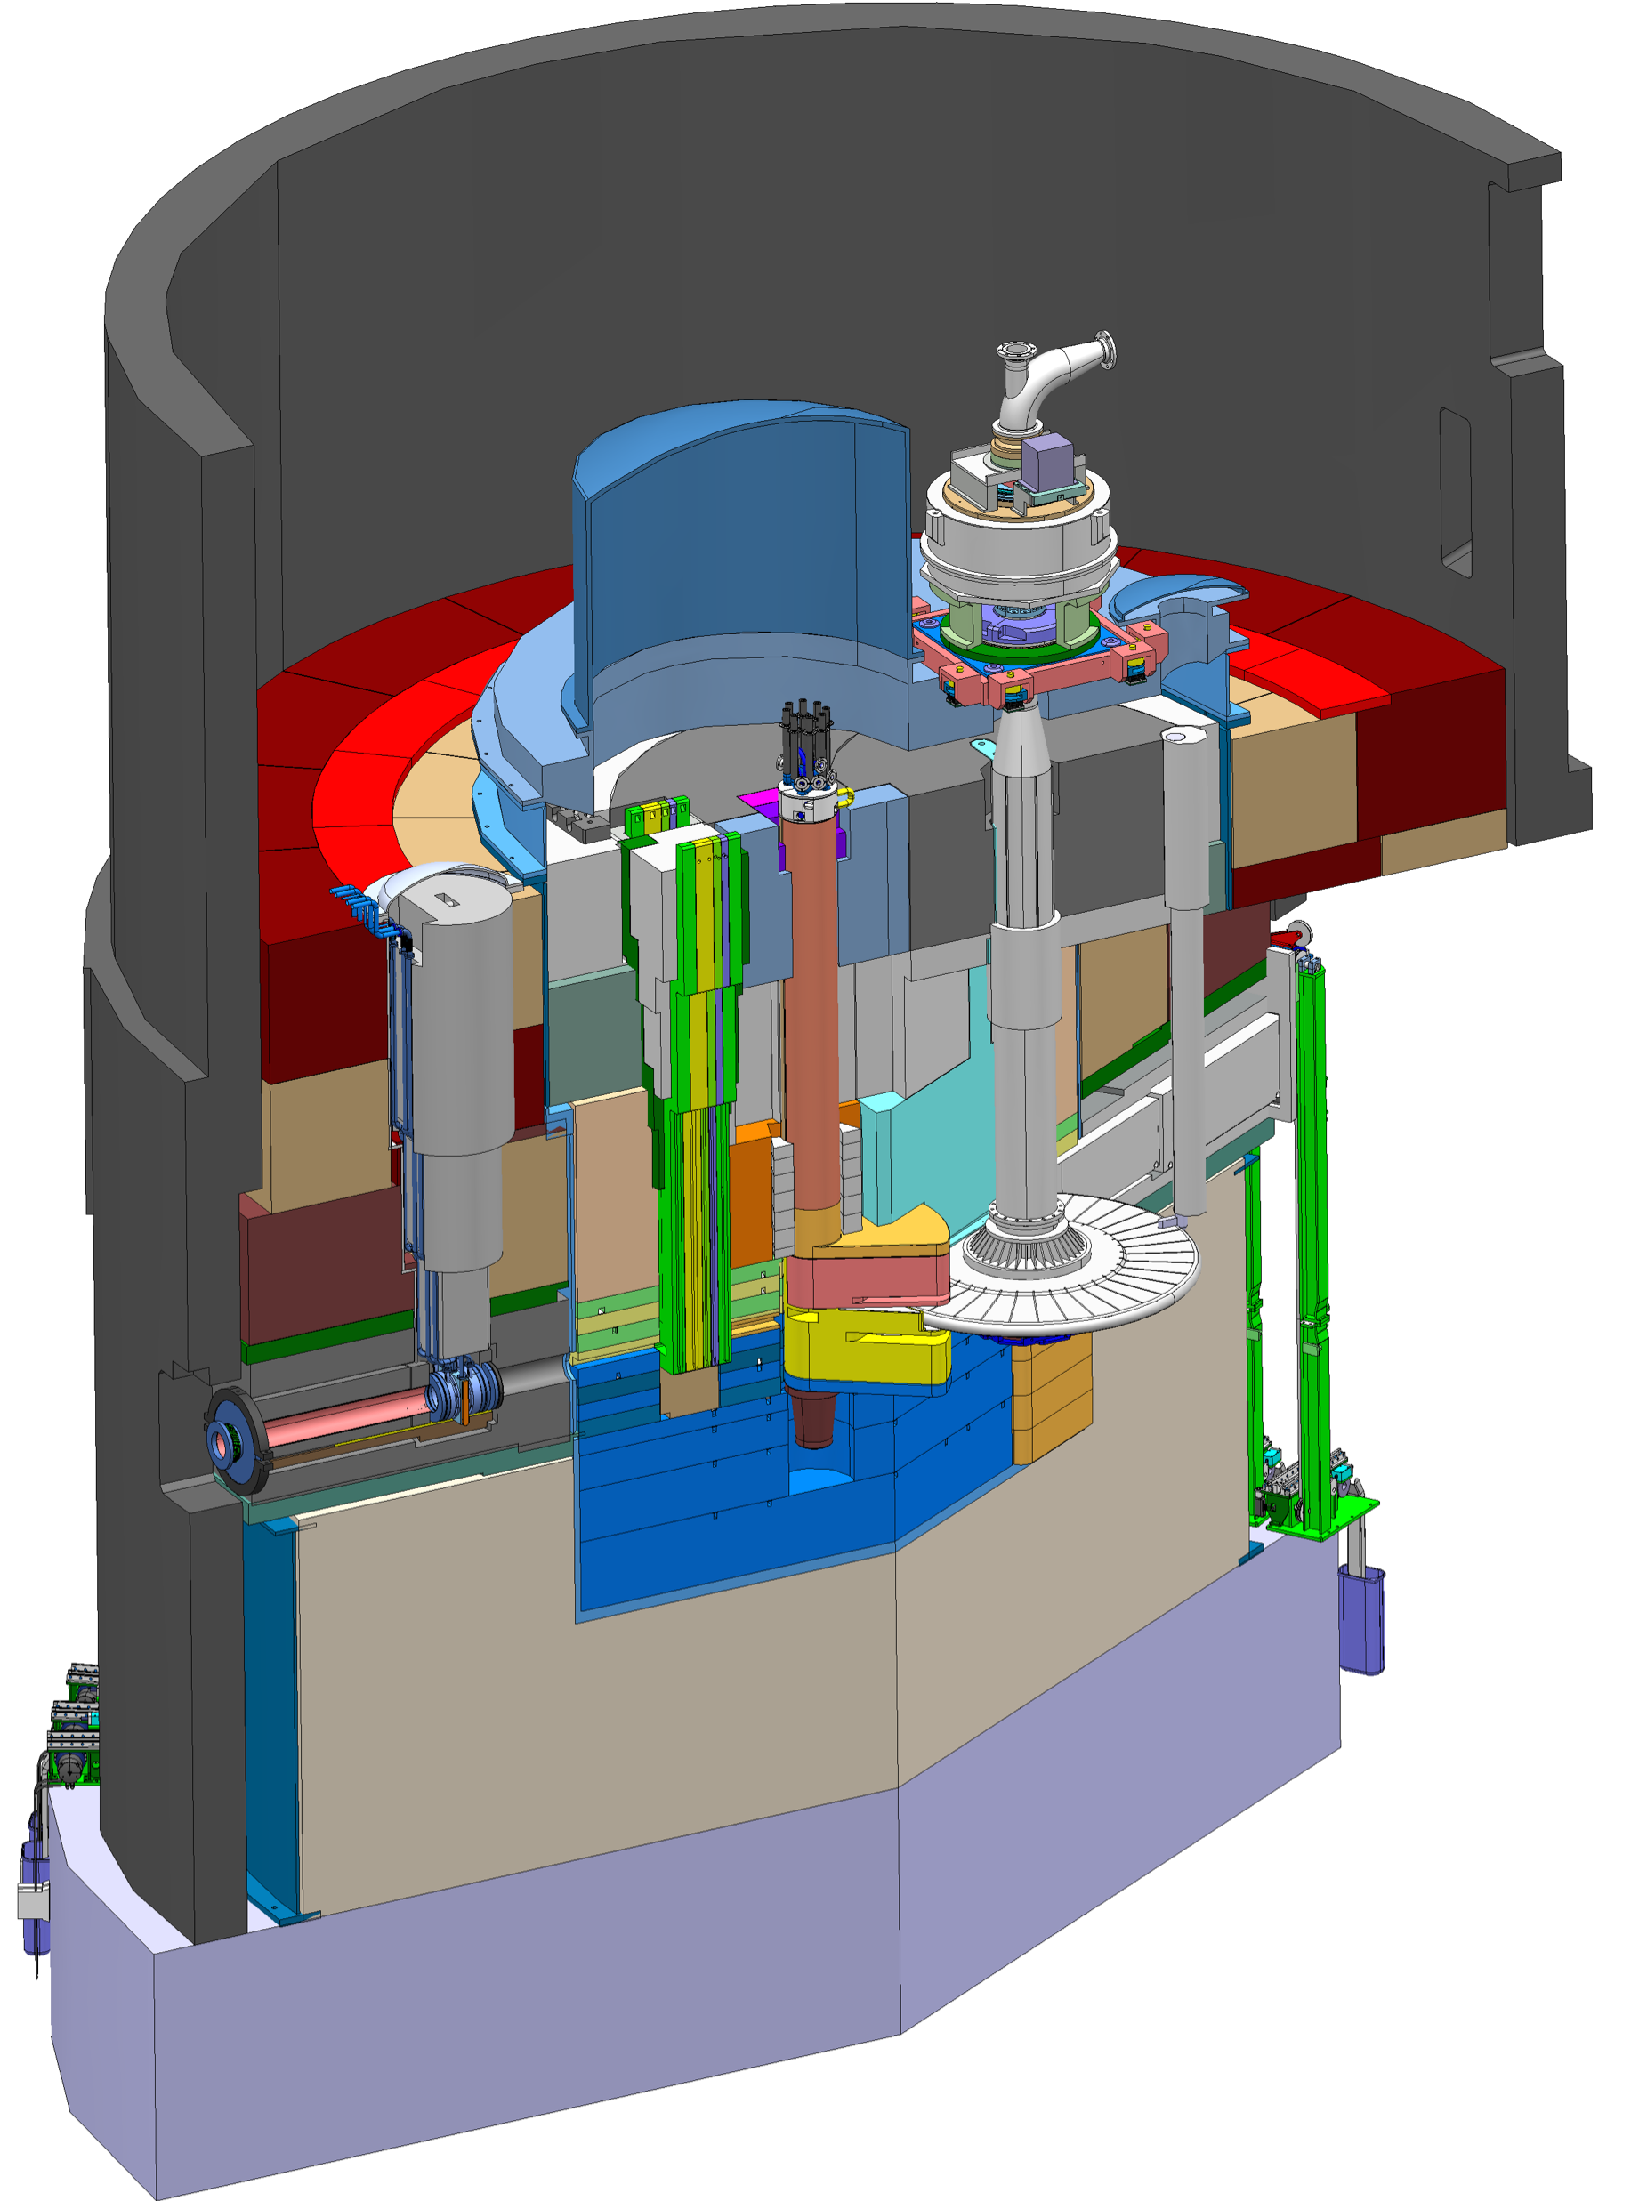
Technical Progress:
WP2 Target Systems 2(2)
Monolith Shielding
  Procurement of the Ground Shielding in progress, signed contract in April 2018
  Procurement of the Outer Shielding started up
  CDR for the Inner Shielding in May 2018
  Budget underestimated
Tuning Beam Dump
  CDR for the Tuning Beam Dump Shielding performed
  CDR for the Tuning Beam Dump System in April 2018
Outer Shielding
Inner Shielding
Ground Shielding
Tuning Beam Dump

Slide 15
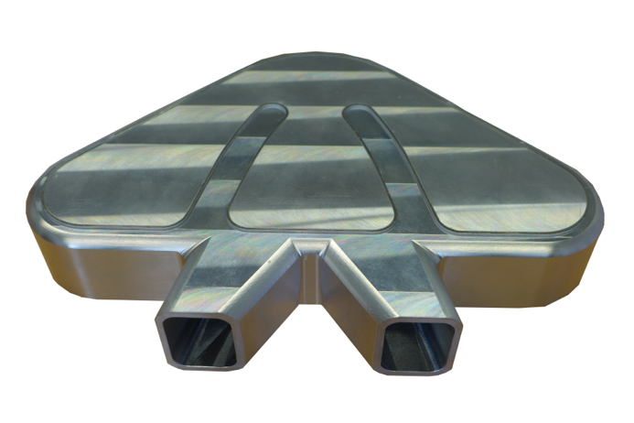
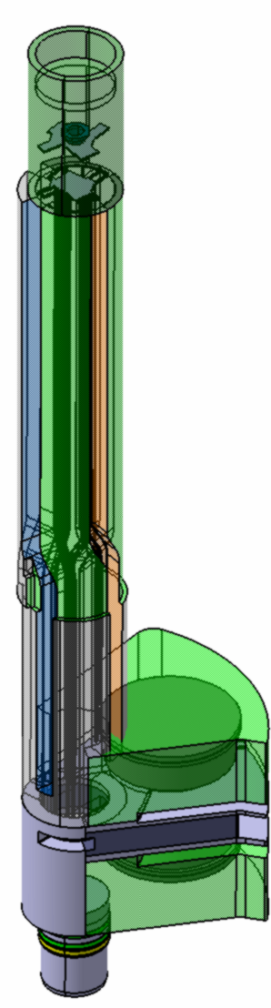
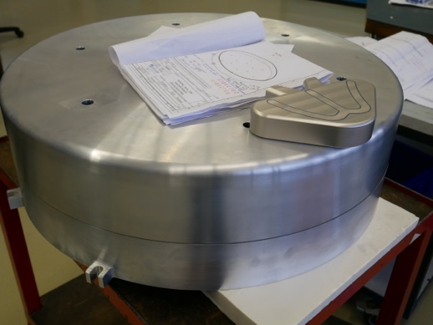
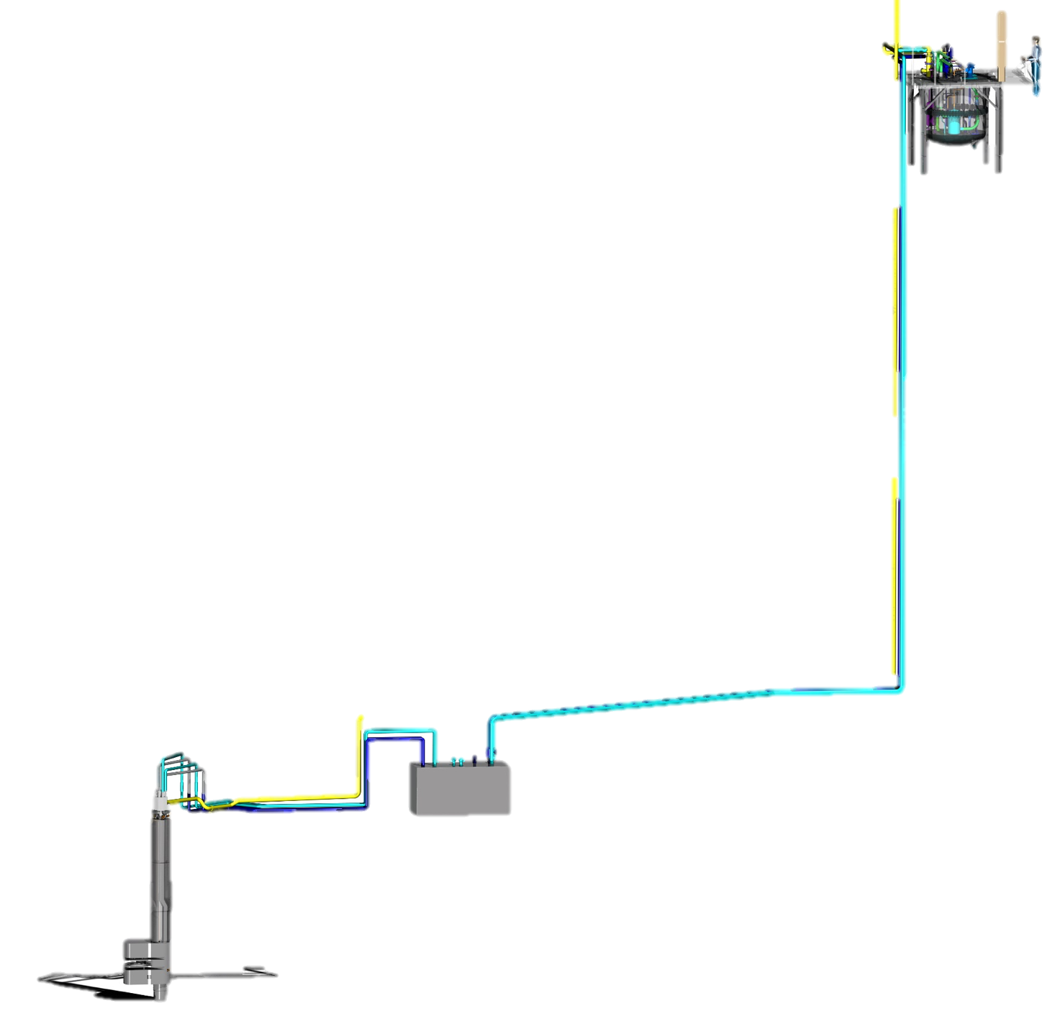
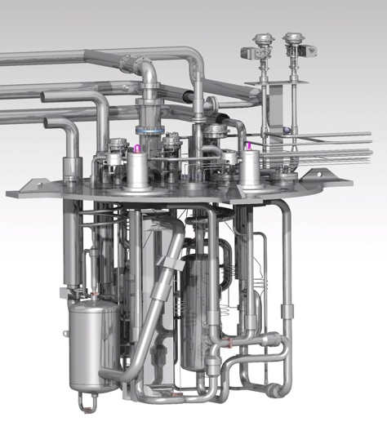
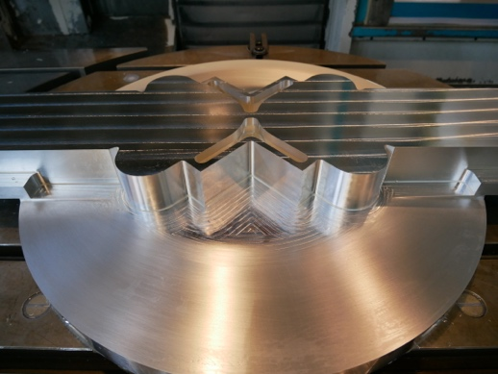

Technical Progress
WP3 Moderator and Reflector Systems,
Moderator & Reflector Plug
  Detail Design Completed in 2017
  Cold Moderators finished manufactured
  Reflector, Thermal Moderator et al in manufacturing
Cryogenic Hydrogen System
  Detailed design completed 2017
  Manufacturing ongoing
  LH2 pumps delivered
Helium Cryoplant
  Detail design Completed in 2017
  Delivery of Compressor Skids 18Q2 and coldbox 18Q3
Irradiation module
  Detail Design finished in 2017,
  Manufacturing completed
Cryogenic moderator prototype
MR Plug
Reflector Vessel & Cold Moderator
CMS Cryostat internals
Thermal Moderator

Slide 16
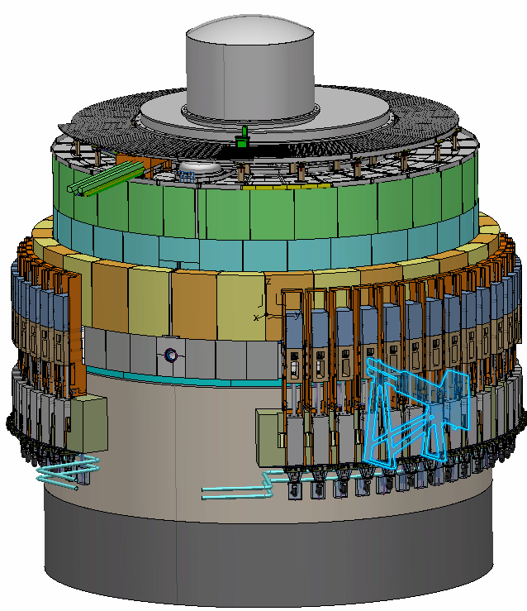
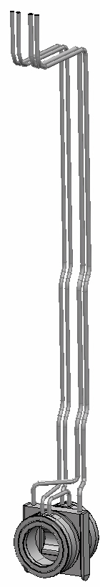
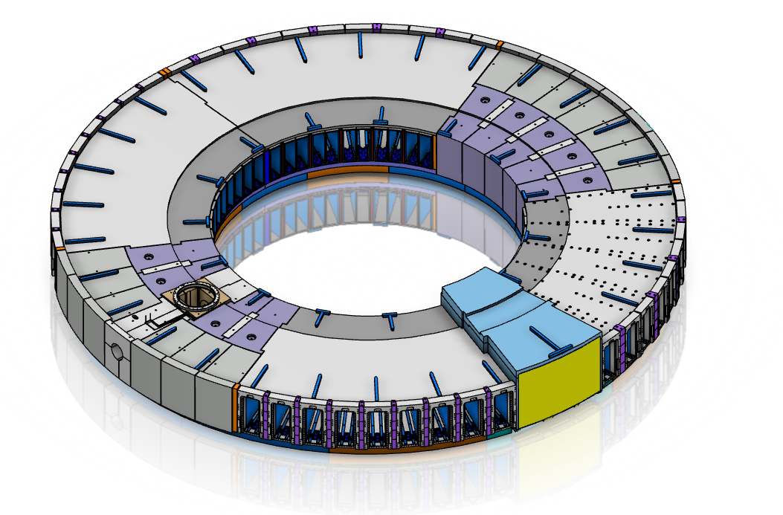
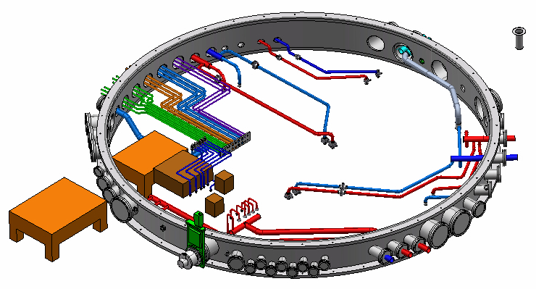
Technical Progress
WP4 Monolith systems
Monolith vessel
  Design finalized for lower parts and Call for Tender is published
  Final design on-going for connection ring and covers
Proton beam window
  Final design on-going
  Tests on PBW and inflatable seals are on-going.
Proton beam instrumentation plug
  Specifications of instrumentation equipment in progress by ACCSYS and their Norwegian in-kind partner
Monolith port block package
  Preliminary design finalized February 2018
  Preparations for procurement ongoing
Monolith Atmosphere System
  Decision taken for pursuing rough vacuum (< 100Pa) with PBW in place as primary operation mode.
  Preliminary design performed by Target and then hand-over to ACCSYS for final design
proton beam instrumentation plug
monolith vessel
proton
beam window
Proton Beam Window
Monolith port block package
Monolith vessel connection ring

Slide 17
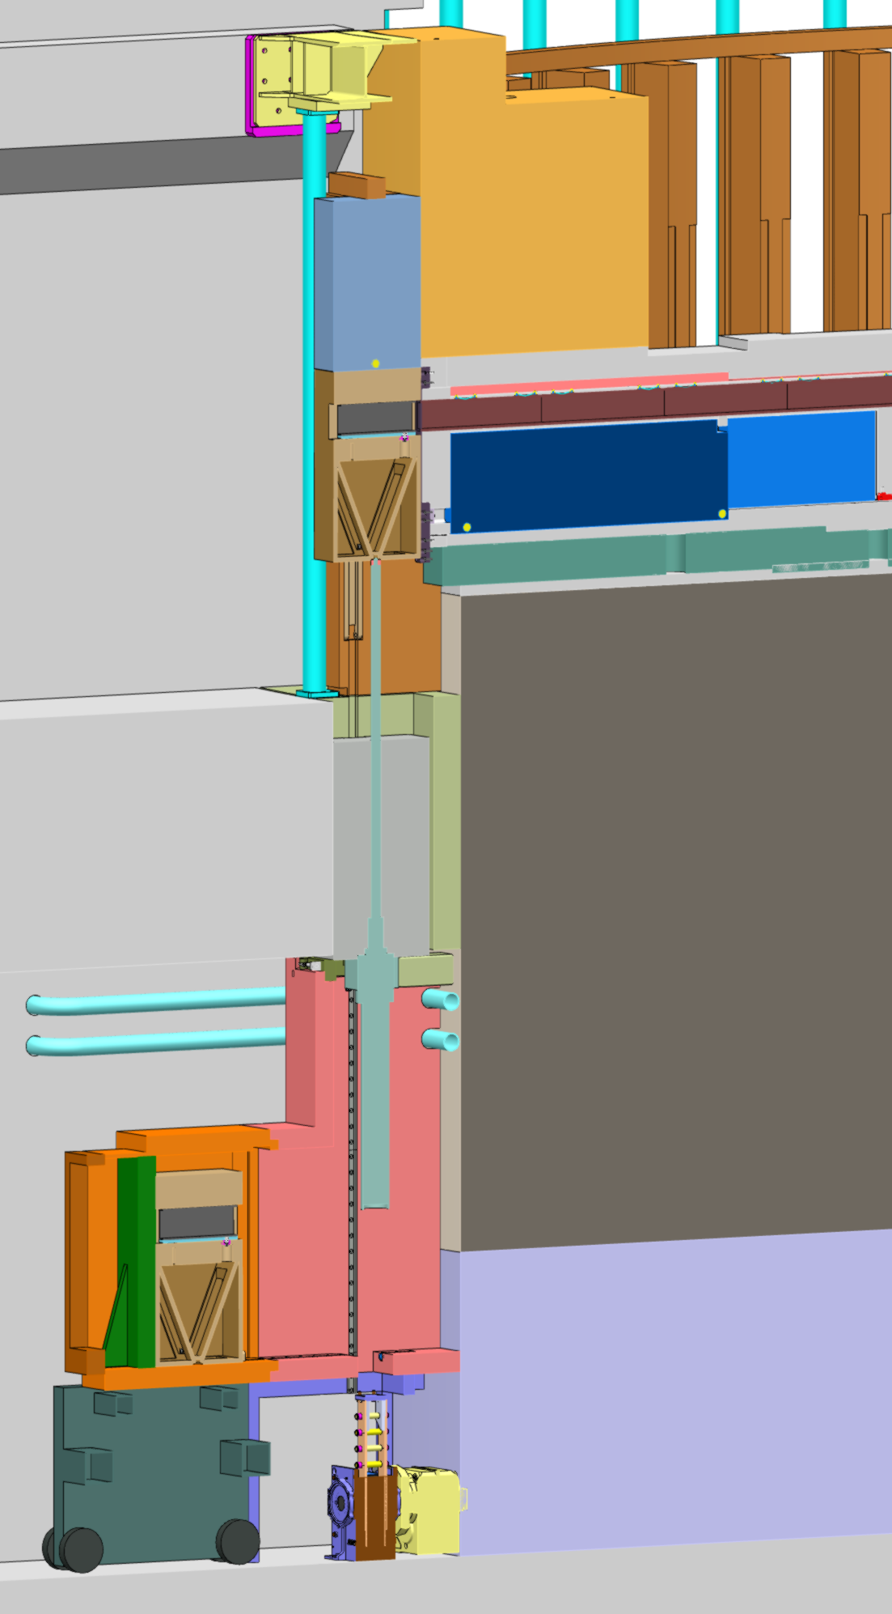
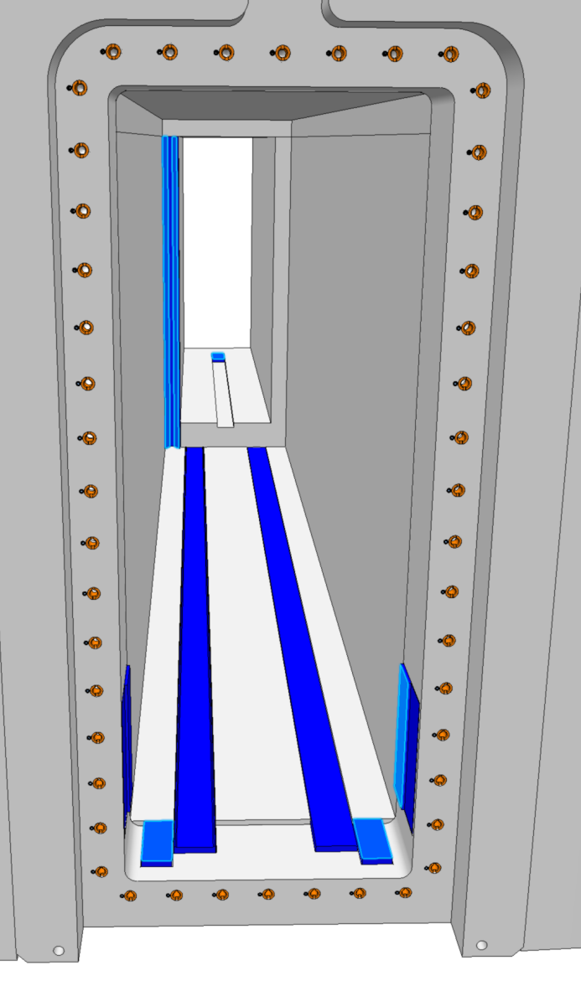
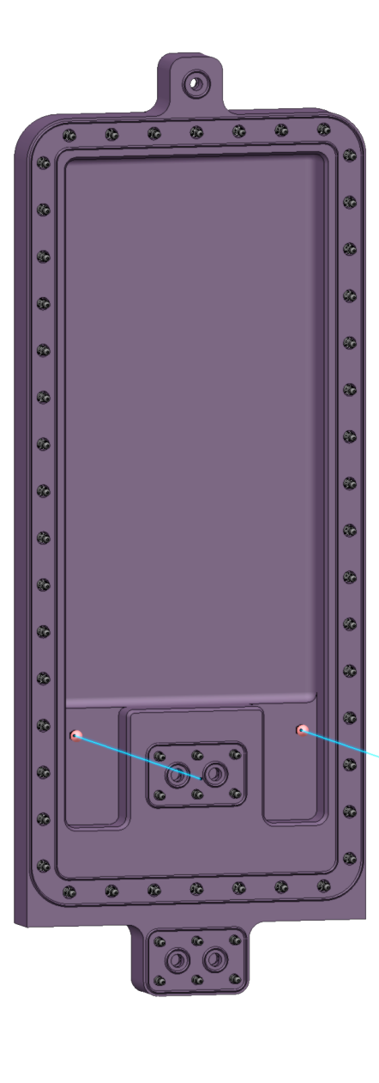
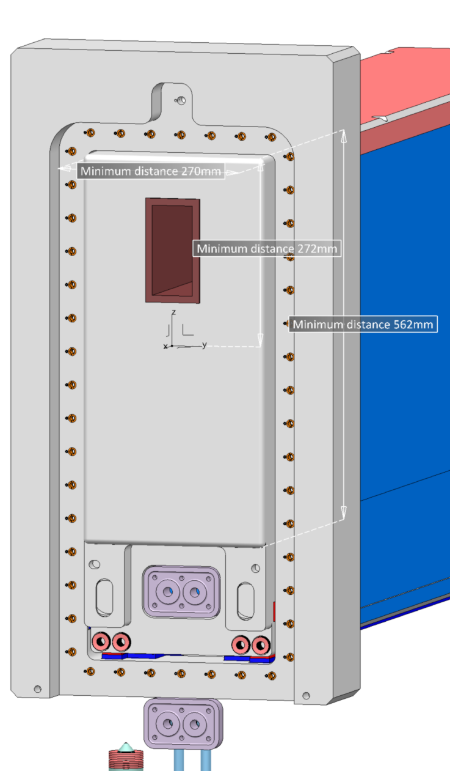
Technical Progress
WP4 Monolith Systems
Neutron beam extraction system
  Detailed design on-going
  System split into several Critical Design Reviews due to complexity. Prototypes ongoing for plugs and planned for Light Shutter System.
Neutron Beam Windows
  Excellent results on vacuum seal tests on prototypes.
GBS
NBW
BBG
NBPI
Instrument position
Target level floor
Handling tooling
17

Slide 18
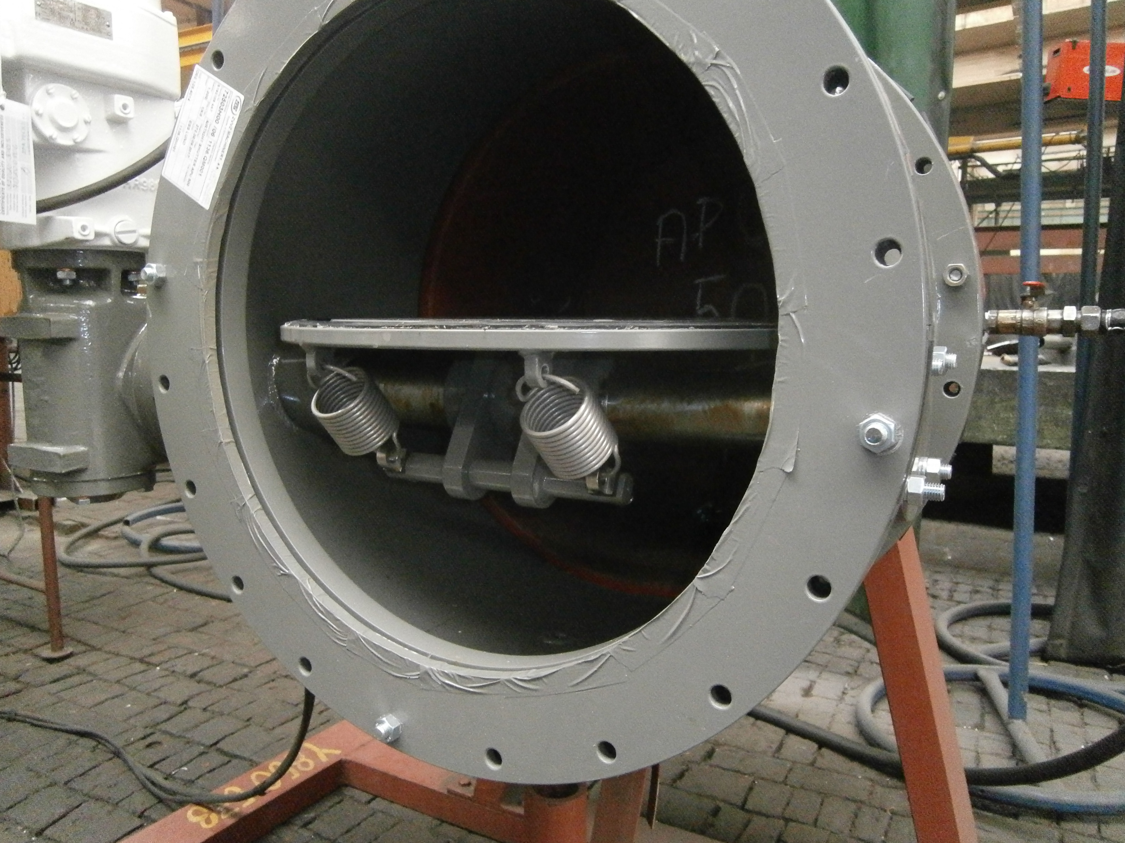
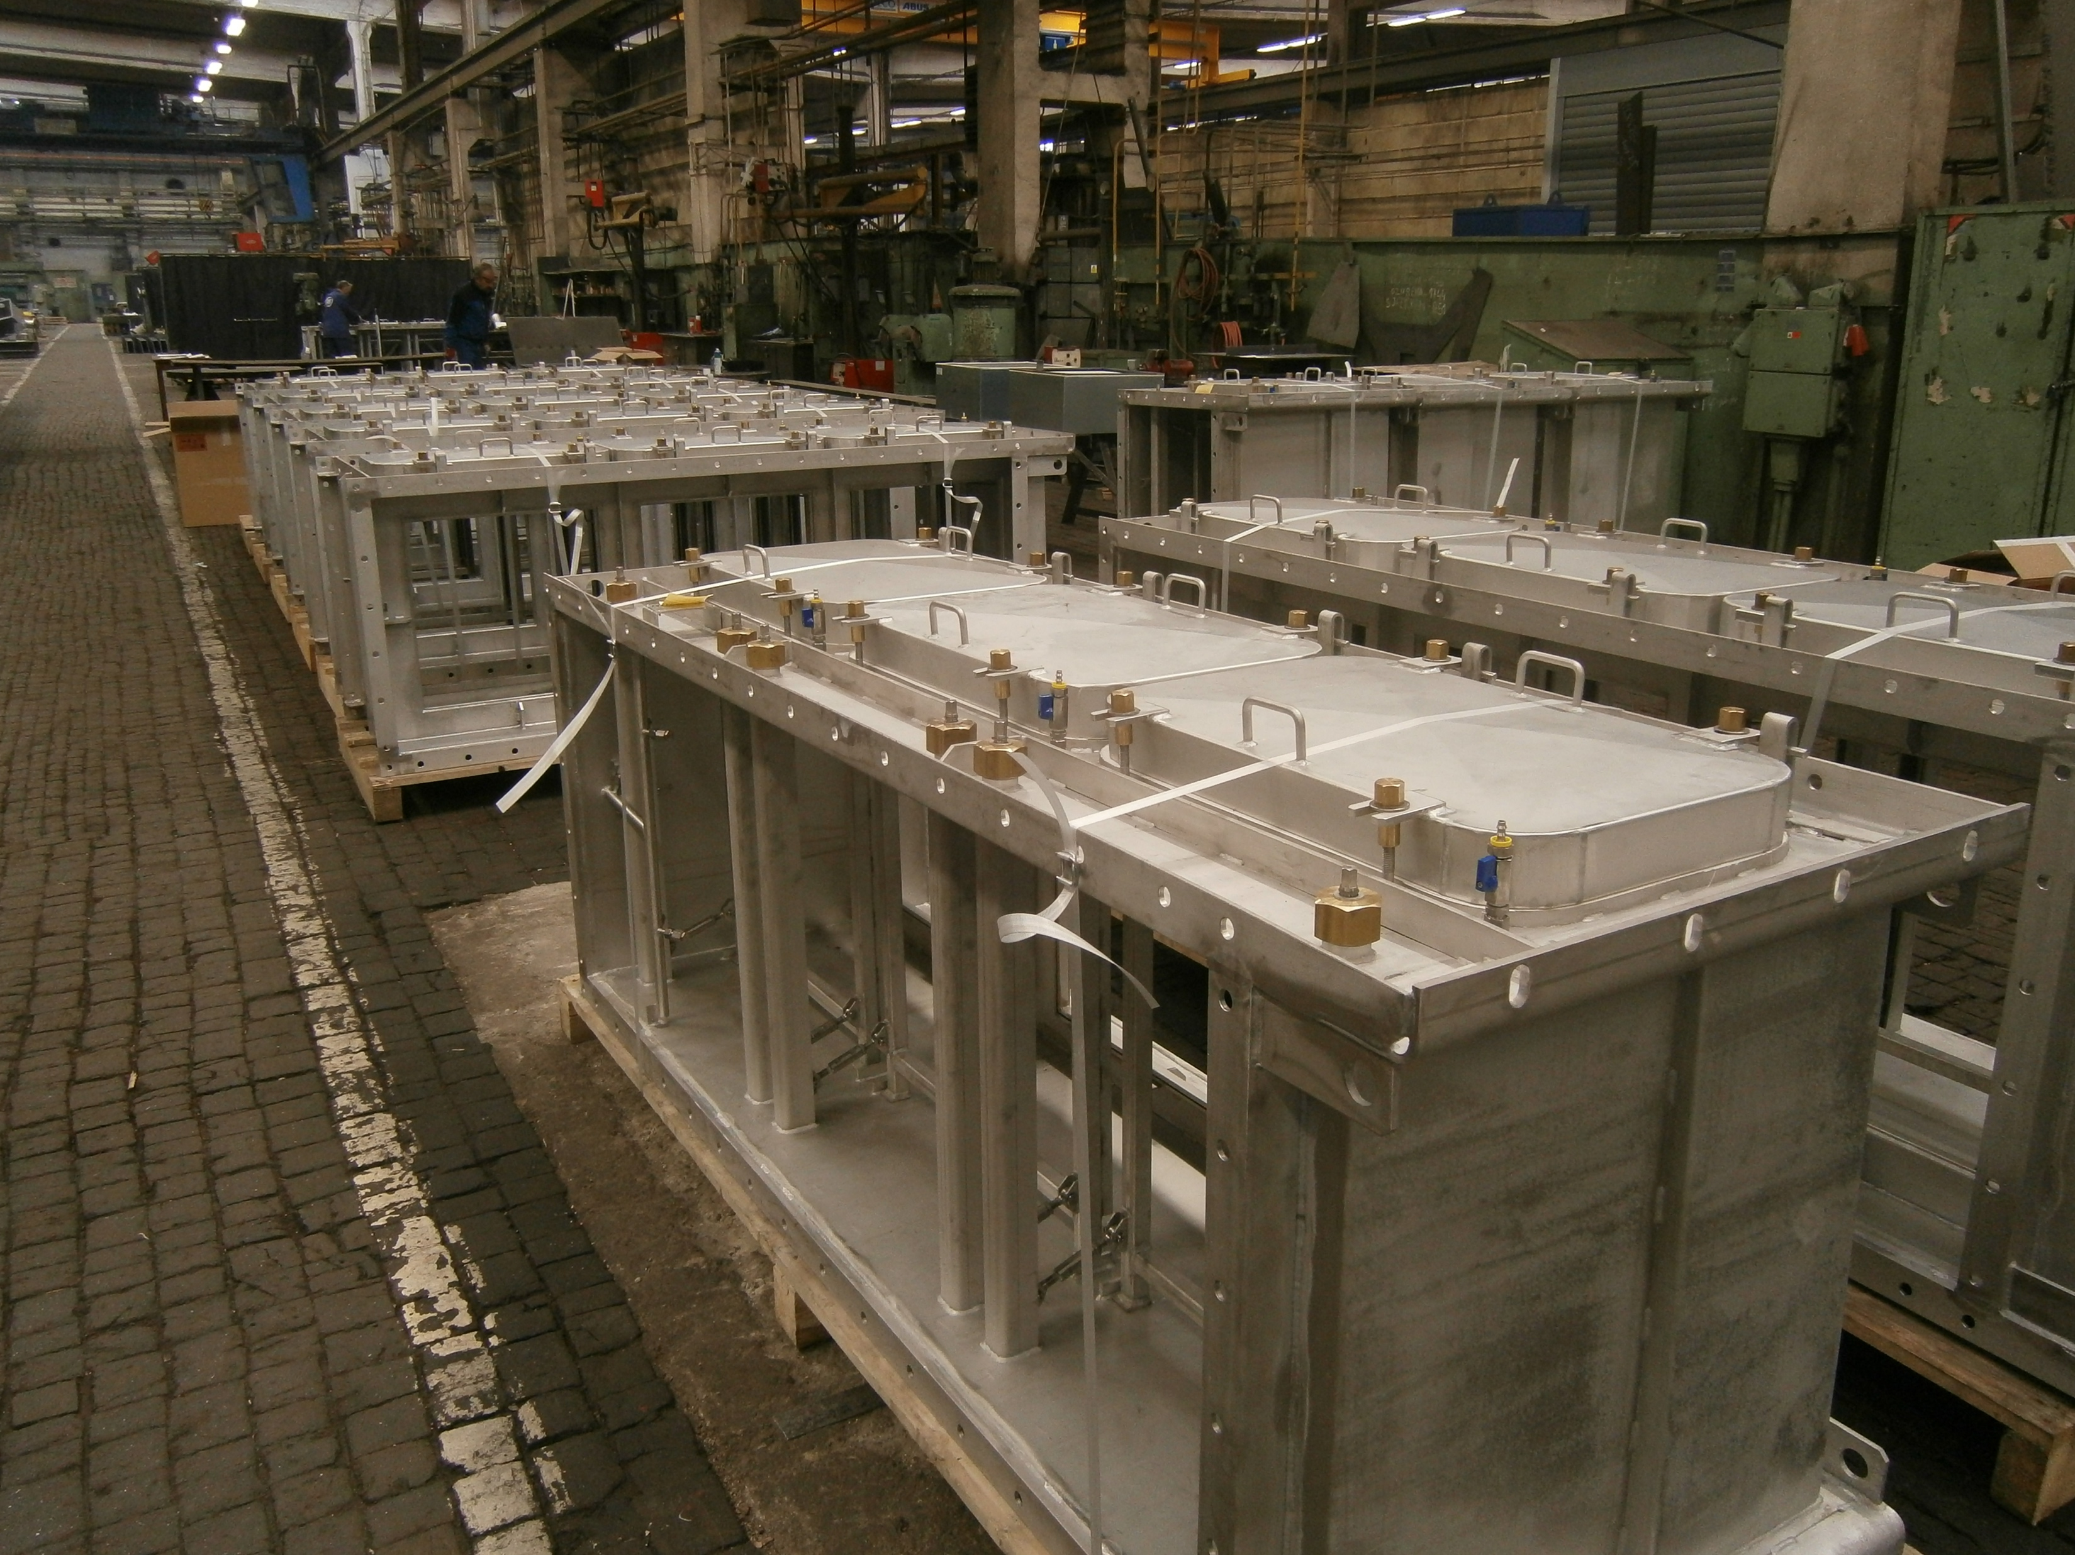
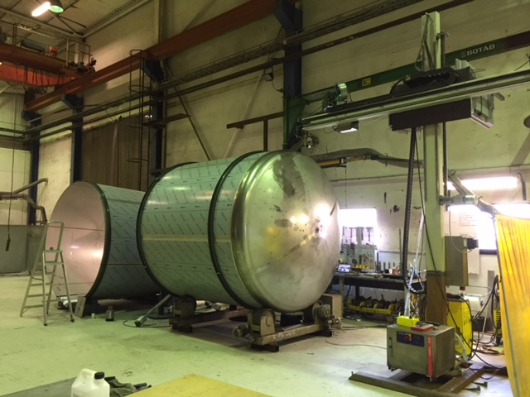
Technical Progress
WP5 Fluid Systems
Primary and intermediate water cooling systems
  Safety classification not ready for primary water cooling systems
    Procurement delayed
  Procurement started for intermediate water cooling systems
Target Station HVAC system
  Detailed design finalized – procurement ongoing
Offgas/monolith vessel relief
  Preliminary design ongoing
Electrical Infrastructure & automation cabinets
  Preliminary design ongoing
All other utility and process systems
  Completion of detailed designs are imminent
  Drain tanks procured and in fabrication
Other
  Procurement preparation of HVAC & Piping installation ongoing
  Turn-key procurement ongoing for Helium purification & Radiolysis Gas Handling systems

Slide 19
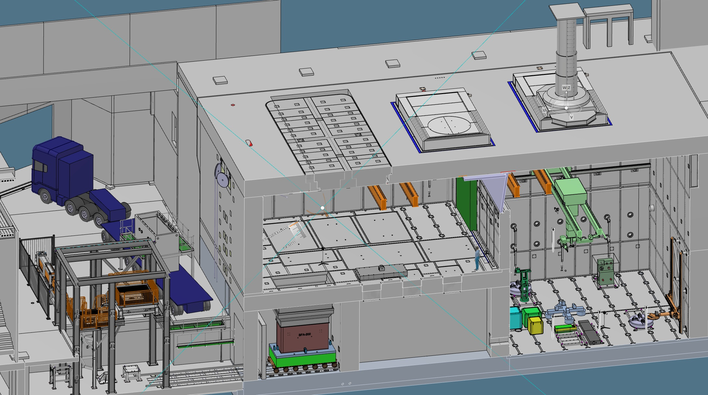
Technical Progress
WP6 Remote Handling Systems
Casks
Active Cells Facility:
Length: 30 m
Depth: 12 m
Height: 15 m
MUTS
Active Cells Facility

Slide 20
Technical Progress
WP6 Remote Handling Systems
Active Cells Facility – Liner package, cast-in items
  Final design completed and design packages delivered to Conventional Facilities as needed
  Components are manufactured and delivered to site as needed for installation
  Installation is now at the maintenance cell (joist slab) floor level (about 6 meters up from ground floor)
Active Cells Facility
  Long lead-time confinement structures and equipment as well as the primary remote handling systems + in-cell crane - Final design completed and procurement in preparation
  Final design well advanced for all remote handling equipment, electrical distribution and safety & control system
Mock-Up and Test Stands (MUTS)
  Preliminary design completed
  Decision to self perform taken since no in-kind partner found
Casks and Associated Handling Devices (CASKS)
  Preliminary design completed
  Decision to self perform taken since no in-kind partner found

Slide 21
Technical Progress
WP7 Target Safety System and Target Controls
TSS Detailed Design
  FBS, LBS, component lists for cabinets 80% completed, ePlan for cabinets 50% completed
  TSS power supply strategy in place including access to backup power
  TSS global cable routing space claim finalized
  Earthquake events handled by seismic breaker system, not TSS
Driving establishment of ESS processes necessary for TSS
  Delivered I&C classification – ESS rules for qualification of electrical and I&C equipment
  Configuration management for TSS and ESS (with ICS, EIS)
  Established Lightning Protection Cross-Functional Working Group
  Guideline for qualification of electrical, instrumentation, & control equipment (with QA)
  Establishing procurement strategy and supply chain audit for Safety Group I&C systems (with QA & Procurement)
Target Controls – ongoing discussions with ICS
  Understanding of ICS scope, processes, EPICS, infrastructure, FBS, machine protection
  Content & format of Functional Package from Target to ICS, use of ICDs, state machines
  IT security & configuration management
Conventional safety – Performing HAZIDs to identify worker hazards in Target areas

Slide 22
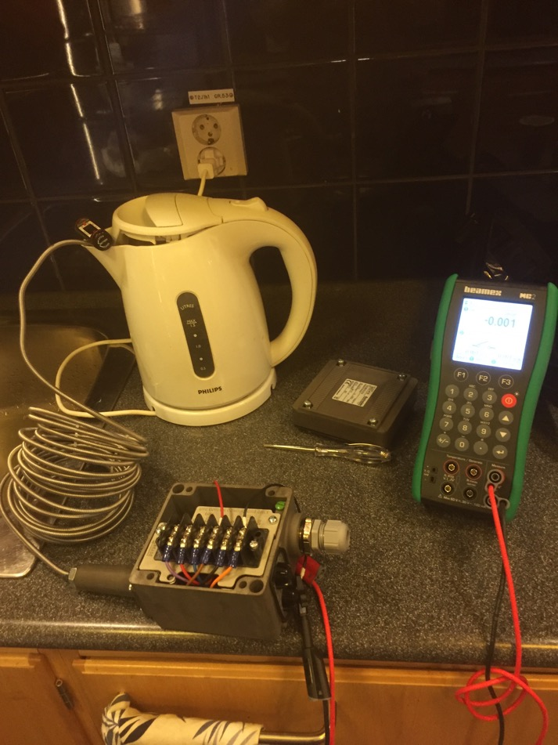
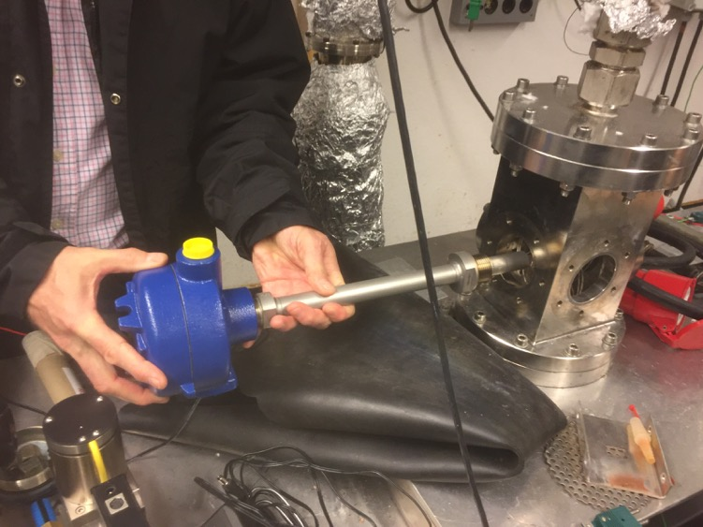
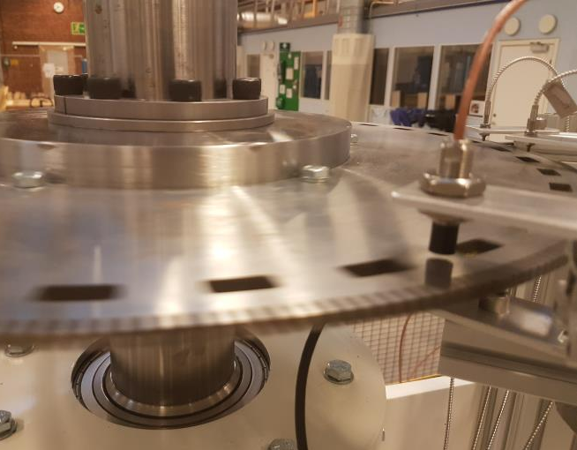
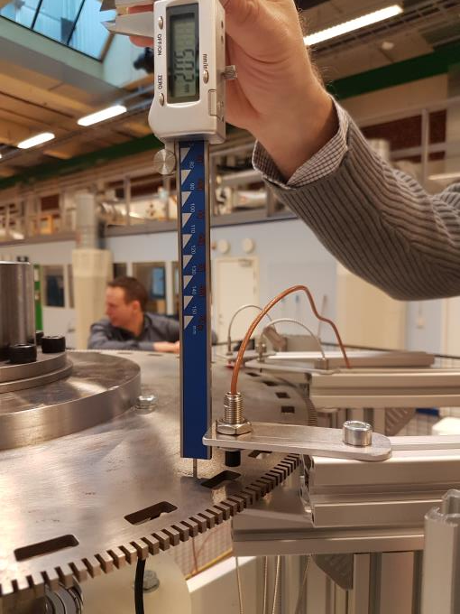
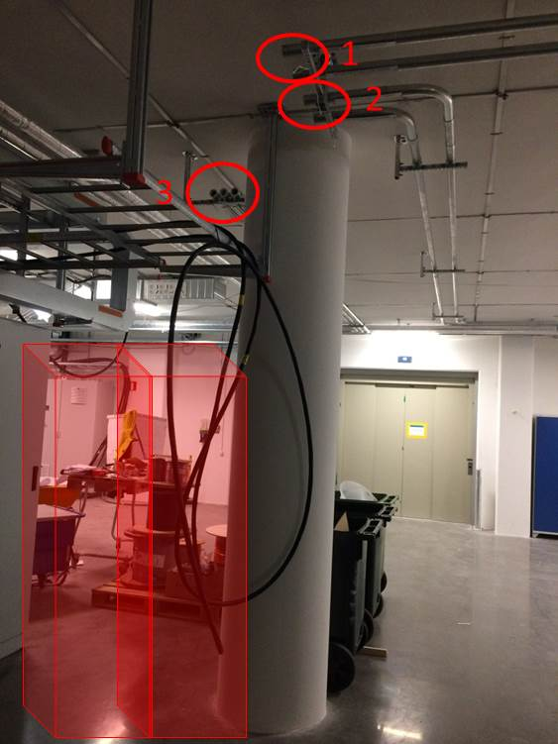
Technical Progress
WP7 Target Safety System
TSS instruments selected, purchased & undergoing testing at ESS
  Pressure switches for monolith & for helium system
  Temperature switch for helium
  Flow switch for helium
  Wheel rotation sensor evaluated at RATS lab on target shaft mock-up
  Testing pressure, temp, flow in ETHEL (LTH)
  Measurement of helium flow remains problematic & in search of a solution
  When environmental conditions finalized g go for qualification
TSS cable pipes installed in FEB for connections to ion source and RFQ

Slide 23
Technical Progress
WP8 Target Physics
Extensive collaboration with CF/Skanska/COWI/SWECO
  Finding working solutions to ensure H1 shielding needs and H4 earthquake demands.
  Addressing CF Requests For Information (CFRFIs)
Support for the licensing process.
  Review and approval of shielding reports.
  Working with in-kind partners to ensure required quality on shielding and inventory calculation reports.
  Support for the target accident analysis
  Presentation to SSM on shielding
Material handbook is released and continuously updated
  Based on knowledge acquired through collaborations with partner labs
Support target division work packages with shielding and inventory calculations.
Work on the target imaging system (Collaborating with DTU).
Work on radiation damage in materials (collaborators in STIP-V and BLIP)

Slide 24
Licensing Application Update
Delivered source term package to SSM – 3 April
  For SSM emergency planning zoning – significant updates required as a result of new aerosol production information learned in TOAST
  Included TOAST report, tungsten release fractions, AA calculations defining realistic scenario development & material damaged, unmitigated AA3 (LOCA), source term, transport model docs
Delivered IT security package to SSM – 3 April
  Required supplement to Oct2017 delivery prior to NC LINAC application
  Included ESS Rules for IT Security for Programmable Safety and Safety-related Systems, PSS Configuration Management, & TSS Configuration Management documents
Significant changes in underlying rules for Radiation Safety Analyses – 12 April
  Clarification to application of deterministic analysis for accident analyses
  Developed new comprehensive approach to Radiation Safety for Workers
    Presenting proposal to differentiate between workers and public to SSM – 12 April
  Major impact on effort to update accident analyses, system classification, KFMs, etc.
Updating many analyses & documents for 2018 PSAR
  TSS – requirements, architecture, FMEA, classified component list, TSS-ACC ICD-R
  AA3 (LOCA), AA11/AA10 (water leaks), AA14 (Earthquake), AA22(getter fire)
  Supporting documentation (normal ops releases, classification, KFMs, inventories, materials, barriers, facility safe state)

Slide 25
Issues and Conclusion

Slide 26
Target Project Issues
Failure to secure in-kind partner for a few but large work elements,
  Late decisions and preparation to self-perform major work elements impacts staffing, procurement, and work load
Schedule impacts
  Accident and safety analysis works and support for license application draws significantly more resources than anticipated and budgeted for
  In-kind deliveries from Spain pushed deliverables 9 – 12 months, several manufacturing contracts yet to be signed
Manufacturing contracts, proposals received are higher than budget.

Slide 27
Concluding Remarks
Project is progressing well, but forecast a significant delay, RBOT March 2022
Target is in Final Design phase for most systems, and also in Procurement and Manufacturing for some of them
Significant efforts have been spent on support for license application to the Swedish Radiation Safety Authority
Target has entered installation phase, mainly for ACF, embedded and cast-in items, TSS and front end bldg.
Responses to TAC-16 recommendations can be found in separate presentation, uploaded to Indico.

