Slide 1
ICS update for TAC 17
Henrik Carling
Head of ICS division
www.europeanspallationsource.se
2018-04-06

Slide 2
Contents
Brief introduction to the integrated control system
Updates since last TAC
Construction project status and planning
Summary
TAC 16 answers

Slide 3
Brief introduction to the integrated control system

Slide 4
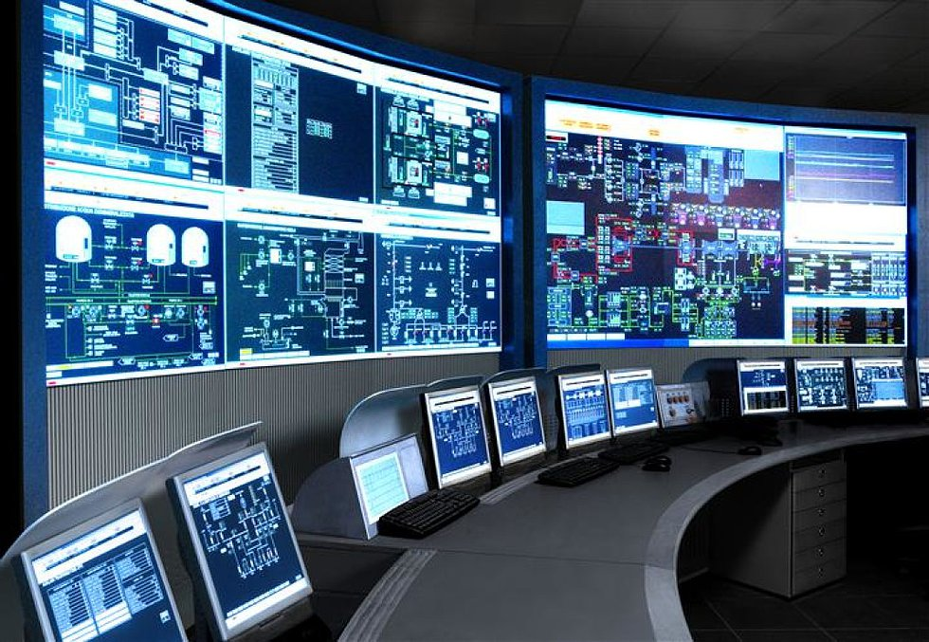
The ESS integrated control system
The ESS facility is a large and complex machine with very much and diverse equipment that needs to work in synchronization and with well-known configurations
The Integrated Control System Division (ICS division) is responsible for the control systems within the ESS facility including controls for
  Accelerator
  Target
  Neutron Scattering Systems
  Conventional Facilities
In addition, ICS will implement
  Machine Protection System
  Personnel Safety System
To build a distributed control
system of this size is a major
undertaking

Slide 5


ESS/ICS challenges
The ESS control system complexity is very high
  About 1 600 000 “process values”
  Ambitious approach to automation of control system configuration
Facility availability goals are very high
  ICS plays a key role for the availability of the facility - 95% availability
  Requires high performance and availability equipment
Some new approaches will be implemented at ESS/ICS
  Full scale deployment of EPICS 7
    ESS is committed to contributing to the EPICS community
  Full scale deployment of MicroTCA.4
    ESS is involved in a public procurement for innovation initiative

Slide 6





ICS Project scope
Work package 01 Management and administration
Work package 03 Software core
Work package 04 Hardware core
Work package 05 Machine protection
Work package 06 Equipment
Work package 07 Control system infrastructure
Work package 08 Physics
Work package 09 Personnel safety systems
Work package 10 Integration - Accelerator
Work package 11 Integration - Target
Work package 12 Integration - Instruments
Work package 13 Integration - Conventional facilities
Work package 14 Test Stands
Work package 20 Installation
Software
Electronics
Infrastructure
Safety & protection

Slide 7
ICS Organization
2018-04
Henrik Carling
Division head
Wojtek Fabianowski in-kind manager
Maria Romedahl
Technical coordinator
Thilo Friedrich
Systems engineer
Remy Mudingay
Controls infrastructure
Anna Gillberg
Team assistant
Annika Nordt
Safety and protection
Karl Vestin
Hardware and integraion
Hector Novella
Deputy project manager
Susanne Regnell
Controls Software
Timo Korhonen
Chief engineer
Alessio Curri
System administrator
Alberto Toral
Technician
David Sanchez
Automation engineer
Angel Monera
FPGA Engineer
Benedetto Gallese
Integrator
Ben Folsom
PhD student
Banafsheh Hajinasab
Software engineer
Benjamin Bertrand
Software engineer
Denis Paulic
DGL, PLC engineer
Enric Bargalló
Lead analyst engineer
Faye Chicken
Technician
François Bellorini
Integrator
Claudio Rosati
Software engineer
Dirk Nordt
Software engineer
Johan Christensson
Infrastructure technology engineer
Fernando Carrasco
Technician
Manuel Zaera-Sanz
Lead engineer slow interlocks
Javier Cerejo
PhD Student
Jeong Han Lee
Integrator
Emanuele Laface
Accelerator physicist
Georg Weiss
Software engineer
Susann Skarin
Network administrator
Morteza Mansouri
Safety systems engineer
Mattias Eriksson
Technician
John Sparger
Integrator
Joao Martins
Integrator
Fredrik Söderberg
Software engineer
Jan-Åke Persson
Senior software engineer
Anders Harrisson
Software configuration manager
Stephane Gabourin
Lead engineer fast interlocks
Riccard Andersson
Technical coordinator
Peter van Velze
Technician
Julen Etxeberria
Junior controls engineer
Juan Esteban Müller
Software scientist
Karin Rathsman
Accelerator scientist
Fredrik Luthander
Software engineer
Szandra Kövecses
Lead integrator
Stuart Birch
Senior engineer
Saeed Haghtalab
Integrator
Simone Farina
Embedded systems egineer
Ricardo Fernandes
Control system software architect
Consultants
Peter Holgersson
Electriocal engineer
Yong Kian Sin
IEC61508 engineer
Viktor Fred
Lead engineer electrical installations
Thomas Fay
Integrator
Tomasz Brys
Integrator
Philippe Rabis
Work package manager
Miklos Boros
Integrator
Mehdi Mohammednezhad
Integrator
Michael Beck
Work package manager
Oliver Talevski
Embedded engineer
Nour Akel
ICS Installation coordinator
Marino Vojneski
Integrator
Johannes Kazantzidis
Integrator
William Ledda
Integrator
Employee
Consultant
Open positions (4)
ESS-0081625
Temporary employee
Consultant
off-site
Position under consideration

Slide 8
Layer Architecture of the ESS Control Systems
Human Users
Engineers, Operators,
Scientists, Technicians, ...
display ESS facility data,
task execution
ESS Main Control Room
Experiment workstations
Other Human Operations Facilities
Applications
System
GUIs
Equipmet
GUIs
Physics
Apps
Config.
tools
post
mortem
analysis
PSS
GUIs
GUIs for data analysis,
processing and archive services,
system configuration, ...
send/receive
ESS facility data
EPICS (Ethernet)
Network
equipment
Facility Integration
runtime & historical data,
complex control functions,
configuration databases
EPICS
IOC
EPICS
IOC
EPICS
IOC
EPICS
IOC
EPICS
IOC
EPICS
Archive
EVG, Master
Oscillator
Timing System
system specific
data exchange
FBIS
Machine Protection: Beam Interlock System
Local System Control
high dependability,
executes local control functions
PLC
PLC
Ether
CAT
MicroTCA
system
MicroTCA
system
PSS
PLC
Personnel Safety System
Ethernet fieldbus
local control,
run-time data
Signal Conditioning (a/d)
Equipment Electronics
remote
I/O
cont-
roller
device
electronics
device
electronics
cont-
roller
remote
I/O
remote
I/O
Device signals
device specific
signals
Physical Equipment
machinery, sensors, actuators
pump
flowmeter
motor
sensor
chopper
PS
switch
sensor
sensor
measure and adjust
Physical Processes
H₂O Flow
He Flow
Mech. Movement
RF
Proton
Neutron
etc.
Temp
Electricity

Slide 9
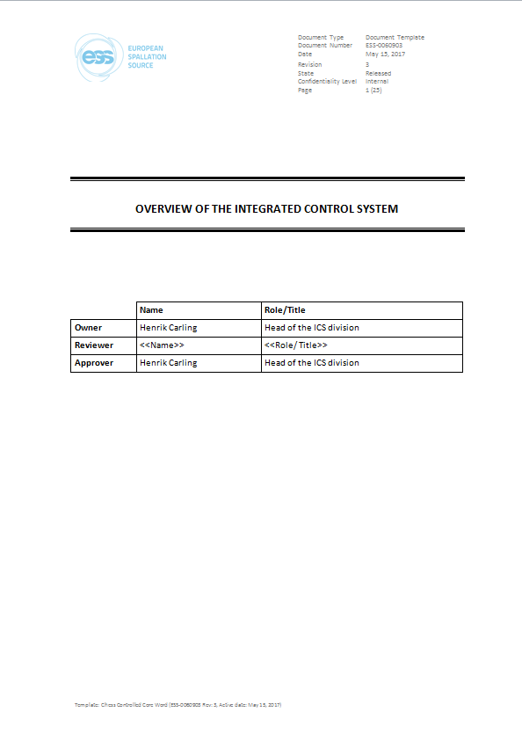
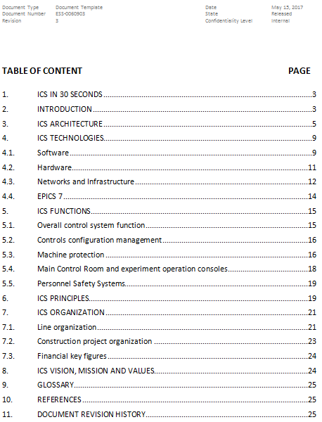
ICS overview
A description of ICS concepts, architecture, technologies, organization and more
An overview document with many references to more detailed documentation

Slide 10
Updates since last TAC

Slide 11
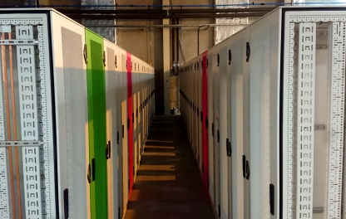
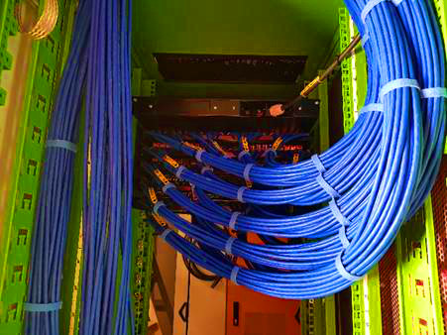
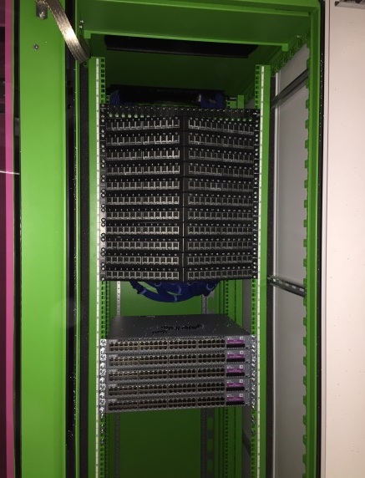
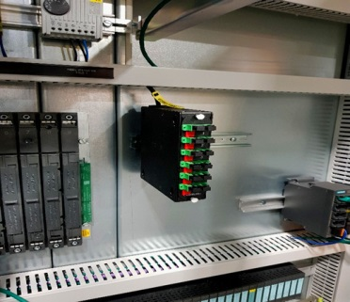
Installation of control system infrastructure
Installation and deployment of control system infrastructure is progressing according to plan
Fibre, cabling, switches, routers, patch panels etc. are installed and commissioned

Slide 12
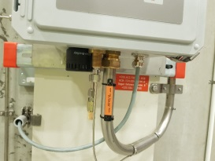
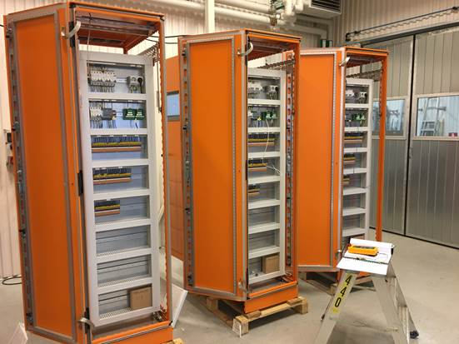
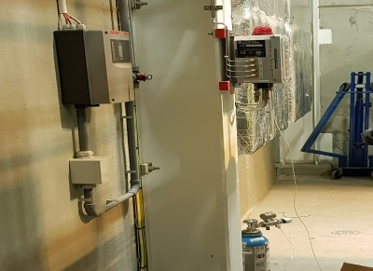
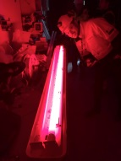
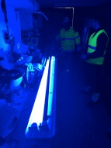
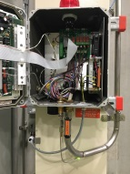
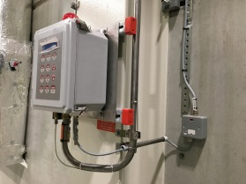
Installation of Personnel safety systems
ESS personnel safety
systems are among the
earliest systems that need to be in
place before operating equipment
A lot of installation is ongoing, in
particular for Oxygen deficiency hazard monitors

Slide 13
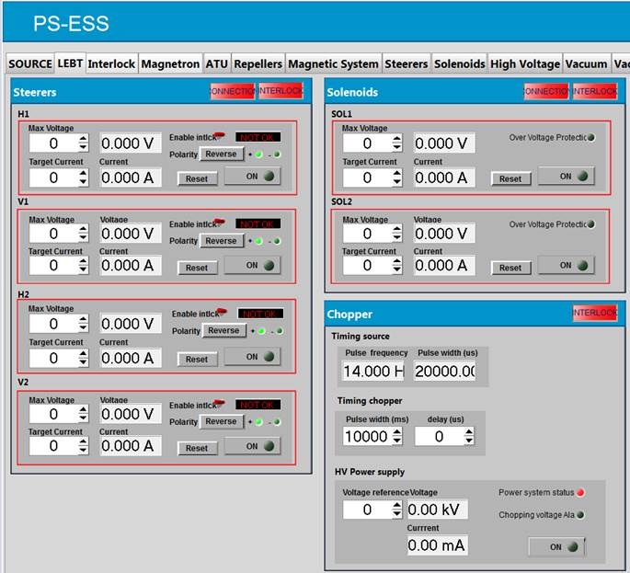
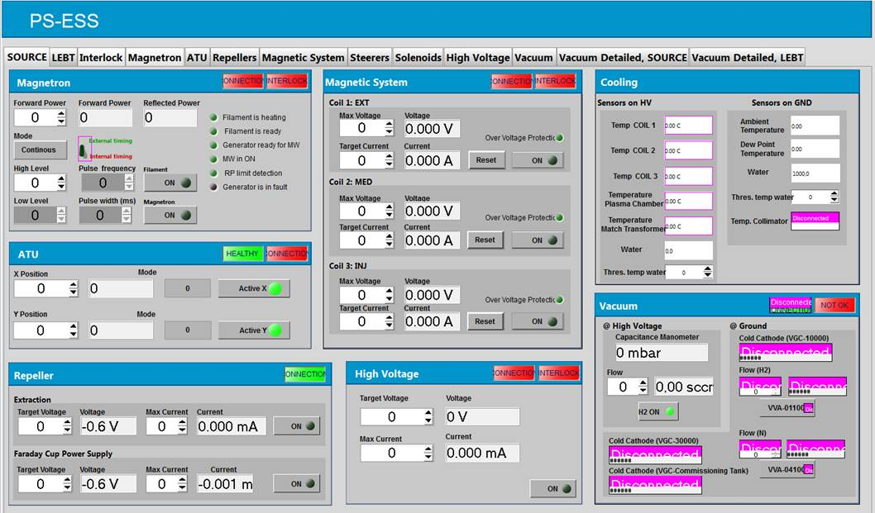
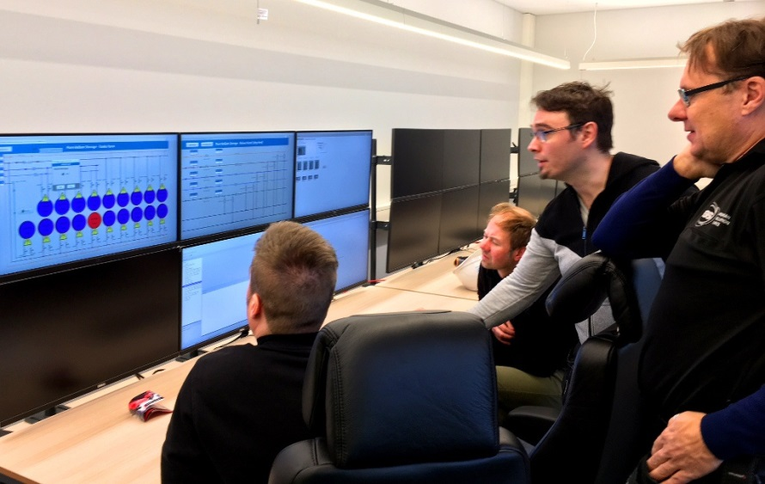
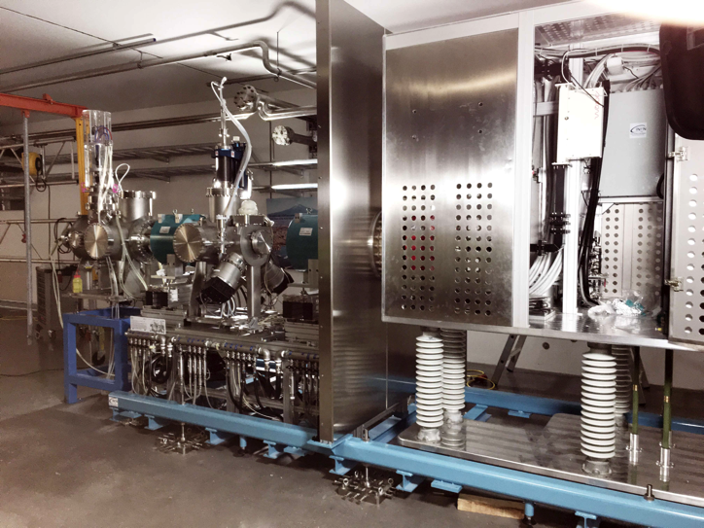
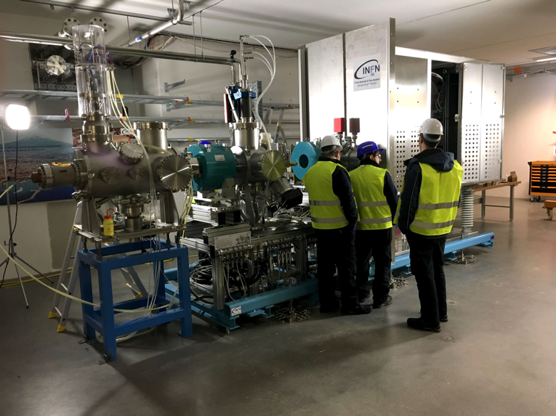
Controlling systems from the local control room
Recent achievements include controlling the pure Helium storage and parts of the ion source and LEBT from the local control room

Slide 14
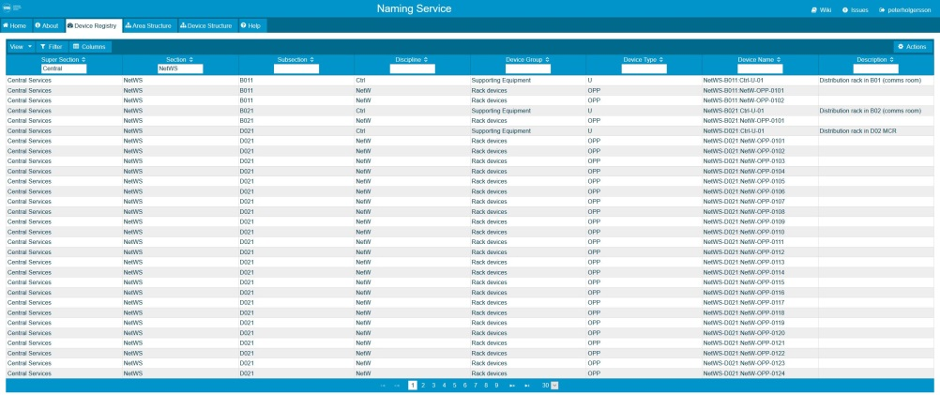
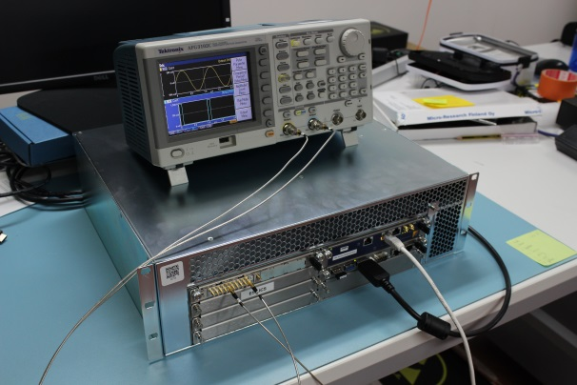
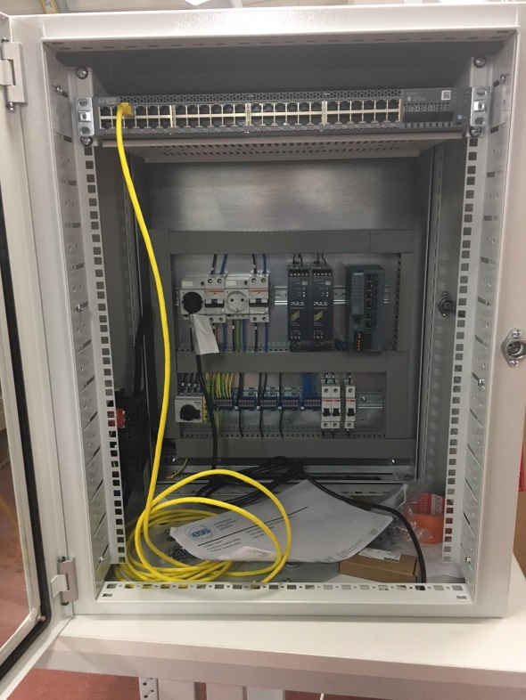
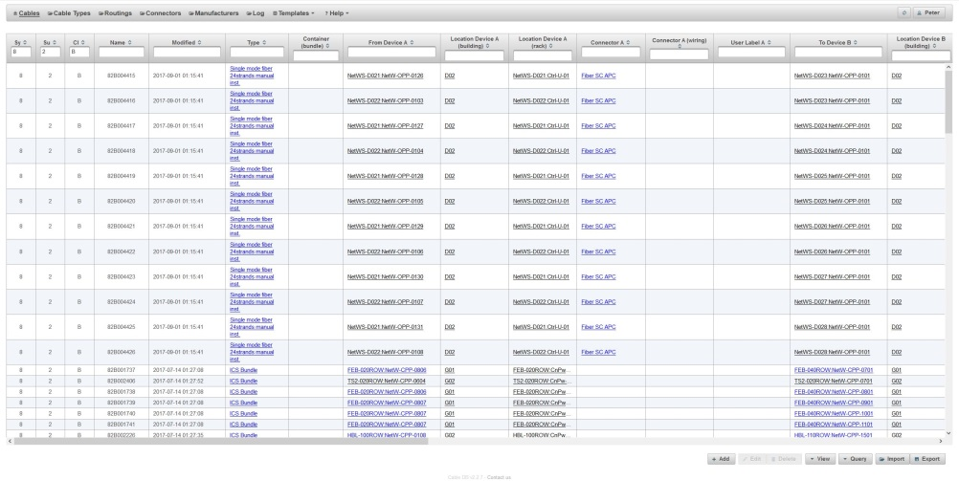
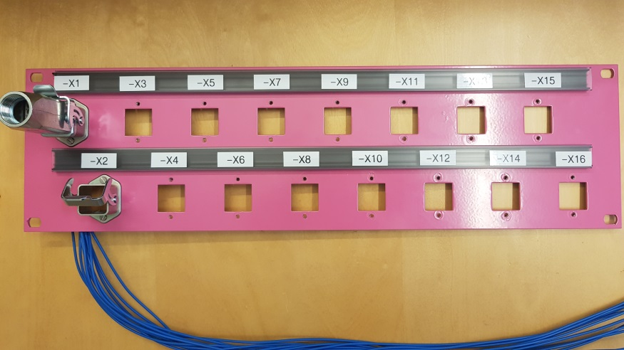
Building control systems
Many components are being assembled into ICS subsystems and readied for installation
Meanwhile, work is continuing with maintaining and developing the ICS and EPICS software solutions

Slide 15
ICS In-kind partners
Agreement signed
Agreement waiting for signature
Collaboration/other agreement

Slide 16
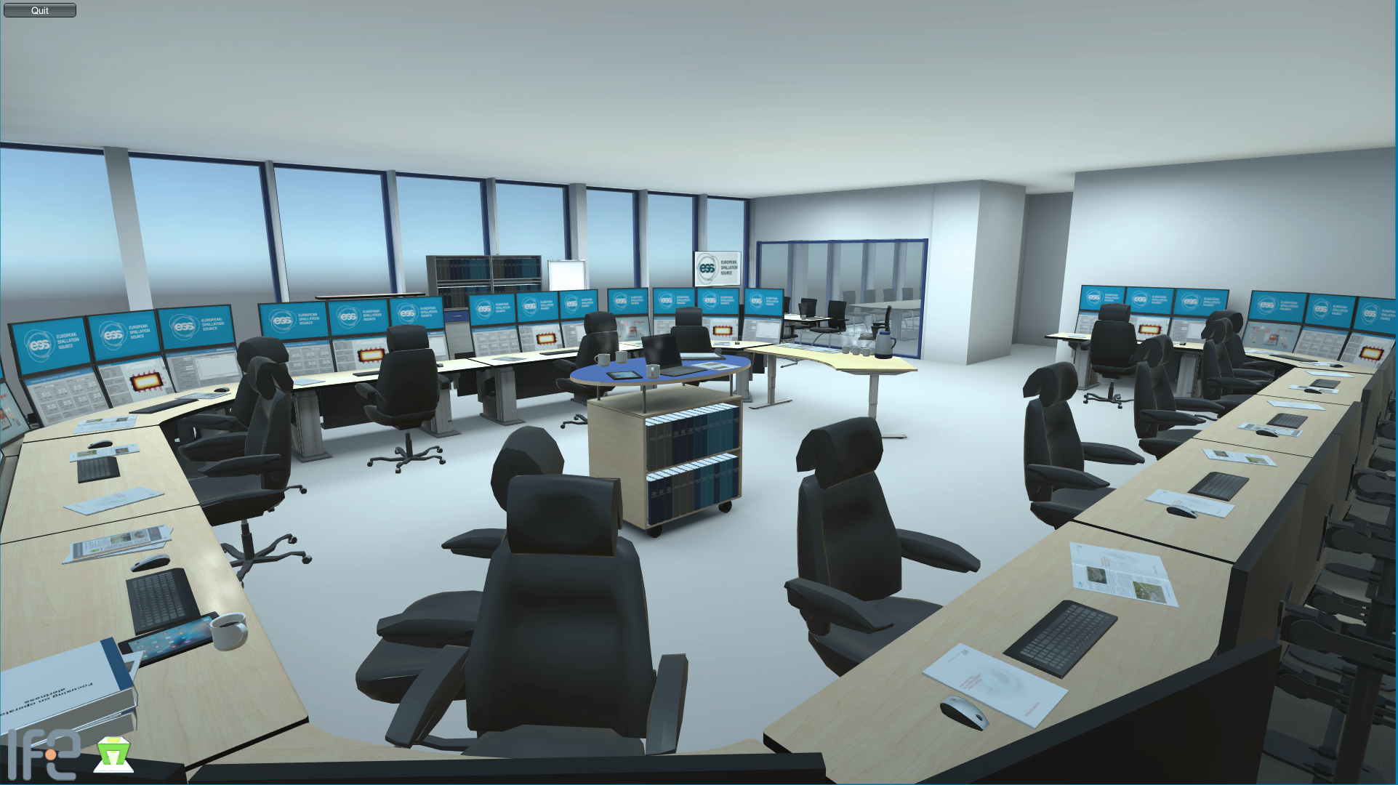
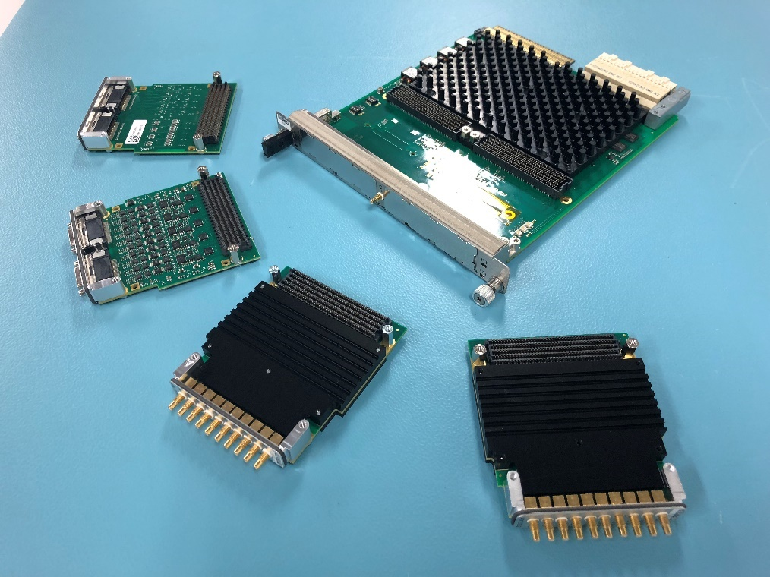
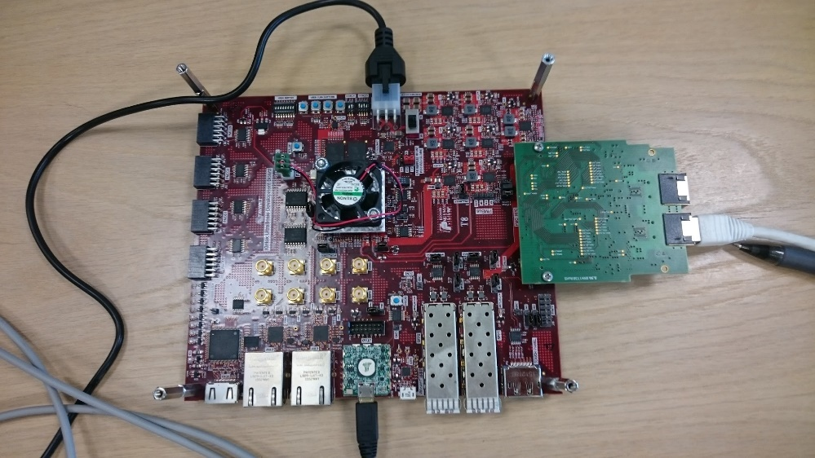
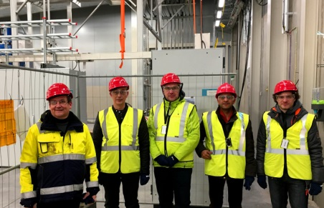
Examples of ongoing in-kind activities
IFE control room contribution
PSI IFC card family contribution
Testing Tallinn University of Technology contribution
An engineering team from Swiss in-kind partner PSI visited ESS

Slide 17
ICS Organization
2017-04
Henrik Carling
Division head
Wojtek Fabianowski in-kind manager
Thilo Friedrich
Systems engineer
Henrik Carling (act)
Controls infrastructure
Anna Gillberg
Team assistant
Annika Nordt
Safety and protection
Daniel Piso
Hardware and integration
Hector Novella
Deputy project manager
Susanne Regnell
Controls Software
Timo Korhonen
Chief engineer
Alessio Curri
ICS administrator
Alberto Toral
Technician
Angel Monera
FPGA Engineer
Benedetto Gallese
Integrator
Ben Folsom
PhD student
Claudio Rosati
Software engineer
Benjamin Bertrand
Software engineer
Denis Paulic
PLC Engineer
David Brodrick
Integrator
François Bellorini
Integrator
Emanuele Laface
Accelerator physicist
Jan-Åke Persson
Senior software engineer
Remy Mudingay
Infrastructure engineer
Manuel Zaera-Sanz
PLC Engineer
Javier Cerejo
PhD Student
Jeong Han Lee
Integrator
Juan Esteban Müller
Software scientist
Karin Rathsman
Senior scientist
Susann Skarin
Network administrator
Morteza Mansouri
Safety Engineer
Joao Martins
Integrator
Nick Levchenko
Integrator
Ricardo Fernandes
Senior software engineer
Consultants
Viktor Fred
Electrical engineer
Riccard Andersson
PhD student
Julen Etxeberria
Junior controls engineer
Tomasz Brys
Integrator
Fredrik Luthander
Software engineer
Open positions (2)
Jonny Svärd
Software engineer
Stuart Birch
Senior safety engineer
Simone Farina
Embedded systems egineer
Krisztián Löki
Integrator
Yong Kian Sin
IEC61508 engineer
Niklas Claesson
Integrator
Oliver Talevski
Embedded engineer
Szandra Kövecses
Technical coordinator
Alexander Söderqvist
Integrator
Open positions (1)
Open positions (2)
Employee
Consultant
Temporary employee
Consultant
off-site
Position under consideration

Slide 18
ICS Organization
2018-04
Henrik Carling
Division head
Wojtek Fabianowski in-kind manager
Maria Romedahl
Technical coordinator
Thilo Friedrich
Systems engineer
Remy Mudingay
Controls infrastructure
Anna Gillberg
Team assistant
Annika Nordt
Safety and protection
Karl Vestin
Hardware and integraion
Hector Novella
Deputy project manager
Susanne Regnell
Controls Software
Timo Korhonen
Chief engineer
Alessio Curri
System administrator
Alberto Toral
Technician
David Sanchez
Automation engineer
Angel Monera
FPGA Engineer
Benedetto Gallese
Integrator
Ben Folsom
PhD student
Banafsheh Hajinasab
Software engineer
Benjamin Bertrand
Software engineer
Denis Paulic
DGL, PLC engineer
Enric Bargalló
Lead analyst engineer
Faye Chicken
Technician
François Bellorini
Integrator
Claudio Rosati
Software engineer
Dirk Nordt
Software engineer
Johan Christensson
Infrastructure technology engineer
Fernando Carrasco
Technician
Manuel Zaera-Sanz
Lead engineer slow interlocks
Javier Cerejo
PhD Student
Jeong Han Lee
Integrator
Emanuele Laface
Accelerator physicist
Georg Weiss
Software engineer
Susann Skarin
Network administrator
Morteza Mansouri
Safety systems engineer
Mattias Eriksson
Technician
John Sparger
Integrator
Joao Martins
Integrator
Fredrik Söderberg
Software engineer
Jan-Åke Persson
Senior software engineer
Anders Harrisson
Software configuration manager
Stephane Gabourin
Lead engineer fast interlocks
Riccard Andersson
Technical coordinator
Peter van Velze
Technician
Julen Etxeberria
Junior controls engineer
Juan Esteban Müller
Software scientist
Karin Rathsman
Accelerator scientist
Fredrik Luthander
Software engineer
Szandra Kövecses
Lead integrator
Stuart Birch
Senior engineer
Saeed Haghtalab
Integrator
Simone Farina
Embedded systems egineer
Ricardo Fernandes
Control system software architect
Consultants
Peter Holgersson
Electriocal engineer
Yong Kian Sin
IEC61508 engineer
Viktor Fred
Lead engineer electrical installations
Thomas Fay
Integrator
Tomasz Brys
Integrator
Philippe Rabis
Work package manager
Miklos Boros
Integrator
Mehdi Mohammednezhad
Integrator
Michael Beck
Work package manager
Oliver Talevski
Embedded engineer
Nour Akel
ICS Installation coordinator
Marino Vojneski
Integrator
Johannes Kazantzidis
Integrator
William Ledda
Integrator
Employee
Consultant
Open positions (4)
ESS-0081625
Temporary employee
Consultant
off-site
Position under consideration

Slide 19
ICS Organization - issues
2017-08
Henrik Carling
Division head
Wojtek Fabianowski in-kind manager
Maria Romedahl
Technical coordinator
Thilo Friedrich
Systems engineer
Remy Mudingay
Controls infrastructure
Anna Gillberg
Team assistant
Annika Nordt
Safety and protection
Daniel Piso
Hardware and integration
Hector Novella
Deputy project manager
Susanne Regnell
Controls Software
Timo Korhonen
Chief engineer
Alessio Curri
ICS administrator
Alberto Toral
Technician
David Sanchez
Automation engineer
Angel Monera
FPGA Engineer
Benedetto Gallese
Integrator
Ben Folsom
PhD student
Claudio Rosati
Software engineer
Benjamin Bertrand
Software engineer
Denis Paulic
PLC engineer
Enric Bargalló
Accelerator reliability
David Brodrick
Integrator
Faye Chicken
Technician
Emanuele Laface
Accelerator physicist
Fredrik Söderberg
Senior software engineer
Susann Skarin
Network administrator
Manuel Zaera-Sanz
PLC engineer
Mattias Eriksson
Technician
François Bellorini
Integrator
Javier Cerejo
PhD Student
Jan-Åke Persson
Senior software engineer
Juan Esteban Müller
Software scientist
Anders Harrisson
Electrical engineer
Morteza Mansouri
Safety engineer
Riccard Andersson
Technical coordinator
John Sparger
Integrator
Joao Martins
Integrator
Karin Rathsman
Senior scientist
Ricardo Fernandes
Senior software engineer
Fredrik Luthander
Software engineer
Stephane Gabourin
Interlocks engineer
Stuart Birch
Senior safety engineer
Jeong Han Lee
Integrator
Julen Etxeberria
Junior controls engineer
Consultants
Open positions (2)
Tryggve Johannesson
System Administrator
Szandra Kövecses
Technical coordinator
Viktor Fred
Lead electrical engineer
Peter van Velze
Technician
Simone Farina
Embedded systems egineer
Open positions (1)
Yong Kian Sin
IEC61508 engineer
Manorma Kumar
PSS analyst
Tomasz Brys
Integrator
Krisztián Löki
Integrator
Open positions (1)
Michael Davidsaver
Integrator
Mehdi Mohammednezhad
Integrator
Miklos Boros
Integrator
Nour Akel
ICS Installation coordinator
Oliver Talevski
Embedded engineer
William Ledda
Integrator
Employee
Consultant
Open positions (5)
Temporary employee
Consultant
off-site
Position under consideration

Slide 20
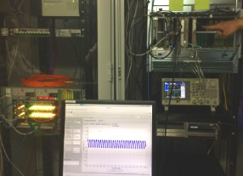

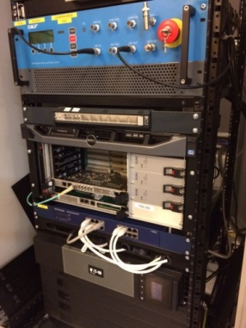
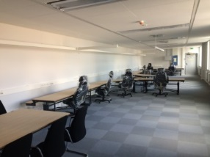
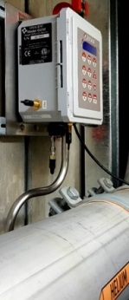
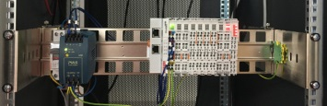
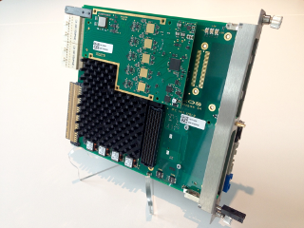
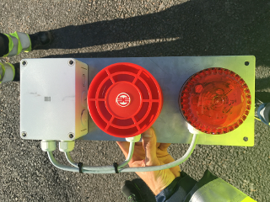
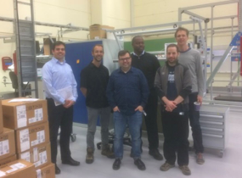
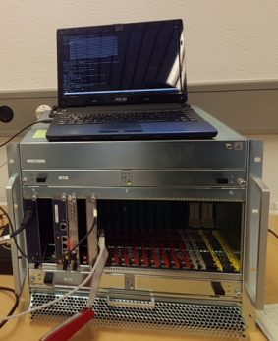
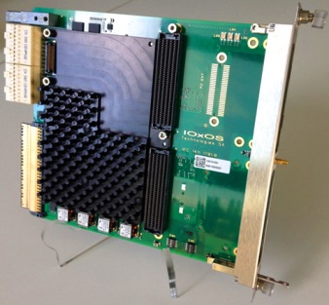
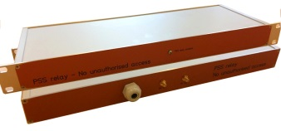
Current ICS priorities
High intensity areas
  ICS Contributions to SSM warm linac trial operation permit application
  Completing re-baselining towards the total ESS plan
  Commissioning of Ion source and LEBT (including PSS0)
  RF Test stand 2 support
  Installation and deployment of PSS and control system infrastructure
  Beam instrumentation system support
  Alignment with target division on project processes and responsibilities
  Alignment with NSS division on project priorities and staffing

Slide 21
Construction project status and planning

Slide 22
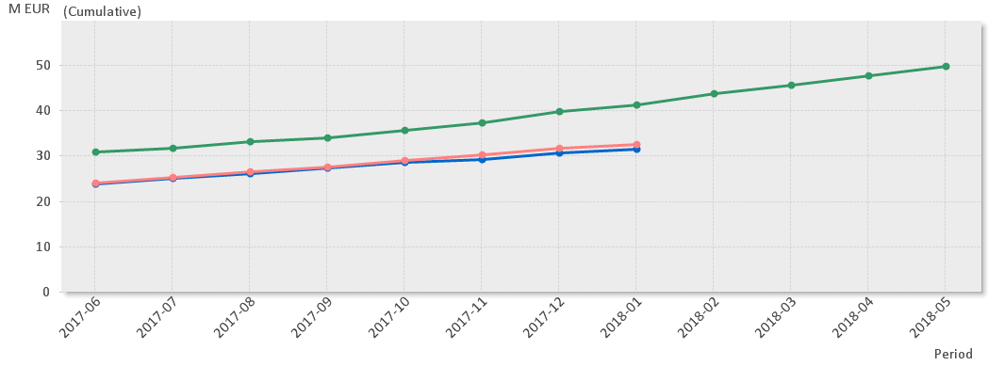
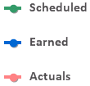

EV Graph
(* No InKind included)
Current Status
Cumulative cost variance for ICS is within established variance reporting thresholds
Cumulative schedule variance exceeds reporting thresholds, Cumulative – 9 671k€ (January - 634k€).
  Main contributors to the negative variance are Equipment, IO Controllers and Accelerator Integration.
  In-kind cumulative schedule variance is -3 372€ (Jan -687k€)

Slide 23









ICS in-kind status
  PSI: Project in production, test and delivery phase. Full production in 2018. Progress OK with delays
  TUT: Ethercat: Prototype hardware available. FPGA-IOC: Final stages of design. Progress OK with delays
  IPNO: Still no contract signed for cryo distribution system controls. Progress not OK
  CEA: Working on the RFQ controls. Collaboration agreement on nBLM. Progress OK
  ESS Bilbao: MEBT controls re-planned to follow accelerator re-baselining. Ambitious plan. Progress OK
  ZHAW: On track, high quality - Progress OK
  INFN Legnaro: Contract signed and work for DTL controls started. Progress OK
  IFE: Several projects finalized. Others in their final phases. MCR implementation remains. Progress OK
  Atomki: No activities
  STFC: High-level agreement missing but work ongoing. Needs more interaction
  Łódź: Project started for IPMI, RTM and BLM development. Progress OK

Slide 24
ESS re-baselining
An ongoing ESS-wide re-baselining includes ICS’ plans
Re-baselining dependencies
  ICS has strong dependencies to stakeholders schedules - much of our re-baselining follows re-baselined schedules from Accelerator, Target, NSS and CF projects
  We have discussed in-kind deliverables with in-kind partners - after they have re-baselined with Accelerator, Target and NSS
  Due to the high level of dependencies towards stakeholders’ schedules, it is not possible to identify a single critical path
  In the context of the re-baselining, ICS will instead work with continuous and iterative evaluation of critical deliveries in the schedule with a dynamic resource allocation to cover for the highest prioritized activities.
End of construction transition
  ICS has a four-staged approach for the transition from Construction to Initial operations. These transitions define the financing of ICS activities rather than the ICS scope

Slide 25
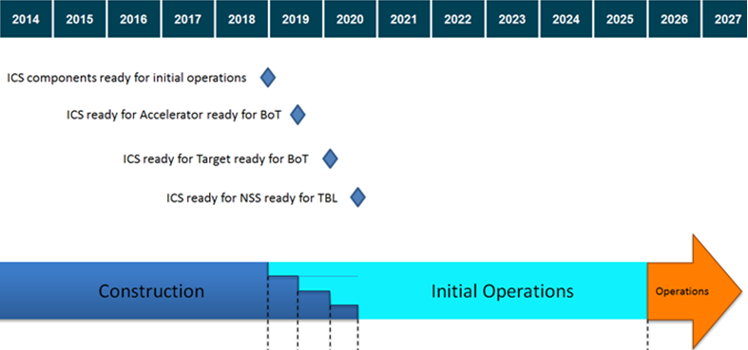
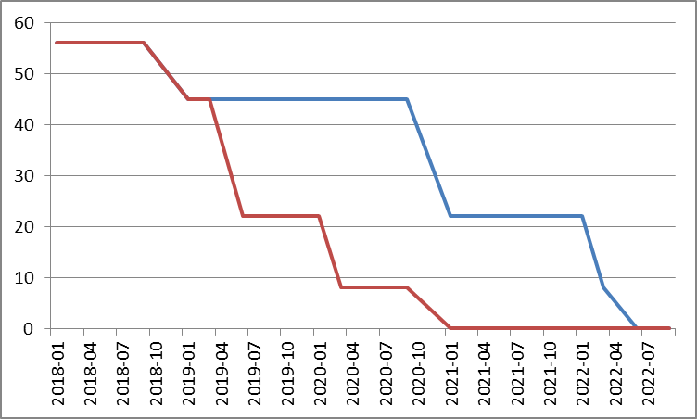
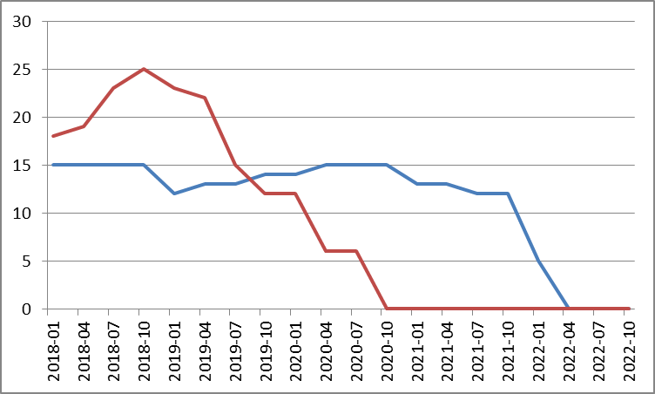
Milestones - Construction -> Initial Operations
The transition for ICS from Construction to Initial operations phase is defined by four major milestones
  ICS Components ready for initial operations 2018-12-21 -> 2018-12-21
  ICS ready for Accelerator RBOT 2019-06-23 -> 2021-01-06
  ICS ready for Target RBOT 2020-03-31 -> 2022-01-03
  ICS ready for NSS Test Beamline 2020-10-15 -> 2022-03-28

Slide 26
Re-baselining cost changes
Current EAC for ICS is 9.1 M€
  4.0 M€ additional installation costs
  3.2 M€ staff delay costs (only accelerator and 9 months delay)
  1.9 M€ accelerator integration cost increase
  0.0 M€ target integration cost increase
New forecast for ICS is 17.2 M€
  4.8 M€ for additional installation costs
    Based on better (evidence based) estimates - only slightly affected by delays
    Installation costs reduced by using in-house staff in “delayed” segments
  8.3 M€ staff delay costs
  2.8 M€ accelerator integration cost increase
  1.3 M€ target integration cost increase

Slide 27
Cost breakdown
Top three impacted work packages
Some work packages are almost unaffected
There is (almost) no impact on planned ICS equipment

Slide 28
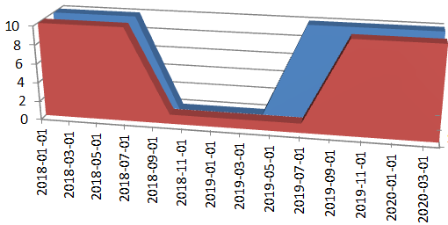
Additional Staff Needs
No additional permanent staff is requested
  Delays does to some extent relieve the peak need for consultants
Hard-to find competency consultants will be needed more than anticipated due to extended support period
“Minimum level of engagement” with
consultant suppliers have been used in
some planning situations

Slide 29
Summary

Slide 30
Summary - ICS
The ICS construction project is progressing with some schedule variance but acceptable cost variances
The on-going re-baselining sets renewed focus for ICS on changes in stakeholders’ plans. As expected, it will still be a challenge for ICS to cope with a high level of stakeholder activity parallelism
There is very good progress on early installation activities such as controls infrastructure and personnel safety systems. Customized commercial framework agreements for installation services have been key to this succes
First systems have been successfully integrated in the early ICS, demonstrating stable controls of equipment from the local control room
Organizational growth pains during 2017 are now being channeled by reorganizations of the ICS management functions into a better structured and more efficient set-up
In-kind projects are progressing quite well. Many projects are affected by re-baselining changes but other projects progress as planned or with minor delays

Slide 31
Response to TAC 16 recommendations

Slide 32
Response to TAC 16 recommendation
Recommendation
  The information and reference repository accessible via CHESS is a huge asset. ICS should stay in tune with all aspects relevant for controls.
  This holds especially for the mapping of the ICS naming convention to CHESS names. ICS specific configuration management tools should take advantage of the CHESS repository wherever the variety of generic controls applications have to be configured to become functional.
  Consistency is required and has to be maintained for a reliable ESS commissioning, operation and development
Response
  A function has been implemented mapping CHESS repository entities with ESS naming convention. The implementation allows easy cross-referencing between CHESS, ICS configuration tools and Inventory functions currently being developed at ESS.

Slide 33
ICS vision and mission statements
ICS vision statement
ESS operated efficiently, reliably and safely, with a control system that everyone loves
ICS mission
The ICS division shall provide and maintain world-class and cost-efficient control, protection and safety systems and services for the ESS facility.
The division shall develop competence and innovative solutions that can be shared in the community through open processes

