Slide 1

Cryogenic and Vacuum System
Status
J. G. Weisend II
April 12, 2017

Slide 2
Introduction
  Specialized Technical Services provides
    Cryogenic support throughout ESS (Accelerator, Target and Science)
    Vacuum Support throughout ESS (Accelerator, Target and Science)
    Technical Cooling Water support to Accelerator and Science
    Technical Electrical support to Accelerator
    Elliptical Cavity Cryomodule Test Stand
  This talk will cover Cryogenic, Test Stand & Vacuum activities.

Slide 3
Specialized Technical Services Group
Specialized Technical Services
John Weisend II – GL
Gunilla Jacobsson
Utilities and Test Stand Wolfgang Hees - SL
Anton Lundmark
Evangelia Vaena
Frithiof Jensen
Emilio Asensi
Owen Buchan
Steven McGlasson
Lars Rosberg (2018-05-14)
Jörgen Jönsson (EIS)
Akif Coku (C)
Andreas Olenmark (C)
Fredrik Persson (C)
Miguel Lund (C)
Susanna Sjöström (C)
Cryogenics
Philipp Arnold – SL
Jaroslaw Fydrych
John Jurns
Xilong Wang
Xiaotao Su
Johnny Råström
Mattias Olsson
Per Nilsson
Romain Goncalves (2018-05-23)
Ila Sjöholm (C)
Piotr Tereszkowski (C)
Fredrik Nilsson (C)
Vacuum
Marcelo Juni Ferreira – SL
Hilko Spoelstra
Simone Scolari
Christophe Jarrige
Fabio Ravelli
Kristell Barthélemy
Ralf Huber
Laurence Page
Fredrik Svensson (2018-04-11)
Henric Gunnarsson (2018-05-02)
Peter Ladd (C 50%)

Slide 4
Cryogenic Systems &
Cryomodule Test Stand
Status

Slide 5
System overview
Pure Helium
Gas Storage 1
Standalone Helium Purifier
Helium Recovery System
Pure Helium
Gas Storage 2
Target Moderator
Cryoplant
Accelerator
Cryoplant
20 m³ LHe Tank
5 m³
LHe Tank
Test & Instrument Cryoplant
Target Cryodistribution System
LHe Mobile Dewars
Test Stand Cryodistribution System
Cryodistribution System for Elliptical Linac
Cryodistribution System for
Spoke Linac
LN2 Storage Tanks
Hydrogen Circulation Box
Elliptical
Cryomodules
Spoke
Cryomodules
LN2 Mobile Dewars
Instruments & Experiments
Test Stand Lund 2
Hydrogen Moderator
Notes:
ACCP: 3kW @ 2K, 11kW @ 40K, 270 l/h Liquefaction → special plant, power consumption in MW range, big industrial compressors, sophisticated CC system
TICP: 76W @ 2K, 420W @ 40K, 6 l/h Liquefaction → plant well in the standard range
TMCP: 32kW @ 15-20K → very large again, some challenges but not terribly sophisticated process, compared to ACCP
Large and sophisticated cryo-distribution system for all plants and their consumers

Slide 6
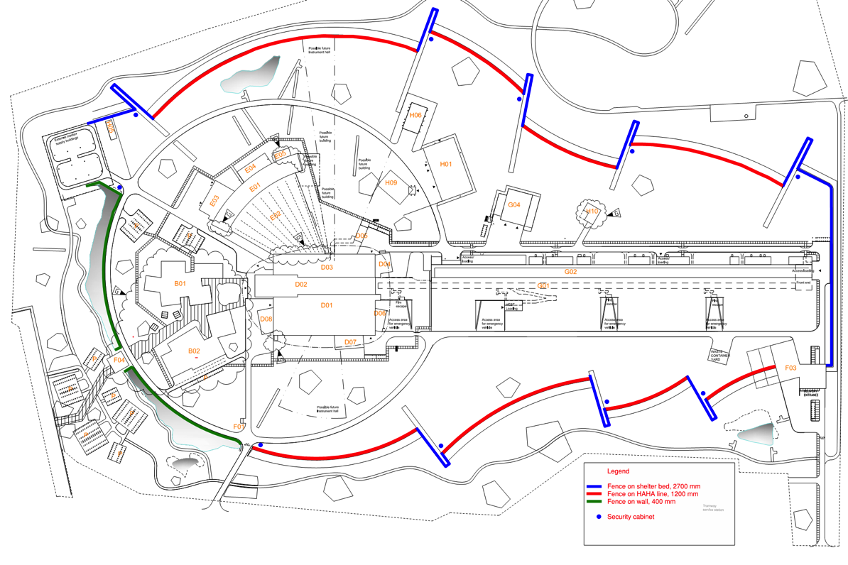
Cryogenics at the site - overview
Neutron Instrument Halls
Cryogenic Moderator Room
Cryo Compressor Building
Coldbox Hall and
Cryomodule Test stand
Accelerator Tunnel

Slide 7
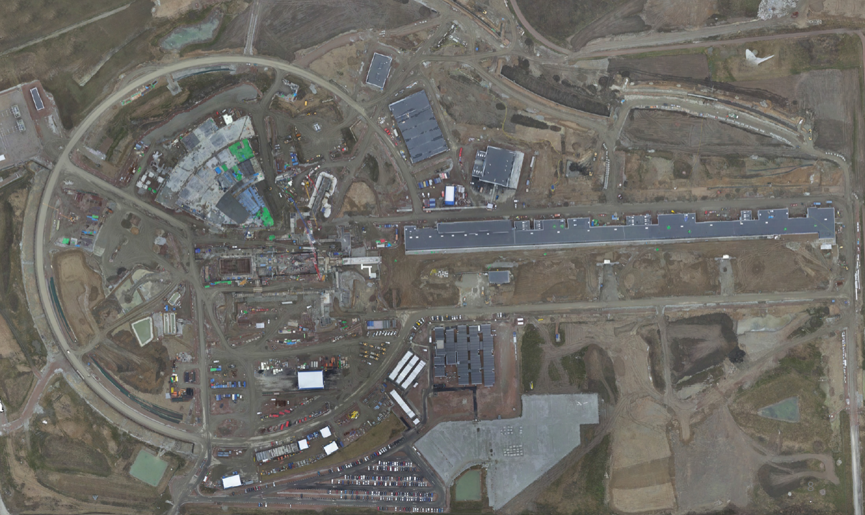
Cryogenics at the site - aerial view
Cryo Compressor Building G.04
Coldbox Building G.02

Slide 8
Major Components and Status
Work Unit and Name | Supplier | Status
11.11.3 ACCP | Linde Kryotechnik, CH | Installation, pre-commissioning
11.11.4 TICP | Air Liquide Advanced Technologies, FR | Installation, pre-commissioning
11.11.5 TMCP | Linde Kryotechnik, CH | Manufacturing
11.11.5 TMCP-CTL 1 | Kriosystem, PL | Finished
11.11.6.1 CDS-LTS2 | Wroclaw University of Science and Technology, PL | Manufacturing
11.11.6.2 CDS-el |  | Manufacturing
11.11.6.3 CDS-sl | IPNO, FR | Procurement
11.11.7 CMS (Target, WP3) | Forschungszentrum Jülich, DE | Manufacturing
11.11.8 Warm Interconnecting Piping | Powerheat AB, SE | Finished
11.11.9.1 PHS | UBH, UK | Manufacturing, Installation
11.11.9.2 LN2 tanks and supply | Air Liquide Gas AB, SE | Commissioning, Operation
11.11.9.3 Helium supply | Strandmöllen AB, SE | Operation
In-kind
In-kind
In-kind
In-kind

Slide 9
Master Schedule WP11 Cryogenics

Slide 10
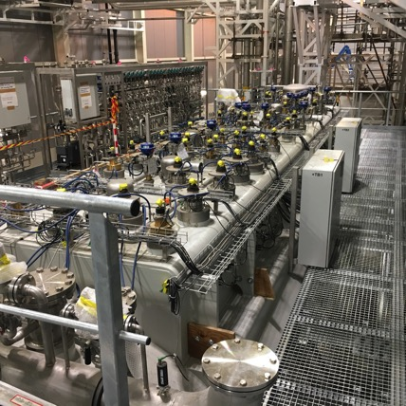
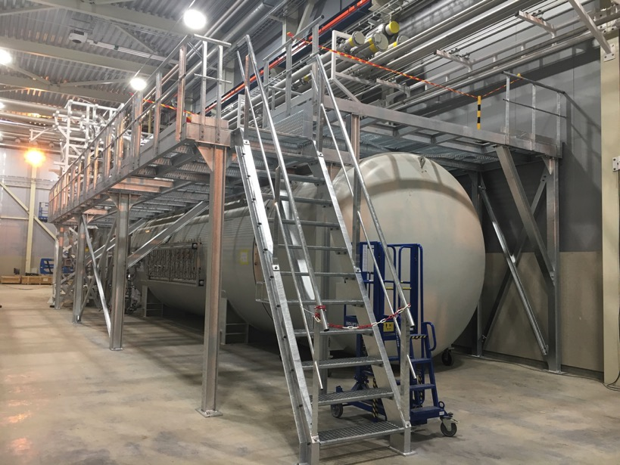
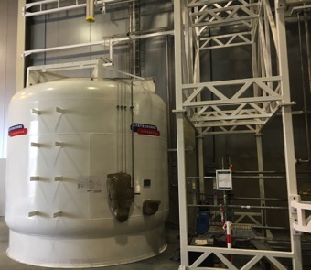
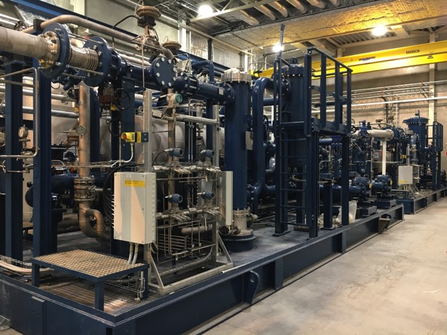
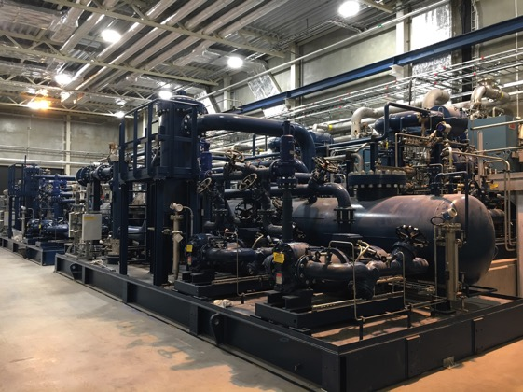
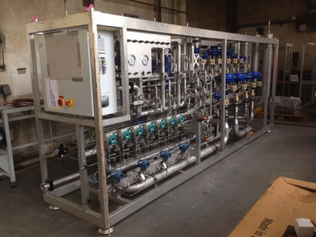
Accelerator Cryoplant (ACCP)

Slide 11
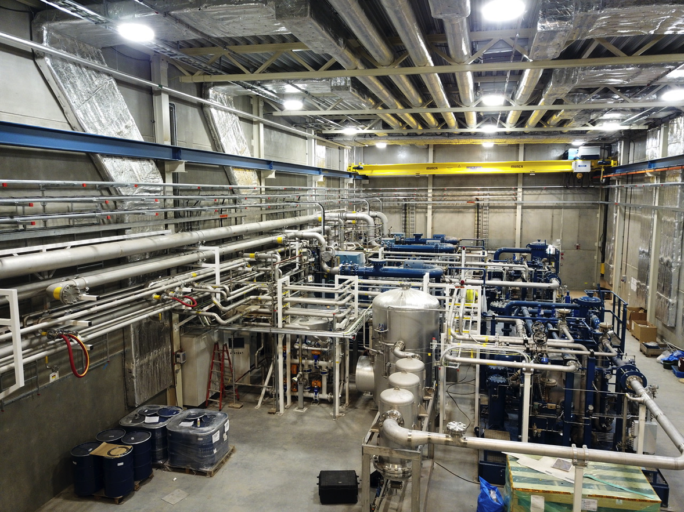
ACCP Compressors

Slide 12
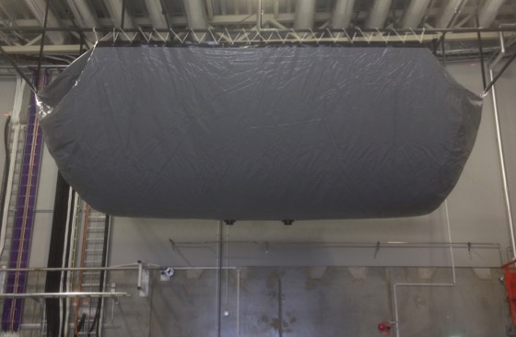
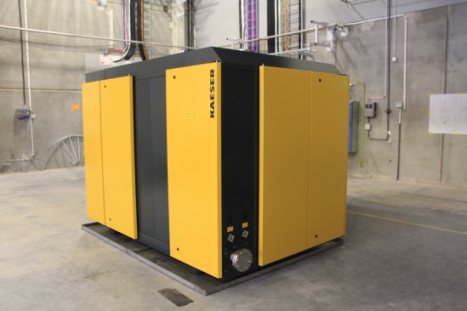
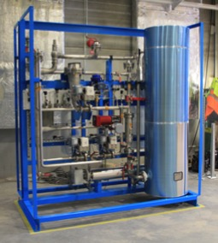
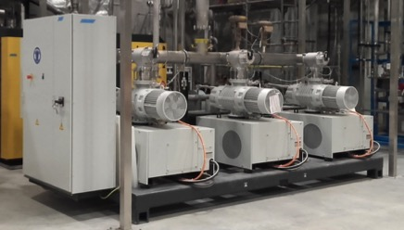
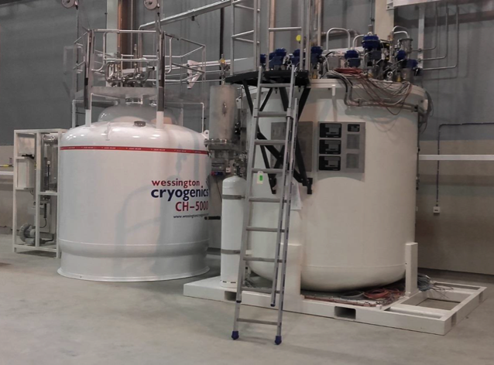
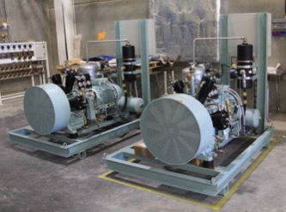
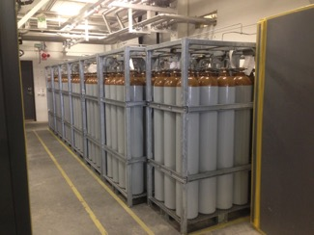
Test and Instruments Cryoplant
Impure Helium Sources

Slide 13
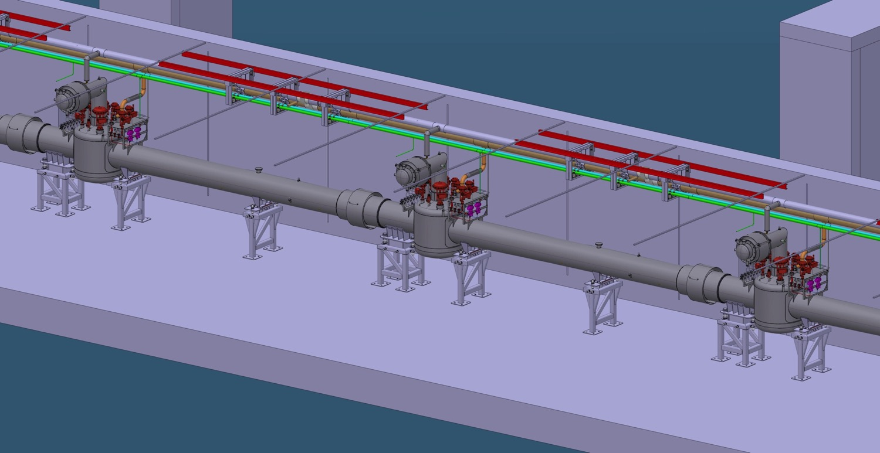
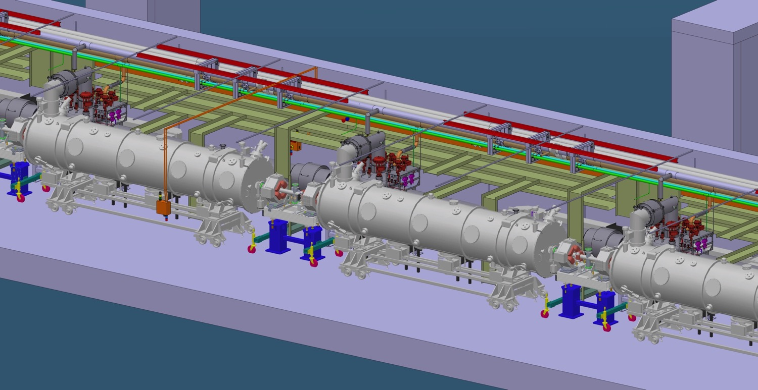
Accelerator Cryogenics, Elliptical Section CDS

Slide 14
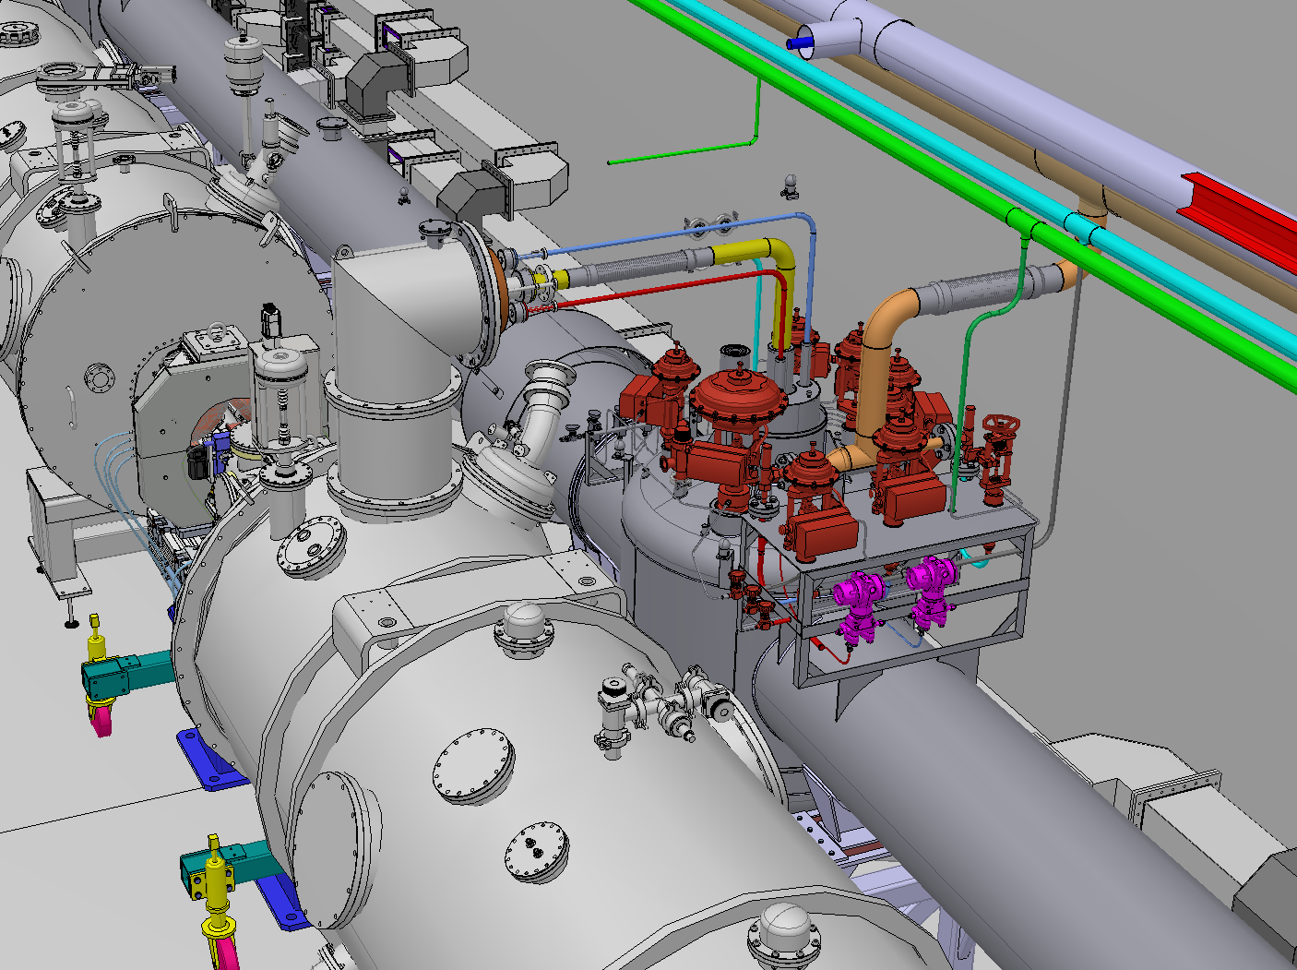
Integration Tunnel CMs - CDS

Slide 15
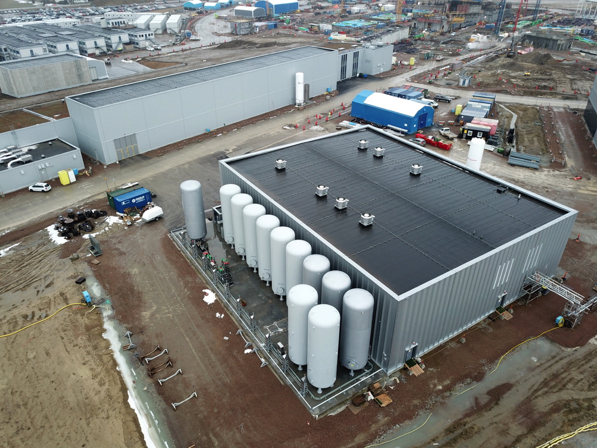
Aerial View of Compressor Facility & Cold Box Hall Showing Pure Helium Storage Tanks & LN₂ Dewars

Slide 16
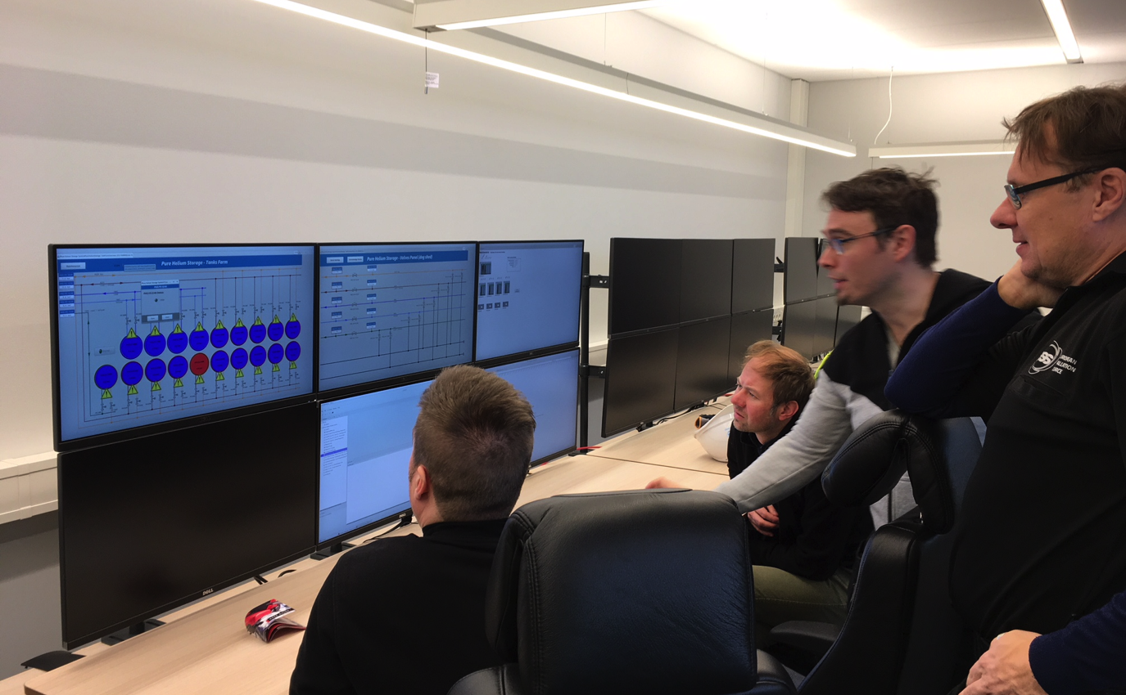
Start of Pure Helium Storage
Commissioning using an ICS Provided Control System

Slide 17
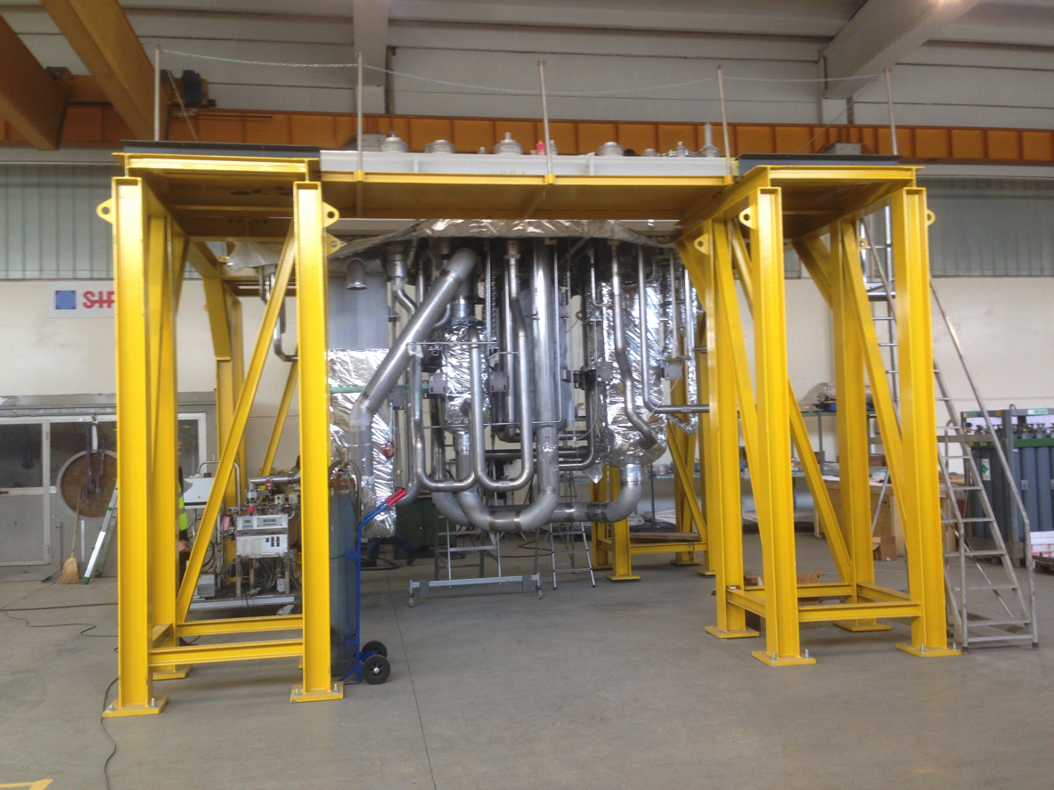
Target Moderator Cryoplant Cold Box
Under construction at vendor
March 2018

Slide 18
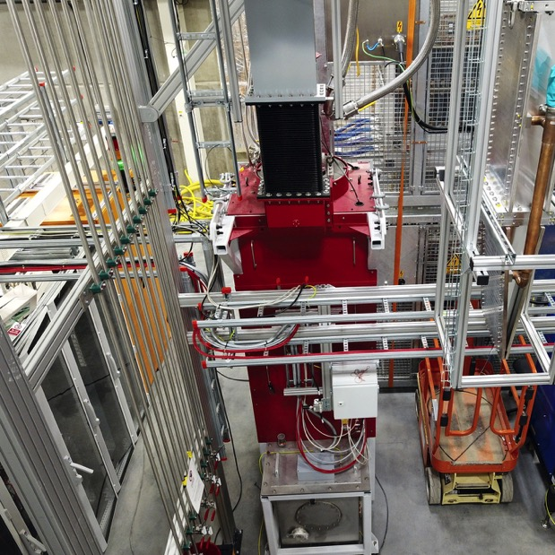
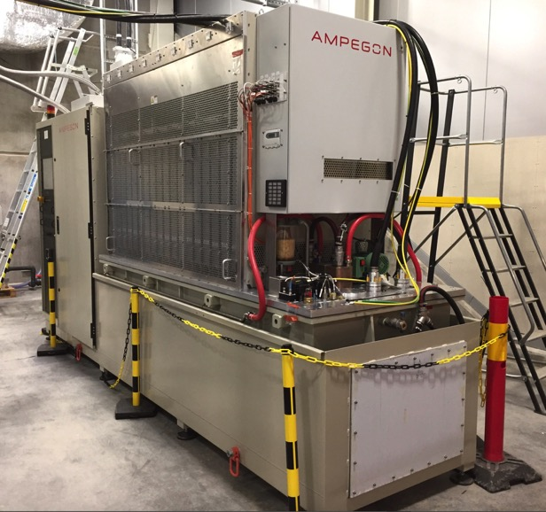
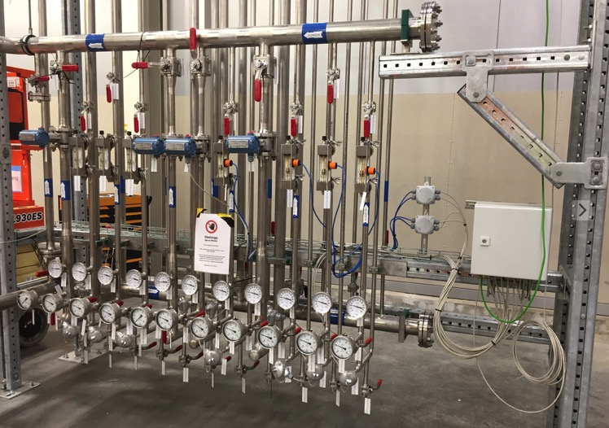
Cryomodule Test Stand
Bunker: procurement ongoing
RF: 2 klystrons installed
HV: modulator installed
Utilities: installed

Slide 19
Cryogenic System Issues
Final ACCP Commissioning delayed due to corrosion in the compressor oil / water heat exchangers ( now solved)
Unacceptably short lifetime of Cold Compressor bearings seen at DESY & Fermilab plants. Identical bearings planned for ACCP. Linde is continuing to address this issue for both DESY and ESS.
  Improved Axial Fixation of the Bearings
  Parallel Development of Magnetic Bearings ready ~ 2020
Delays possible in IPN Orsay / ICS controls for Cryodistribution system and cryomodules

Slide 20
Vacuum Systems
Status

Slide 21
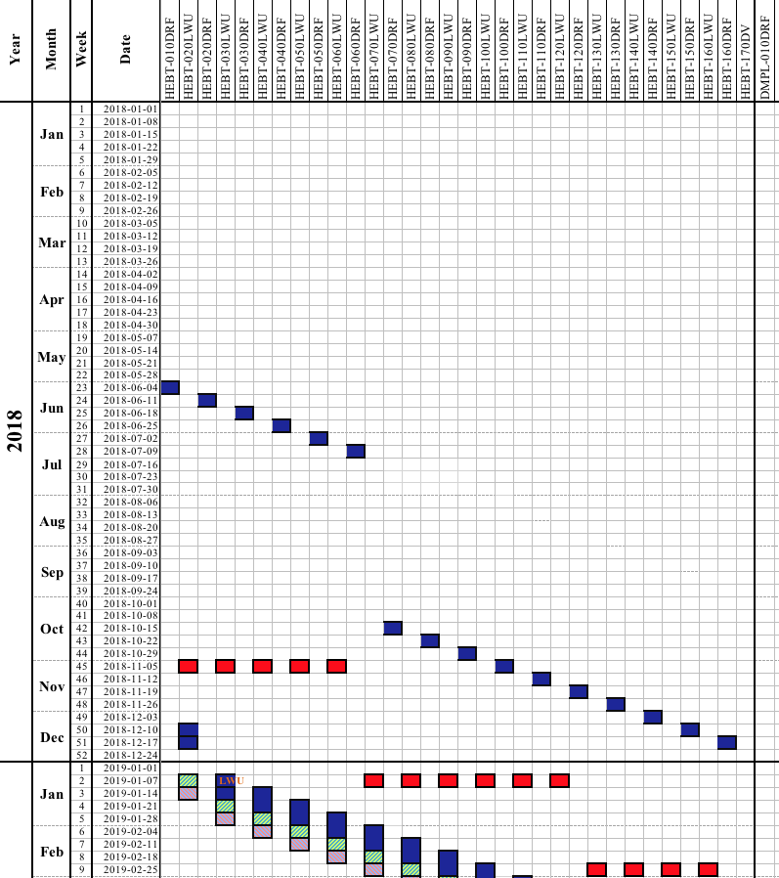
ESS Vacuum System: status & scheduling
HEBT area will be the first tunnel installation with Vacuum System scope:
- x6 Dummy Cryo modules (DCM) starting in June,
New DCM for HEBT coming at the end of the year including particle free for HB area,
First LWU delivery confirmed.
The TA is signed with STFC/Daresbury for the Accelerator vacuum system:
- Production is on schedule (milestones confirmed),
All chambers delivered pass ESS acceptance test and moving to installation phase.
Recent System Review held on Particle Free Assembly. No major issues identified. Recommendations are being implemented

Slide 22
ESS Vacuum System
Test on the transportation of the LWU prototype to the tunnel
Dummy cryo modules ready for installation on HEBT area
Ion source + LEBT
Ion Source, LEBT and Iris on the acceptance procedures at ESS site
Iris

Slide 23
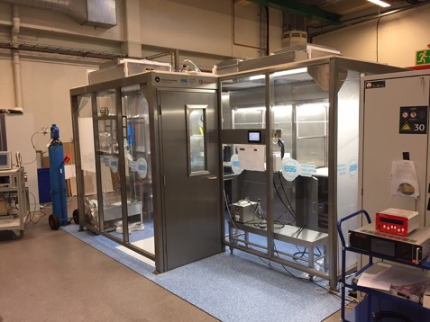
ESS Vacuum System
Particle free room: testing equipment and procedures for the LWU installation
Portable clean room practice to evaluate particle free installation
Supporting Raster Magnet test assembling at Aarhus University.

Slide 24
ESS Vacuum System
Support to the Cryo system: leak test on the cryo installations at ESS site.
Outgassing Test Facility to support Accelerator, Target and NSS design.
Development of the NBEX flange for the monolith port blocks.

Slide 25
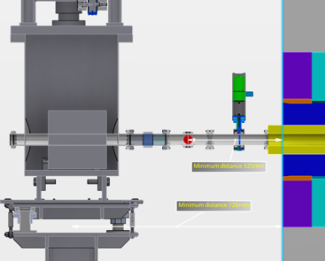
ESS Vacuum System: Issue
Proton Beam Drift Room: discussion on the shield wall configuration.
Monolith Vessel
Some of the work delayed for the in kind (STFC/Daresbury) scope on the A2T area and specifications for vacuum components waiting simulations for the shield wall.
A2T area

Slide 26
Summary
Specialized Technical Services provides cryogenics and vacuum expertise throughout ESS.
A very strong team of engineers and technicians has been developed.
Significant progress has been made to date. Cryogenics and vacuum systems are well into production, installation and commissioning. Some of these will be among the first systems installed and commissioned at ESS.
We expect issues to naturally arise during commissioning but expect to have the proper resources to address all but the most extreme problems.

