Slide 1
ESS RF SYSTEMS AND SPECIALISED POWER CONVERTERS
Anders Sunesson RF group leader
Contributions from the RF group (WP 8, Morten Jensen; WP 17, Carlos Martins)
Contributions from IK partners
TAC #17, April 12, 2018
www.europeanspallationsource.se

Slide 2
Summary
ESS Linac
RF systems highlights and status :
  High Voltage Power conversion
  High Power RF Amplifiers
  Local Protection system/Interlock
  Low Level RF system
  Phase reference / Master Oscillator
  RF Distribution System
Status of each subsystem

Slide 3





An artists impression of ESS

Slide 4
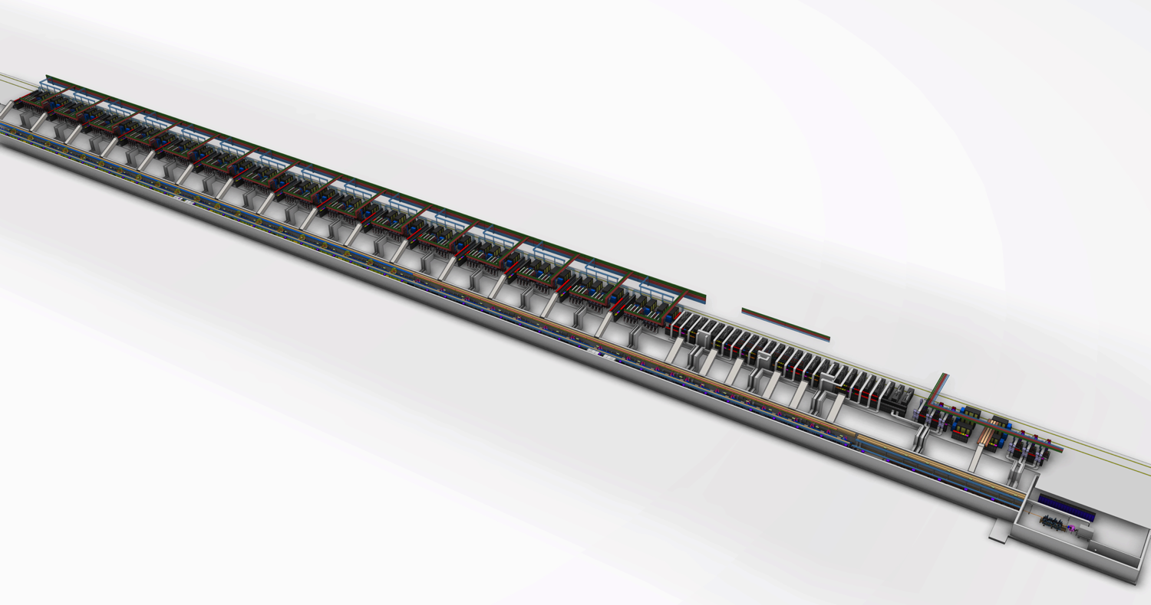
ESS Linac Layout
155 cavities in total, total length ca 350 m until HEBT
High beta RF
NC linac RF
Medium beta RF
Low Energy Front end
Spoke RF
High beta cryomodules
Medium beta cryomodules
Spoke cryo-modules
NC linac cavities

Slide 5
RF Requirements
352.21 MHz
704.42 MHz
2.4 m
4.5 m
3.6 m
40 m
54 m
75 m
174 m
Target
Source
LEBT
RFQ
MEBT
DTL
Spokes
Medium β
High β
HEBT & Contingency
75 keV
3.6 MeV
90 MeV
220 MeV
570 MeV
2000 MeV
 | Energy (MeV) | Frequency /MHz | No. of Cavities | βg | Temp / K | RF power /kW
Source | 0.075 | - | 0 | – | ~300 | –
LEBT | 0.075 | - | 0 | – | ~300 | –
RFQ | 3.6 | 352.21 | 1 | – | ~300 | 1600
MEBT | 3.6 | 352.21 | 3 | – | ~300 | 20
DTL | 90 | 352.21 | 5 | – | ~300 | 2200
Spoke | 220 | 352.21 | 26 (2/CM) | 0.5 βopt | ~2 | 330
Medium β | 570 | 704.42 | 36 (4/CM) | 0.67 | ~2 | 870
High β | 2000 | 704.42 | 84 (4/CM) | 0.86 | ~2 | 1100
HEBT | 2000 | – | 0 | – | ~300 | –

Slide 6
RF systems
Power to 155 cavities, one RF station/cavity
  High Voltage development: SML modulator topology (see presentation Carlos Martins after lunch)
  High Power RF Amplifier development: MB-IOT, aimed at high beta linac (see presentation Morten Jensen after lunch)
A large part of the RF systems is provided in collaboration with partners
      RF NC linac (ESS Bilbao, Spain)
      Spoke RF stations (Elettra, Italy)
      Interlock systems (ESS Bilbao, Spain; Elettra, Italy; ATM Atomki, Hungary)
      LLRF (ESS Bilbao, Spain and Polish Electronic Group, Poland)
      RF high power distribution (STFC and Huddersfield University, UK)
      Phase ref distribution (Warsaw University of Technology, Poland)
      Installation (IFJ PAN, Krakow, Poland)
Collaboration Lund Univ (test stand, LLRF) and Uppsala Univ (FREIA facility)

Slide 7
Highlights RF
Modulator contracts in place for NC and MB linacs
Klystron deliveries Medium Beta starting in June
Set-up of test stands at ESS site priority and in progress
Installation in RF Gallery of RF equipment ongoing
Testing IOT done
Comparison IOT vs klystrons prepared

Slide 8
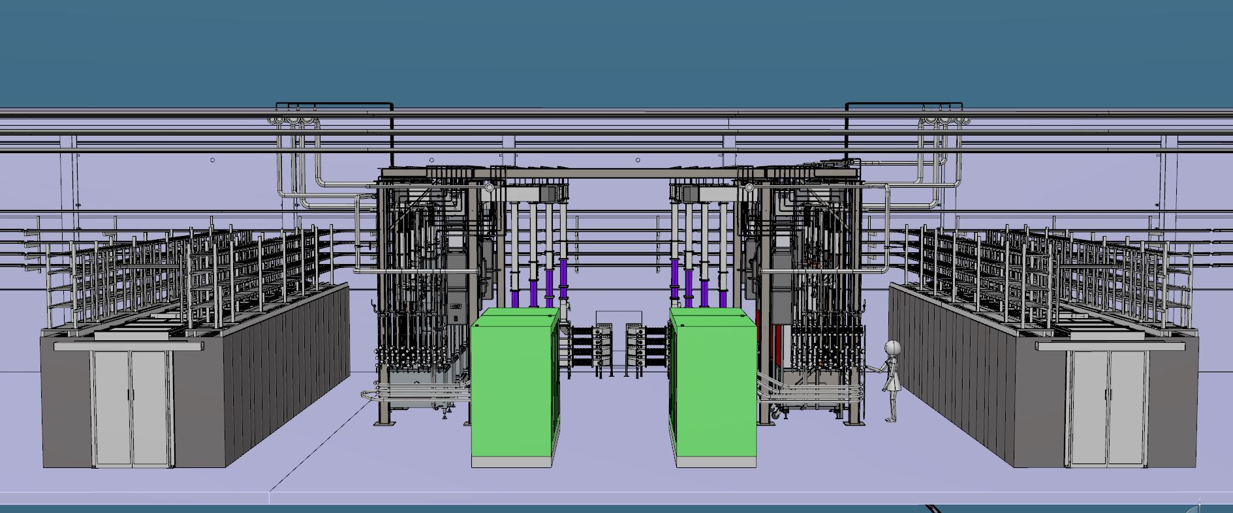
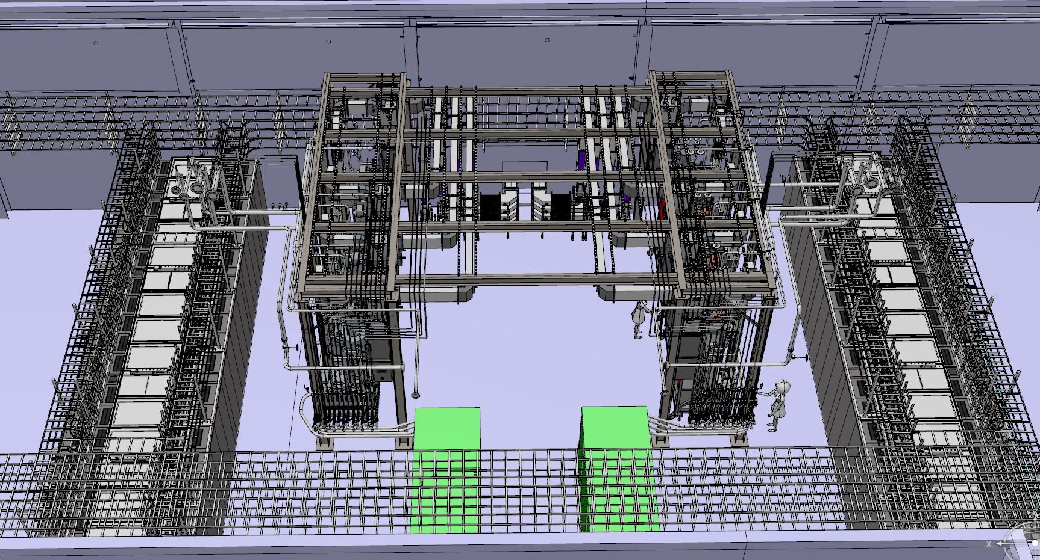
Highlights Gallery integration/installation
Layout ready for all of RF gallery
3D model updated to as-built after 3D scan
Installation activities involving RF: RFDS support structures, Test stand 2, Test stand 3

Slide 9
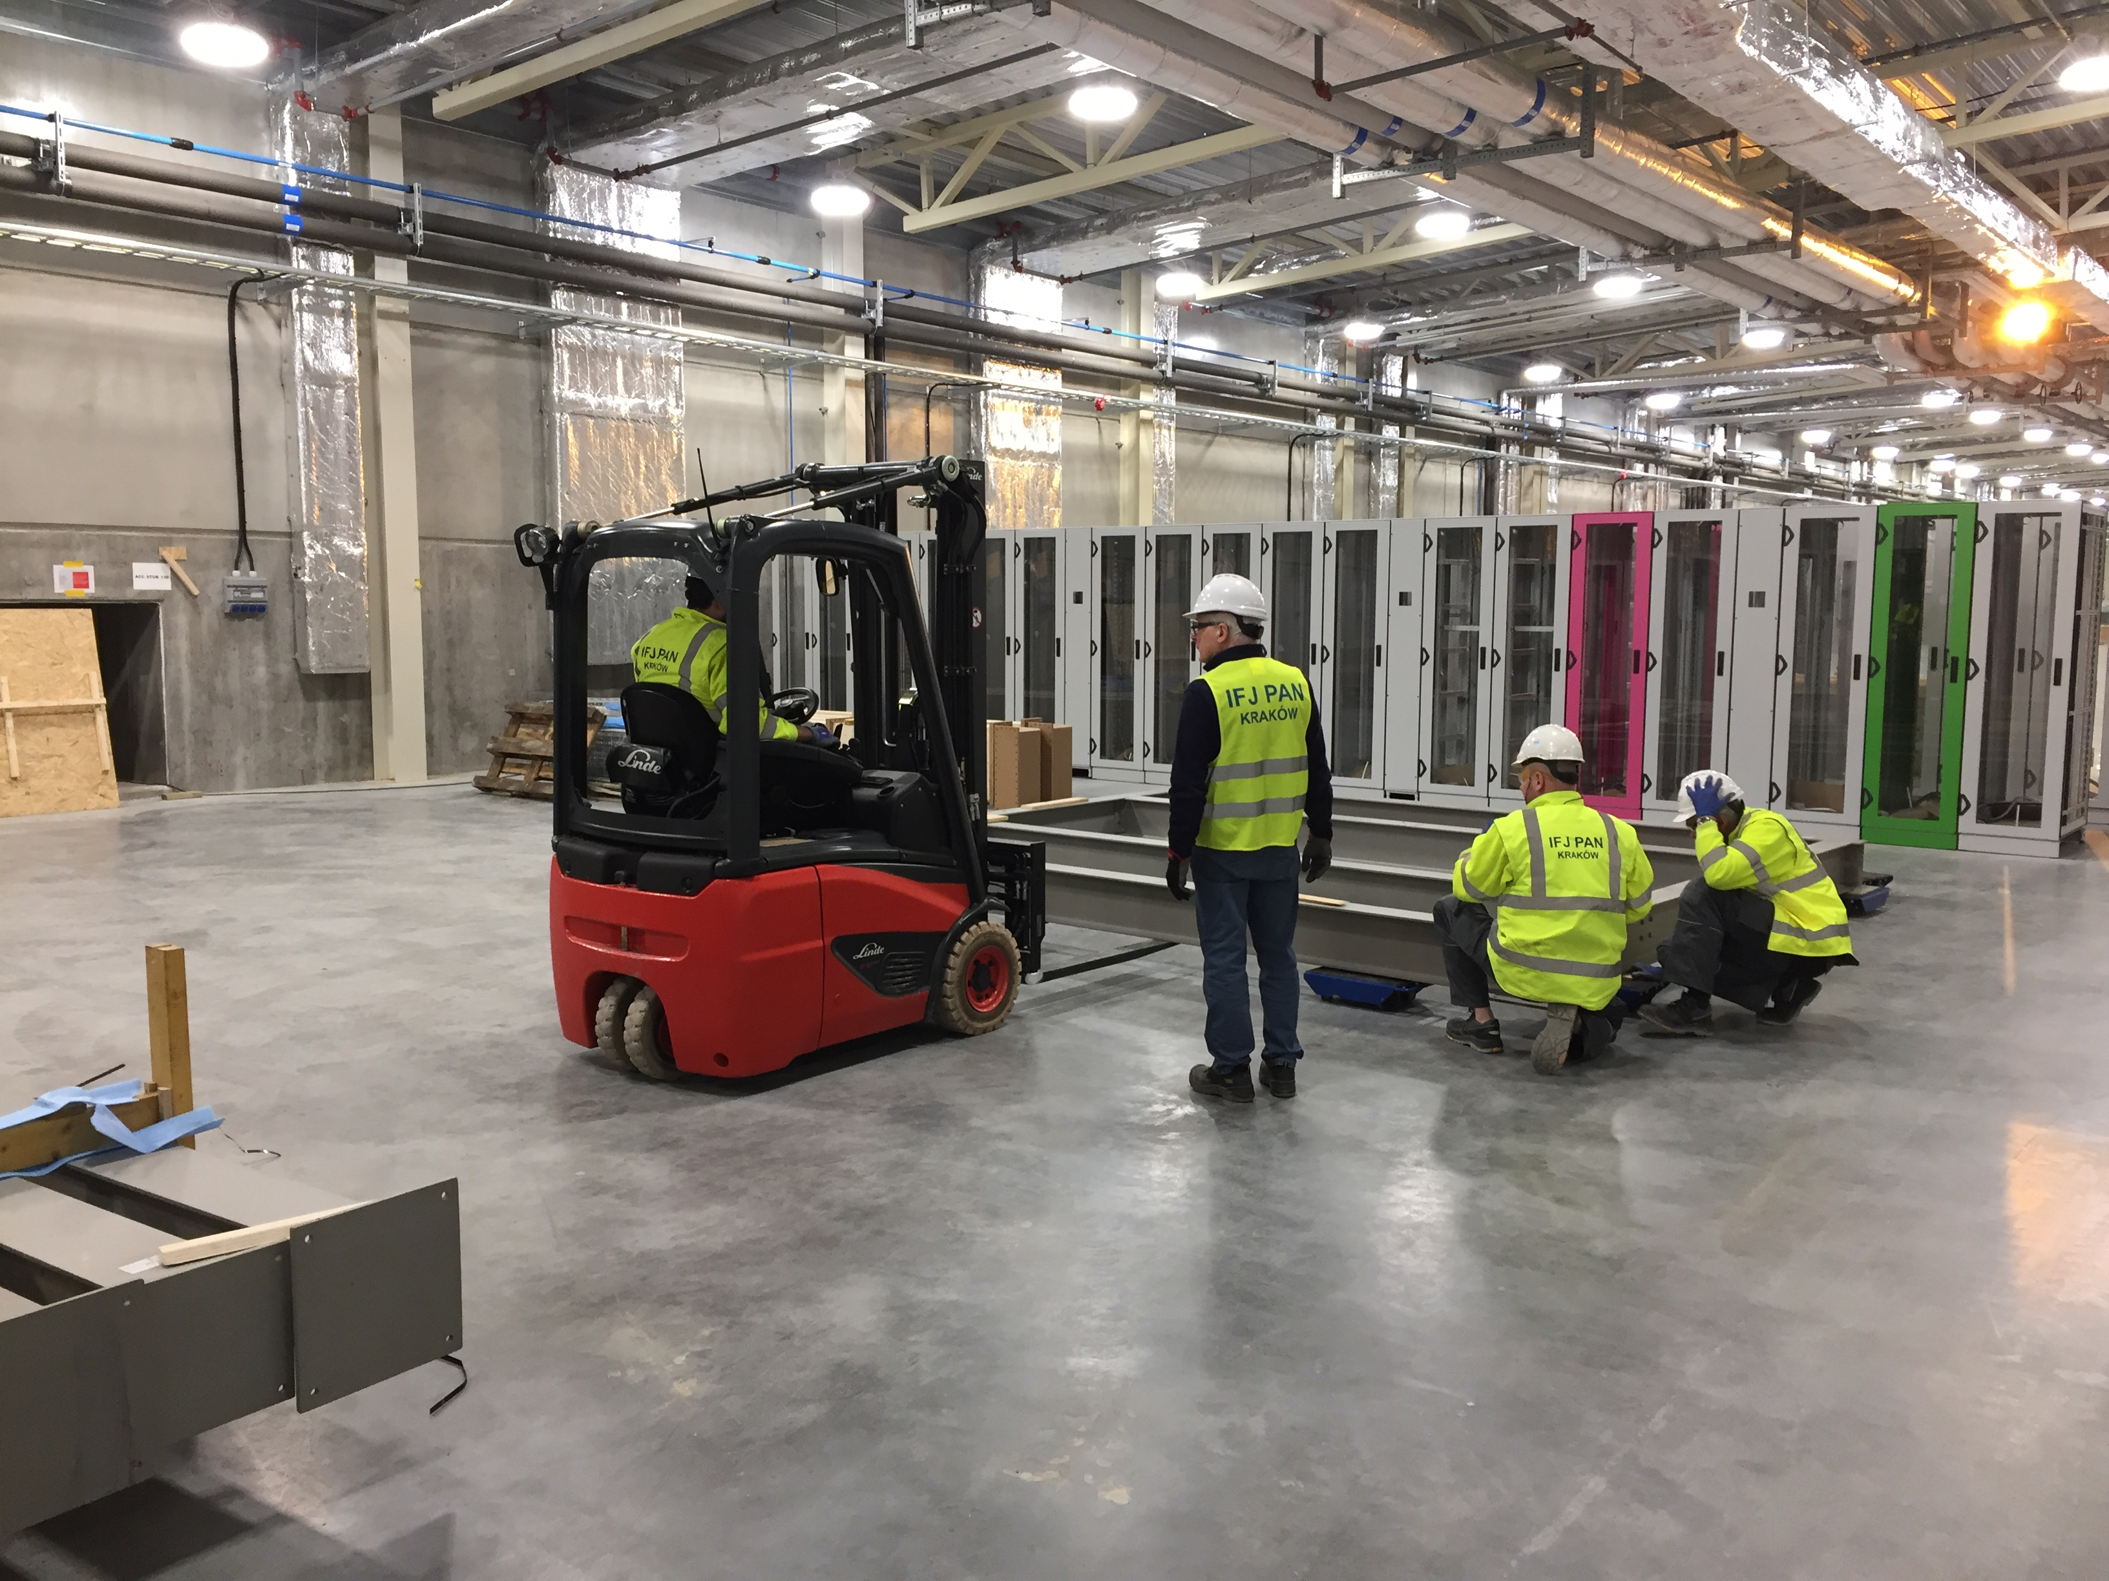
Installation work IFJ PAN Krakow

Slide 10
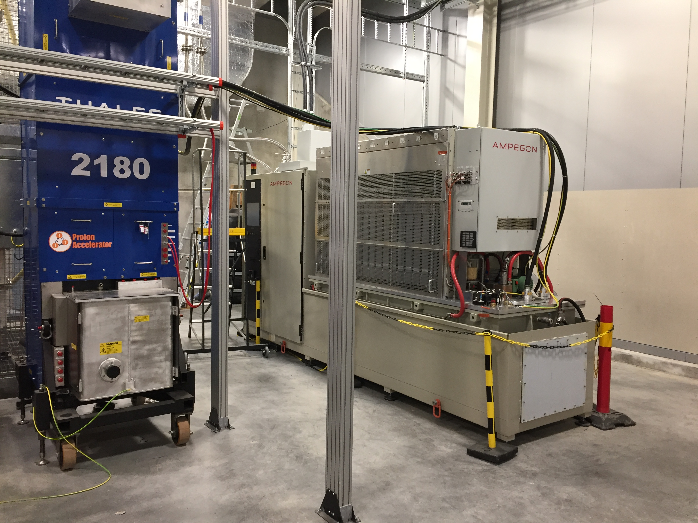
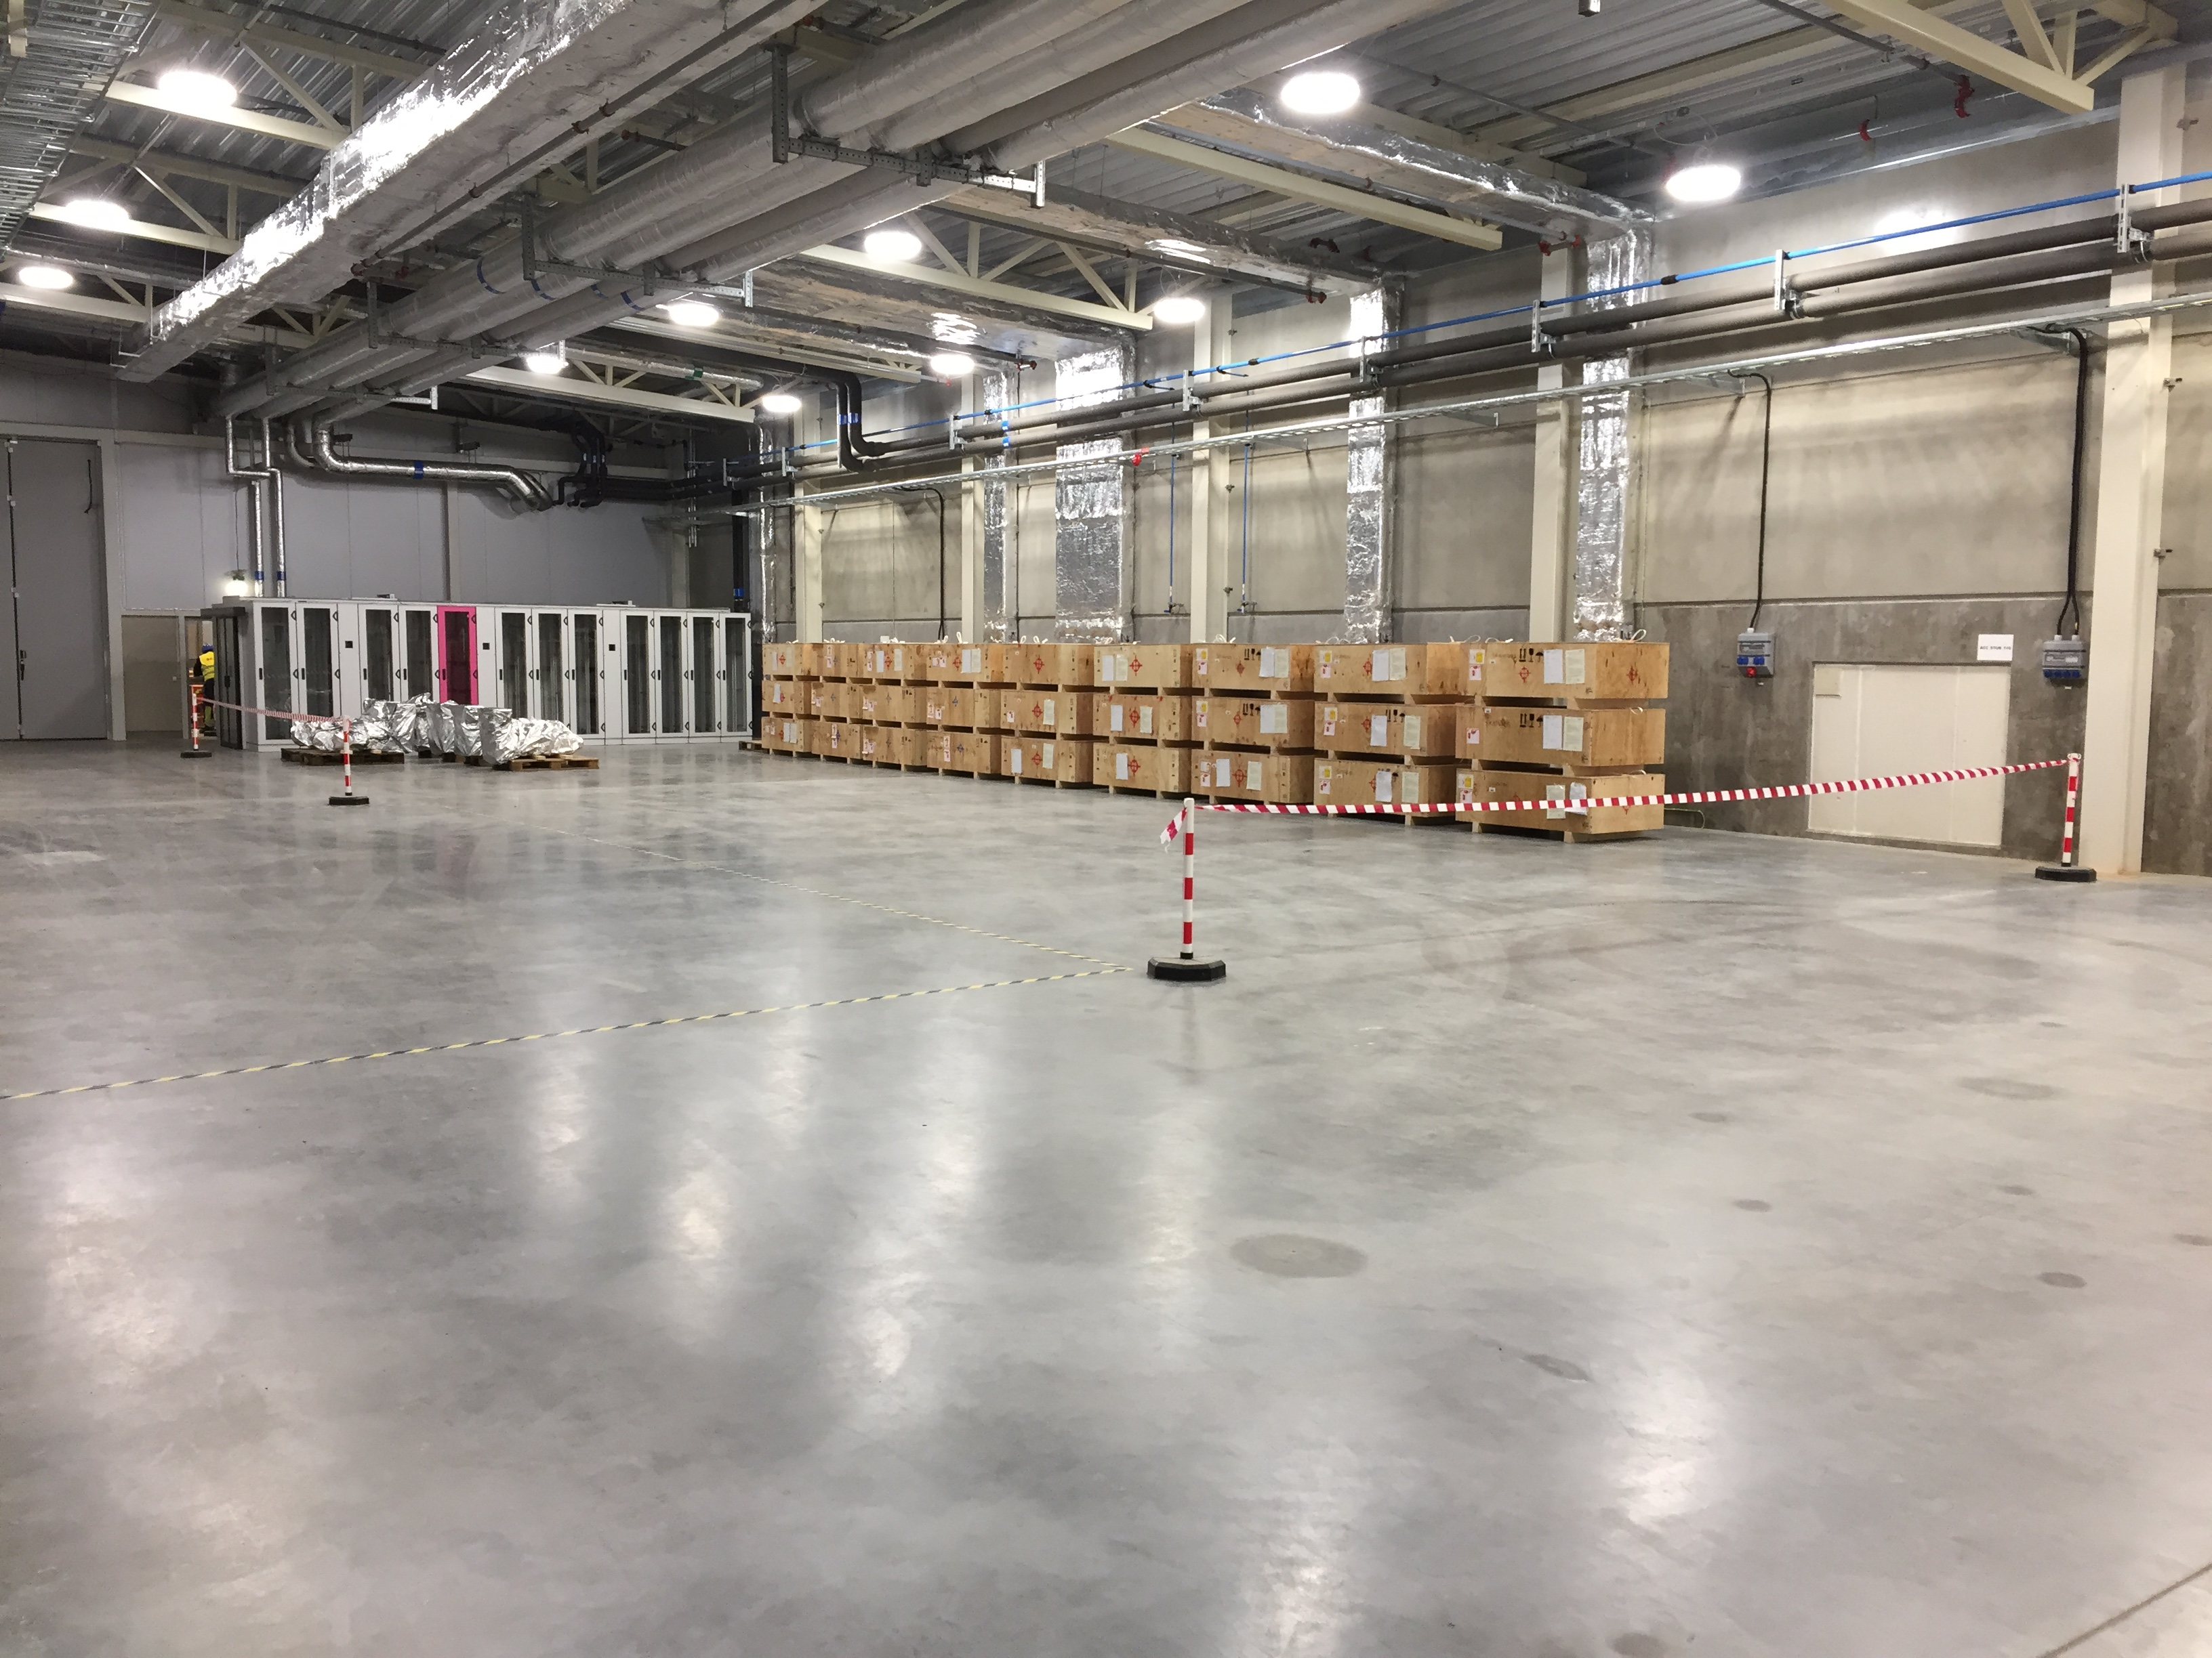
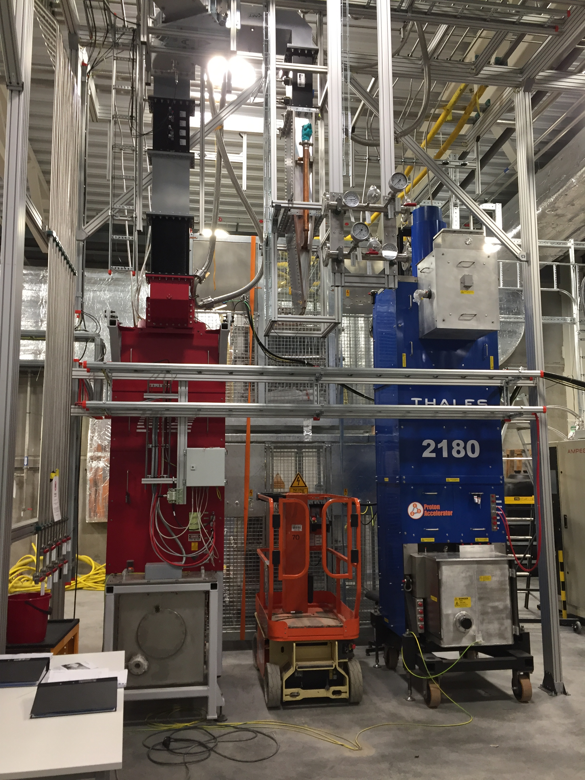
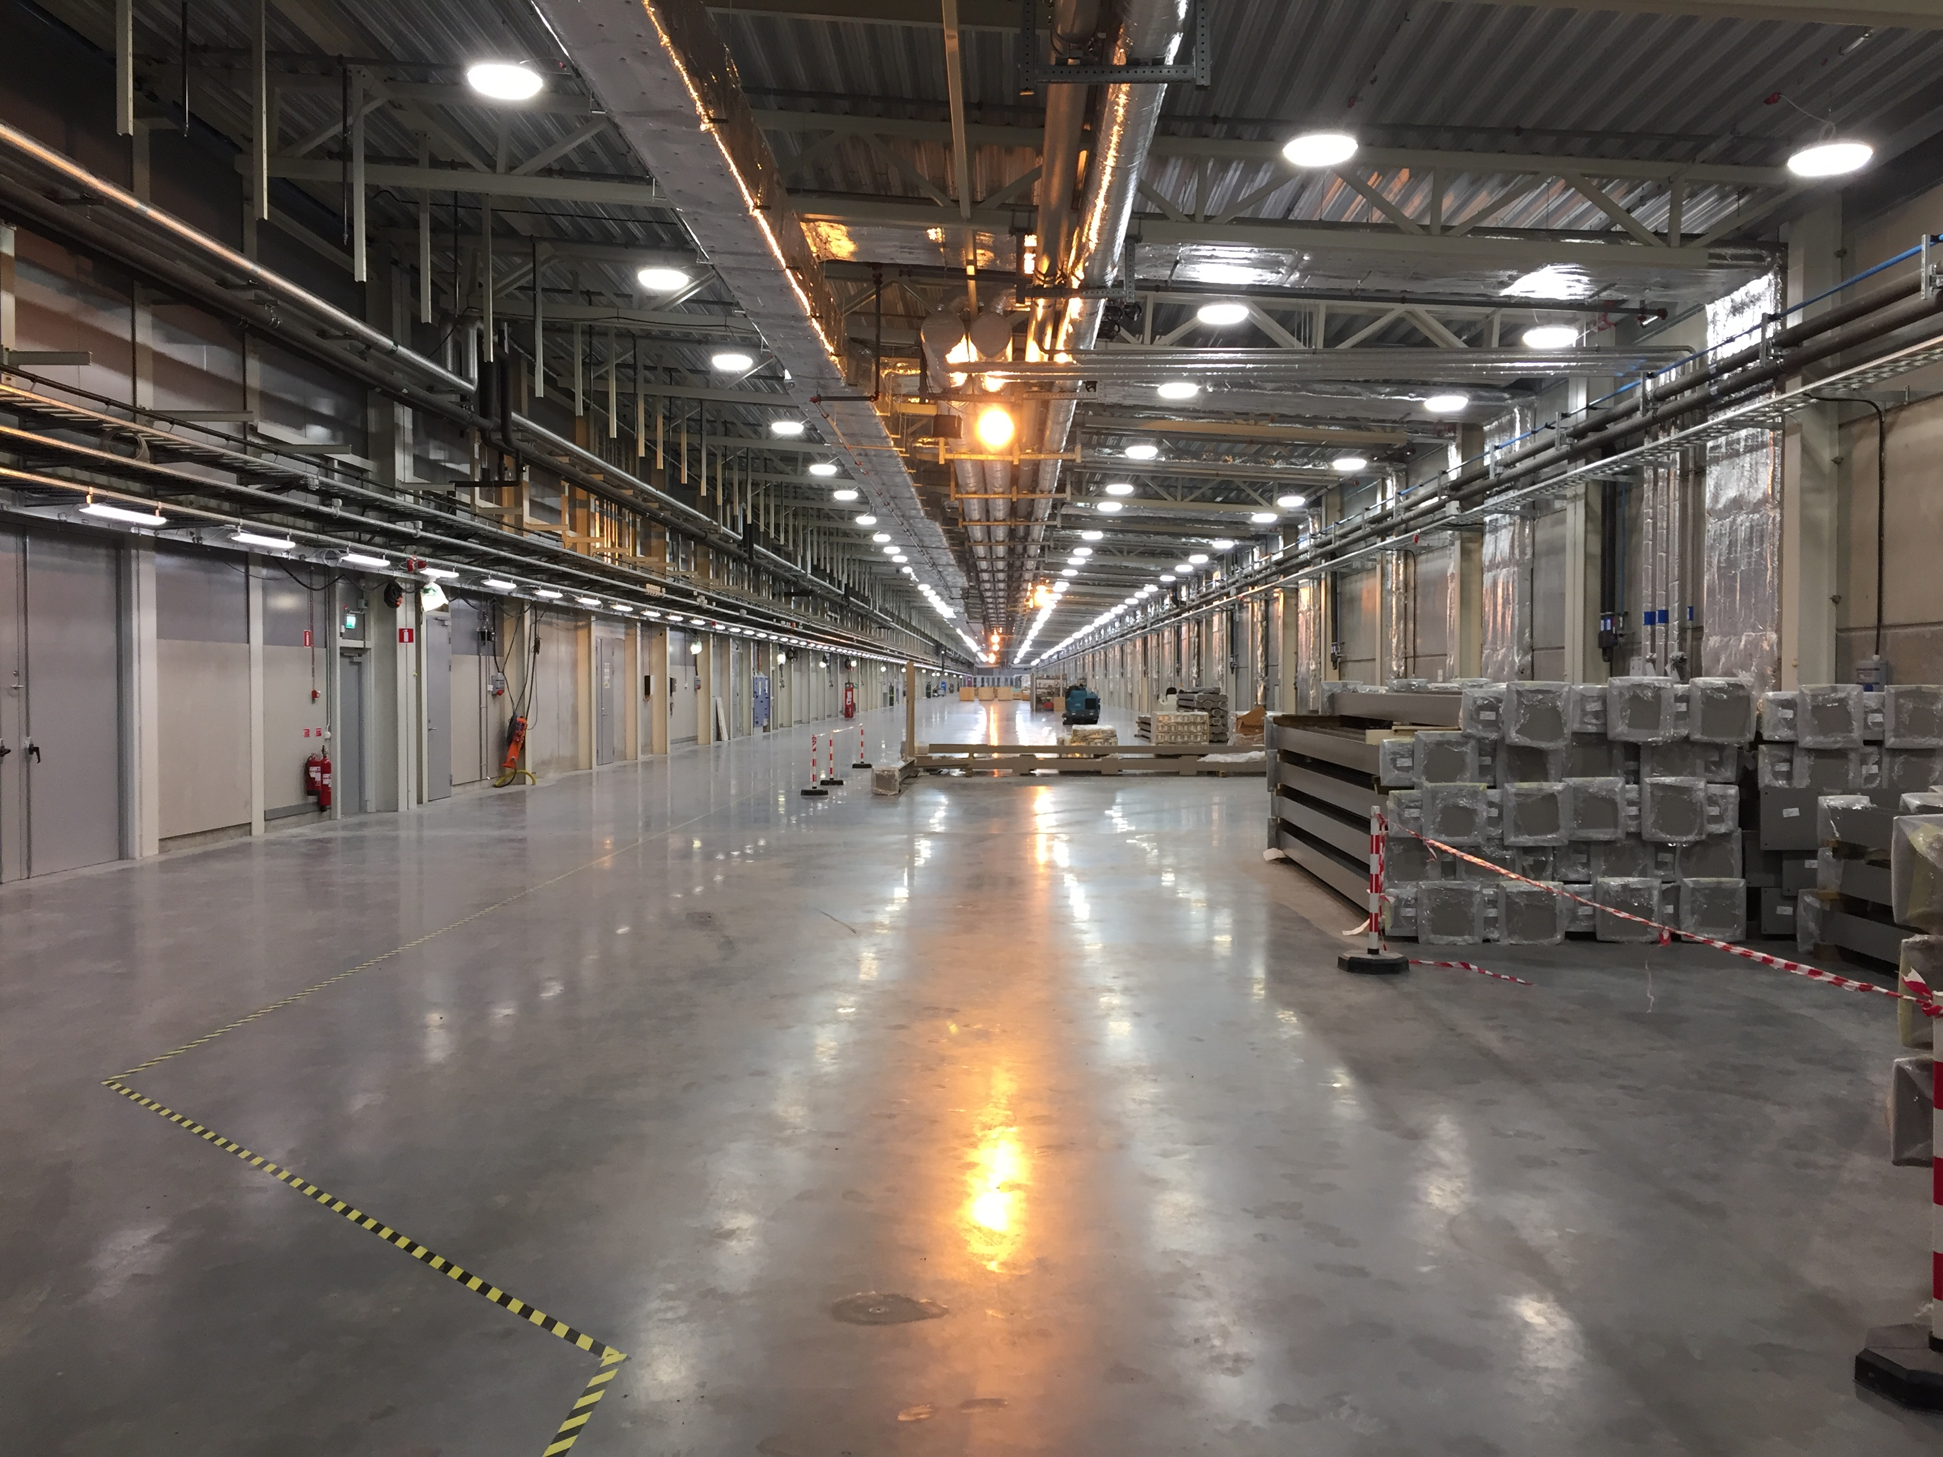
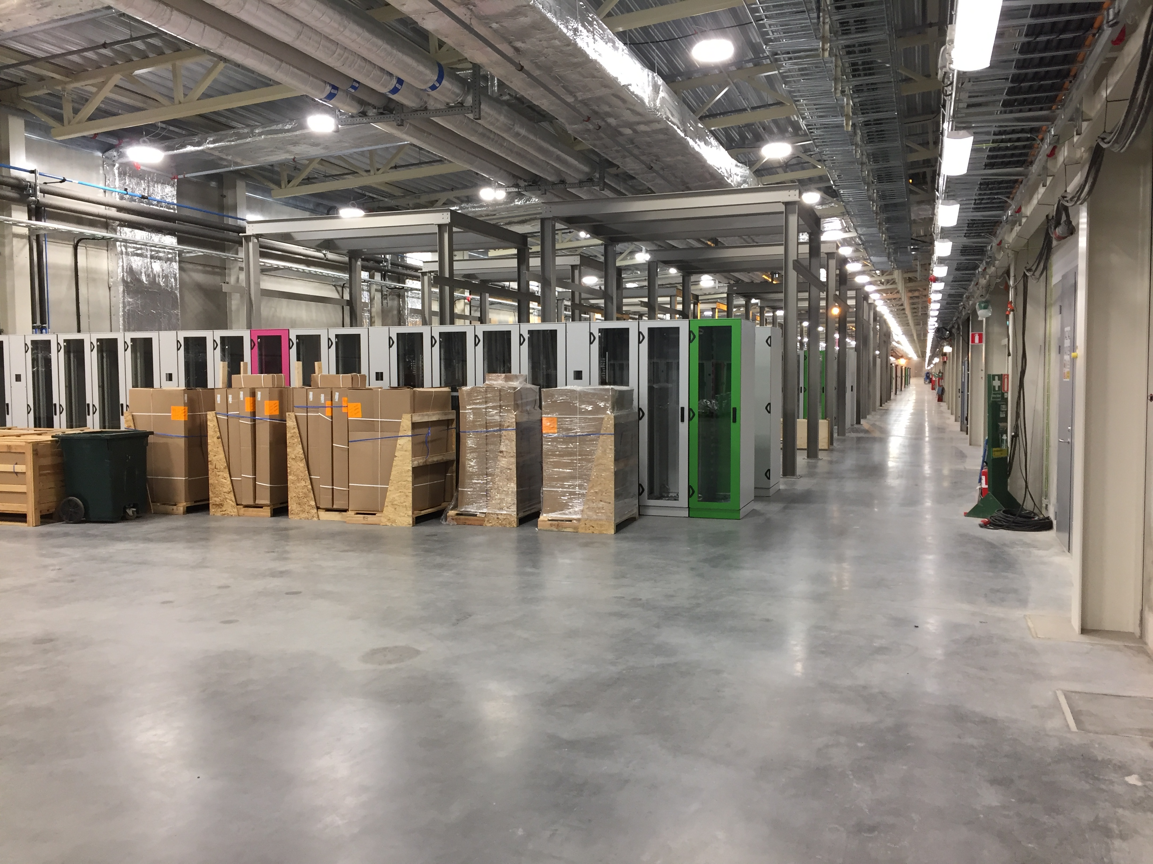
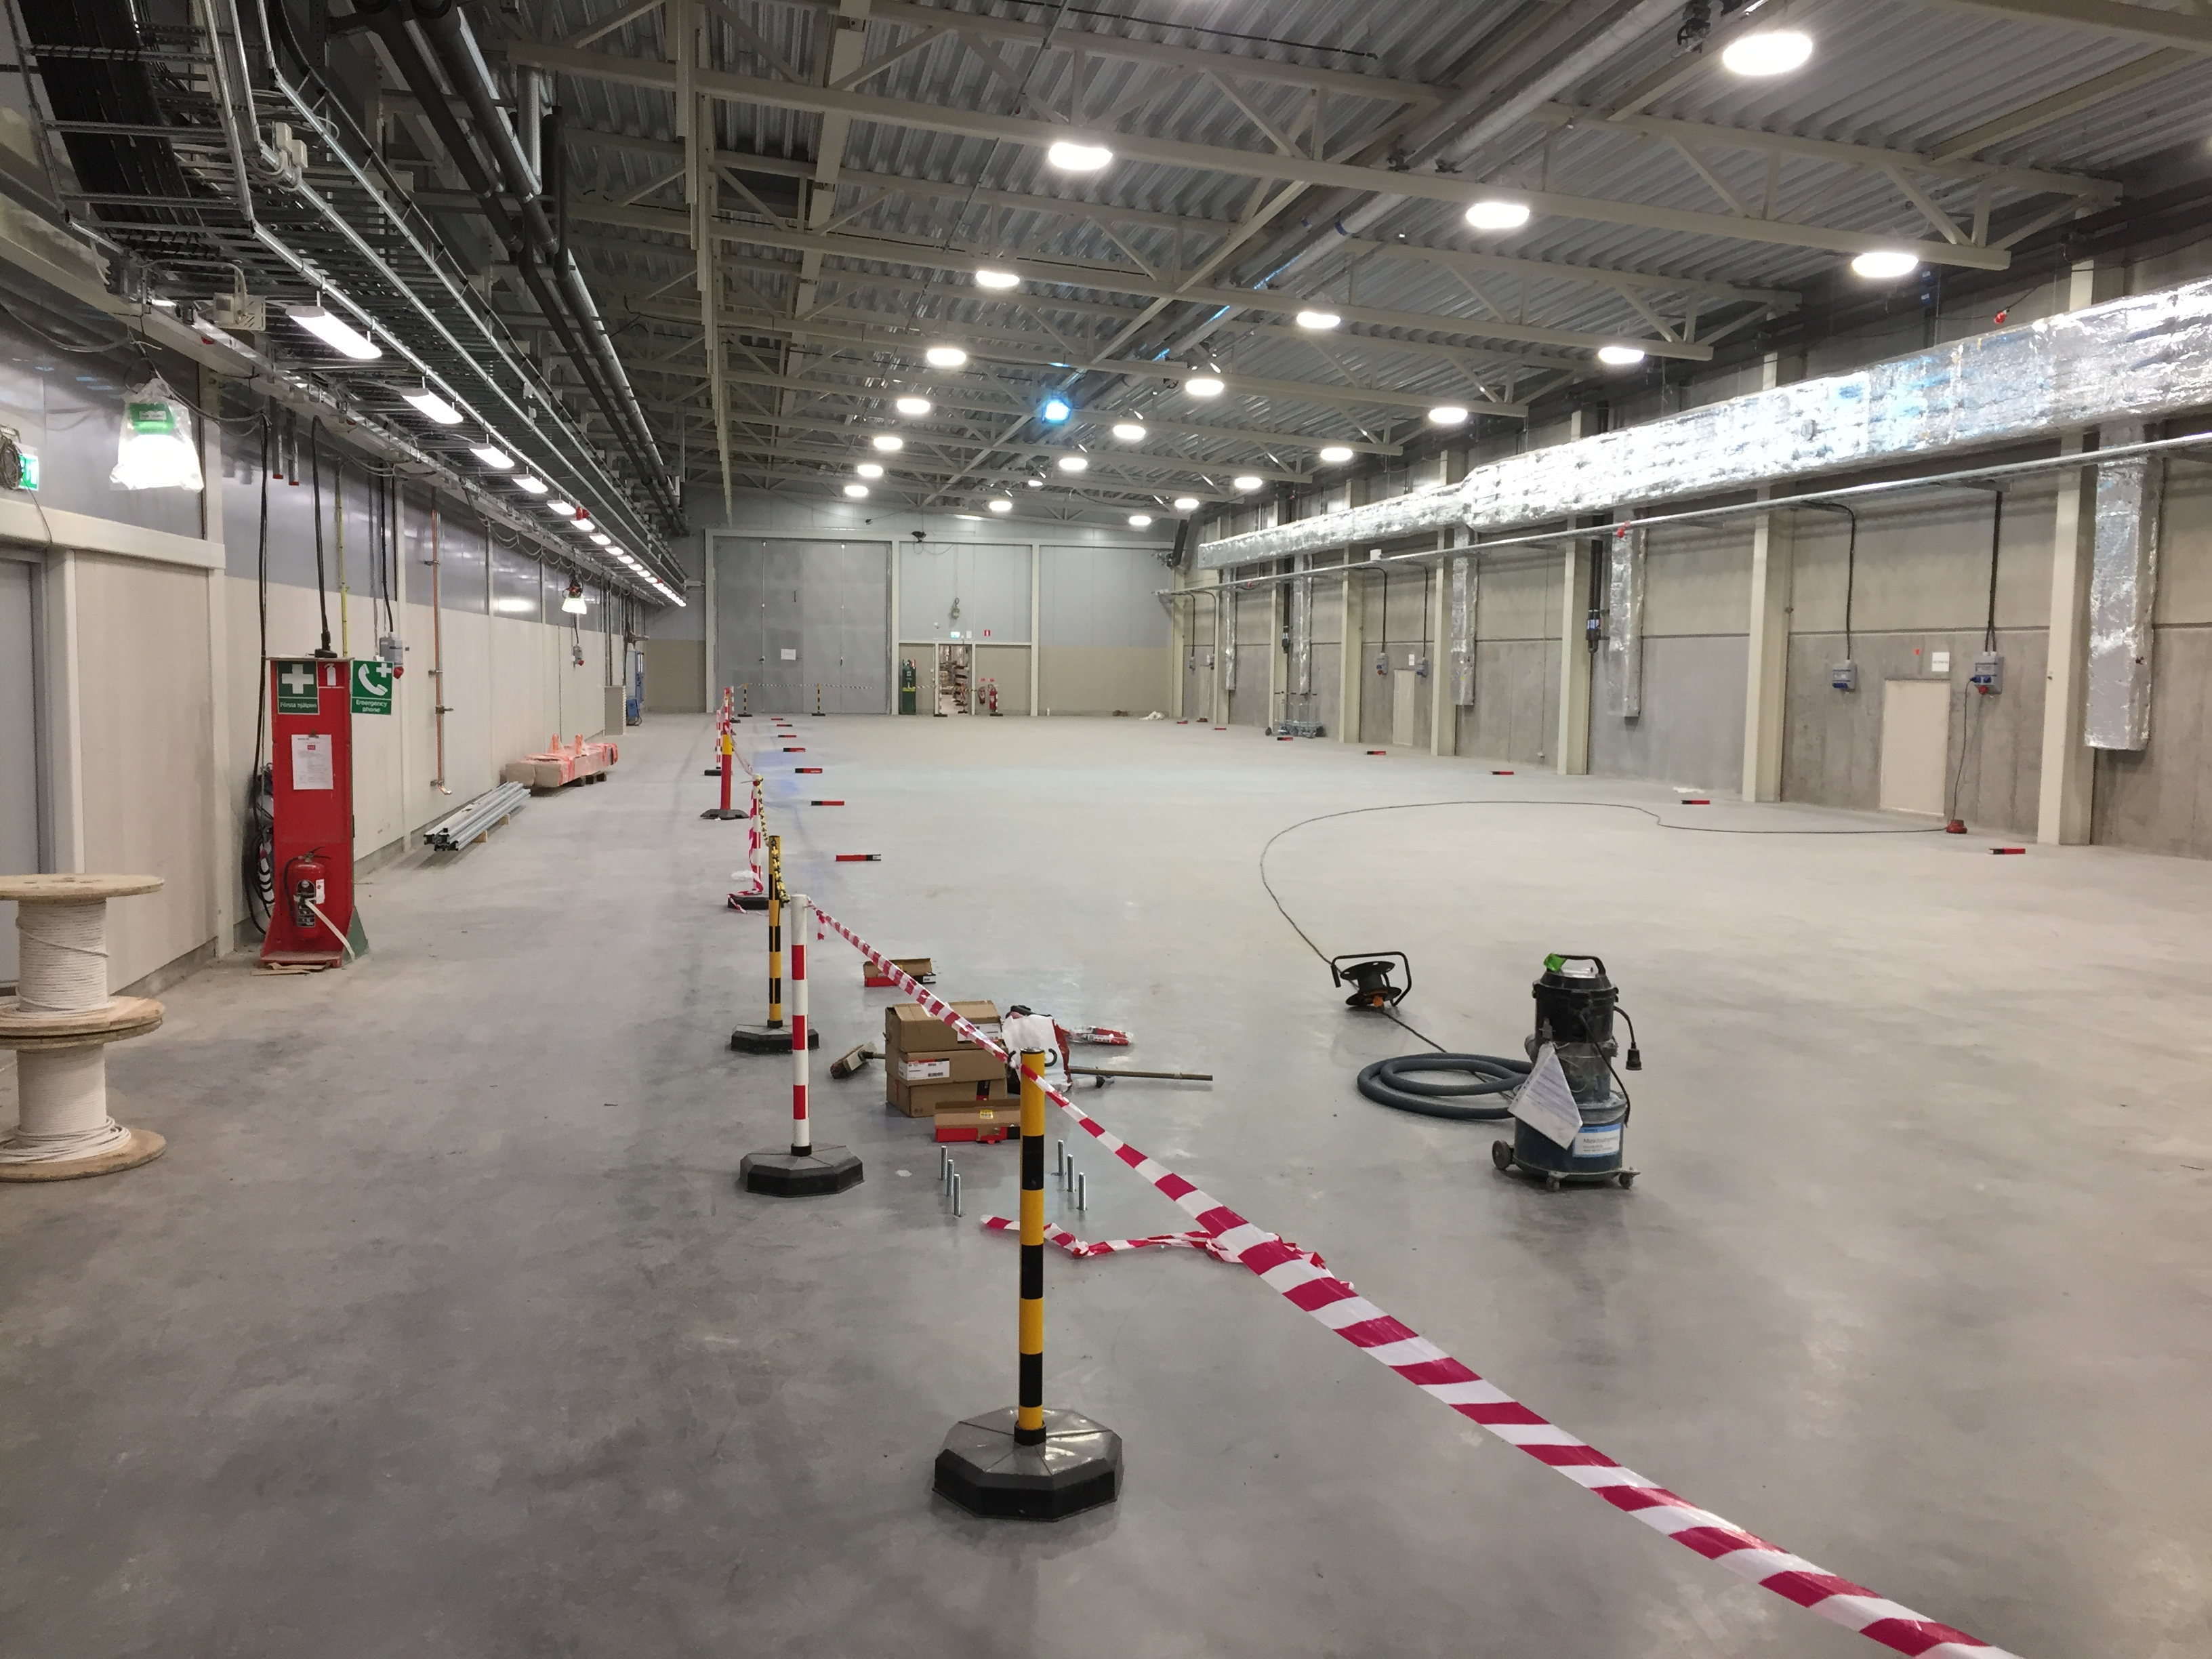
Pictures from G02, WP 17, WP 8

Slide 11
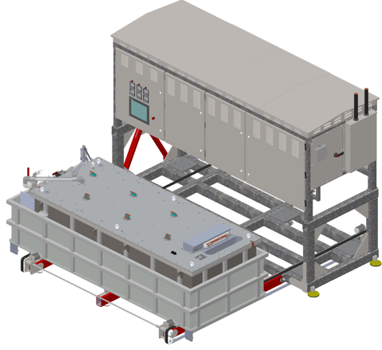
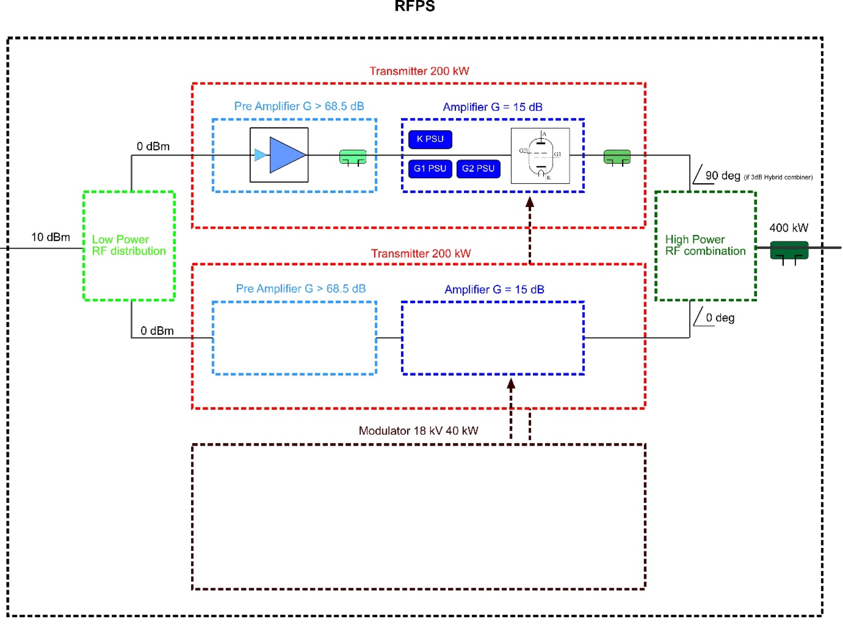
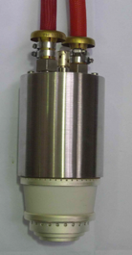
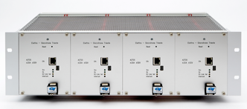
Highlights Power Converters
Modulators RFQ/DTL and medium beta
  Contracts in place (JEMA, Spain)
  SML topology, 660 kVA
  CDR passed NC
Tender returns Spoke RF stations, under evaluation
Tender returns received for Magnet power converters , under evaluation
  RFPS

Slide 12
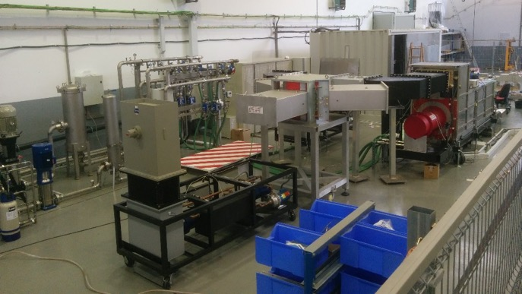
Highlights high power RF amplifiers
Medium beta klystrons deliveries start in June, orders placed for 36 klystrons, 2 suppliers
Driver amplifiers for MB
  Design review with R&S done
  1st delivery scheduled
  Prototype measured and report done
ESS Bilbao NC klystrons
  Has three klystrons
  Reconditioning to ESS spec
  Tendering for three more

Slide 13
Status Medium Beta klystrons
Toshiba
  FAT of the first tube performed on April 3-5
  First tube arriving at ESS mid-June
  Testing of the second klystron starting week 20 (mid-May)
  Baking of third klystron will be completed in week 14 (April 2-8)
CPI
  FAT first tube planned for June 27th
  First tube arrives at ESS end July (1.5 months delay)
  The delay on the first unit has no impact on other units
  Second tube assembly is almost complete

Slide 14
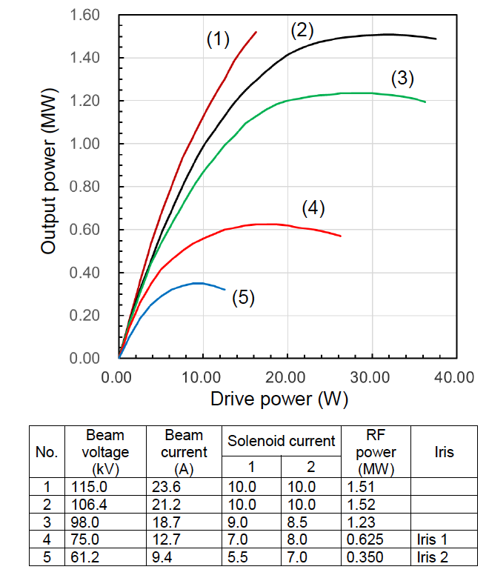
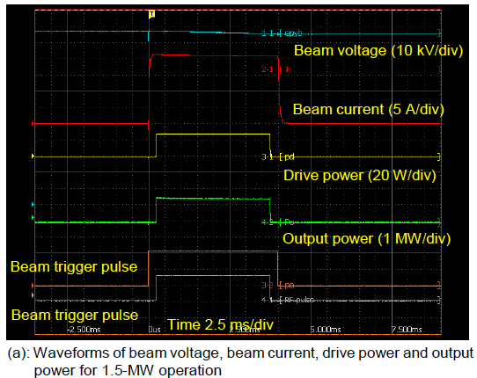
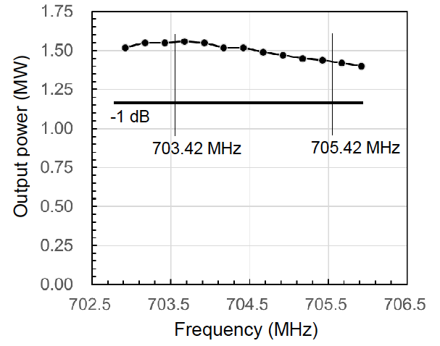
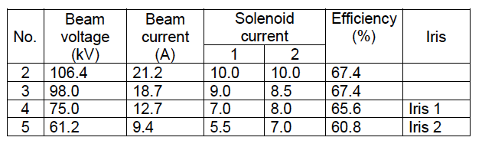
Toshiba FAT, some results

Slide 15
RF cell overview

Slide 16
Highlights interlock system
The following interlock systems are provided
  352.21 MHz – provided by ESS Bilbao
    1 – RFQ
    3 – MEBT
    5 – DTL
  352.21 MHz - provided by Elettra and ESS ERIC
    26 - Spoke
  704.42 MHz –provided by ESS & ATM Atomki
    36 – Medium β
    84 – High β
Design by ESS ERIC

Slide 17
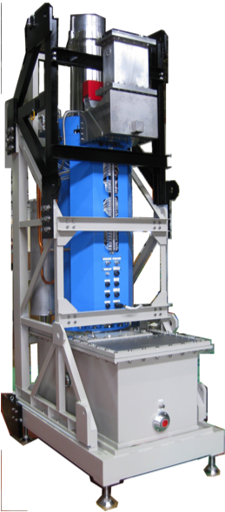
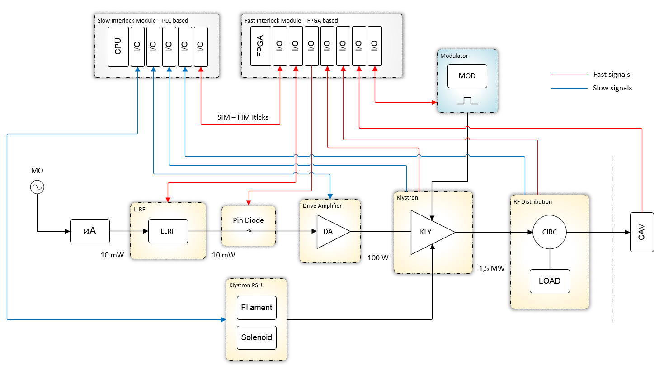
Status interlock
Three SIM prototype modules ready
  ATM Atomki
  2 by ESS ERIC, one in Lund (TS2) and one at FREIA
Three FIM prototypes under development/test
  2x in ESS ERIC labs medicon village
  1 offline in TS2, wait for IT network
All systems fully EPICS integrated

Slide 18
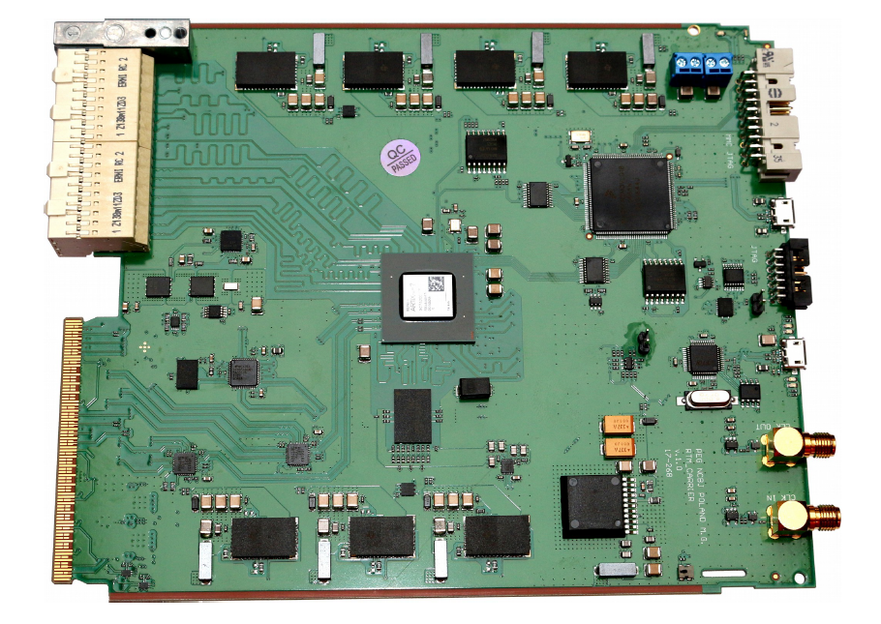
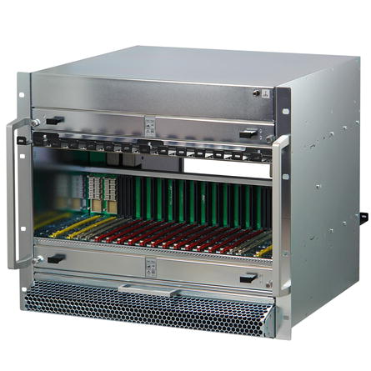
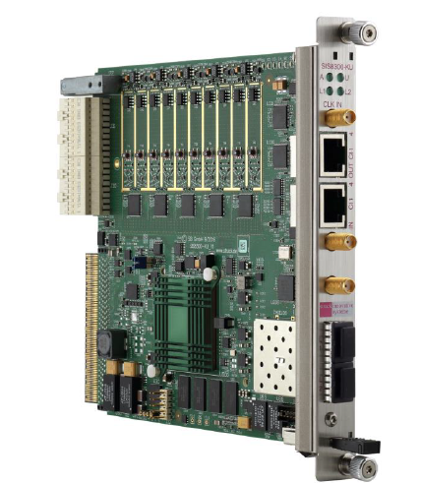
Highlights LLRF
LLRF systems provided:
  352.21 MHz ESS Bilbao
    RFQ, MEBT, DTL
  352.21 MHz ESS Bilbao
    Spoke
  704.42 MHz PEG
    Medium β
    High β
ESS Concept

Slide 19
Highlights LLRF
LLRF system has been running in two test systems in Lund and two in Uppsala/Freia since some time. The system will be used for cavity tests in Sweden and France
Main digitiser boards have been updated to latest version of FPGA hardware, and now have a newly developed AXI-framework running
Additional modules being developed by in-kind partners in Poland have reached CDR status, and these are planned for later this month
Procurement of first parts for final master oscillator version has started

Slide 20
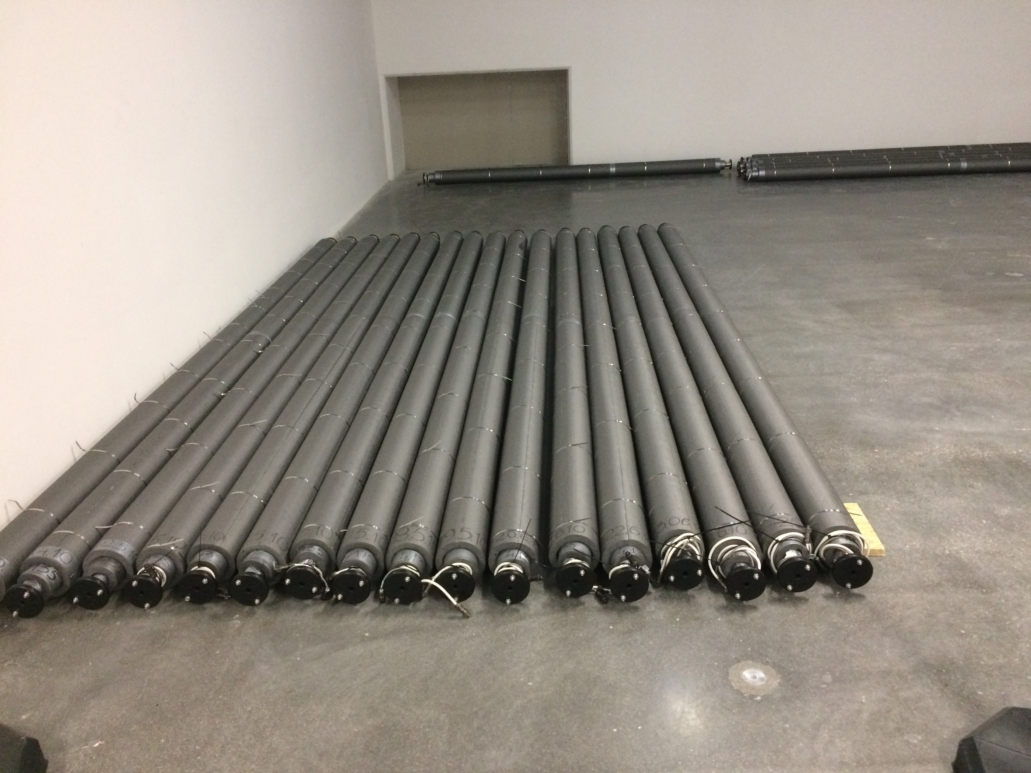
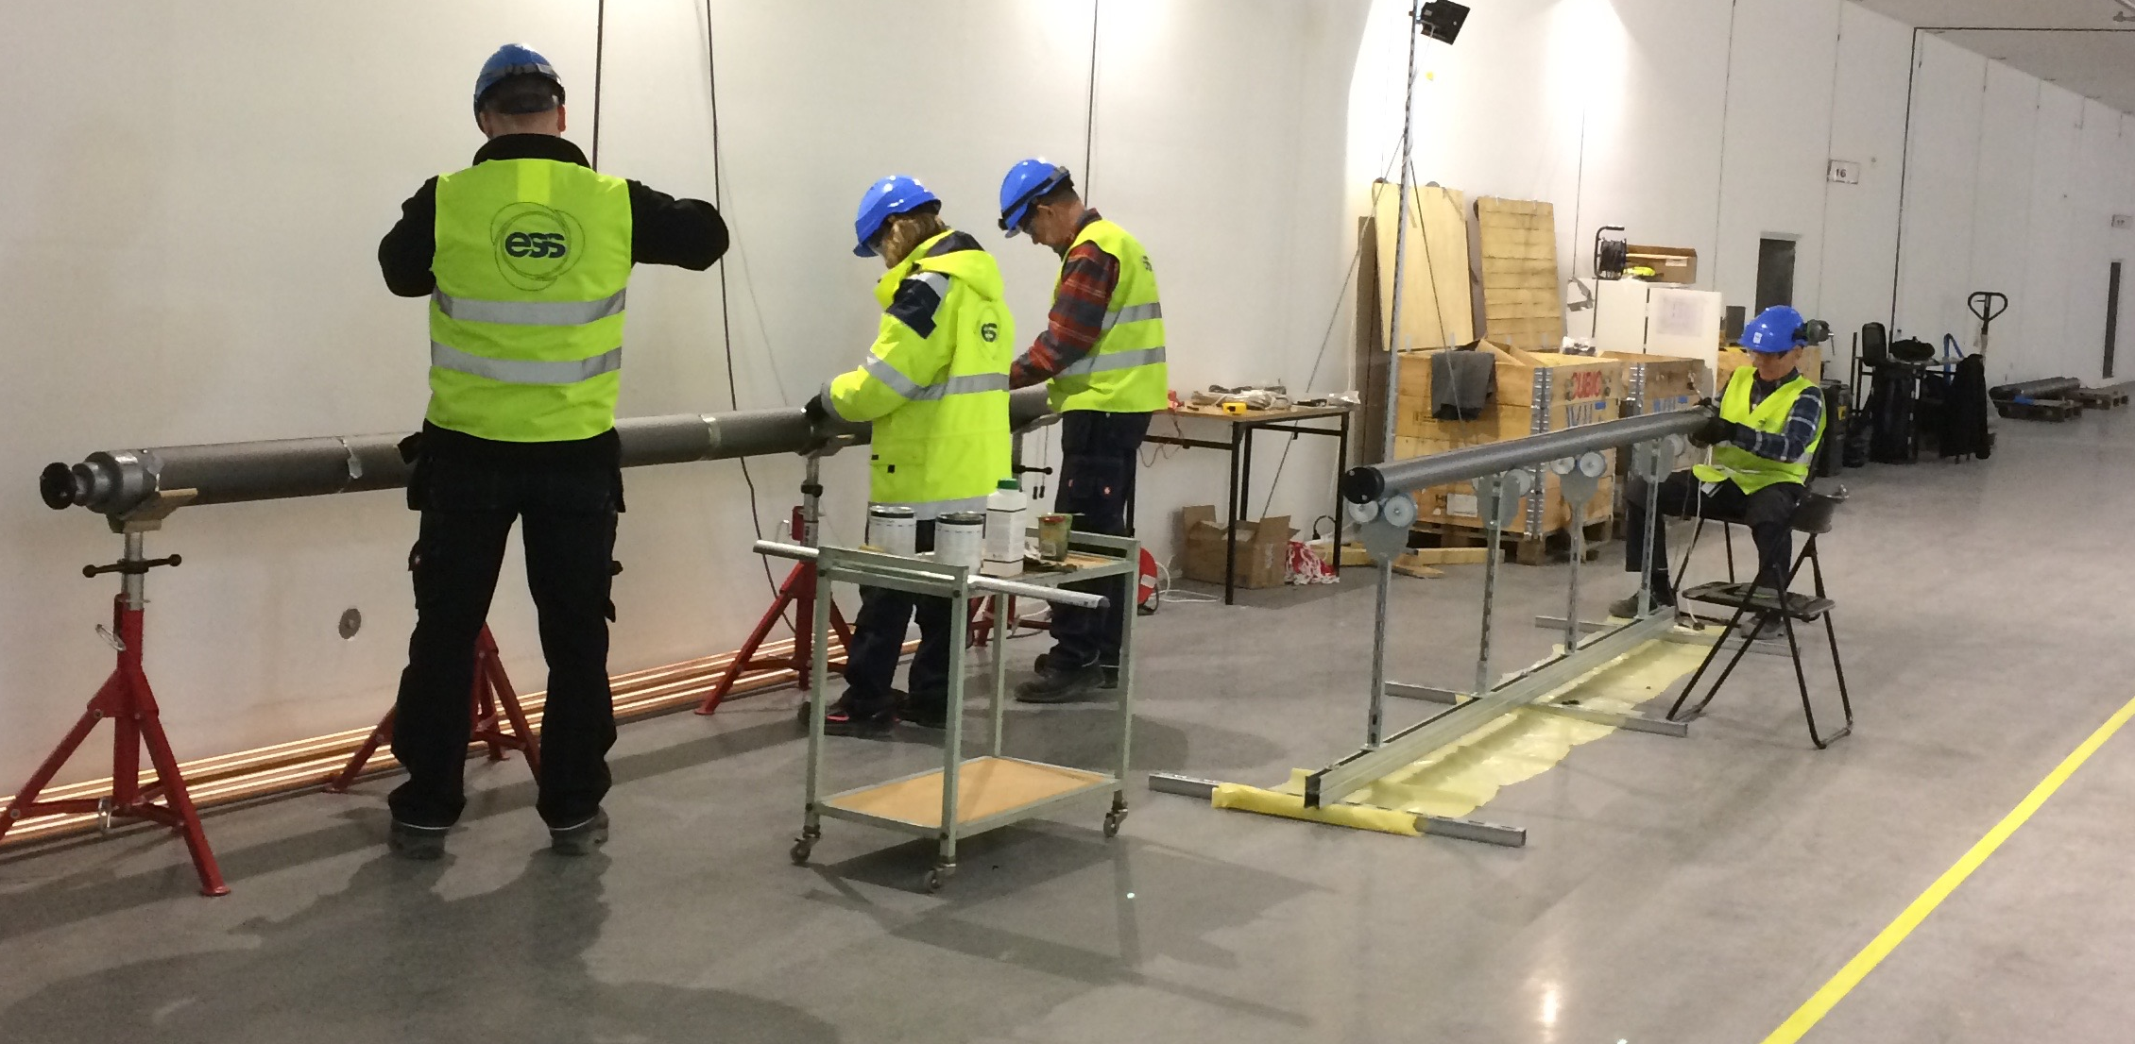
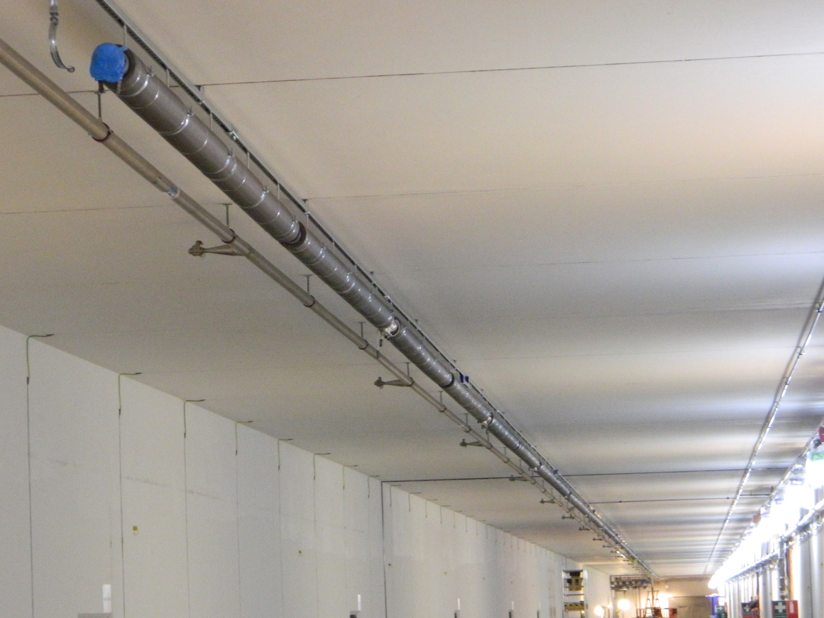
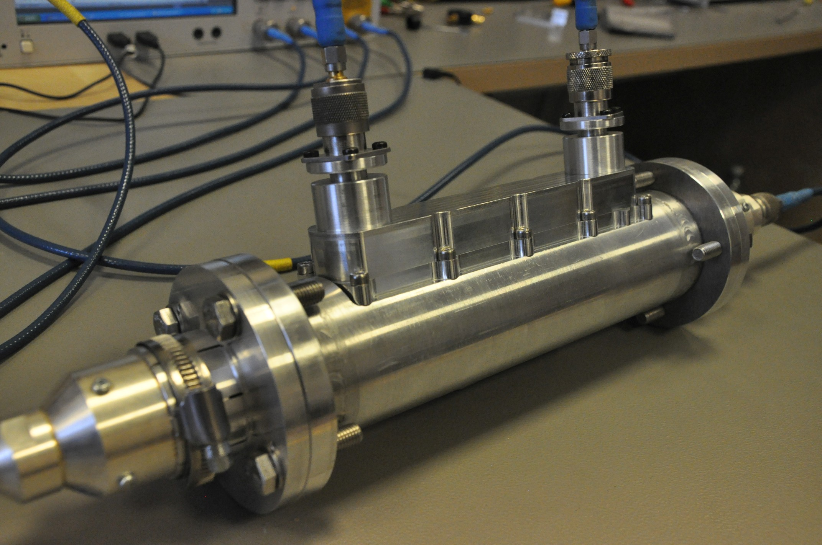
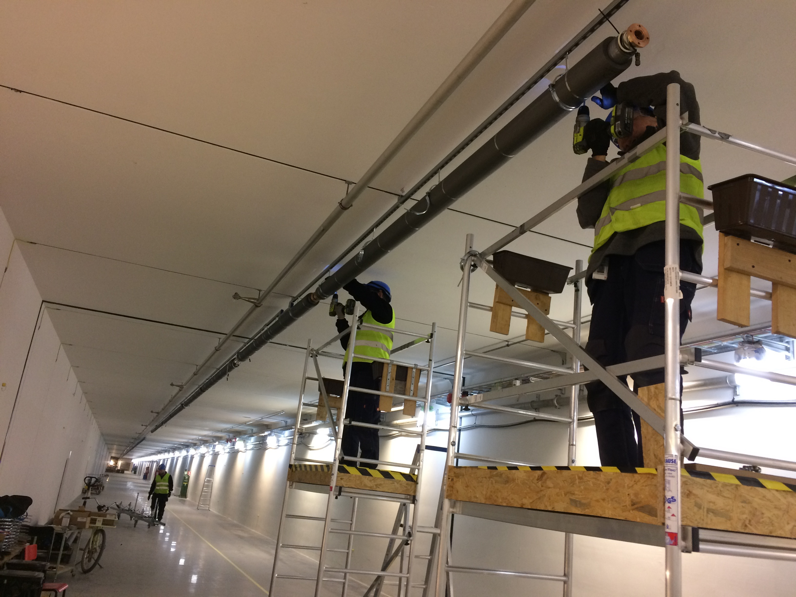
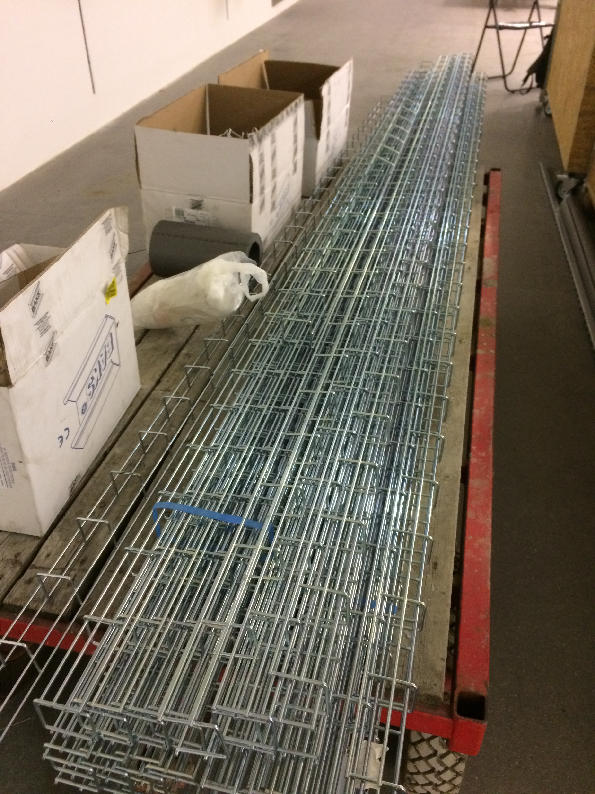
Highlights phase reference distribution
119 rigid line sections
heating cables,
Temperature sensors
thermal insulation jacket
Installation in Tunnel
Install hanging system
Assembly heating cables, temperature sensors, thermal insulation
Install rigid line sections and couplers
Install cable tray
Status today in tunnel
~500m PRL line installed from ion source to Dogleg
~100m PRL line remain to install this year from Dogleg to A2T
53 directional couplers
~500m-long cable tray

Slide 21
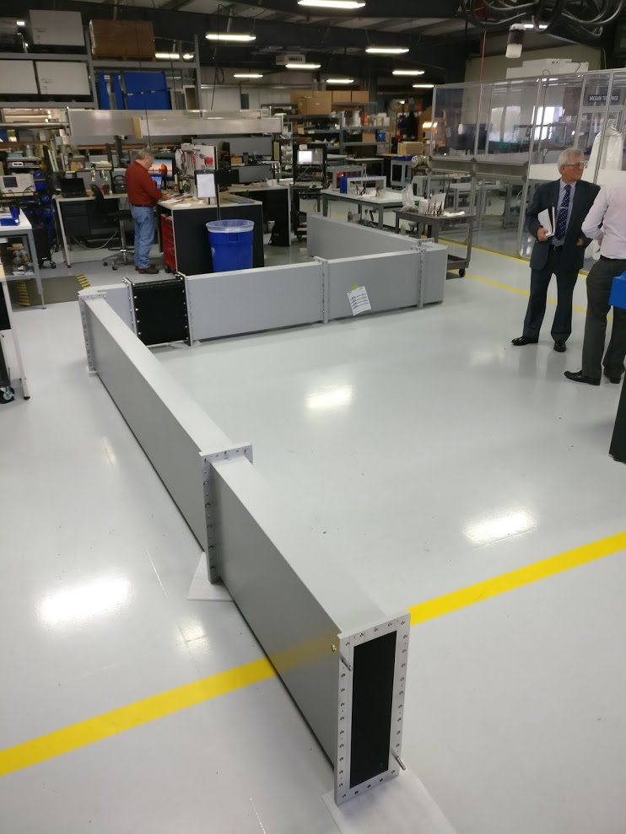
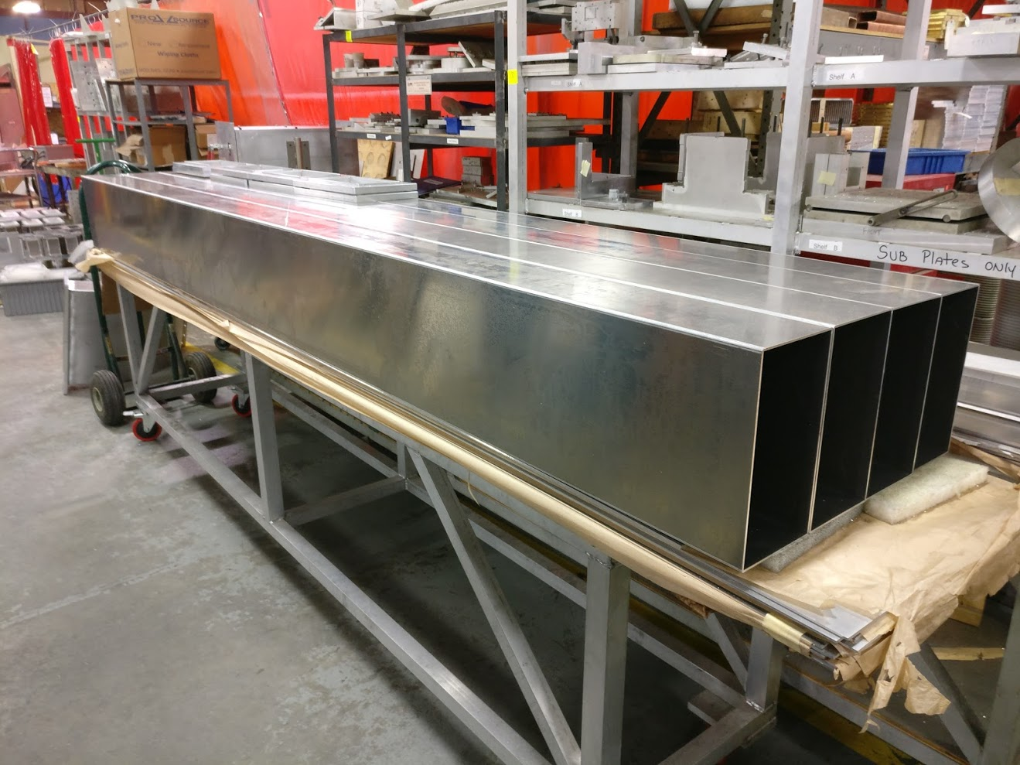
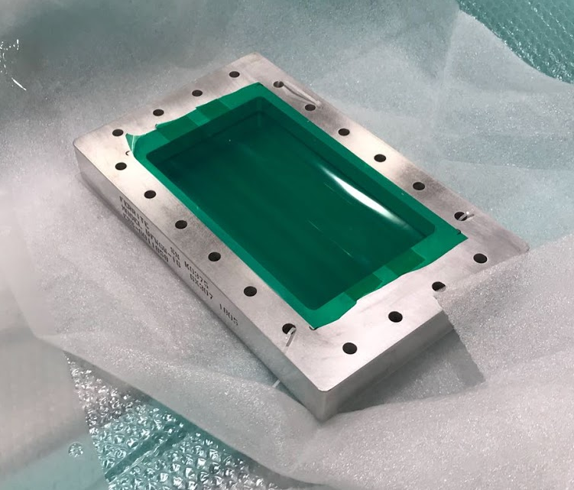
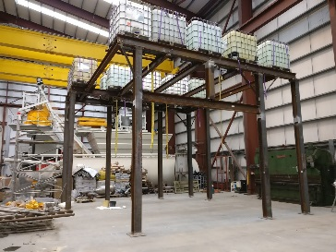
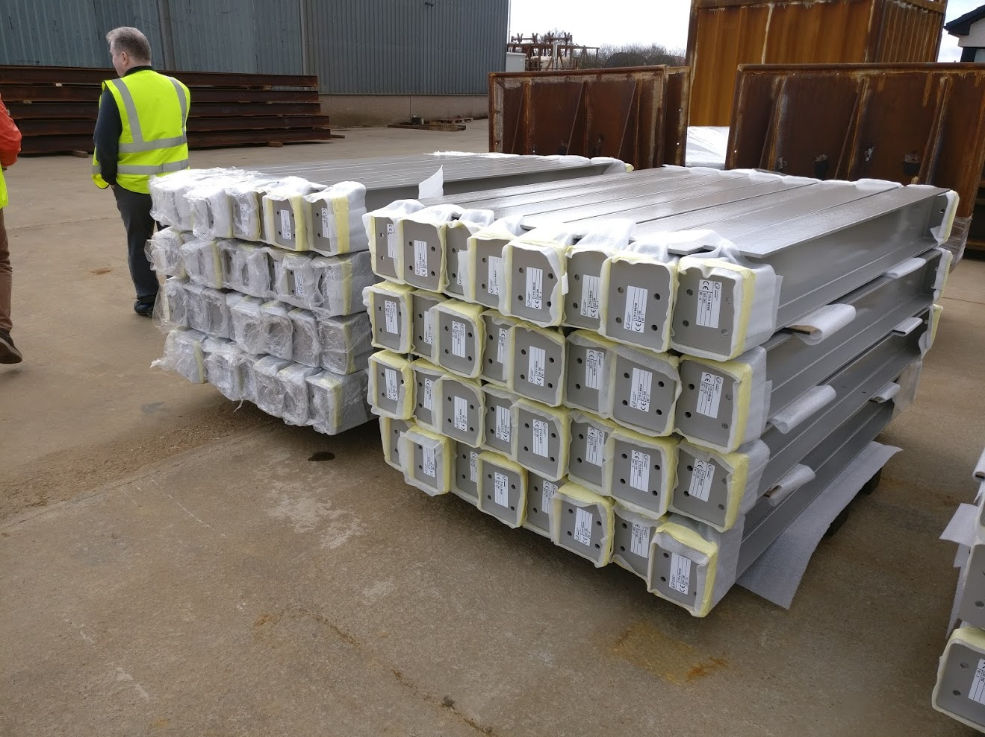
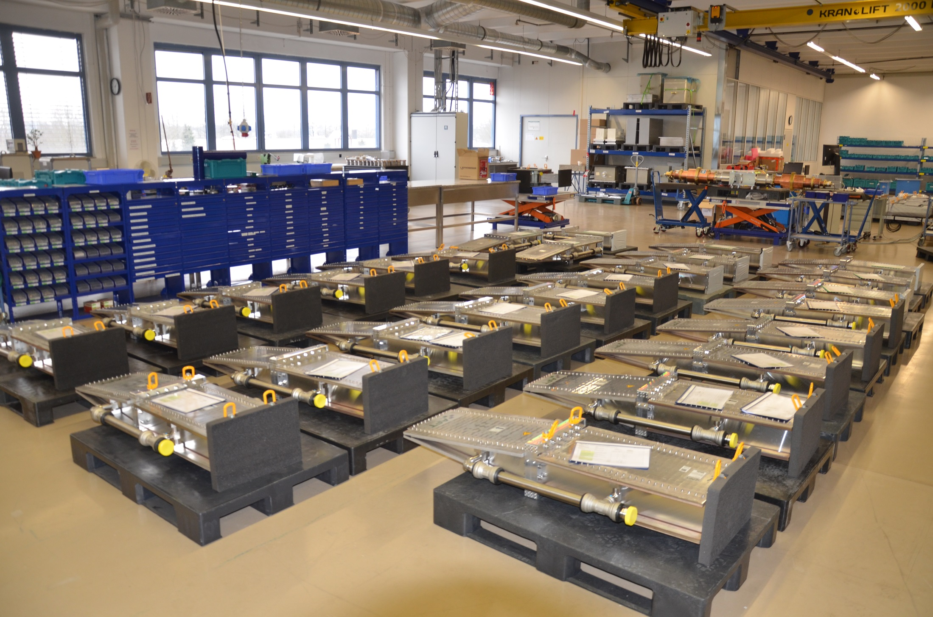
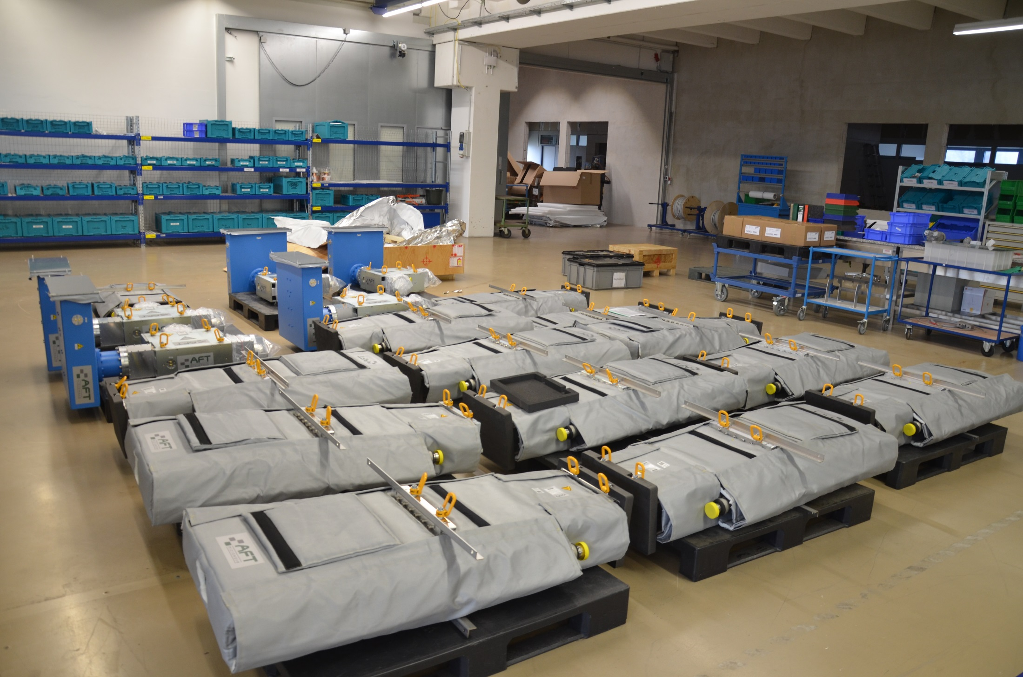
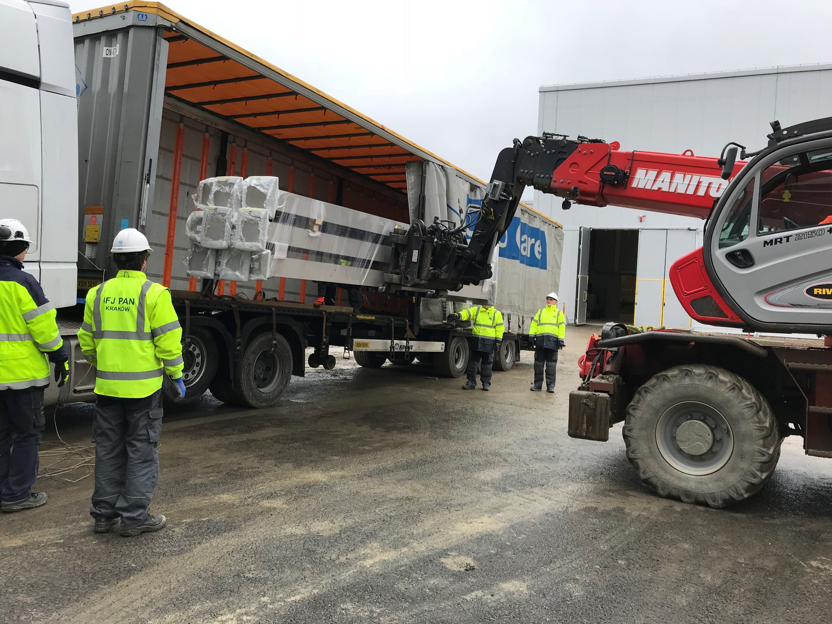
Highlights RFDS systems
All Spoke Loads and Circulators now at ESS
Spoke and MB RF windows now at ESS
All but one Spoke support installed in gallery
Spoke waveguide mounts for stub sections at ESS
Full Stub waveguide arriving this week
Delivery rate about once per week!

Slide 22
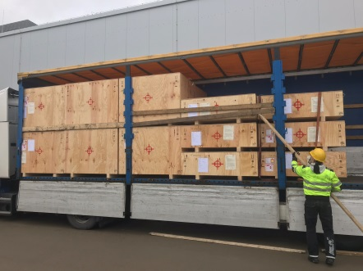
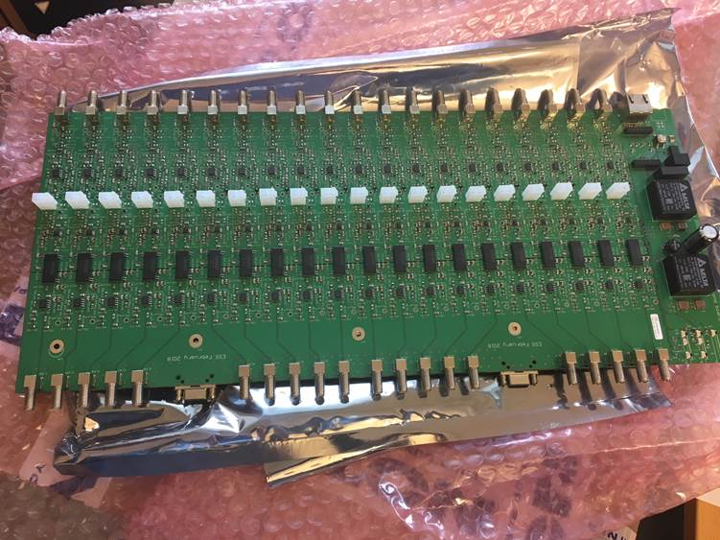
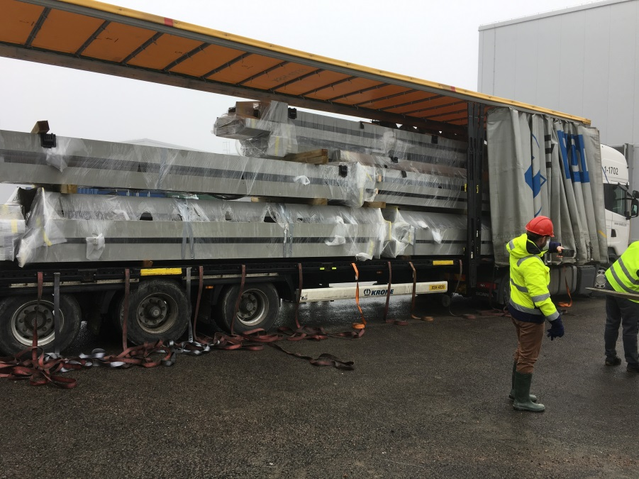
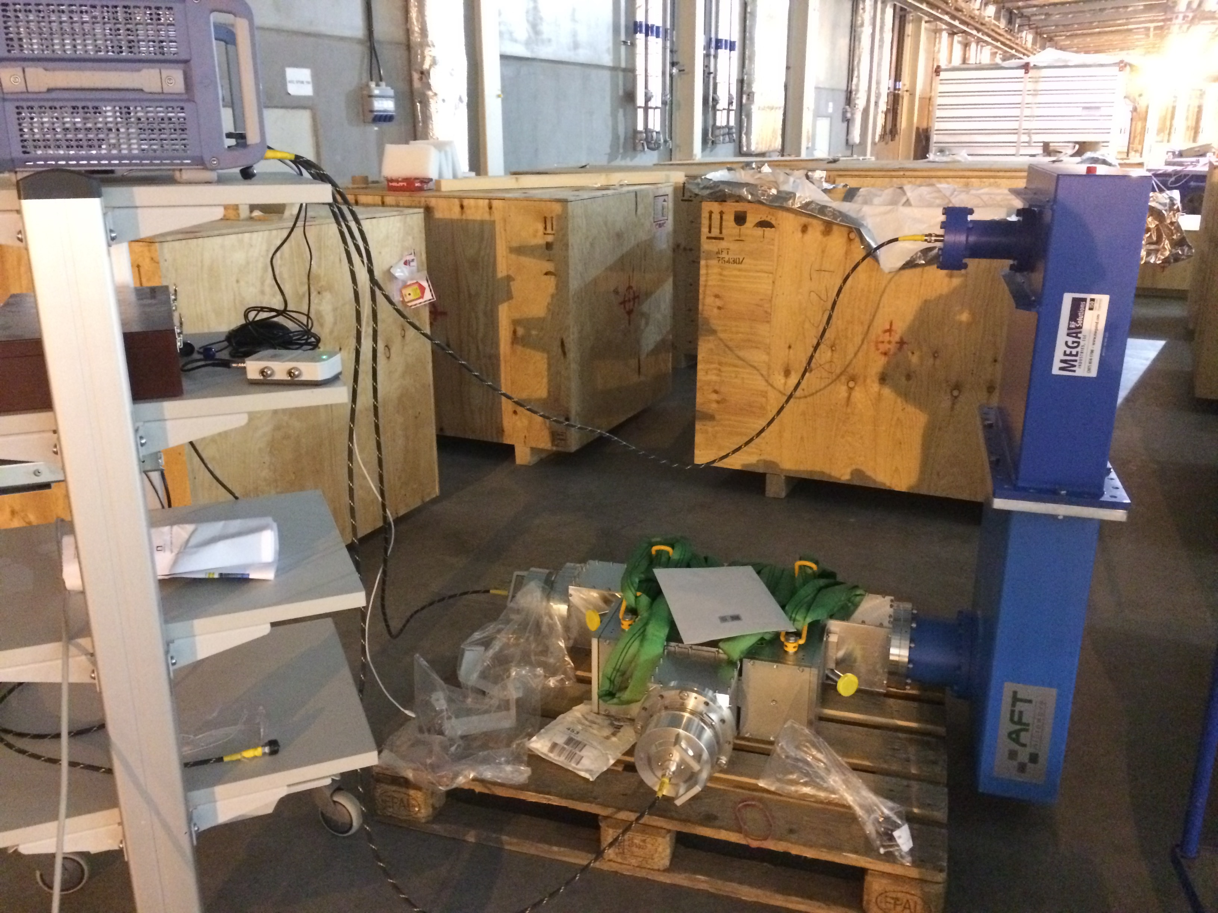
RFDS, E- Pick up and Pin diode status
RFDS
  26 Load 352MHz Measured (SAT done)
  22 circulators 352MHz delivered and incoming inspection done (2 tilted will be sent back)
  26 Windows 352MHz received and inspected
  26 Windows 704MHz received and inspected
  7 Circulators 352MHz received (one measured measurements procedure doc ongoing)
  FAT for circulator 704 MHz planned May 2018
  Superstructure MB/HB delivery ongoing
  Catia model update ongoing with the Arc detector sensor
  Issue with the painting of the spoke structure (fix ongoing)
E- Pick up and Pin diode (interlock)
  Installation on going on TS2
  Integration on ICS platform (ICS support)
RF Distribution NC:
  Layout and phase matching finalized
  Waveguides and supports for stubs and gallery/tunnel design and procurement
  Circulators and Loads being procured

Slide 23
Test stands
It is important to prototype and test RF equipment
ESS employs several test stands:
  Integration test stand in Lund University (to be phased out)
  FREIA test stand in Uppsala (352 cryomodules, 352 power, modulator prototype, 704 cavity prototype)
  Cryomodule test stand at ESS (704 cryomodules)
  RF HP test stand at ESS (high power RF components, starting with modulators)
  CERN tests of IOT prototypes

Slide 24
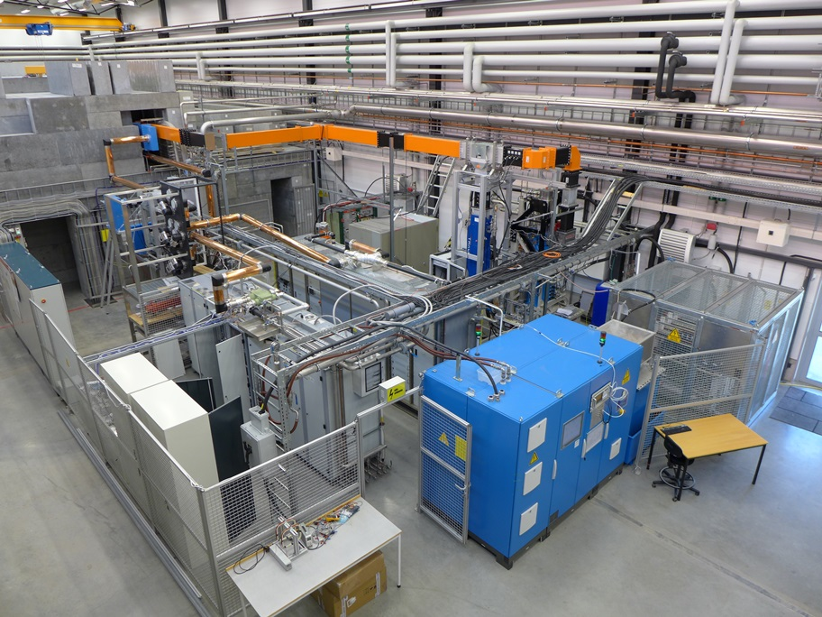
FREIA test facility Uppsala University
High beta prototype test
  Toshiba prototype klystron
  PPT modulator
Spoke serial tests
  DB Elettronica and Itelco tetrode-based power stations
FREIA infrastructure
704 MHz
klystron
dummy
load
tetrode stations
modulator
RF Amplifier Stations

Slide 25
Next steps
Cryomodule test stand set-up
Installation of support more structures and waveguides/circulators/loads in gallery
Stub installation
Test stand 3 installation
Getting RF for NC linac, especially RFQ, in place
Getting deliveries of series medium beta klystrons

Slide 26
Thank you

