Slide 1
TAC #17
Accelerating Structures
Håkan Danared
Deputy Head Accelerator Division, Linac Group Leader, Accelerator Installation Manager
www.europeanspallationsource.se
12 April, 2018

Slide 2
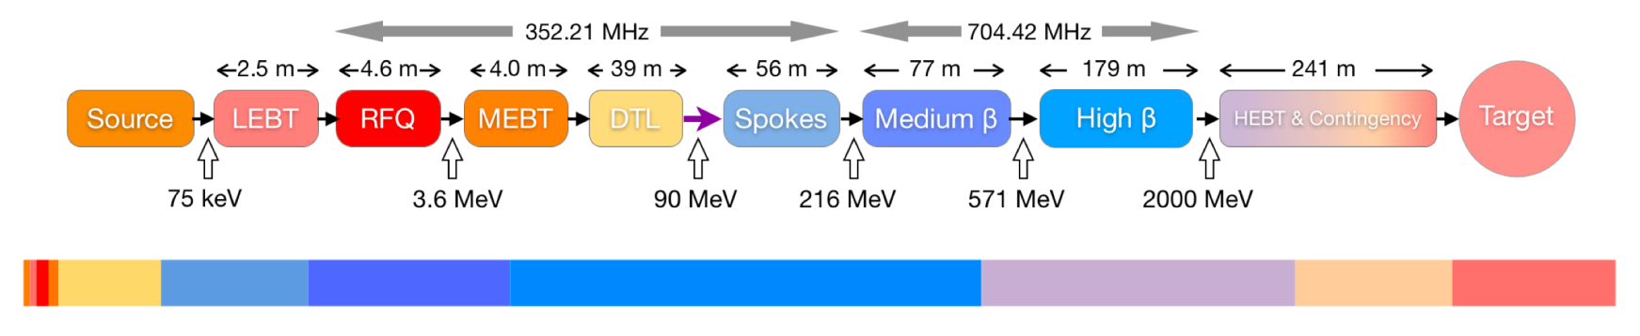
Work Packages in Linac Group
The Linac Group is responsible for the warm linac (WP3), the cold linac (WP4&5), rastering system and gamma blockers (WP6) and magnets (WP14). All these are in-kind contributions, with additional collaboration agreement with DESY and further collaborations through partners.
Ion source and LEBT: INFN Catania
RFQ: CEA Saclay
MEBT: ESS-Bilbao
DTL: INFN Legnaro
Magnets: Elettra
Spoke cavities, cryomodules: IPN Orsay
Spoke cryomodule test: Uppsala Univ
Medium-beta cavities: INFN Milan
High-beta cavities: STFC Daresbury Lab
Elliptical cavities, cryomodules: CEA Saclay
Nb sheet scanning, He fill lines: DESY
Beam-delivery systems, Aarhus Univ
Gamma blockers, NCBJ Świerk

Slide 3
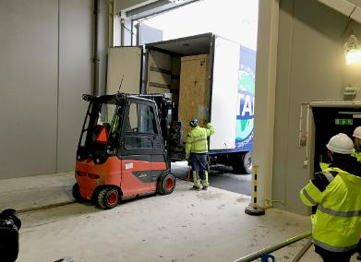
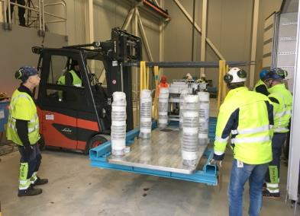
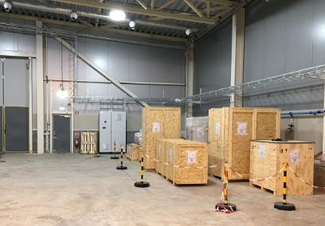
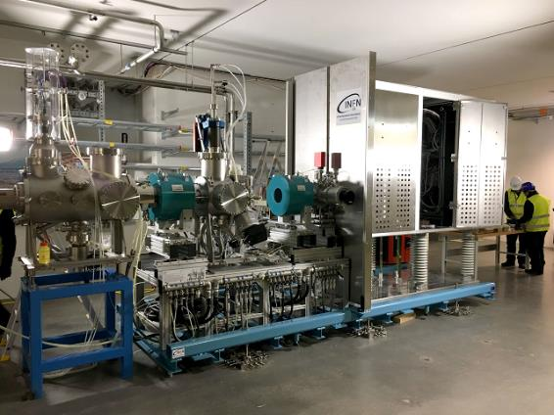
Ion Source and LEBT
12 Dec 2017
31 Jan 2018
Preparation with installation of utilities during autumn 2017.
Ion source and LEBT delivered to ESS in Dec 2017.
Assembly started when a team of 6 arrived from Catania 15 Jan 2018.
After three weeks everything was assembled a the team returned home.
Checks of vacuum and internal connections performed.
Connection to electrical power and cooling water in progress.
Start of beam commissioning planned for early July 2018.

Slide 4
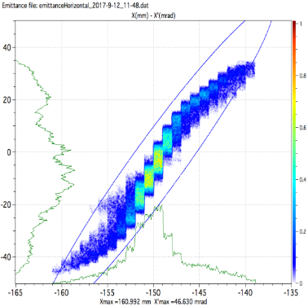
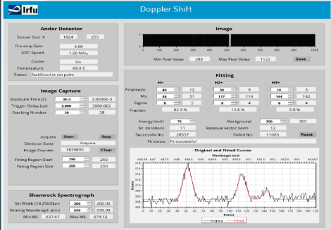
Ion Source and LEBT
Main parameters
Beam energy 75 keV
Nominal beam current 74 mA
Pulse length 3 ms
Repetition rate 14 Hz
Transv emittance (99%) 1.8 µm, at IS-LEBT interface
Transv emittance (99%) 2.25 µm, at LEBT-RFQ interf.
Flat-top stability ±2 %
Pulse-to-pulse stability ±3.5 %
Plot of horizontal emittance of 70 mA beam, taken at the LEBT-RFQ lattice interface.
Transverse emittance (99%) 2.26 µm.
Near-term activities
Installation of high-voltage fence April 2018
Vacuum checked April 2018
Cable installations ready May 2018
PSS0 tested May 2018
Cooling water May 2018
High voltage checked June 2018
SRR June 2018
Start of beam commissioning July 2018
Doppler spectrum of 85 mA proton beam at INFN
Total beam:
Protons 84.8 %
H₂⁺ 11.9 %
H₃⁺ 3.3 %

Slide 5

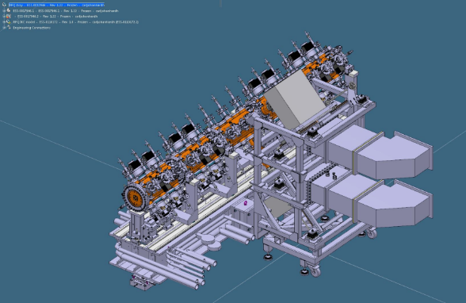
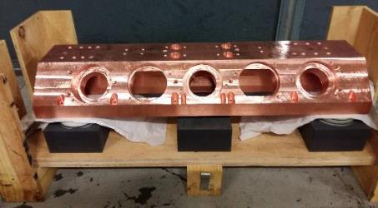
RFQ
 | Status | Note
Pre-series manufacturing/brazing - section 1 | 60% | Section 1 waiting for fine machining.
Section 2 manufacturing | 50% | Section 2 waiting for fine machining.
Section 3 manufacturing | 50% | Section 3 waiting for fine machining.
Section 4 manufacturing | 45% | Section 4 almost ready for fine machining.
Section 5 manufacturing | 2%
Series production manufacturing/brazing - section 2 to 5 | 34% | Average of section 2 to 5 progress
RFQ Skid | 100% | Manufactured; tests week 14
Main parameters
Input energy 75 keV
Output energy 3.6 MeV
Number of sections 5
Total length 4.6 m
Transmission > 97 %
3D model of RFQ and waveguides
Section 1 major vane before annealing.

Slide 6
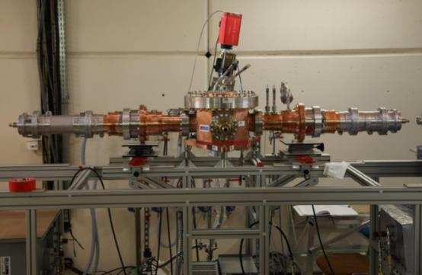
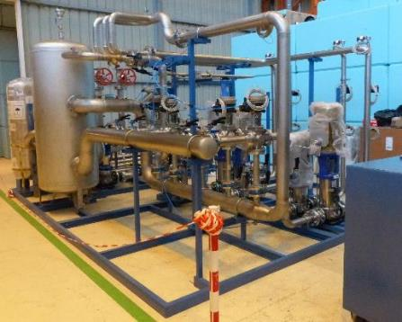
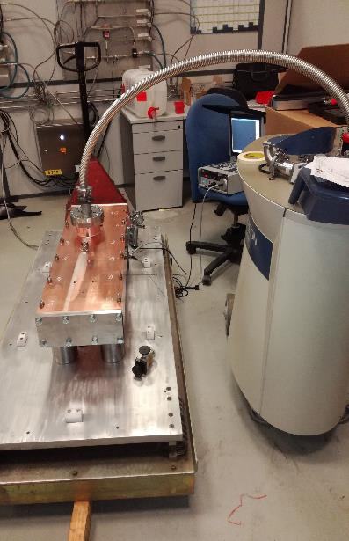
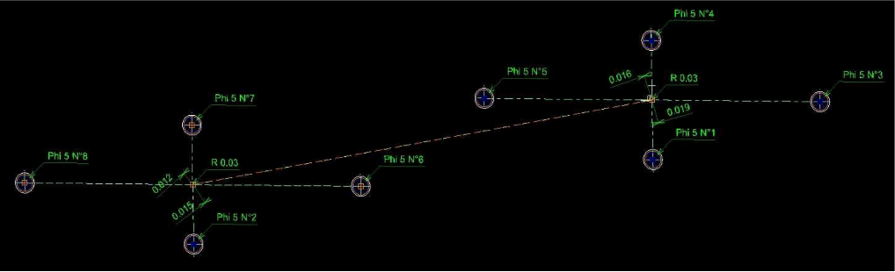
RFQ
Two power couplers on test cavity at CEA
Cooling skid being assembled at CEA
Brazing mock-up leak test
Dimensional verification of the brazing mock-up

Slide 7

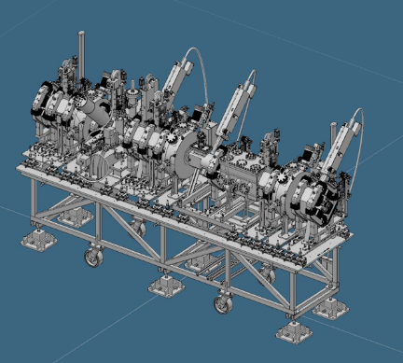
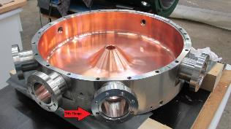
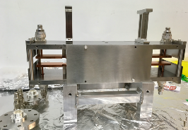
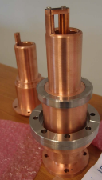
MEBT
Quadrupoles 11
Buncher cavities 3
Collimator units 3
Choppers 1
Total length 4.0 m
Several types of beam instrumentation
Quadrupole #1 under FAT at Danfysik, front view
Side view
Buncher cavity copper-plated at GSI
Chopper
3D model of MEBT
Power couplers for buncher cavity

Slide 8
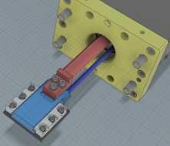
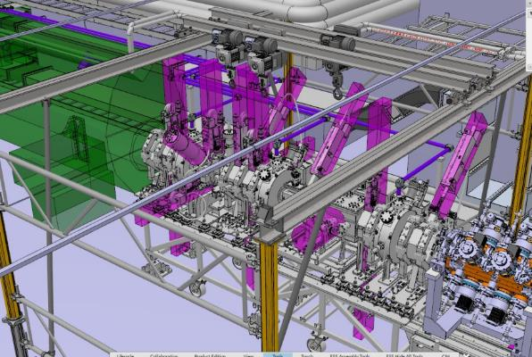
MEBT
Collimator model and vacuum vessel for collimator
Activities at ESS (similar to other components)
Cables registered
Interlock signals defined
Controls integration and verification of MPS interfaces
Evaluation of installation procedure
Discussion about installation team coming from Bilbao
3D model of MEBT with crane in tunnel, for
modelling of complicated assembly procedure

Slide 9
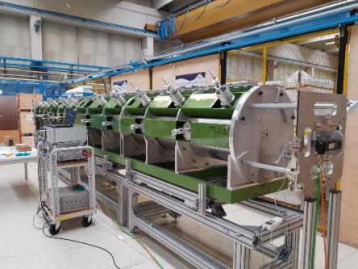
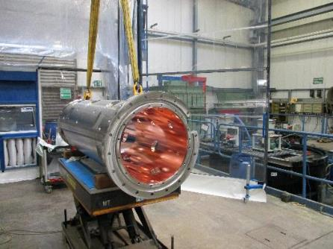
DTL
Main parameters
Input energy 3.6 MeV
Output energy 90 MeV
Number of tanks 5
Sections per tank 4
Length 39 m
Weight 34 tons
Mock-up of tank, for bead-pull tests etc.
DTL schedule
Tank # | BPM's ready | DT EB welded (except BPM) | DT RFI (BPM's included) | RFI TUNNEL (forecast)
T4 | 2018-09-30 | 2018-06-30 | 2018-11-30 | 2019-01-01
T1 | 2018-09-30 | 2018-07-31 | 2018-11-30 | 2019-02-10
T3 | 2018-09-30 | 2018-09-30 | 2019-01-10 | 2019-03-15
T2 | 2018-09-30 | 2019-05-30 | 2019-05-30 | 2019-06-05
T5 | 2018-09-30 | 2019-05-30 | 2019-05-30 | 2019-09-30
Copper plated tank section #4-1 at GSI

Slide 10
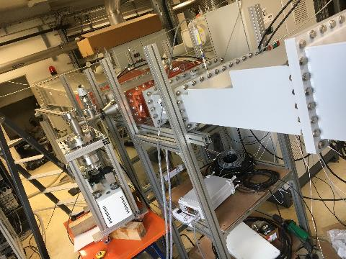
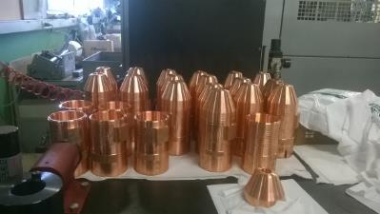
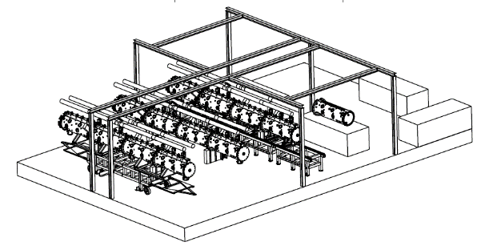
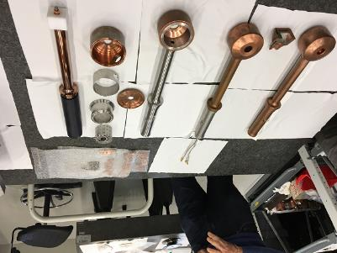
DTL
Drift tubes for tank #4, machining at INFN in Legnaro and Turin.
RF window being tested at IPN Orsay
Model of DTL assembly workshop in ESS klystron gallery
Assembly expected to take 18 months for two teams of 2-3 persons each
Drift tubes prototypes for tank #1. Test assembly with beam position monitor and permanent magnets.

Slide 11

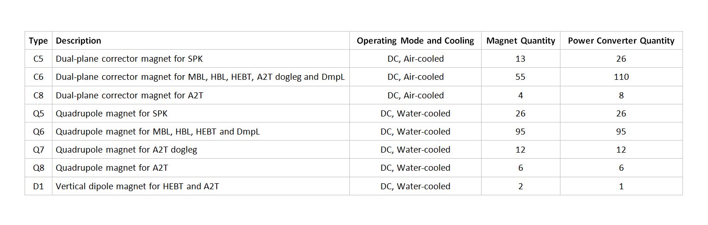
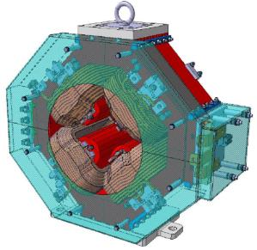
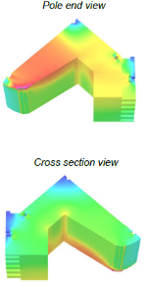
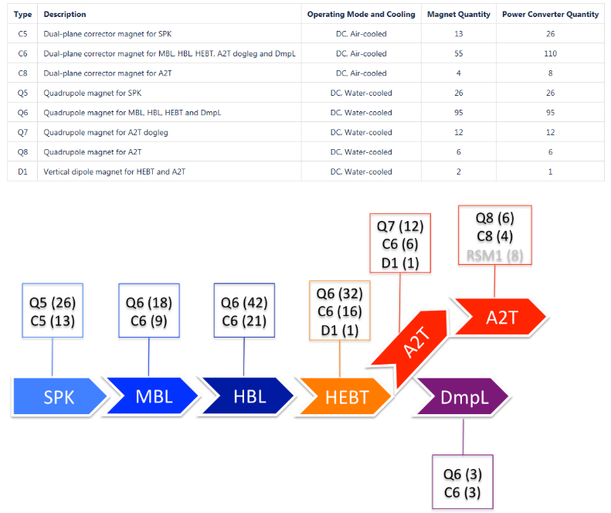
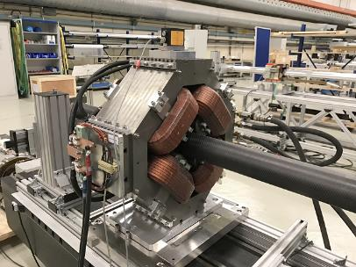
Magnets
Q5 spoke LWU quadrupole
Q6 elliptical LWU quadrupole prototype at CERN

Slide 12




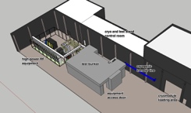
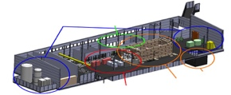
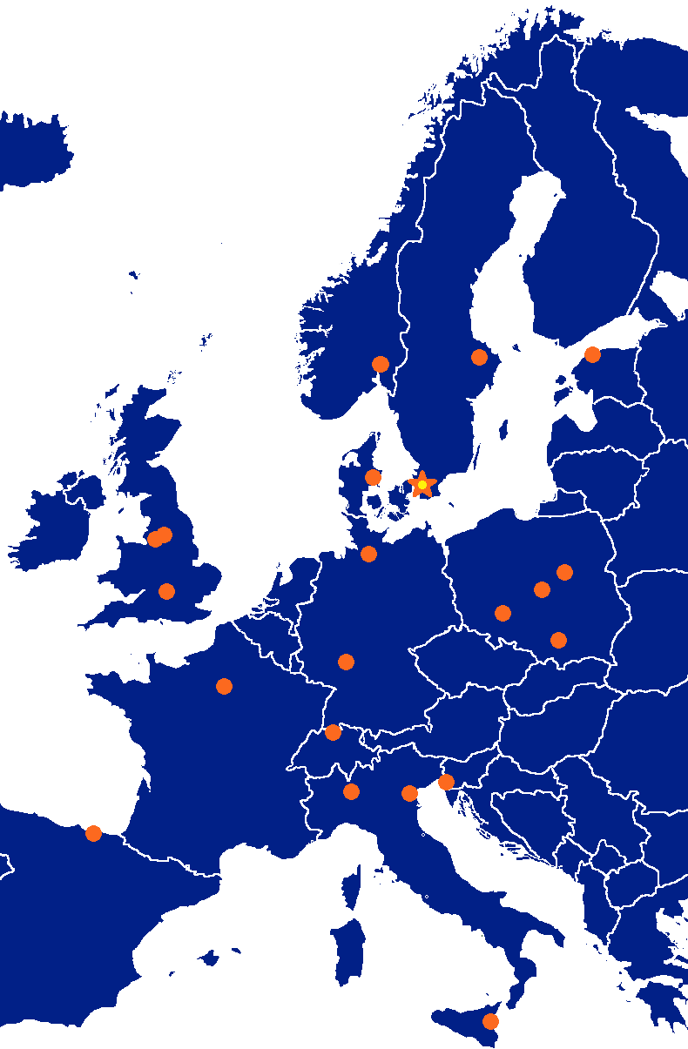








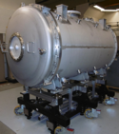



ESS SRF Collaboration
Test
Facilities
(FREIA/TS2)
Cold linac (T=2K)
Assembly
Components

Slide 13
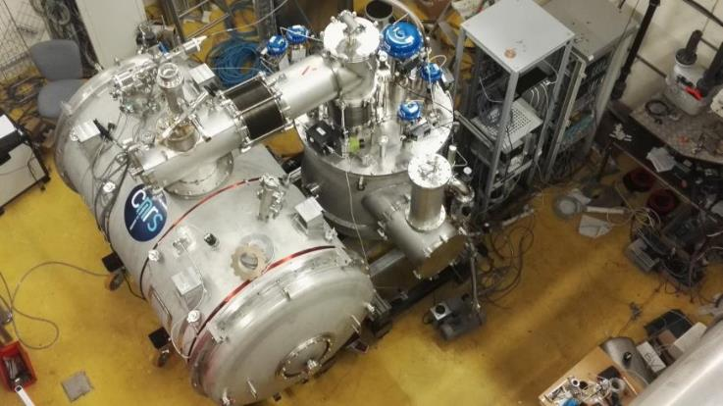
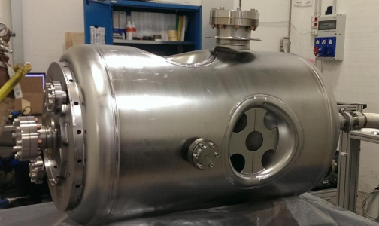
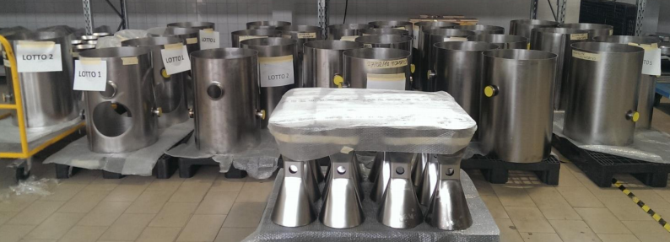
IPNO - Spoke components
Proto Cryomodule and
Valve Box in final cryo
validation stages at IPNO
  To be assembled with 2 cavities
  @FREIA in June RF High Power
Series cavities fabrication
  In full swing (but power coupler and vacuum vessels in critical path)
  First 4 cavities at IPNO May, then test and release of full series

Slide 14
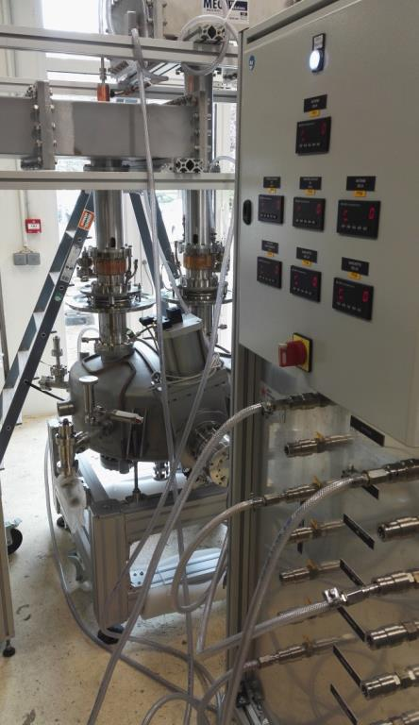
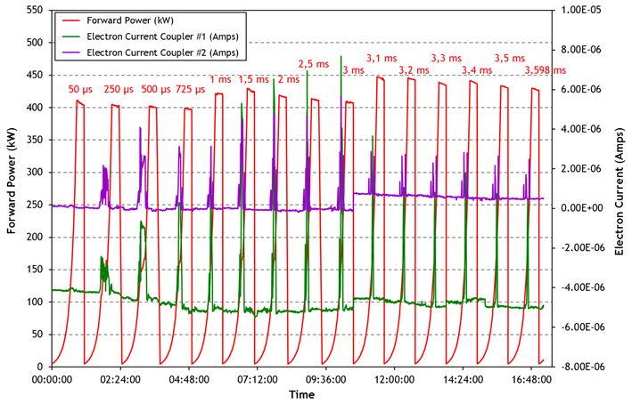
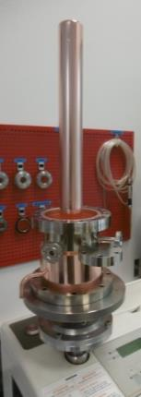
IPNO - Spoke Power Couplers
Validate with RF conditioning of two pre-series power couplers with 3.6 ms pulse length at 14 Hz, up to
420kW in travelling wave mode
120kW in standing wave mode

Slide 15

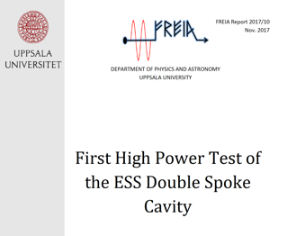
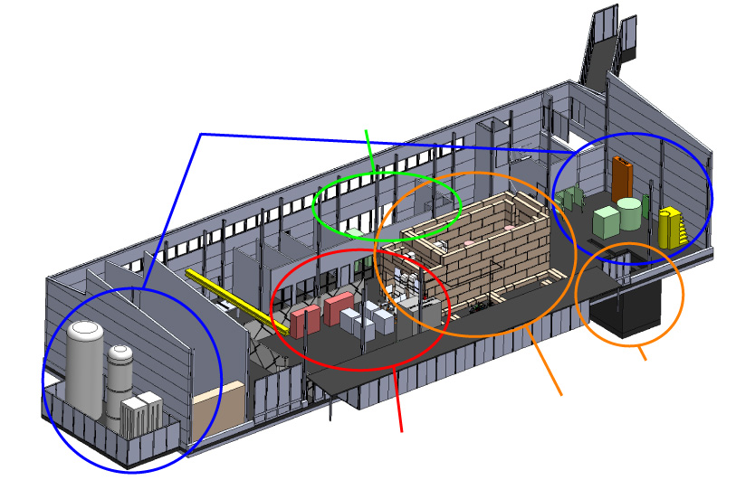
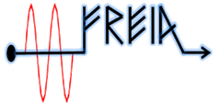
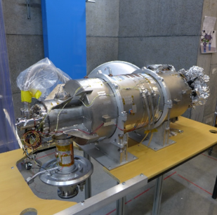
UU - FREIA Infrastructure for Spokes
Several Spoke prototypes tested in HNOSS
Preparation of HB validation test (>March)
Preparation of Spoke Prototype test (>May)
State-of-the-art Equipment
cryogenics
- liquid helium
- liquid nitrogen
control room
- equipment controls
- data acquisition
Romea in HNOSS
HB package at FREIA
vertical cryostat
3 bunkers
with test stands
horizontal cryostat
radio-frequency (RF) power sources

Slide 16
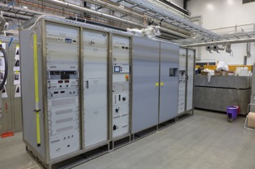
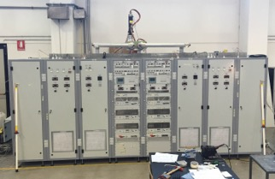
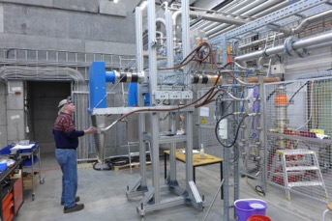
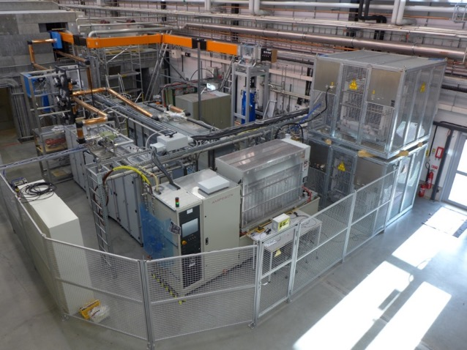
UU - High Power RF Amplifiers
704 MHz Klystron
(for validation of HB package)
1.1 MW, 3 ms, 14 Hz
  PPT modulator (on loan ESS)
  Toshiba klystron (on loan ESS)
352 MHz Tetrodes
(for Spokes)
2x 400 kW, 3.5 ms,
14-28 Hz
  combined output 2 tetrodes TH595

Slide 17
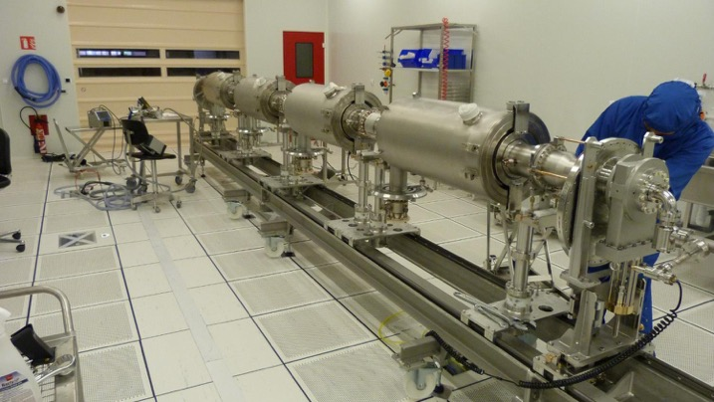
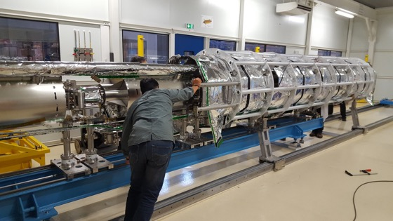




CEA – MB Prototype Cryomodule
March 2017
May 2017
July 2017
Assembly in ISO4 CEA CR
4 medium β 6 cell elliptical SRF cavities (1 LASA/3 CEA)
Cooldown at CEA test stand in Sept 2017
  No RF operation due to accidental rupture of coupler ceramic
10 couplers at nominal specs

Slide 18

CEA – M-ECCTD preparation
Cavities reprocessed successfully after accident
  String assembly started (3 cavities equipped with couplers)
  High power testing at CEA by July 2018
  At TS2/ESS at end of July
M-ECCTD (2), i.e. Phoenix
OK!

Slide 19



INFN - LASA MB Vertical Test-stand
INFN Medium-β cavities to be tested at DESY
  in the AMTF infrastructure, insert for two cavities
LASA MB test-stand for prototype validation
  single cavity insert, 4 m x Ø 0.7 m
  w or w/o helium tank
  refurbishment during Summer 2018
    decrease residual magnetic field < 8mG
  down to 1.6 K
    50W at 2K
  650W RF
Second Sound Sensors
Fast Thermometry

Slide 20





INFN – Series Components
2 out of 3 Nb batches received, last in May
Production started at vendor
  First two cavities ready for vertical test at end July 2018
  6 cavities for M1 expected at beginning of October 2018
  2 cavities every 3 weeks in steady state (or higher rate)
  Last cavity pair available for M9 September 2019
Nb inspection
Eddy current scanning
Deep drawing test

Slide 21





STFC - High-β Vertical Test-stand
Dimensions: 3650mm x Ø 1692mm internal
  3 ESS cavities, beam axis horizontal
  LHe only in cavity helium tanks
  2 inserts fabricated
Commissioning schedule
  Q1 2018: Final installation
  Q2 2018: Start of commissioning
  Q4 2018: Benchmarking
  2019: Ready for qualification testing
Modular cleanrooms being assembled for ISO 4 connections to the cavity. End of March 2018
Top of cryostat and 2 K box

Slide 22
STFC – Series Components
1 out of 5 Nb batches received, all by end of 2018
  ECS at DESY 67 Discs scanned, 59 accepted single side, 8 discs scanned on both sides. 1 disc required further investigation, as of 2/03/18.
  2nd Batch inspected w/c 19th March, 202 Discs produced awaiting QA/QC reports.
Call for tender for cavity construction closed 19th March,
  STFC Panel started review phase
  Commencement of contract to winning bidder in April 2018
Planned flow (reassessment at kickoff)
  First four cavities ready for qualification at end Feb 2019
  8 cavities for H1 expected at beginning of October 2019
  Last cavity pair available for H21 May 2021

Slide 23



ESS - Cryomodule Test Stand 2 (Lund)
Uses contingency part of the klystron gallery
Provide the facilities for the SAT of the elliptical cavity cryomodules and preparing installation in the tunnel
  SRF Testing in SRF Section Scope
  Involvement of IFJ-PAN for tests
  in discussion
Preparation ongoing
  klystrons & electronics ok
  modulator in place
  waiting for bunker
  Test program being defined

Slide 24
ESS – Gearing up SRF activities
Equipped an SRF Laboratory at ESS for the preparation of Hardware/Software tools
  Acquired test instrumentation for SAT and TS2 activities
  Elliptical 5 Cell beta=0.47 cavity on loan from INFN as RF mockup
Proposal to involve IFJ-PAN
in SRF Test plan at TS2
included in the re-baseline
of the installation plan
“hands-on” SRF expertise
consolidation in advance of the component

Slide 25





Rastering system
Current density on beam-entrance window
2 Magnets
Cables
2 Power Supplies
Two pre-series magnets manufactured at Danfysik. Tests in progress at Aarhus University.
Girder/Support
Termination box
Ceramic chamber
(not installed here)

Slide 26





Gamma Blockers
Enable maintenance of accelerator components by blocking gamma radiation from target and tuning beam dump.
Contribution from NCBJ, Świerk.
DmpL
44.5 kg
Ø375mm
50mm thick
312mm travel
A2T
gamma blocker
Dump-line gamma blocker
Stepper motor
Limit Switches
Bellows
Actuator mechanism
Vacuum chamber
Core (inside)
A2T
50.5 kg
Ø200mm
200mm thick
180mm travel
Stand/Support

Slide 27
Some Remaining Challenges at ESS
Synchronise and consolidate installation plan between different projects and WPs with dependencies.
Continue work on structure/organisation and procedures for test, commissioning and initial operation.
Ramp up the hands-on activities on components received from in kind partners, with the aim of reducing learning time (in particular for SRF)
  ‘Proactive’ approach vs passive ‘Waiting for instructions’
  E.g. installation and SAT tooling and instrumentation
Fully understand design intent of all main subcomponents
  Be prepared for spotting NCR and handling fast decision process
Transfer, adapt and properly document design, turn-on and operating procedures
  Take ownership at ESS

Slide 28
Contributors
Front-End & Magnets
Edgar Sargsyan
Richard Bebb
Georg Hulla
Janet Schmidt
Øystein Midttun
Frank Hellström
Teams from
INFN Catania
CEA Saclay
ESS-Bilbao
INFN Legnaro
Elettra
Superconducting RF
Paolo Pierini
Christine Darve
Cecilia Maiano
Felix Schlander
Nuno Elias
Saeid Pirani
Fredrik Håkansson
Teams from
IPN Orsay
Uppsala University
INFN Milan
STFC Daresbury Lab
CEA Saclay
Linac Group WP6
Iñigo Alonso
Teams from
Aarhus University
NCBJ, Świerk
Collaborations with
DESY, Hamburg
GSI, Darmstadt
CERN

