Slide 1

Target Charge and Agenda
of the 17th TAC meeting
11-13 April 2018, Lund
Mark Anthony
https://indico.esss.lu.se/event/985

Slide 2
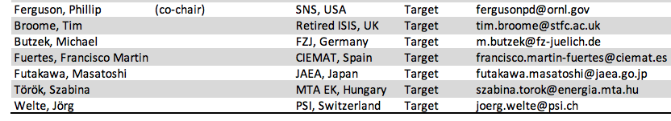
T-TAC Members

Slide 3
Questions to the TAC for its 17th meeting
- Target (1/2)-
t1) Concerning Process controls and joint plan with ICS:
Is there a clear integration strategy that accounts for installation, verification and validation of the integrated system?
Do integration plans have specific margins and a flexible approach in order to control progress and handle unforeseen events?
Are integration activities planned and performed at an appropriate level of detail?
Are the available people, tools and procedures sufficient and appropriate to support the foreseen integration activities?
t2) Concerning Target monolith and instrument bunker interface:
Does the design satisfy the functional and performance requirements?
Are the Radiological Safety Aspects adequately addressed?
Are the Operation and Maintenance sequences for Port Inserts adequate?
t3) Concerning Waste management and the Active Cells Facility:
Is the ESS approach to waste management robust and thorough
Is the current division of responsibility sound?
Do you recommend changing some interfaces?
Would a change of interfaces now save/cost money/schedule?

Slide 4
Questions to the TAC for its 17th meeting
- Target (2/2) -
t4) Concerning Worker Radiation Safety Strategy and Policy:
Is the current strategy and policy for worker radiation safety appropriate and reasonable?
Is the risk matrix for radiation hazards for workers in reasonable balance to other conventional hazards?
Are the defined dose limits for workers appropriate?
Are the ESS General Safety Objectives, classification methodology for disciplines, PSAR coherent with regards to worker safety?
t5) Concerning TOAST experimental results and impact on licensing:
Is the response to the higher ARF adequately addressed?
Are the changes to AA3 sufficiently supported and justified?
Are the existing SSC’s being credited properly?
t6) Concerning Helium filter:
Does the helium filter design seem adequate?
Is the approach for remote maintenance of helium filters sound and appropriate?

Slide 5
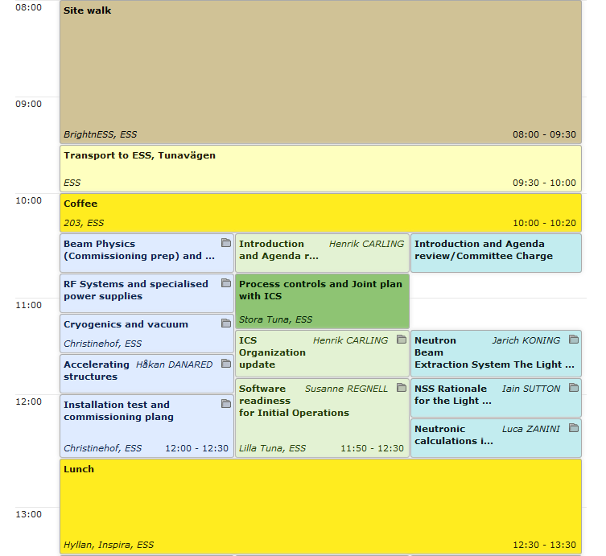
Agenda TAC#17
Thursday 12 April 2018 (am)

Slide 6
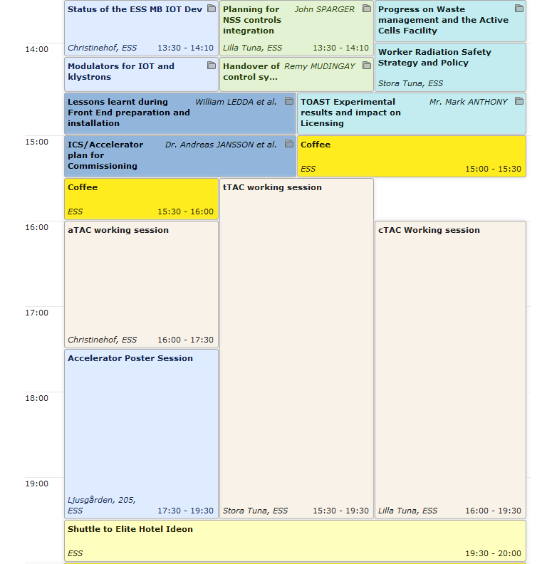
Agenda TAC#17
Thursday 12 April 2018 (pm)

Slide 7
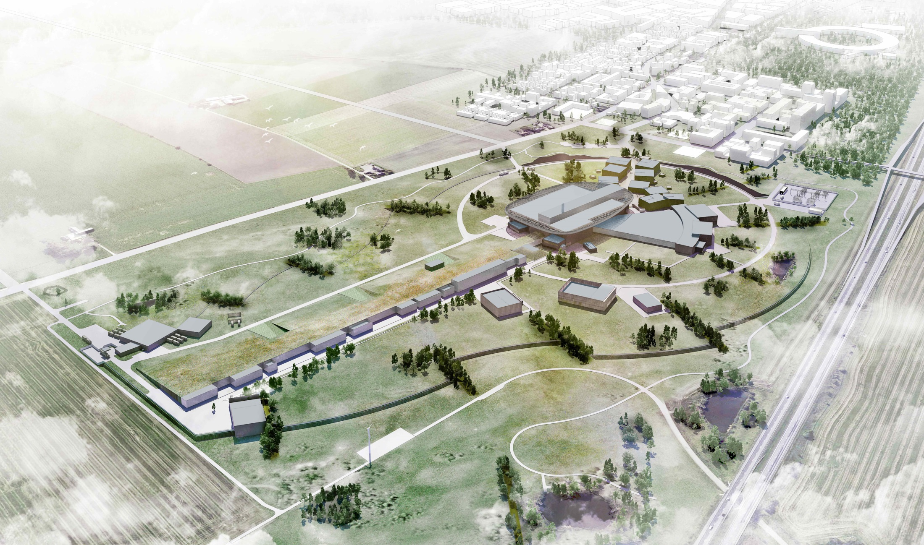
Thank you for being here.
We look forward to your advice!

