Slide 1
Software readiness for transfer to Initial Operations
Susanne Regnell
Group leader, Control system software
ESS/ICS
Date: 2018-04-12

Slide 2
Software readiness for transfer into Initial Operations
Overview
Group structure
Strategy
Competence plan
Areas of functionality
Allocation
Controls Configuration Applications
Control System Studio and applications
Maintenance, User support and Ways-of-working
2

Slide 3
Software readiness for transfer into Initial Operations
Current group structure
Control System Software Services Group
Susanne Regnell Group Leader, Work package manager (2015-11)
Software - work package 03
Banafsheh Hajinasab (Software Engineer, 2017-12) - resigned
Claudio Rosati (Software Engineer, 2016-06)
Fredrik Söderberg (Software Engineer, 2017-09)
Georg Weiss (Software Engineer, 2017-11)
Jan-Åke Persson (Senior Software Engineer, 2017-01)
Karin Rathsman (Software Engineer, 2010-07)
Temporary contract
Dirk Nordt (GUI Engineer, 2018-01)
Consultants (1,5 FTE:s):
Sunil Sah (Software Engineer, 2014-06)
Marcel Salmic (Software Engineer, 2017)
Parental leave 2018:
Ricardo Fernandes (Software Engineer, 2014-10)
Open position:
Software Engineer/developer (replacing Banafsheh)
Physics - work package 08
Emanuele Laface (Accelerator Physicist, WPM: 2017-12)
Juan E. Esteban Müller (Software Scientist, 2017-02)
Ben Folsom (PhD-student, dissertation in 2019)
Experiences from other facility:
Emanuele Laface CERN
Juan E. Esteban Müller CERN
Karin Rathsman Uppsala University, SLAC
Ricardo Fernandes ESRF, CERN, ALS
Goal: Build a flexible team, sharing and extending the different skill-sets.
For every area/application, at least two has the needed knowledge.
3
Notes:
What is missing? A senior engineer invested with the formal power to act as a software architect, working together with the ICS Chief Engineer.

Slide 4



Software readiness for transfer into Initial Operations
Strategy
Chose open source software used at other facilities when possible
  EPICS
  Control system studio (EPICS-clients for controlling the machine)
  OpenXAL (Framework for high-level Physics applications for orbit control)
Maintain ESS code branches for community applications
  Keep our own code up-to-date with contributions to the main, community, branch
  Collaborate with other facilities and contribute to development of common applications
Staged approach
  Start out with delivering basic, working, functionality
  Continue working on both ESS and community applications
  Continously evaluate and plan potential upgrades of releases
Limit the amount of technologies
  Primary language for own development is Java
  Standardize frameworks and databases as far as possible
Training and support
  Develop training to support our users
4

Slide 5

Software readiness for transfer into Initial Operations
Competence plan
Visit other facilities (PSI, CERN, SNS, Diamond Light Source)
  Many of the employees have no research facility background
  Validation of Software components
EPICS Community
  Participate in EPICS Collaboration meetings
  Participate in EPICS Core Developers meetings
On the job training
  Interacting with / supporting users
  Maintaining the code, fixing bugs
  Re-factoring and/or continued development of the applications
Share expertise and knowledge in the group
  Group members share their knowledge on specific technologies
  Group members share newly acquired knowledge
  Bring in outside experts for training purposes
k
5

Slide 6
Software readiness for transfer into Initial Operations
Four areas of functionality
1. OpenXAL framework and online model
Support, development, maintenance and training
2. CS-studio framework and display builder
Support, maintenance development and training
3. Applications, work ongoing
CS-studio-plugins
Calibration Service Application; development ongoing
Controls Configuration applications (CCDB, CDB, IOC Factory, Naming Service, Role Based Access Control); support, development, maintenance and training
Logbook
EPICS7 Core development (outsourced service contract)
  4. Work not started
  Post Mortem Application
  Operation Sequencer
  Software interlock system
Physics,
with 2 employees and one PhD-student
CS-studio,
with 2 employees
Applications,
with 6 employees, 1,5 contractors, inkind project
Not started,
Applications resources needed
k
6
Notes:
Software is never ”done”.
You cannot stop maintaining the code, as you continously, at least to some extent, need to update dependencies as old software gets deprecated and no longer supported by any community.
Also, as the surrounding world evolves, additional functionality is requested, new bugs are found, and need to be fixed.
Resourcing is tight;
We have not taken the applications where work is not yet started into account in this table.
Nor do we have room for any *major* development for any of the applications listed in the table except for the Calibration Service.

Slide 7
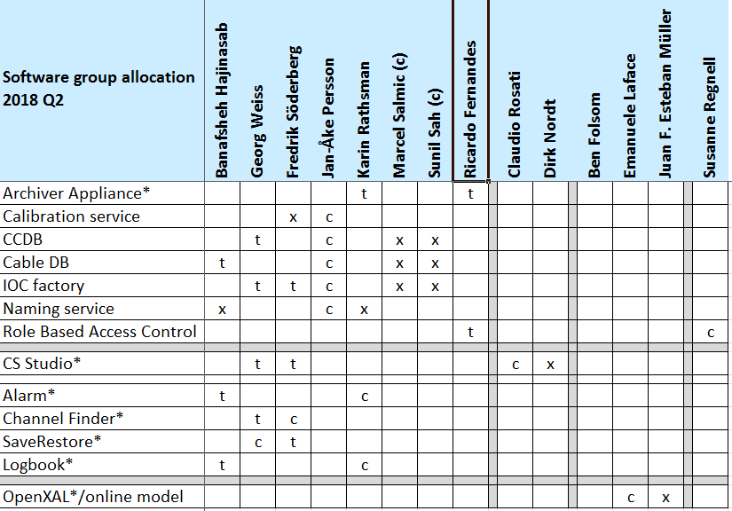
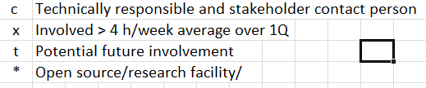
Software readiness for transfer into Initial Operations
Allocation (current and future)
7
Notes:
Resourcing is tight;
We have not taken the applications where work is not yet started into account in this table.
Nor do we have room for any *major* development for any of the applications listed in the table except for the Calibration Service.

Slide 8
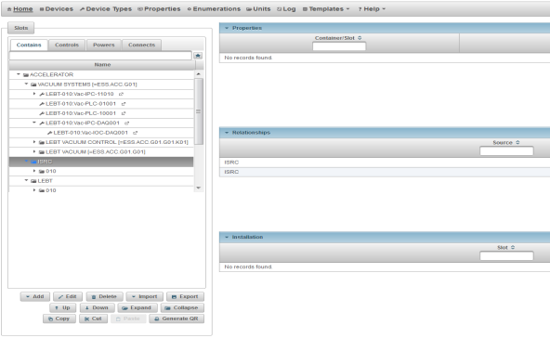
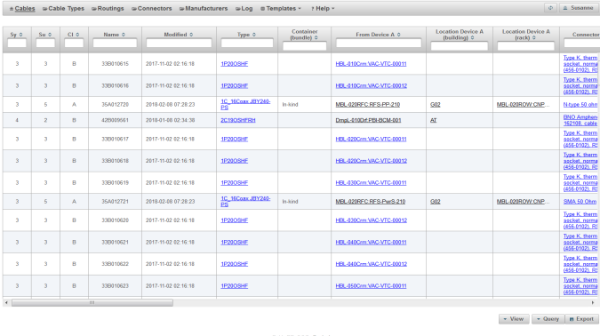
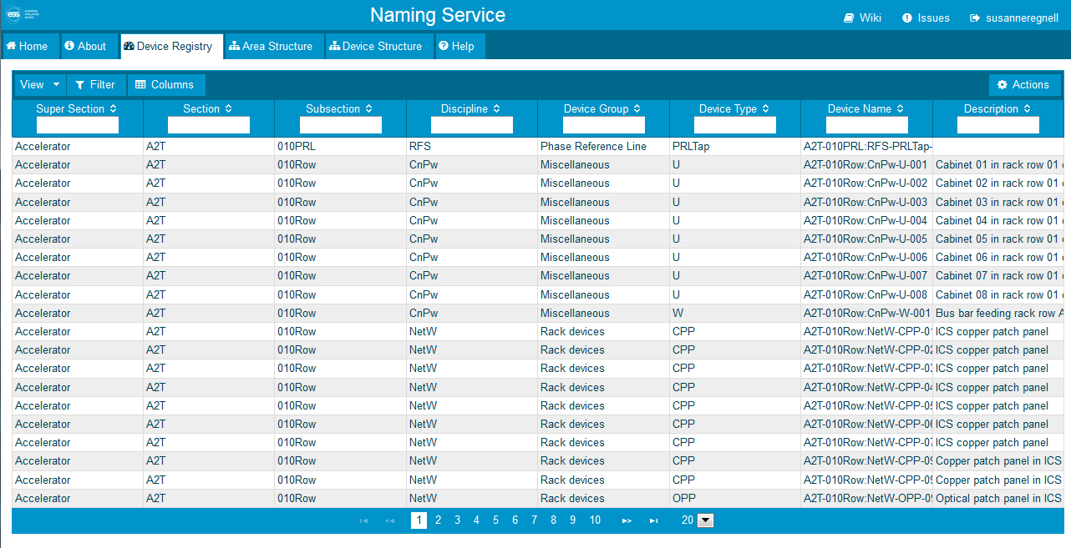
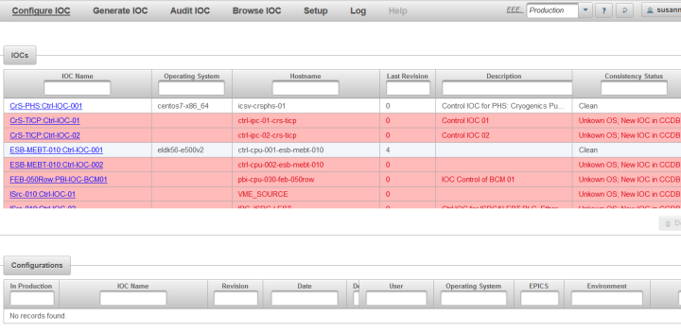
Software readiness for transfer into Initial Operations
Controls Configuration applications
Controls Configuration Database (CCDB) – in production*
  A model of the control system
  Stores all devices and how they are related
Cable Database (CDB) – in production*
  Stores all cables, serves as installation support
Naming Service (NS) – in production*
  Enforces the ESS Naming Convention of naming devices
  Integrated with ESS standard lifecycle management system
IOC Factory – in production*
  Automates creation of EPICS start-up scripts
Calibration Service – under development
  Measurement database and IOC calibration service
  * In production means that application has users populating the databases with ESS specific information.
k
8
Notes:
Webapplications
RBAC, Role Based Access Control are not on this slide, as it currently controls application accesss only in this realm

Slide 9
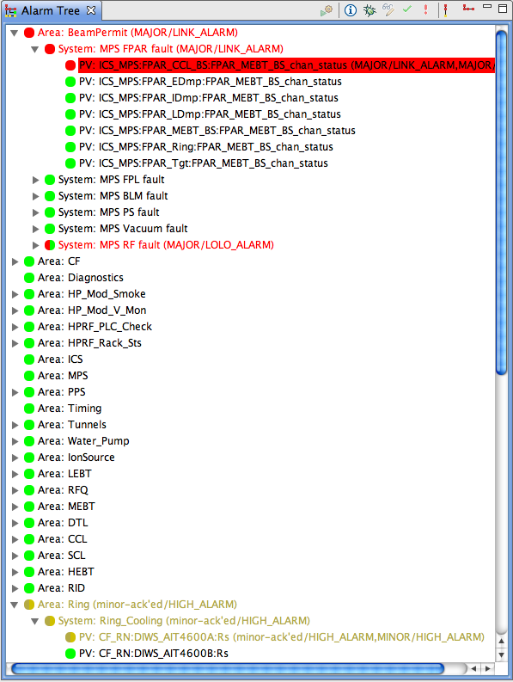
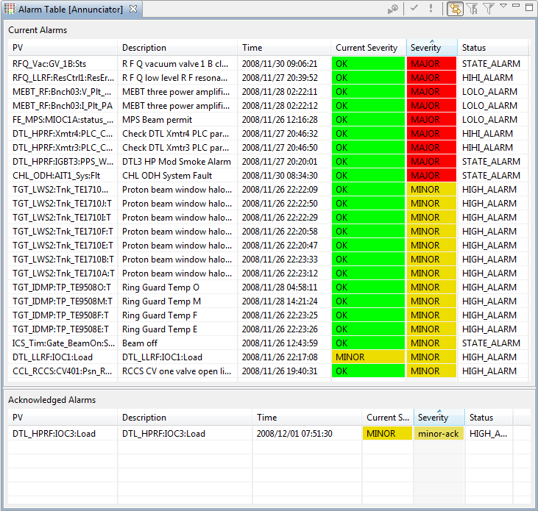
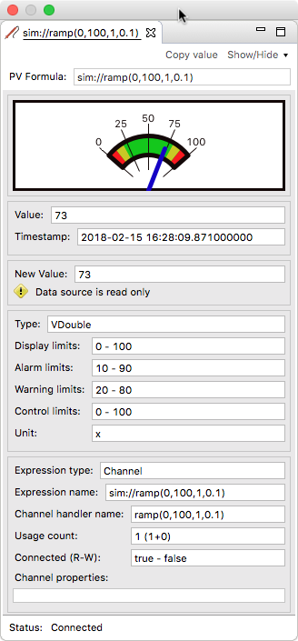
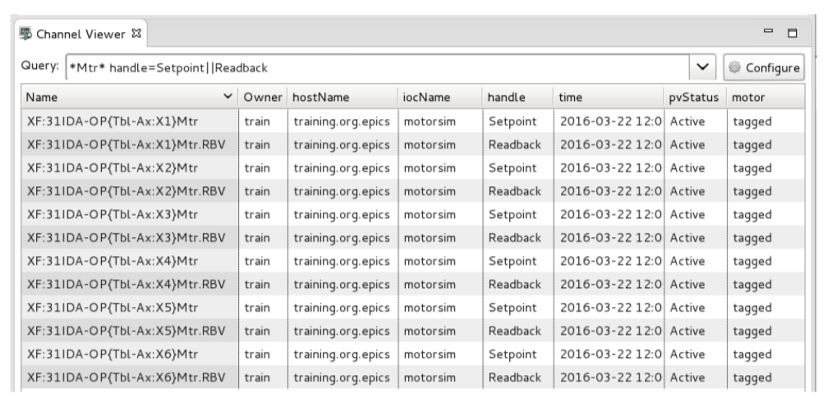
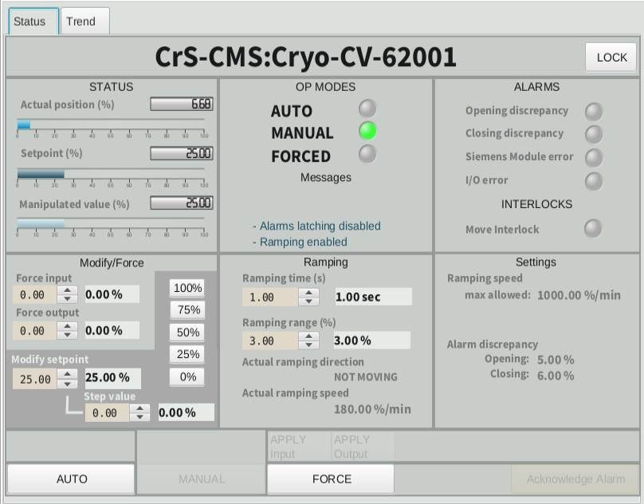
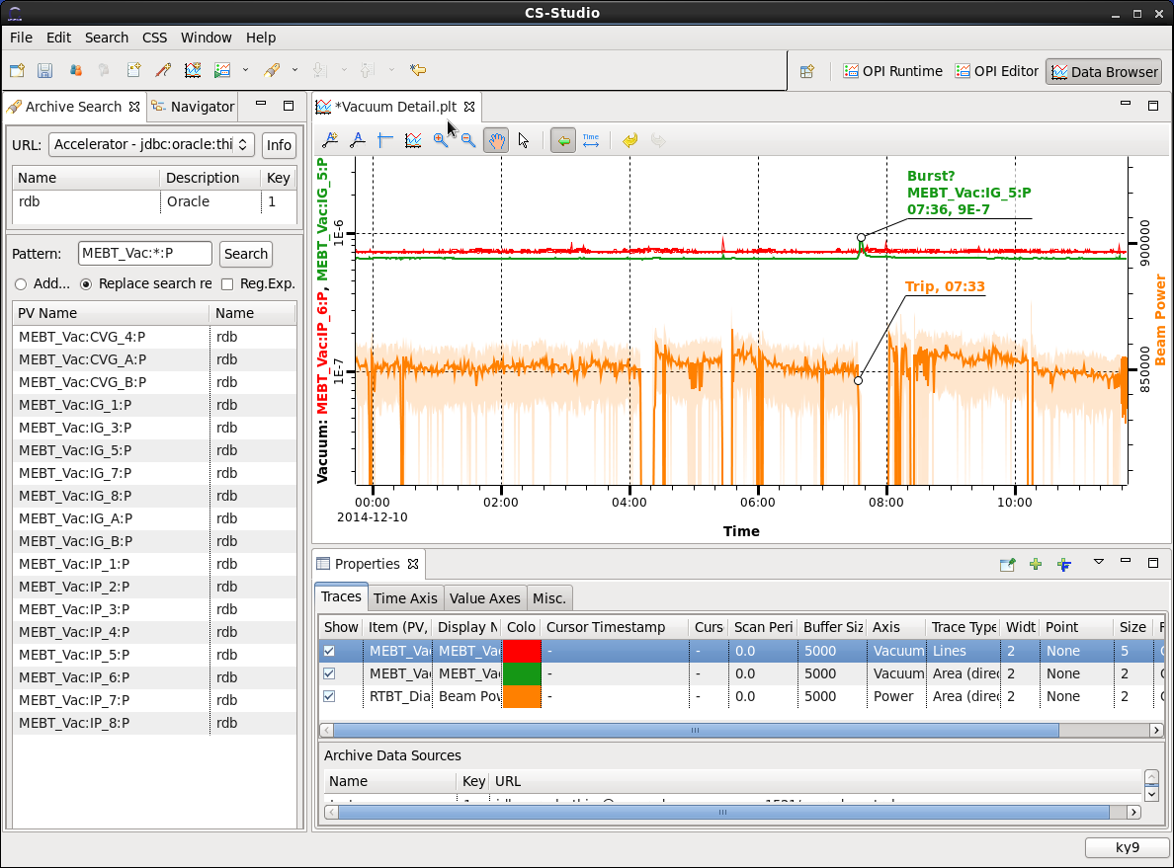
Software readiness for transfer into Initial Operations
Control System Studio
CS-Studio Display Builder – in production*
  Tool to construct Operator Interface Screens
CS-Studio Data Browser – in production*
  Tool to view PV-data, live or archived
CS-Studio Data Probe – in production*
  Tool to monitor single PVs
CS-Studio Alarms Service (BEAST) – in production*
  Tool displaying the alarms produced by the EPICS Alarm handler (ALH)
CS-Studio; Channel Finder – in production*
  Tool to locate the channel that connects to the IOC that controls the PV you want to access.
CS-Studio; Save and Restore – in production*
  Tool to store a selected set of PV-settings and restore them.
* In production means that the application has been tested in the local control room when we go into initial operations.
9
Notes:
CS-Studio is a framework based on Eclipse RCP, containing a number of operational tools.

Slide 10
Software readiness for transfer into Initial Operations
Other Applications
Logbook (Elog)
  Long term we will migrate to CS-Studio Olog, but as Olog need to be further developed and we needed a logbook immediately Elog (PSI, MAX IV) was chosen.
Role Based Access Control
  Webapplication currently used to control write access to the applications that are not connected to EPICS.
k
10

Slide 11
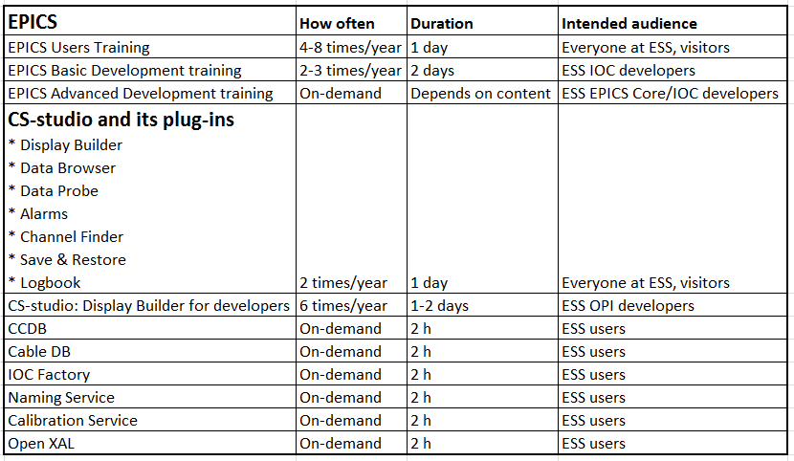
Software readiness for transfer into Initial Operations
Maintenance, user support and ways of working
Agile ways-of-working (Scrum and Kanban)
  All issues tracked in Jira issue tool
  Requirements collected from stakeholders/users (prototyping, discussions, interviews)
  Feature requests and issues prioritised in a backlog or in Kanban workflows
  Setting up 2-4 week development sprints (Scrum)
  Automatic build and test
User support/helpdesk
  Users are reporting their issues in the appropriate Jira Helpdesk
Training
  Training is being developed for users to use our applications
Release management
  Ambition is to have a working system ready to be deployed after each sprint (iteration)
  Integrate and verify code often
Open questions/issues
  No plans for shift or on-call work in initial operations
11

Slide 12
Software readiness for transfer into Initial Operations
Summary
Is the selection of Software Components appropriate for transfer into Initial operations?
  We believe that we have most of the needed applications, and using a staged approach enables us to have applications available that need further development.
Is the plan for staff transfer into Initial operations consistent with the needs of our stakeholders in this phase?
  Resourcing is tight. Unclear today if the initial operations budget in the software group will allow to have any contractors.
Is there any software component missing that should be made available for the Initial operations phase?
  We believe that the initial work for Post mortem application and Operations Sequencer is needed, but currently not in plan.
Solutions?
  Carefully choose/prioritise what additional functionality to develop
  Carefully choose/prioritise when to upgrade and when not to upgrade underlying dependencies
  Carefully choose/prioritise what new technologies to bring in
  More resources or cut the scope?
k
12
Notes:
Many applications to develop and support, with a limited number of resources.

