Slide 1
Neutron Beam Extraction System
The Light Shutter System (LSS)
Jarich Koning, Mats Olsson, Bengt Jönsson, Lennart Åström, Sara Ghatnekar
www.europeanspallationsource.se
11 April, 2018

Slide 2
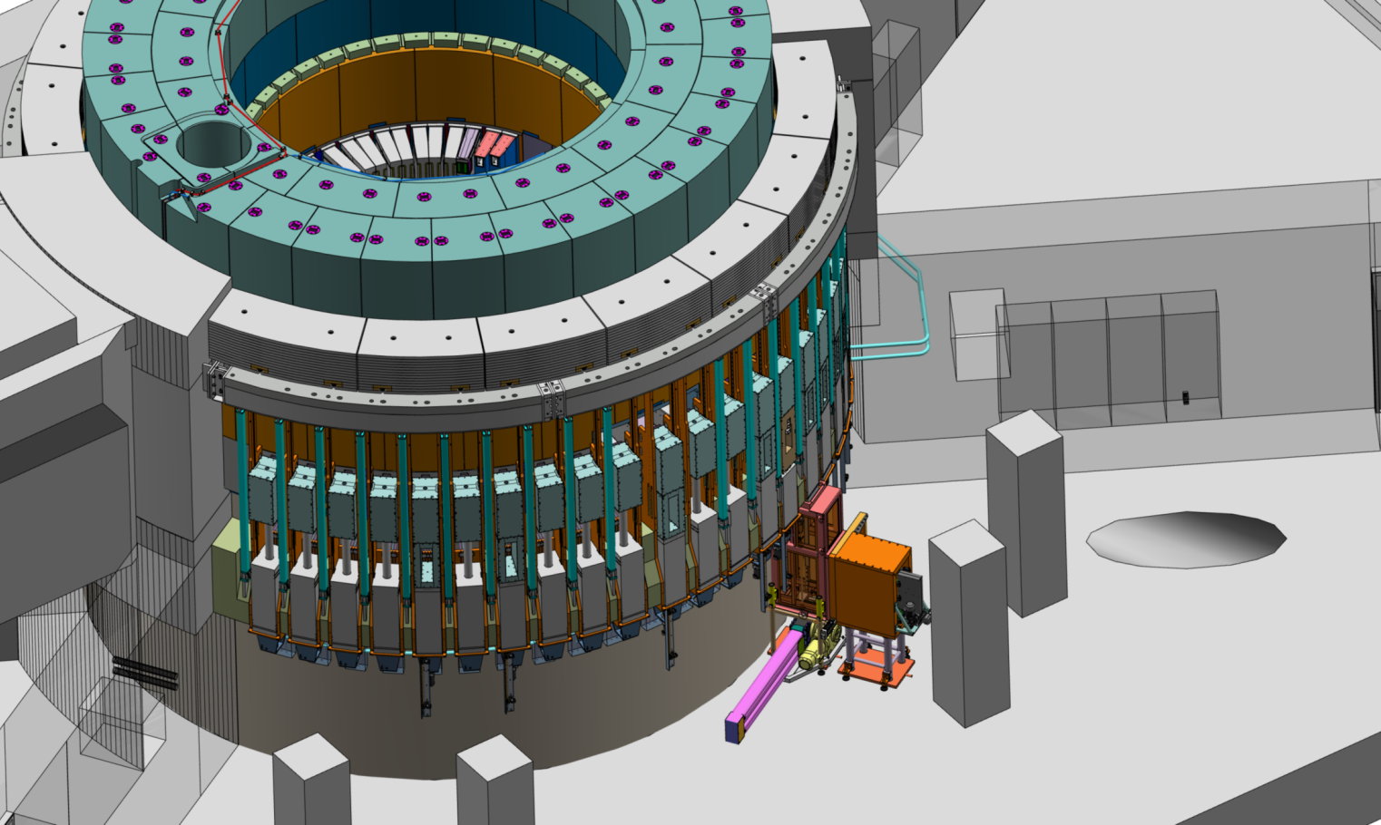
Table of Contents
Light shutter history
Functions & Requirements
Design overview
Bridge Beam Guide Optical Assembly Integration
Control concepts
Handling concepts

Slide 3
NBEX from TAC-15 to TAC-17
System overview was presented at TAC-15, the concepts are not changed, however:
  In-vessel guides needed protective helium atmosphere
  This caused to include two more windows (1 to 2mm each) on NPBI
  Sealing requirement made the design of NBPI much more complex
  And to add helium routing through NBW – copy of cooling line concept
  And to add helium conditioning system for which the specs were only recently acquired
  Furthermore much technical detailing undertaken
  Re-baselining schedule resulted in more realistic prototype-testing-final design-final procurement order
July 2017 NBEX was up for an interim-design review, where the committee endorsed the system concept
Dec 2017 parts of NBEX were up for CDR but found to be ready for prototyping (Insert Installation Tool, Neutron Beam Port Plug, Horizontal Test Stand)
April 2018 Light shutter concept internal review
The procurement of the Horizontal Test Stand is ongoing

Slide 4
Light Shutter System – some history
Selection of Baseline Shutter Configuration Concept (ESS-0016124 & ESS-0065434, Aug-2013):
“Viability of using horizontal access to in-monolith beamline components for maintaining, constructing and bringing new instruments on-line
Beam extraction design development leading to specification of:
  Number of beamlines
  Installation of in-monolith components at a rate that supports the instruments installation schedule goals
  Maintenance approach for beam line components, both in-monolith and outside, that support instrument availability goals
Optimization of light shutters addressing:
  Shutter configuration – location, size, and shape
  Shutter material composition
  Shutter actuation method and configuration”
✔
✔
✔
✔
✔
✔

Slide 5
Light Shutter System – considerations
Cross-functional working group on beam extraction 2013 – tasked by ESS management
History of light shutter - Selection of Baseline Shutter Configuration Concept (ESS-0016124 & ESS-0065434, 2013)
  Many goals relevant to a heavy shutter, some goals irrelevant to shutters in general (Appendix 1)
  Attenuation (p-beam on with light shutter closed) is listed but not allowed (yet) in current design.
  PSS not considered at all
  TDR design was light shutters, which is assessed and re-confirmed in these documents
  ESS-doc-279-v1 (stakeholder consultation) shows project vs operational aspect of different options contradicting.
Some considerations for the present-day design:
  LSS not compatible with ECHIR
  ECHIR basement structures will inhibit LSS for complete West sector
  LSS likely not compatible with N-Nbar

Slide 6
Light Shutter System function
Primary function:
  Gamma beam shutter during shutdown: shield open channel & shield open port
  (automatically) close at: PSS command / power loss / system failure
Secondary functions:
  Host 0.5m of beam guide: positioning & repeatability
  Maintenance compatible
  Low self-activation
  Optics switch
Constraints
  R5.5-R6m from TCS
  LVL91 (basement) to Z +1500mm
  Integrate with R6 bunker roof pillars
Design strategy
  Closing possible by gravity only
  Handling from LVL91 basement incl Monolith NBW
Notes:
50cm ~ 8x 10th layers, so 2kSv/h from Target Wheel gets to be 20μSv/h beyond the shutter – this is worst-case estimation, the calculated numbers are much lower and 40cm of mild steel thickness is enough
TD need shielding to be (automatically) closed during insert exchange

Slide 7
Light Shutter System requirements
NSS:
  Interested in open position(s) positioning, and shutdown shielding
  Absolute position (measured) and position repeatability (ballpark 50μm) of BBG
  @1 day @R11.5-R24m <25µSv/h (originating from NBEX)
  @3 days @R6-R11.5m <150µSv/h (originating from NBEX, contact or no-contact)
PSS:
  Interested in getting shutter closed, and keeping it closed
  LSS to keep shutter in front of beam port
  PSS use safety contactor to kill power to LSS -> shutters close then cannot move
  Sensing closed position by switches
MPS:
  Interested in shutter-open before P-beam on, and turn P-beam off at shutter-not-open
  Sensing open position by switches
ICS:
  Interested in managing LSS from ESS system perspective
  ICS manages LSS motion, LSS executes ICS commands
  State machine logic used
Notes:
Who is in control?
Who can command a change of state ?

Slide 8
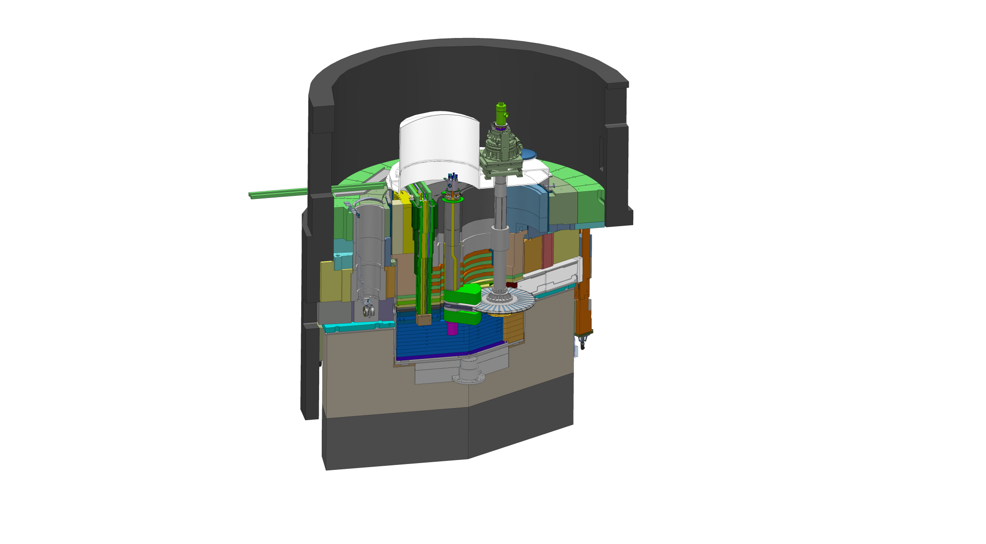
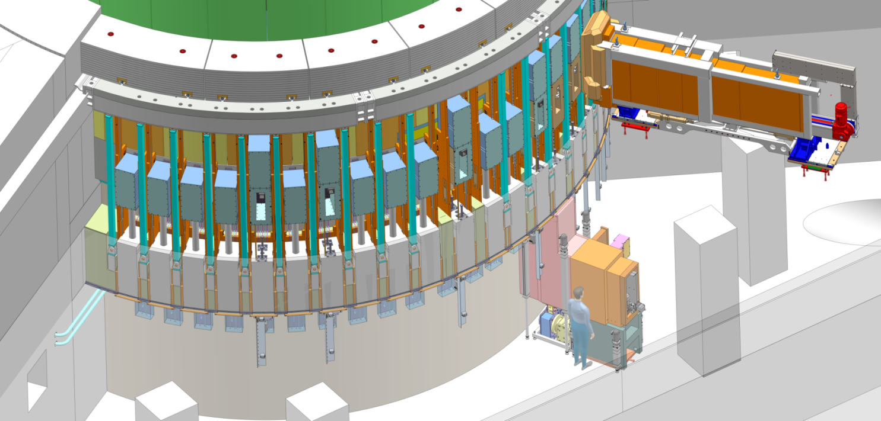
NBEX Neutron Beam Extraction System
GBS
BBG
MPS switches, servo location
PSS switches
Outside of Monolith and Monolith Basement, location of Light Shutter System (LSS)
In Monolith, location of Neutron Beam Port Insert
Notes:
GBS = Gamma Beam Shutter (the ‘shutter’ part of the light shutter)
BBG = Bridge Beam Guide (the beam-guide bearing part of the light shutter, bridging the in-monolith beam guides to the bunker beam guides)
PSS = Personnel Safety System
MPS = Machine Protection System

Slide 9
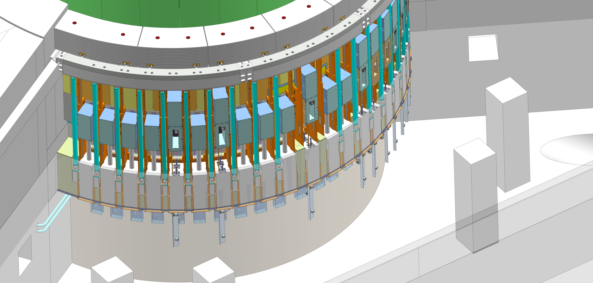
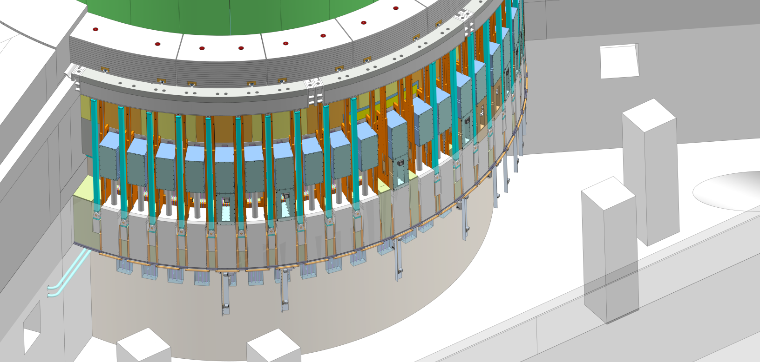
Shutters Opened -> Closed

Slide 10

NBEX overview
R6 bunker roof support pillars & beam
NBEX cabinets
D02.091.4003
Water lines
West sector
P-beam
North sector
Cable routing @R~7m
ECHIR beam dump
Light shutter tools
D02.091.4002/4004

Slide 11
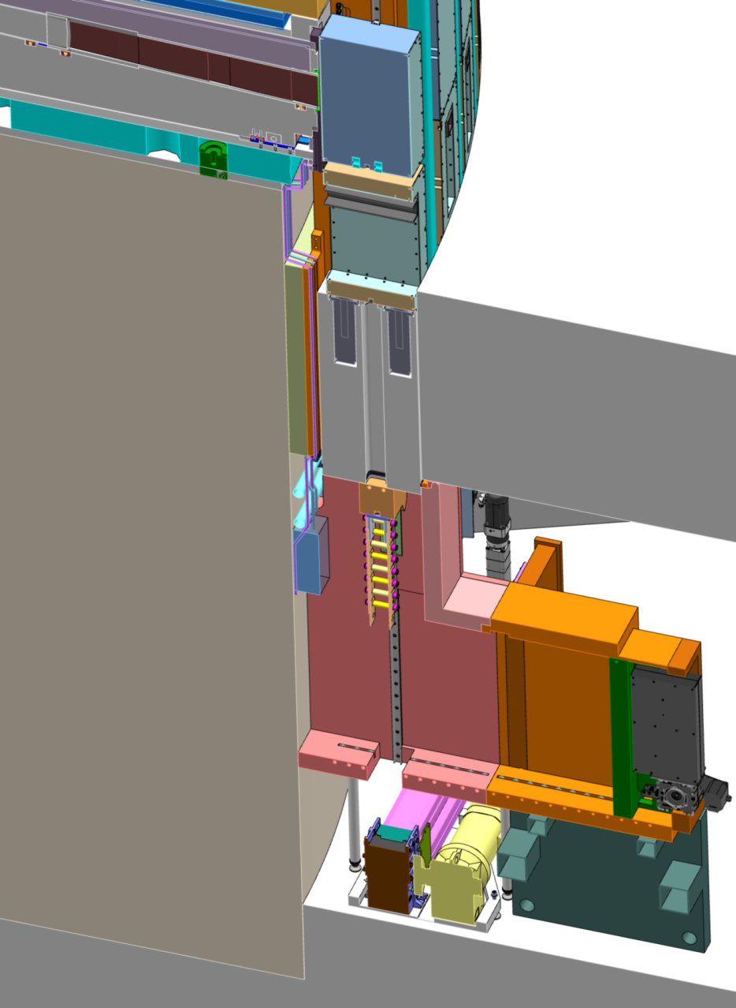
NBEX components
Neutron Beam Port Insert (NBPI):
  In monolith carrying optics.
Neutron Beam Port Plug (NBPP):
  In monolith plugging unused port.
Neutron Beam Window (NBW):
  Monolith/Bunker confinement barrier.
Light Shutter System (LSS):
  Shutter and parts facilitating beam transport outside the Monolith towards bunker area.
Test Stands (TS):
  Verify function of the system parts and tooling
  LSS (vertical handling) test stand
Cold Handling Tools (CHT):
  For first installation and handling of non-activated components.
Hot Handling Tools (HHT):
  For installation and handling of activated components.
NBPI/NBPP
GBS
LSS
NBW
BBG
Monolith
FFB
Bunker floor
Handling tooling
Situation at start of shutdown

Slide 12
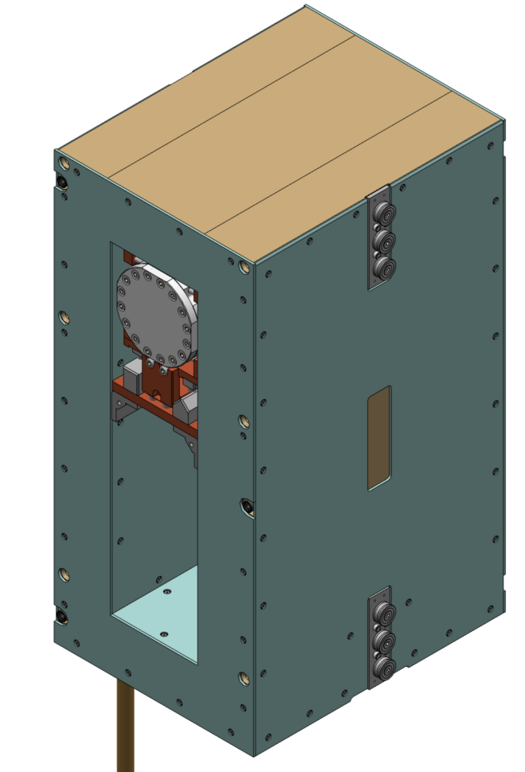
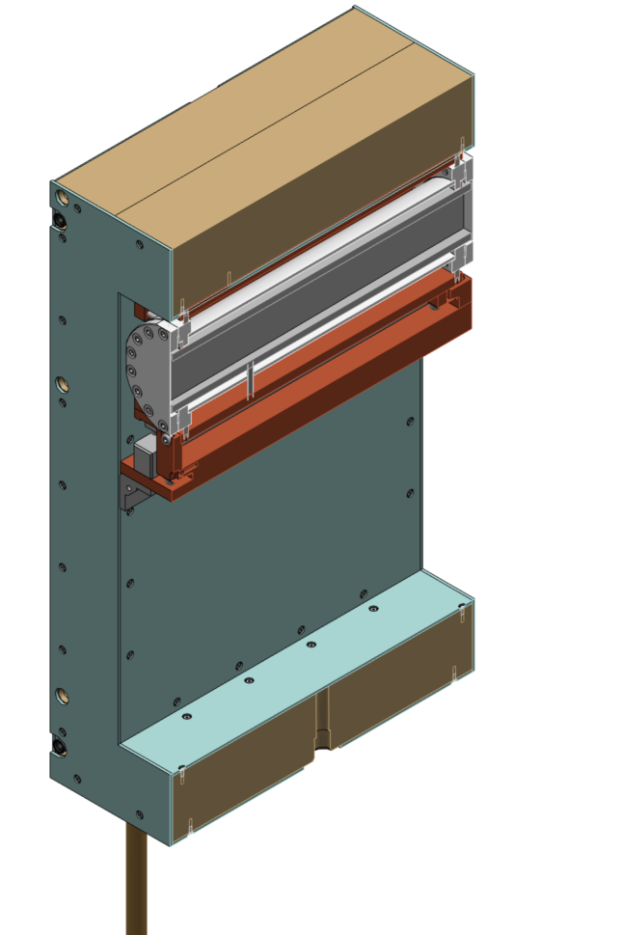
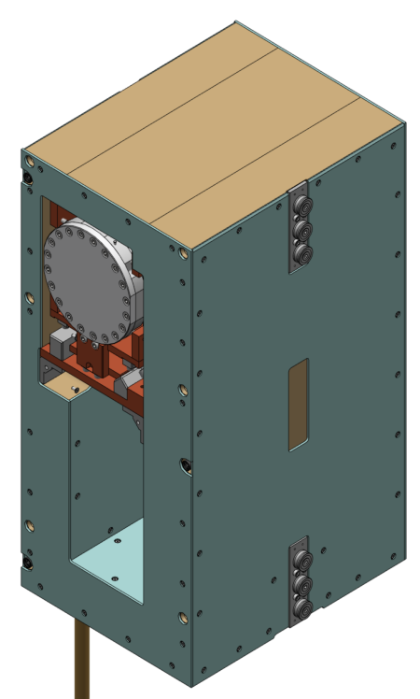
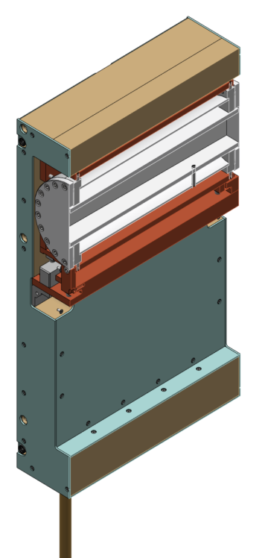
BBG – BBGOA integration
NSS (G. László) prepares tailored BBGOA designs and procures
Any volume cut and fastening points needed in BBG material will be provided by TD
Need on-site optical integration location
On-site transport and
installation have to
consider sensitivity
BBG Optical Assembly
BBG body parts
Beam guide
Example: BEER
Example: MIRACLES
Roller blocks
(1 on other side)
Permanent retro-reflectors visible from bunker
Boronated HDPE sheets
BBG cam rod

Slide 13
LSS control functions
Light Shutter open (up) / close (down)
  Per port one servo drive on the Vertical Actuator
  Ballscrew as actuator (85% backdriveability -> shutter will come down by gravity if no power)
  Default-disengaged brake on servo axis
  One overall PLC as controller (end-responsible)
  Same PLC is EPICS bridge
Light Shutter open-to-open position
  For 10s (and after getting MPS clearance) moving to new open position
  2 or 3 open positions defined for some shutters, instrument dependent
Light shutter adjust open X position setpoint Y
  Allow for ±0.5mm adjustment from mounted open position
Confirm open (MPS)
  Double switches on open position, wired to MPS PLC in NBEX cabinet
Confirm closed (PSS)
  Double (prefer dissimilar) switches on closed position, PSS wiring
Force and/or keep closed (PSS)
  PSS Safety contactor disabling power to drives and to brakes
  No power: brake disengages and gravity ensures shutter moving down to close
  UPS power to PLC and drive logic to manage downward motion and report status during power loss
  Employing back-EMF to manage downward motion is allowed

Slide 14
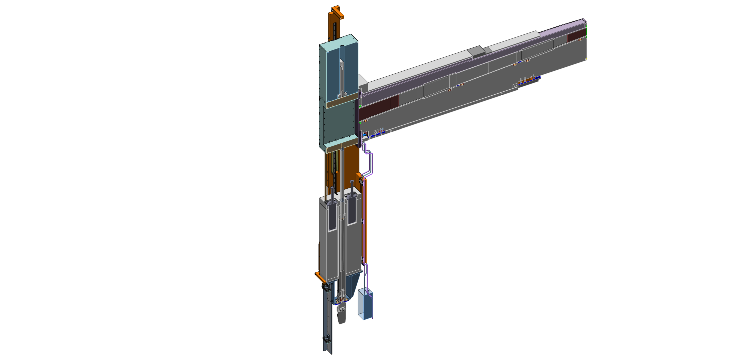
LSS control concept – Shutter open
NBEX cabinet(s)
GBS
Gamma Beam Shutter
Beckhoff
NBEX
PLC
831mm
Bridge Beam Guide
BBG
Local
HMI
Ballscrew
BBG Rod
Servo drive
Shock absorbers
Exported over network
Servo
Servo + resolver +brake
Servo limit switches
Siemens S7
@NBEX cabinet
MPS
PLC
BBG Cam
MPS switches
PSS switches
PSS

Slide 15
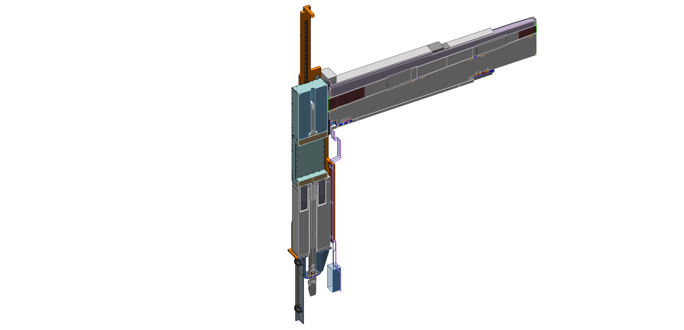
LSS control concept – Shutter closed
NBEX cabinet(s)
NBEX
PLC
GBS
Local
HMI
BBG
Servo drive
Servo
MPS
PLC
PSS

Slide 16
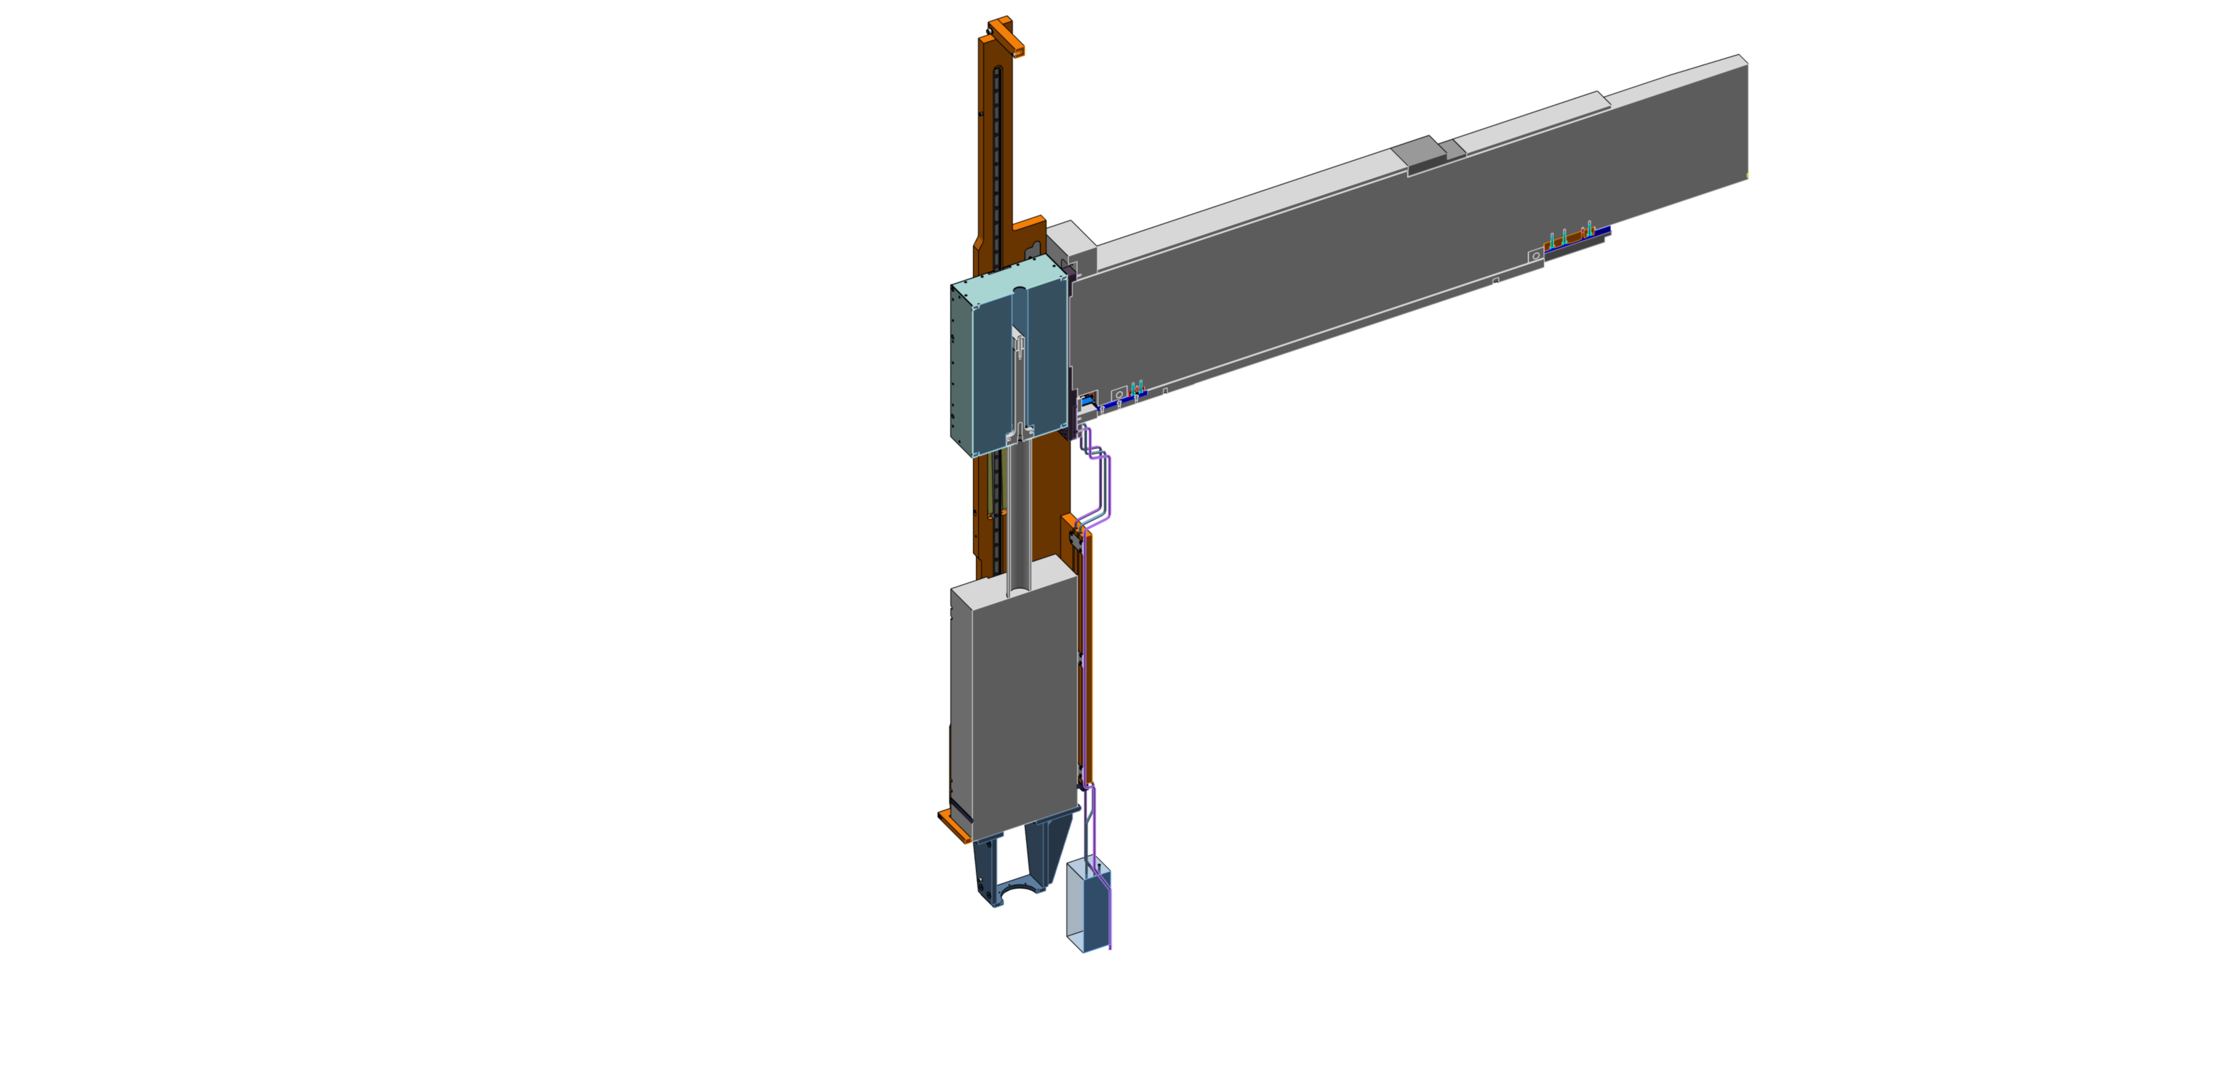
LSS control concept – Plugged port
NBEX cabinet(s)
NBEX
PLC
GBS
Local
HMI

Slide 17
LSS control concept - Optics Switch
NBEX cabinet(s)
GBS
NBEX
PLC
BBG
Local
HMI
Servo drive
Servo
MPS
PLC
PSS

Slide 18
LSS control concept – Multiple systems
NBEX cabinet(s)
GBS
GBS
GBS
GBS
NBEX
PLC
BBG
BBG
BBG
BBG
Local
HMI
Servo drives
Servo
Servo
Servo
Servo
MPS
PLC
PSS

Slide 19
LSS control concept - operational
Central command
GBS
HMIs
NBEX cabinet(s)
GBS
GBS
GBS
ESS state machine
Optic switch X
state machine
NBEX
PLC
Optics 1
state machine
BBG
Optics 1
state machine
BBG
Optics 1
state machine
BBG
BBG
EPICS
layer
Siemens PLC (Target)
Target station state machine
Servo drives
Servo
Servo
Monolith
state machine
Servo
Servo
NBEX
state machine
MPS
PLC
Beamline X
state machine
Beamline 1
state machine
Beamline 1
state machine
Beamline 1
state machine
PSS

Slide 20
LSS cabinet electrical layout
24VDC UPS-backup power for logic
PSS Safety contactor shuts down drives’ bus power
PLC fieldbus supplier picked
Dump resistors if supplier needs them
Bus voltage supplier picked
Brake-on fed by bus
power, not by UPS
NBEX
PLC
NBEX
cabinet(s)
Fieldbus
Dump resistors
Current
Servo
Servo drives
Sensing
Brake
Limits
EPICS CA
Bus voltage
MPS
PLC
MPS
Power convertors
2kW 24 VDC UPS
PSS safety contactor
100kW 380VAC
PSS

Slide 21

Bunker handling overview
Part I Close beam (controlled by PS system)
Gamma shutter lowered - First command, can force through power-off
PSS interlock on roof released
Part II Open roof (controlled by RP procedure)
Remove roof blocks
RP dose measurement
Install PSS access equipment (?)
Permission to access work zone granted
N
Notes:
Remove highly active components
Activity of monolith

Slide 22
NBEX components - handling
Through LSS vault:
Neutron Beam Window (NBW)
Bridge Beam Guide (BBG)
Gamma Beam Shutter (GBS)
Floor Filler Block (FFB)
Using:
NBW tools (4 block-shaped tools)
Lower Exchange Tool (LET)
Light Shutter Cask (LSC)
Lower Actuator Cart (LAC)
Along beamline (next slide):
Neutron Beam Port Insert (NBPI)
Neutron Beam Port Plug (NBPP)
Using:
Insert Exchange Tool (IET)
NBPI/NBPP
GBS
LSS
NBW
BBG
Monolith
FFB
Bunker floor
Exchange route NBW, GBS, BBG, FFB
Handling tooling
Exchange route
NBW
Situation at start of shutdown

Slide 23
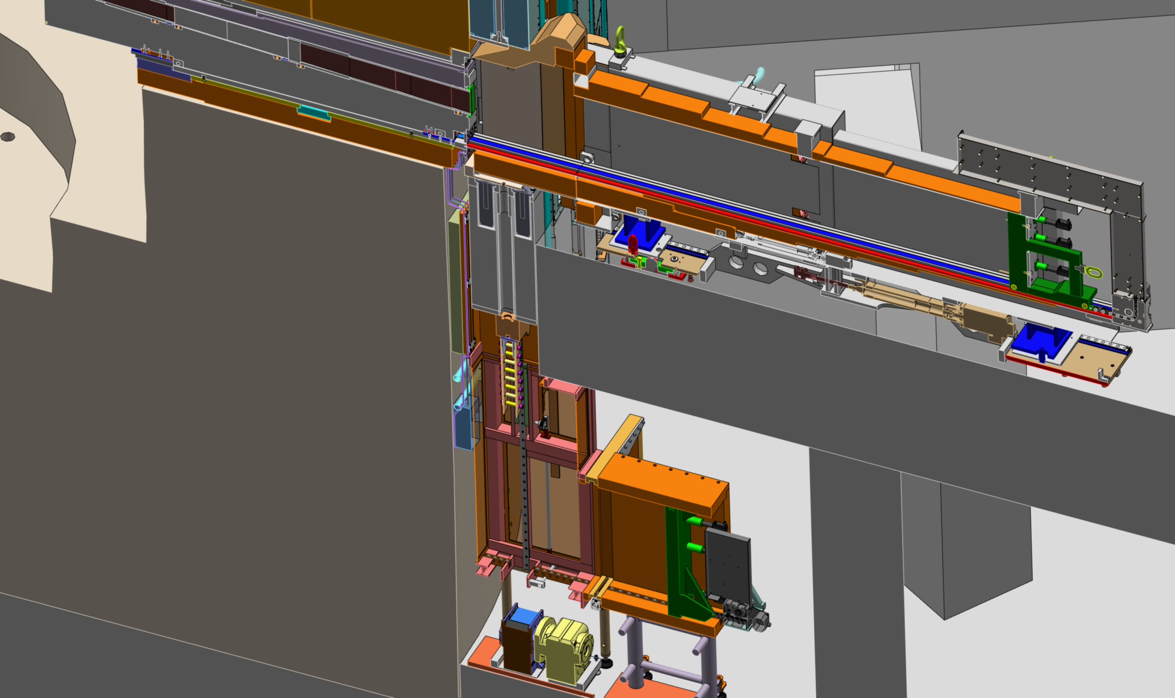
NBPI/NBPP exchange scenario
GBS pushed up by extra shielding
IET (Insert Exchange Tool)
NBPI
Extra shielding
Exchange route NBPI/NBPP
FFB pushed up by rigid chain actuator
LSC (Light Shutter Cask)
LET (Lower Exchange Tool)
LAC (Lower Actuator Cart)
Air pallets

Slide 24
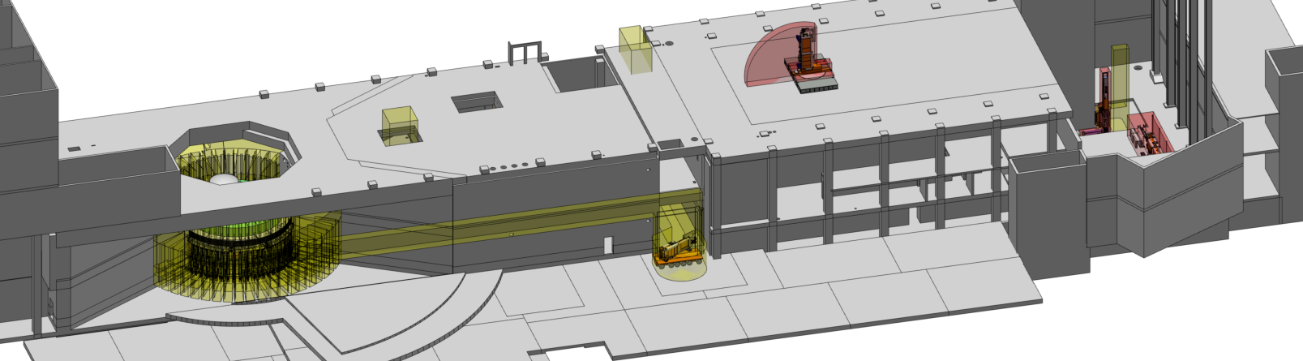
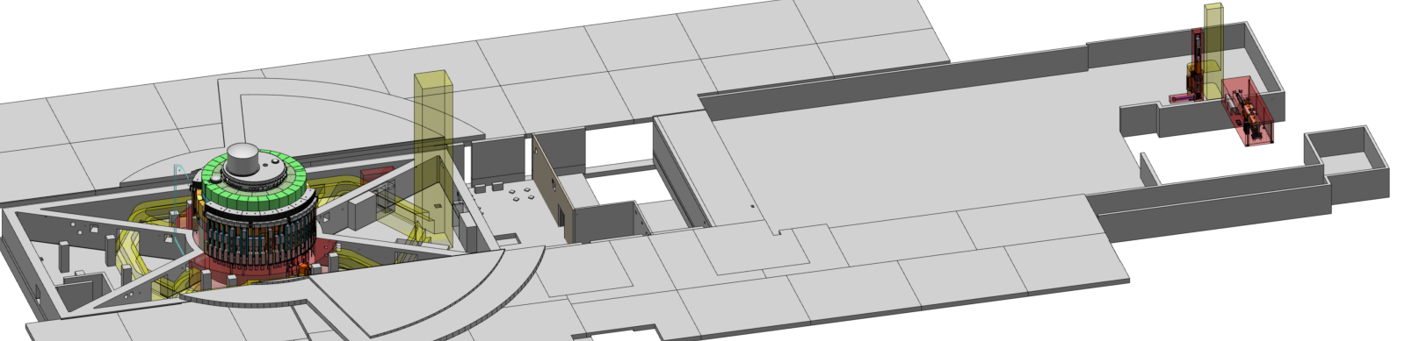
NBEX locations and transport
IET transport
ACF docking
IET handover on bunker roof from bunker crane to D01/D03 crane
Exchange route NBPI/NBPP
Vertical handling test stand
LSC transport
Horizontal handling test stand

Slide 25
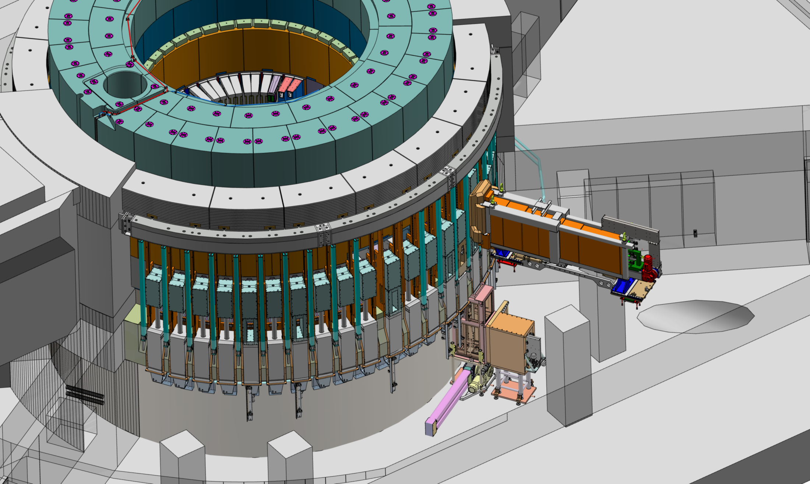
That’s all folks!

Slide 26
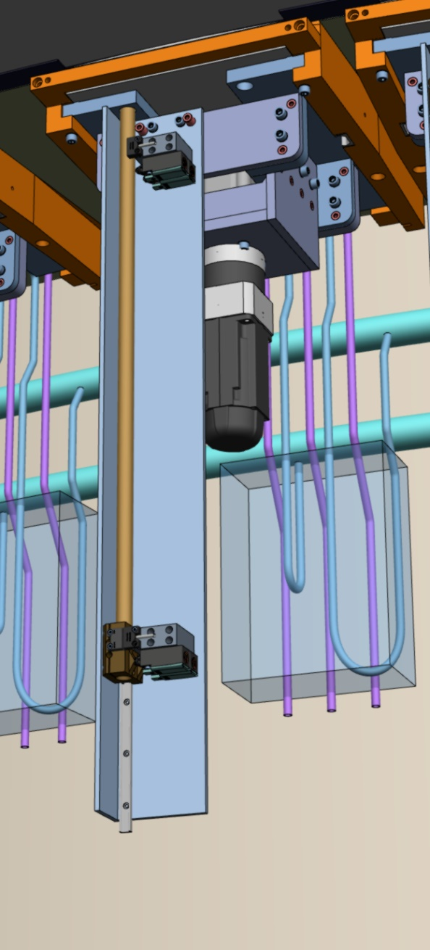
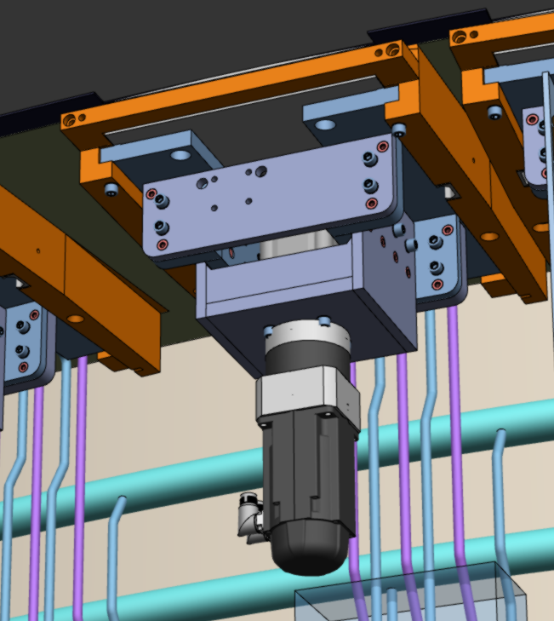
Ballscrew, servo, switches
831mm stroke nominal, 1031mm stroke for bi-spectral
Max 250mm/s, max 48kN, Ø40x10 spindle
7:1 gearing with 2.5kW servo. No power means disengaged brake
Back-driveability estimated at some 83%
Mounted on a frame which also supports all LSS blocks
Limit, protection and
safety switches mounted
on a switch profile
3 switches per position
Sensor: Resolver on servo
Index on resolver allows
to re-calibrate exact
position as offset from a
switch
Switch profile
LSS frame
Switch rod
Actuator frame
Switches
Gear
Cam block
Servo
Guide rail

Slide 27
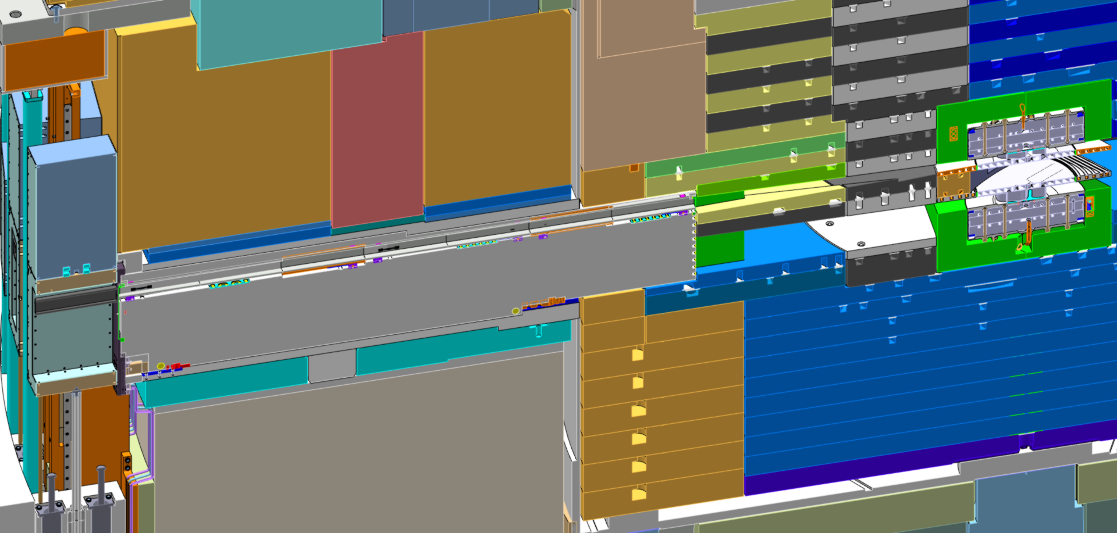
BBG-NBPI-Moderator

Slide 28
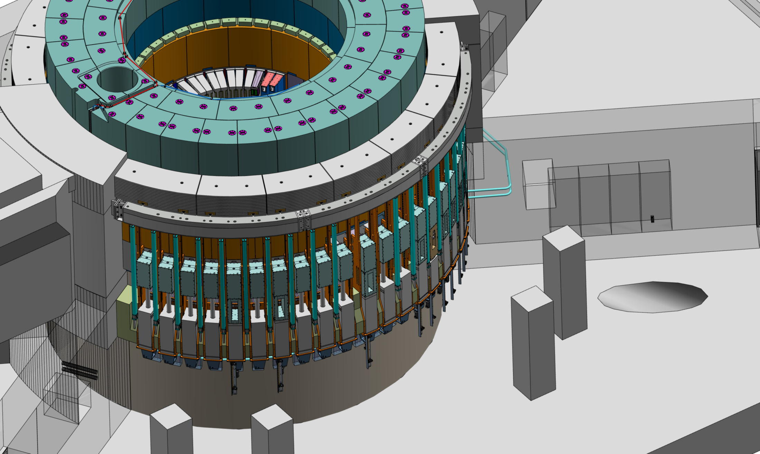
Operational - closed

