Slide 1
Status of the ESS MB IOT Developments
Review of the prototype test results
Comparisons of energy and cost between Klystrons and IOTs.
Dr Morten Jensen
RF Section Leader
www.europeanspallationsource.se
ESS TAC 11-13 April 2018

Slide 2
Agenda
RF requirements at ESS
Technology Options
Klystron Prototypes and Results
IOT Prototypes and Results
Energy Consumption and Energy cost comparison
Summary

Slide 3
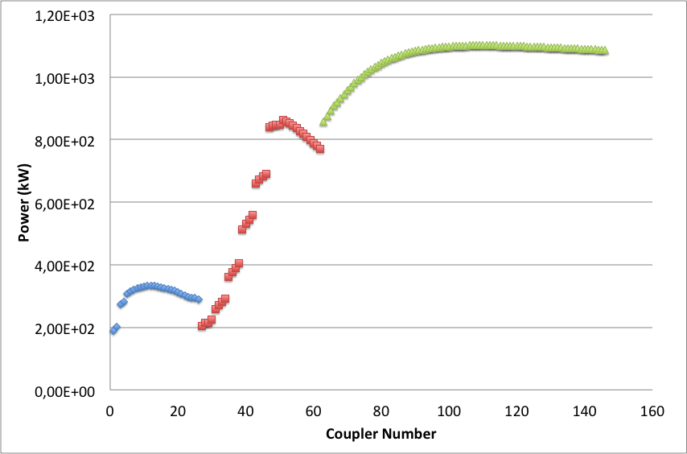
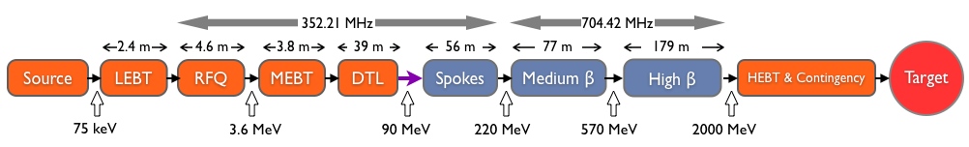
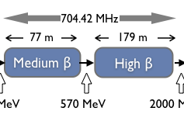
RF Power Requirements
Average of HB Power-to-Beam = 1060 kW
Average of last HB Phase 2 = 1096 kW
84 High beta cavities:
1.2 MW MB IOTs
30 kW Solid State Amplifiers
3 MW Klystrons
200 kW Tetrodes
1.5 MW Klystrons
1.2 MW IOTs

Slide 4
Klystron Prototypes
ESS Placed Contracts for three klystron prototypes
Klystrons designed to be compatible for both medium and high beta linacs
Suppliers encouraged to add removable mismatch in the output to recover efficiency for operation at reduced power
All klystrons have the ‘same’ perveance to be ‘roughly’ interchangeable
ESS also placed contracts for two Multi-Beam IOTs
Intended as technology demonstrators – not final series production samples
Design and manufacture in 24 months
Suppliers encouraged to minimise risk
Contract extended to include a 15 kW driver for FAT testing and for ESS test stand

Slide 5
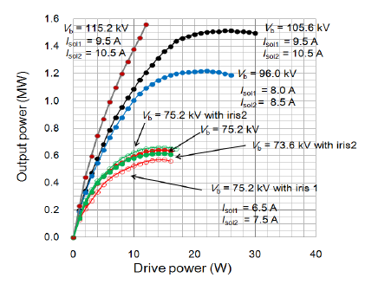
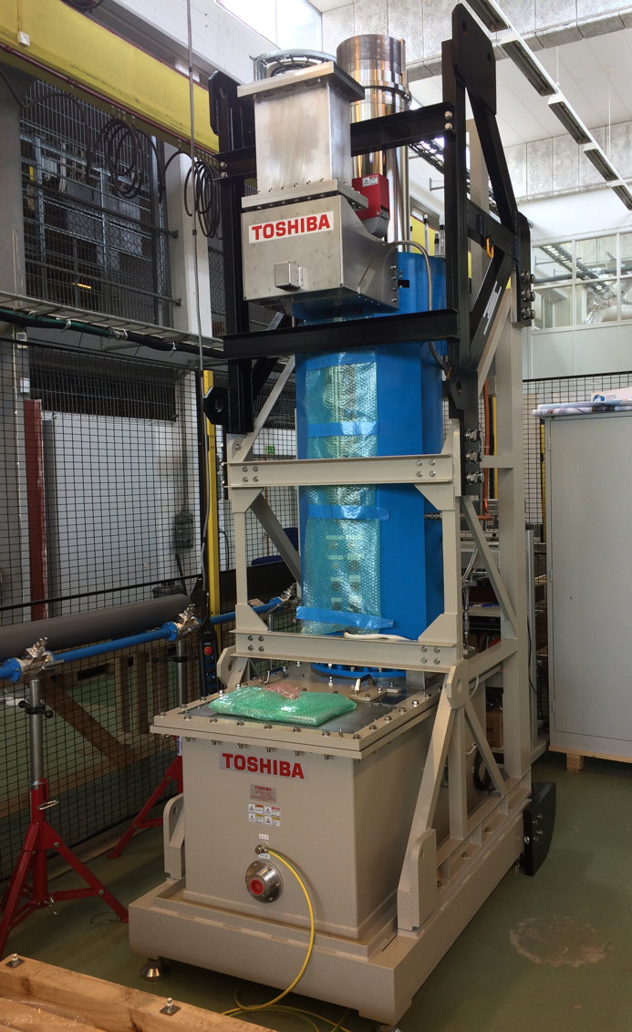
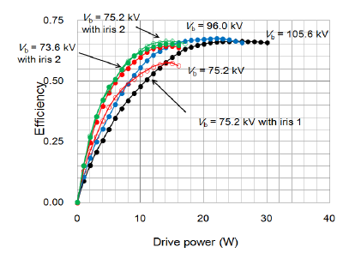
Toshiba klystron E37504 prototype
Some results from the Factory Acceptance Test (February 2016):
1.5 MW
Performance at 115 kV
> 60% efficiency even at 600 kW

Slide 6
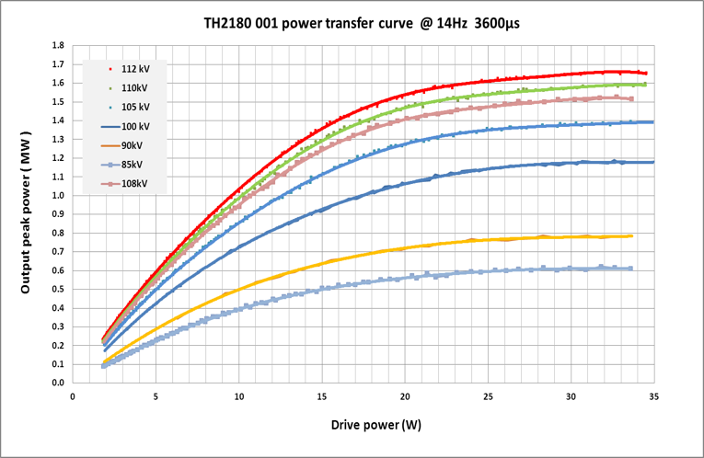
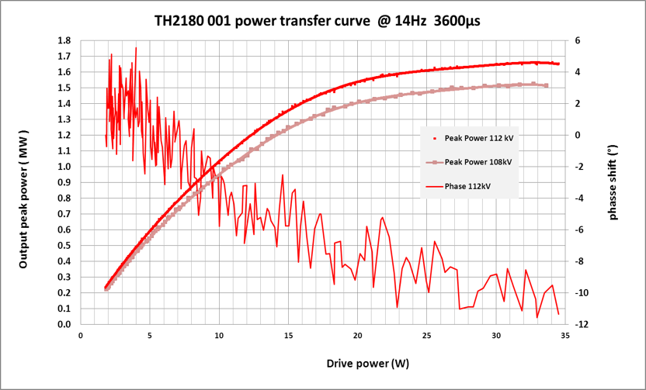
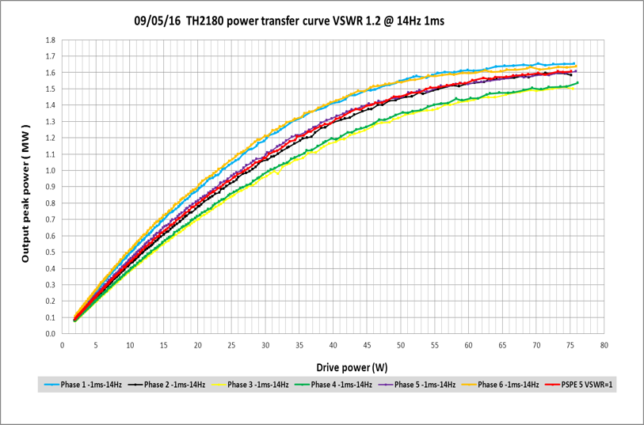
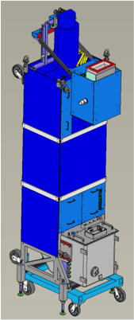
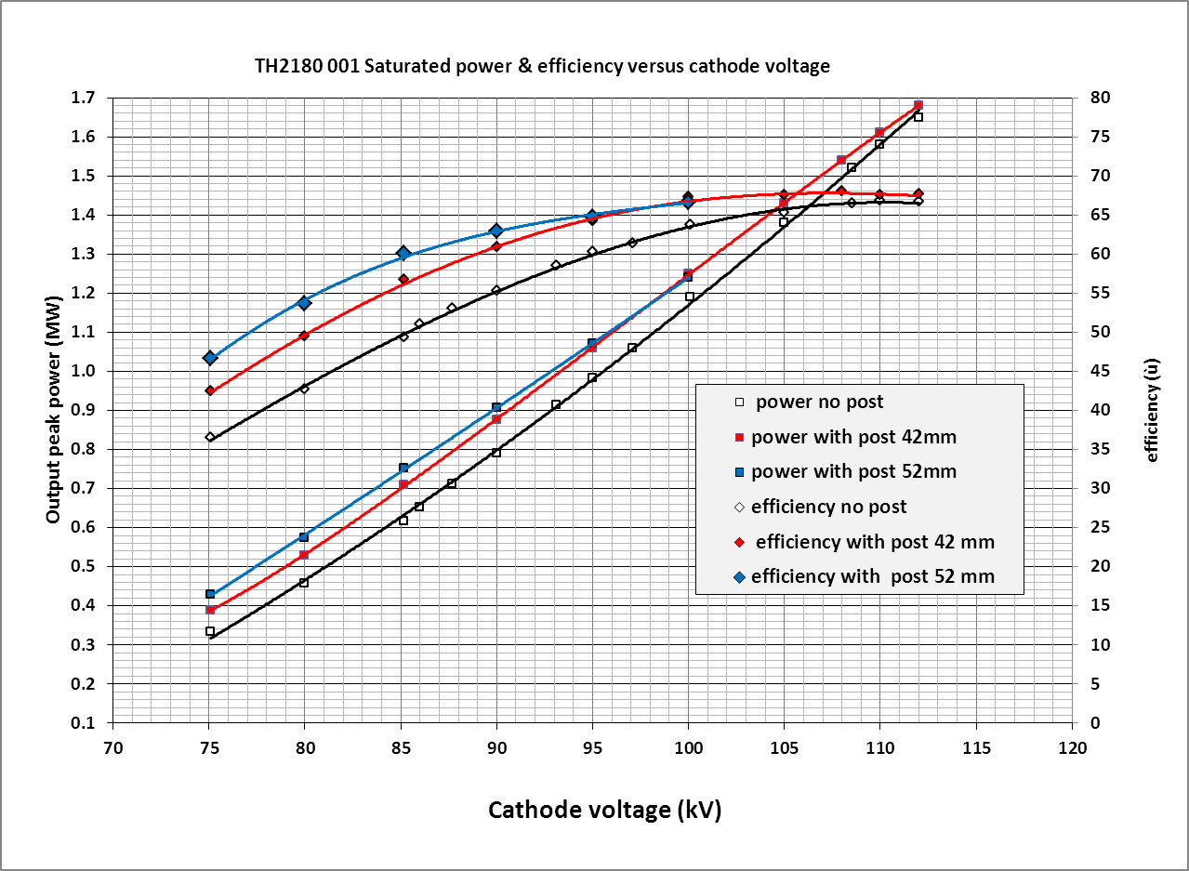
Thales klystron prototype TH2180
Results of factory tests in May 2016.
Saturated efficiency 66%.
1.5 MW at 108 kV
1.5 MW
65%
Efficiency
600 kW
55%
80 kV
Power

Slide 7
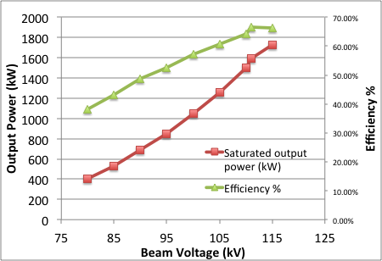
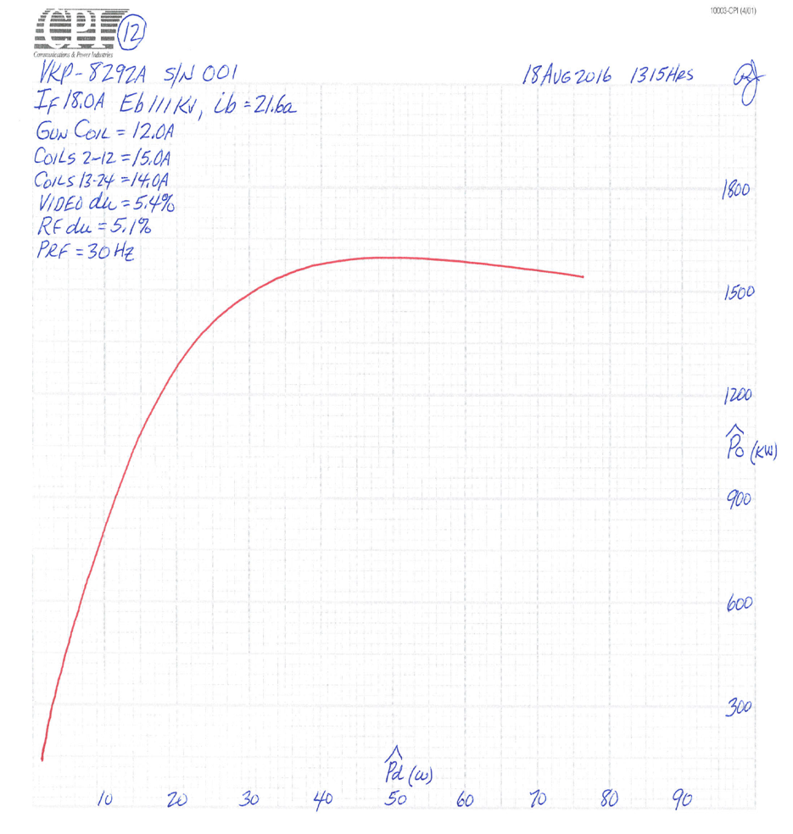
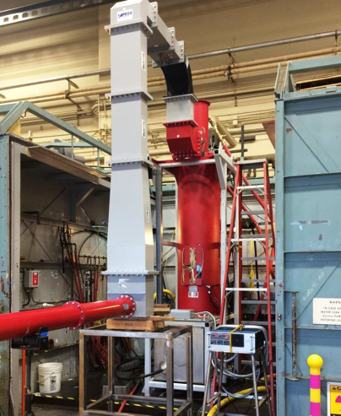
CPI Klystron prototype VKP-8292A
Results of factory tests in August 2016.
1.6 MW
Specification 1.5 MW
Output power and Efficiency
vs Beam voltage
Transfer curve at nominal 111 kV

Slide 8
Prototype Klystron Summary
All klystrons have passed the Factory Acceptance Tests.
  One klystron had a failure during the FAT and was rebuilt (same issue already observed on a similar klystron from CERN)
  One Klystron suffered from arcing in the output transition following delivery – has been repaired.
The efficiency at saturation is up to 67%
The micro perveances are similar at 0.6 +/- 0.1
Variations in efficiency will reduce overall efficiency at point of operation slightly when operated on a single modulator.
Extended testing has not yet been possible.

Slide 9
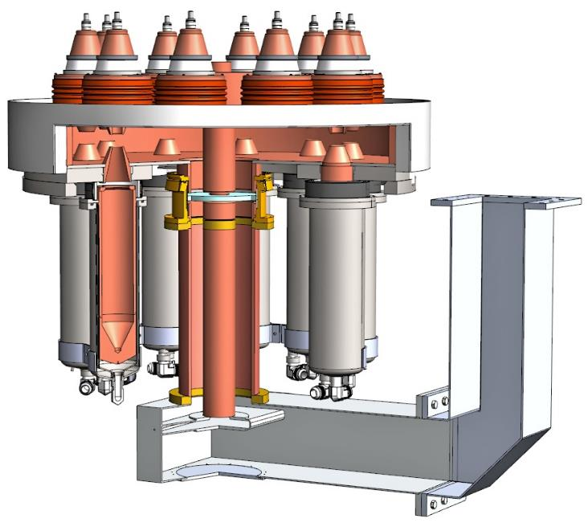

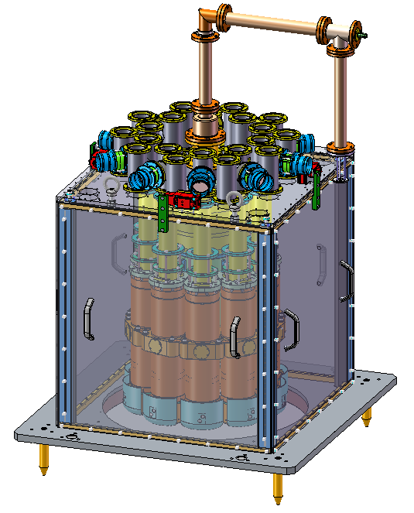
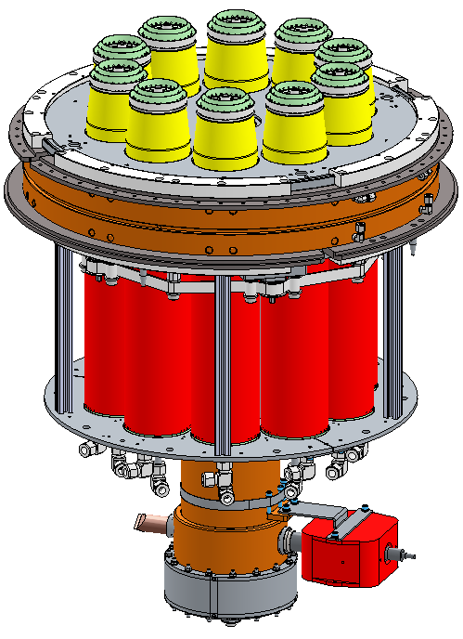


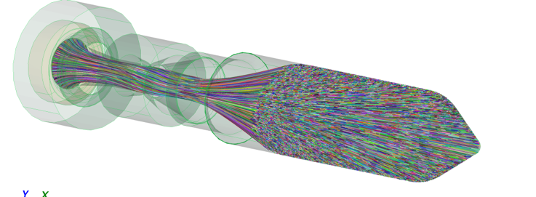
The ESS MB-IOTs
10 Electron guns placed in a circle
Cavity with 10 separate interaction gaps and single output
Magnetic focusing (PPM or solenoid)
Output windows based on high power klystron designs
Extensive modelling and simulation (beam optics, mode analysis, thermal and structural analysis, innovative manufacturing, …
Single beam prototypes, sub-assembly prototypes, …
Design driven by reliability and efficiency

Slide 10
L3 IOT Results
Efficiency

Slide 11
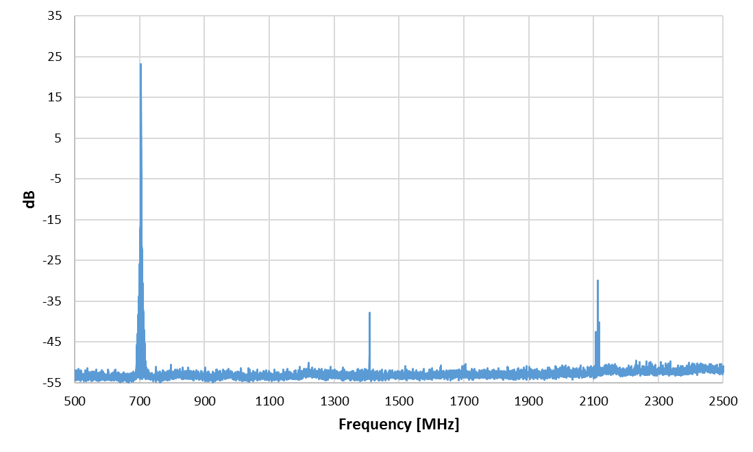
L3 IOT Results
Harmonic content at 1 MW
Second Harmonic: -48 dBc
Third Harmonic: -57 dBc
Fundamental
2nd Harmonic
3rd Harmonic
Output spectrum at 1 MW
No power seen from harmonic cavity modes.

Slide 12
L3 IOT Results
Gain – spec 21 dB

Slide 13
L3 IOT Results
Phase insensitive to high voltage ripple
Low phase shift vs output power
Insertion phase at 1 MW
Factory Measurements at -43.4 kV

Slide 14
L3 IOT Results
Body current versus output power and cathode voltage.
Body current reduces with increasing high voltage
Note that the IOT is focused using permanent magnet

Slide 15
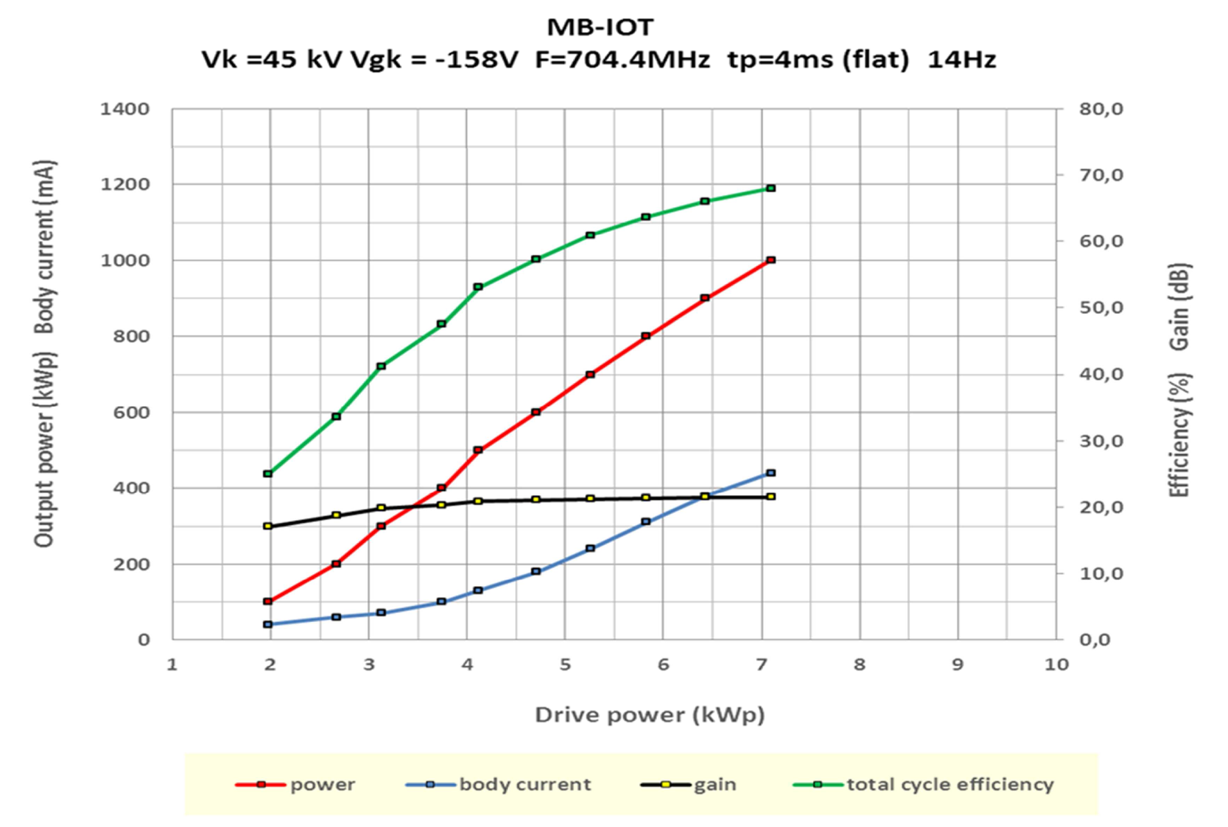
Thales/CPI IOT: ‘Factory’ testing at CERN
1 MW, 4 ms, 14 Hz
Efficiency
Output Power
Gain
Body Current

Slide 16
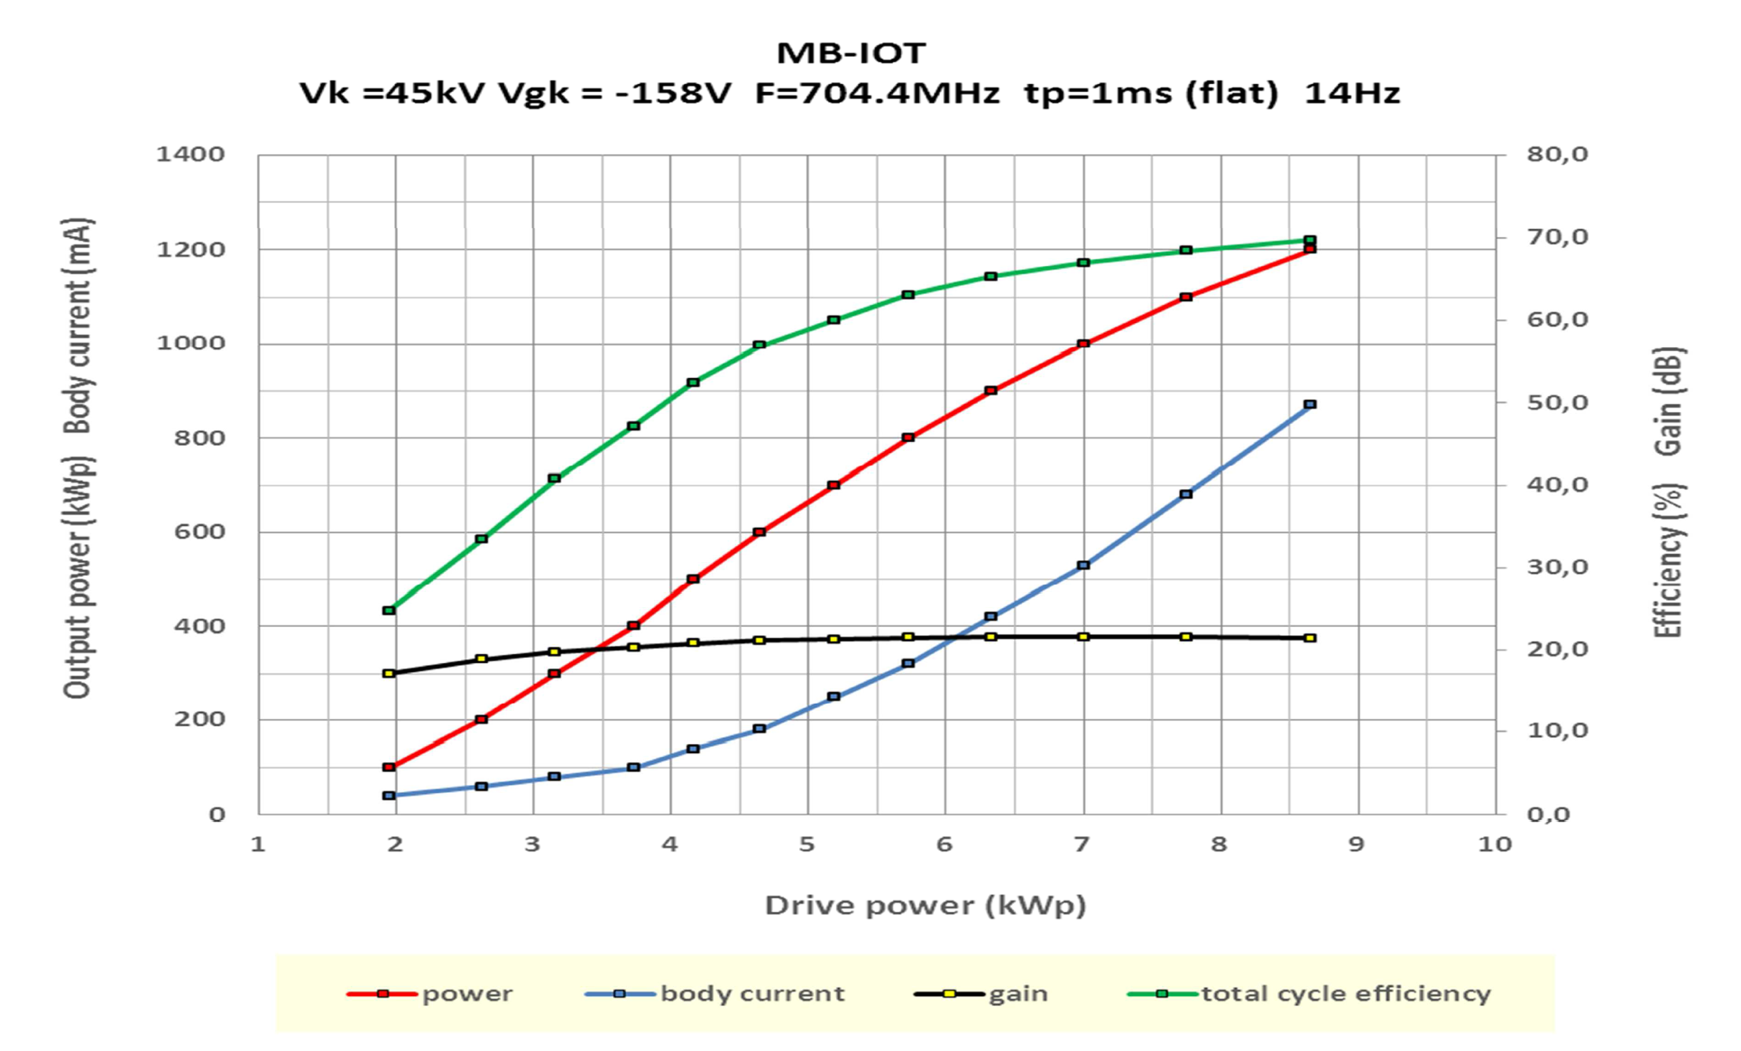
Thales/CPI IOT: ‘Factory’ testing at CERN
1.2 MW, 1 ms, 14 Hz
Efficiency
Output Power
Body Current
Gain

Slide 17
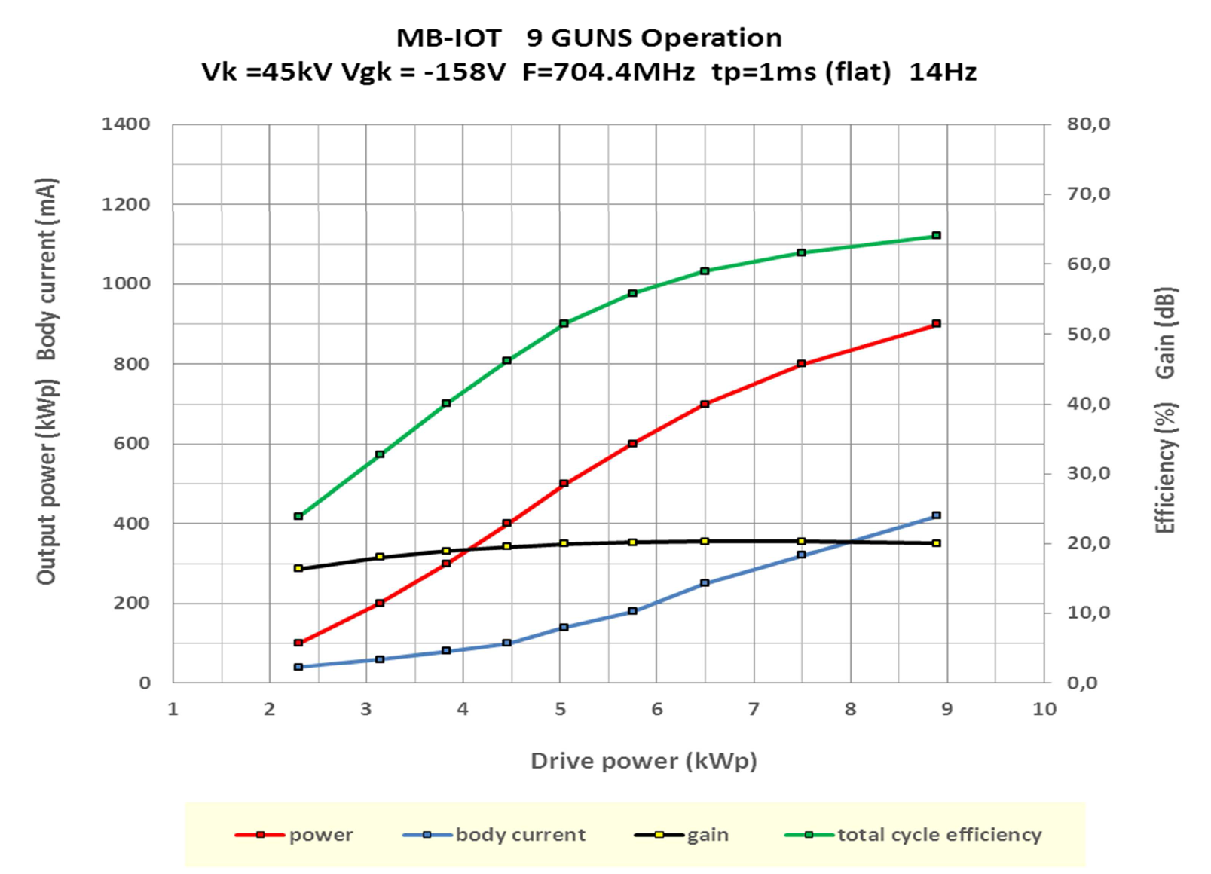
Thales/CPI: Operation with one beam off
Output power limited by missing driver.
No sign of tube limitation observed
Efficiency
Output Power
Gain
Body Current

Slide 18
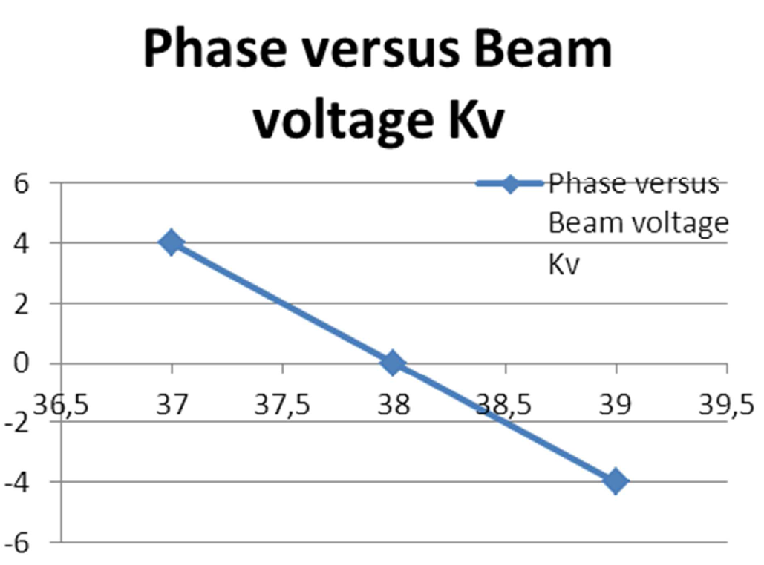
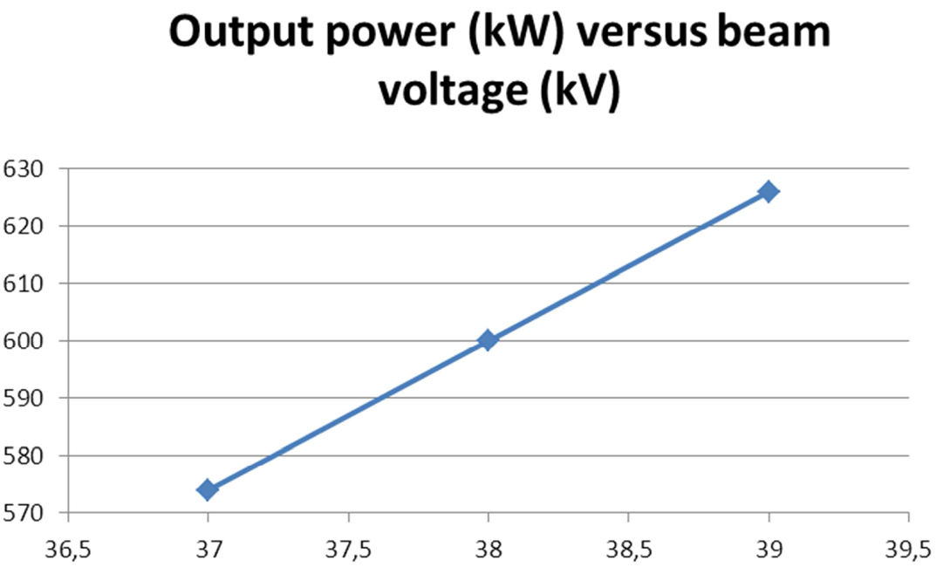
Thales/CPI: Operation with one beam off
Phase insensitive to high voltage ripple
Low phase shift vs output power
Measurements at 600 kW due to failure of output window

Slide 19
The efficiency promise of IOTs for operation below ‘Saturation’
L3 MBIOT
Toshiba Factory Test
105.6 kV
96 kV
Efficiency at Point of Operation = 52%
Efficiency at Point of Operation = 69%
75.2 kV
For Power to Beam of 1 MW
Operation with 20% Overhead

Slide 20
IOT Summary
L3
Testing at the factory limited due to HV power supply issues.
Factory test demonstrated 1.2 MW for short pulses
At CERN 3.5 ms pulses demonstrated at 1.12 MW limited by drivers.
Thales/CPI
1 MW for 4 ms pulses
Large trip on output window reduced performance
  IOT has been repaired and awaiting further testing
Both
Long term testing still to be done
Cost optimisation possible for a series tube.

Slide 21
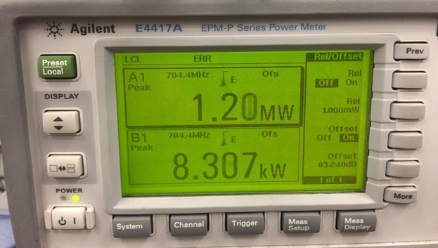
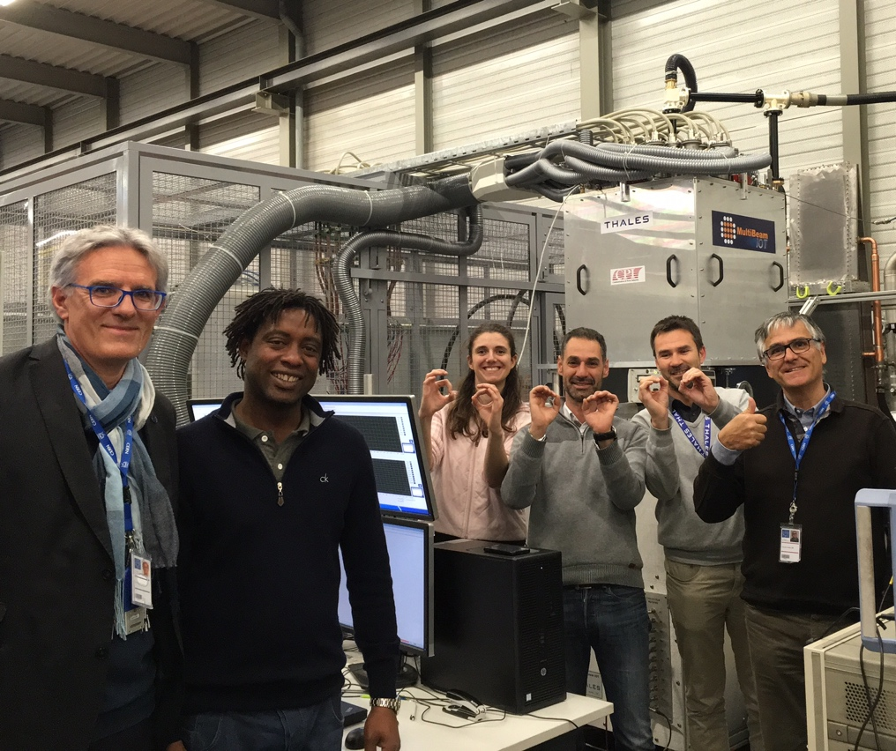
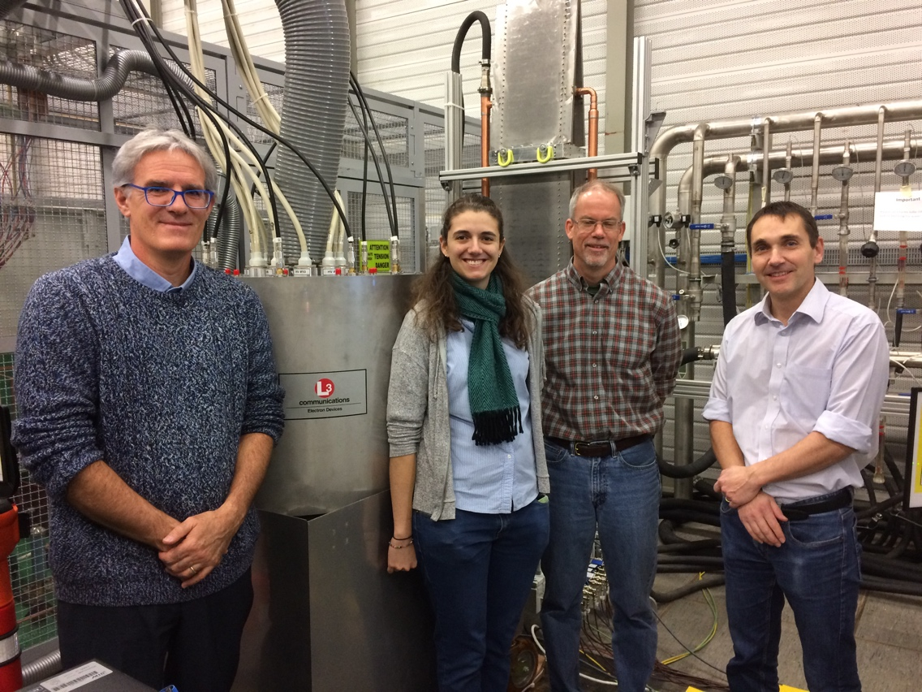
MBIOT Status
World Record
MBIOTs delivered to CERN for testing
Both MBIOTs have delivered 1.2 MW
Overall Technical Specification achieved
Thales/CPI MBIOT
Testing at CERN
L3 MBIOT

Slide 22
Energy and Power Estimates Klystrons vs IOTs

Slide 23
Energy and Power Estimates of Klystrons vs IOTs
Key Numbers used in Calculations
Operating Hours per Year | 5000 hrs | Steady State Operation
Klystron and IOT life expectancy | 60’000 hrs | Klystron: Based on mix of experience from other labs IOT: Based on data for critical components from Broadcast industry.
Power to beam during pulse | 1060 kW | Average value for all of HB. The value is slightly higher if only the last 40 stations are considered.
RF overhead for operation with klystrons | 20% | May be optimistic. Most facilities tend to operate well below saturation.

Slide 24
Efficiency and Cost
Proton Beam Pulse Width (train) | 2.86 ms
Cavity ramp and RF settling time | 150 μs
Modulator Rise/Fall Time | 100 μs / 100 μs | Zero for a constant HV supply
Total | 3.21 ms
3.21 ms
Proton Beam Pulse
RF settling and cavity ramp
Time
Modulator Rise Time
Modulator Fall Time

Slide 25
Efficiency and Cost
Auxiliary Power Consumption
Klystron auxiliary Power | 3.7 kW | Filament, solenoid and drive amplifier.
IOT auxiliary Power | 5 kW | Filament, solenoid, drive amplifiers and air blowers.
Klystron modulator Efficiency | 92%
IOT power supply efficiency | 95%
Waste heat removal efficiency | 33% | Assumes that it takes 1 kW electrical power to remove 3 kW of waste heat.

Slide 26
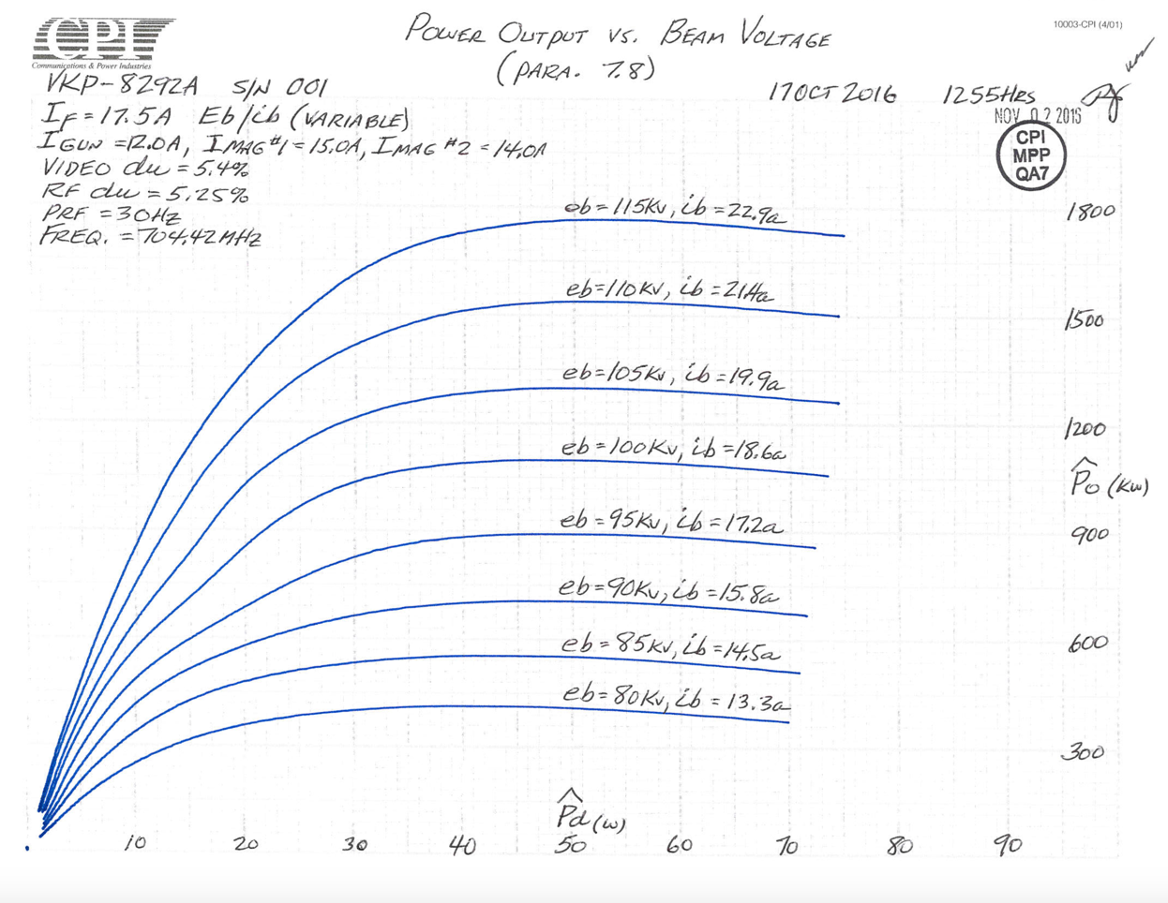
Efficiency and Cost
Klystron Operating Points
Average operating points from the three prototypes.
Klystron high voltage | 105 kV
Klystron current | 19.8 A
Klystron efficiency | 61%
Note: Individual klystrons, in particular from different suppliers, behave differently and have different optimal operating points subject to output power requirements.
All klystrons connected to the same Modulator must operate at the same high voltage
Example:
CPI FAT.
Sample

Slide 27
Efficiency and Cost
Capital Cost Considerations
Klystrons:
Three klystron manufacturers bid for 36 medium beta klystrons
Contracts were placed with two suppliers; each to deliver 18 units.
Average price per klystron 255 kEUR.
3rd Supplier was significantly more expensive.
We assume future series to be priced approximately the same as the MB series.
  Future price may vary subject to actual cost of manufacturer of first series
  Perceived competition between vendors

Slide 28
Efficiency and Cost
IOTs:
Budgetary offers requested.
Supplier 1: 477 kEUR (USD 590k) per IOT in a batch of 6
      372 kEUR (USD 460k) per IOT for 20
Supplier 2: 574 kEUR (USD 710k) per IOT low quantity
      405 kEUR (USD 500k) per IOT for a larger batch
At the time none of the IOTs had been tested to full power and the price of klystrons was unknown (but the price was expected to be higher based on pricing from other facilities).
Klystron costs are well understood by manufacturers
Component cost of IOTs from the broadcast industry is well understood but MBIOTs are new and represents a higher risk (cost) to industry
None of the budgetary costs were against cost targets and both Suppliers indicated options to reduce the price to achieve a cost target.

Slide 29
Efficiency and Cost
Power Consumption
High Beta Linac | Klystrons | IOTs | Energy Saving of using IOTs
Phase 1: 44 Amplifiers (Klystrons) | 26.5 GWh / Year | 19.0 GWh / Year | 7.5 GWh / Year
Phase 2: 84 amplifiers | 50.7 GWh / Year | 36.2 GWh / Year | 14.5 GWh / Year
Split technology from year 2025 - 44 Klystrons - 40 IOTs | 26.5 GWh / Year | 17.2 GWh / Year | 7 GWh / Year
High Beta Linac | Klystrons | IOTs | Energy Saving of using IOTs
Phase 1: 44 Amplifiers (Klystrons) | 26.5 GWh / Year | 19.0 GWh / Year | 7.5 GWh / Year
Phase 2: 84 amplifiers | 50.7 GWh / Year | 36.2 GWh / Year | 14.5 GWh / Year
Split technology from year 2025 - 44 Klystrons - 40 IOTs | 26.5 GWh / Year | 17.2 GWh / Year | 7 GWh / Year

Slide 30
Efficiency and Cost

Slide 31
Efficiency and Cost

Slide 32
Efficiency and Cost

Slide 33
Efficiency and Cost

Slide 34
Cost of ownership summary
Considering IOTs from 2025
 | IOT costs 5 years | Klystron Cost s 5 Years | IOT costs 10 years | Klystron Costs 10 Years
Initial tube purchase | 385 k | 255 k | 385 k | 255 k
Electrical costs of operation | 158 k | 221 k | 341 k | 478 k
Total | 543 k | 476 k | 726 k | 733 k
Capital cost of series auxiliary supplies are subject to design and tbc.

Slide 35
Summary
Klystrons
Prototypes successfully manufactured
Reducing HV improves efficiency reduced power levels
Output mismatch improves efficiency further
Mature technology, good efficiency 66 % at saturation
Efficiency suffers for applications which require power overhead
Full power consumption for operation at reduced power levels – e.g. low beam current, machine shifts, means very low efficiency.
IOTs
Technology demonstrators successfully manufactured
High efficiency at point of operation
Further optimisation for low extended low power operation is possible
Still requires long term testing and industrialization
High voltage power supply and auxiliary power supply decks to be developed
Reduced power consumption for machines with high overhead requirements and/or high duty operation
Low power consumption for low power-to-beam e.g. low beam current operation, machine shifts

Slide 36
Sincere thanks to our external collaborators in particular
Toshiba, CPI, Thales and L3
and to
Eric Montesinos, Maria S Barrueta and Gino Cipolla at CERN for a great job with the IOT test stand

Slide 37
Main summary and proposal
The MBIOT development has been very successful and promising with both IOTs demonstrating key parameters already.
To proceed to a full series production, a pre-series is required to reduce cost and risk.
The first part (44 units) of the high beta linac will be based on a tender for klystrons; same specification as for the medium beta linac.
Due to staff availability and budget constraints, ESS does not currently intend to continue to fund this development within the construction budget, however we will continue to follow the test activities to be carried out at CERN.
We welcome accompanying initiatives by other members of the community to take the development further.

