Slide 1
Accelerator controls readiness and plans for normal conducting linac commissioning
Henrik Carling
Andreas Jansson
Date: 2018-04-08

Slide 2
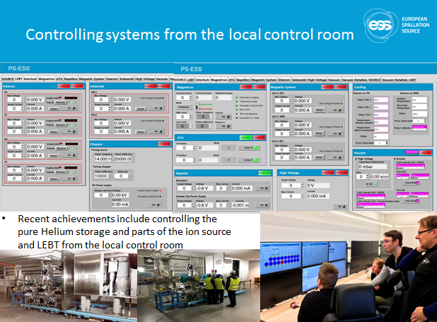
Success stories for integrated controls
There are several examples of successful integration of accelerator systems
As expected, progress happens when accelerator and ICS staff work together in close collaboration rather than as two separate teams
Accelerator and ICS brining systems on-line in the local control room

Slide 3
Controls scope for normal conducting linac
The Lattice database contains beamline devices, which can be listed through the synoptic viewer application
Each beamline element may have one or more IOC associated with it
Some systems, such as vacuum and water cooling, are not the in the lattice database
CCDB is intended to contain the a model of the control system. It currently does not contain a complete model of all devices
As a result, we currently do not have a central list of devices to integrate in the control system
A combination of lattice database and CCDB gives the best current overall picture

Slide 4
Layered Architecture of the ESS Control Systems
Human Users
Engineers, Operators,
Scientists, Technicians, ...
display ESS facility data,
task execution
ESS Main Control Room
Experiment workstations
Other Human Operations Facilities
Applications
System
GUIs
Equipmet
GUIs
Physics
Apps
Config.
tools
post
mortem
analysis
PSS
GUIs
GUIs for data analysis,
processing and archive services,
system configuration, ...
send/receive
ESS facility data
EPICS (Ethernet)
Network
equipment
Facility Integration
runtime & historical data,
complex control functions,
configuration databases
EPICS
IOC
EPICS
IOC
EPICS
IOC
EPICS
IOC
EPICS
IOC
EPICS
Archive
EVG, Master
Oscillator
Timing System
system specific
data exchange
FBIS
Machine Protection: Beam Interlock System
Local System Control
high dependability,
executes local control functions
PLC
PLC
Ether
CAT
MicroTCA
system
MicroTCA
system
PSS
PLC
Personnel Safety System
Ethernet fieldbus
local control,
run-time data
Signal Conditioning (a/d)
Equipment Electronics
remote
I/O
cont-
roller
device
electronics
device
electronics
cont-
roller
remote
I/O
remote
I/O
Device signals
device specific
signals
Physical Equipment
machinery, sensors, actuators
pump
flowmeter
motor
sensor
chopper
PS
switch
sensor
sensor
measure and adjust
Physical Processes
H₂O Flow
He Flow
Mech. Movement
RF
Proton
Neutron
etc.
Temp
Electricity

Slide 5
Accelerator/ICS technical interfaces
AD
ICS
Physical
devices
Data Acquisition/
Feedback
IOC
Systems with internal processing in same unit as control processor Software/Firmware framework interface. Examples: LLRF, BI
Increased performance/throughput
Systems with internal processing in
separate unit from control processor
High level interface.
Examples: Power supplies
Devices with low level interface to control processor
Examples: Valve, Flow meter
”Classical Controls”
90% of accelerator
Central services:
Timing, BIS, Archiving, etc

Slide 6
The move of the digital interface for high performance systems
As performance of ADCs and FPGAs improve, more and more of the signal processing which used to be analog is going digital
1990:s
ADC
RAM
C
2000:s
ADC
RAM
2010:s
ADC
RAM

Slide 7
Technical interface for high performance systems
The interface at ESS is internal for both hardware and software
  ICS provides firmware and firmware/software frameworks, including drivers
  Domain groups use this to develop application specific firmware and software
  ICS supports all development
  ICS is responsible for deployment
Some models used at other facilities (simplified)
  Keep Controls interface at the ADC (FRIB)
    Requires controls to have domain expertise
    ”Clean” physical interface at the expense of difficult logical interface
  Interface to network port (SNS)
    Requires domain groups to have EPICS expertise
  Interface at crate backplane (CERN)
    Still requires some system specific code to run on CPU

Slide 8
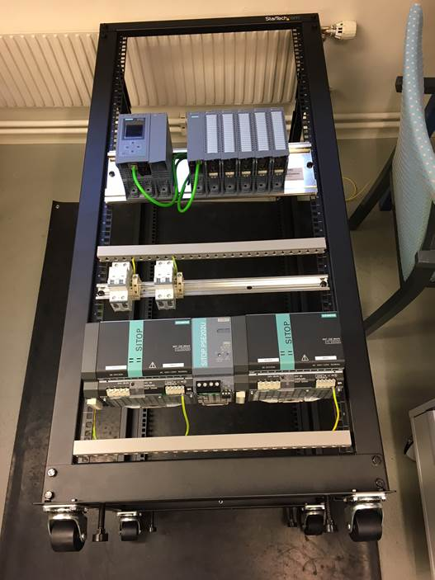
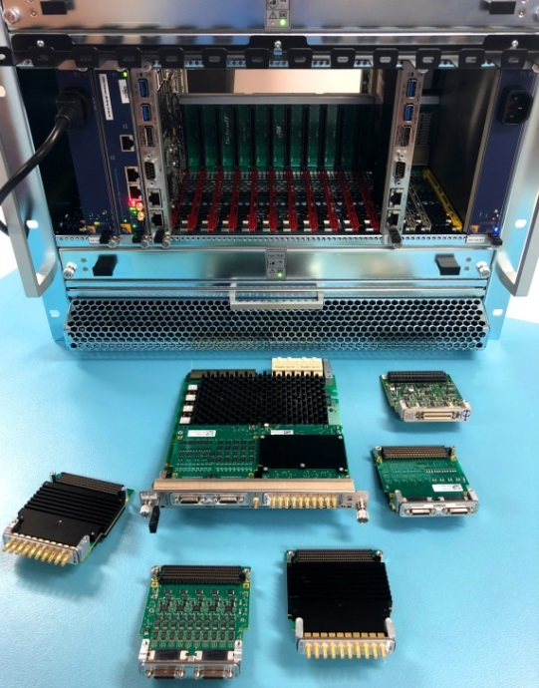
Accelerator assessment of integration status
Systems integrated with industrial automation in good shape
  Good in-house competence in ICS on these platforms
  COTS platform standardization decided early on (Siemens, Beckhoff)
Systems integrated with the high performance MicroTCA
platform have lagged behind
  Not enough in-house capacity at ICS
  High performance MicroTCA platform development as in-kind
    In-kind contract delayed with delayed deliverables as result
  ICS has worked with issues on the MicroTCA base platform
    Such as issues with the backplane, MCH:s and more
  ICS is continuing to work on the firmware framework
    Project coordination has room for improvement

Slide 9
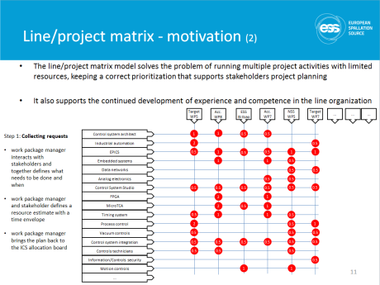
Staffing issues
Attrition of key staff has been problematic
  Integration work package leader left the project hanging for 6 months
  Controls resource for ion source integration leaving at a critical moment
  Changes among other involved staff has also led to confusion
It has been unclear for accelerator work package leaders who the counterpart is
It has been unclear for accelerator in-kind partners who the ICS counterpart is
A reorganization of the ICS hardware and integration group has been made
  A new group leader has been recruited
  A dedicated, project management capable work package manager has
  been appointed for accelerator - this is the single point of contact
  A system for allocating resources using a matrix model has been devised

Slide 10
In-kind interfaces and communication paths
AD IK-partner
ICS IK-partner
ESS AD
ESS ICS
Many different collaboration combinations may be possible
Accelerator and ICS in-kind partners may be
  The same team
  Different teams at the same lab
  Teams at different labs
Sometimes information flows the wrong path, leaving some stakeholders out of the loop
Lesson learned: Structured communication is essential for collaborating in a distributed team
Lesson learned: Roles and responsibilities need to be clearly defined

Slide 11
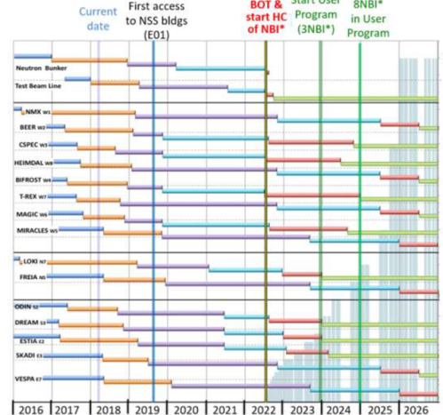
Plan for system integration
Dependencies and re-baselining
  ICS has strong dependencies to stakeholders schedules - much of the ICS planning follows schedules from Accelerator, Target, NSS and CF projects
  ICS plans are also adapted to deliverables from in-kind partners
  Currently, the ICS plan for accelerator integration is being revisited as part of the ESS re-baselining
Outlook for normal conducting linac
  With the current tentative re-baselined outlook of the accelerator construction plan, the corresponding controls plan seems challenging but not impossible
  Main challenges will be prioritization of ICS resources to accelerator tasks compared to other subprojects’ tasks.
    The ESS-level plan is highly parallelized from ICS perspective
  To find specialized competence capacity at the right time may be a
  challenge for the ICS line organization in particular for EPICS and FPGA
  Unsurprisingly, the most challenging areas for ICS/accelerator will be the
  RF and beam instrumentation scopes

Slide 12

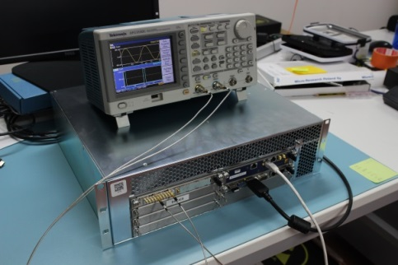
Status and plans for IFC MicroTCA platform
The ICS standard MicroTCA platform is an in-kind delivery from PSI, Switzerland
The in-kind project scope consists of
  Platform development - hardware, firmware and software (completed)
  Platform deliveries - hardware, firmware and software - in total 400 units across two variants
  Platform characterization - analog performance measurements (completed)
  Platform maturization and support (ongoing)
The in-kind project has suffered from contractual difficulties causing a 6 - 9 month delay
Status today
  The first system built on the platform; RF local protection system, has been delivered to RF
  Progress on other integrations has been limited, mainly due to resource and planning constraints
  Some technical issues with the firmware and software remain to be solved
  Several in-kind partners have started to work on the platform
  The platform has been characterized at PSI with excellent results
  The ESS beam interlock system interface has been designed with the platform in mind
  The ICS hardware and integration group will be reinforced to address the problems
  As always we want a tight collaboration with accelerator

Slide 13
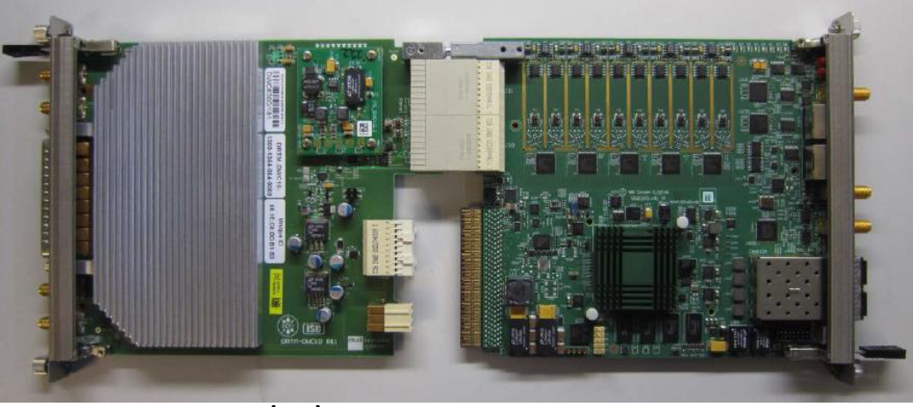
Status and plans for Struck MicroTCA platform
For historical reasons and because of the limited
availability of the ICS standard MicroTCA platform in
the early phases of the project, ICS is also committed
to supporting a COTS MicroTCA platform based on
the STRUCK SIS8300-family of products [link]
This platform is the current baseline platform for low level RF systems
The platform is also selected for several beam instrumentation systems
Status today
  Due to resource limitations - the ICS hardware team has grown rapidly in the last year - the ICS support for this platform has not been available to the extent needed
  This has led to a situation with two firmware framework solutions developed, which may not be compatible
  Much of the framework development on the Struck platform is driven by accelerator resources
  By building both frameworks on industry standards such as PCI Express and AXI-4, there is some outlook of interaction between the frameworks
  The ICS hardware and integration group will support the alternate platform as long as required

Slide 14
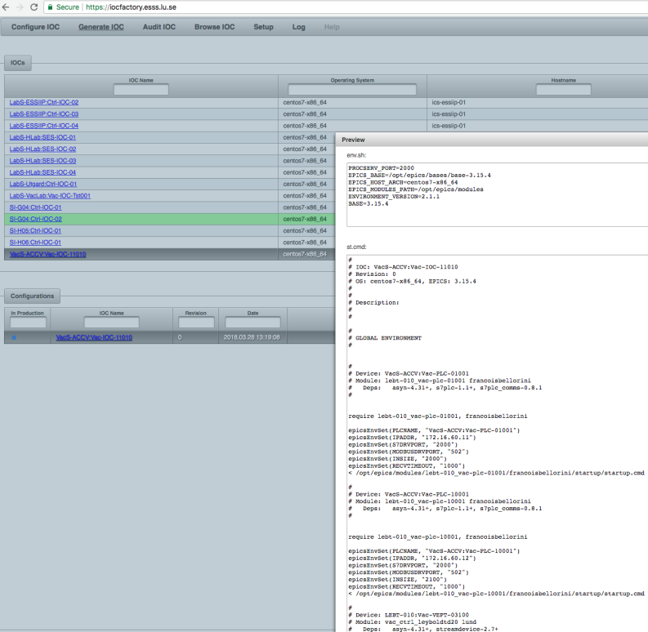
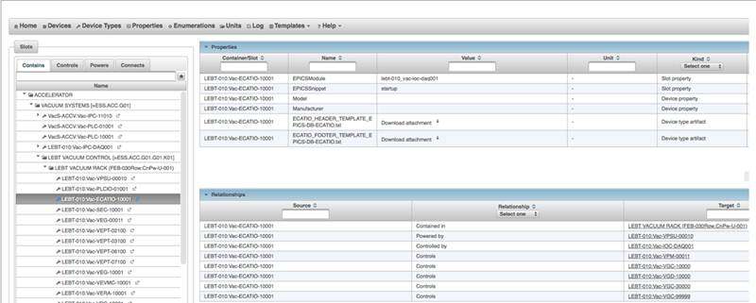
Status and plans for CCDB
The controls configuration database (CCDB) product has
been in active production for more than 18 months.
The product has been developed since 2013 and is a
web based, database driven application for modelling the
control system. The concepts have been defined by the
DISCS collaboration [link]
Integrators and stakeholders have been encouraged since
2015 to use the tool extensively
Status today
  CCDB is being used mainly by ICS integrators
  The usage of the CCDB product has been sporadic
  CCDB now contains detailed data for some domains, such as vacuum while other domains are ”white spots”
  ICS intends to strengthen the usage of CCDB through stricter design and construction processes
  Due to technical limitations, it will probably not be possible to model all ICS systems in CCDB

Slide 15
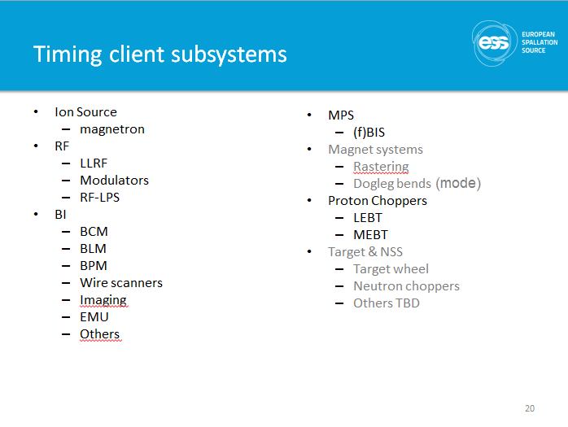
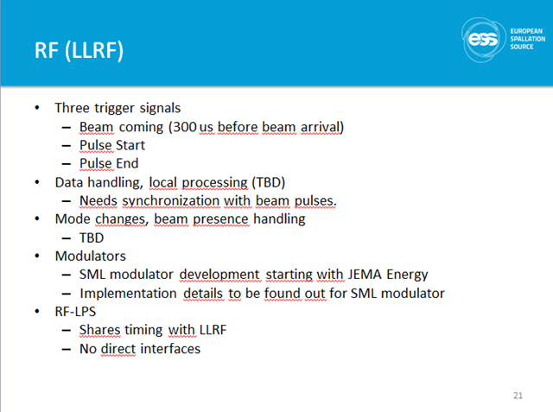
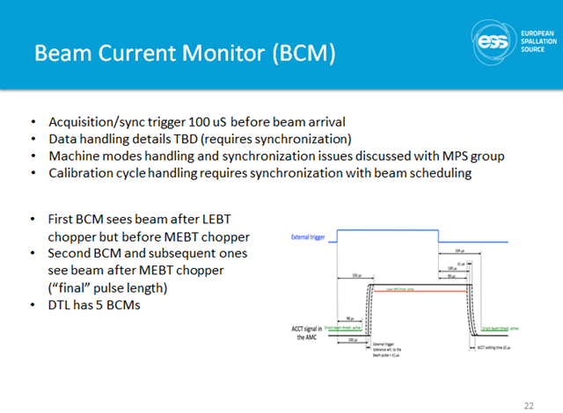
Status and plans for timing
Work on the timing system needs to progress together with stakeholders to meet all defined requirements
Accelerator and ICS have held timing workshops where definitions and structures are discussed and agreed. These are now being implemented into test setups
More information [link]

Slide 16
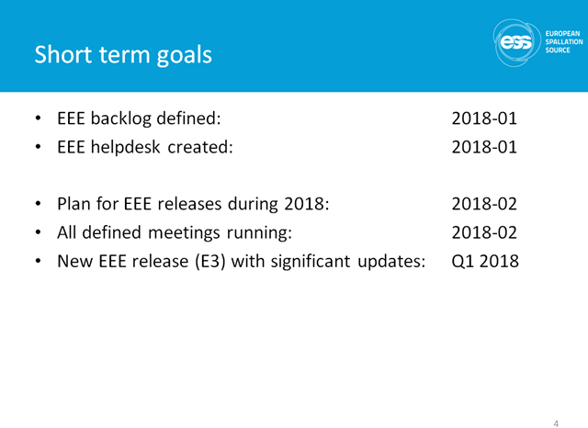
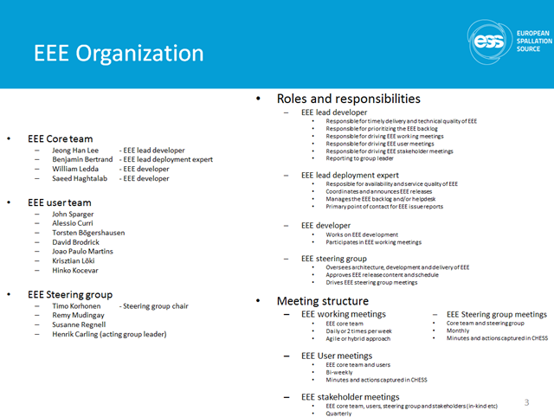
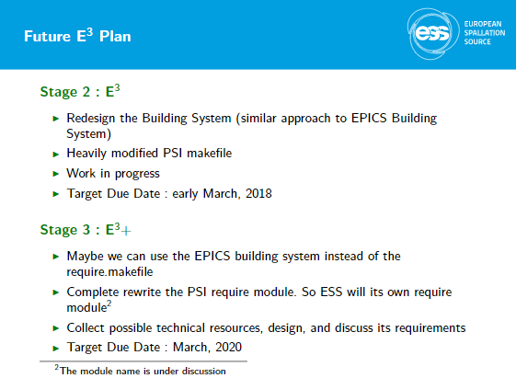
Status and plans for EEE
The ESS Epics Environment, formerly known as EEE, now E3 has been refurbished under the leadership of Han Lee
The decision was made in 2017-12 to reinforce the environment and distribution mechanisms
Status today
  Development and deployment has continued since 2017-12 the new version is being tested for the first release
More information [link]

Slide 17


Plans for EPICS7
EPICS 7 will be introduced for all of ESS by normal conducting linac commissioning
EPICS7 is fully compatible with EPICS v3 on the IOC level
On the client software level, the EPICS v3 protocol channel access needs to
be replaced with pvAccess
  pvAcess is a modern, performant network protocol that supports scientific applications
    Combine metadata with acquired data - essential for analysis
    Normative types support multi-dimensional data
    Much improved performance - close to theoretical bandwith limits
  Channel access was designed in early 1990’s, last important update in 2002
  Channel access has too many limitations to cope with today’s expectations
  Reports from other facilities such as SNS and SLAC indicate stability
All client software has been updated to support PVA
  Some testing is still needed but only minor corrections/completions are expected

Slide 18
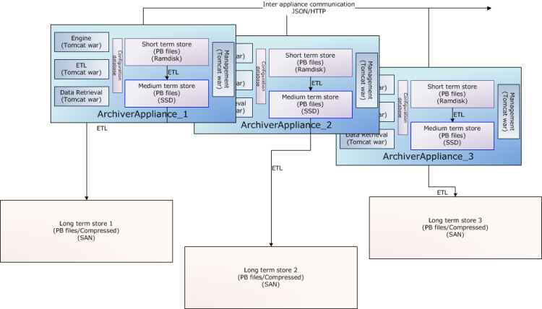
Status and plans for archiving
Archiving of control system data will be made through the
archiver appliance [link] product, which is a standard part
of the EPICS software family
The archive appliance is already fully operational and
configured for Ion source and LEBT
Archiving policies still need to be aligned between accelerator and ICS so that normal conducting linac expectations are set correctly and can be fulfilled
  Data storage frequency
  Volumes
  Retention periods short term – large volume, long term – reduced number of samples)

