Slide 1
Lessons learnt during Front End preparation and installation
William Ledda - Control System Integrator (ICS)
Thomas Shea - Beam Diagnostic Section Leader
www.europeanspallationsource.se
2018-04-12

Slide 2
Outline
Overview
Organization and coordination
Technical challenges
Lessons learnt
Conclusions

Slide 3
Outline
Overview
Organization and coordination
Technical challenges
Lessons learnt
Conclusions

Slide 4
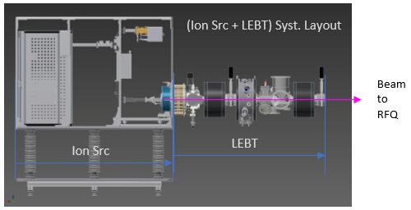
Overview
The "Injection system"
  Ion source produce the beam
  LEBT "transports" the beam till the RFQ for the first stage of acceleration
The "Control system"
  Infrastructure (HW and SW) that make it possible provide required data, information and services to engineers, operators.

Slide 5
Outline
Overview
Organization and coordination
Technical challenges
Lessons learnt
Conclusions

Slide 6
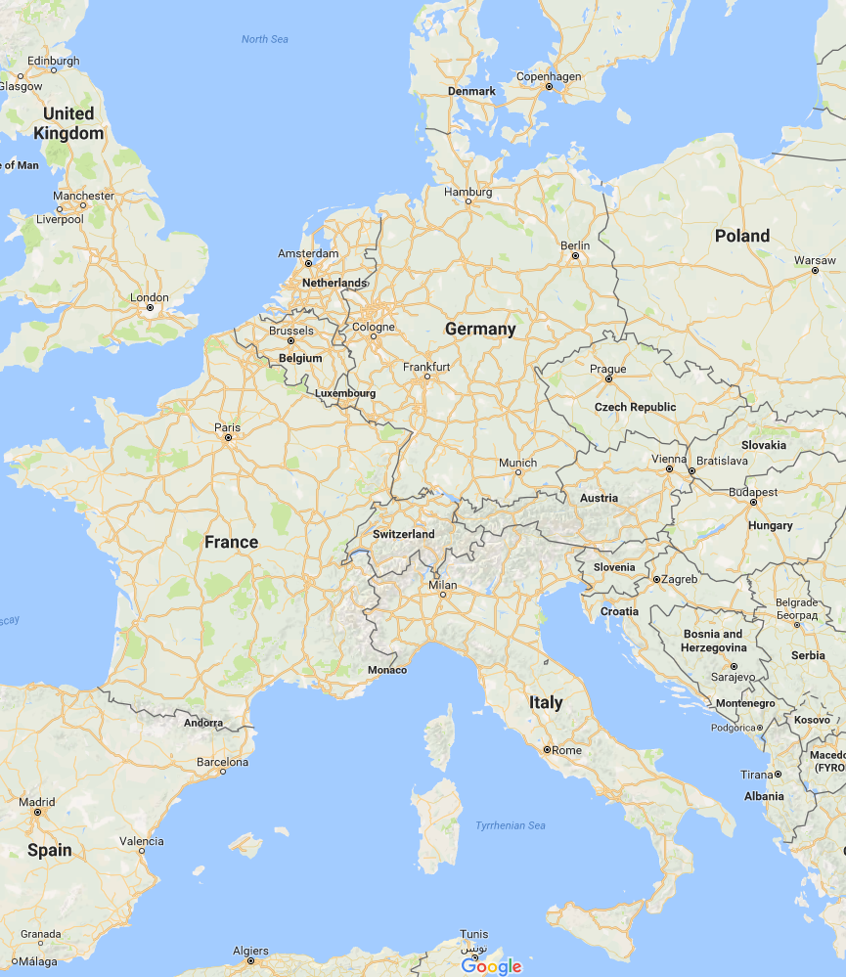
Organization and Coordination
Distributed team
ESS
INFN-LNS
In-kind contributor for the ISRC and LEBT
CEA
In-kind contributor for the control system
CEA
ESS
Accelerator Division
ICS Division
INFN-LNS
Notes:
Describes the difficulties encountered due to multiple teams working in different places with different priorities.
Coordination: regular meetings, mail exchange, phone tlaks, frequent travels

Slide 7





Organization and Coordination
Distributed team
Relations between the teams are very good, there are bonds between the different team members.
Communications, either through phone, videoconference or in person.
Frequent travels in Catania during installation, set-up, testing and acceptance of the system

Slide 8
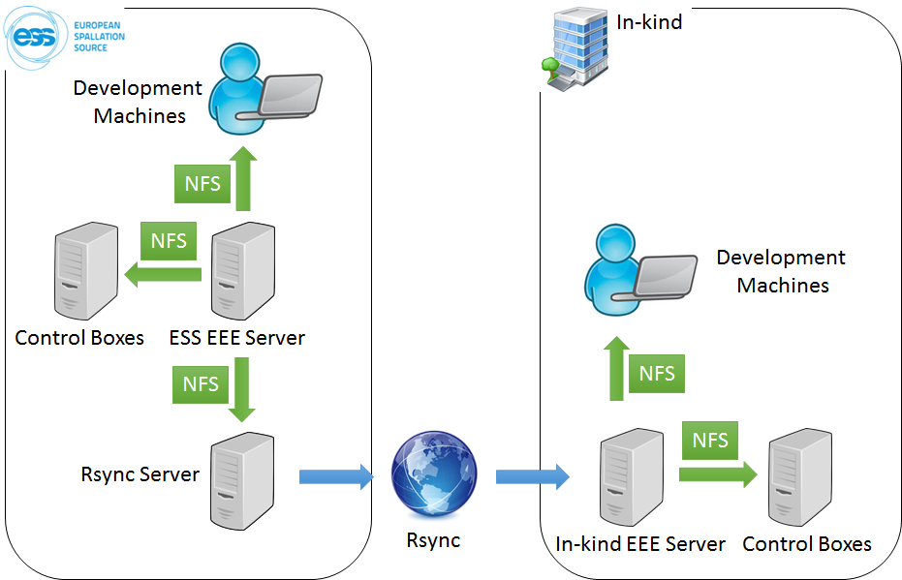
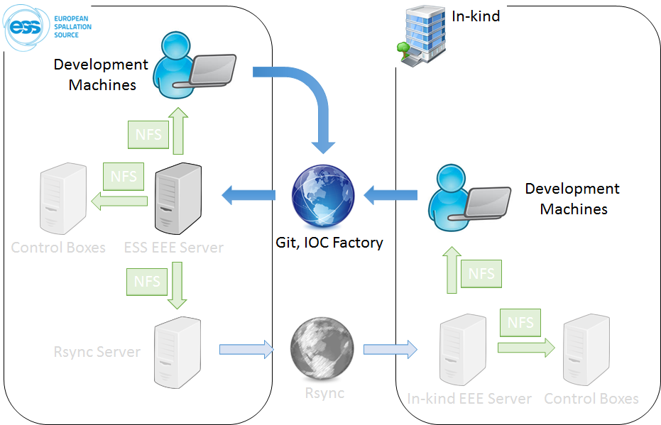
Organization and Coordination
Distributed Development
ICS intends to align distributed in-kind development of controls by distributing a development environment
Notes:
The Development Environment is the software and the supporting infrastructure for development at ESS and at in-kind partners.
The Development Machine (physical or virtual) is where development is performed
A centralized file server hosting the ESS EPICS Environment (thus “EEE server”).
Both (Development Machine and EEE server) are released in numbered versions to ensure a common environment for all users.
Servers at different locations are synchronized one way from ESS outwards to ensure stable versions of EPICS related software that are up-to-date
New functionality added to the EEE server at ESS are distributed to external contributors by periodic one-way synchronizing of in-kind EEE servers with the ESS EEE server.
using Rsync protocoll over Internet.
EPICS module are version controlled using Git. When a new tag is pushed into the ESS git-repository a build process starts and, if successful, the module is installed in the ESS EEE Server with the
numbered tag.
Modules can be installed locally on the In-kind EEE server but they will not appear on the ESS EEE server.

Slide 9
Outline
Overview
Organization and coordination
Technical challenges
Lessons learnt
Conclusions

Slide 10
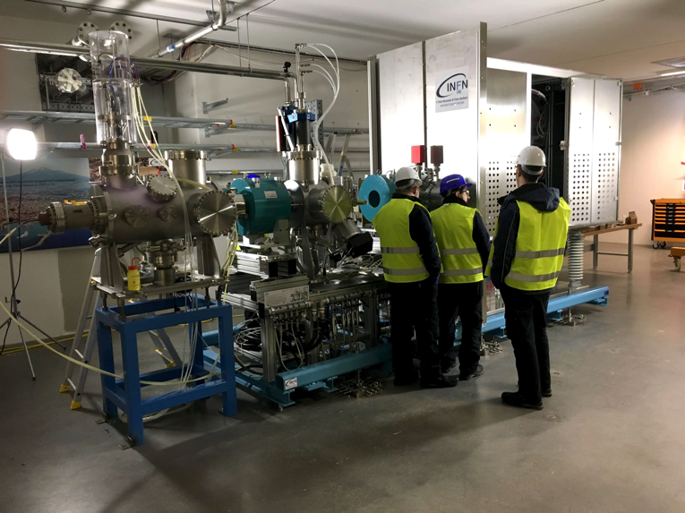

Technical challenges
Device integration
Many different devices to be integrated
  PLCs
  Field devices
  Power Supplies
  …
Different interfaces and protocols
  Serial vs Ethernet
  Modbus
  SCPI/GPIB
  Simatic step7
  EtherCAT
  …
The “glue” that makes all these devices communicate is the EPICS framework
For the Ion source and LEBT there are
  ~ 10 IOCs running
  ~ 9500 EPICS PVs

Slide 11

Ion Source Controls Architecture
CAT5 Ethernet (10.10.0.xxx,
Channel Acces, boot, nfs,…)
Archiving PC
Server
Serial, etc.
Source IPC
CAT5 Ethernet (10.10.1.xxx)
Vacuum System
Scalance
X204-2 (0)
Fibre
11
Electrical, etc.
(physical I/O, power, etc.)
Source
PLC
Scalance X204-2 (2)
Scalance X212-2 (1)
4
Source EtherCAT I/O
CU1561
5
8
3
1
HV Platform
Source EtherCAT I/O
CU1561
Source I/O
Controller
ACQ
9
Scalance X212-2 (6)
Modbus TCP
Magnetron
Scalance X204-2 (3)
SCPI
Repeller Electrodes PS (x2)
Modbus TCP
ATU
Serial Server
ASCII
Mass Flow and Gauge Controller
Scalance X212-2 (4)
2
SCPI
Source Coils PS (x3)
10
Scalance X204-2 (5)
Profinet
Source PLC
Remote I/O
SCPI
HV PS
Controls Equipment (PLC, IPC, I/O, etc.)
LINAC Equipment (PS, etc.)
Notes:
This slides gives an idea of what there’s underneath and which is the challenge to make all devices working together.

Slide 12
LEBT Controls Architecture
Serial, etc.
CAT5 Ethernet
Fibre
NPM
IPC
ASCII
Electrical, etc.
(physical I/O, power, etc.)
1
5
NPM MC
9
8
To Source
PLC
FC Bias PS
DSM
IPC
To Source
PLC
To Source
CB EVR
DSM Spectrometer
Camera
FC
NPM
IRIS
Chopper
DSM
BCM
EMU
BCT RTM Interface Unit
IRIS MC
ASCII
EMU MC
To ISRC
VME
Controls
4
EMU Plate PS (x2)
ASCII
EMU
EtherCAT I/O
ACQ
BCM I/O
Controller
SCPI
EMU Bias PS
To ISRC
VME
Controls
Solenoid PS (x2)
3
2
EMU I/O
Controller
SCPI
ACQ
EMU
IPC
10
Steerer PS (x4)
Future
EMU
PLC
s7plc
Controls Equipment (PLC, IPC, I/O, etc.)
LINAC Equipment (PS, etc.)
Notes:
As for the ISrc, a brief introduction, than pick an example and describe it with a some more detail

Slide 13
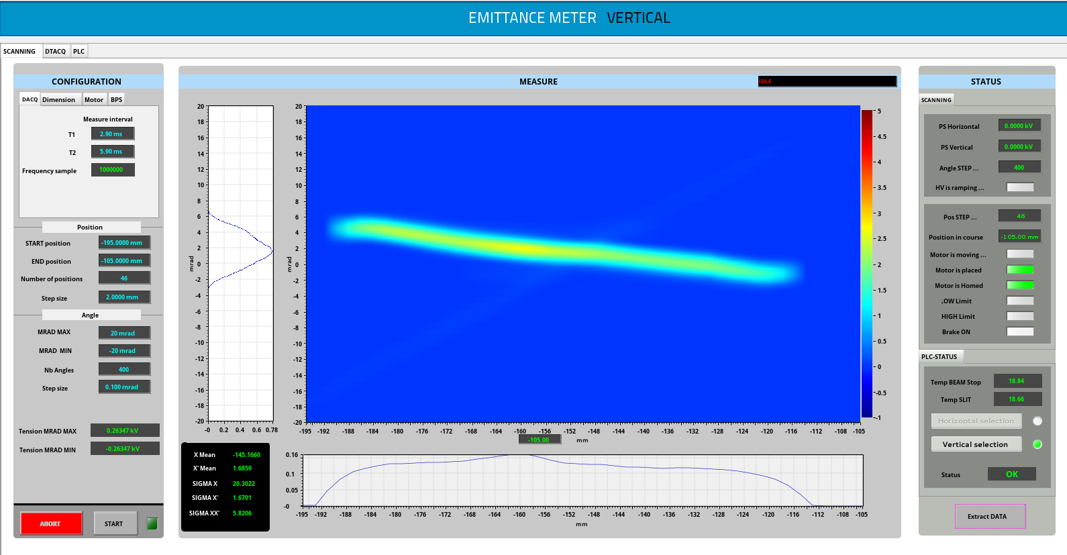
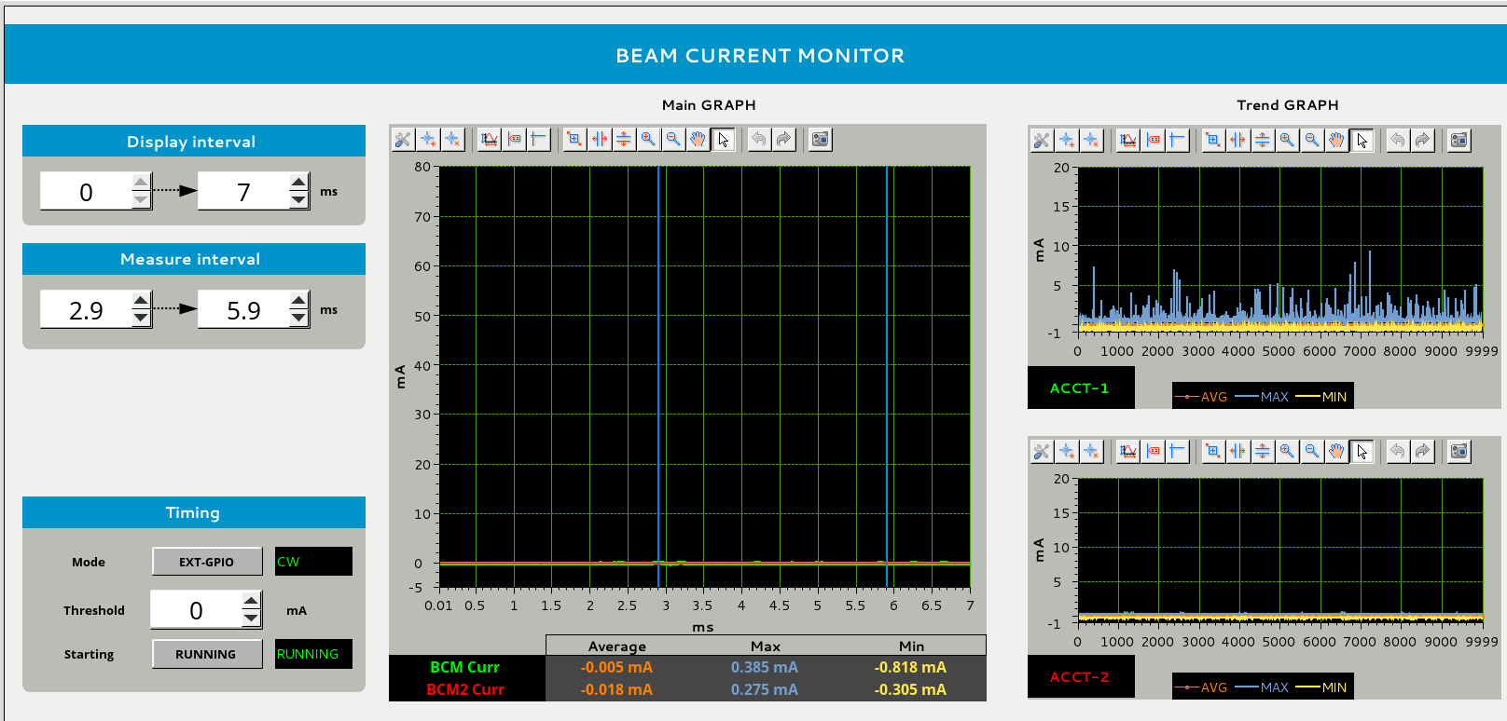
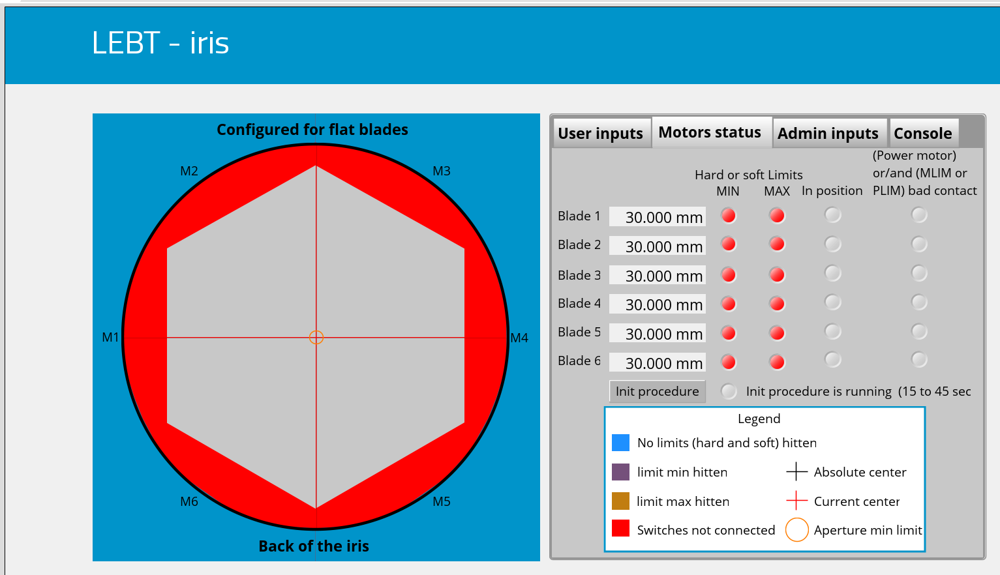
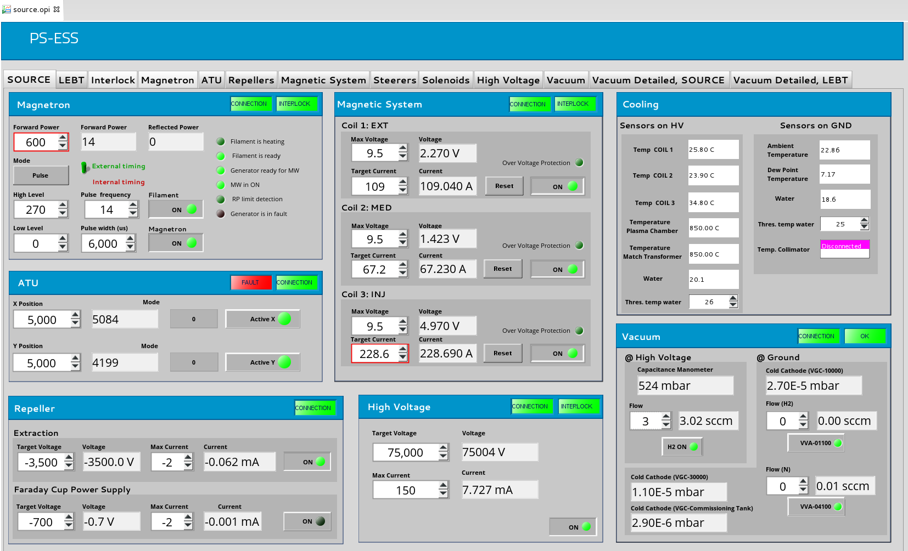
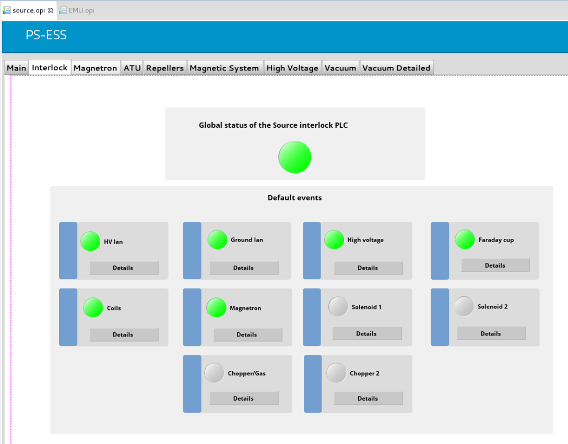
Technical challenges
Control GUI
Simplified GUI for the operator
to have everything under control
Notes:
Different GUIs, from hi-level overview to more detailed ones

Slide 14
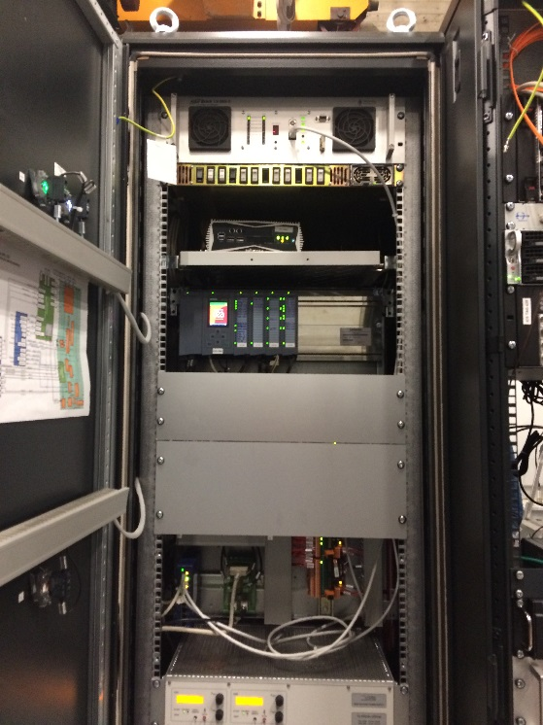
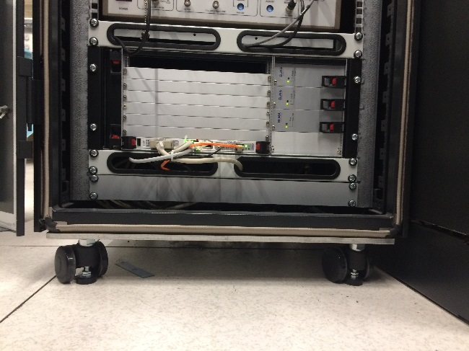
Technical challenges
Technical compromises
The integration strategy had to be tailored and adapted to the situation
  All standards were not fully defined
  Not all processes were established
  Due to schedule pressure we were advised to keep moving forward
  Expertise of teams involved allowed to mitigate potential risks
Prototype timing system deployed as it was required to run the machine
Machine modes were not defined
  Controls implementation made so that modes can be deployed in the future
VME system was used instead of µTCA
  µTCA systems were not mature and difficult to procure
Geobrick was used instead of EtherCAT for motion control
EPICS v3 used for stability at the time
MPS and PSS was not implemented
  However, the local protection system includes some MPS and PSS functions

Slide 15
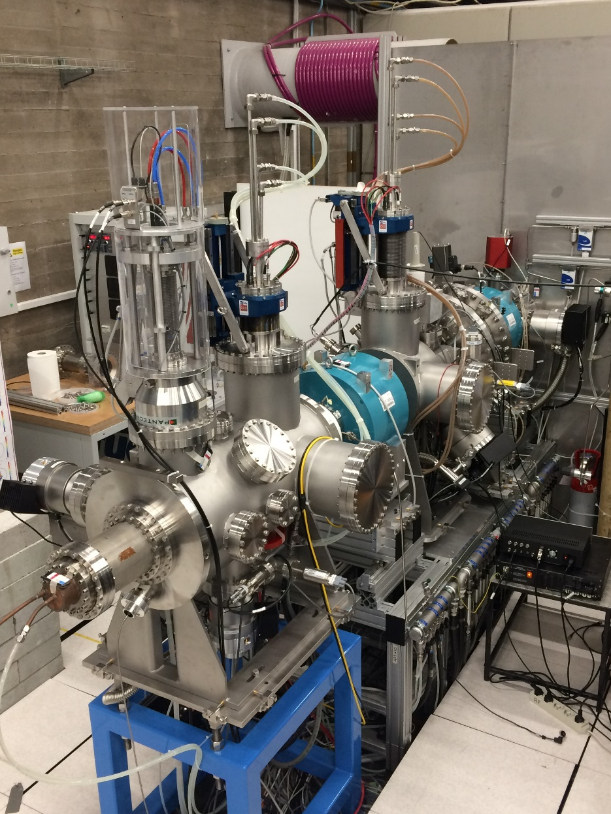
Technical challenges
Achievements
ISRC and LEBT is a reality!!!!
  ISRC Control system accepted in July 2017-07
  LEBT Control system accepted in 2017-09
Relevant documentation is available even though it still needs to be collected into one place
  Wiring list
  I/O Signals
  Datasheets
  user manuals
  …
All EPICS modules are under configuration control
  Version
  Tested
  Documented
All equipment is integrated in the control system

Slide 16
Outline
Overview
Organization and coordination
Technical challenges
Lessons learnt
Conclusions

Slide 17
Lessons
General
Structure, methodologies, processes and standards were not fully defined since the beginning
  This led to several technical compromises in the implementation
ISRC and LEBT was seen as "test stand" more than a final system
  Some systems need to be updated
    From VME to µTCA
    Timing system
    Motion control (Geobrick -> EtherCAT)
Compression in time schedule led to take fast decisions on the fly
  This require a structure inspired to the "agile" thinking
Lesson learned: Processes and standards need to be prepared early
Lesson learned: Schedule pressure creates “prototype systems” that are expensive to maintain

Slide 18
Lessons
Organization and coordination
All the teams involved communicated regularly in a good ‘atmosphere’
  A team spread over different countries is challenging and can be very time consuming
  Different teams have different views and expectations.
We have always to keep in mind how efficient the communication is
  Are the meetings efficient and solve problems?
  Do we need to have in regular meetings are they useful to improve the system understanding and speed up the process?
  Do we prioritize issues properly?
Sometimes lack of communication and alignment between all parties
  "Who is doing what?", misunderstanding, delays
Even the strongest team players have a tendency to try to solve problems on their own
Documentation is “distributed" and sometimes not fully updated
Lesson learned: Structured communication is essential for collaborating in a distributed team
Lesson learned: Roles and responsibilities need to be clearly defined

Slide 19
Lessons
Installation
This was the first time a real system installation happened at ESS
  There are many experiences made that can be used in future installations
Installation work involves a huge number of decisions that should not be underestimated in terms of time
Good communication between all involved parties is essential to drive the installation in the right way
The installation should be seen as for the whole system, not “my part and then your part”
Lesson learned: Installation requires careful planning and preparation
Lesson learned: Even if we are well prepared, collaboration and communication is needed to mitigate inevitable surprises

Slide 20
Lessons
Continuous Improvement
Example of continuous improvement through lessons learned
Experience:
Beam-induced damage of the Emittance Measurement Unit
Analysis:
Delays led to aggressive commissioning schedule and ad-hoc activities.
EMU operated without complete verification.
Lesson learned: conduct of operations with a proper plan and verification.
Lesion learned: Measure ”safe” beam prior to increasing duty factor.
Molten tungsten - Emittance Measurement Unit

Slide 21
Outline
Overview
Organization and coordination
Technical challenges
Lessons learnt
Conclusions

Slide 22
Conclusions
ISRC and LEBT are the first elements, result of a strong collaboration of different teams
We have had issues, of course!
  We have to extract many good lessons from them in order to avoid the same mistakes.
ISRC and LEBT are the starting point from which ESS has to improve methodology, structure, process and knowledge.
The synergy between all parties is essential to avoid decision has to be reconsidered after
  We have to improve communication with partners

Slide 23
Questions?
Thank you!

