Slide 1
Neutronic calculations in support of Light Shutter System
L. Zanini, ESS
Group Leader Neutronics
TAC17, 12 April 2018

Slide 2
CONTENTS
MODELS
Gamma source term and comparison with ISIS
Gamma shutter thickness
Activation of gamma shutter and bridge beam guide
Option of no Bridge Beam Guide

Slide 3
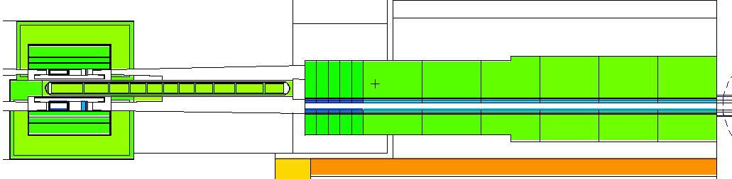
Calculation tools used for the reports
Activation of Target area and NBPI are treated separately
MCNPX runs from protons or form source term at 2 m. -> fluxes
Activation using CINDER
  Gamma source generation
Gamma transport with MCNPX
-> dose rates
Activation includes:
  Target (W+SS316L)
  Reflector
  Moderators
  Inner shielding
  NBPI (SS316L + substrate)

Slide 4
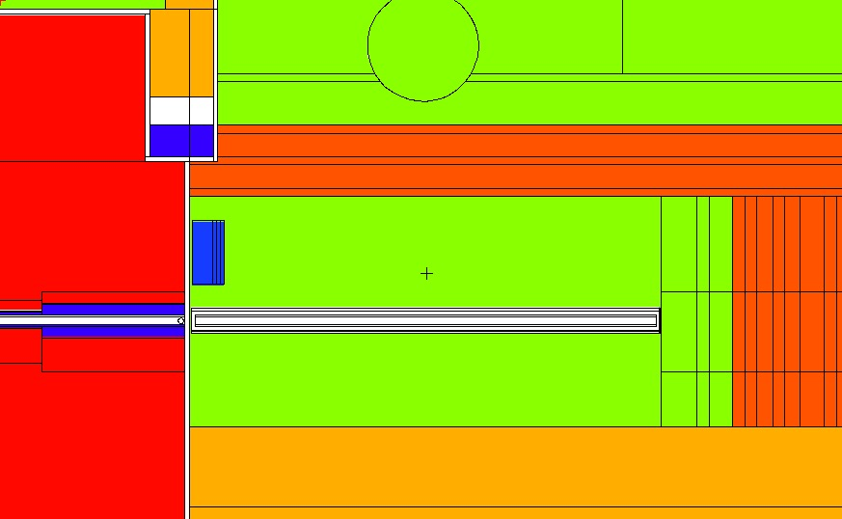
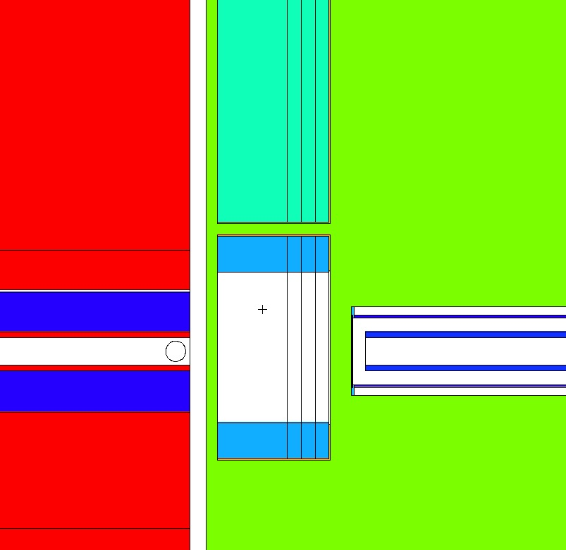
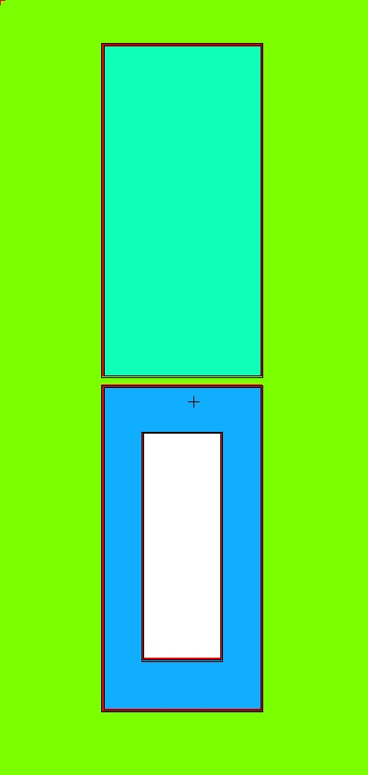
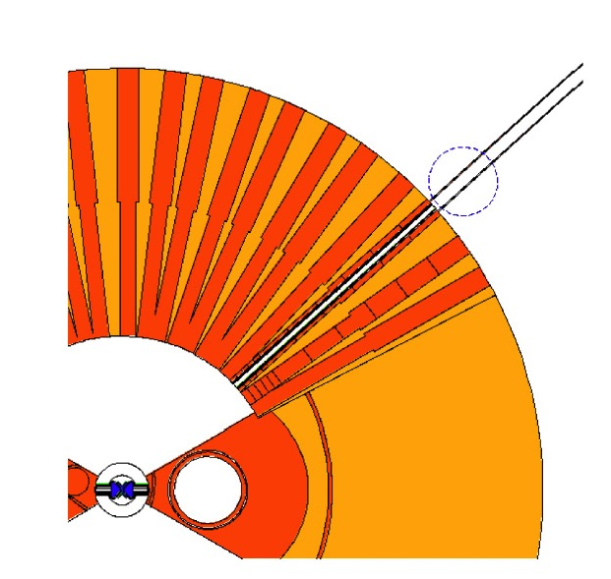
Geometry of shutters inside bunker
CSPEC (7 cm X 5.5 cm)

Slide 5
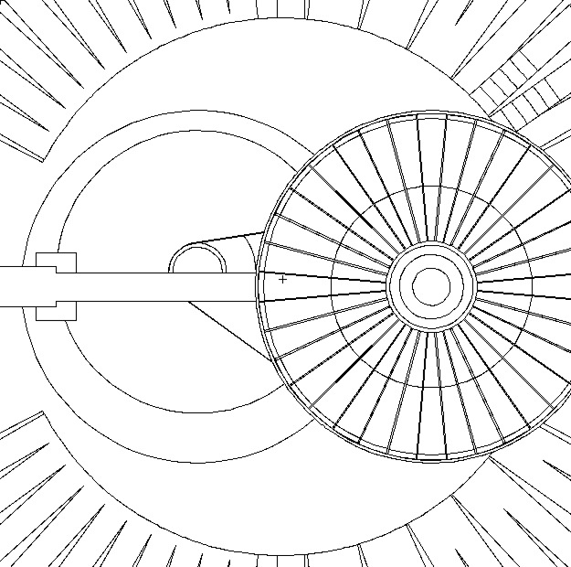
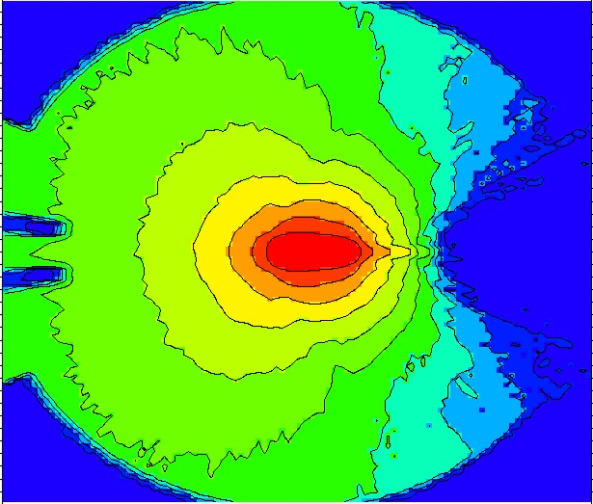
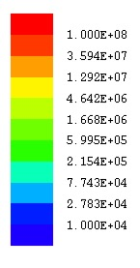
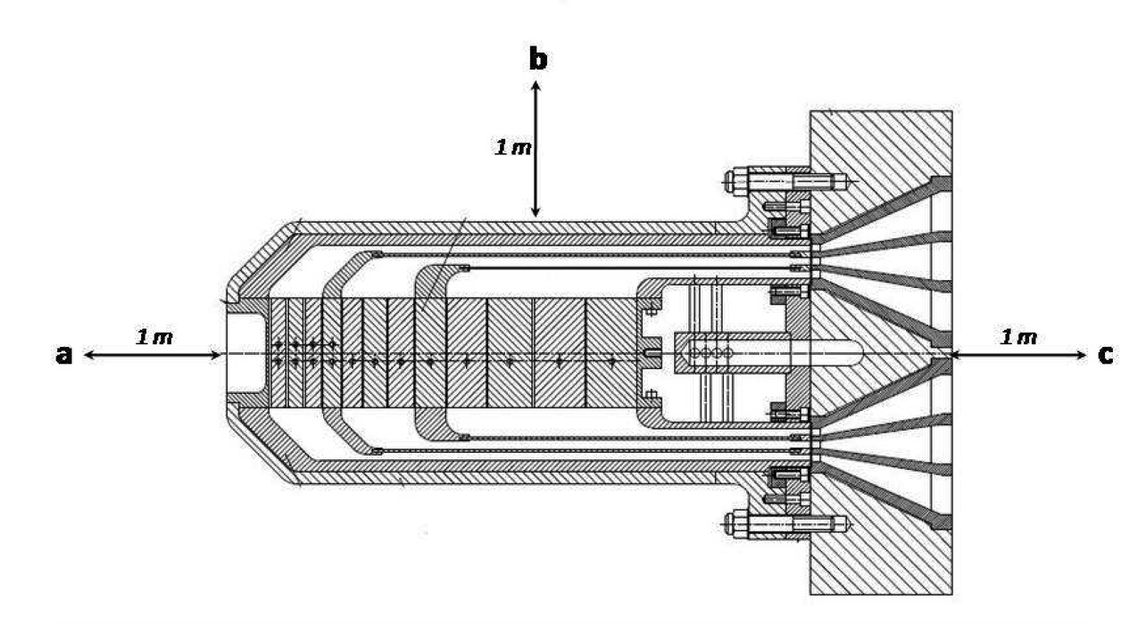
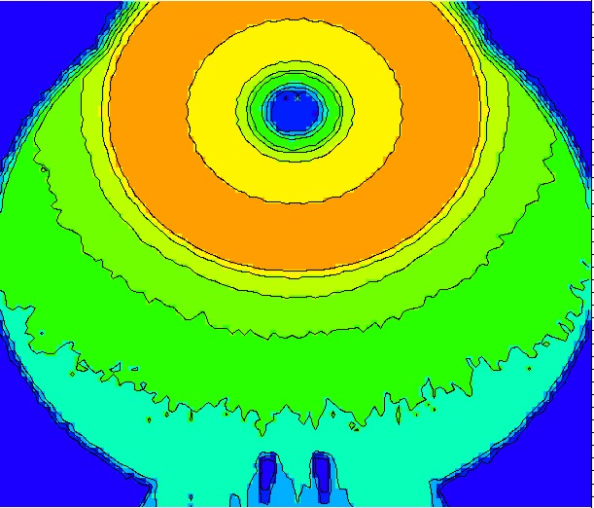
Comparison with ISIS TS1 activation. Activation of ISS target for ISIS TS1 conditions: similar results
1.5 Sv/h (only W) at ISIS power
μSv/h
ISIS irradiation: 2676 mA hr
( = 0.046 MW for 5 years), 1 day decay
3.8 Sv/h
(only W)
(G. Skoro, ISIS)
with rotating target the activity is spread

Slide 6
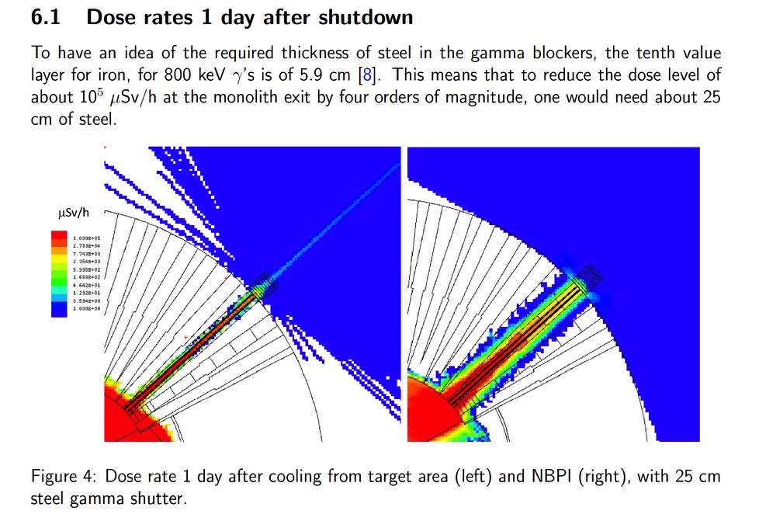
Shutter thickness and material
40 cm mild steel
From target
30 cm enough to shield gammas from target and NBPI for the considered CSPEC case
Recommended shutter thickness of at least 40 cm to account for worst cases and to be conservative.
see ESS-0213543
From NBPI

Slide 7
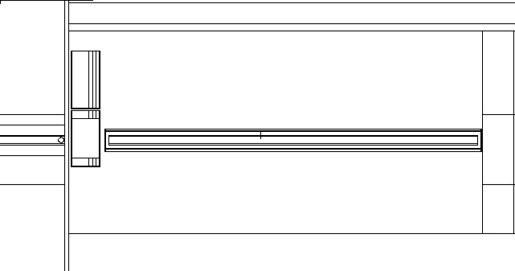
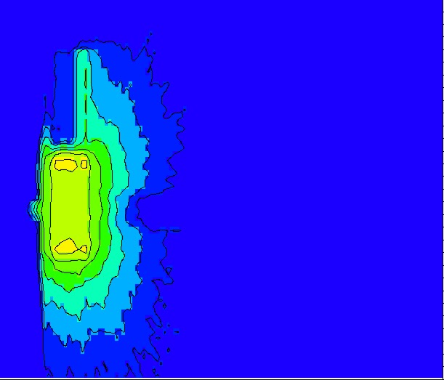
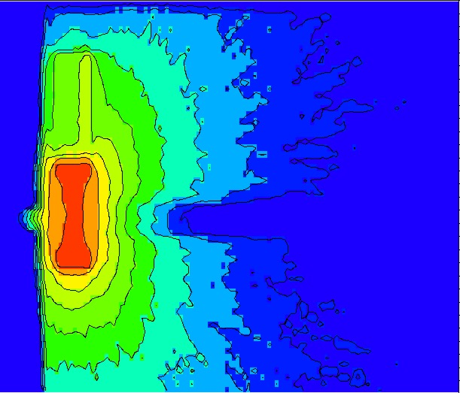
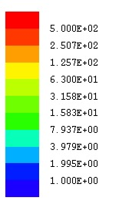
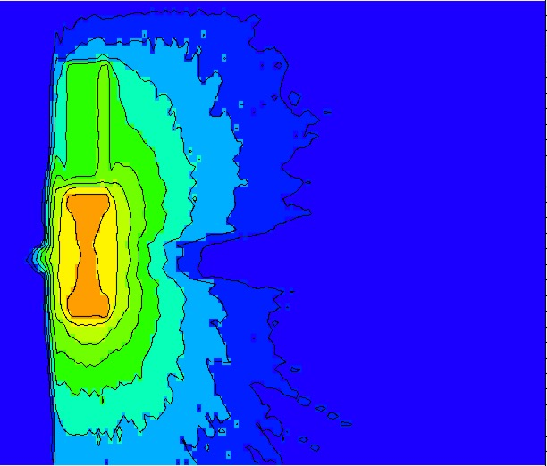
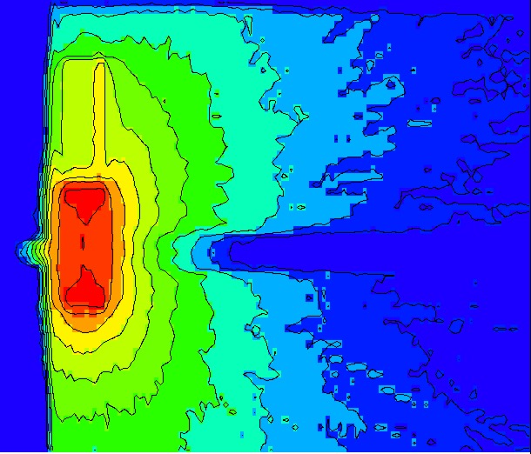
BBG and GBS of mild steel,
and effect of cobalt impurity
10 years irradiation, 1 day decay, BBG and GBS of mild steel
0.% Co
0.05% Co
μSv/h
0.10% Co
0.018% Co (reference)

Slide 8
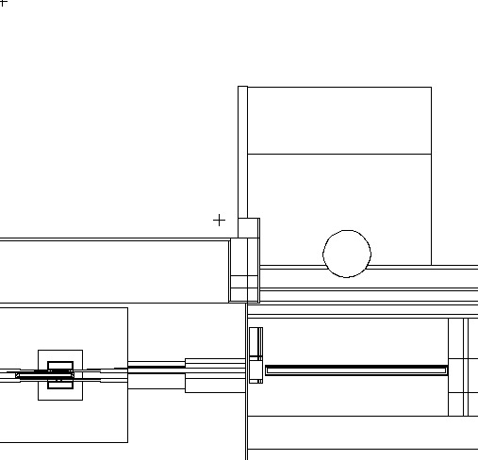
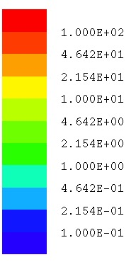
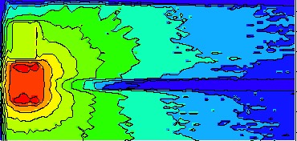
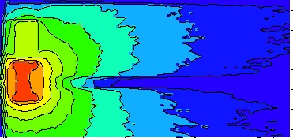
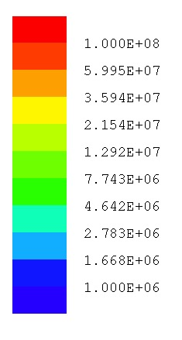
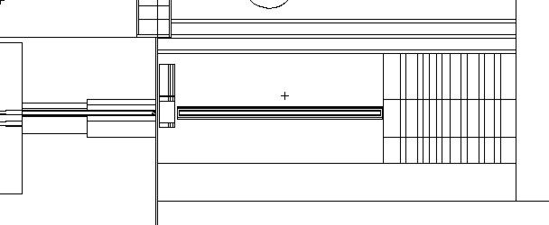
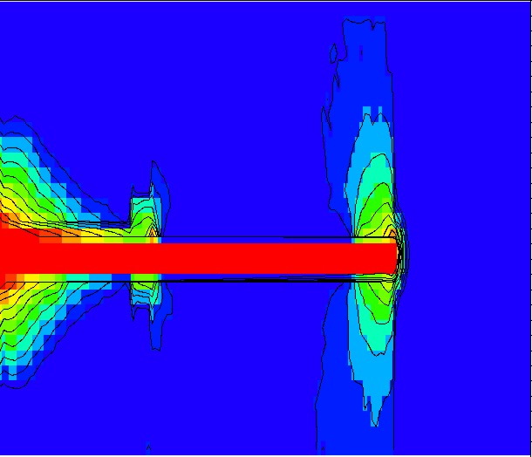
ACTIVATION OF BBG (CuCrZr) AND GBS (mild steel) FROM BEAM
With Borated
poly layer
no layer
3 day decay
μSv/h
6 m
n/cm2/s
E < 1 eV flux

Slide 9
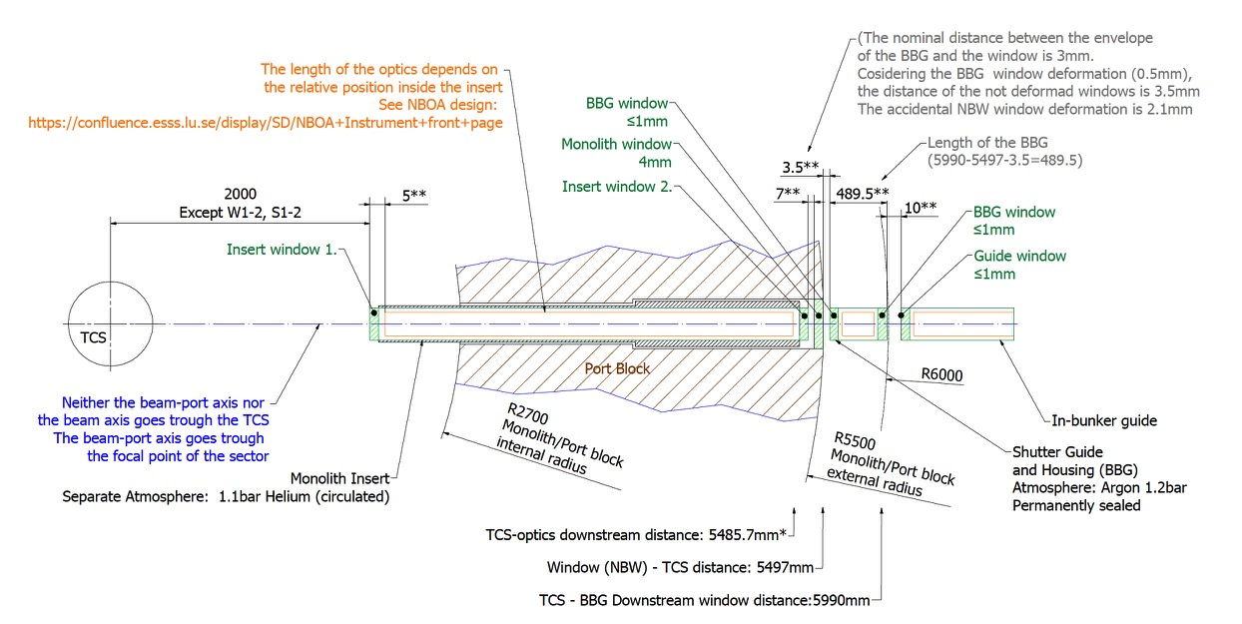
Option of no BBG. Main neutronic advantage would be the removal of two windows.
(G. Laszlo)

Slide 10
Option of no BBG. Guide installation and removal
(F. Mezei)

Slide 11
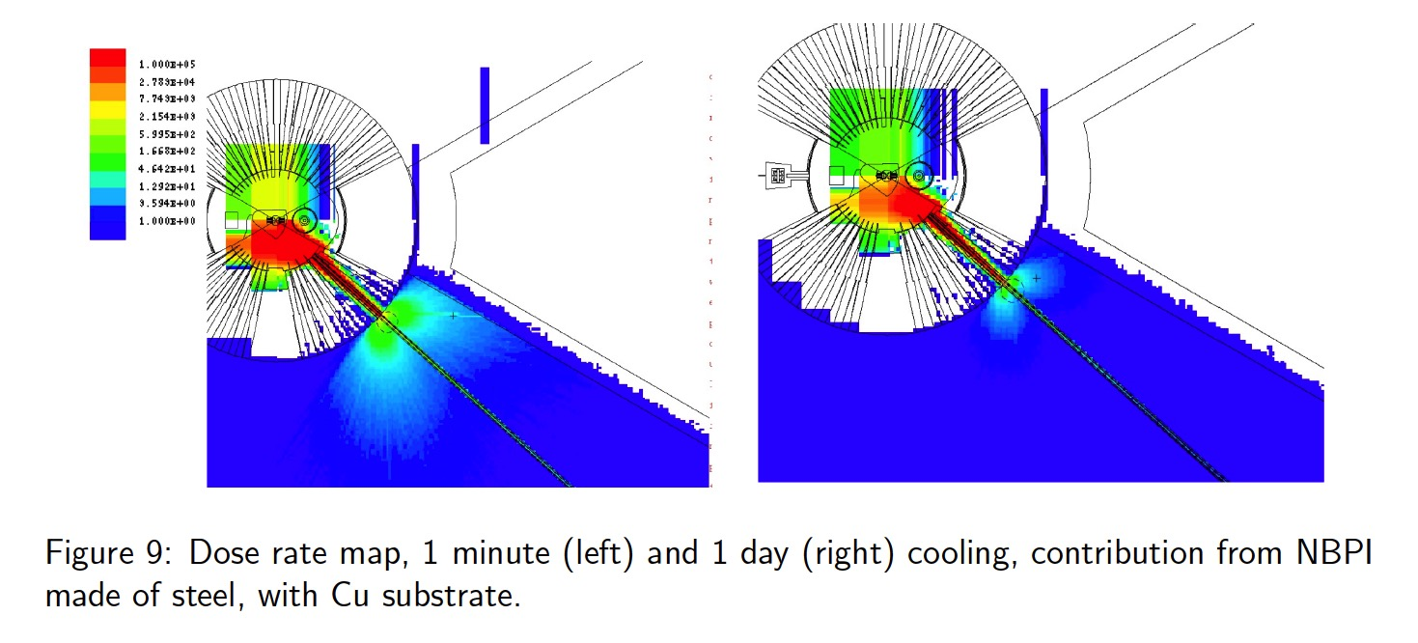
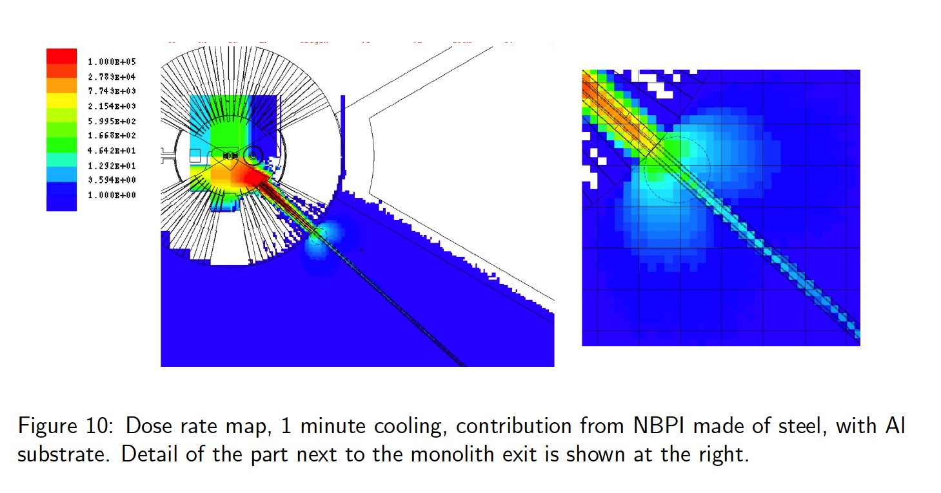
Option of no BBG
Dose rates from NBPI
μSv/h
If there is no BBG, shielding of gamma is provided by guide substrate and vacuum pipe.
From the NBPI activation, radiation is scattered, however it is localized close to the guide exit and dominated by substrate activation

Slide 12
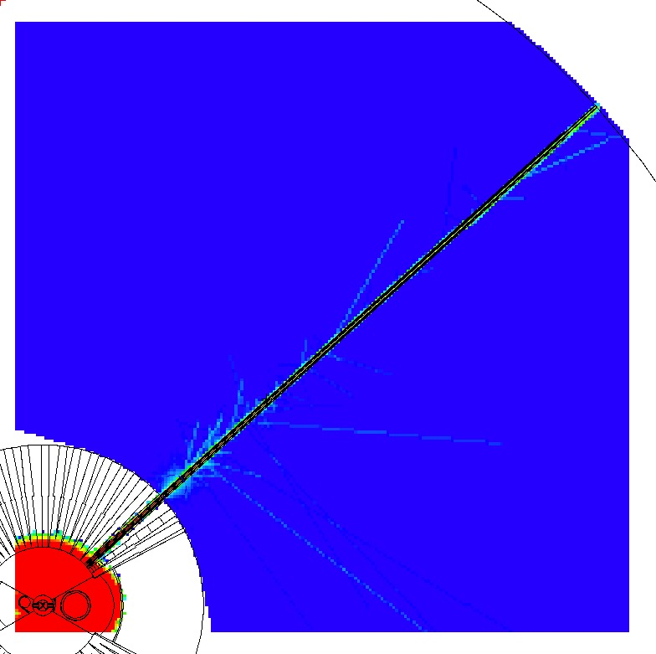
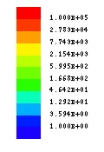
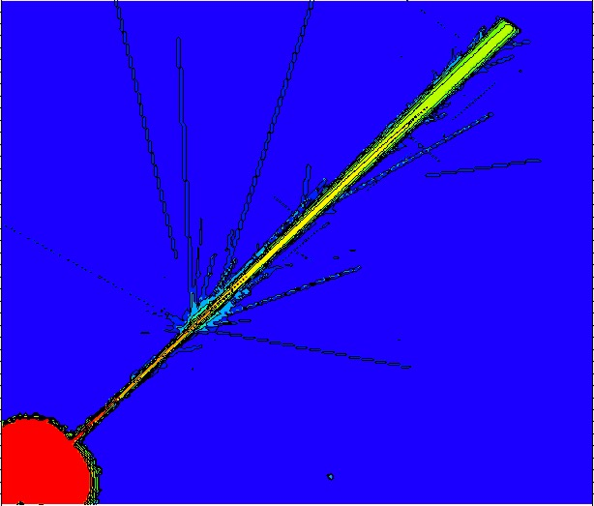
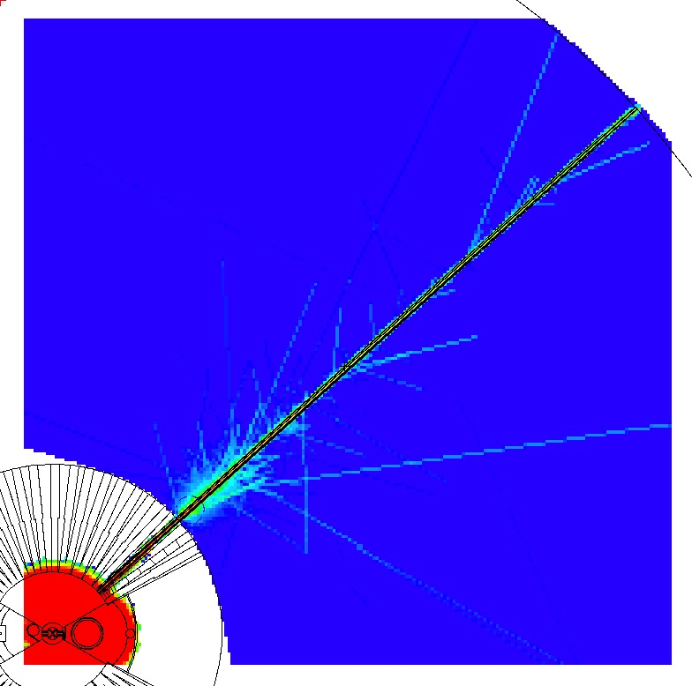
Option of no BBG
Guide substrate (plus Al vacuum pipe) can shield the gamma from the target area
Cu substrate
10 years irradiation, 1 day decay
μSv/h
Dose rates from target
No substrate
Scattering from 10 mm Al window would give small increase to dose rate
NBK7 substrate

Slide 13
SUMMARY
Gamma shutter material and thickness selected
  mild steel
  low cobalt content (< 0.02%) recommended
  40 cm thick recommended
  Activation values for shutter, BBG, available
    Should be integrated with comprehensive activation study of bunker materials
If no BBG is used, gamma radiation is contained by substrate material and possibly vacuum pipe.
  Gamma scattering from Al windows negligible

Slide 14
REPORTS
Dose rates in the bunker with and without the use of light shutter gamma blockers. CHESS ESS-0213543 - released
  Thickness of gamma shutters
  Shielding from vacuum pipe, in case no BBG is used
Shielding of the neutron beam port inserts during extraction: baseline solution ESS-0094274 – under review
  NBPI activation and thickness of lead shielding
Bunker value engineering neutronic study: options for walls and roof of heavy concrete. ESS-0246564 – under review
  Comprehensive neutronic study of the bunker with heavy concrete walls and roof.
In preparation:
Activation and dose rates from Gamma Beam Shutter and Bridge Beam Guide
  Activation and dose rates of GBS and BBG

Slide 15
BACKUP SLIDES

Slide 16
CSPEC case used for CHESS ESS-0213543
(ESTIA and FREIA and test beam line potentially worst)
Beam openings at 2 m. Compiled by A. Takibayev from drawings from I. Sutton
Instrument | Tip | Tip
Name | Height | Width | area
[-] | [cm] | [cm]
ODIN | 3.3 | 4.38 | 14.45
DREAM | 2.39 | ?
VESPA | 3.5 | 3.5 | 12.25
SKADI | 3 | 3 | 9
ESTIA | 13.428 | 6.713 | 90.14
FREIA | 13.8 | 4 | 55.2
LOKI | 2.5 | 3 | 7.5
HEIMDAL|C | 2 | 2 | 4
HEIMDAL|T | 3.494 | 6.722 | 23.49
TREX | 3 | 9 | 27
MAGIC | 3 | 12.4 | 37.2
MIRACLES | 4.9 | 6.05 | 29.65
BIFROST | 3.463 | 6.873 | 23.8
CSPEC | 5.5 | 7 | 38.5
BEER | 3.5 | 8.5 | 29.75
NMX | 2.8 | 3 | 8.4

Slide 17
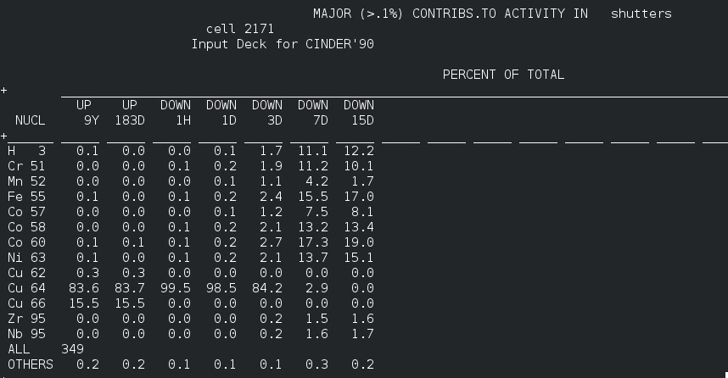
Major activity contributors in CuCrZr

Slide 18
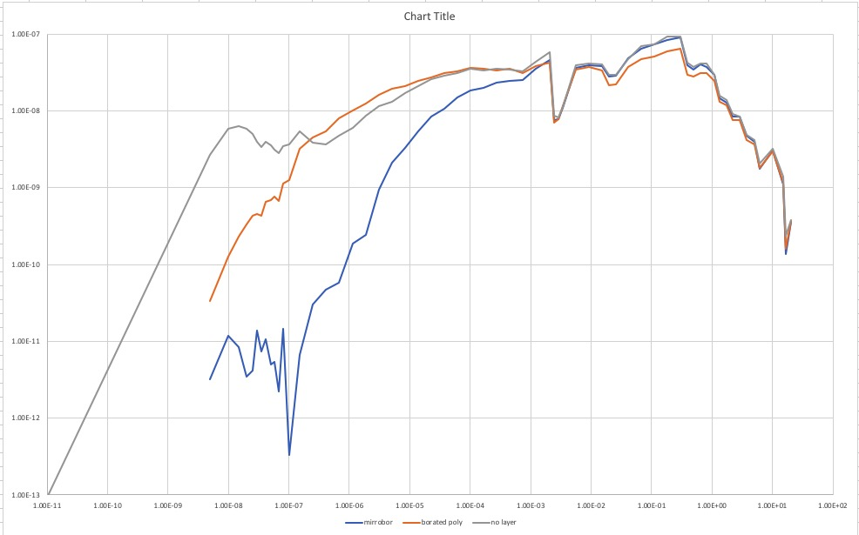
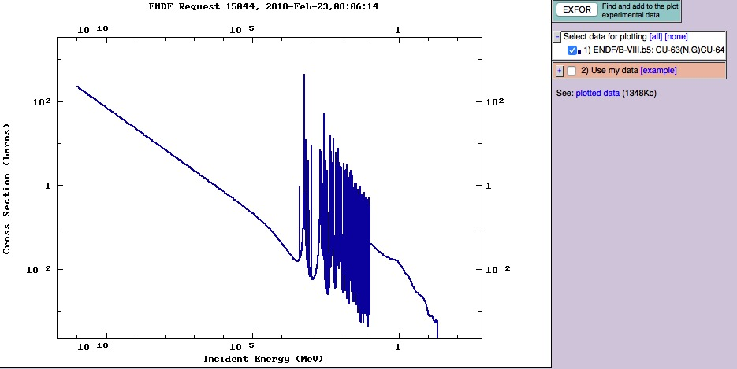
Effect of boron layers on activation
Cu 64 production from Cu63
σ (25 meV) = 4.47 b
B poly
mirrobor
Still substantial activation due to resonance capture

Slide 19
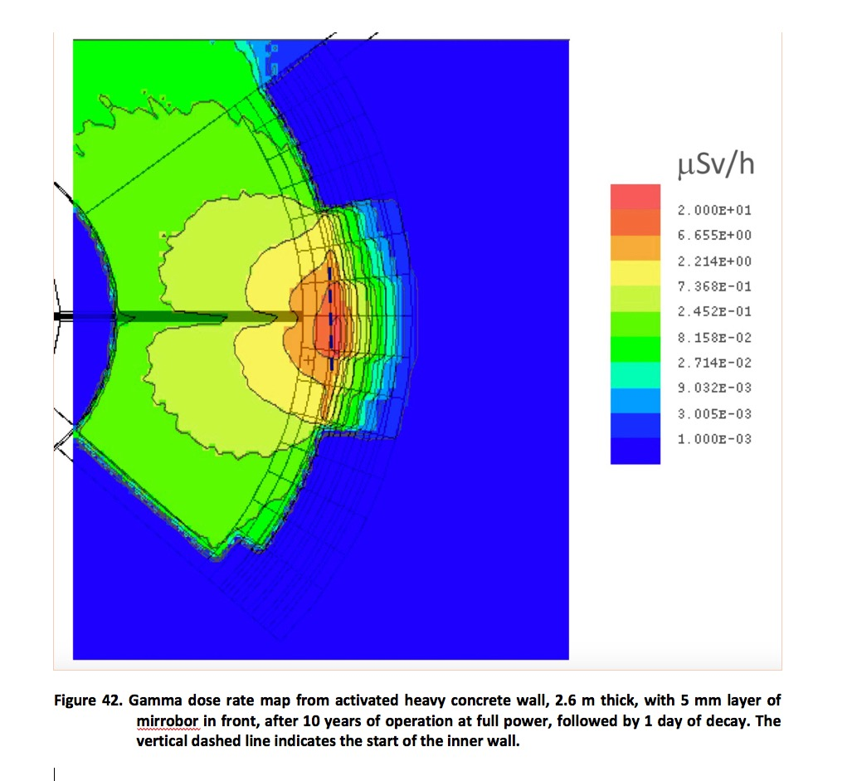
Comparison: activation of bunker wall (assuming Heavy concrete)

Slide 20
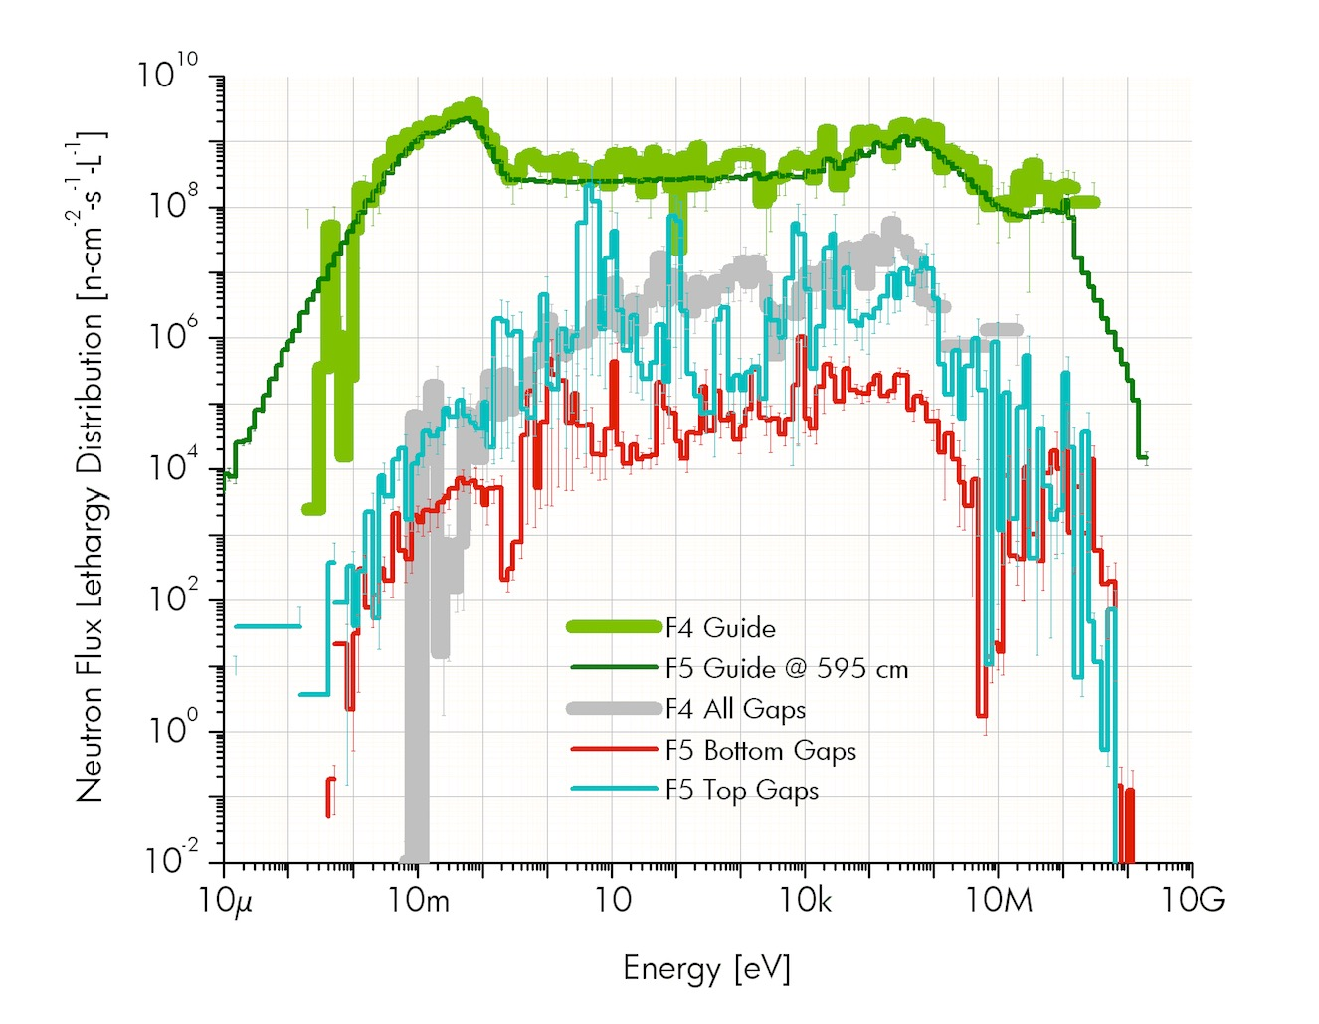
Activation , when in beam plug, for 40 years, from gaps
 | Max flux [n/cm2/s]
Guide exit | 1.6 10¹⁰
Maximum flux at gaps, with guide | 1.1 10⁸
Maximum flux at gaps, with plug | 6 10⁵
The flux at the gaps, for the NBPI without guide is more than two orders of magnitude lower than the flux from back scattered neutrons in the bunker: the activation of a GBS positioned at the NBPI extreme, will therefore be dominated by these back scattered neutrons.
Flux at gaps WITH guides is much higher.
It might be worthwhile to have shielding material in the BBG
(A. Takibayev)

