Slide 1

Commissioning status
of the first Solid-State Power Amplifier
SLHiPP-8, Uppsala, June 12-13th, 2018
F. Pompon, franck.pompon@sckcen.be

Slide 2
Outline
MYRRHA phase 1
Injector status
RFQ SSA design
RFQ SSA integration
RFQ SSA first commissioning results
RFQ SSA final integration and commissioning plan
Conclusions and perspectives
Q&A

Slide 3
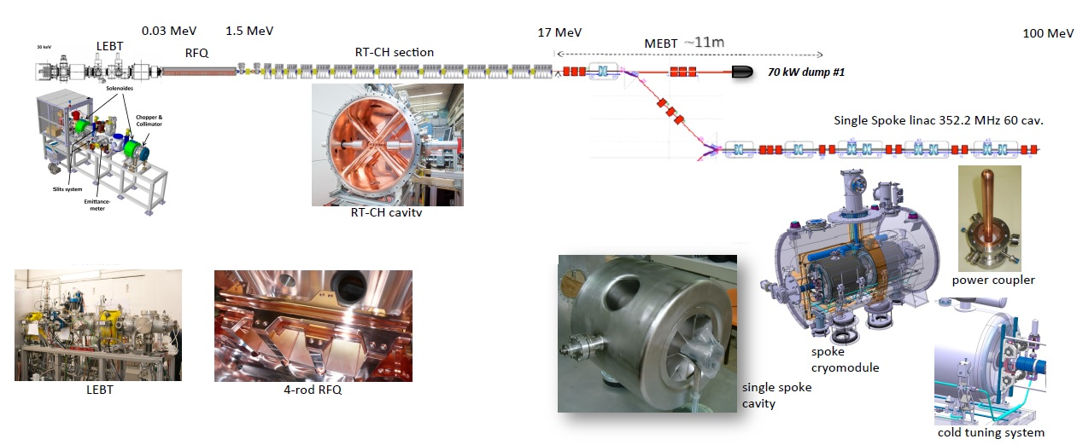
MYRRHA phase 1
MINERVA = 100 MeV proton linac with one injector + Proton Target Facility
A fraction of the beam redirected to the Target Facility
Currently manufactured and installed at UCL-CRC (Louvain-la-Neuve), up to RT-CH#7 (5.9 MeV)
400 kW dump
Proton
Target
Facility
Source: SCK•CEN MYRRHA Project Team

Slide 4
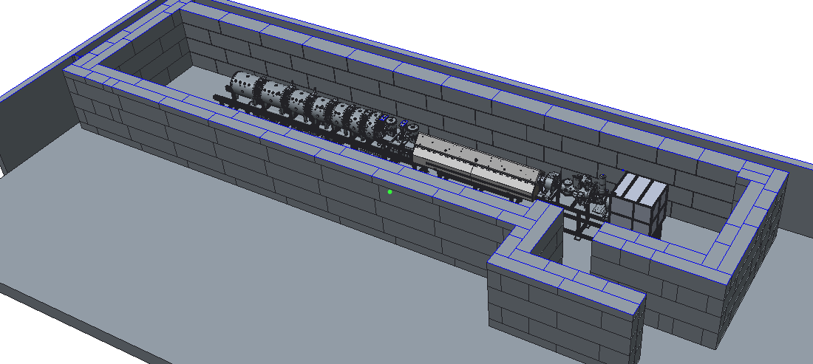
Current status at SCK•CEN vault at UCL/CRC
Current status of the 5.9 MeV injector:
  The injector facilities are ready (electrical, cooling…)
  The Proton source and LEBT are installed and almost ready for re-commissioning
  The RFQ amplifier is in place, integration with its test-bench is on going
  The RFQ cavity has been delivered and stored in the bunker
  The two rebuncher cavities, magnets and couplers are under manufacturing
  The two first CH cavities are manufactured and currently under low power tests
RFQ cavity
Proton source and LEBT
CH1 and CH2 cavities
Rebuncher cavities (MEBT1)
Source: SCK•CEN MYRRHA Project Team

Slide 5
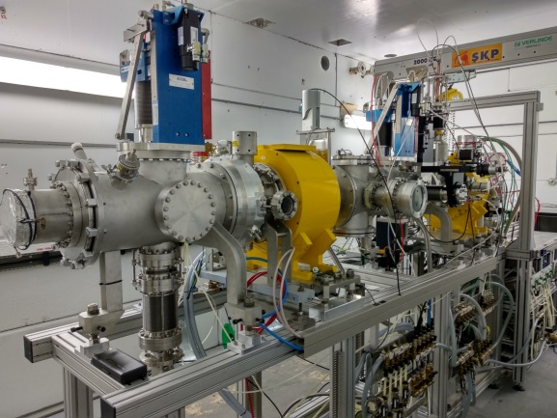
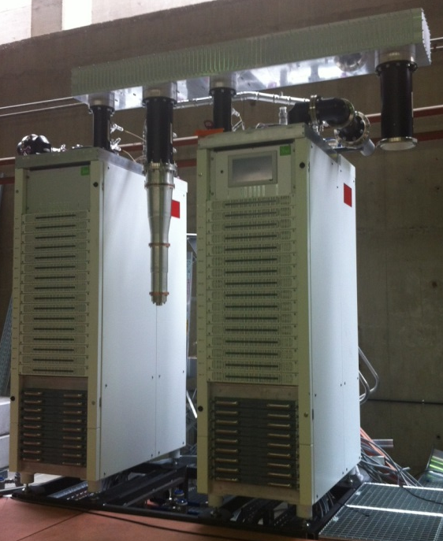
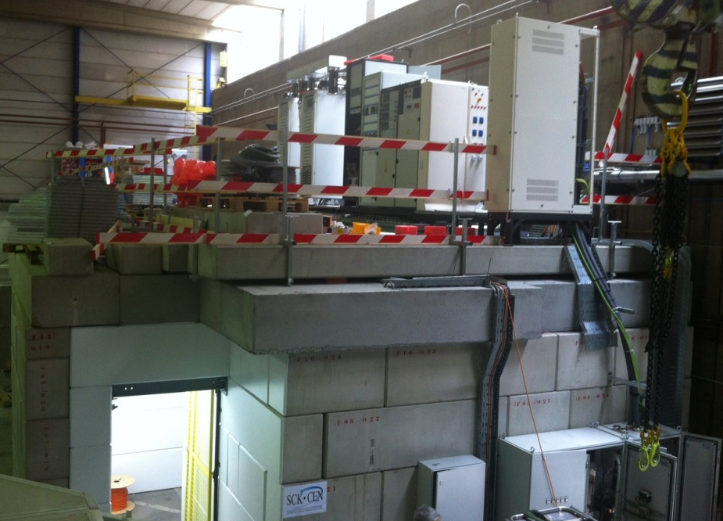
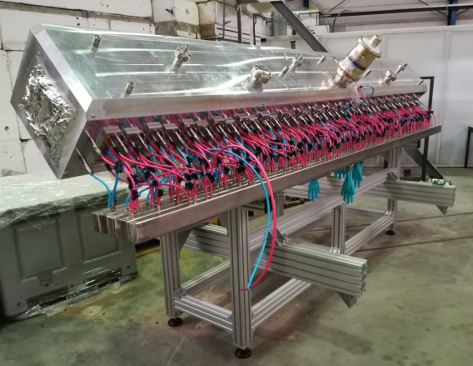
Current status at SCK•CEN vault at UCL/CRC
Proton source and LEBT
RFQ SSA amplifier
RFQ cavity
Roof and entrance of the vault
Source: SCK•CEN MYRRHA Project Team

Slide 6
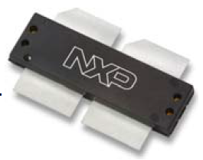
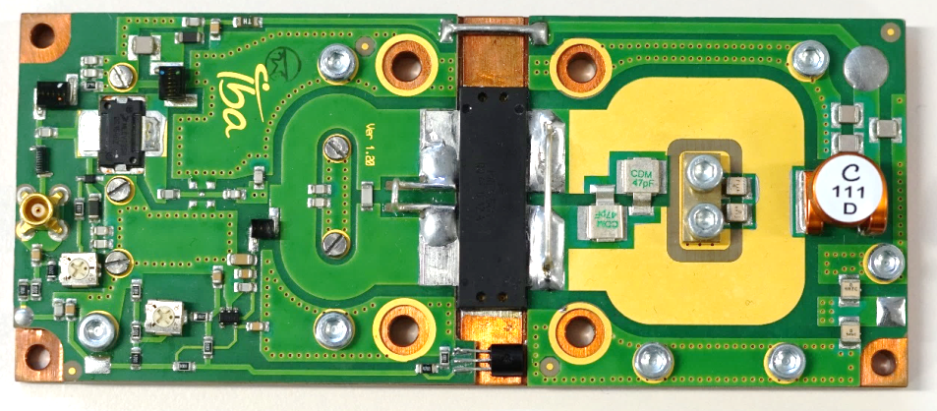
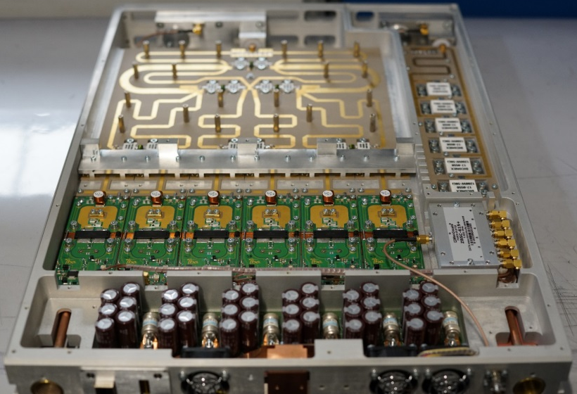
RFQ SSA design
MARISA Project (09/2013 -> 09/2016)
  IBA made a conceptual design of a 160kW-176MHz CW Solid-State Amplifier
MYRTE Project (04/2015 -> 04/2019)
  IBA had the task to manufacture the first Solid-State amplifier prototype
1 kW elementary RF pallet
  Active device: MRF1K50N
  Including driver
  Optimized design with CST Microwave Studio
  Planar technology for good reproducibility
  Class B operation
6 kW integrated rack
  Using a Wilkinson combiner (6 -> 3 -> 1)
  Optimized design with CST Microwave Studio and Spice
  Minimized losses and high isolation between inputs
  Planar technology
  50 W driver amplifier + 1-to-6 splitter
  7 kW dummy load
  Measures and protections
  Electronics for control and communication
Source: SCK•CEN MYRRHA Project Team

Slide 7
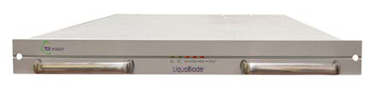
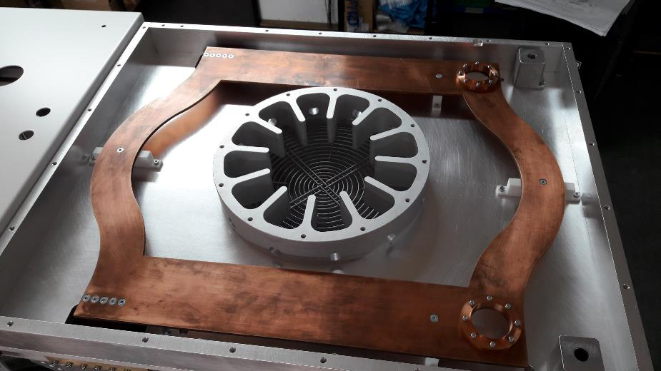
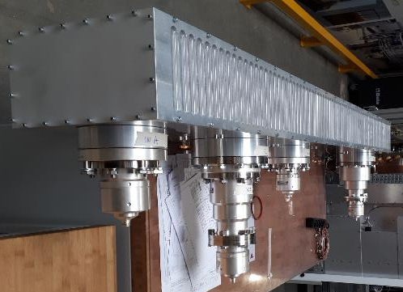
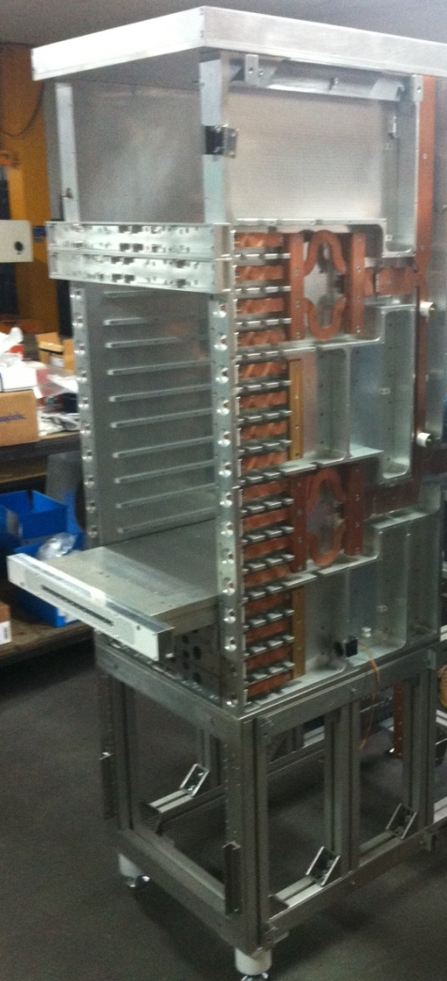
RFQ SSA design
16,5 kW power supply unit
  Water cooled for compactness (1 U)
  High reliability
  Easy maintainability (hot swap)
6 kW to 192 kW combining structures
  Gysel combiner (6 -> 24 kW)
  Coupled line combiner (24 -> 48 kW)
  Branch-line combiner (48 -> 96 kW)
  Coupled line combiner (96 -> 192 kW)
Source: SCK•CEN MYRRHA Project Team

Slide 8
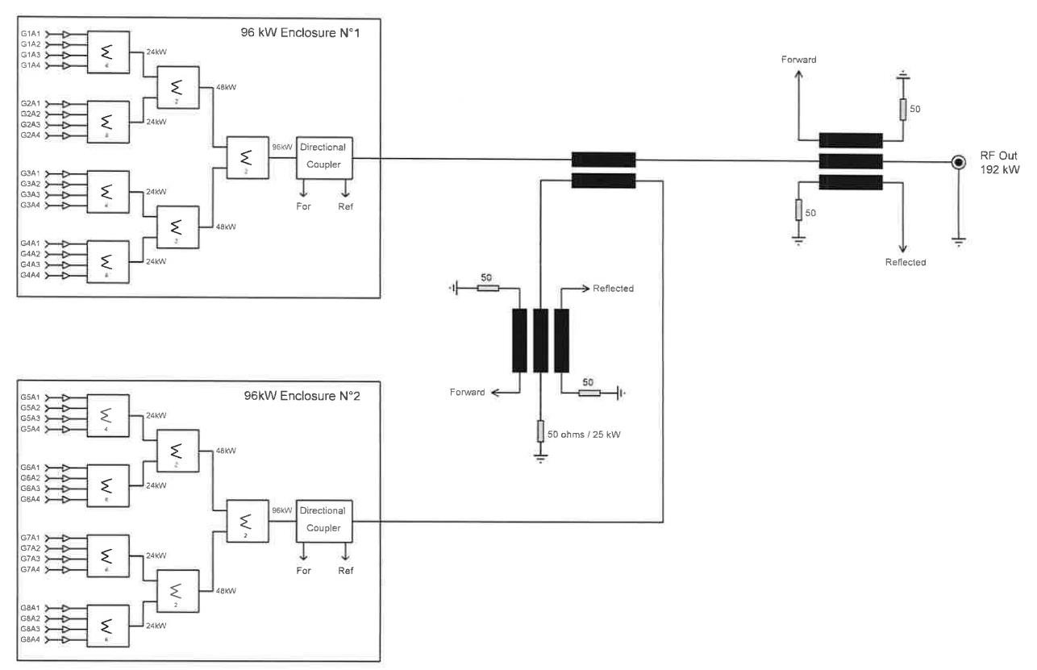
RFQ SSA integration
Source: SCK•CEN MYRRHA Project Team

Slide 9
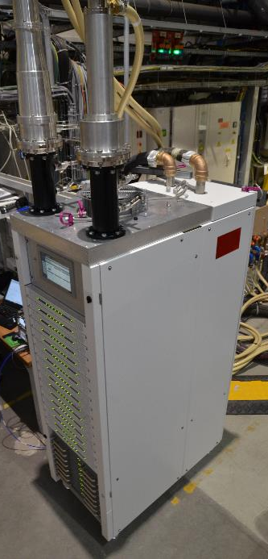
RFQ SSA first commissioning results
Factory commissioning performed at IBA
  Each cabinet (96 kW CW) has been tested separately, on matched load
  The external 3 dB combiner has been tested at low level
1 kW RF pallet production results (over 50 items)
  Very good gain homogeneity (+/- 0,25 dB)
  Optimized RF to DC efficiency
Source: SCK•CEN MYRRHA Project Team

Slide 10
RFQ SSA first commissioning results
Almost 100 kW CW RF power easily reached, per cabinet
Max DC to RF efficiency = 72,6 %
Max AC to RF efficiency = 65,7 %
AC to RF efficiency at operating point = 55 % -> can be improved by V_{DD} adjustment
Gain variation over 20 dB input dynamic = 7,5 dB
Absolute phase variation over 20 dB input dynamic = 34,8 deg
Expected to be acceptable for the LLRF stability requirements
Operating point ~ 55 kW
Operating point (77,5 dBm)
Source: SCK•CEN MYRRHA Project Team

Slide 11
RFQ SSA first commissioning results
DC current and power dispersion
  At 82 kW CW output power per cabinet
  192 pallets (1 kW)
  32 racks (6 kW)
  About 1 kW losses through combiners (~ 0,05 dB)
Minor failure detected afterwards on drivers

Slide 12
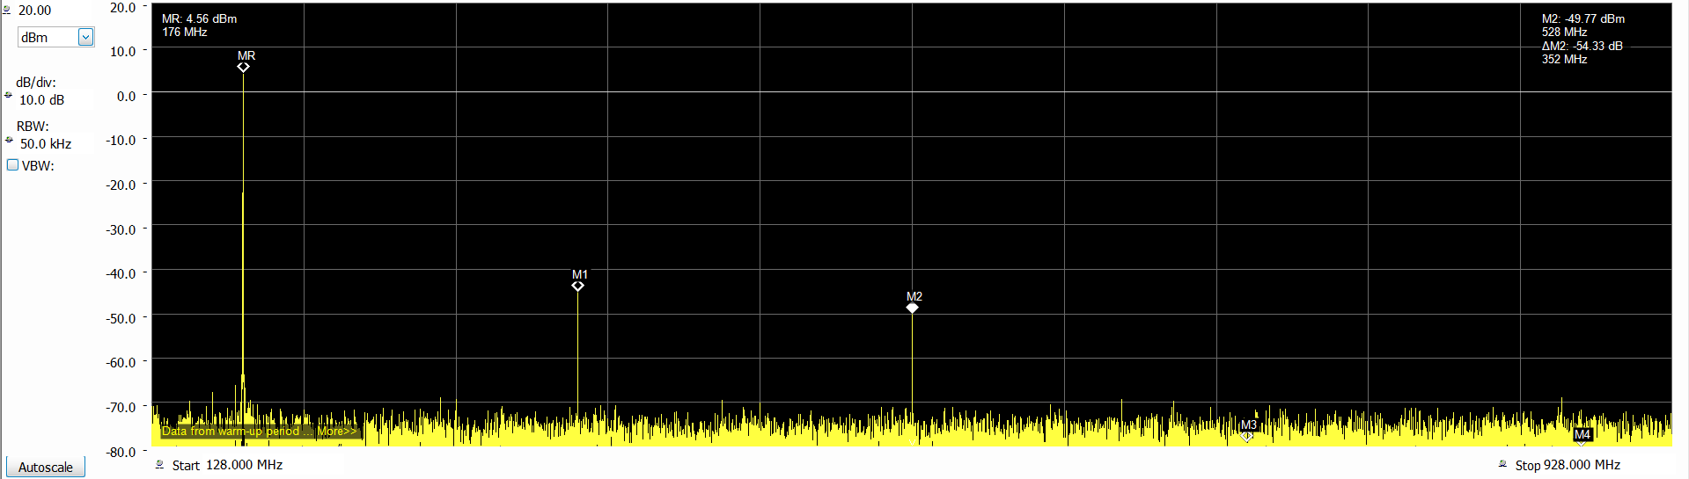
RFQ SSA first commissioning results
Harmonics content at 71 kW output power
  Excellent signal purity thanks to multiple combiner effect
Harmonics | Level (dBc)
H2 (352 MHz) | -55
H3 (528 MHz) | -63
H4 (704 MHz) | Below noise
H5 (880 MHz) | Below noise

Slide 13
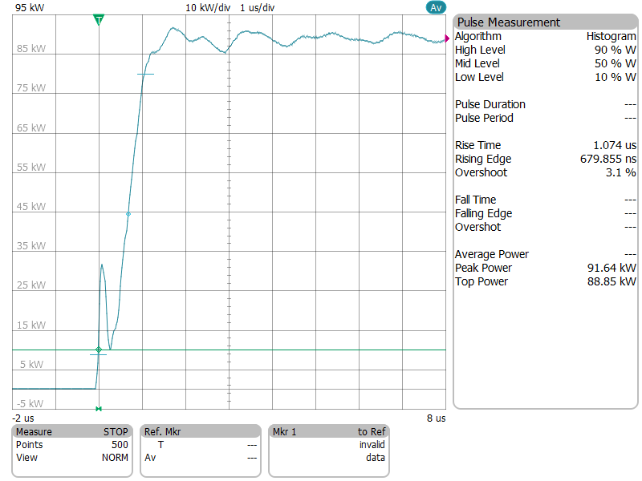
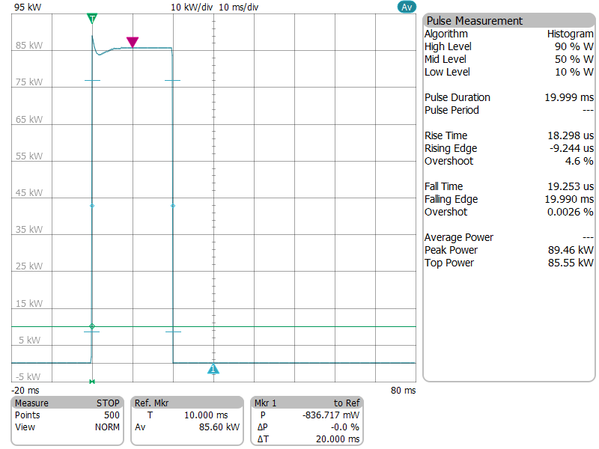
RFQ SSA first commissioning results
Pulse modulation @ 85 kW – 20 ms length
  Rise time ~ 1 µs
  Overshoot = 4.5 %
  Transient shape due to voltage ringing on transistor supply (low decoupling capacitor for low energy storage)
  Time to stabilize > 5 ms (seems to be linked to transistor supply -> to be further investigated)

Slide 14
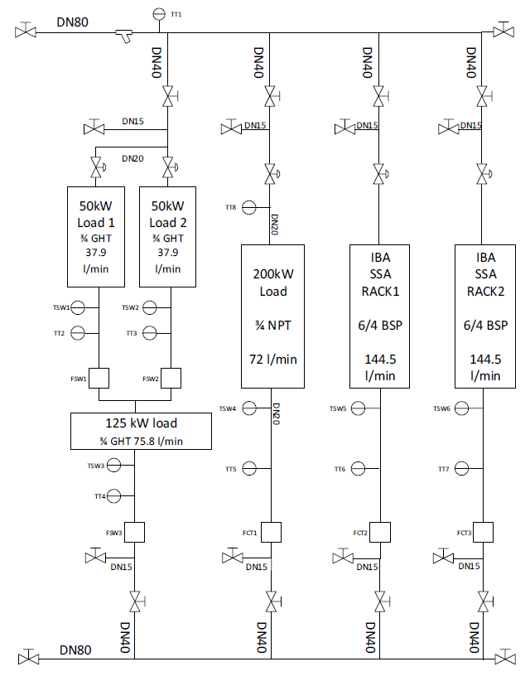

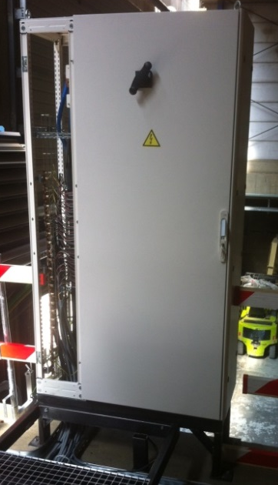
RFQ SSA integration at UCL/CRC
Low level characterization of directionnal couplers
  Including attenuator, filter and cable (w/o filter for spectrum measurement)
  Up to harmonic 5 for accurate harmonics mesurement
Electrical wiring to the distribution board
Water cooling manifold installation
  Allowing calorimetric measurements and associated data acquisition
6 1/8’’ Tx line and 200 kW D. L. to be assembled
Should be ready to start commissioning by the end of June
Source: SCK•CEN MYRRHA Project Team

Slide 15
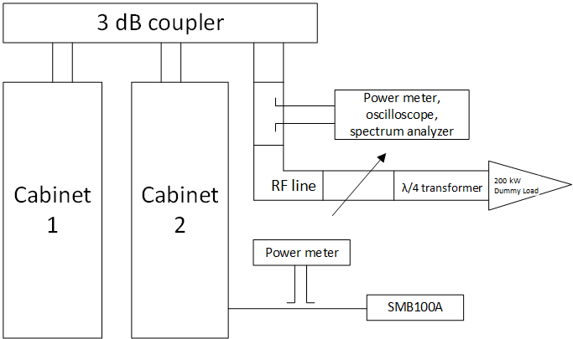
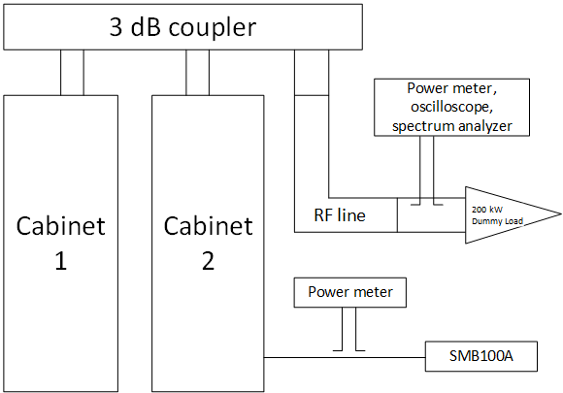
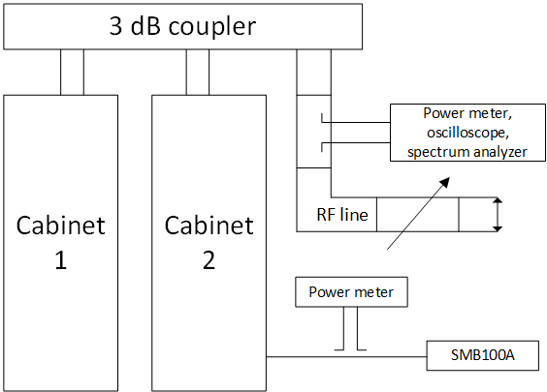
RFQ SSA final commissioning plan
Test on matched load
  Global RF parameters measurement (gain and phase linearity, pulse operation…)
  EMC measurement w.r.t. standards
  Global behavior w.r.t. redundancy
  Run test (duration to be defined)
Test on mismatched load
  With λ/4 transformer and variable length
  VSWR of 2, 3 and 5 any phase (45° steps)
  Power capability characterization
Test with full reflection
  Short-circuit between inner and outer conductors
  Extreme high VSWR (limited by losses in the lines, any phase)
  Power capability characterization
Source: SCK•CEN MYRRHA Project Team

Slide 16
Conclusions and perspectives
Commissioning activities are begining for the MYRRHA injector
  Source, LEBT and RFQ will be commissioned by the end of this year
  CH1, CH2 and rebunchers are under production and tests
The first MYRRHA Solid-State Amplifier is based on:
  Intensive and accurate modelization of RF elements (pallet, rack, combiners…)
  Very compact integration (~ 100 kW/m² CW)
  The high level reliability required for the MYRRHA linac (redundancy, robustness…)
The first MYRRHA Solid-State Amplifier is ready for final commissioning
  After very promising first results on each cabinet
  Will be fully characterized in stand-alone and under various load conditions
  Will be commissioned with remote Control System, LLRF and RFQ by the end of this year
Source: SCK•CEN MYRRHA Project Team

Slide 17
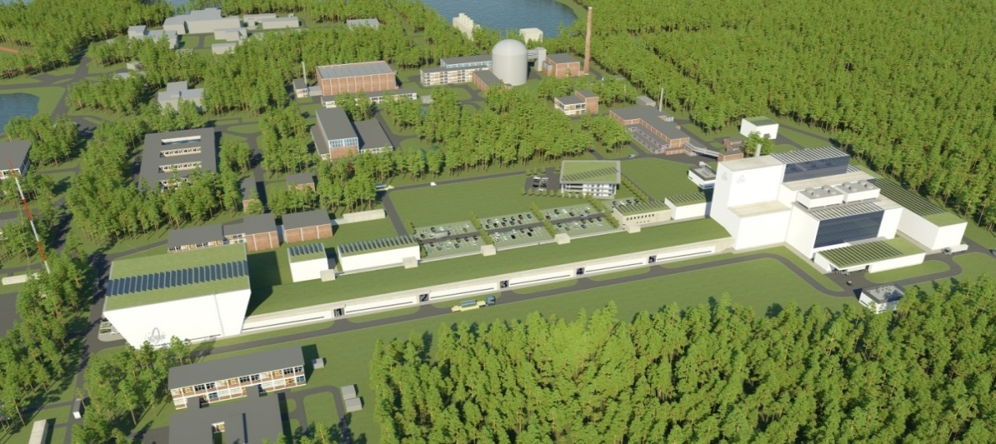
A jump in the future for innovation in Belgium

Slide 18
Copyright © 2018 - SCK•CEN
PLEASE NOTE!
This presentation contains data, information and formats for dedicated use ONLY and may not be copied, distributed or cited without the explicit permission of the SCK•CEN. If this has been obtained, please reference it as a “personal communication. By courtesy of SCK•CEN”.
SCK•CEN
Studiecentrum voor Kernenergie
Centre d'Etude de l'Energie Nucléaire
Belgian Nuclear Research Centre
Stichting van Openbaar Nut
Fondation d'Utilité Publique
Foundation of Public Utility
Registered Office: Avenue Herrmann-Debrouxlaan 40 – BE-1160 BRUSSELS
Operational Office: Boeretang 200 – BE-2400 MOL

