Slide 1
ESS ion source & LEBT commissioning experience Santo Gammino
Uppsala– June 13th , 2018

Slide 2
INFN Contribution to ESS
The involvement of INFN is following the R&D efforts done by our people in the frame of the TRASCO-ADS research programme (a study for a high power proton accelerator for the radioactive waste transmutation), of the daughter programmes at national level, along with different EU programmes aimed to the design of components for high power proton accelerators (HPPA):
studies done for the production of intense beams of protons with small emittance and high reliability/stability;
the R&D for the components of the low energy high power accelerator;
the development of high performance superconducting cavities;
the industrial procedures for series production.

Slide 4
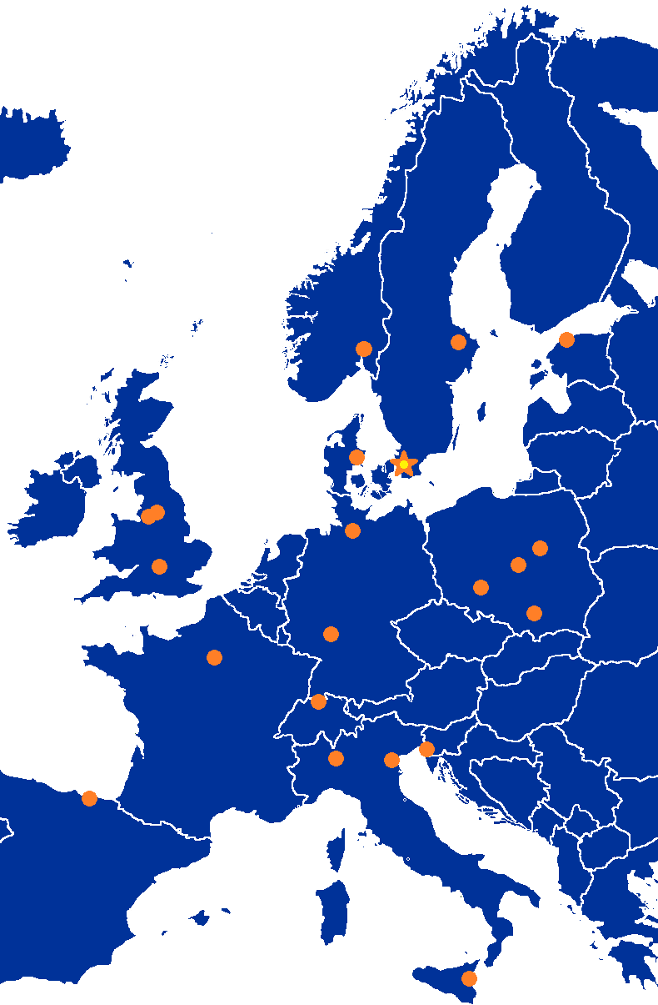
Accelerator Collaboration - Accelerator
INFN IK-Contribution to European Spallation Source linac:
Proton Source, LEBT INFN-LNS
DTL INFN-LNL
Medium Beta cavities INFN-MI
352.21 MHz
704.42 MHz
2.4 m
4.6 m
3.8 m
39 m
56 m
77 m
179 m
Target
Source
LEBT
RFQ
MEBT
DTL
Spokes
Medium β
High β
HEBT & Contingency
75 keV
3.6 MeV
90 MeV
216 MeV
571 MeV
2000 MeV
-2.86 ms pulses
>74mA
-14 Hz
-Protons (H+)
-Small emittance < 0.25π
-High stability
-Flexible design

Slide 5
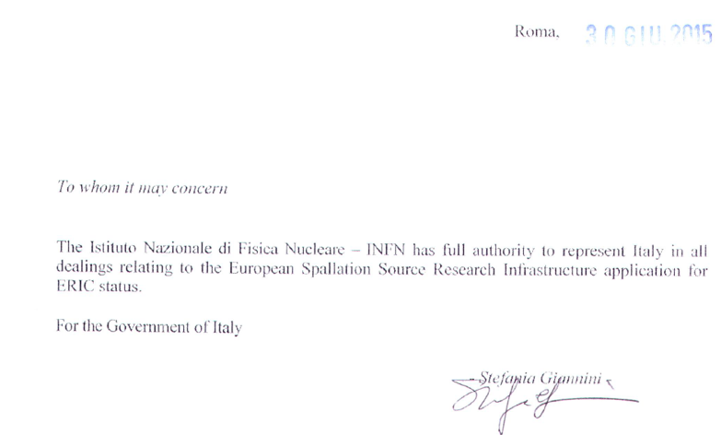
ERIC – INFN as Representing Entity (2015)
The 3 main TAs of INFN have been approved by INFN Board and signed in 2016 (DTL in April, Ion Source&LEBT in June, Medium beta cavities in November)

Slide 6
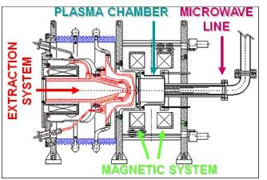
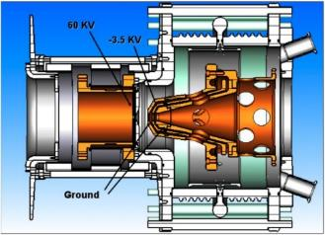
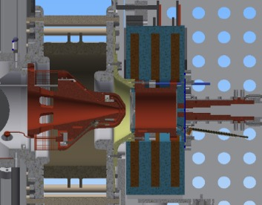
Background
PS-ESS (2016)
TRIPS (2001)
VIS (2008)
+ 25% current
Requirement | Value
Beam energy | 75±5 keV
Proton beam current | 74 mA
Proton fraction | >75%
Pulse length | 6 ms
Pulse flat top | 3 ms
Repetition rate | 14 Hz
Pulse to pulse stability | ±3.5 %
Flat top stability | ±2 %
Transverse emittance (99%) | 1.8 pi.mm.mrad
Beam divergence (99%) | <80 mrad
Start-up after maintenance | 32 hours
Pulsed beams
Higher stability
Slightly lower emittance
Easy maintenance

Slide 7
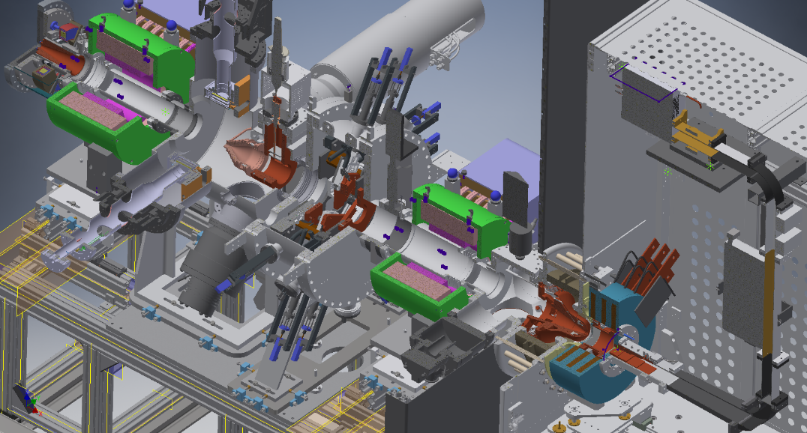
Improvements with respect to TRIPS and VIS
Pulse rise and fall time using LEBT chopper (Prototype tested on BETSI)
Flexible magnetic system design
(OPERA, Comsol)
Reduction of electric field (Comsol)
Microwave to plasma coupling (3D Full wave simulation code)
Beam extraction
(Axcel)
Plasma dynamics and species fraction composition (Particle in cell simulation code)
Defocusing chopper (Comsol, TraceWin)
Improvements starting from IFMIF design (in collaboration with CEA)
Stationary and time dependent beam transport in space charge compensation regime (Particle in cell simulation code)

Slide 8
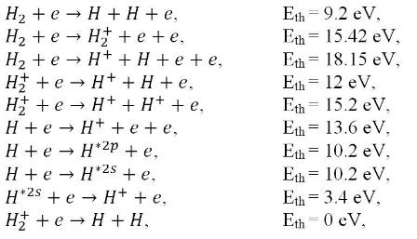
Plasma modeling
Electron Energy Distribution Function
RF energy adsorption
Magnetic system flexibility helps to tailor the EEDF
Ion formation
Generation maps
e⁻
p⁺
L. Neri et al. "Recent progress in plasma modelling at INFN-LNS", Rev. Sci. Instrum. 2016 Feb, 87(2):02(A)505

Slide 9
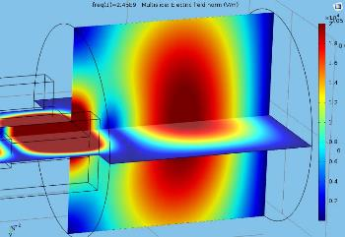
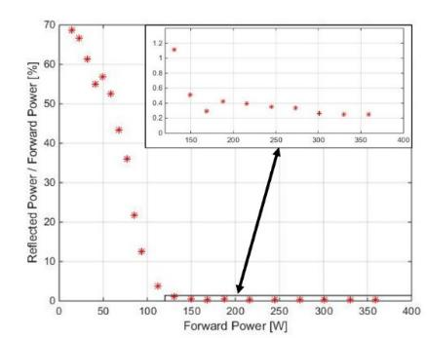
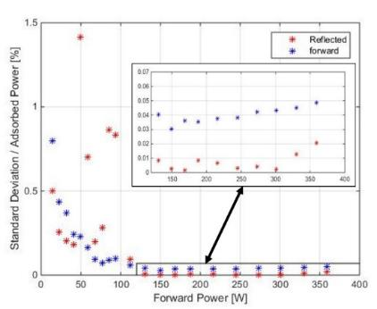
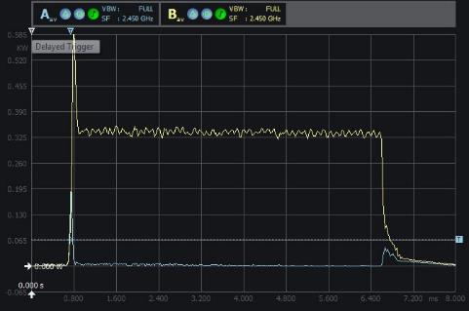
Microwave to plasma coupling
Cold tensor plasma approximation
Empty cavity
3D full wave e-m simulation in presence of the electron plasma density and strong magnetic field has driven the design of the matching transformer
G. Torrisi et al. "Full-wave FEM simulations of electromagnetic waves in strongly magnetized non-homogeneous plasma", JEWA 2014 vol. 20, no. 9, 1085-1099
Low measured reflected power
High measured stability of forward and reflected power
Measured forward and reflected pulsed power
Forward
Reflected
< 1%
< 1‰
G. Torrisi et al. "Microwave injection and coupling optimization in ECRIS and MDIS , Jour. of Phys, 874 (2017) 012034

Slide 10
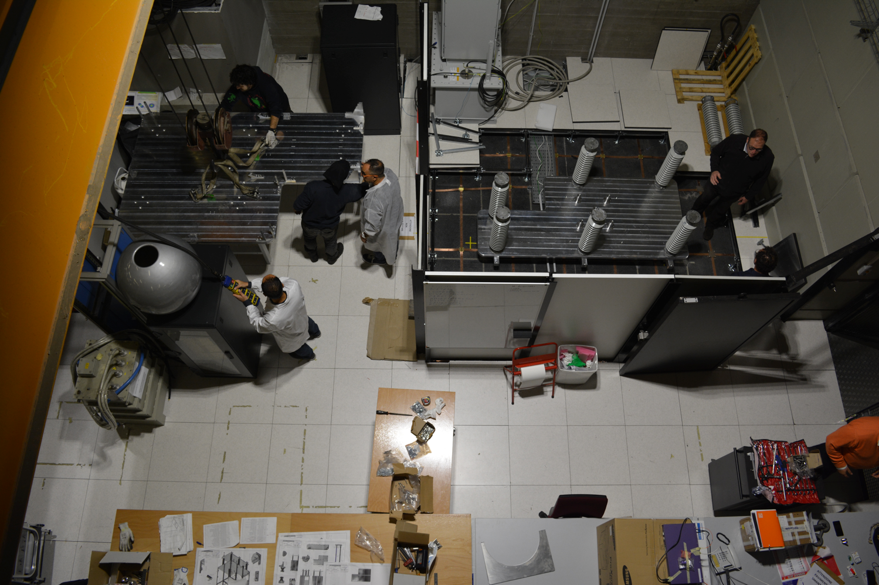
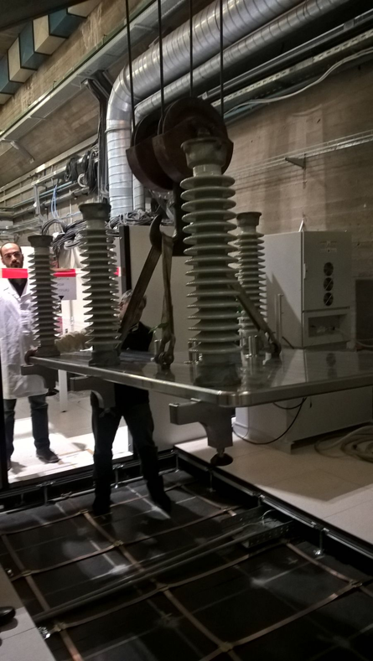
Platform assembly

Slide 11
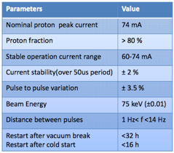
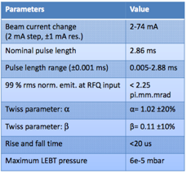
Source & LEBT
Extraction
Solenoid
Iris
Solenoid
Chopper
Gate valve
Collimator
Source
Diagnostics

Slide 12
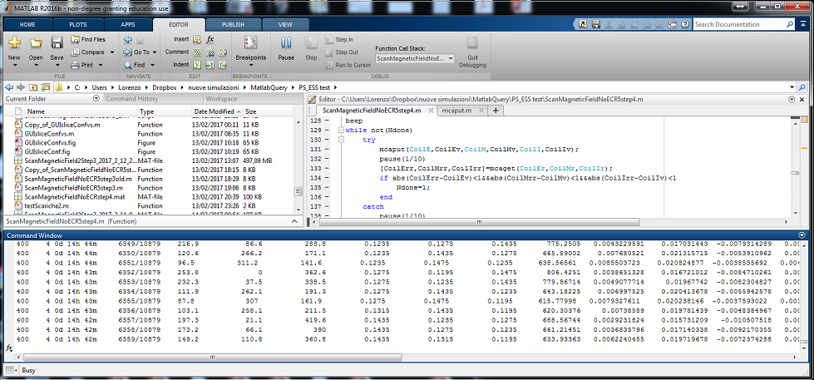
Semi-automatic characterization tool
Time left
Configurations
left
Coil 1
Coil 2
Coil 3
Watt
SCCM
Plasma modelling ➔
parameters range to be tested:
Field @ 0 mm ==> 835:20:975 Gauss
Field @ 35 mm ==> 795:40:1395 Gauss
Field @ 84 mm ==> 675:40:1995 Gauss
H2 flow ==> 2:1:5 SCCM
RF power ==> 600:200:1200 Watt
40ֺ192 configurations
From the 23/01/2017 the source is extracting beam seamless, more than 300˙000 tested configurations, no stops due to sparks.

Slide 13
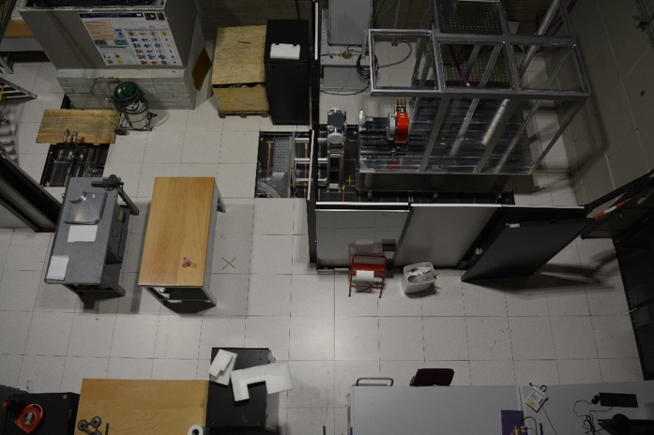
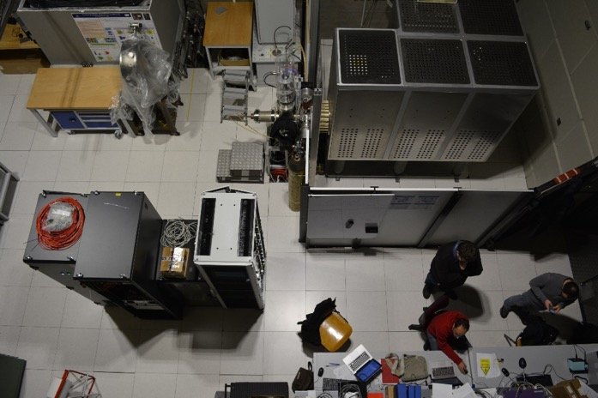
Proton source and LEBT
Done in 2016:
Source and HV platform fully assembled
LEBT & beam diagnostics assembled
All four racks fully assembled
Control system fully assembled
Iris fully assembled
Solenoids and 2 diagnostic tanks available
First plasma 15/6/2016
First beam 22/9/2016
Chopper ordered
LEBT collimator ordered
Done in 2017:
Debugging of beam instruments
Debugging of control system
Characterization of the source
Assembly of the full LEBT
8 weeks continuous operation
Fulfillment of specifications
Dismantling
Preparation to the transport
Transfer to ESS Lund
23/01/2016
23/01/2017

Slide 14
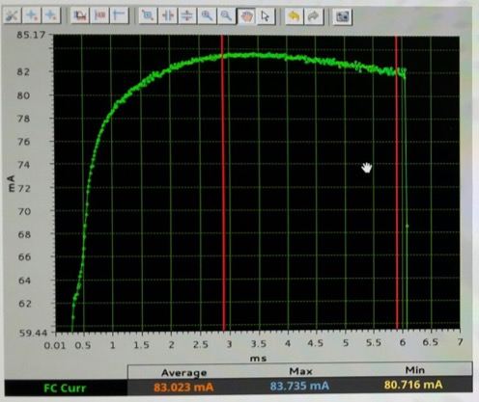
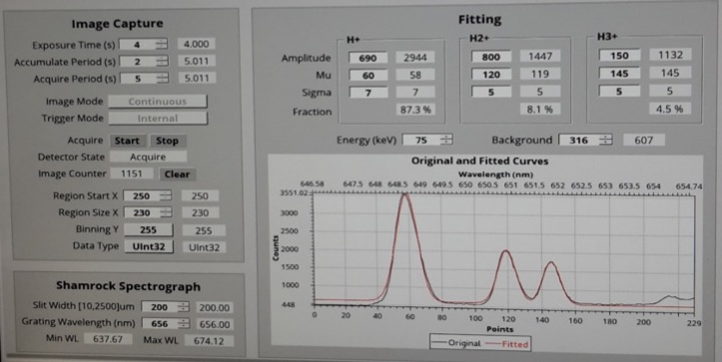
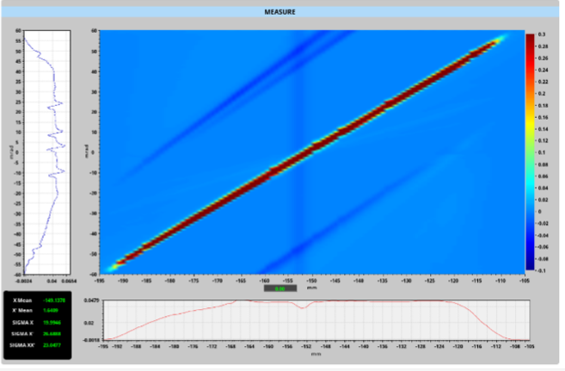
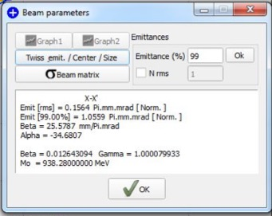
Proton Fraction: 83% (> 75%)
Beam characterization before LEBT
Pulse stability: ±1% (better than ±2%)
Pulse repeatability: ±1.8% (< ±3.5%)
Emittance: 1.06 π.mm.mrad (< 1.8) Max divergence: 55 mrad (< 80)

Slide 15
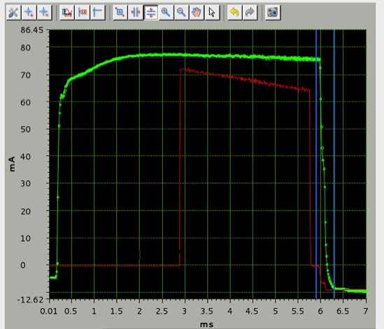
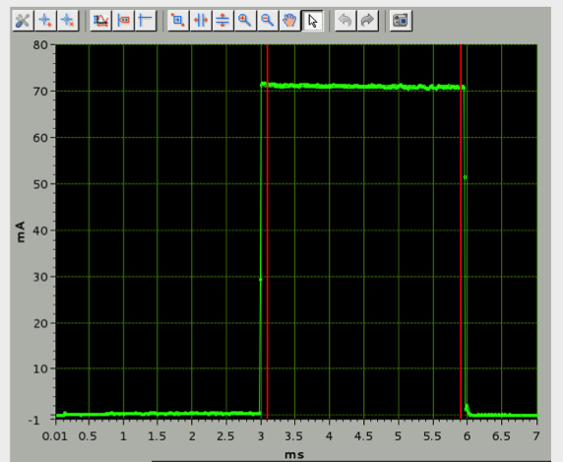
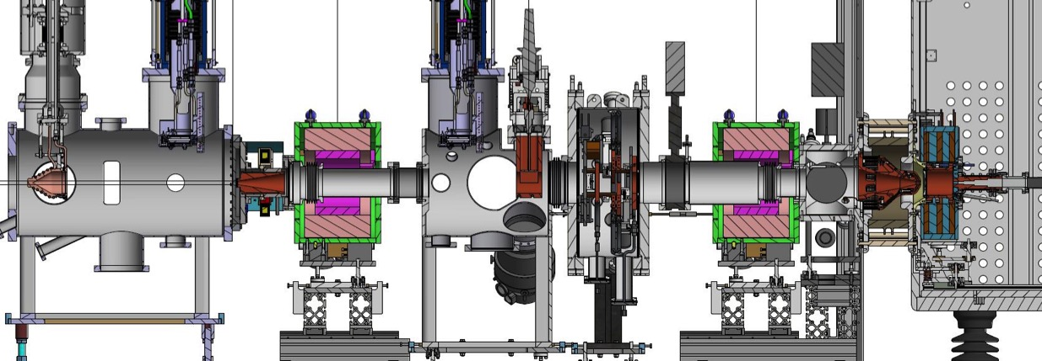
Chopping performances
Total current
FC current
LEBT ACCT
Chopper
Collimator
Notes:
Questa la finisco domani

Slide 16
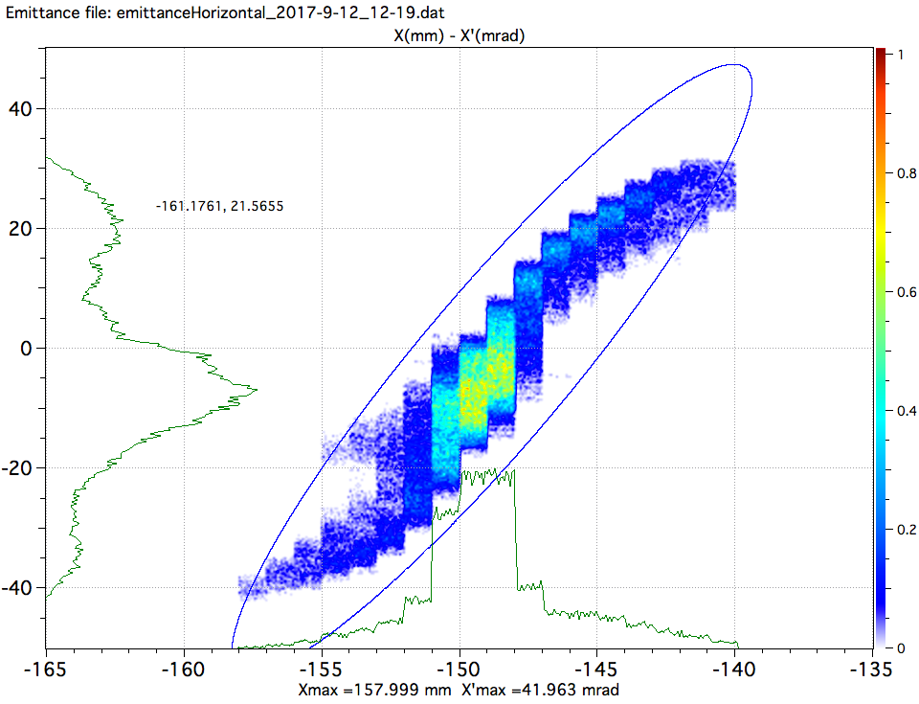
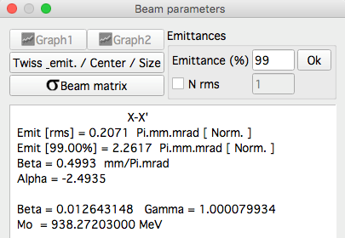
Beam emittance at RFQ location
Transverse emittance SATISFIED
Emit [rms] < 0.25 Pi.mm.mrad
Emit [99%] < 2.25 Pi.mm.mrad

Slide 17
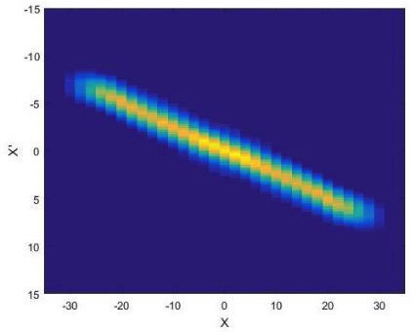
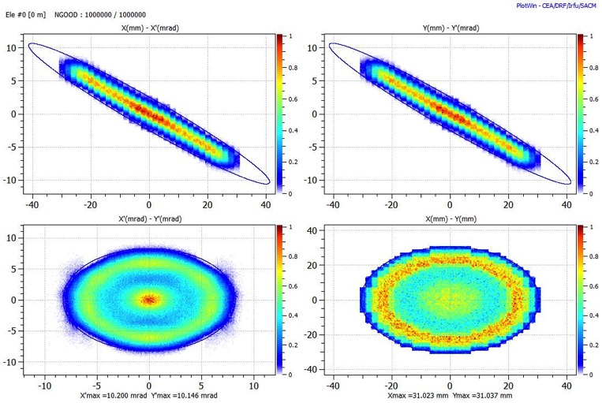
4D particle distribution generation from real emittance measurement
Measurement plane XX’
Emittance measurement
Post processing
XX’ and YY’ reconstruction

Slide 18
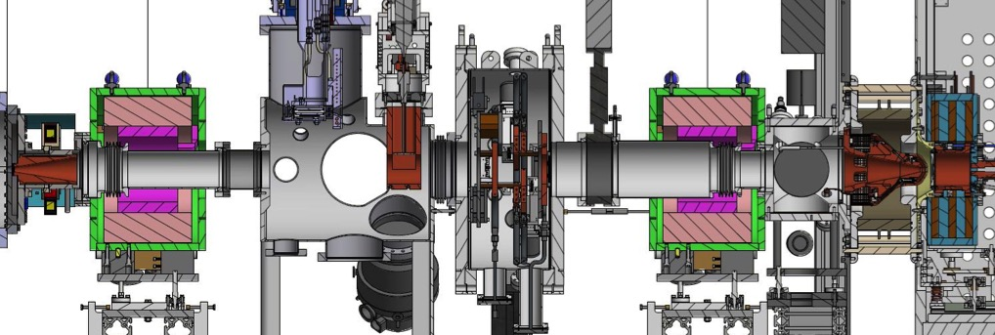
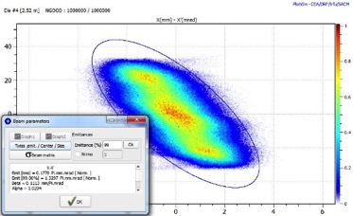
Forward tracking to RFQ
Twiss parameter at RFQ SATISFIED
Alpha = 1.02 (1.02±10%)
Beta = 0.11 (0.1±10%)
source
RFQ

Slide 19
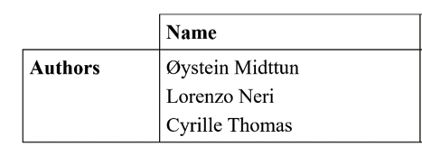
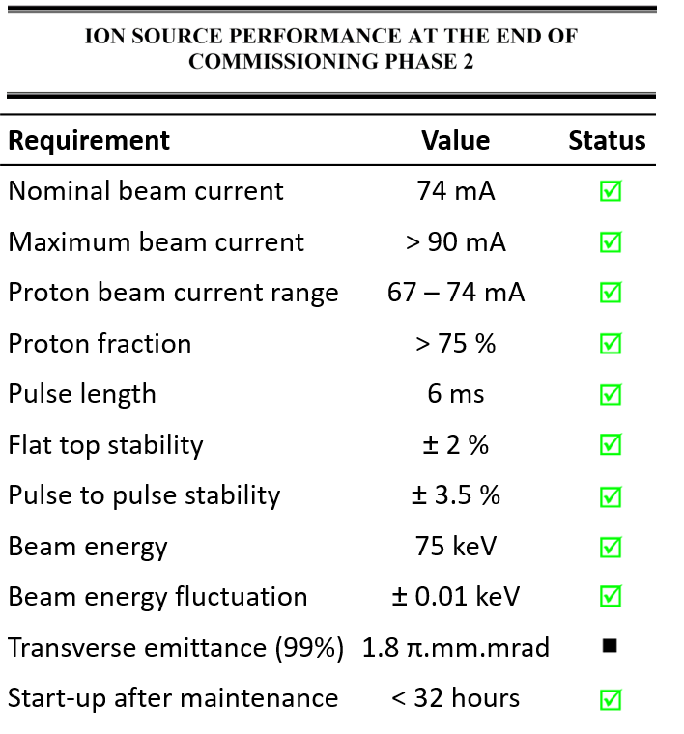
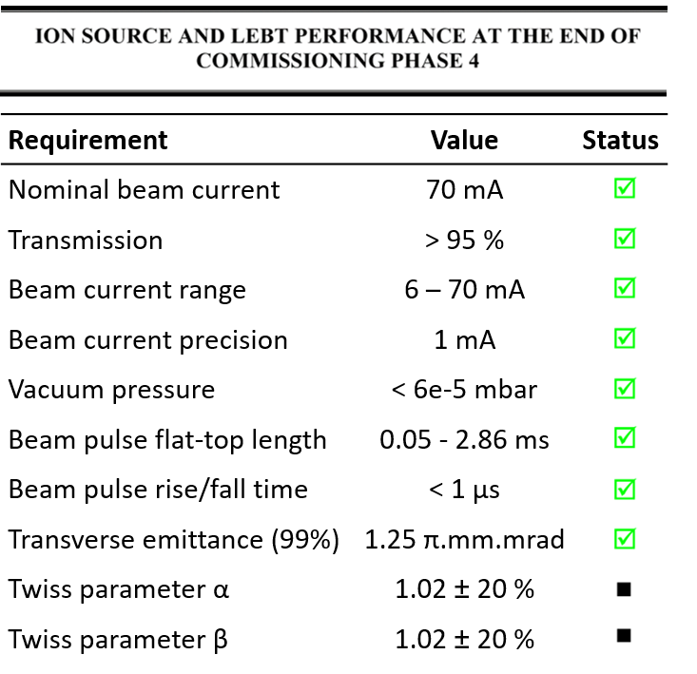
Site Acceptance Review
Backward tracking simulation confirmation
Stable EMU was not provided in time

Slide 20
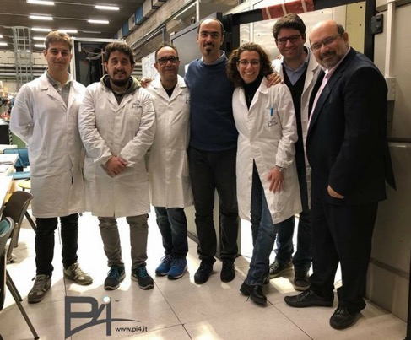
Dismantling / Packaging
Where: INFN-LNS (Catania)
Start: 06/11/2017
Duration estimate: 19 work days

Slide 21
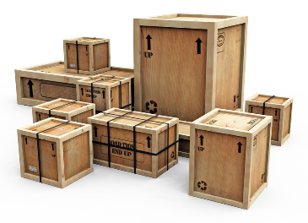
ISLEBT operational in Catania (2017)
A detailed plan to manage shared resources of the Lab to:
Dismantling
Storage
Transport
Only 19 working
days

Slide 22
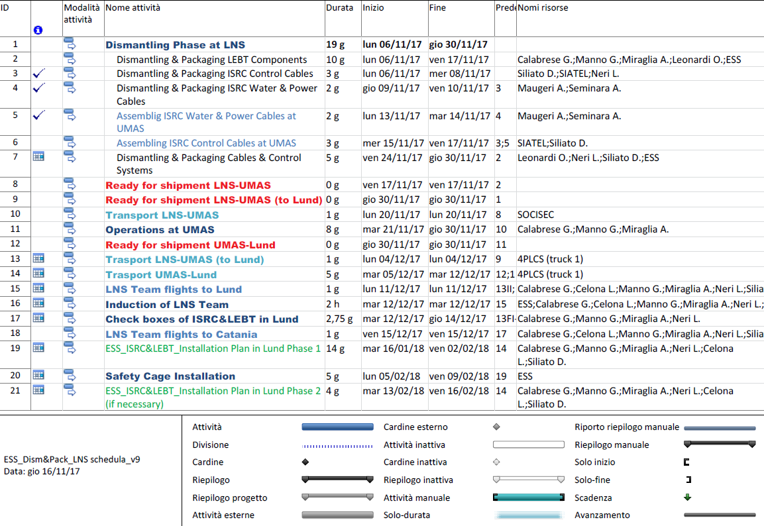
Dismantling phase at INFN-LNS
Updated daily plan with activities, duration and resources needed
Shared with ESS and LNS Team
To optimize the activities/time we chose to work in parallel @LNS in Catania and @UMAS Company in Piazza Armerina (EN)

Slide 23
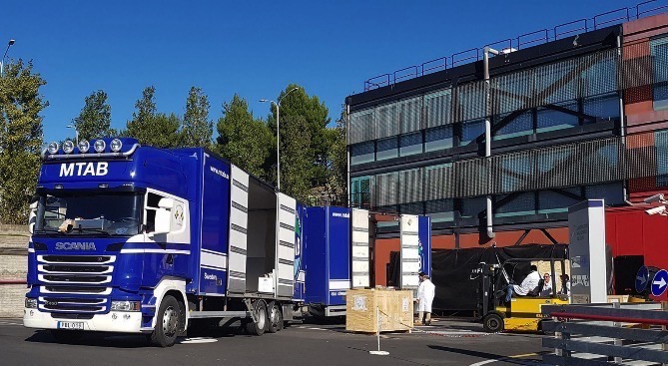
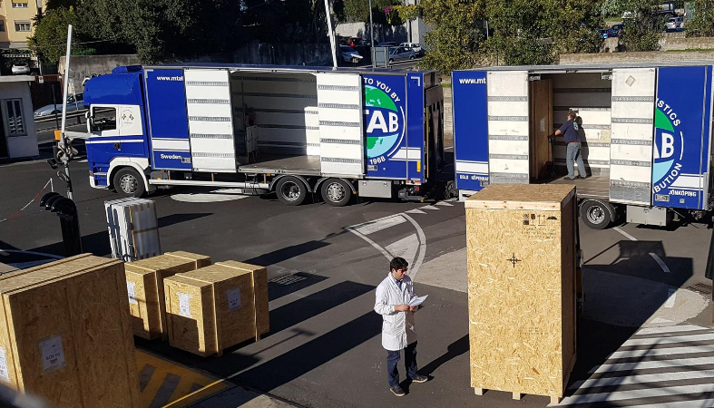
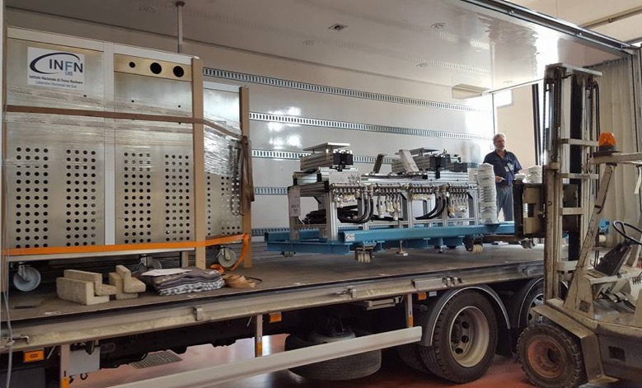
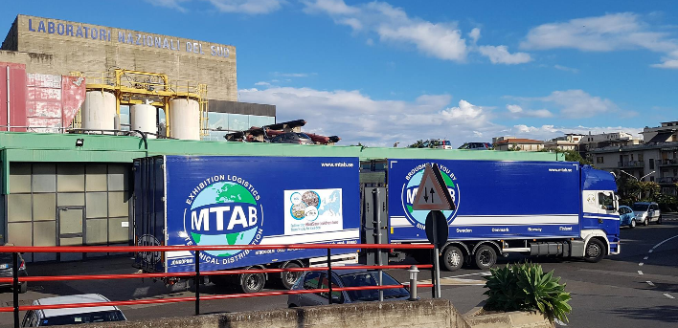
Transportation

Slide 24
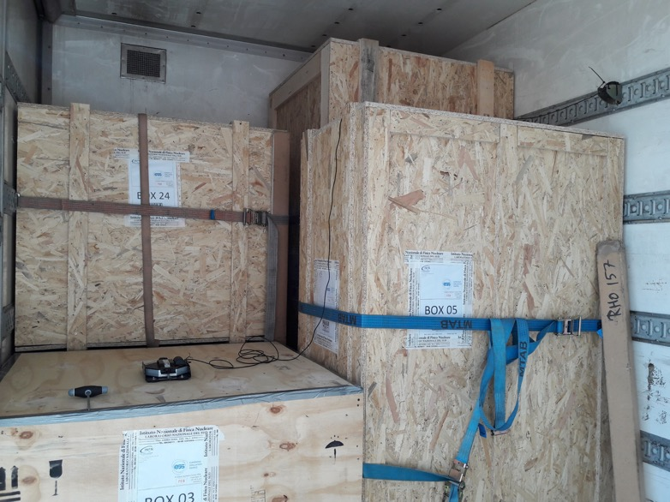
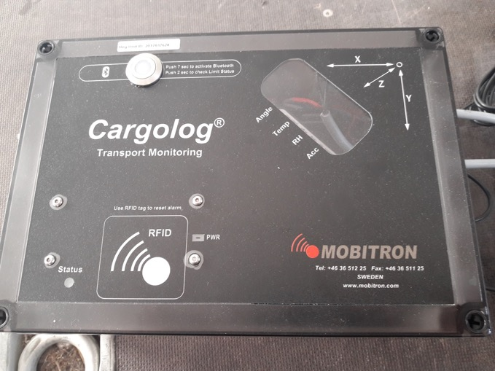
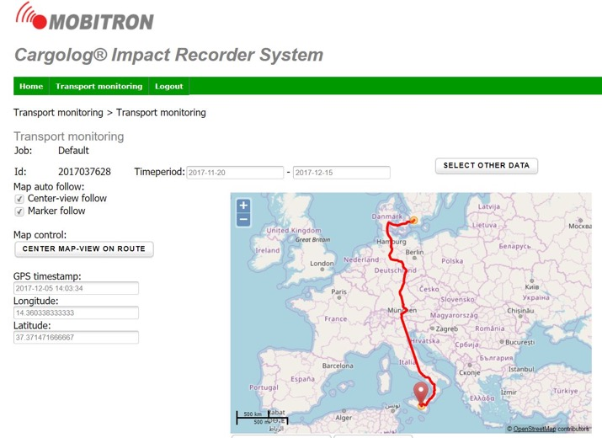
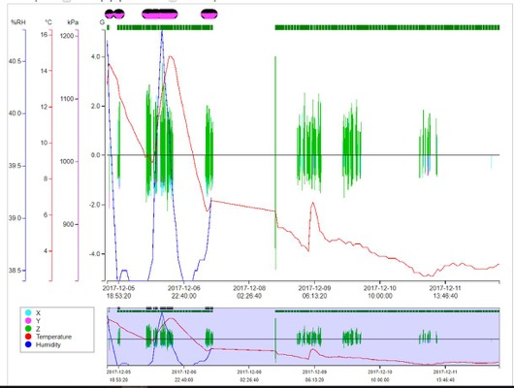
Transportation
Real-time monitoring with alarm for the driver
Shocking recorder
REAL-TIME System
REAL-TIME System

Slide 25
Social Media Campaign
https://www.facebook.com/IstitutoFisicaNucleare/videos/10155913763047579/
https://twitter.com/hashtag/IonSourceAdventure?src=hash

Slide 26
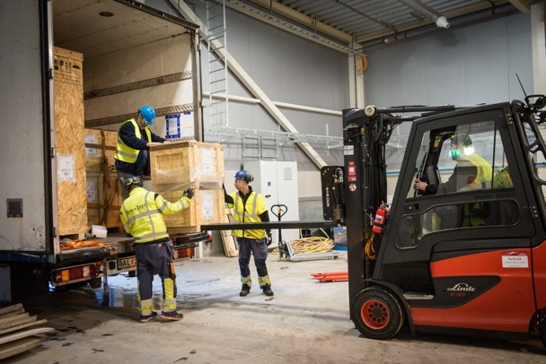
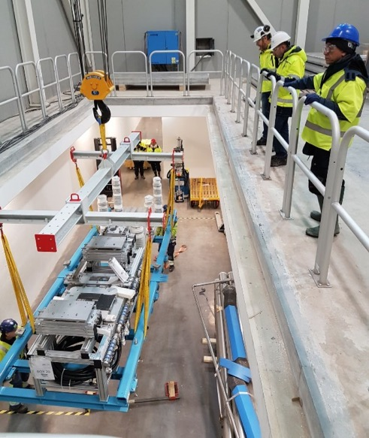
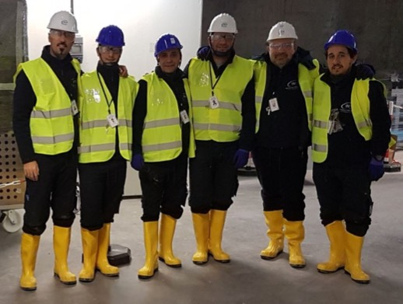
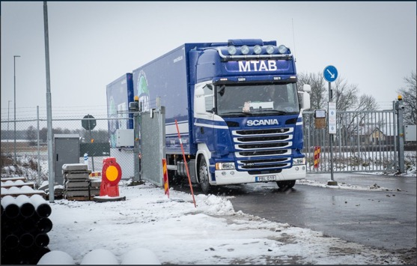
Installation Plan
Where: ESS (Lund) Start: 16/01/2018
Duration estimate: 14 work days
Reference document: ESS_ISRCLEBT_Installation Plan in Lund
ESS personnel followed Dismantling phase in Catania, but the procedure was determined by the INFN personnel
Hazards have been identified and evaluated prior to the start-up of the work

Slide 27
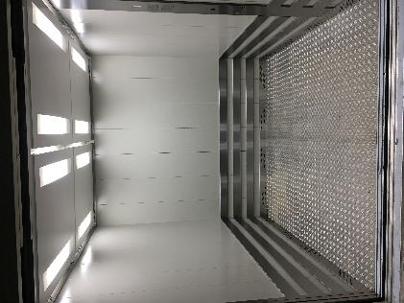
ESS charges
(preparation of the area, safety, cabling, piping)
Electrical safety
HV platform at 75kV
Grounded floor-to-ceiling cage surrounds the complete HV platform
1 m tall top plates with ø2.5 mm holes (IP3x) to allow hydrogen gas to escape
Radiation safety
X-rays generated by 75 keV electrons
2.5 m tall, 2 mm thick lead sheets sandwiched between two aluminum plates
PSS0
Mitigate against electrical hazards
Key exchange : HV PS/cage door
Interlock HV PS, disconnect mains
Grounding relay and grounding stick
Access to installation area:
Elevator FEB100 FEB090
3050 kg
~2.3 x 2.3 x 2.3 meter
No personnel transportation allowed

Slide 28
Installation in Lund

Slide 29
Installation sequence
Installation of the HV platform (using FEB Drop-Hatch crane)
Installation of the ISRC & LEBT components on the beamline (crane by Tunga Lyft)
Connection to infrastructure
Power
Ground
Water
IA
VAC
ICS
Installation of the ISRC & LEBT components on the beamline (crane by Tunga Lyft)

Slide 30
2018-02-01 Source fully assembled in Lund by INFN-LNS team

Slide 31
ISRC&LEBT Documentations
INFN is providing a shared folder collecting:
Drawings
Diagrams
Cable specifications
Manuals
Factory acceptance test
Guides
Certification of conformities
Interface drawings
Non conformity reports
The documentation is collected in folders organized following the Product Breackdown Structure.
700 MB of documentations
Notes:
product breackdown structure e visione sito cloud: isrc-estrazione-drawings+ps+certificato rame, insulating column-drawings+certificato vuoto, magneti sorgente con documento completo, magnetron con manuale, lebt solenoidi drawings+ps+fat, chopper+disegni+diagramma blocchi+schematics+signal list, irisdisegni+manuale,supporti-disegni, base-disegni, fug, cavi,
Interfacce documento edgar, cartella interfacce
Standard dentro i disegni, guide, slide andrea+ornella^2

Slide 32
Certifications of materials used for the fabrication
Notes:
product breackdown structure e visione sito cloud: isrc-estrazione-drawings+ps+certificato rame, insulating column-drawings+certificato vuoto, magneti sorgente con documento completo, magnetron con manuale, lebt solenoidi drawings+ps+fat, chopper+disegni+diagramma blocchi+schematics+signal list, irisdisegni+manuale,supporti-disegni, base-disegni, fug, cavi,
Interfacce documento edgar, cartella interfacce
Standard dentro i disegni, guide, slide andrea+ornella^2

Slide 33
Leak tests of custom purchased equipment
Notes:
product breackdown structure e visione sito cloud: isrc-estrazione-drawings+ps+certificato rame, insulating column-drawings+certificato vuoto, magneti sorgente con documento completo, magnetron con manuale, lebt solenoidi drawings+ps+fat, chopper+disegni+diagramma blocchi+schematics+signal list, irisdisegni+manuale,supporti-disegni, base-disegni, fug, cavi,
Interfacce documento edgar, cartella interfacce
Standard dentro i disegni, guide, slide andrea+ornella^2

Slide 34
Specification of purchased equipment
Notes:
product breackdown structure e visione sito cloud: isrc-estrazione-drawings+ps+certificato rame, insulating column-drawings+certificato vuoto, magneti sorgente con documento completo, magnetron con manuale, lebt solenoidi drawings+ps+fat, chopper+disegni+diagramma blocchi+schematics+signal list, irisdisegni+manuale,supporti-disegni, base-disegni, fug, cavi,
Interfacce documento edgar, cartella interfacce
Standard dentro i disegni, guide, slide andrea+ornella^2

Slide 35
User manuals of purchased equipment
Notes:
product breackdown structure e visione sito cloud: isrc-estrazione-drawings+ps+certificato rame, insulating column-drawings+certificato vuoto, magneti sorgente con documento completo, magnetron con manuale, lebt solenoidi drawings+ps+fat, chopper+disegni+diagramma blocchi+schematics+signal list, irisdisegni+manuale,supporti-disegni, base-disegni, fug, cavi,
Interfacce documento edgar, cartella interfacce
Standard dentro i disegni, guide, slide andrea+ornella^2

Slide 36
Wiring diagrams
Notes:
product breackdown structure e visione sito cloud: isrc-estrazione-drawings+ps+certificato rame, insulating column-drawings+certificato vuoto, magneti sorgente con documento completo, magnetron con manuale, lebt solenoidi drawings+ps+fat, chopper+disegni+diagramma blocchi+schematics+signal list, irisdisegni+manuale,supporti-disegni, base-disegni, fug, cavi,
Interfacce documento edgar, cartella interfacce
Standard dentro i disegni, guide, slide andrea+ornella^2

Slide 37
GUI control system user guides
Notes:
product breackdown structure e visione sito cloud: isrc-estrazione-drawings+ps+certificato rame, insulating column-drawings+certificato vuoto, magneti sorgente con documento completo, magnetron con manuale, lebt solenoidi drawings+ps+fat, chopper+disegni+diagramma blocchi+schematics+signal list, irisdisegni+manuale,supporti-disegni, base-disegni, fug, cavi,
Interfacce documento edgar, cartella interfacce
Standard dentro i disegni, guide, slide andrea+ornella^2

Slide 38
Non conformities documentation
Almost all non conformities encountered during the construction and commissioning period were solved or mitigated
Notes:
product breackdown structure e visione sito cloud: isrc-estrazione-drawings+ps+certificato rame, insulating column-drawings+certificato vuoto, magneti sorgente con documento completo, magnetron con manuale, lebt solenoidi drawings+ps+fat, chopper+disegni+diagramma blocchi+schematics+signal list, irisdisegni+manuale,supporti-disegni, base-disegni, fug, cavi,
Interfacce documento edgar, cartella interfacce
Standard dentro i disegni, guide, slide andrea+ornella^2

Slide 39
Assembling manuals
Notes:
product breackdown structure e visione sito cloud: isrc-estrazione-drawings+ps+certificato rame, insulating column-drawings+certificato vuoto, magneti sorgente con documento completo, magnetron con manuale, lebt solenoidi drawings+ps+fat, chopper+disegni+diagramma blocchi+schematics+signal list, irisdisegni+manuale,supporti-disegni, base-disegni, fug, cavi,
Interfacce documento edgar, cartella interfacce
Standard dentro i disegni, guide, slide andrea+ornella^2

Slide 40
Summary
Source&LEBT ready for beam commissioning at ESS site
Ideal performances have been achieved and all requirements are checked, except the ones affected by the stability of EMU
Transfer of documentation is almost complete for ISLEBT
Rebaselining the ESS schedule will allow more tests for the IS&LEBT and ESS personnel training
Advantages for ESS: personnel skillness largely improved because of the challenges met during these years, moreover the handover of this first part of the accelerator will push the ESS staff to adapt to the need of the future facility, to be operated 24h/day for many weeks
July’18: Safety review and permission to operate the source → test of components → test with beams → long run test (1 month)→ emittance
A second source will be built in the course of 2018-19, without the LEBT.

