Slide 1
Status of the ESS High Power RF Systems
Rihua Zeng,
On behalf of Morten Jensen (RF section leader) and all RF section colleagues
SHLIPP8, June 13, 2018
www.europeanspallationsource.se

Slide 2
Outline
RF systems highlights and status :
  Ongoing RF section installation activities(klystron gallery, tunnel, TS2)
  High Power RF Amplifiers
  Local Protection system/Interlock
  Low Level RF system
Status of each subsystem

Slide 3
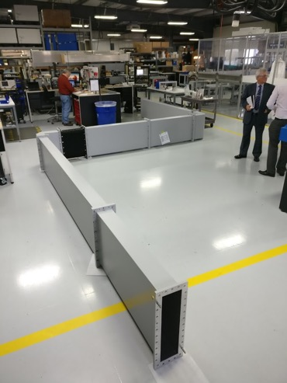
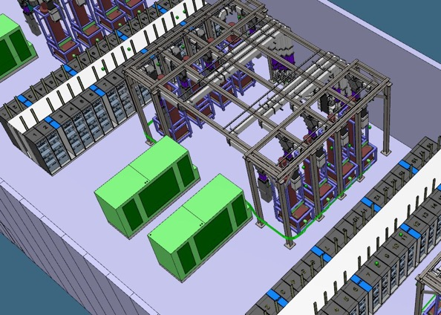
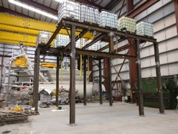
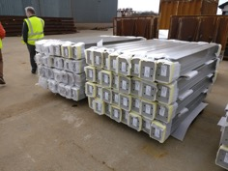
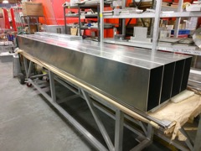
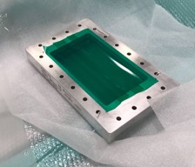
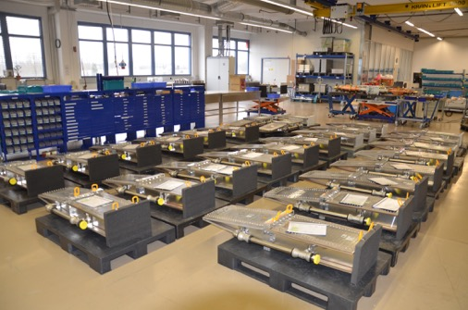
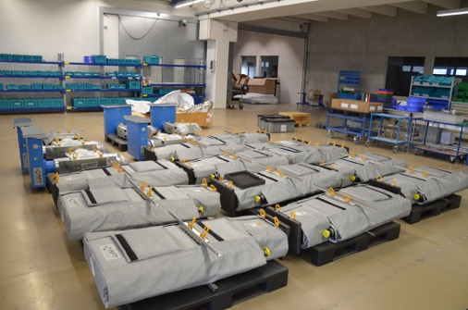
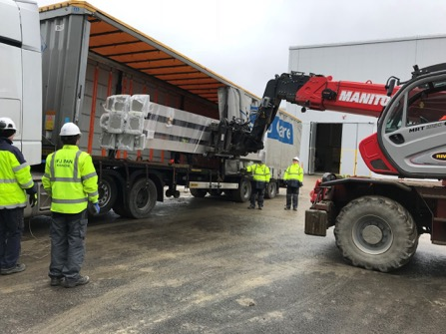
Highlights: RF Installation, Deliveries and Test Activities

Slide 4
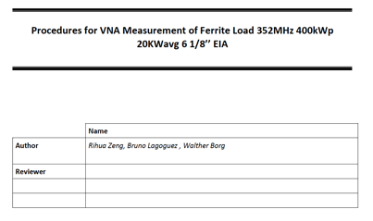
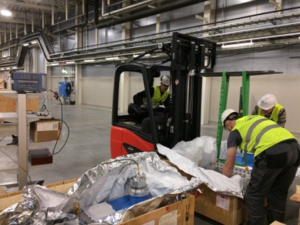
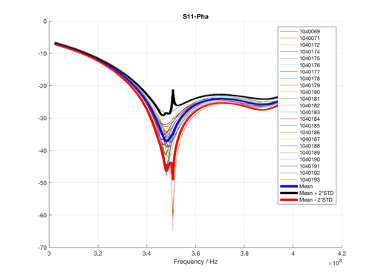
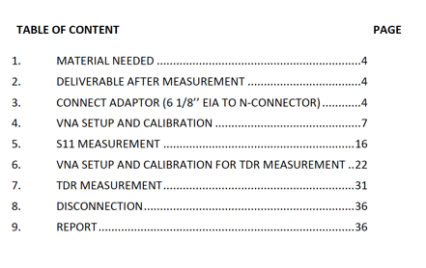
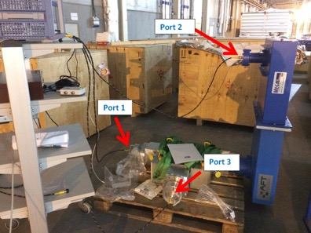
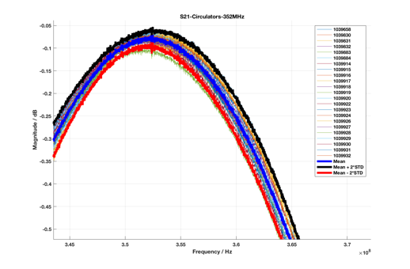
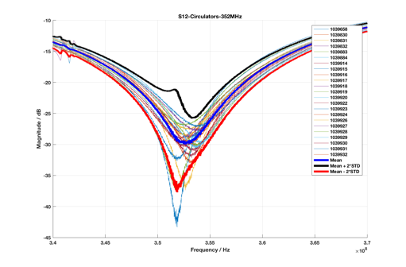
Highlights: RF section Installation, Test Activities in Klystron Gallery
All Spoke supporting structures have been installed, MB&HB supporting structures have been delivered.
27 352MHz loads, 26 352MHz Circulators, 71 704MHz loads has been delivered to G02 and complete site acceptance tests

Slide 5
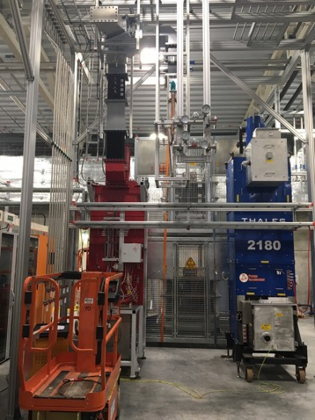
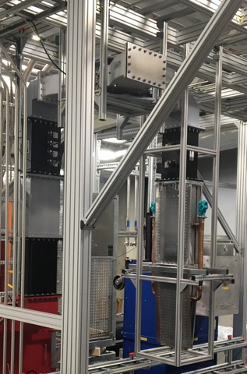
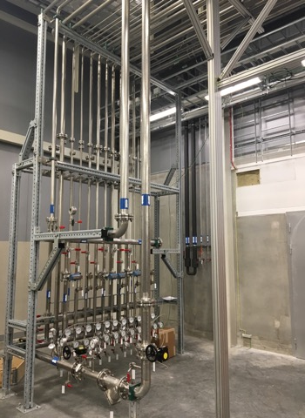
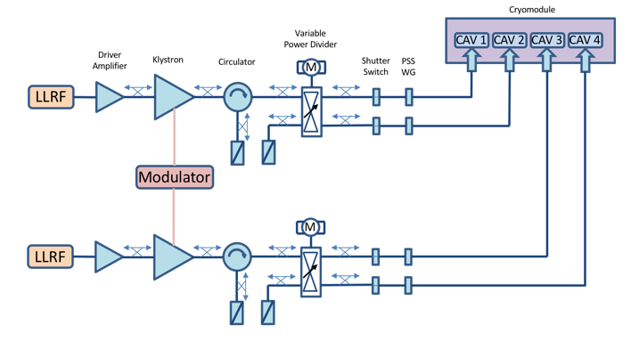
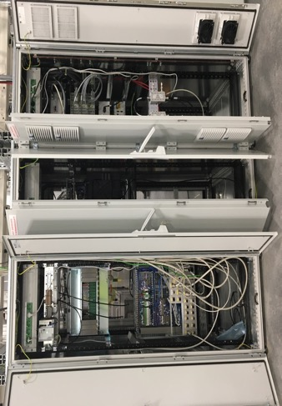
Highlights: RF Installation and Test Activities in TS2
CPI Klystron is ready to be powered up….
Toshiba klystron and interlock system operational for HB cavity testing in Uppsala (see presentation from Magnus)
Racks are being used to trial the installation and to see how we optimise power distribution, mechanical supports,
cable routing, grounding etc.

Slide 6
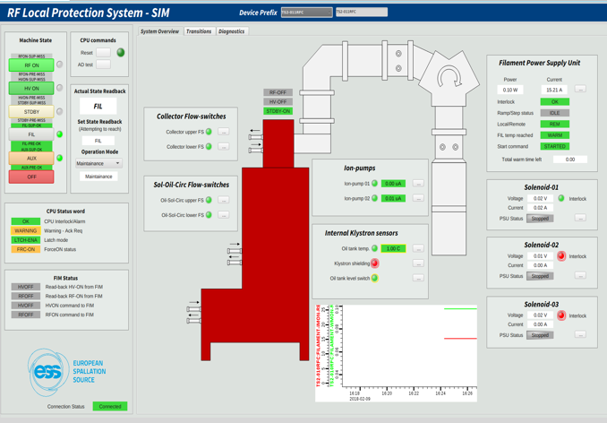
RF LPS User Interface in TS2
CPI Klystron: Interlocks tested and devices run up to ”STBY” state.
R. Montano

Slide 7
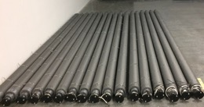
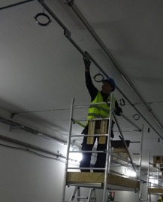
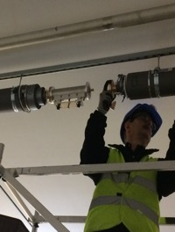
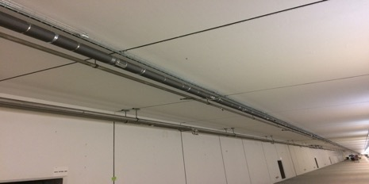
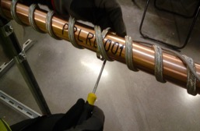
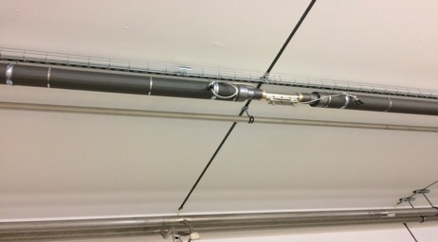
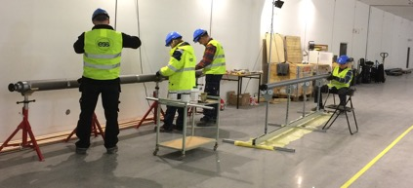
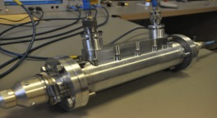
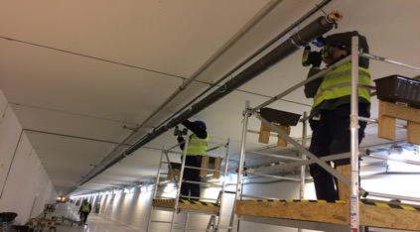
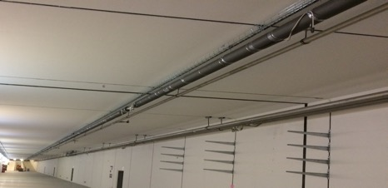
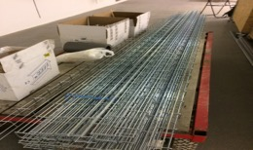
Highlights: RF Section Installation, Test Activities in Tunnel
119 rigid line sections with
heating cables,
Temperature sensors
thermal insulation jacket
Installation in Tunnel
Install hanging system
Assembly heating cables, temperature sensors, thermal insulation
Install rigid line sections, couplers, and cable tray
What it looks like after installation:
~500m PRL line installed from ion source to Dogleg
~100m PRL line remain to be installed this year from Dogleg to A2T
53 directional couplers
~500m-long cable tray

Slide 8
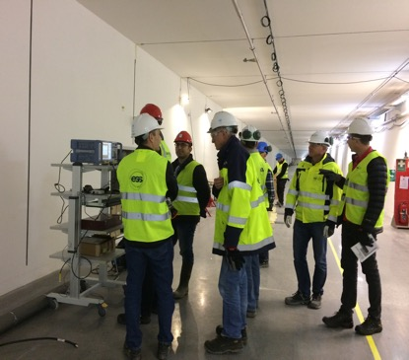
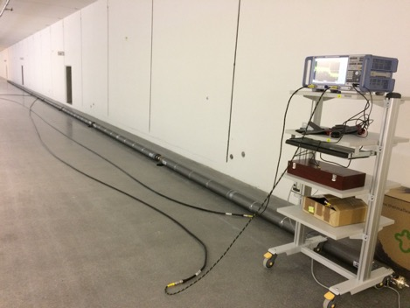
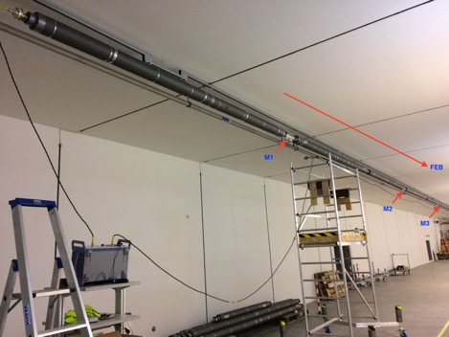
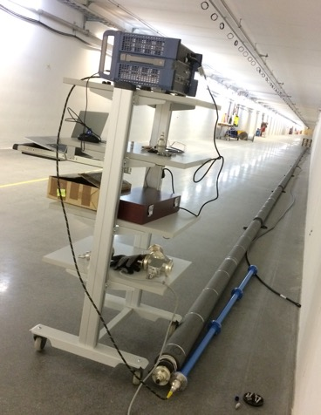
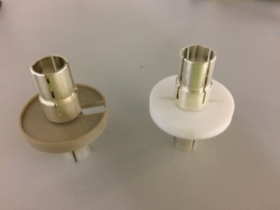
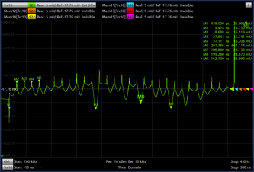
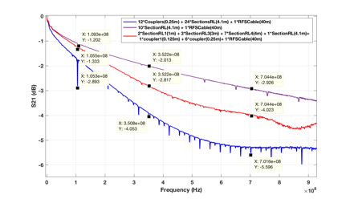
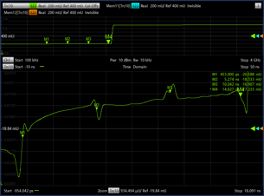
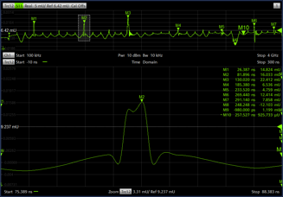
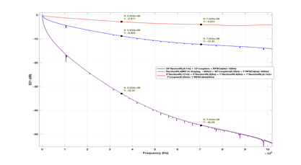
Highlights: RF Section Installation & Test Activities in Tunnel

Slide 9
RF Cell Block Diagram

Slide 10
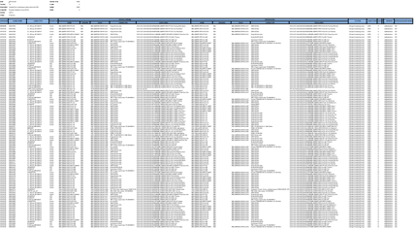
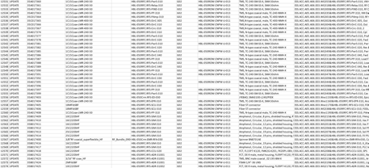

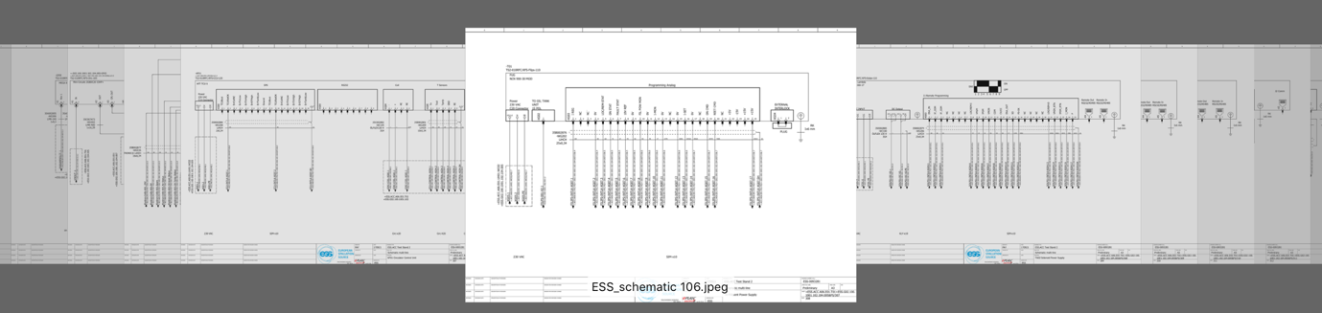
Cable Database, Rack Layout, Electrical Schematics
Detailed information for 14, 325 RF cables already in now database
…
…
…
…
Electrical schematic drawing for rack installation

Slide 11
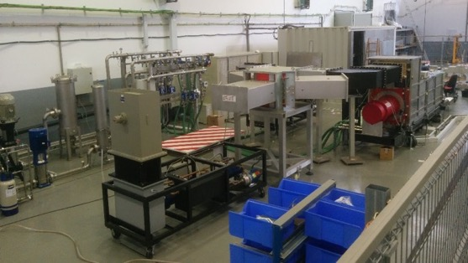
Status: High Power RF Amplifiers
Medium beta klystrons orders placed for 36 klystrons, from Toshiba and CPI
  First klystron on 21st June.
Driver amplifiers for MB
  Design review and first FAT is done with R&S
  1st delivery scheduled
  Prototype measured and report done
ESS Bilbao NC klystrons
  Has three klystrons
  High voltage conditioning started
  Tendering for three more

Slide 12
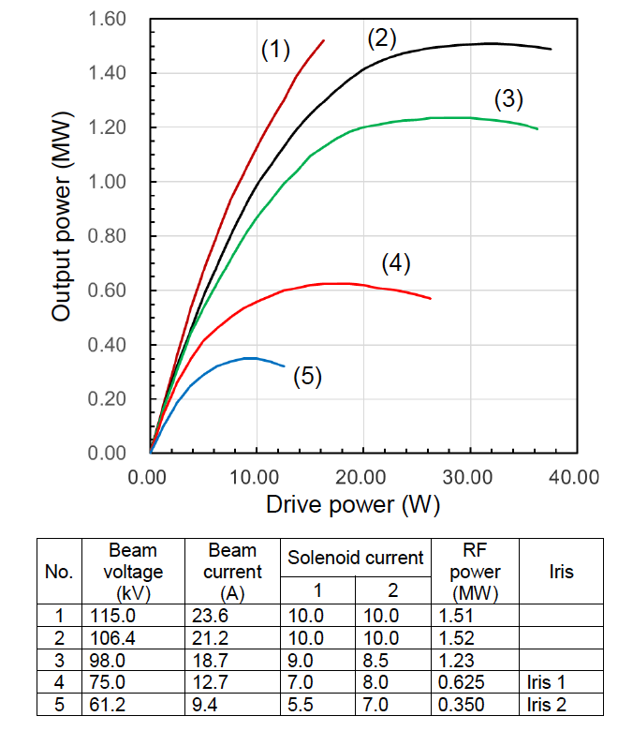
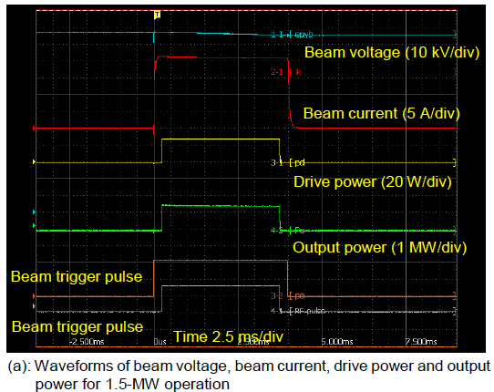
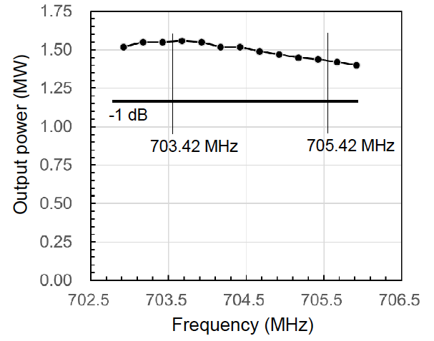

Toshiba FAT, some results

Slide 13

Status: Interlock
Three SIM prototype modules ready
  ATM Atomki at FREIA
  2 by ESS ERIC, one in Lund (TS2)
  Two FIM prototypes under development/test
  1x in TS2 and 1x at ESS labs
All systems fully EPICS integrated

Slide 14








Status: Splitter box, E- Pick up and Pin diode
Installation on going on TS2
Integration on ICS platform (ICS support)
Series production by PEG

Slide 15
Status: LLRF
LLRF system has been running in two test systems in Lund and two in Uppsala/Freia for some time. The system will be used for cavity tests in Sweden and France
Main digitiser boards have been updated to latest version of FPGA hardware, and now have a newly developed AXI-framework running
Additional modules being developed by in-kind partners in Poland have reached CDR status
Procurement of first parts for final master oscillator version has started

Slide 16




LLRF: Hardware and FPGA Programming
Christian Amstutz is guiding FPGA programming for the accelerator division, with contributions from Poland, Spain and beam instrumentation
Developing common FPGA Firmware Framework
Porting of LLRF Firmware to Kintex Ultrascale FPGA
https://confluence.esss.lu.se/display/RFG/AXI-based+FPGA+Framework

Slide 17




RF Technical Lab at Site Office

Slide 18
RF Turn on Procedures
Work together with SRF, RFQ and DTL
Mile stones in 2018/2019:
  Optimum coupler conditioning procedures has been tested in Uppsala, next step is to implement in LLRF&EPICS
  Transfer from SEL loop to Feed forward driven mode
  Transient beam-loading RF tune-up procedures

Slide 19
Thank you

