Slide 1
ESS Target Station for SLHiPP-8
Mark Anthony
Head of Target Division
www.europeanspallationsource.se
June 12, 2018

Slide 2
Agenda
ESS Target Facility
Schedule
Equipment Overviews
Interfaces
Site Photos
Summary

Slide 3
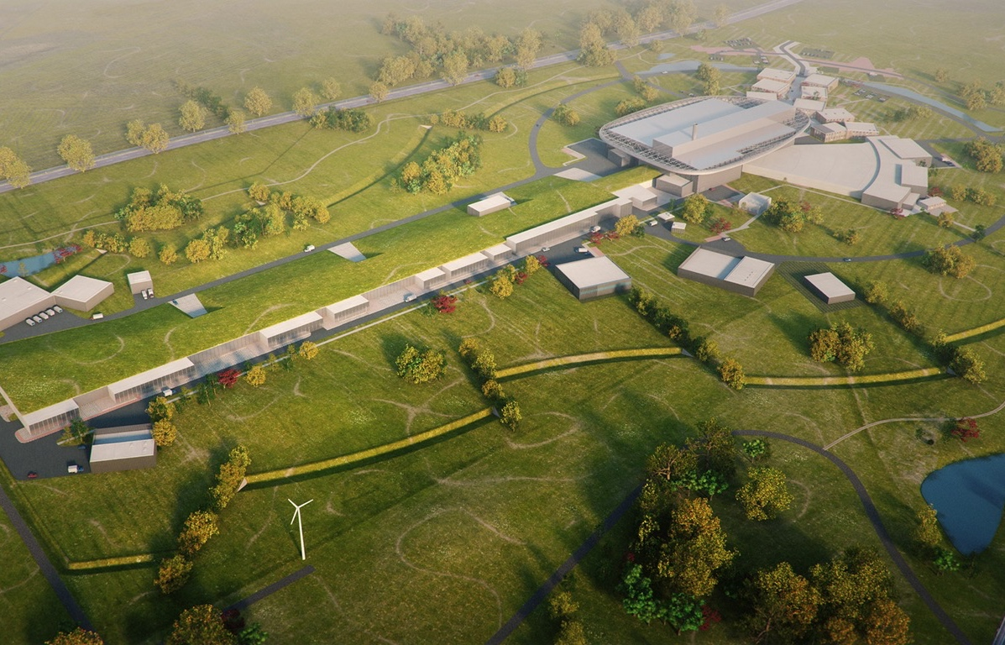
European Spallation Source basics
High Power Accelerator:
Energy: 2 GeV
Rep. Rate: 14 Hz
Current: 62.5 mA
Pulse length: 2.86 ms
Target Station:
He-gas cooled rotating W-target
Average power: 5 MW
Pulse power: 125 MW
Neutron beam ports: 42
16 Instruments in Construction budget
Committed to deliver 22 instruments by 2028
Peak flux ~30-100 brighter than the ILL
Proton Source
Environmental goal (“Sustainability”)
Energy responsible
Renewable energy
Recyclable heat

Slide 4
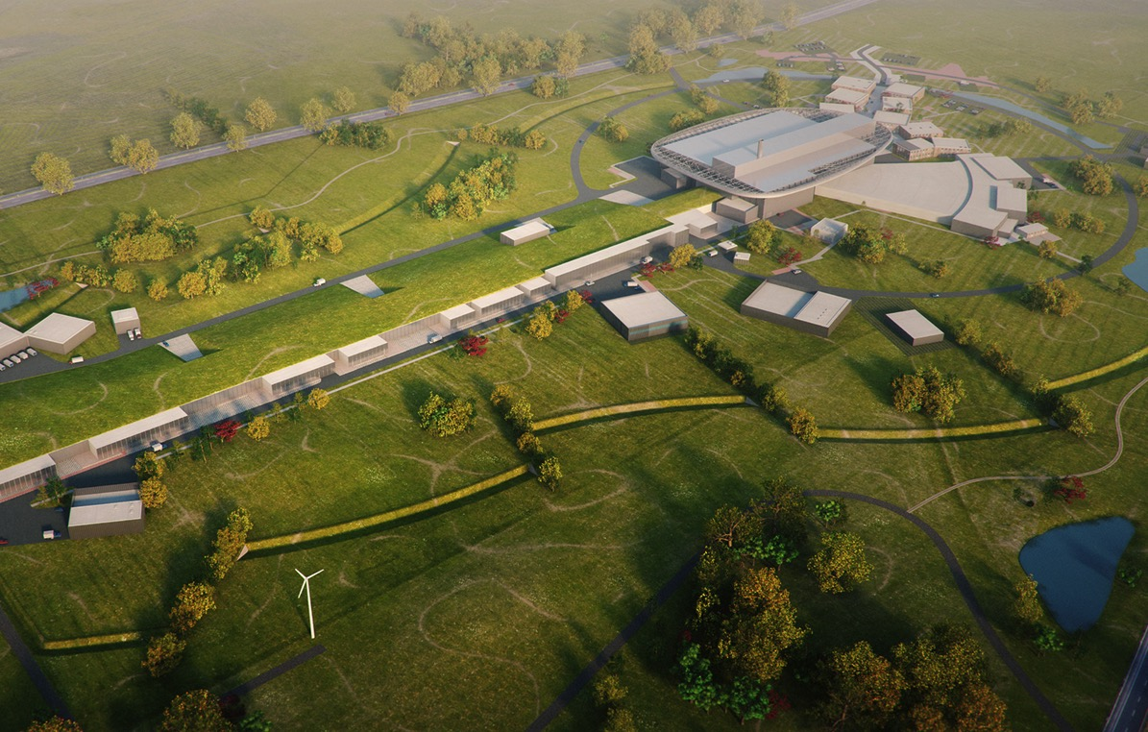

Construction plan
2025
ESS Construction Phase Complete
2014
Construction Starts on Green Field Site
2023
ESS Starts
User Program
2009
Decision to Site ESS in Lund
2022
Machine Ready for
1st Beam on Target
2012
ESS Design Update Phase Complete
2003
European Design of ESS Completed

Slide 5
Summary Schedule for Remaining Work
2018
2019
2020
2021
2022
2023
2024
2025
BOT
SOUP
Warm LINAC Commissioning Steps
EOC
1.3 GeV Capability Installed
Will propose reasonable float to establish external milestone commitment
Accelerator + ICS
Hi-Beta Install
Beam on Dump
(570 MeV)
Accelerator RBOT
Accelerator Schedule Float to BOT
CF + Target + NSS (Bunker+TBL) + ICS
Bunker and Test Beam Line RBOT
Access for Monolith Installation
Target RBOT
March 2022
15th Instrument Complete (Ready for hot commissioning)
NSS Instruments + ICS
Instrument Hall Access for Start of Installation
Start beam commissioning for 1st Instruments
RSOUP

Slide 6
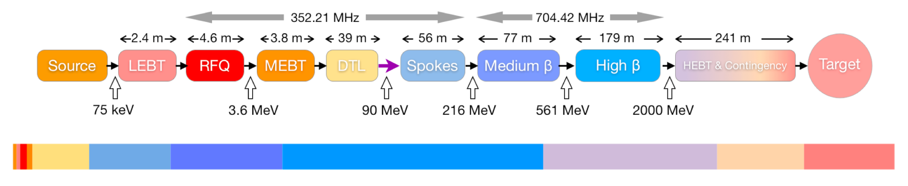
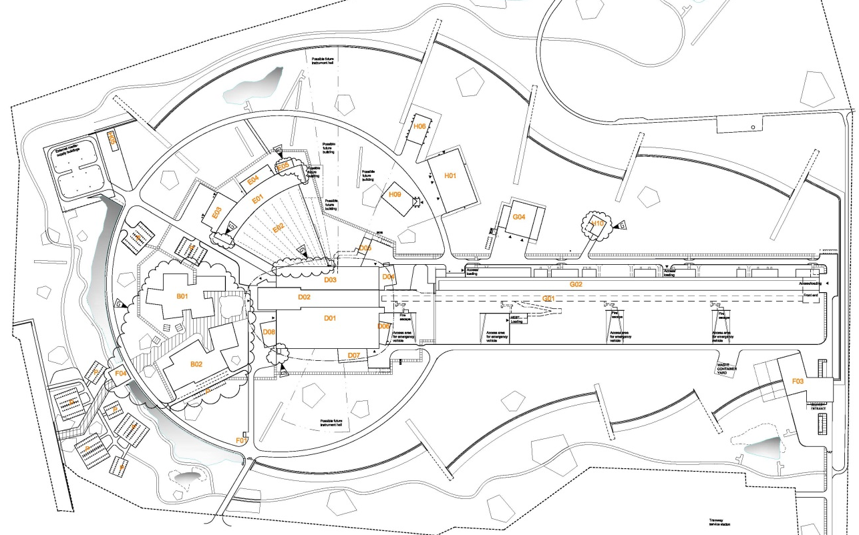

The Accelerator will be the world highest energy/highest power proton linac
Particle species proton
Energy 2.0 GeV (1.3 GeV initially)
Current 62.5 mA
Average power 5 MW (3 MW initially)
Peak power 125 MW (75 MW initially)
Pulse length 2.86 ms
Repetition rate 14 Hz
Operating time ~6000 h/year
Availability goal (incl. target) 95%

Slide 7
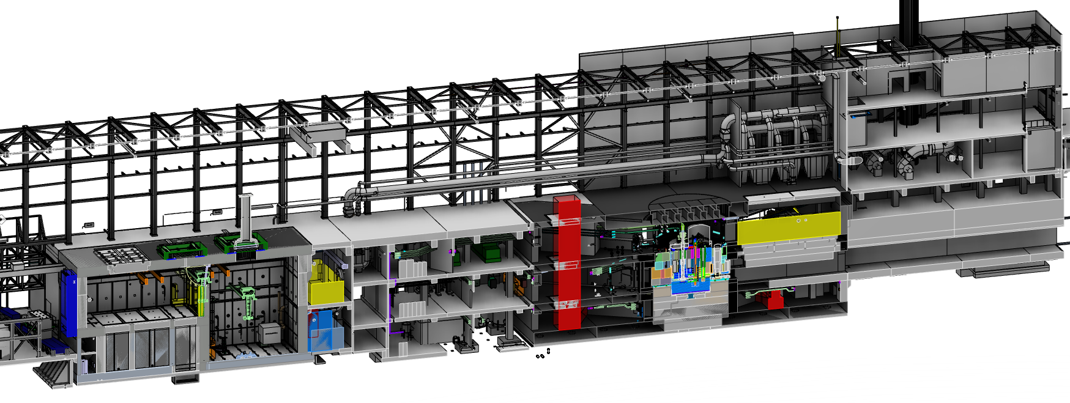
Key features of the ESS Target Station
Utilities and cooling plant
Helium cooling of target wheel
Water cooling of moderators, plugs and shielding
Intermediate water loops between primary circuits and conventional facility utilities
Helium cryoplant for refrigeration of cold moderator system
Nuclear grade HVAC system
Remote handling systems
Large active cells for safe storage and processing of spent radioactive target components
Shielded casks for transfer of spent components from monolith to active cells
High bay
22 m
130 m
Transport hall
37 m
Target
monolith
Active cells
Utilities block
Beam expander hall

Slide 8
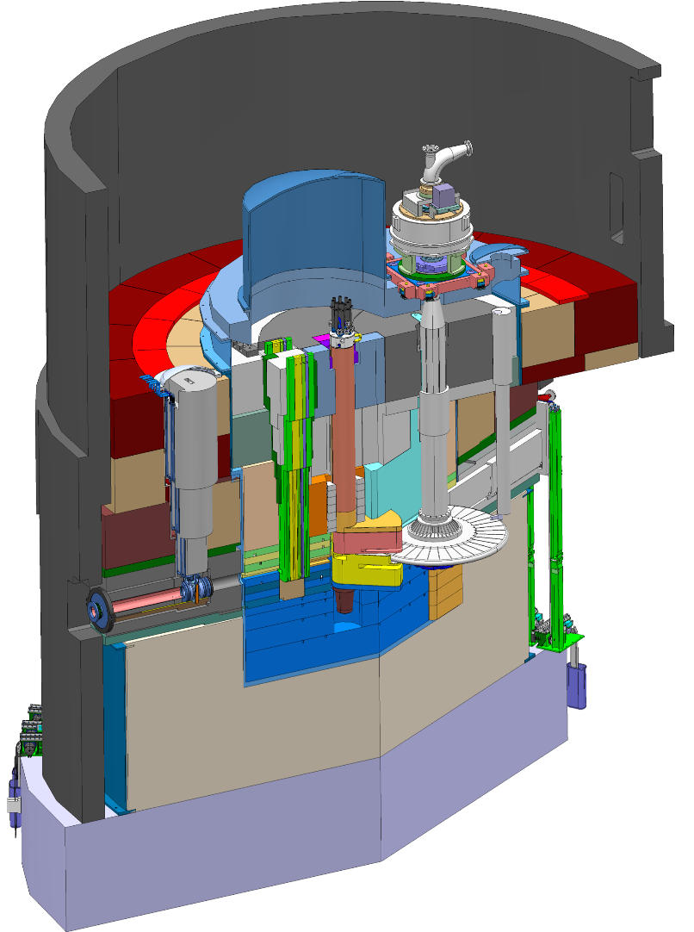
Key features of the ESS Target Station
Moderator and reflector
Target Safety System
Monitors target coolant flow, pressure and temperature, monolith pressure,
& target wheel rotation
Prohibit beam on target if parameters are outside specified limits
proton beam instrumentation plug
Helium cooling of target material
Mass flow 3 kg/s
Pressure 11 bar
Temperature inlet/outlet 40 °C/240 °C
monolith vessel
neutron beam extraction port
Rotating solid tungsten target
36 sectors
Mass, total 11 tonnes, whereof 3 tonnes of W
Rotates 23.3 rpm, synchronized with pulsed proton beam 14 Hz
proton
beam
target wheel
target monitoring plug
proton
beam window
Diagnostics and instrumentation
Controlled and integrated commissioning and operation of the accelerator and target
Fluorescent coating of PBW and target front face
Optical paths, grid profile monitor, aperture monitor
Wheel monitoring including position, temperature, vibration, as well as internal structure
Moderators
Provisional locations of moderators above and beneath the target wheel, i.e. monolith centre
1st MR plug exploits the upper space, offering:
  Cold, 30 mm high, liquid H₂ moderators, 17 K
  Thermal, 30 mm high, H₂O moderator, 300 K

Slide 9
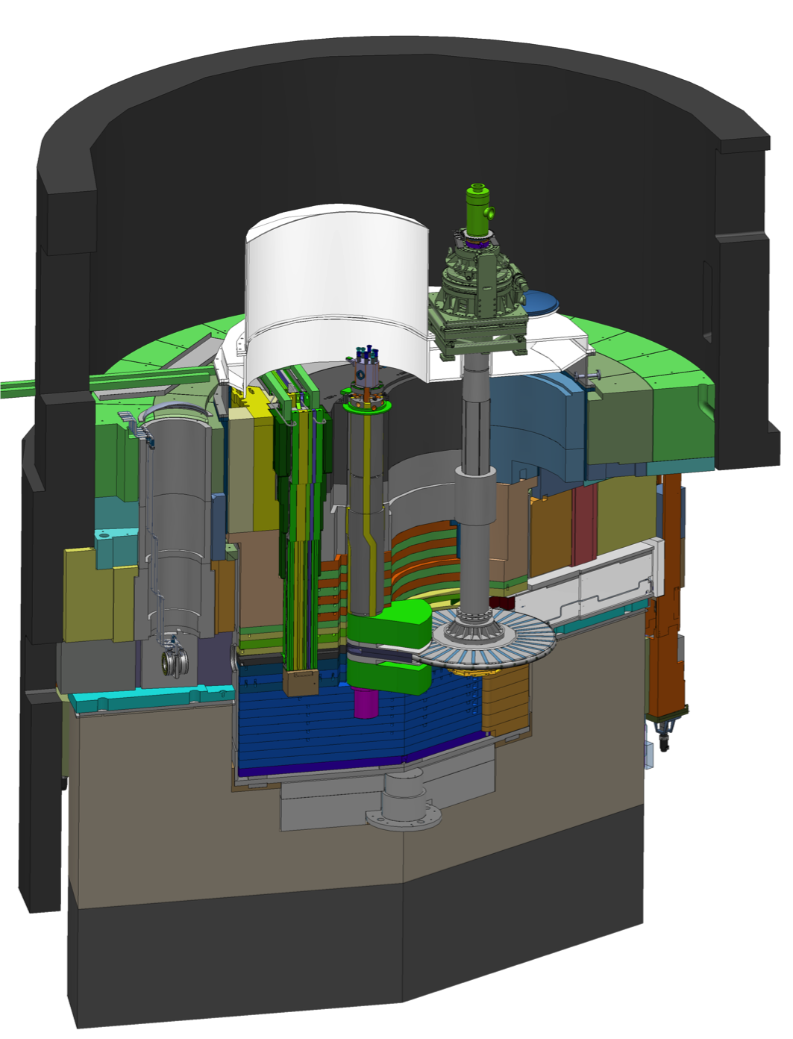
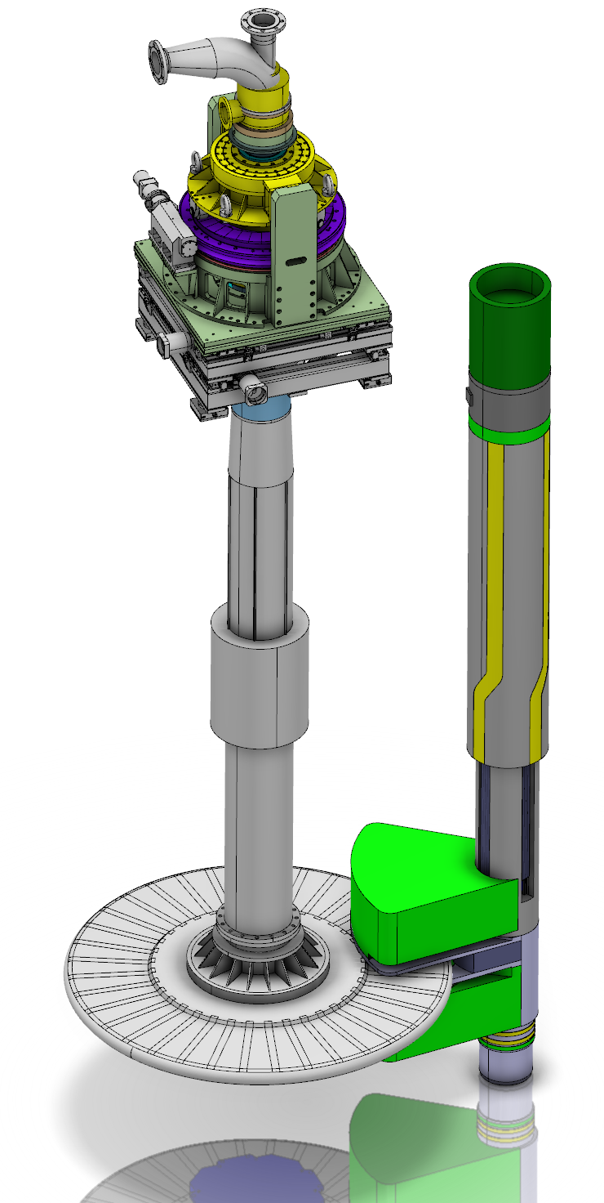
Target Wheel and Moderator and Reflector unit (MR Plug) placement in Monolith
Proton
Beam
Target Wheel
MR Plugs

Slide 10
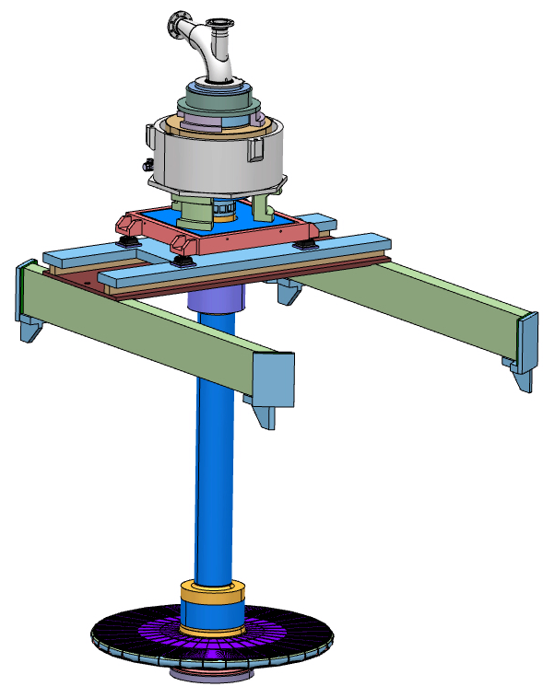
ESS will be the first spallation source to employ a helium-cooled rotating target
Motor and bearings are mounted far away (5 meters) from the high radiation zone
  Wheel is suspended on a 6 meter long shaft
Helium removes 3 MW of heat deposited
in the target by the 5-MW proton beam
Expected lifetime of 5 years
Wheel rotation scheme
  Target wheel has 36 sectors of 10° each
  The beam pulse is 2.86 ms wide, and pulses 14 times per second
  Wheel rotation is synchronized with the
  beam pulse
  Wheel rotational speed is14 Hz/36 = 0.39 Hz,
  or 10° rotation between each pulse
5 m
2.6 m

Slide 11
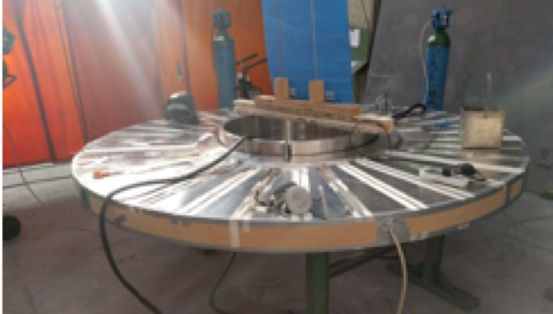
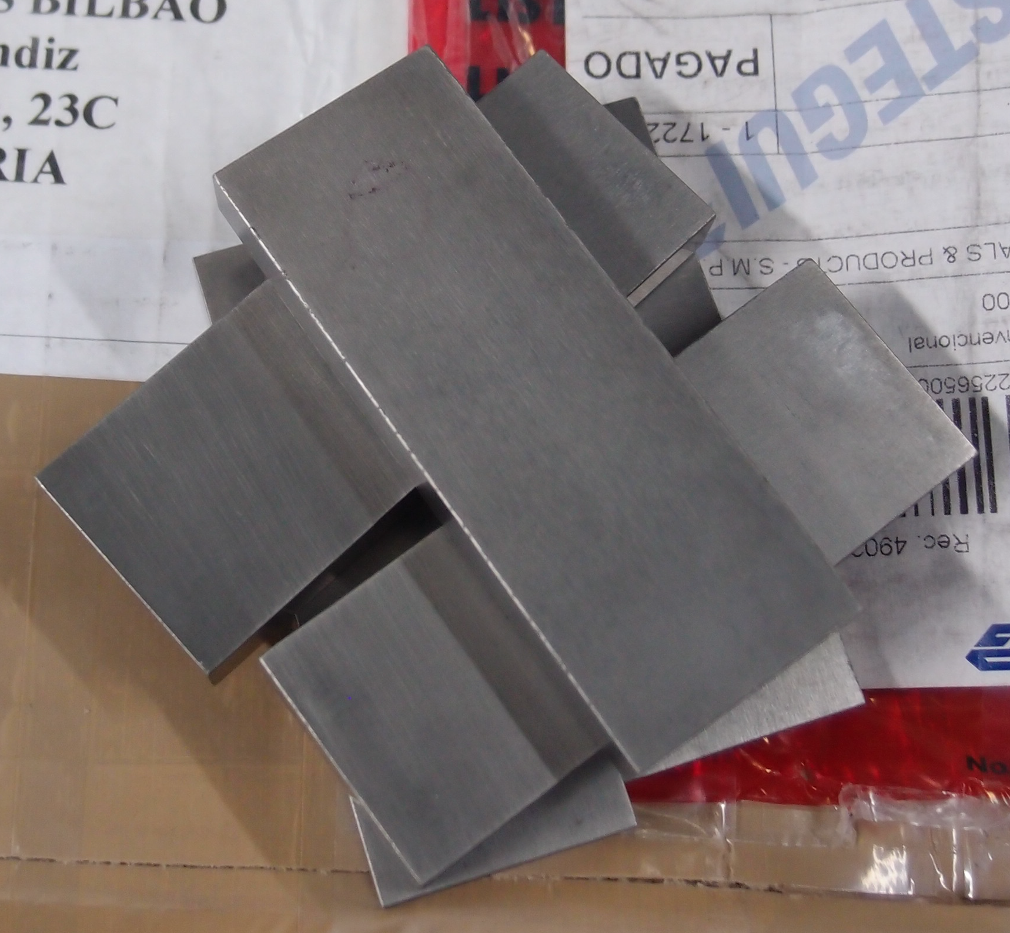

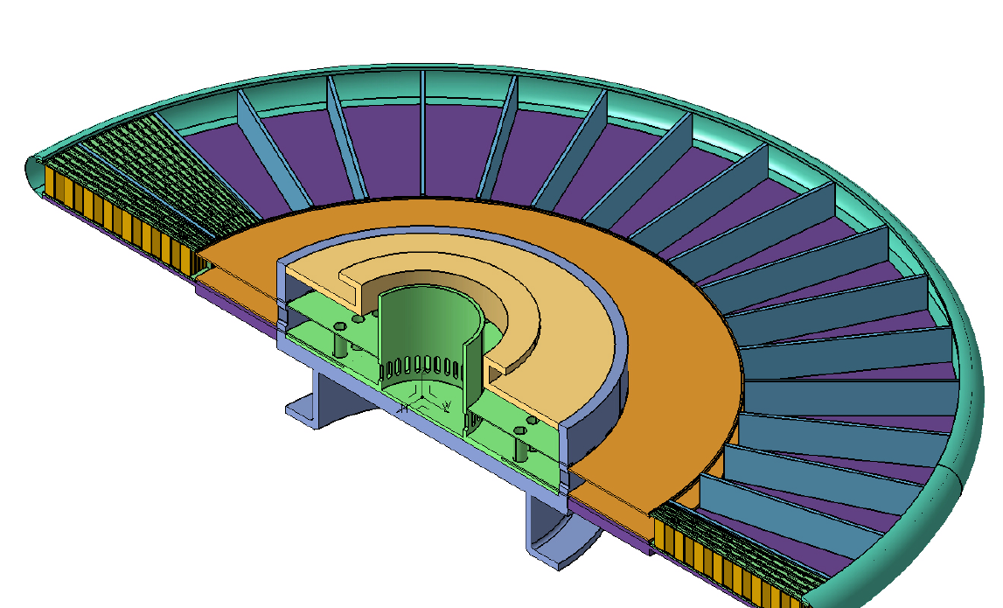
Each 10° sector is loaded with a tungsten-filled cassette
proton
beam
48 cm
Target Wheel prototype
Tungsten bricks
Tungsten depth in
the proton beam direction is 45 cm
The range of a 2-GeV proton in tungsten is 74 cm
Brick dimensions: 10 W x 30 D x 80 H mm³
190 bricks per sector, 6840 bricks in total
Helium flows
  radially outward above and below the cassette,
  reverses direction at the wheel rim,
  and returns through the tungsten
Cassette

Slide 12
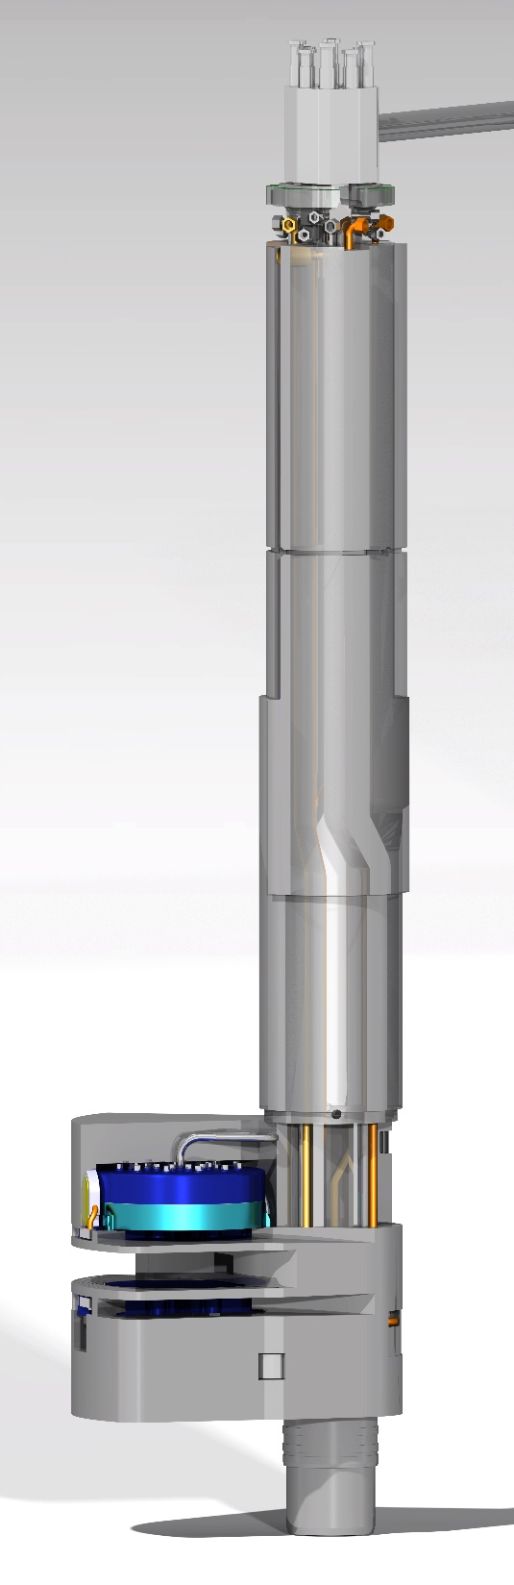
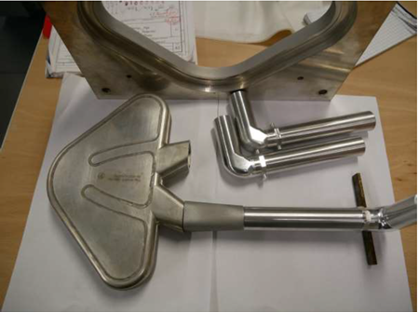
Main functions and design of the ESS
Flat Moderator and Reflector Systems
Moderate neutrons to low energies, thermal and cold, useful for the neutron scattering
Cooling the radiation heat in liquids and solid metal bodies

Slide 13
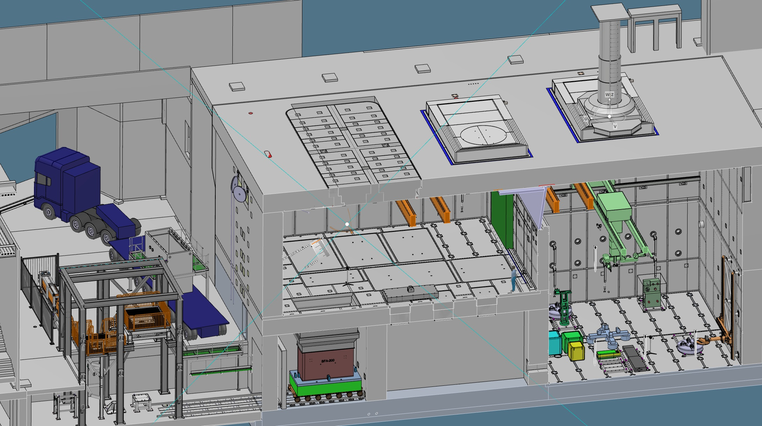
Remote Handling Systems
Casks
Active Cells Facility:
Length: 30 m
Depth: 12 m
Height: 15 m
MUTS
Active Cells Facility

Slide 14
Target Safety System and Target Controls
Coordinated accident analyses
  Finalizing all 22 accident analyses for operations and submitted to the Swedish Radiation Safety Authority
  Implemented new dose-to-worker method and analysis of uncertainties and conservatisms
  Finalized definition of safety functions for the Target Safety System
TSS test stand operational
  Functional HMI
  Logic for single safety instrumented function (SIF) implemented
  Sensor input simulated for system logic and mode testing

Slide 15
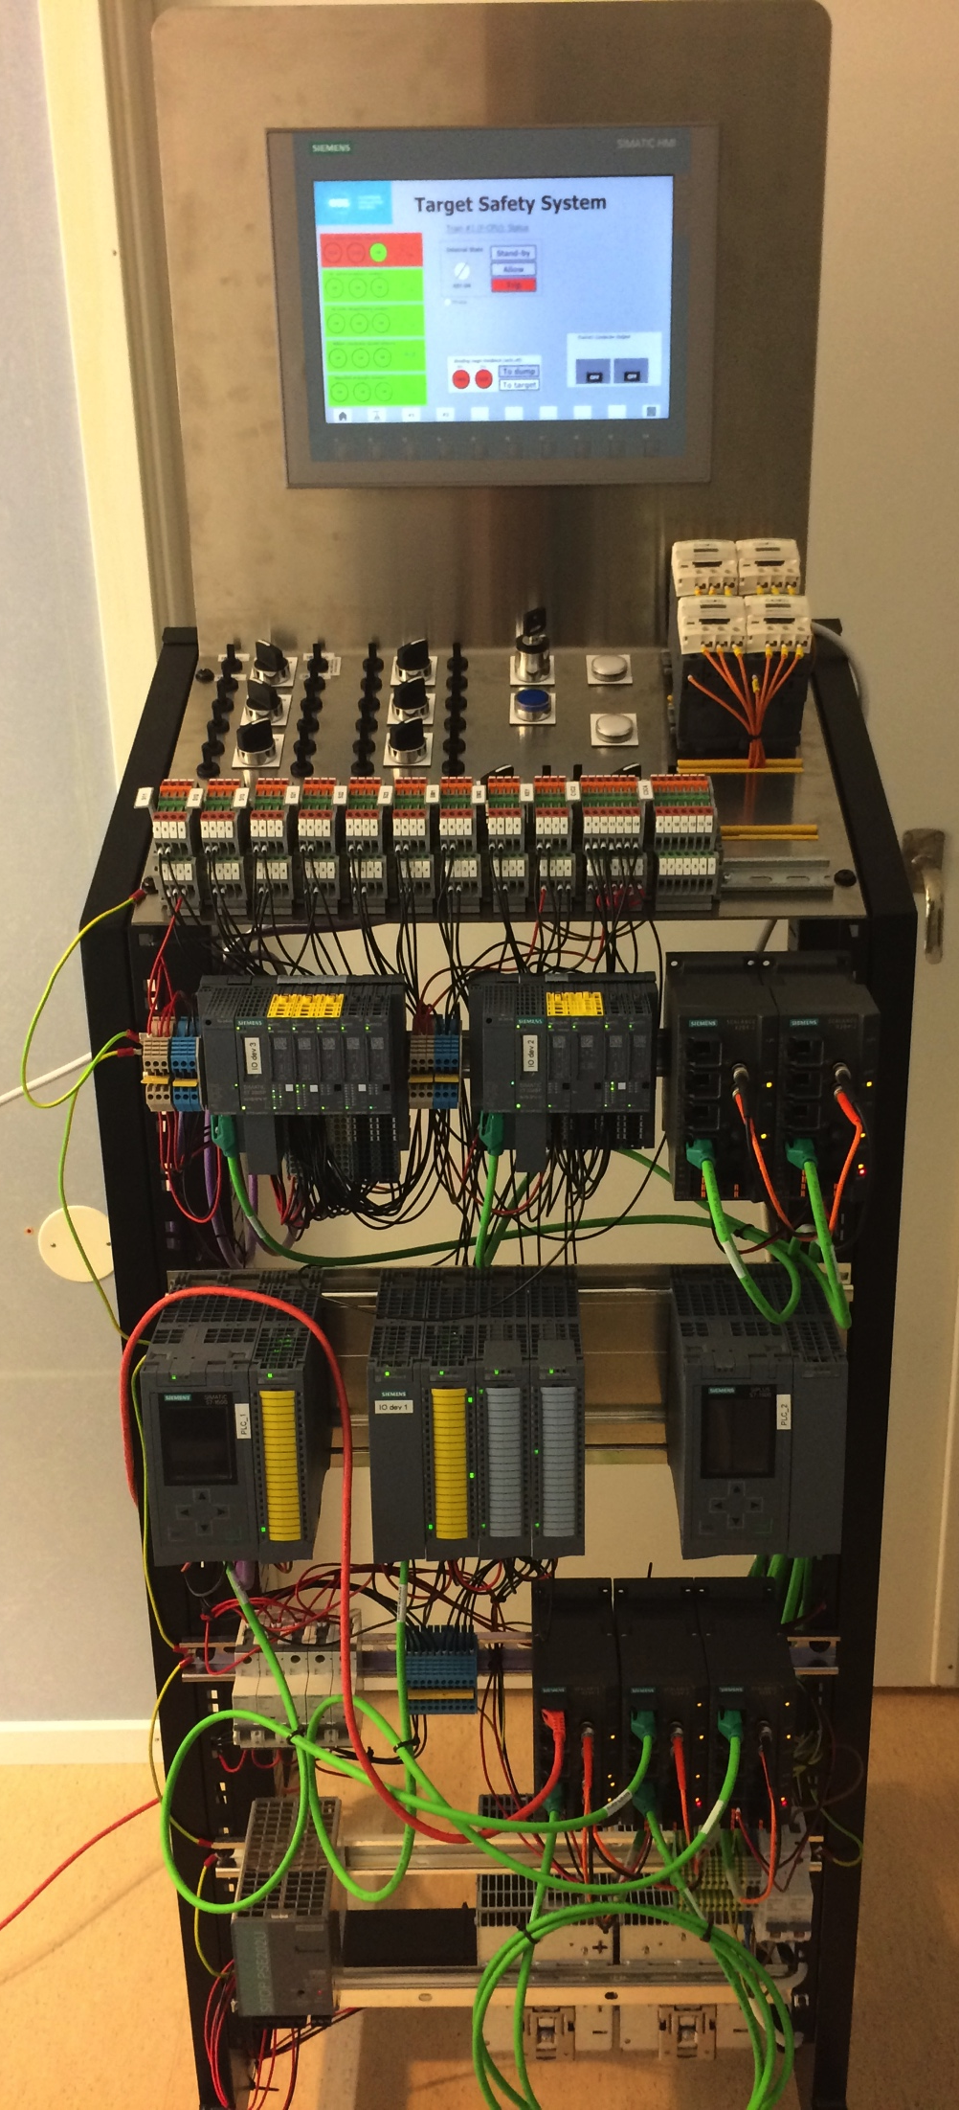
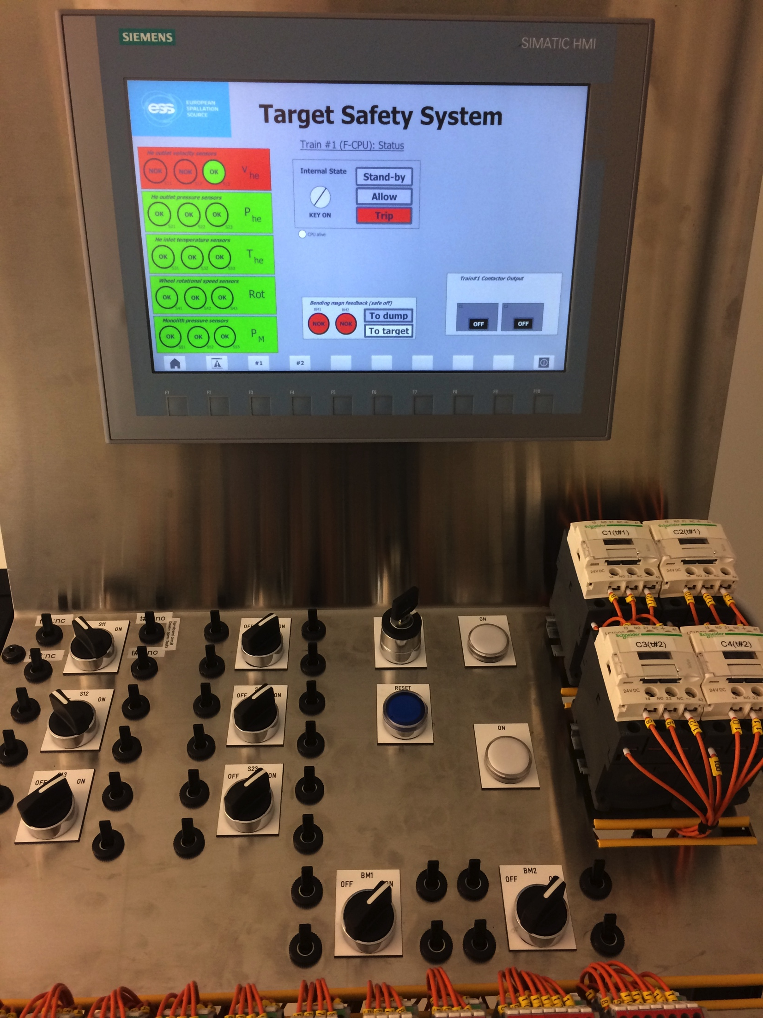
TSS Test Stand

Slide 16
Radiation Hazards Analysis and Safety Functions
Hazards analyses identified 350 events from which 22 were deemed “bounding”
  Accident Analysis reports completed and submitted to SSM early March 2017
  Accompanying dose calculations for public and workers completed for submission
Bounding events for operations:
  8 events with abnormal heating of tungsten due to beam excursions or loss of cooling
  6 events associated with the Active Cells
  6 events associated with water leaks, hydrogen explosion or fire, chopper malfunction, errant beam on tuning beam dump, and getter failures
  2 events associated with earthquake
Identified safety classified systems/functions, i.e. safety and safety related SSCs:
  TSS, monitoring target coolant flow, pressure and temperature, monolith pressure, & target wheel rotation
  Structural integrity of monolith vessel and neutron beam windows
  Structural integrity of primary cooling systems
  Several structures, functions and administrative controls of the Active Cells Facility (ACF)

Slide 17
Target Interfaces

Slide 18
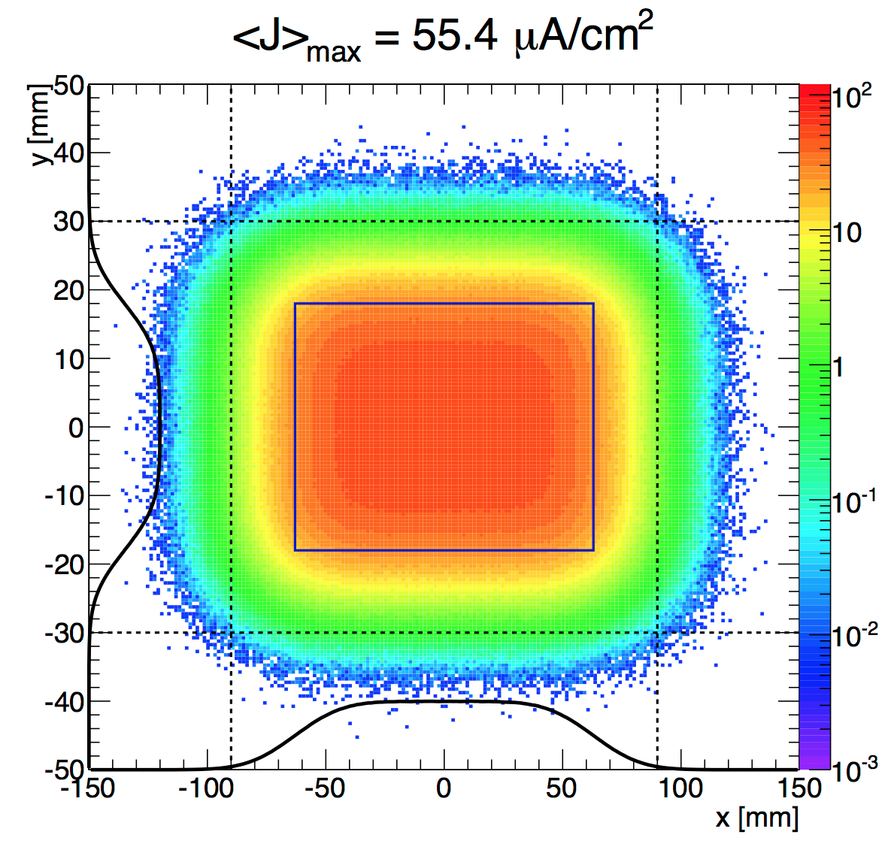
Accelerator - Beam on Target
Beam on target requirements:
  Beam footprint enclosing 97.5% beam fraction: 180 mm (H) × 60 mm (V)
  Beam footprint enclosing 99.9% beam fraction: 200 mm (H) × 64 mm (V)
  Nominal time-averaged peak current density: 56 µA/cm²
  Maximum time-averaged peak current density: 81 µA/cm²
  Max displacement of footprint from nominal position: ±5 mm (H), ±3 mm (H)

Slide 19
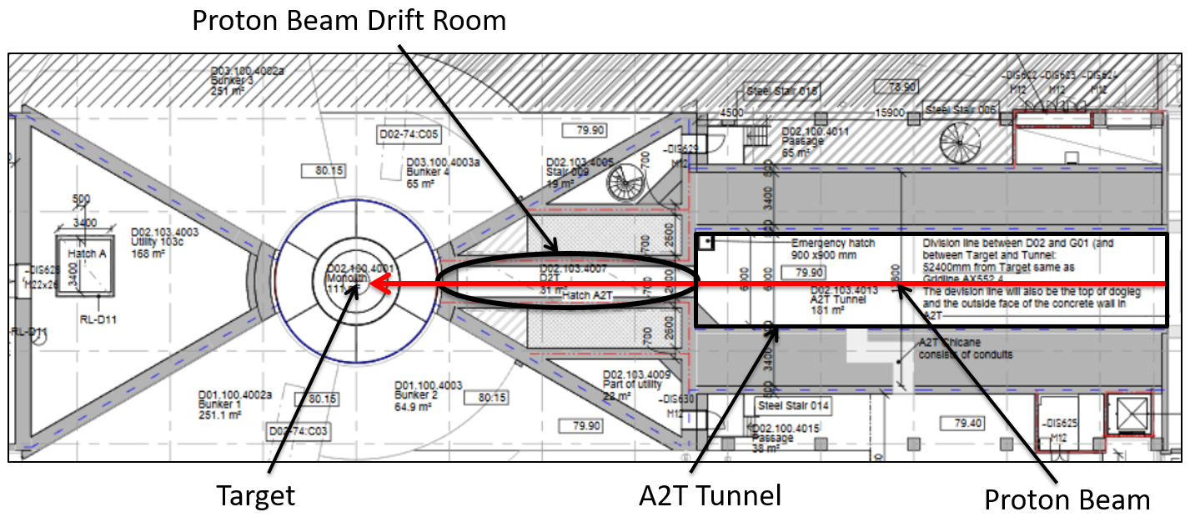
Interface to Accelerator
The Proton Beam Drift Room is located within the Target building, situated between the A2T tunnel and the Monolith/Target.

Slide 20
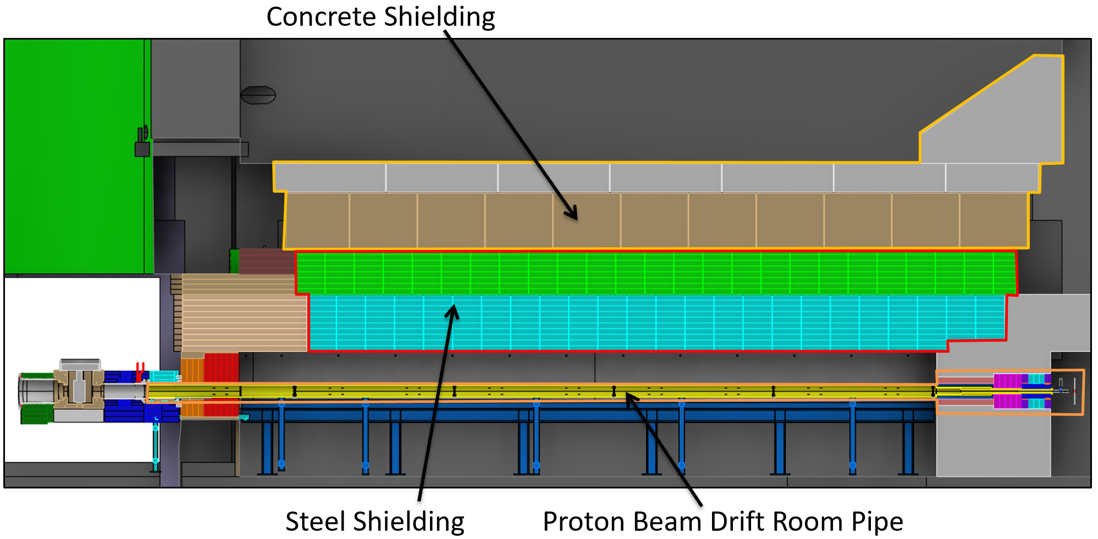
Interface to Accelerator
The primary function of all Concrete and Steel Shielding is to provide radiological shielding, minimize direct streaming passes and to provide a barrier between PBDR and to closest surrounding rooms and areas such as A2T tunnel, Target/A2T.
The primary function of the PBDR Pipe is to maintain ultra high vacuum and to transport the Proton Beam from the A2T tunnel through the PBDR into the Monolith.
PBDR Pipe shall also isolate the Monolith from the Accelerator (A2T tunnel) when proton beam is off and act as a safety device with MQC3 safety classification.

Slide 21
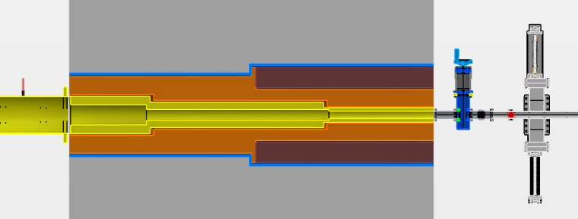
Interface to Accelerator
Remote Handling Isolation Valve
The PBDR Pipe includes an isolation valve located directly towards accelerator
Will be operated remotely from Target/A2T access area.
The isolation valve is a safety device with MQC 3 classification
It needs to be closed during proton beam off operations before people are allowed to enter the accelerator tunnel. The open/close indicator is safety relevant.

Slide 22
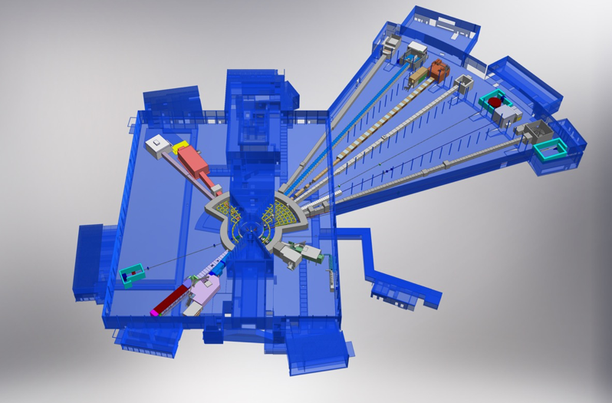

The Beam Lines
Monolith
BEER
NMX
C-SPEC
BIFROST
MIRACLES
MAGIC
ODIN
T-REX
DREAM
HEIMDAL
LoKI
Neutron beam extraction
Offers 42 neutron beam ports
Allows neutron science instruments to view either upper or lower moderator position
VESPA
FREIA
SKADI
ESTIA
22
ESS Instrument Layout (December 2016)

Slide 23
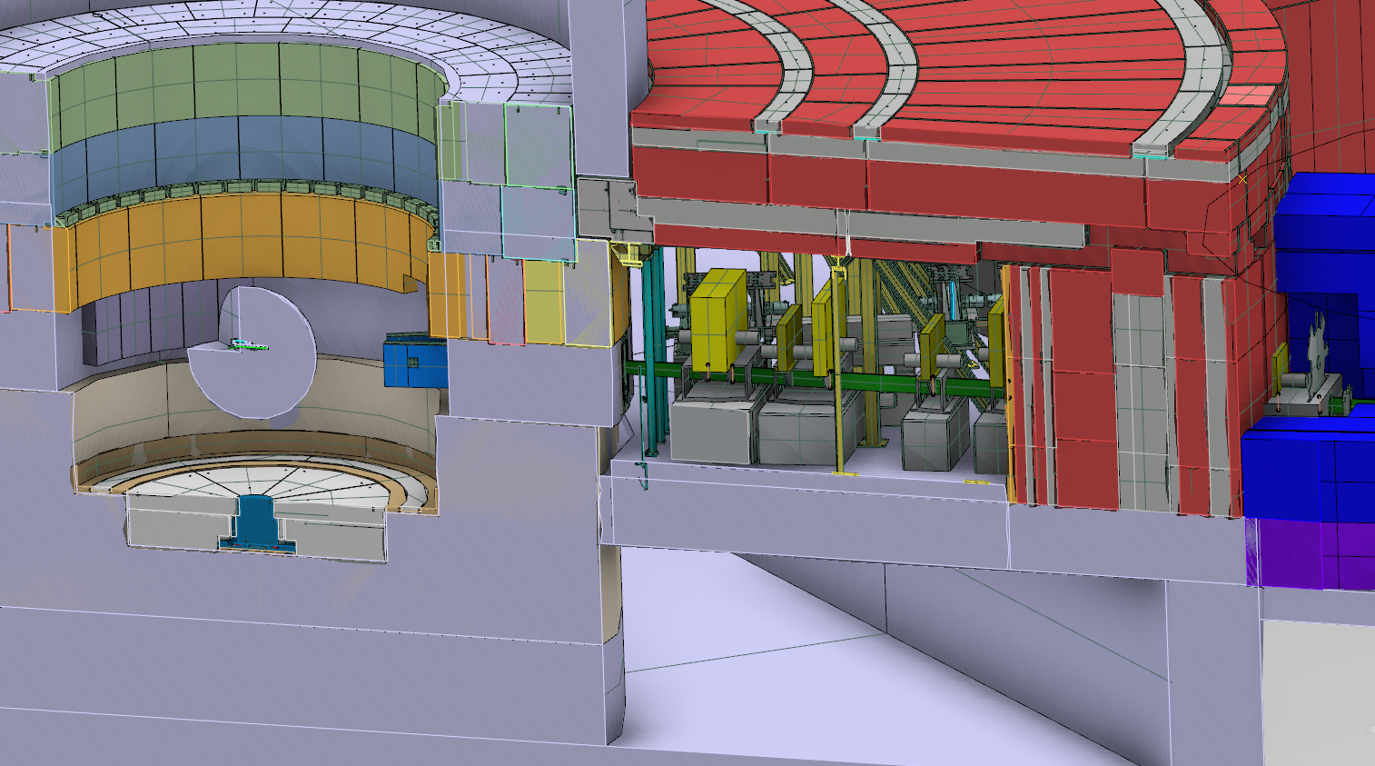
Interface to Neutron Scattering Systems
Bunker roof
Monolith wall
Instrument beam guide
Bunker wall
Notes:
The bunker roof, part of NSS, has to be dismantled during insert changes.
The sequence when changing the insert will be more detailed in Naja’s presentation during the decommissioning of inserts.

Slide 24
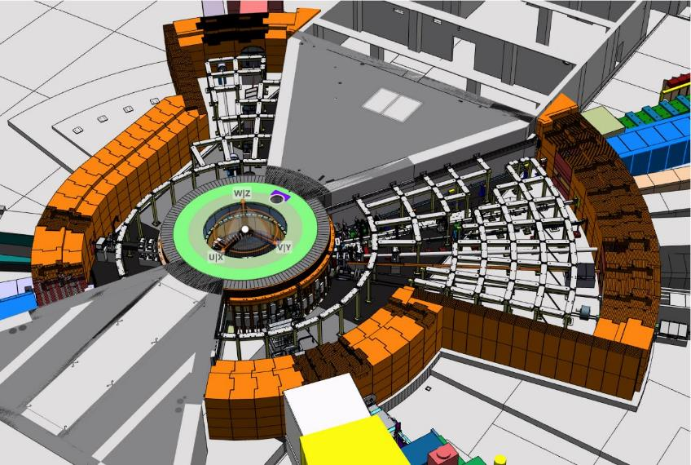
Interface – Beginning of Beam Lines
Construction
Stacked blocks over steel frame
  Number of blocks ~1400
Breakdown
  250t Steel frame
  550t Concrete
  8900t HD Concrete
Each bunker is designed to house the front end components of up to 15+ instruments side measures.
Short sector wall radius 15m from target
Long sector wall radius 28m
Rear wall is 3,5m thick

Slide 25
15 Instruments selected so far
8 to be in user operation by 2023
ODIN imaging
SKADI GP-SANS
LOKI Broadband SANS
Surface Scattering
FREIA Hor. Refl.
ESTIA Ver. Refl.
HEIMDAL Pow. Diffr.
DREAM Pow. Diffr.
Monochromatic Powder Diffractometer
BEER Eng. Diffr.
Extreme Conditions Diffractometer
MAGIC Magn. Diffr.
NMX Macromol. Diffr.
CSPEC ColdChopSp
VOR BroadbandSp
T-REX ThChopSpec
BIFROST Xana Spec
VESPA Vibr.Spec.
MIRACLES BckScatt
High-Resolution Spin-Echo
Wide-Angle Spin-Echo
Fundamental & Particle Physics
Large-Scale Structures
Spectroscopy
Diffraction
life sciences | magnetism & superconductivity
soft condensed matter | engineering & geo-sciences
chemistry of materials | archeology & heritage conservation
energy research | fundamental & particle physics

Slide 26
Equipment Summary
The ESS target station employs many innovative features:
  helium-cooled rotating tungsten target
  flat moderators
  proton beam expansion using raster magnets
  neutron beam ports that allow viewing of either the upper or lower moderator
  small angular separation between beamlines, doubling the number of neutron beam ports
The design fully achieves the specified performance while preserving the safety of employees, the public, and the environment.

Slide 27
Site Photos – The Real World
Progress
www.europeanspallationsource.se
March, 2018

Slide 28
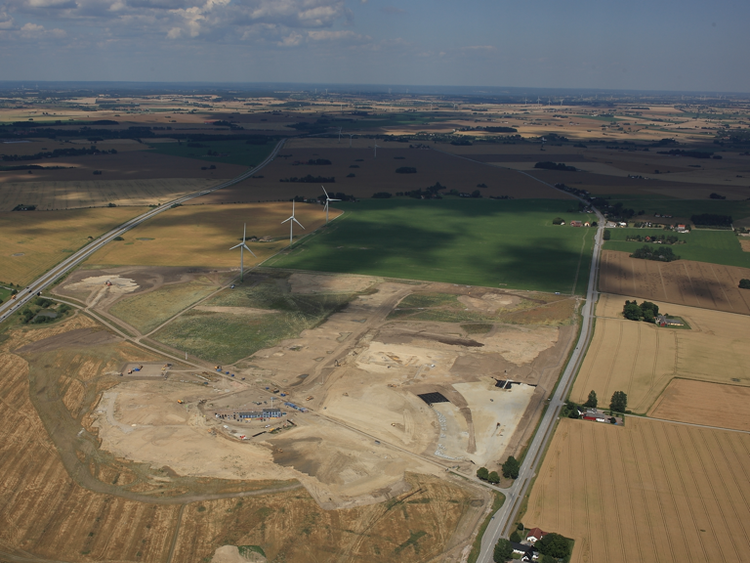
September 2014
Civil construction groundbreaking

Slide 29
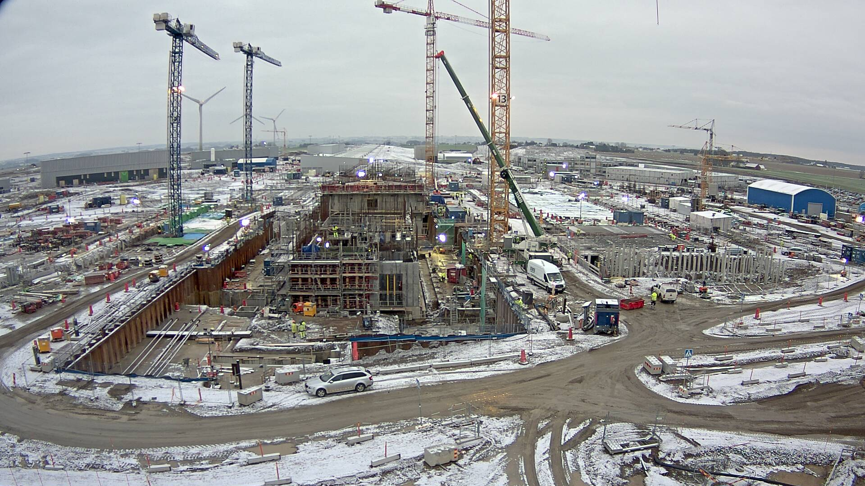
January 2018
…..Hit -10C a few days

Slide 30
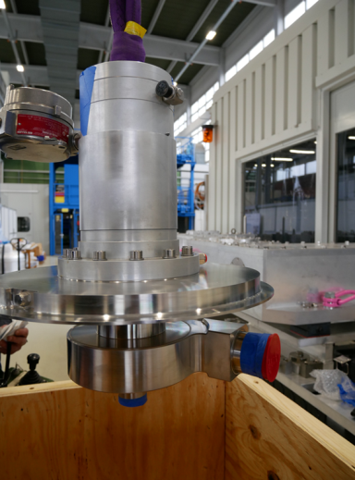
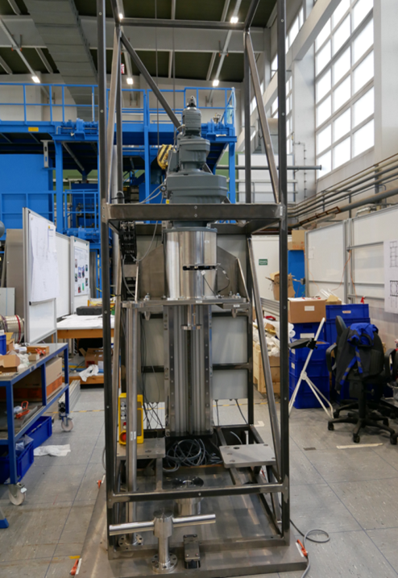
Recent Accomplishments
  Hydrogen Pumps delivered with certificates through ESS Lund to FZ Jülich

Slide 31
Recent Accomplishments
  Manufacturing of MR Plug bottom foundation bucket completed
  MR Plug lifting crown ready through intermediate step machining

Slide 32
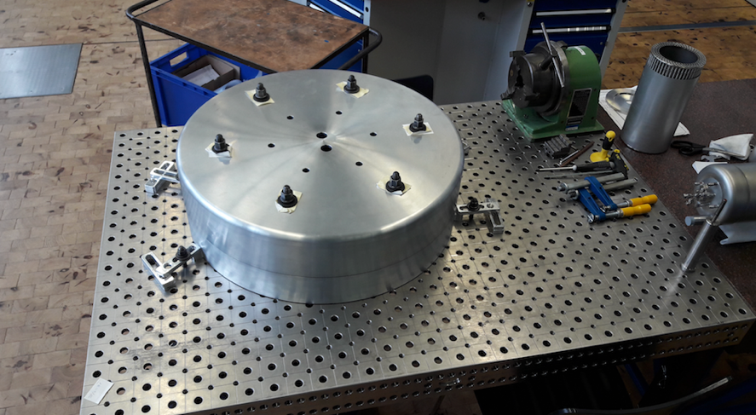
Recent Accomplishments
  Reflector Prototype, MRP lifting crown, MRP bucket, and H2 Hx assembled

Slide 33
Recent Accomplishments
Cryostat

Slide 34
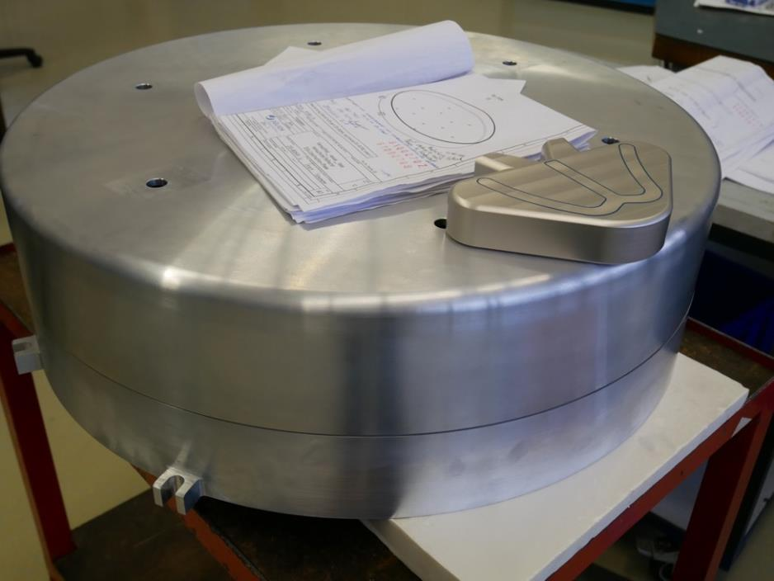
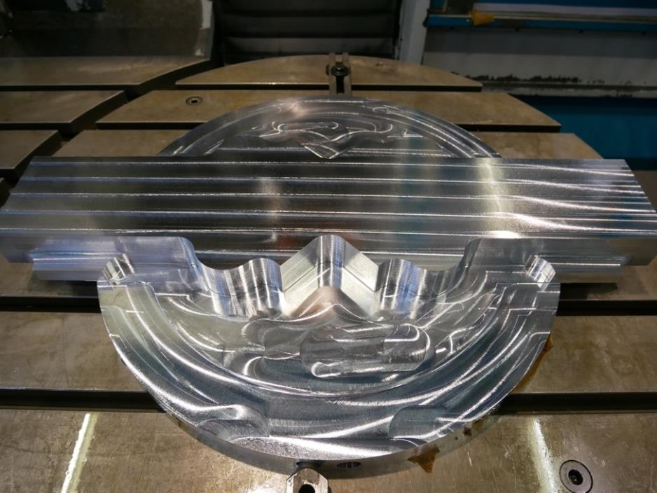
Recent Accomplishments
Bottom Reflector
THERMAL MODERATOR

Slide 35
Recent Accomplishments
  Manufacturing of drainage tanks, Liedholms in Helsingborg

Slide 36
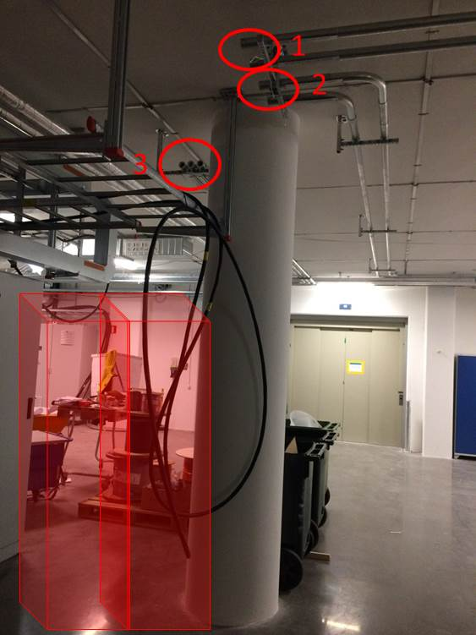
Recent Accomplishments
TSS cable pipes in the Front End Building (FEB) were installed

Slide 37
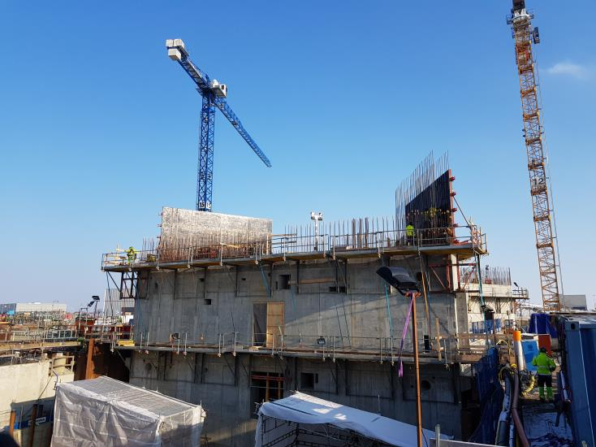
Recent Accomplishments
Work with next level of monolith building started

Slide 38
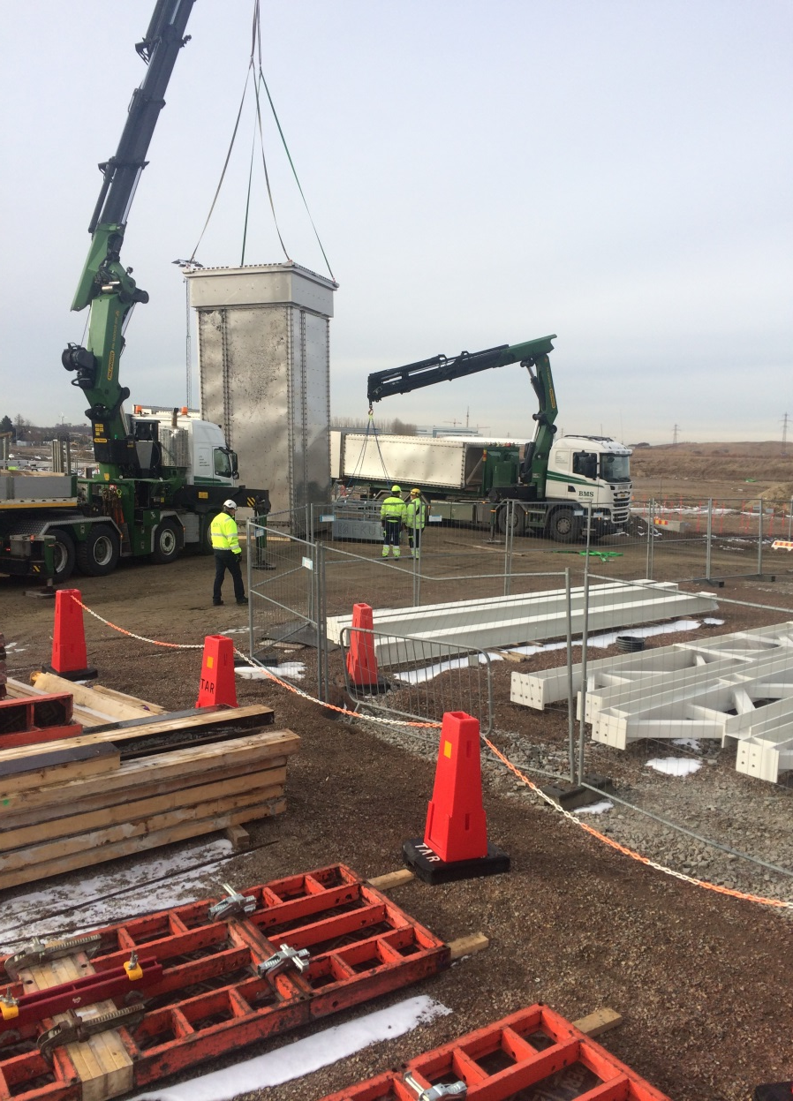
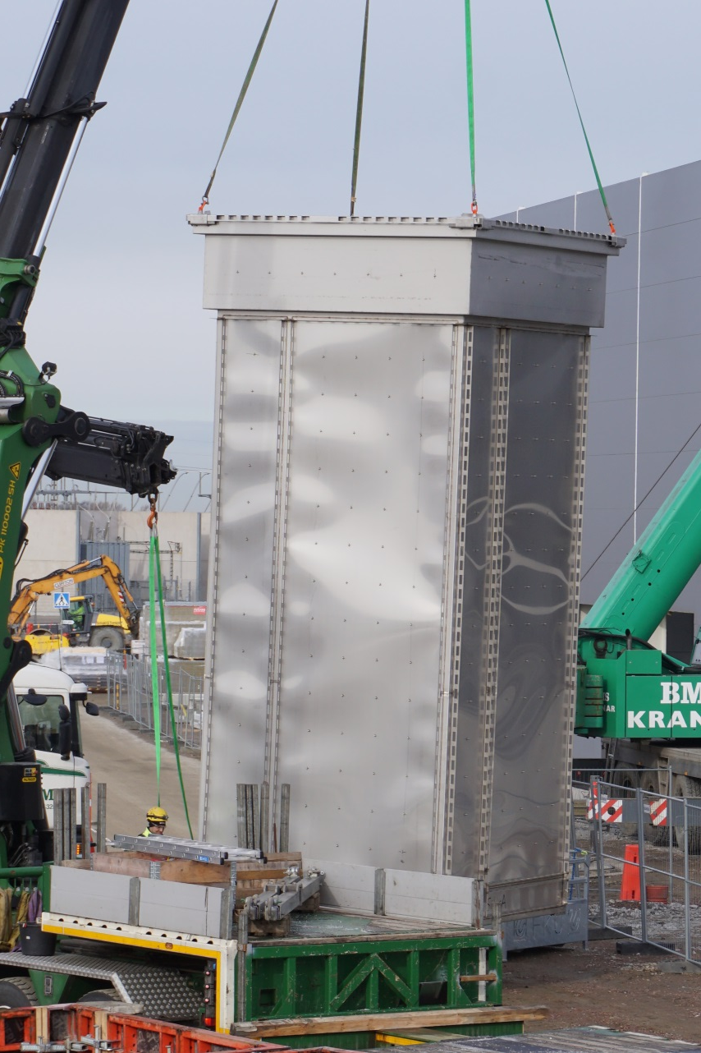
Recent Accomplishments

Slide 39
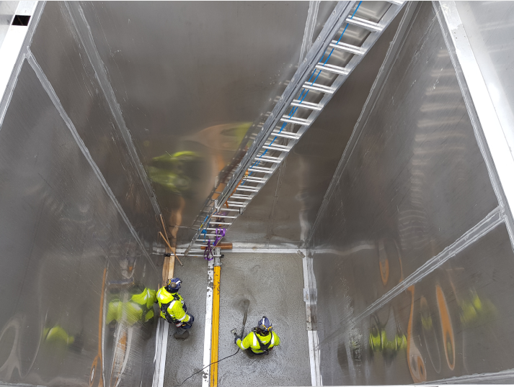
Recent Accomplishments

Slide 40
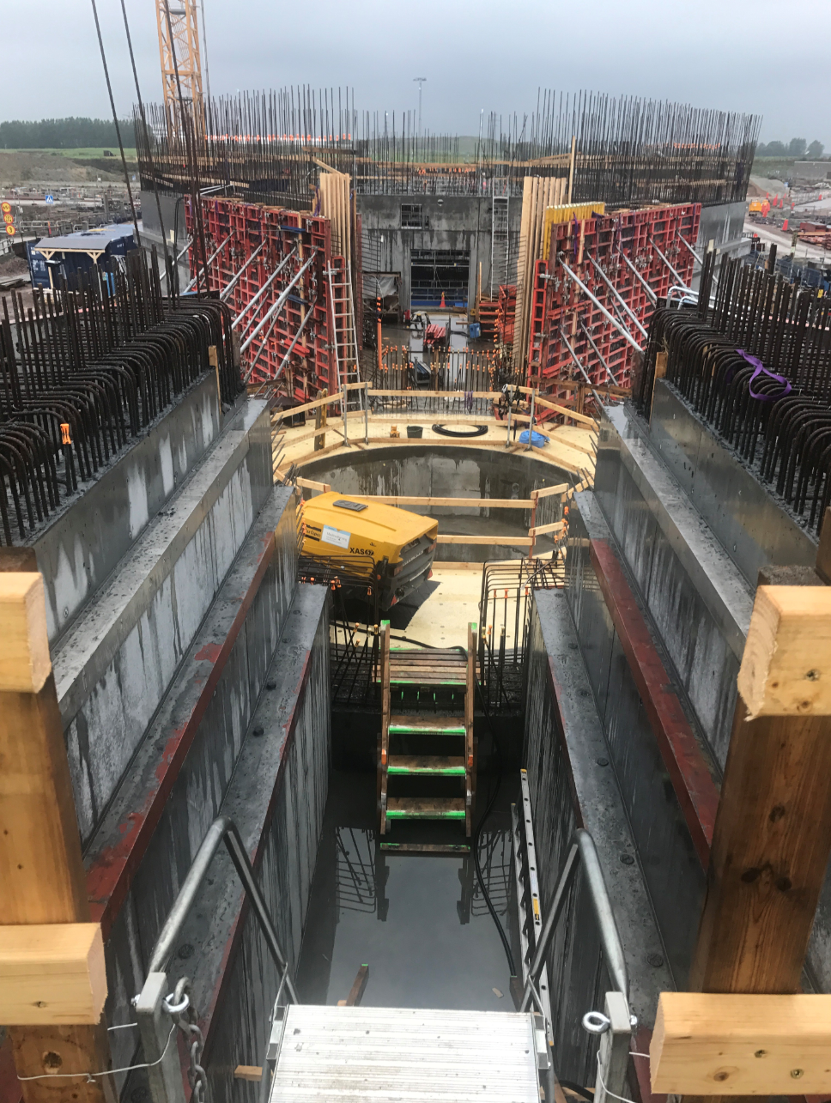
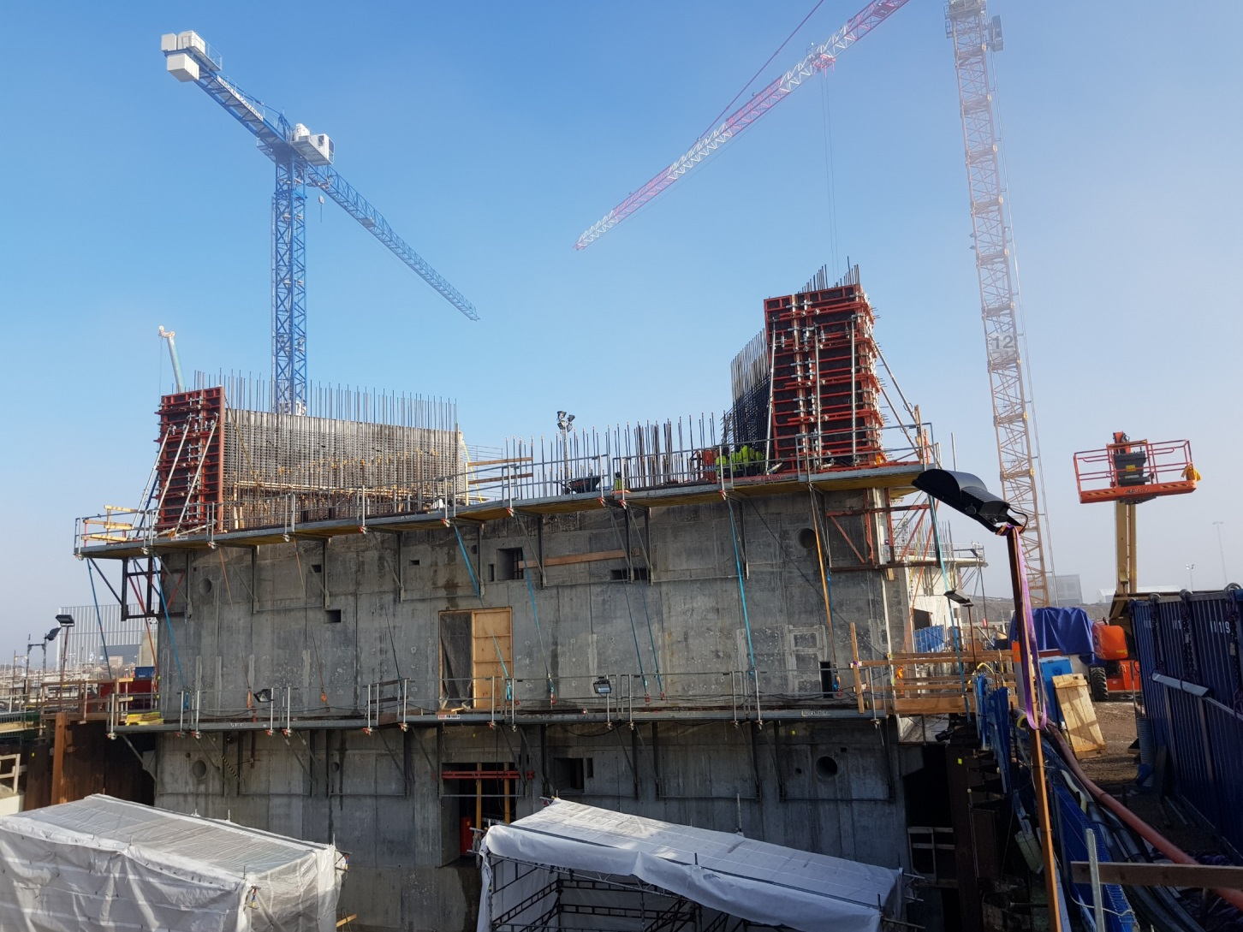
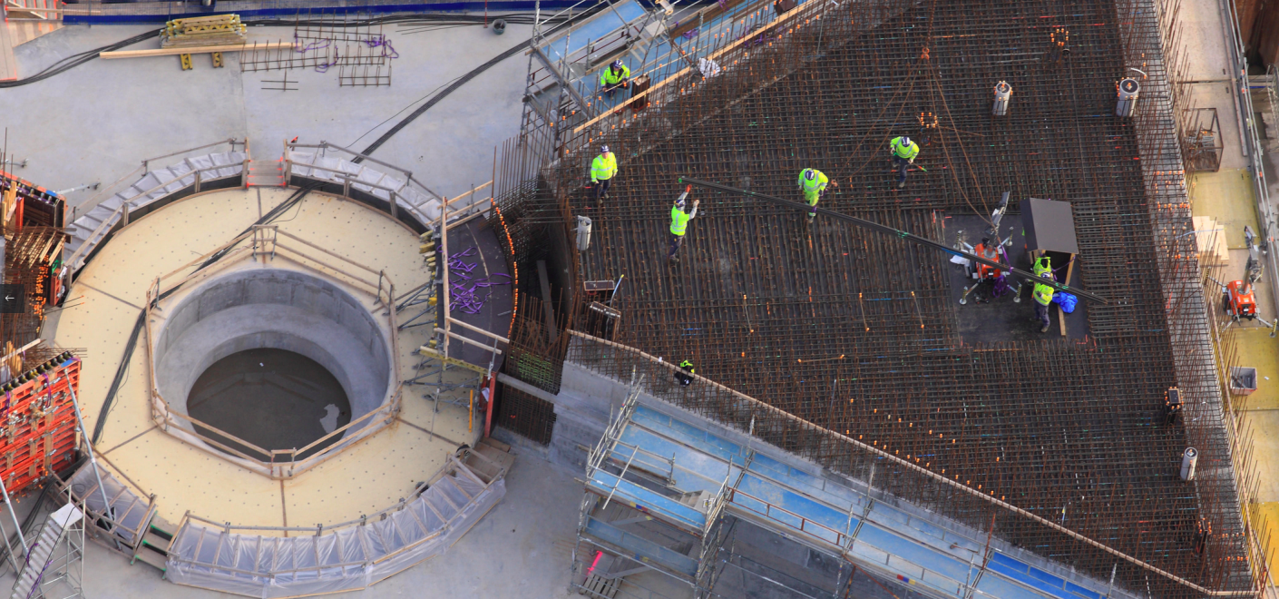
Target Building

Slide 41
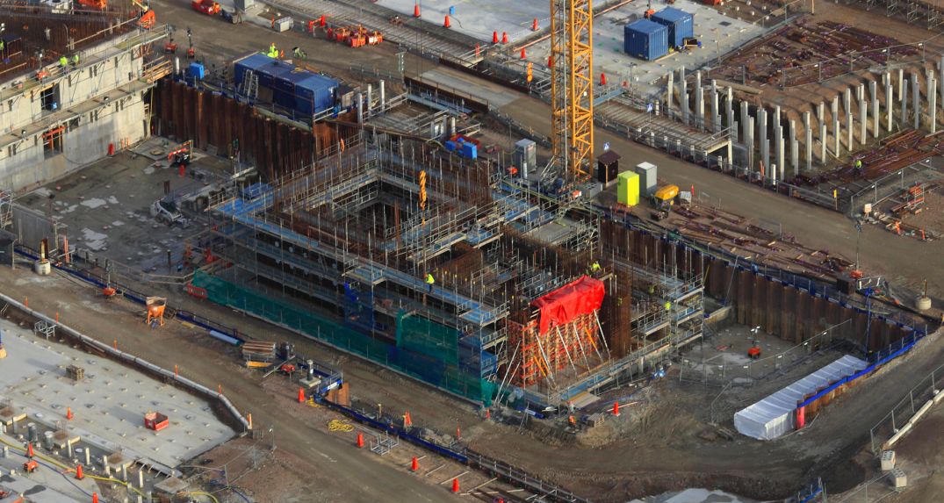
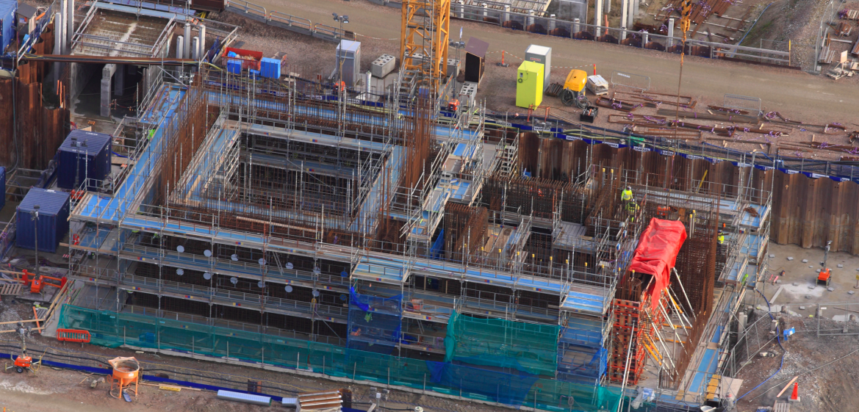
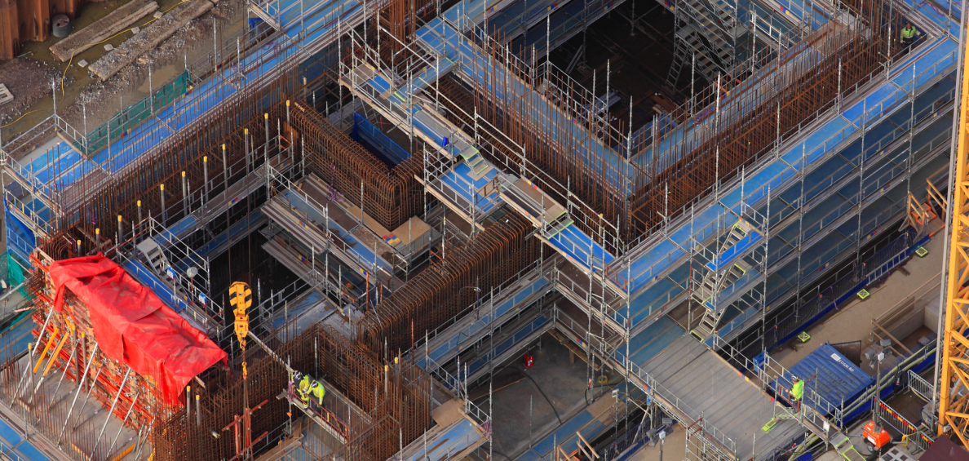
Major Achievements
Active cells

Slide 42
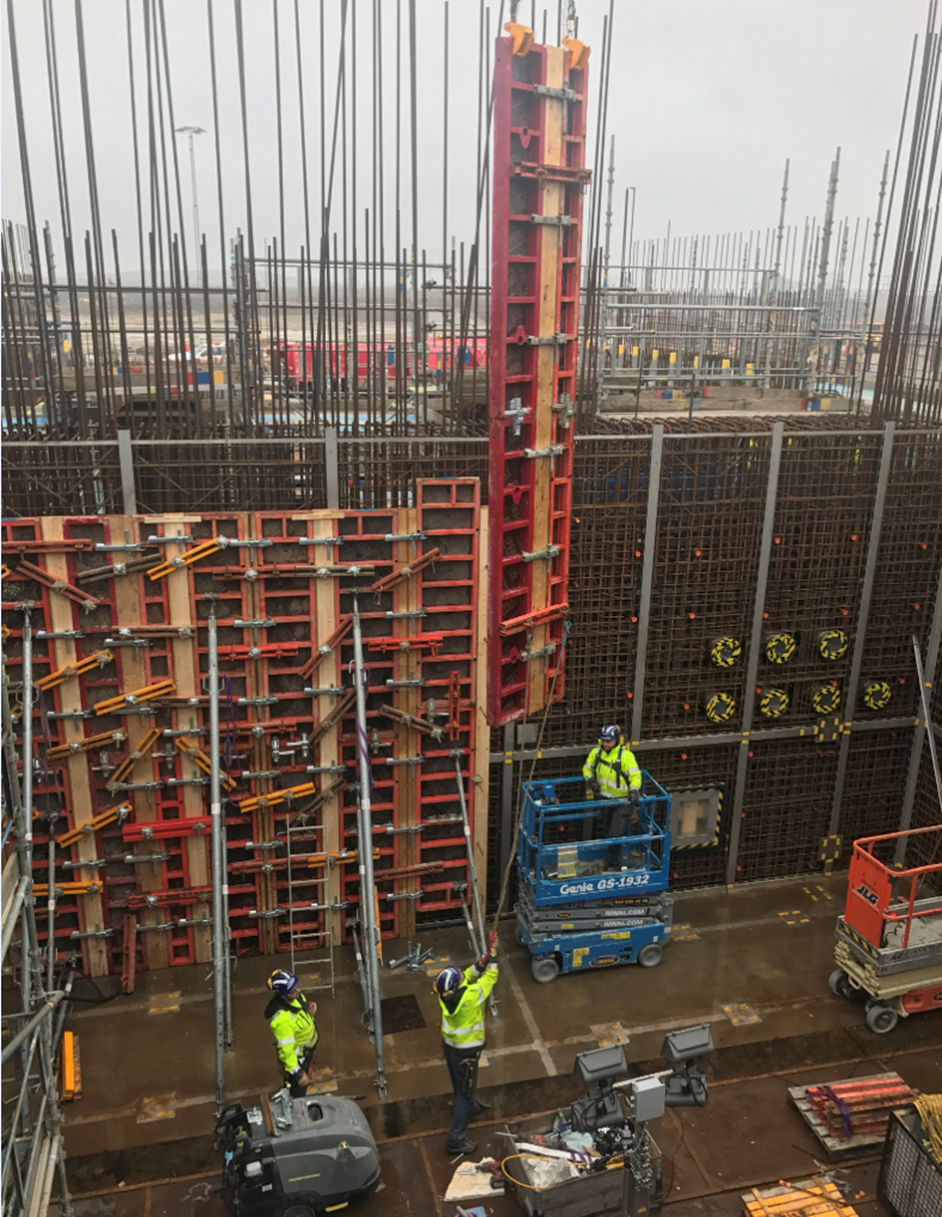
Progress on ACF Construction
Ongoing form-work in West wall
(process cell)

Slide 43
Closing Remarks
Many new staff, mainly consultants has been introduced during 2017, and the organization will continue to develop.
Access dates to the Target Station buildings have slipped due to civil works.
Target is in Final Design phase for most systems, and also in Procurement and Manufacturing for some of them.
Work related to license applications to the Swedish Radiation Safety Authority continues to draw extensive resources.
Target has entered hardware installation phase mainly for embedded and cast-in items.

