Slide 1

Integrated prototyping for MYRRHA
The ADT team : Dirk Vandeplassche, Jorik Belmans, Wouter De Cock, François Davin, Frédéric Doucet, Franck Pompon, Philippe Della Faille, Angélique Gatera
SLHiPP-8, Uppsala, 12-13 June, 2018

Slide 2
Introduction : 100 MeV linac overview
Source: [TBD]

Slide 3
Introduction
MYRRHA phase 1 : 100 MeV project
  cfr. Carmen's presentation
  consists of
    prototype of 600 MeV linac
    ISOL target station
  accelerator : setting up 2 teams for 2 // activities :
    integration : accelerator / accelerator in building (connection BOP)
    industrialisation
    connection to and interface with the target
    integrated prototyping for 100 MeV linac : today's ADT emphasis

Slide 4
Component prototyping activities
providing fundamental framework
obtained through successive Euratom FP's
  reported at earlier SLHiPP meetings

Slide 5
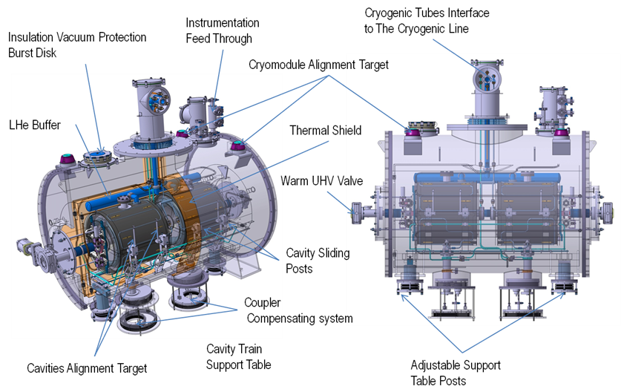
Integrated prototyping
combining components into complete operational entities
dual single spoke cryomodule (β_{opt} = 0.37, 17–100 MeV)
  IPNO, collaboration agreement IN2P3 – SCK•CEN
  strongly inspired by ESS dual double spoke cryomodule, but
    CW
    4 mA
    fault recovery → fast detuning
    (SSA)
  status of components
    cavities : call for tender finalized (Nb sheets available)
    cold tuning systems : driver tests ongoing
    power couplers : designed and under review
    cryostat : call for tender initiated

Slide 6
Integrated prototyping
  auxiliaries
    valve box : specifications to industry, ongoing: design under review
    LLRF : IPNO, µTCA-based, compatible with fault recovery procedure
    2 SSA 352 MHz 40 kW : collaboration agreement IBA – SCK•CEN
    test cavity for power couplers : tbd
global machine studies
  start-to-end beam dynamics + full error studies
    frozen optimized layout of 17 – 100 MeV linac : 30 dual single spoke cryomodules
    layout and design of MEBT3 @ 17 MeV : ongoing at IPHC
  integrated approach to reliability and machine protection
  towards a Virtual Accelerator, considering i.a. AI tools
    essential for the fault recovery procedure
    subject of PhD thesis (Mathieu Debongnie)

Slide 7
Integrated prototyping
beam activity → injector up to 5.9 MeV
  performed at LLN, in collaboration with UCL/CRC
  presently the main SCK•CEN (ADT) effort on the accelerator
  main goals :
    high quality beam & characterize it
    test platform related to reliability : evaluation tool
      technological choices (SSA, µTCA)
      control choices
      diagnostics
      experiments expected : MPS, Virtual Accelerator
    educational platform
  beam dynamics and cavity design by IAP

Slide 8
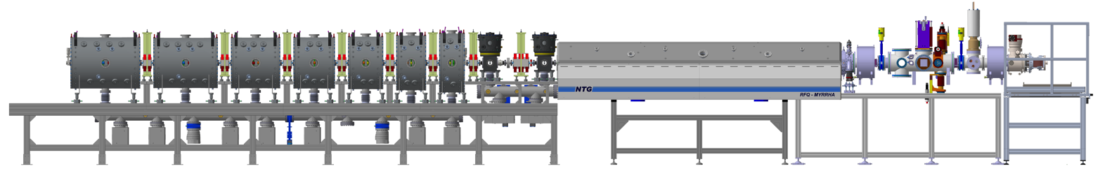
Integrated prototyping
  subsystems :
    infrastructures and services
    source + LEBT (LPSC)
    RFQ (IAP, NTG) with its amplifier (IBA) and LLRF (IPNO)
    MEBT1 (2 QW rebunchers, quad triplet, diagnostics)
    string of 7 CH cavities (IAP, Bevatech, several manufacturers) with their amplifiers (IBA) and LLRF (IPNO) + quadrupole doublets (Scanditronix, JEMA)
    diagnostic chamber (+ dump) incl. emittance measurements
    global : controls w. 3 tiers

Slide 9
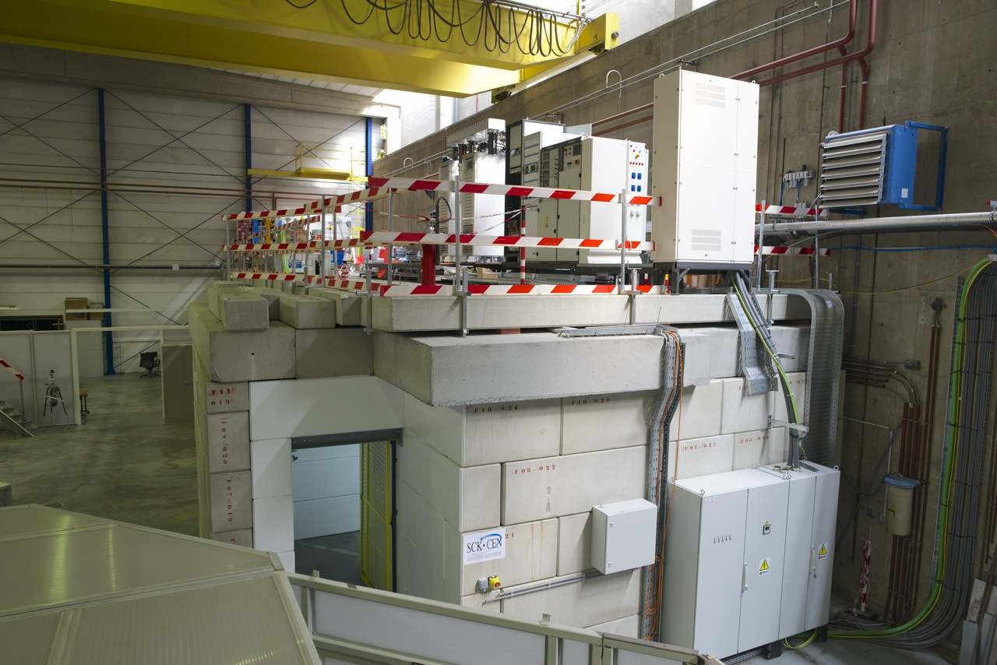
Present status

Slide 10
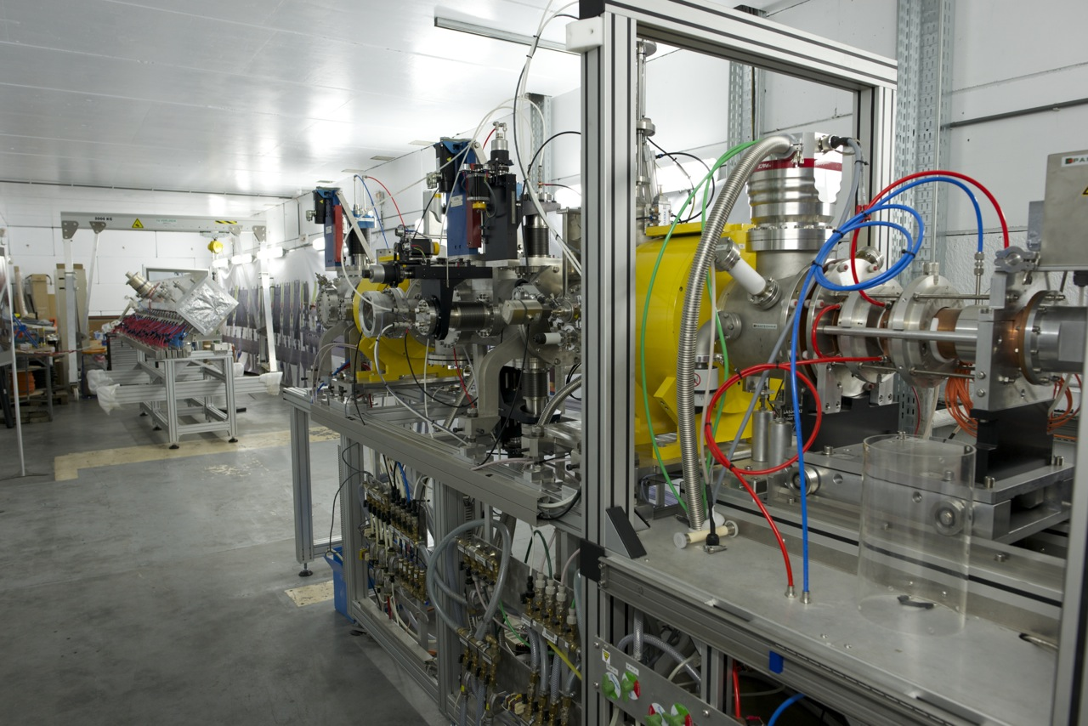
Present status

Slide 11
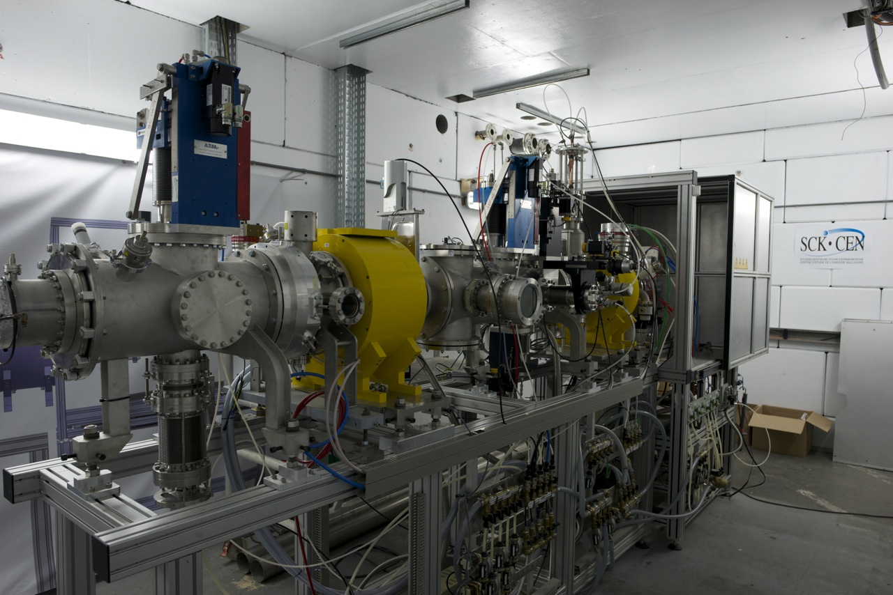
Present status

Slide 12
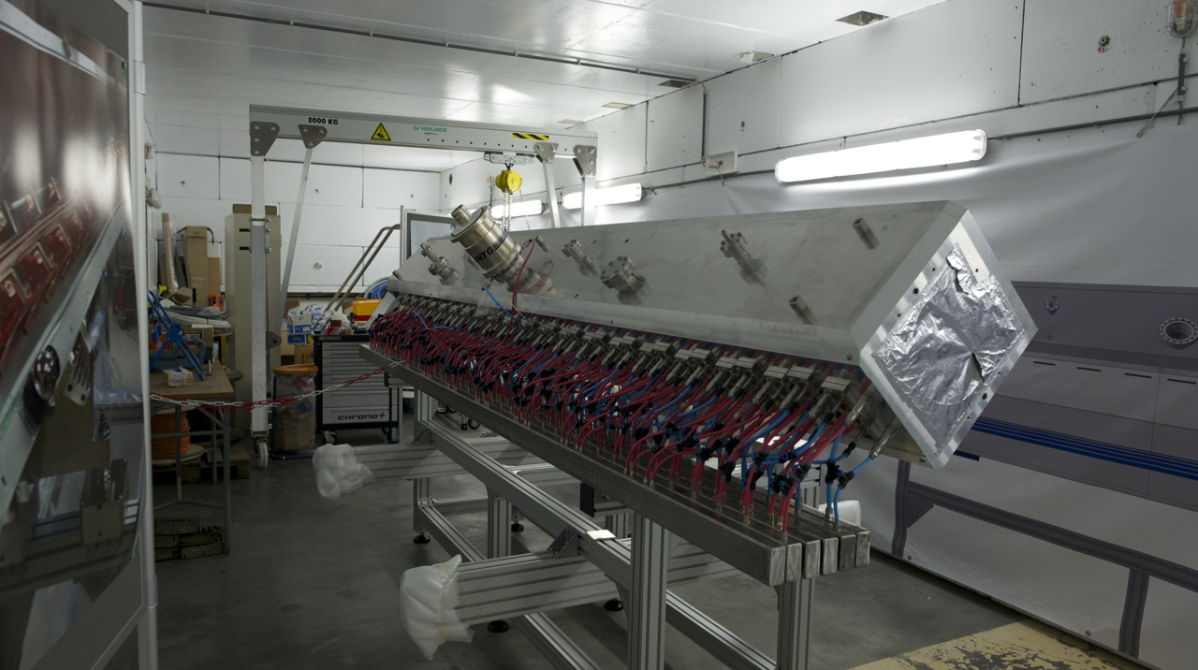
Present status

Slide 13
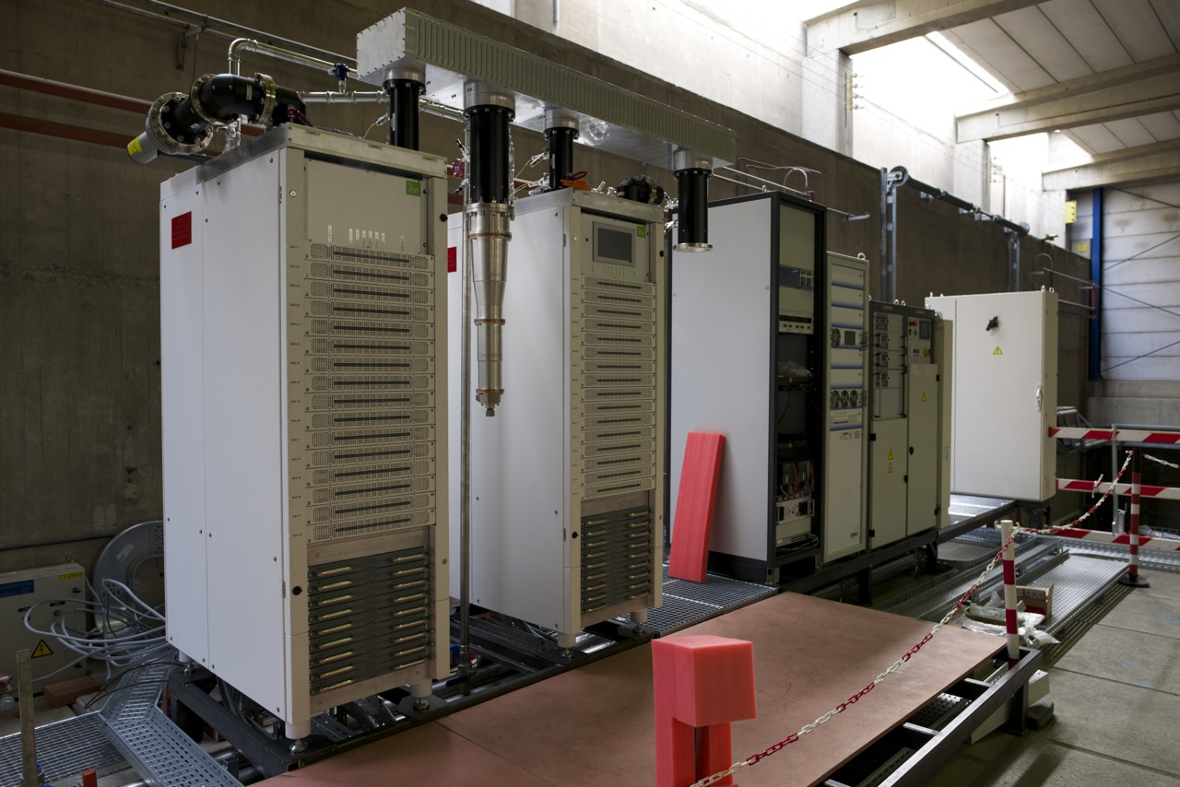
Present status

Slide 14
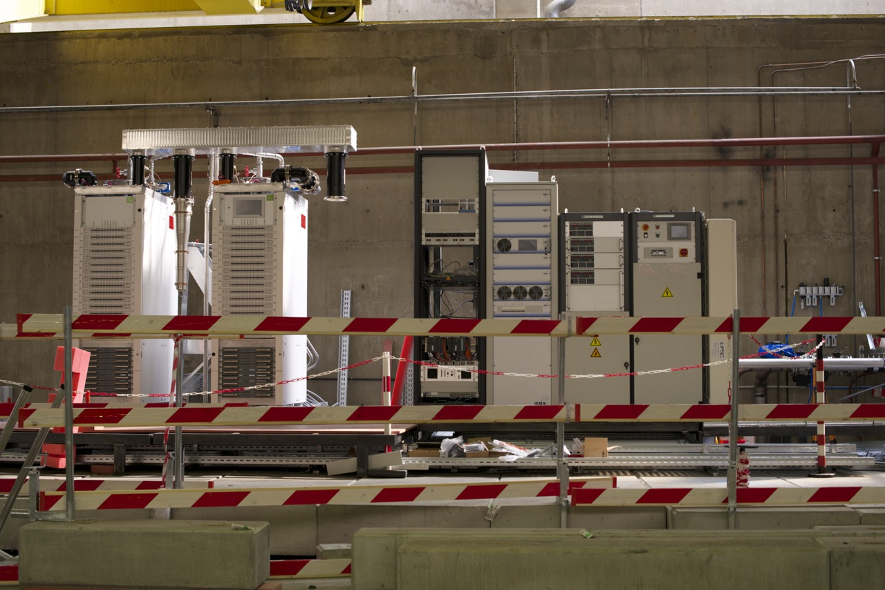
Present status

Slide 15
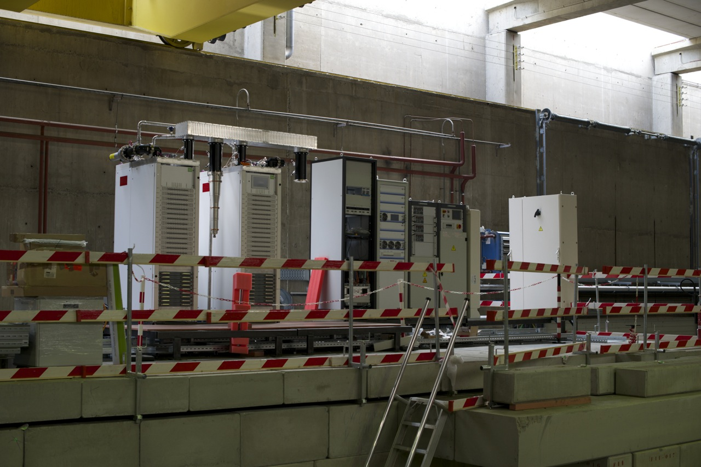
Present status

Slide 16
Conclusion
  lot of effort invested, lot of work accomplished
  results will start to arrive in near future → at next SLHiPP
  thanks !

Slide 17
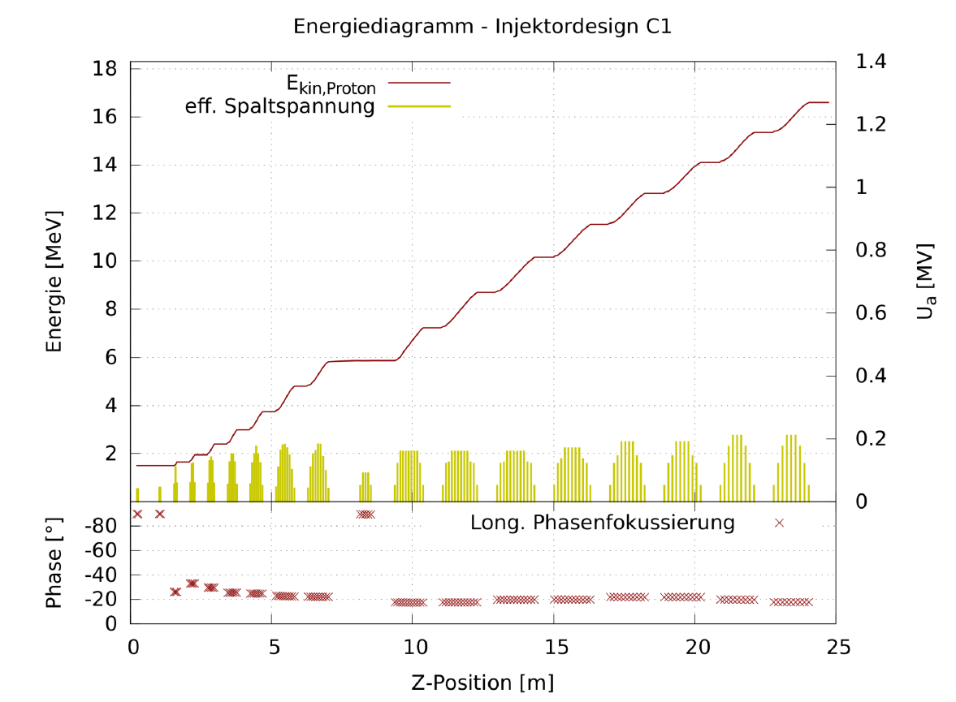
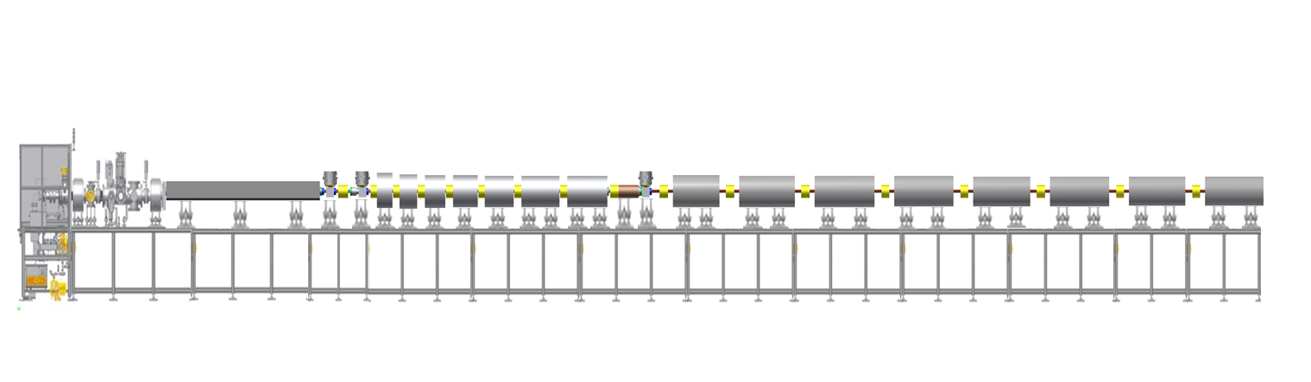
The MYRRHA Injector
Beam dynamics of the injector with constant phase CH cavities.
Design philosophy: As conservative as necessary, as efficient as possible
LEBT
MEBT-1
CH-cavities
MEBT-2
CH-cavities
ECR
RFQ
32 m

Slide 18
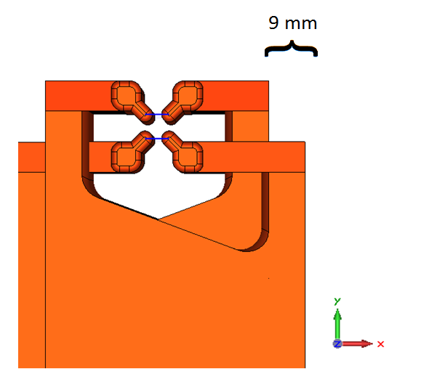
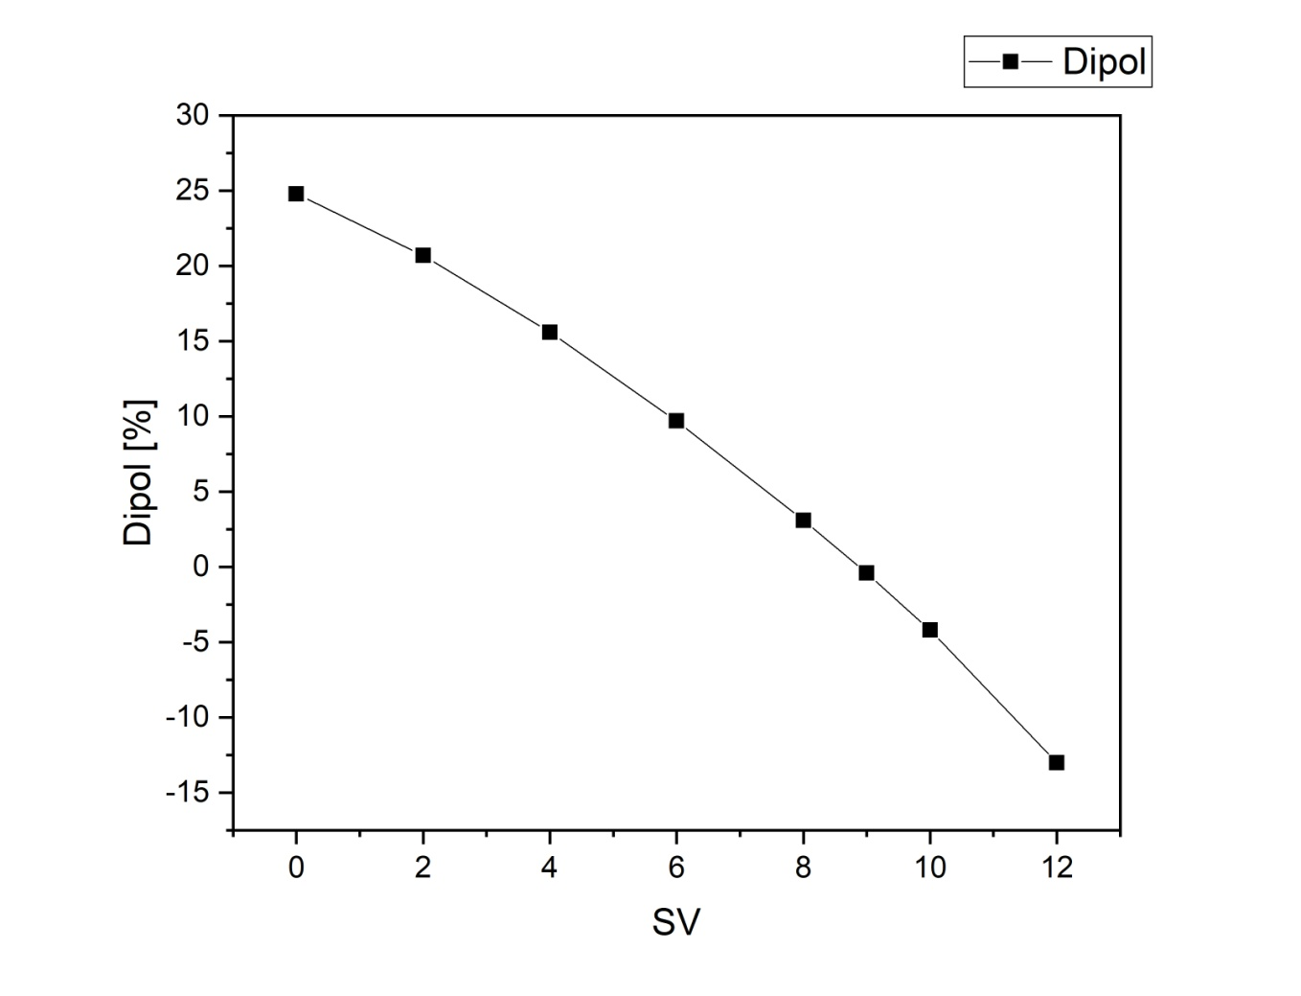
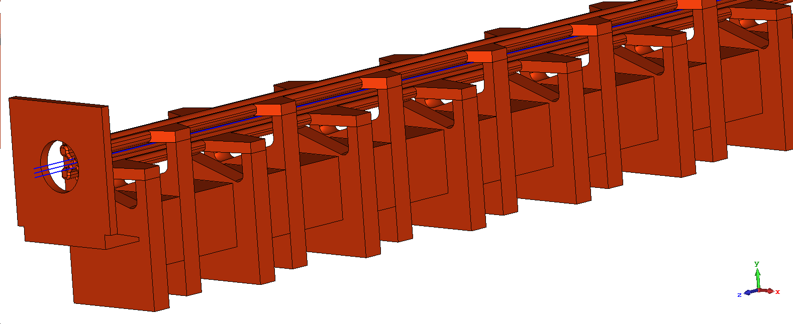
Dipole Compensation

Slide 19
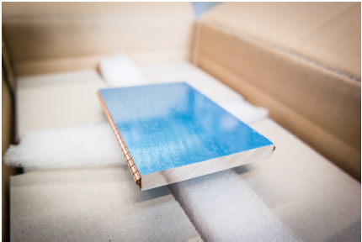
Field Flatness

Slide 20
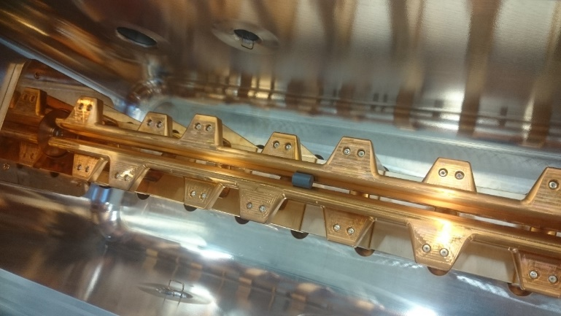
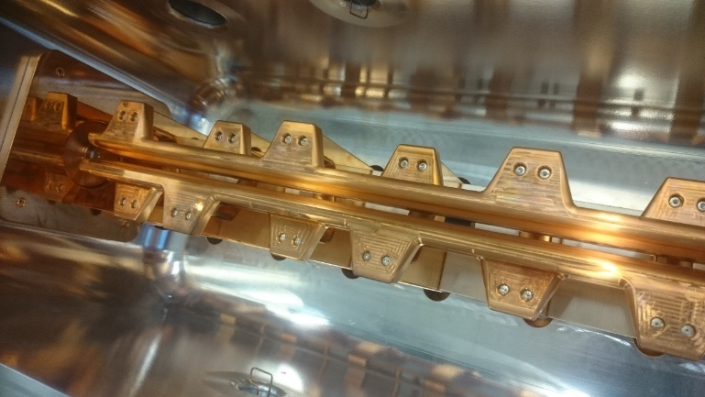
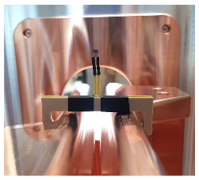

Dipole measurement
Comparison of Measurement and Simulation
 | FRANZ RFQ | MYRRHA RFQ
Simulation | 22,6 % | -0,4 %
Measurement | 23,1 % | -4 %
Discrepancy for the MYRRHA RFQ caused because simulated tuning heights are different from final
Notes:
Messung Durchführung
FORMEL

Slide 21
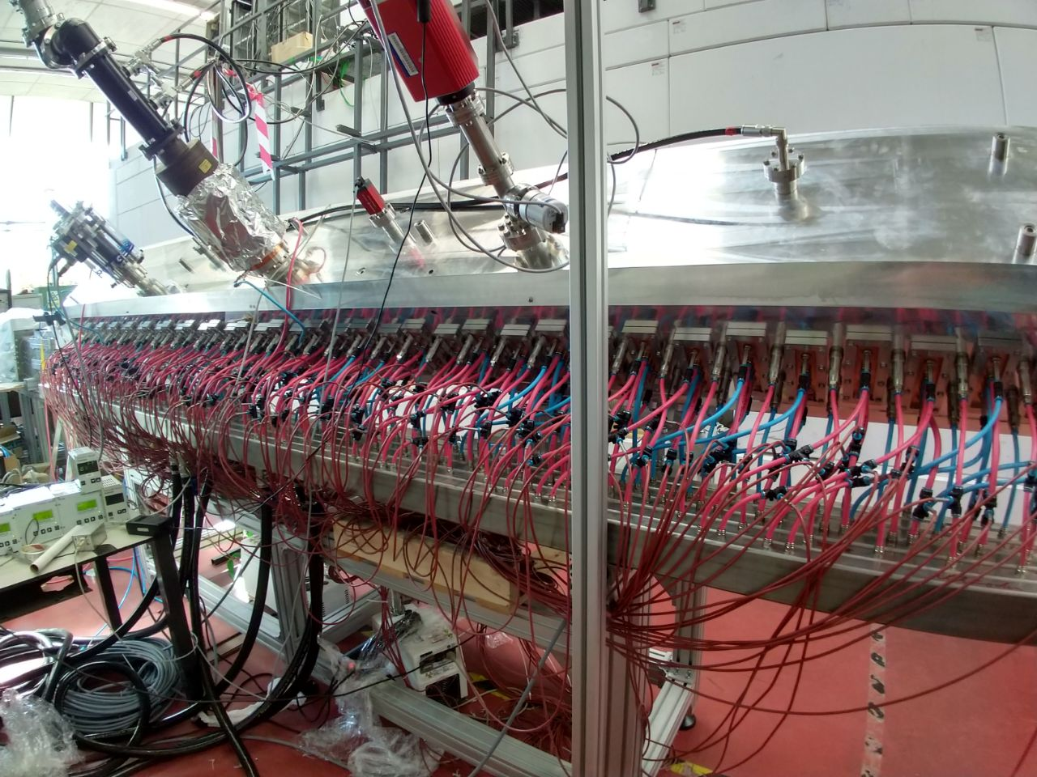
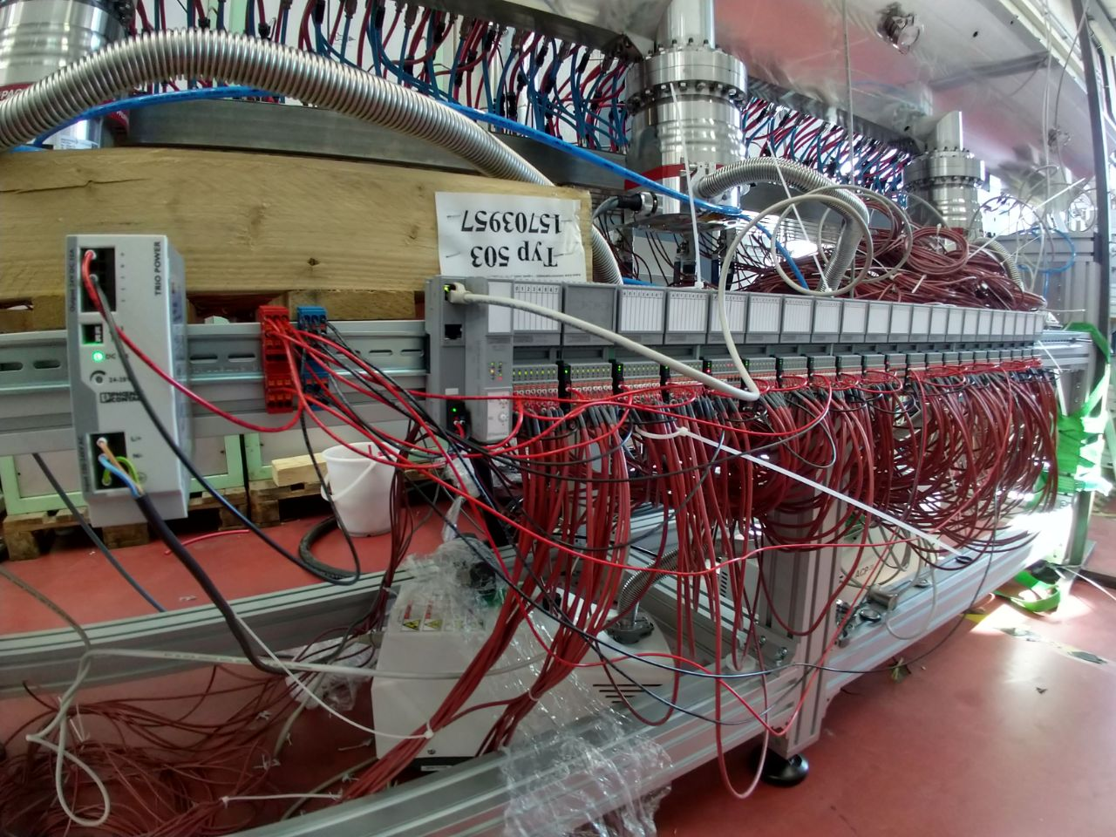
Installation of the temperature sensors

Slide 22
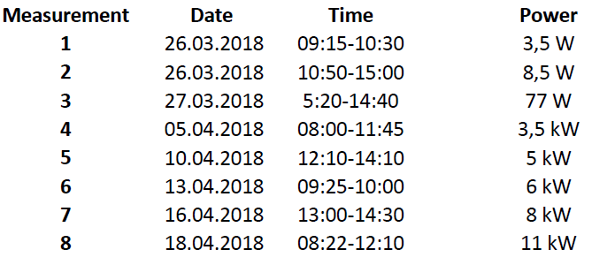
The rf-commissioning was done stepwise over several days. Following table shows the dates on which the rf-commissioning took place and the powers that where reached on that date
The following graphs show the measured data vs. time for all of the measurements 1-8.
P_{F} is the forward power, P_{R} is the reflected power, P_{T} ist the power coupled out at the pickup and p is the pressure

Slide 23
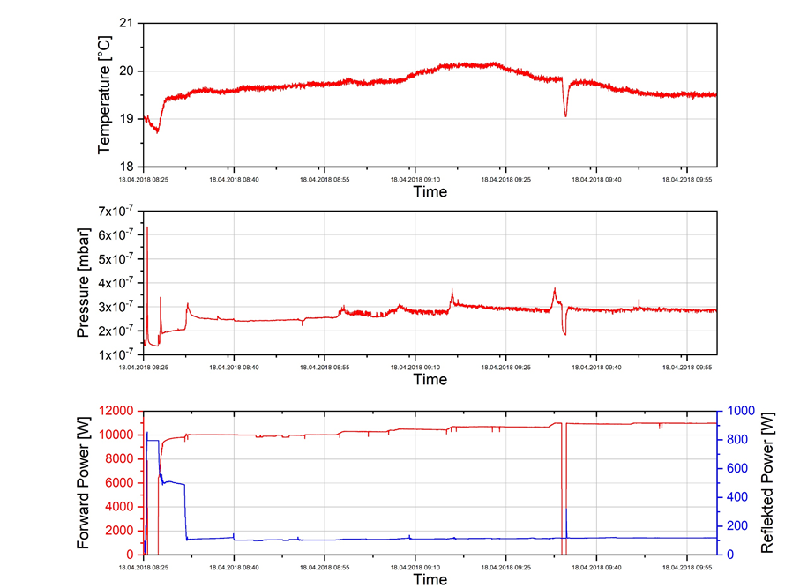
Last day of conditioning at IAP

Slide 24
Copyright © 2018 - SCK•CEN
PLEASE NOTE!
This presentation contains data, information and formats for dedicated use ONLY and may not be copied, distributed or cited without the explicit permission of the SCK•CEN. If this has been obtained, please reference it as a “personal communication. By courtesy of SCK•CEN”.
SCK•CEN
Studiecentrum voor Kernenergie
Centre d'Etude de l'Energie Nucléaire
Belgian Nuclear Research Centre
Stichting van Openbaar Nut
Fondation d'Utilité Publique
Foundation of Public Utility
Registered Office: Avenue Herrmann-Debrouxlaan 40 – BE-1160 BRUSSELS
Operational Office: Boeretang 200 – BE-2400 MOL

