Slide 1
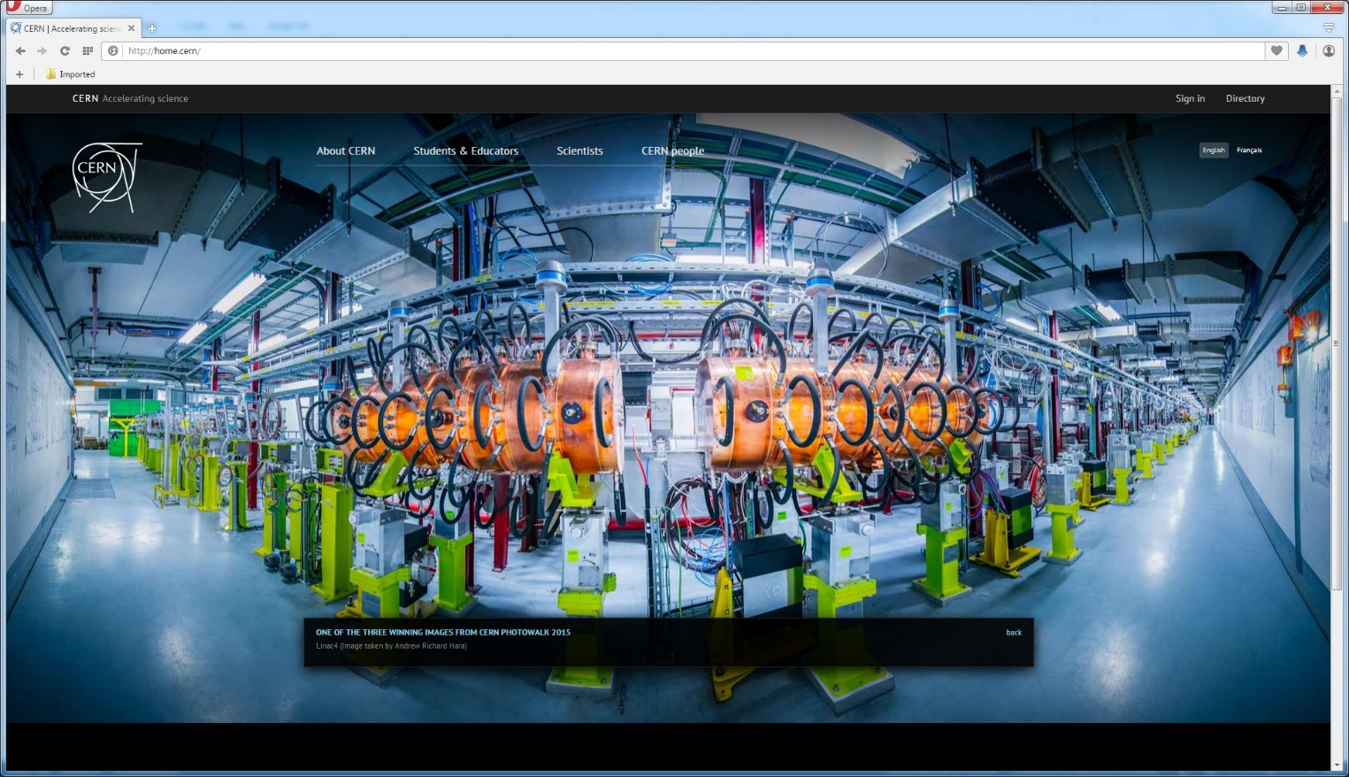
BEAM COMMISSIONING OF LINAC4 at CERN
Silvia Schuh for the LINAC4 Team
8th Open Collaboration Meeting on Superconducting Linacs for High Power Proton Beams (SLHiPP-8)
Uppsala, June 12-13, 2018

Slide 2
Outline
LINAC4 layout and choices
Commissioning results
Reliability and beam quality run
Conclusions and outlook

Slide 3
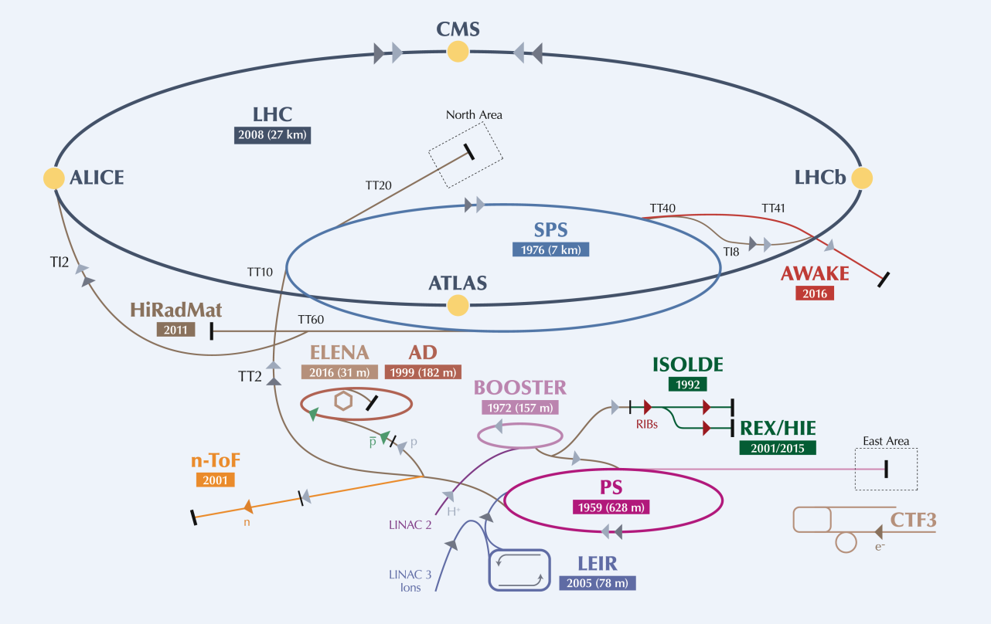

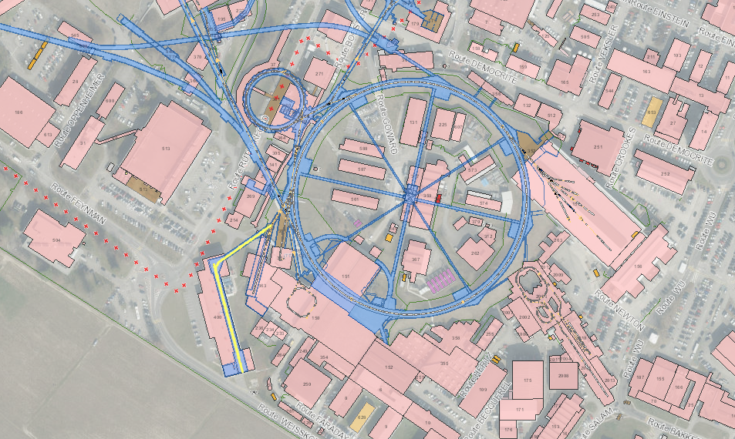
LINAC4
Frequency : 352 MHz
Duty cycle for PSB : 0.06 %
Max duty cycle : 5%
Located 12m underground
Notes:
Linac4 will be connected to the Proton Synchrotron Booster (PSB) during the next long LHC shutdown in 2019 and it will operationally replace Linac2 as provider of protons to the CERN complex as of 2021. Commissioning to the final beam energy of 160 MeV was achieved by the end of 2016. Linac4 is presently undergoing a reliability and beam quality test run to meet the beam specifications and relative tolerances requested by the PSB.
We chose PMQs – among other reasons – to have a better reliability. Replace L2, 352MHz, reuse LEP clystrons, underground & then go up to connect with PSB.
22 RF cavities

Slide 4
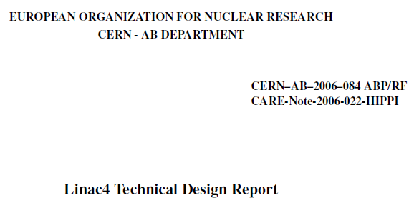
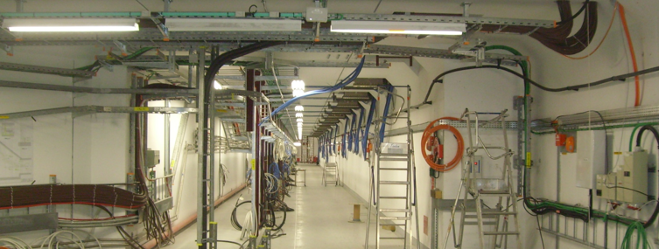
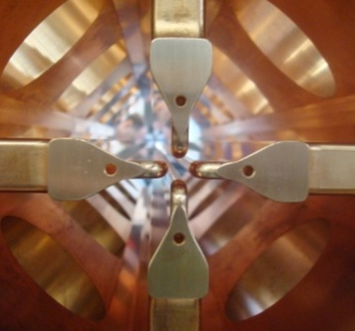
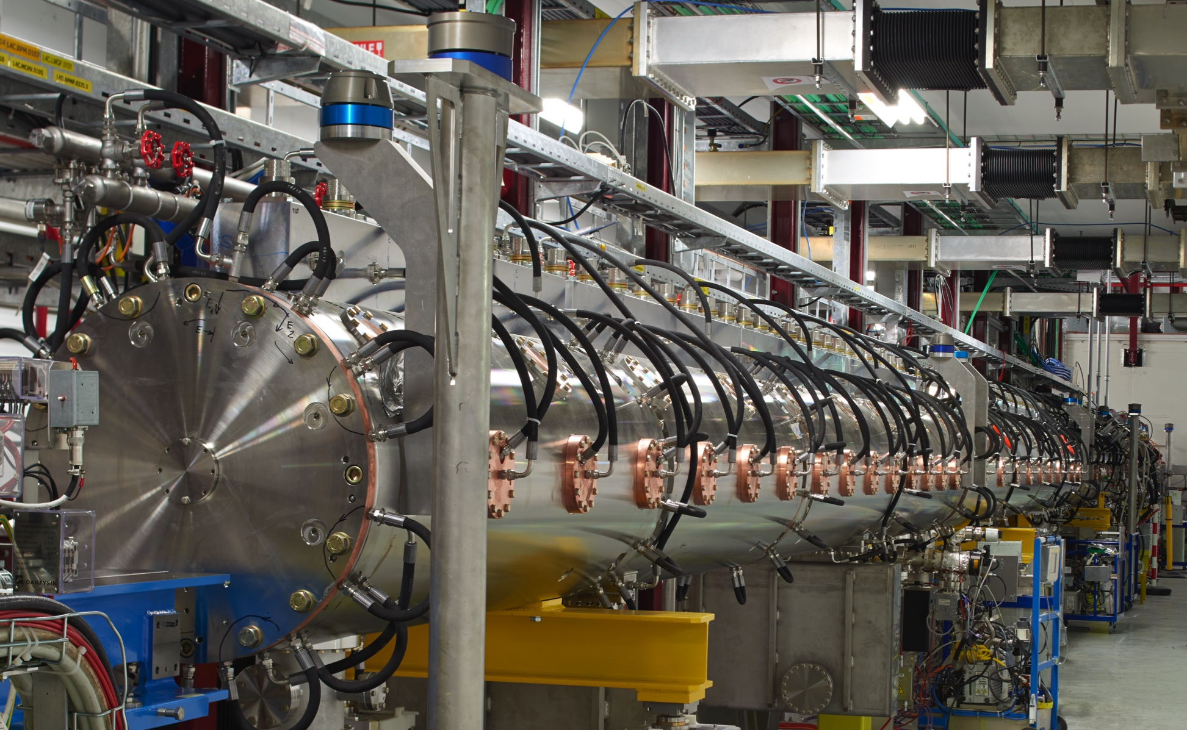
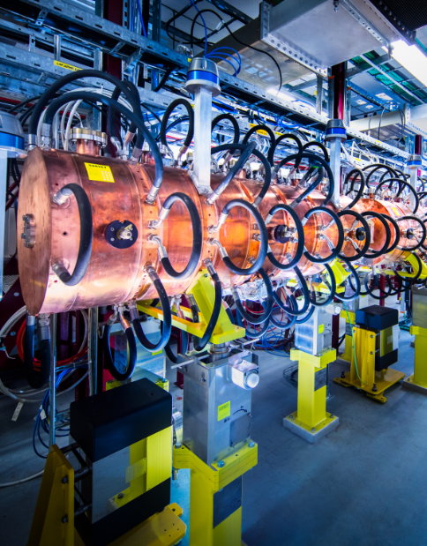
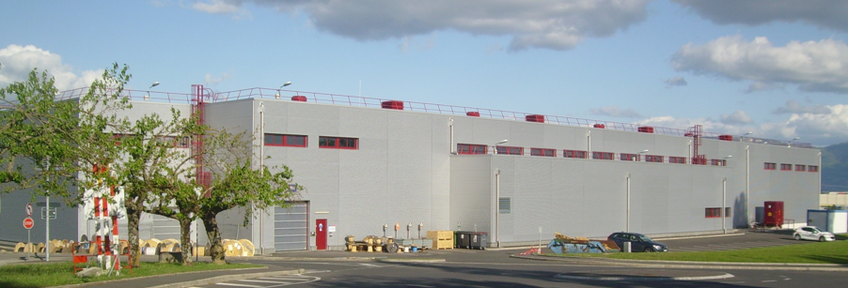


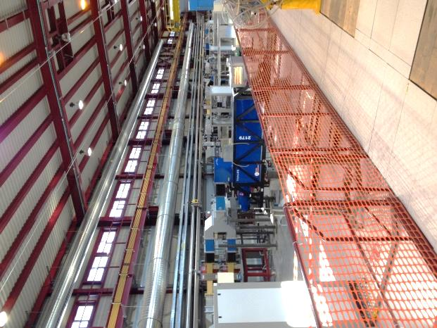
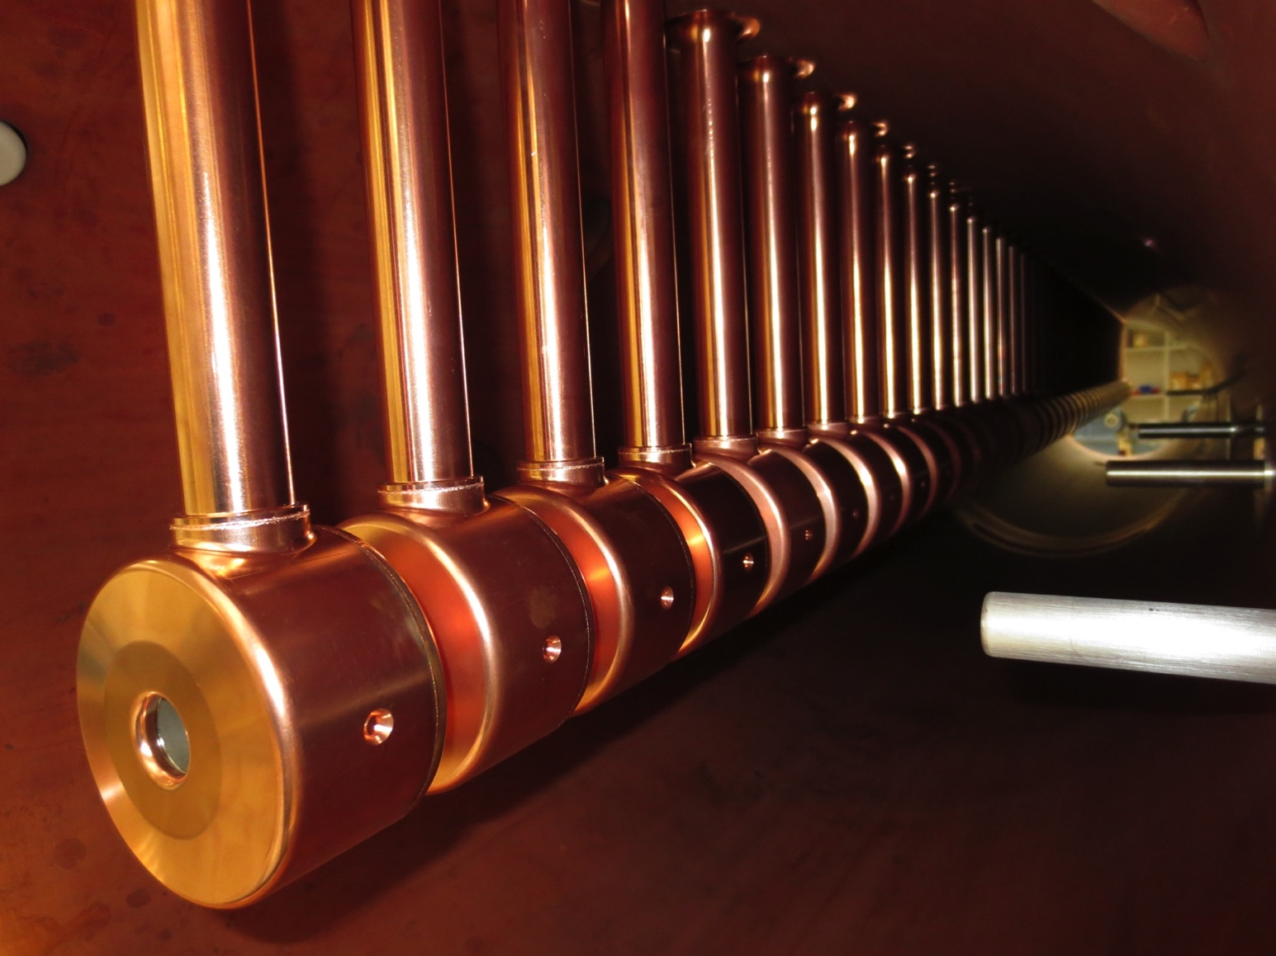
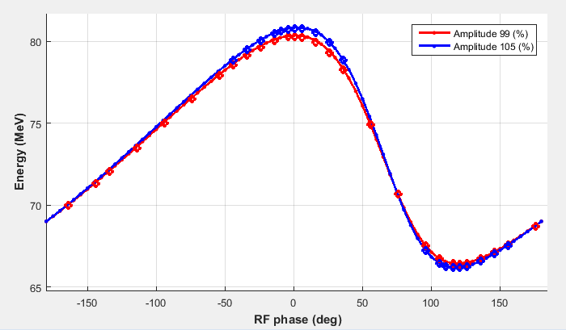
LINAC4 from 2000’s to 2020
2006
2010
2013 - 3MeV
2015 - 50 MeV
2016 -160 MeV
Pre-studies
Construction
Installation
Beam commissioning
Connection
Operation
2008
2012
2014 - 12 MeV
2016 -107 MeV
Project approved

Slide 5
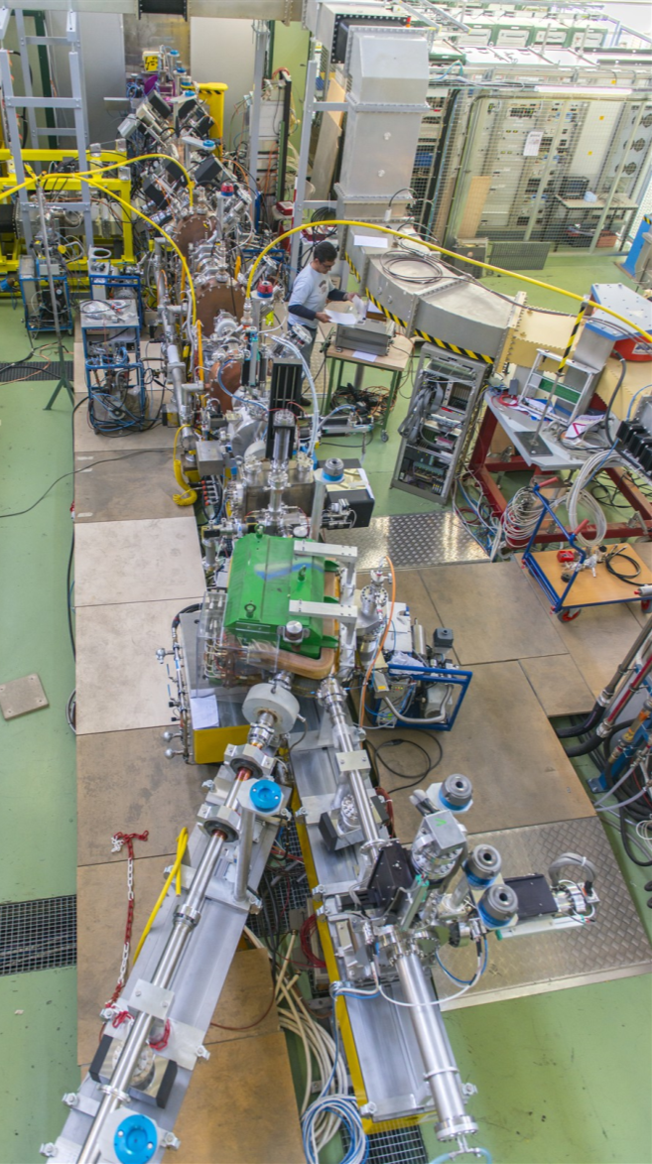
Staged commissioning
Low energy test bench at 3 MeV and 12 MeV
Direct measurements
Transverse emittance with slit-grid
Energy spread with a bending spectrometer
ion source
RFQ
chopper line
High energy test bench at 50 and 107 MeV
Indirect measurements
Transverse emittance with 3 profile monitors
Longitudinal emittance with bunch shape monitor
Energy with Time-of-flight
Diagnostics line
spectrometer
beam dump
Permanent measurement line in the transfer line for 160 MeV
Notes:
Low energy test bench: only until after the RFQ (3 MeV) + then moved down into the tunnel, added MEBT and used same testbench after DTL1.

Slide 6
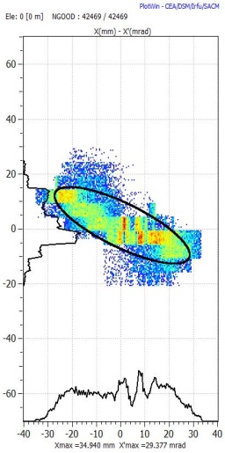
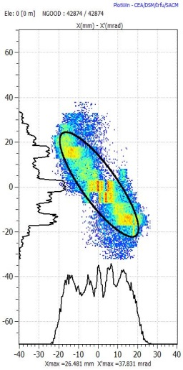
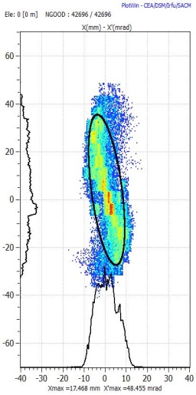
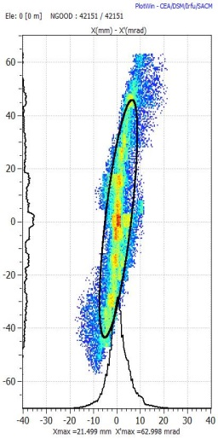
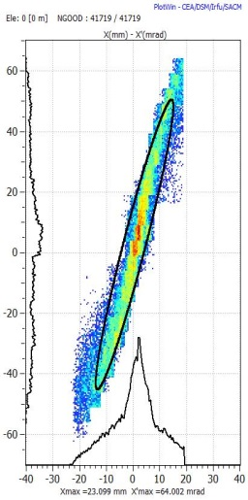
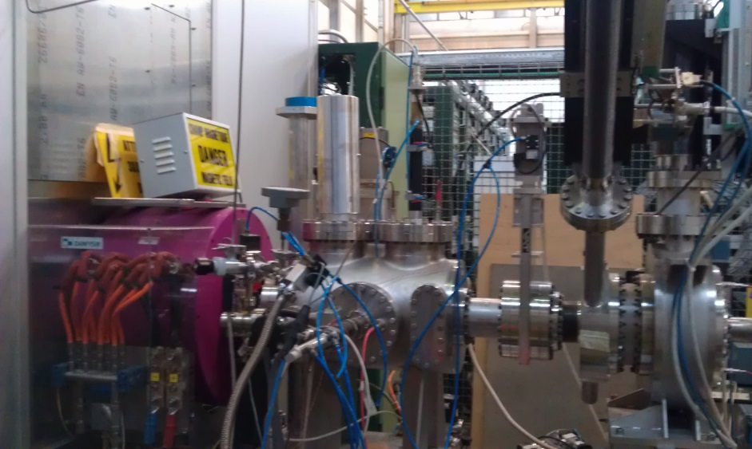
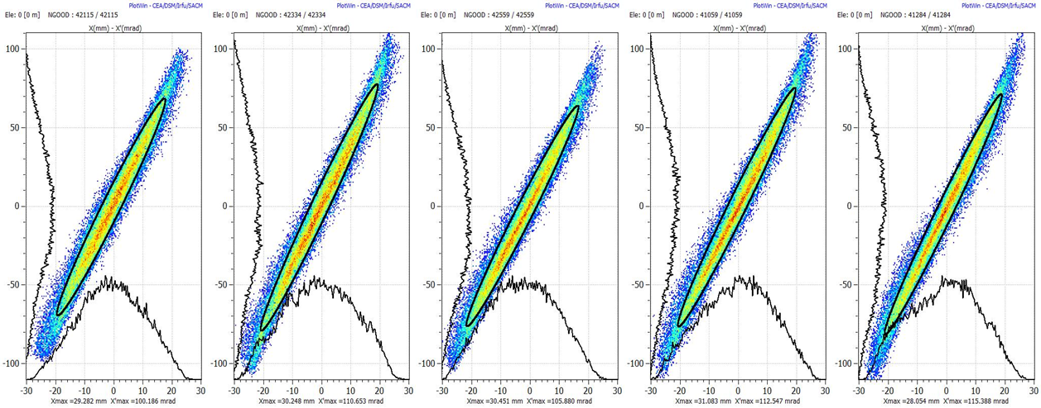
Extensive measurements at 45 keV
Measurements varying solenoidal field & generate beam distributions
Source
Solenoid
Grid
Slit
Back-track to the source output
We have an empirical input beam distribution that very well represents the dynamics in the LEBT and the rest of the accelerator

Slide 7
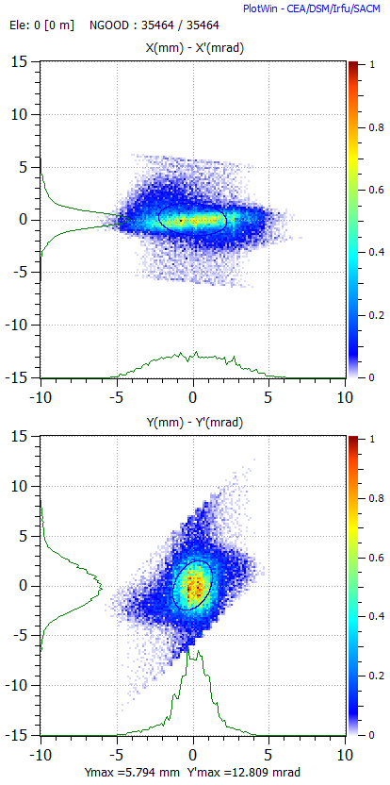
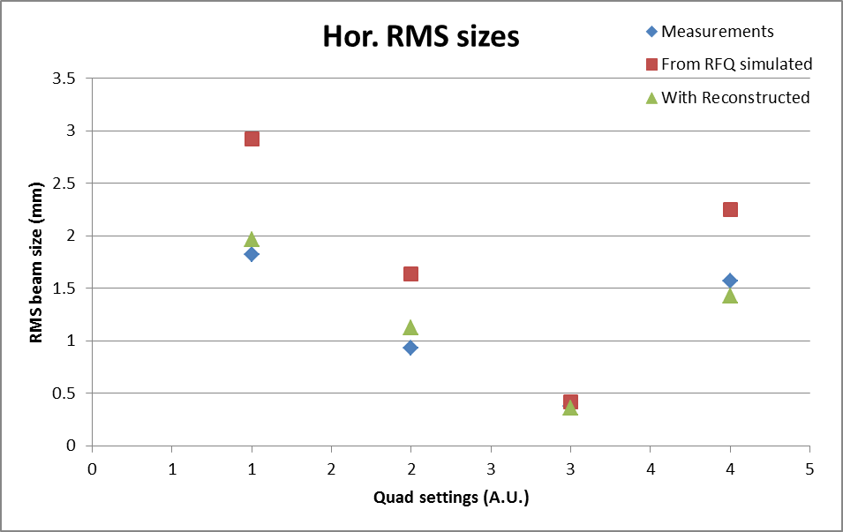
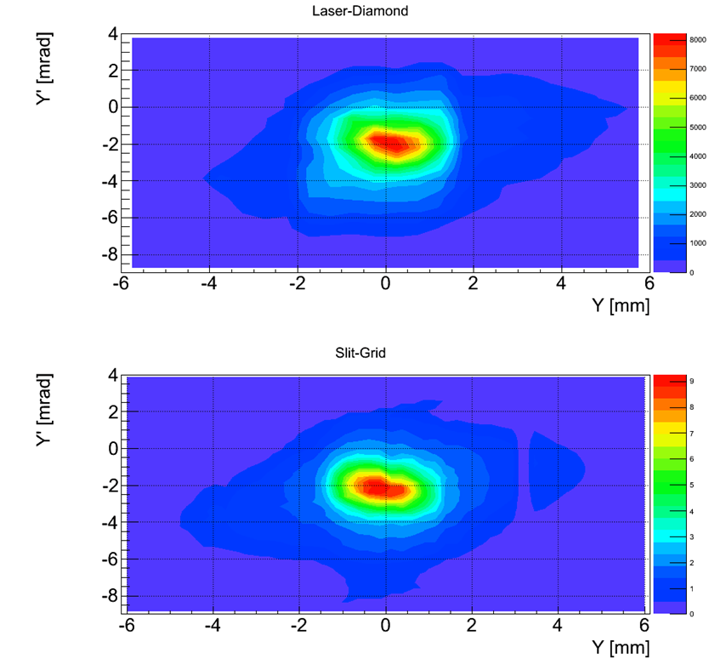
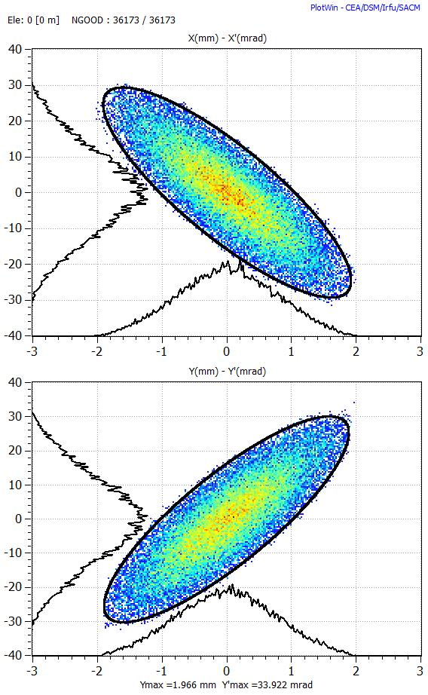
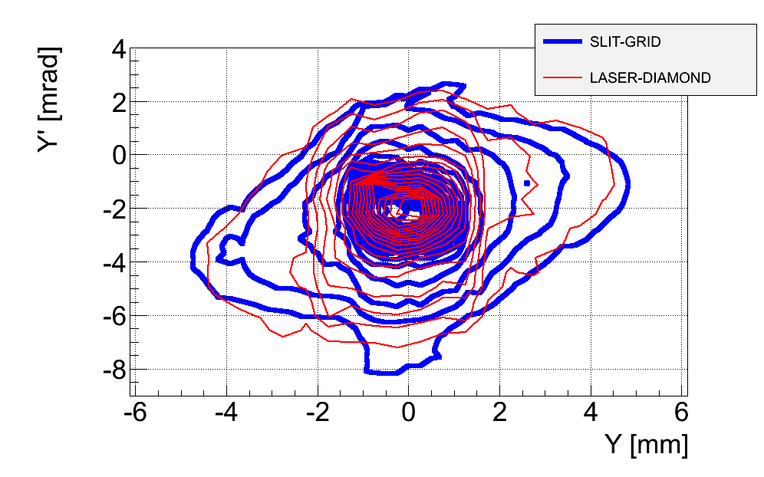
Pre-injector: validation of diagnostics
rms normalised transverse emittance @ 3 MeV measured by 3 independent systems:
0.3 pi mm mrad
Slit-and-grid | From profile measurement | Laser + diamond
Notes:
The 3 different measurements were taken at 3 different locations along the beam -> recalculated to same position: 0.3 pi mm mrad

Slide 8
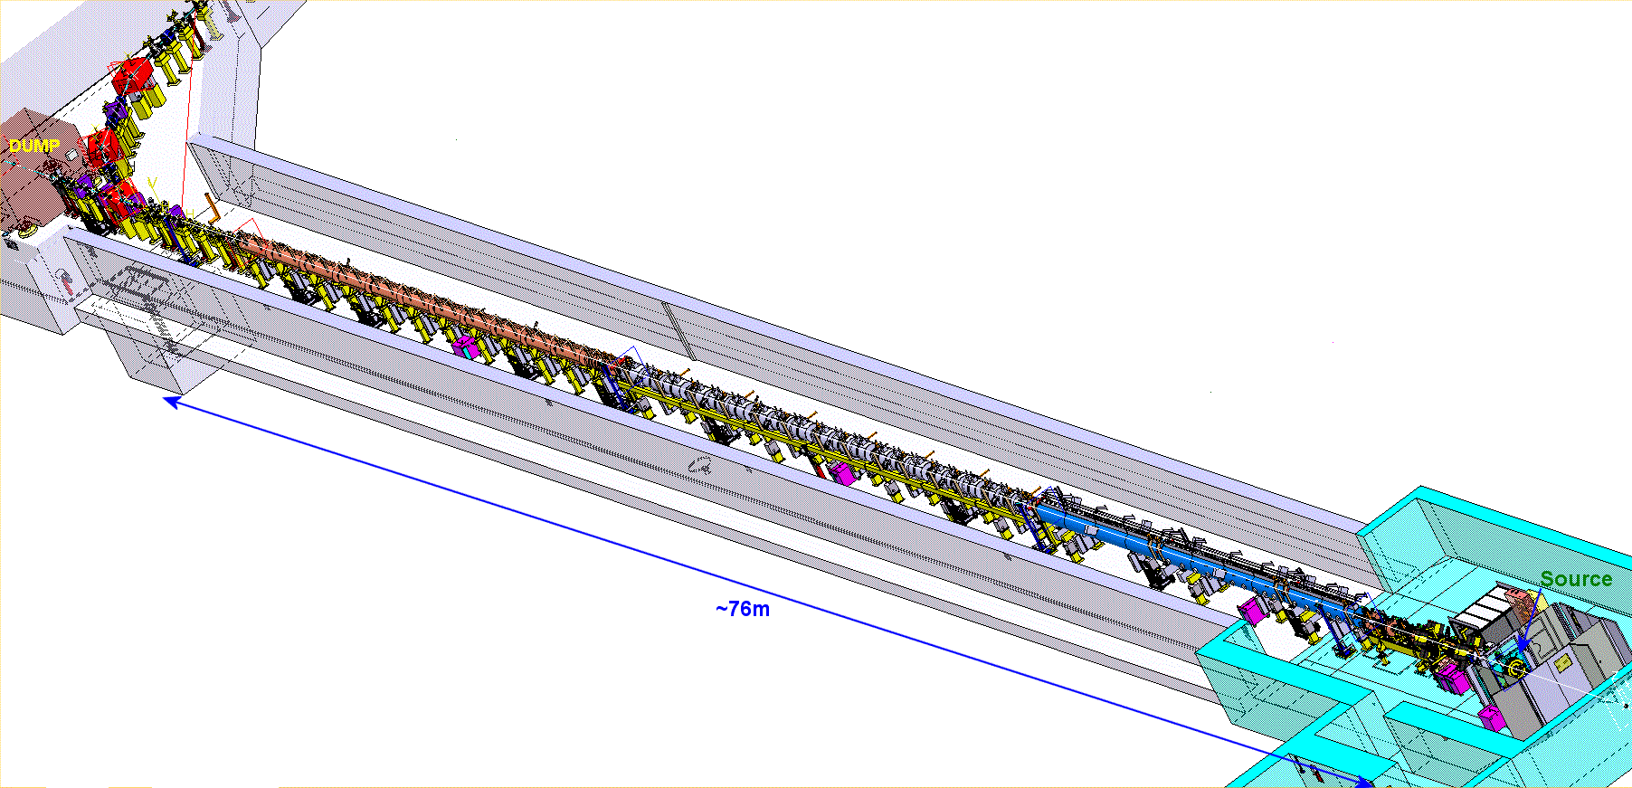
November 2016: the final energy is reached!
Nov 2016
160 MeV
Oct 2013
3 MeV
27 mA
Jun 2016
105 MeV
Nov 2015
50 MeV
Commissioning in stages is key to swift commissioning!
Commissioning time ~3-4 weeks per stage >> HW-checkout + Beam commissioning!
Good beam dynamics combined with good beam diagnostics is key
Good understanding of beam characteristics at low energy essential
45 keV
50 mA

Slide 9
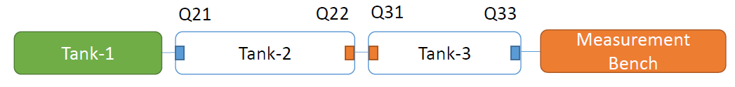
Commissioning lessons
Simulation tools are good guide dogs
Starting the 50 MeV commissioning stage -> low transmission
Advantage of staged commissioning:
Everything up to DTL1 was commissioned
Hot-point at DTL3 entrance (radiation measurement)
Plus beam dynamics simulations
Allowed us to understood that last DTL2 PMQ and first DTL3 PMQ were accidentally inverted
Beam restarted after 3 days…
Notes:
Demonstration why we think that commissioning in stages is essential: everything until after DTL1 had been commissioned, working well. In addition, it was lucky that the hotspot was at the end of DTL2 -> RP was able to detect the higher radioactivity. If it would have been in the middle of the tank it may not have worked so easily/quickly. And beamdynamics helped in confirming the suspicion of inversion.

Slide 10
Reliability/Beam Quality Run (July 17 - May18)
Rationale & Goals
Ensure a smooth transition from commissioning to operation: train operators, necessary software development, learn to deal with the increased flexibility, gain experience with the full system.
Find any weak points and mend them in time for the connection
Achieve a beam-availability for the PSB as high as possible and possibly above 90% : importance of the fault tracking system

Slide 11
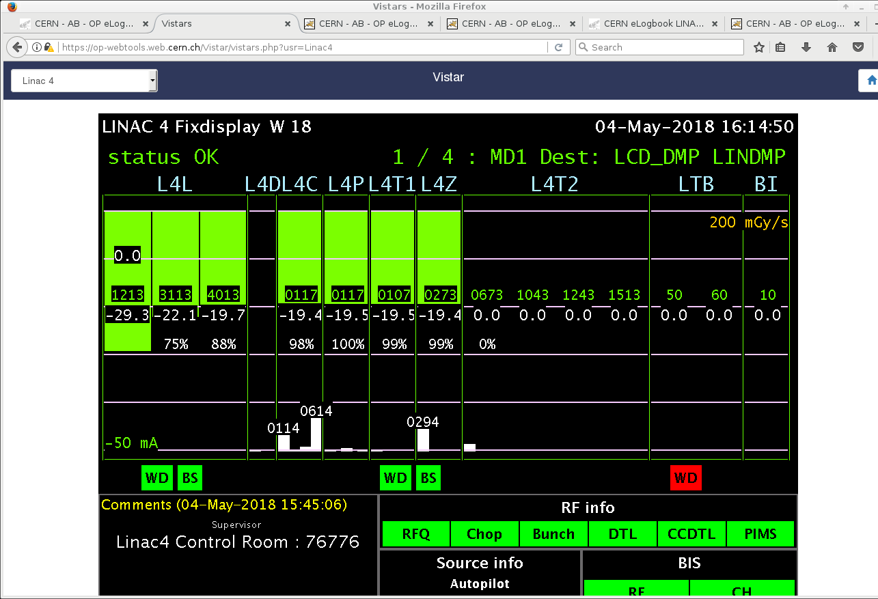





Failure analysis
LINAC4 run 24/7 in parallel to normal operation on best-effort basis with:
  Operators deal with issues where possible
  Expert availability and interventions only during working hours
  Faults are fully tracked (Accelerator Fault Tracker AFT)
  Stop AFT Clock during off-hours when fault needs expert intervention & during MDs
Thorough logbook verification w/ Timber/LASER information
$$t_{Start, Log}$$
$$t_{End, Log}$$
Criterium for LINAC4 availability: Current in BCT before the dump
$$t_{Start, TIMBER}$$
Clock-stop
$$t_{End, TIMBER}$$
Logged fault time
Fault time
Operation
Clock-stop
Effective operation
$Q=\frac{Logged fault time}{Effective Operation}$

Slide 12
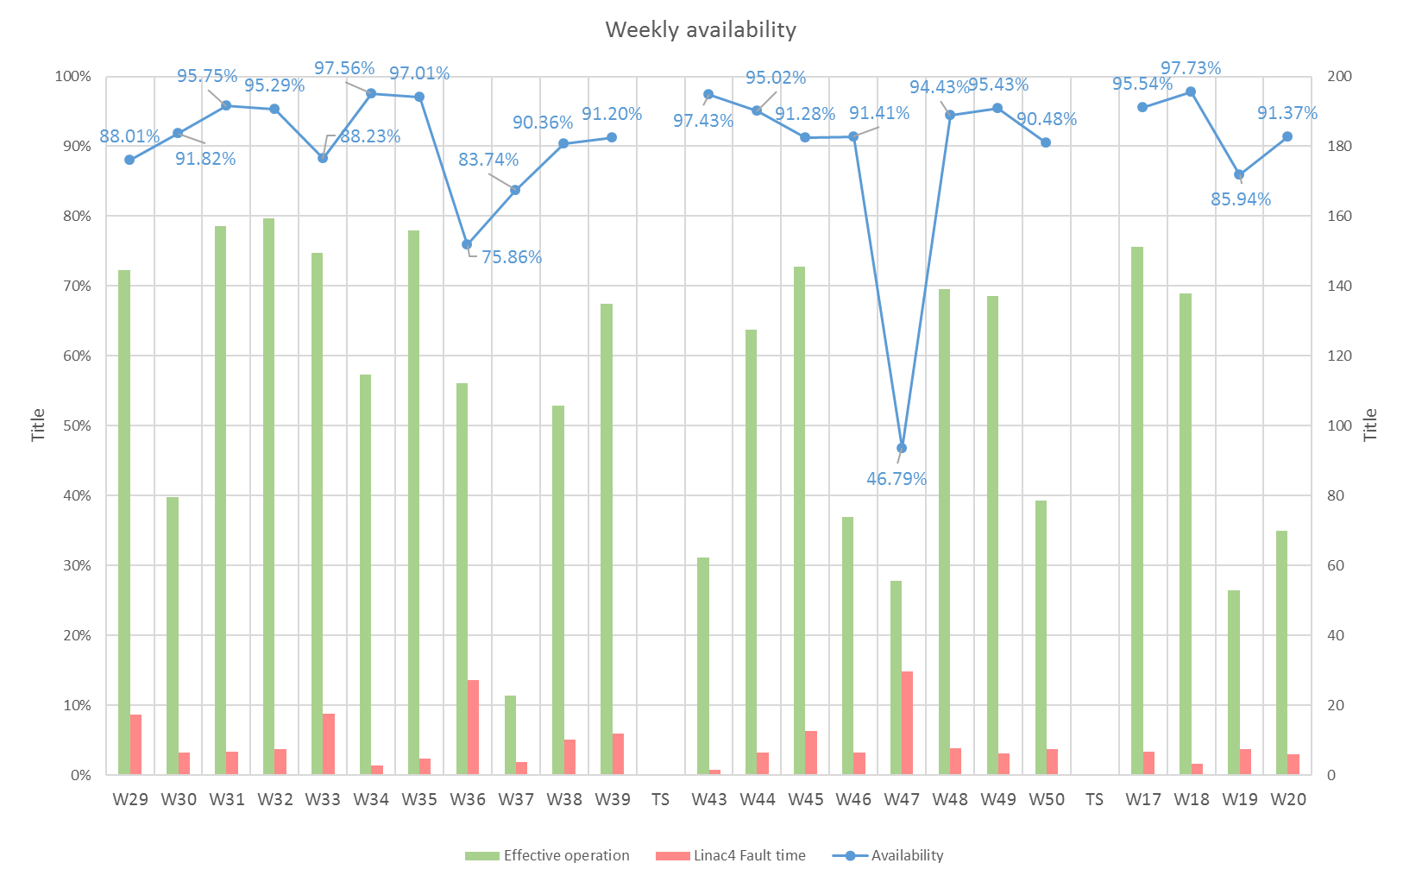
Availability data
Period: 13/07/2017 – 15/05/2018
Last update: 05/06/2018
Availability | Fault Count | Operation | Suspended OP | Effective Operation | Fault Mean Time to Repair
91.5% | 449 | 23 weeks | ~ 8 weeks | ~15 weeks | ~29 min
Average 91.5 %
Week 47: Anode module change 2x, Pre-Chopper connector to feedthrough to vacuum

Slide 13
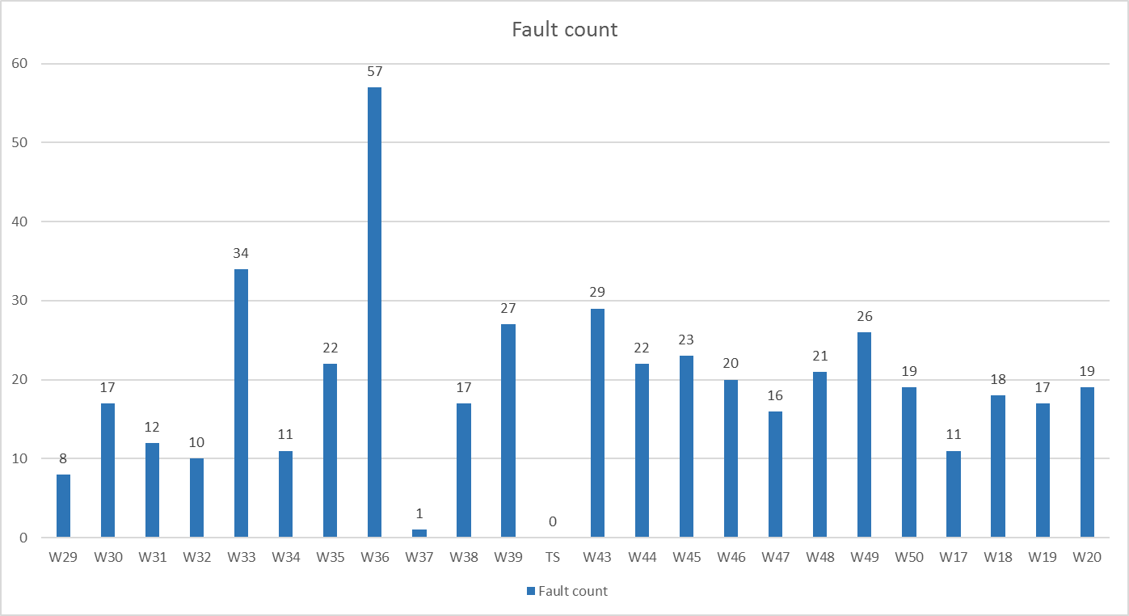
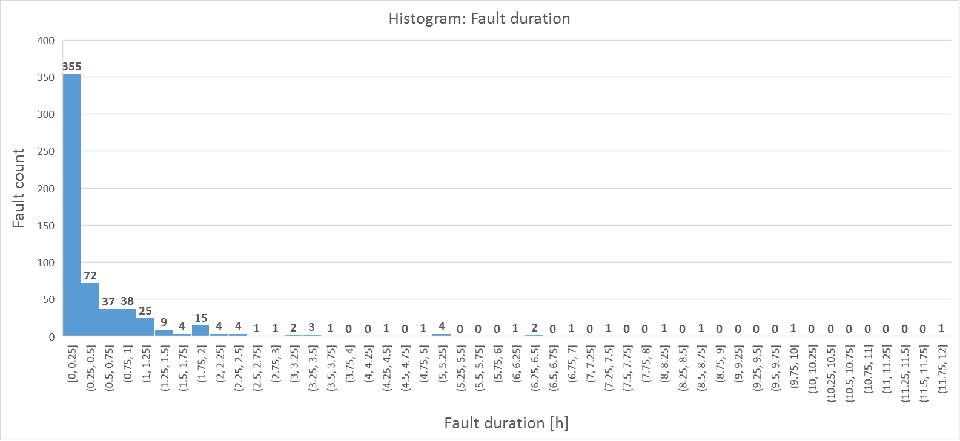
Availability data
Period: 13/07/2017 – 15/05/2018
Last update: 05/06/2018
Average: 21
Fault counts / week
(not including parallel faults)
Mostly short faults < 15’
Notes:
Emphasize that most faults are short, that better training of the operators will still shorten that, and that the LHC filling time is 15’

Slide 14
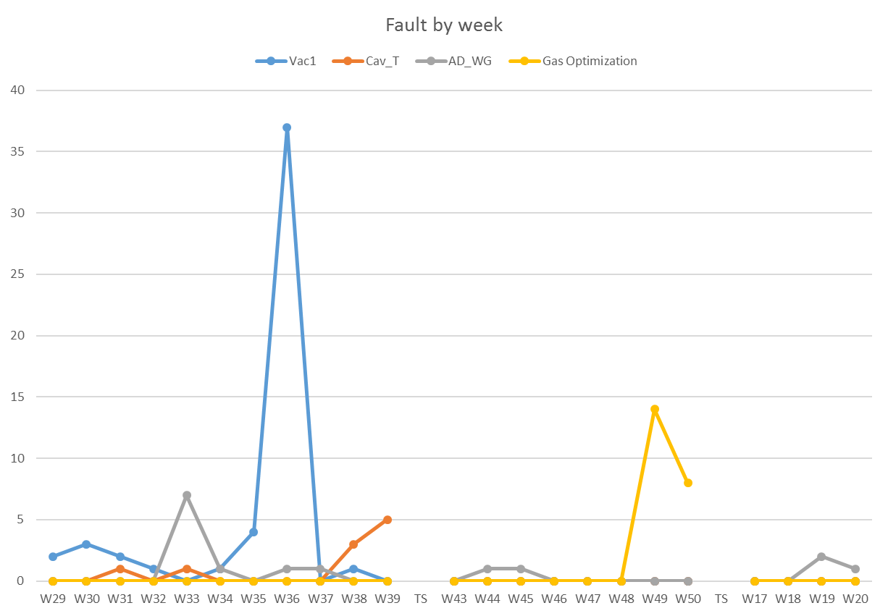
Extrapolated Availability
Period: 13/07/2017 – 15/05/2018
Last update: 15/05/2018
Availability | Fault Count
91.5% | 449
Faults fixed permanently after the Technical Stop:
Power supply of klystron vacuum pump in RF cavities
Flow meter on the Radio Frequency CCDTL tank
Source/Autopilot -> Source Tuning
Fault to be solved in the 2018/19 stop:
R2E issue with the Arc Detectors electronics -> move location
Expect availability of ~93-94% once these known issues are fixed
Notes:
Source tuning; gas optimization; Lesson learned: don’t touch the machine for higher availability (i.e. no tuning)

Slide 15
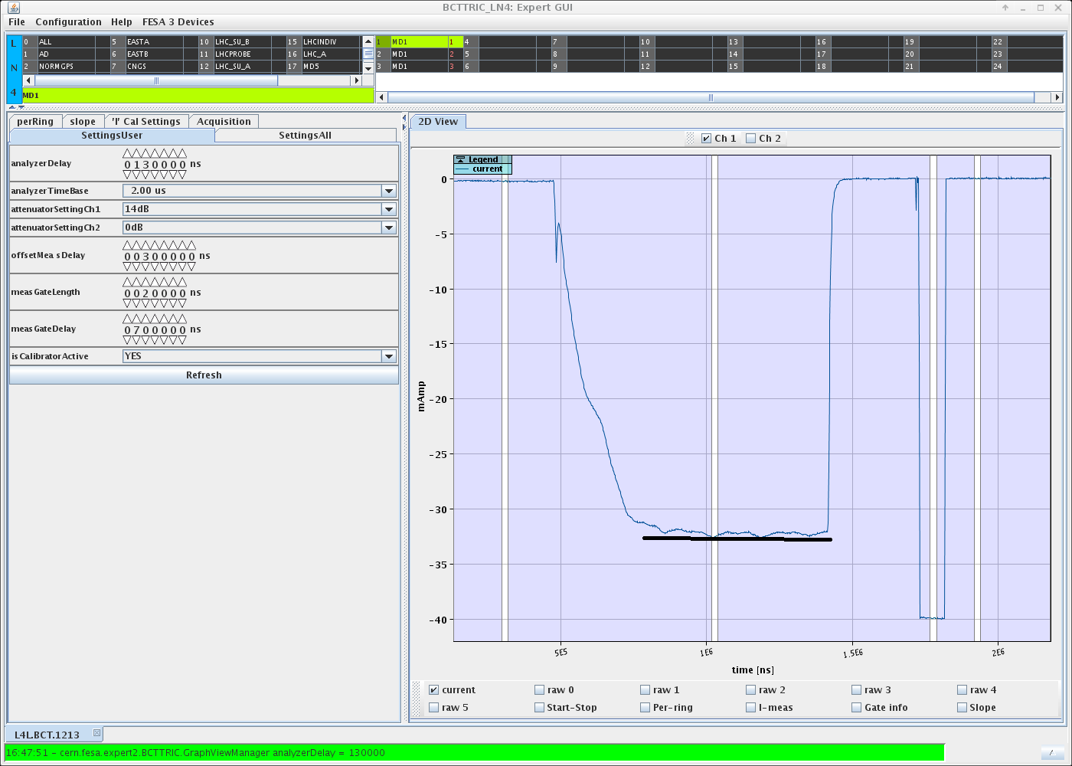
Beam quality run 2018
12 weeks of beam quality run spring 2018
  Extensive HW checkout, RF setup and beam re-commissioning after YETS activities
  Measurements of beam quality & characteristics
Beam pulse shape
600µsec

Slide 16
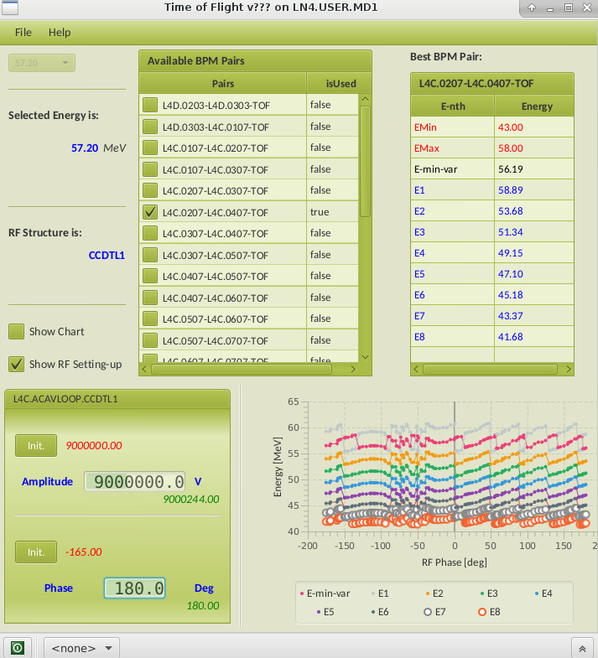
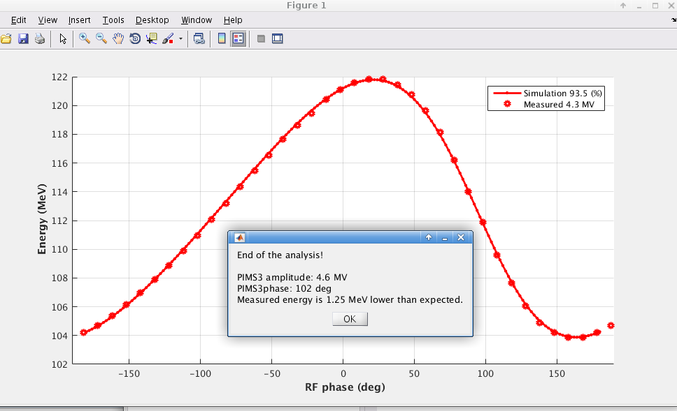
RF setup 2018
Via beam-loading measurements:
Initial setup: automatic phase scan of each cavities with beam loading measurement. Offline analysis to fit the data.
Via energy measurements (ToF technique):
Fine tuning of the setting points.
TOF application validated, human discernment needed for correct data interpretation + offline analysis / fits.
Average energy vs cavity phase
ToF sufficiently precise to allow setting each RF cavity to:
± 0.5 % in amplitude
± 0.5° for the phase

Slide 17
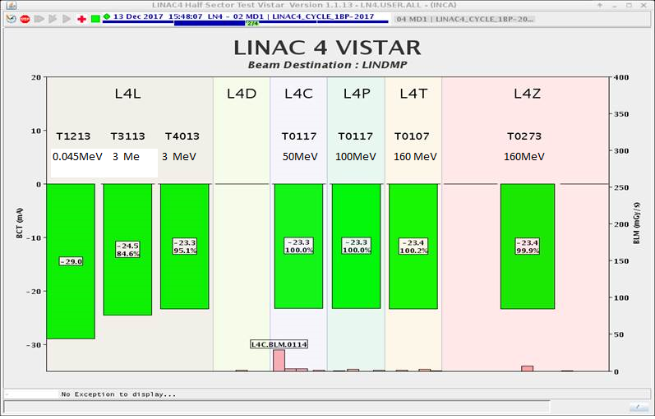
Beam quality measurements - current
Run 2017 – December
Run 2018 – May – after cesiation

Slide 18
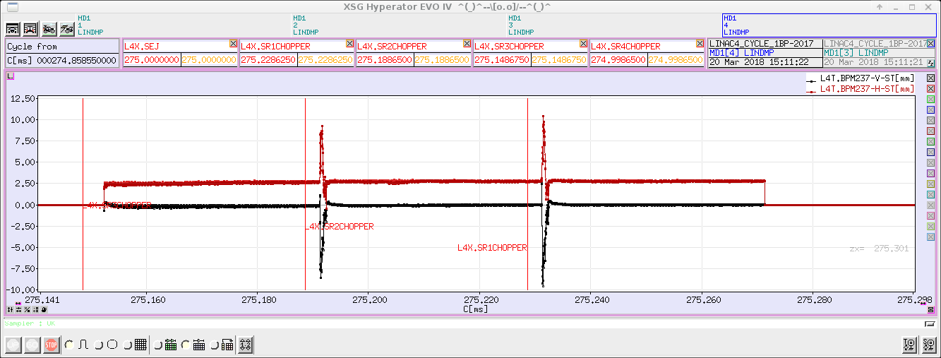
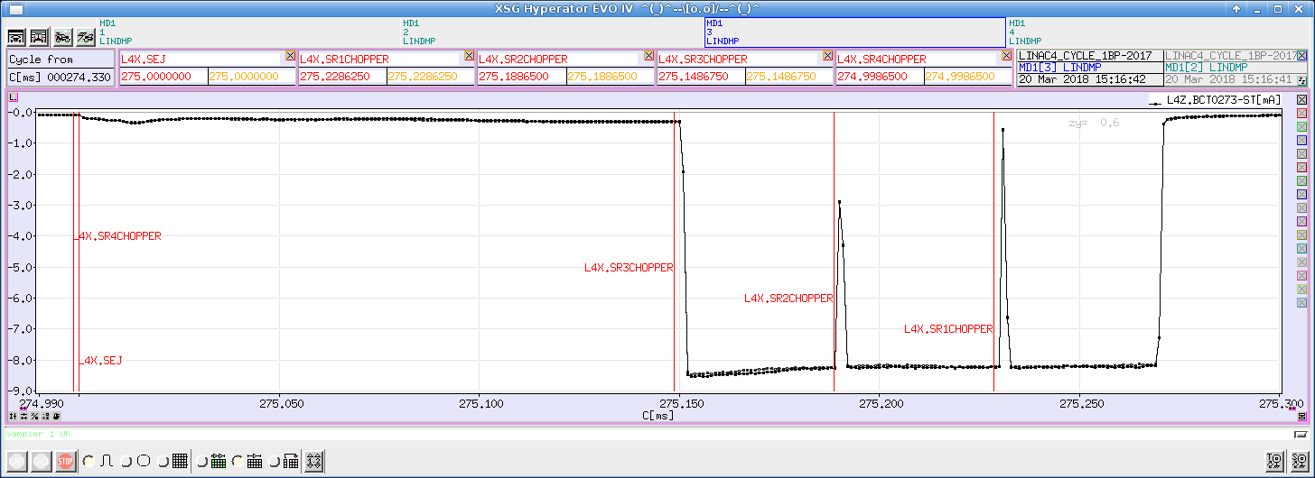
Beam quality measurements – stability at 160 MeV
Current/position stability along pulse
H/V position on L4T pick-up
Ring 3
Ring 2
Ring 1
< +-1mm
Beam intensity on L4Z BCT (3 rings)
Ring 3
Ring 2
Ring 1
< +-2%

Slide 19
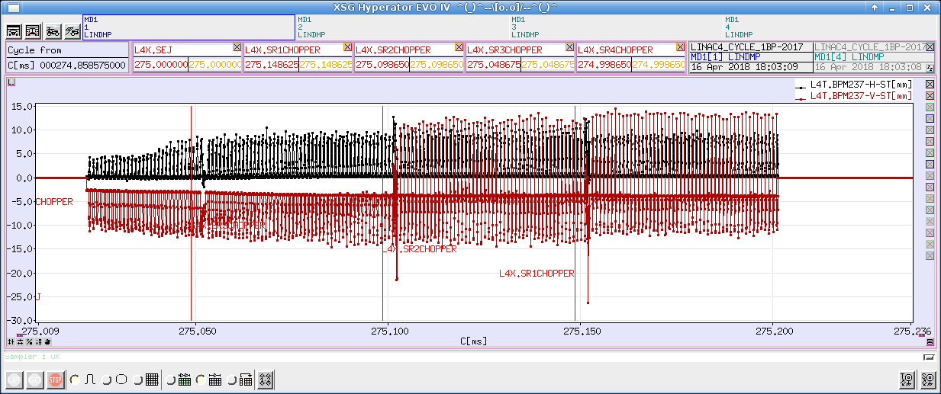
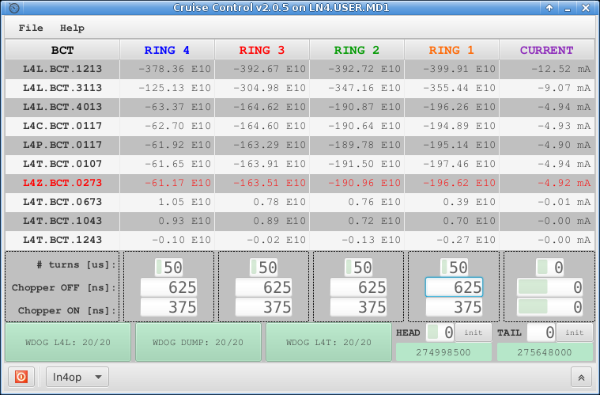
Beam quality measurements - chopping
Chopping pattern for typical LHC pulses for PSB
Notes:
Nominal 60%

Slide 20
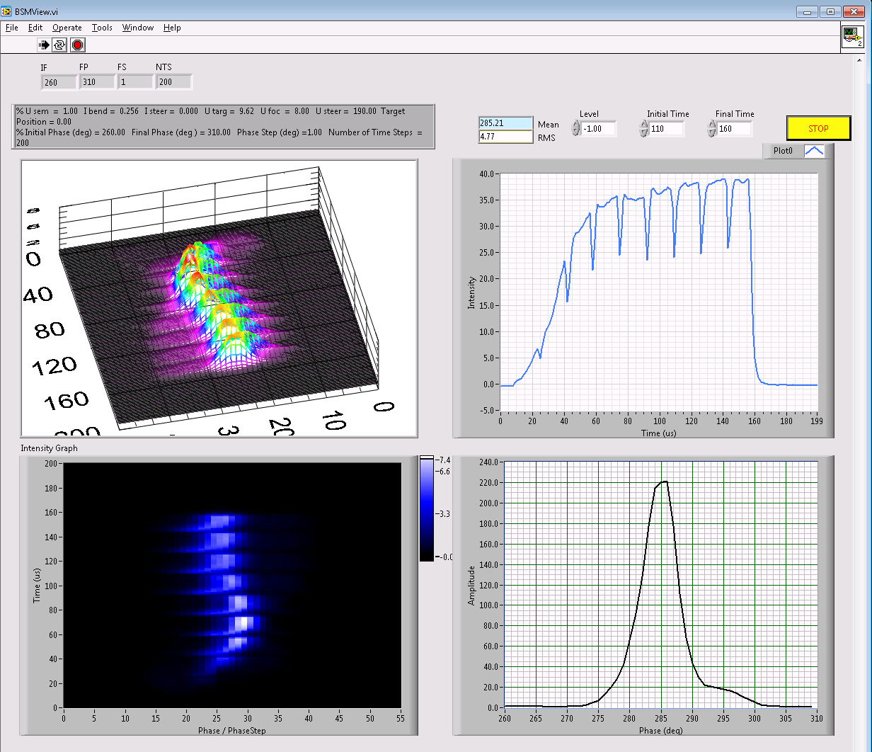
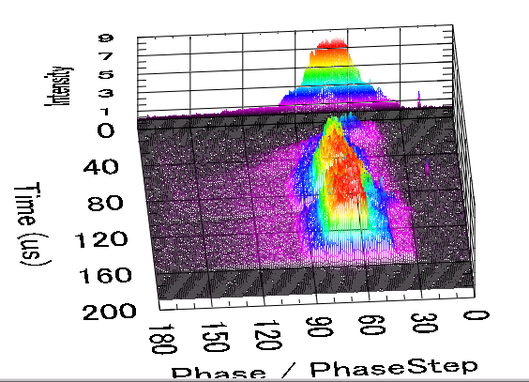
Beam quality measurements – longitudinal shape
Beam Shape Monitor Commissioning
BSM1
BSM2
Caterpillar beam
Notes:
BSM1: beam is chopped; BSM2 beam is not chopped (or differently);

Slide 21
LINAC4: measured beam characteristics
Parameter | Measurement
Peak intensity at 160 MeV | 25 mA
Emittance rms normalized | 0.3 π mm mrad
Max usable pulse length | 600 μs
Stability shot-to-shot | 2%
Pulse flatness | 2% for 160μs pulse 5% fpr 600μs pulse
Beam position jitter along the pulse at the linac dump | +/- 1mm
Fast Chopping at 3 MeV | Rise time < 10ns Extinction factor close to 100% Unprecedented flexibility: beam 1- 600 μs

Slide 22
Conclusions and outlook
Reliability run proved very useful experience allowing to identify issues beyond the possibilities during pure commissioning
  Number of teething problems identified, strategies for mitigation for implementation in 2018
  Gain further experience with a complex system
  Run time used to measure and improve performance
  Identification of areas that need strengthening
Demonstrated reliable operation of the LINAC4 line to the dump
  Most of LINAC4 beam requirements demonstrated (stability, flatness, chopper specifications etc)
  Confidence in running LINAC4 after LS2 strenghtened
Transition from Commissioning to Operation ongoing
More general
  Importance of a teststand that includes the full pre-injector and staged commissioning
  Importance of a validated machine model and accuracy of particle tracking codes
Outlook
  1018: 3 months re-commissioning after scheduled RF upgrade and maintenance activity
  2019: 3 months running with LBE line (emittance measurement)
  After LS2: LINAC4 sole provider of protons for the whole CERN complex
Notes:
re-com-missioning run until the end of the year with the aim of validating all changes implemented.

Slide 23
Thank you for your attention

Slide 25
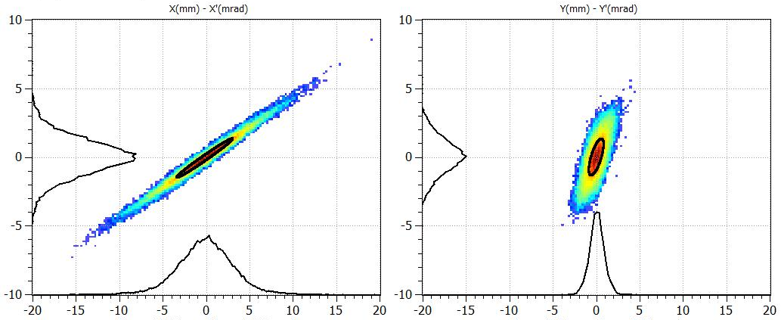
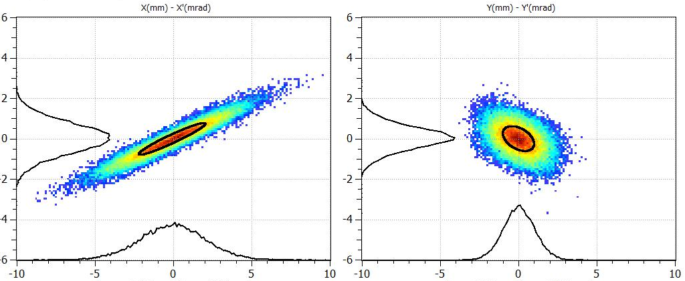
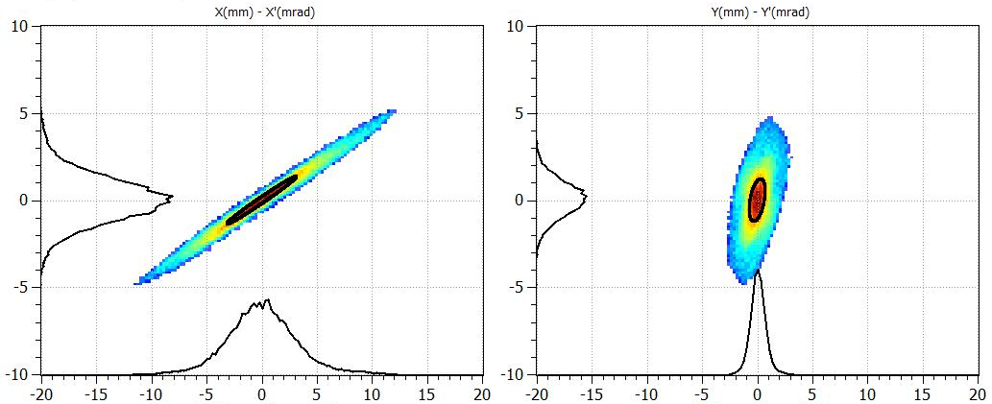
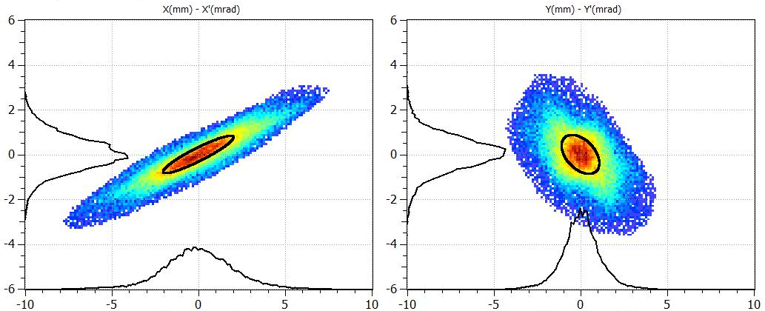
Transverse emittance at higher energies
Transverse emittances were indirectly measured with:
the “Forward method”
the “Hybrid Tomographic method”
Both based on: The 3 profiles method – Including the space charge forces with multi-particle simulation codes.
@ 50 MeV
@ 107 MeV
Expected from simulations
Measured

Slide 26
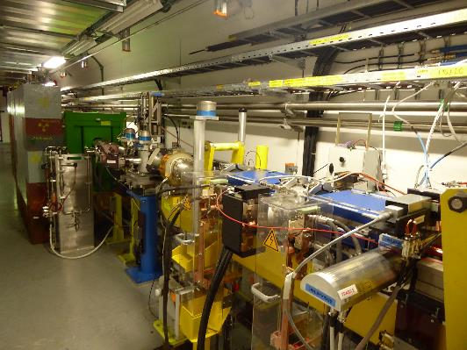
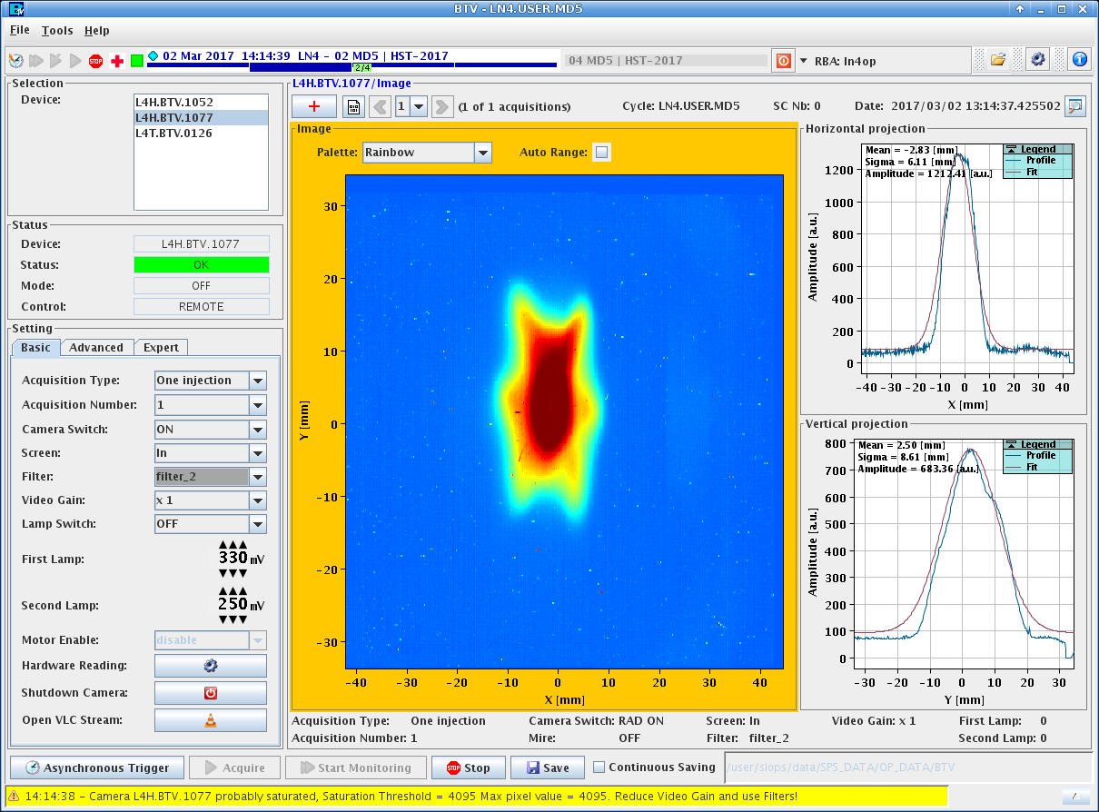
Half Sector Test (Nov ’16 – March ‘17)
Temporary
dump
Chicane
magnets +
H⁰/H⁻ dump
1 µm thick
carbon foil
(24x68mm)
Stripping foil
system
Beam transverse footprint – stripped – 160 MeV at BTV1077 , March ’17
Goals:
Run the beam through half the injection chicane with the aim of mitigating risks for future PSB H⁻ Injection Section – as connection schedule is very tight.
Improve handling and procedures/ gather operational experience
Debugging and improvement of beam instrumentation/ Sensitivity measurements
Stripping efficiency measurements with BCTs & H0/H- monitor

Slide 27
Beam quality measurements
Current/position stability along pulse
Beam Shape Monitor Commissioning
H/V position on L4T pick-up
BSM1
BSM2
Ring 3
Ring 2
Ring 1
< +-1mm
Beam intensity on L4Z BCT (3 rings)
Ring 3
Ring 2
Run 2017 – December
Ring 1
Run 2018 – May – after cesiation
< +-2%
600µsec
Chopping pattern for typical LHC pulses for PSB
Caterpillar beam

Slide 28
LINAC4: A new injector for the CERN proton complex
LINAC2 | LINAC4 – CDR -2006 | LINAC4 – achieved (2017)
protons | H- | Stripping and more tested in Half Sector Test
160 mA | 70mA peak at the source 65 mA peak at 3 MeV 40 mA after chopping | 50mA peak (in twice the acceptance of the RFQ) 27 mA peak at 3 MeV 20 mA after chopping | Peak current from the source Average beam current after chopping (LEBT and RFQ transmission and chopping factor)
50 MeV | 160 MeV | 160.48 MeV | All RF structures performing to specs
1 π mm mrad | 0.4 π mm mrad | 0.3 π mm mrad (at 160MeV) | Smaller emittance , allows for more turns injected
100 µsec 1Hz | 400 µsec 1Hz (4 rings) | Up to 600 µsec 1Hz | Longer injection in the PSB (100-150turns)
200 MHz/ 40 m | 352 MHz / 80 m |  | RF frequency that is not widespread anymore. No components “off the shelf”
- | Fast Chopping at 3 MeV 2µsec inj kicker rise-time | Demonstrated , including transmitted beam quality | Unprecedented flexibility, to be exploited Beam from 1µsec to 150µsec
- | Energy painting with the last accelerating modules | Not yet tested

Slide 29
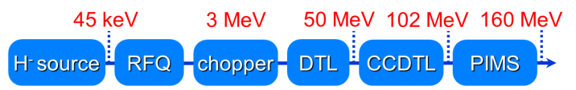
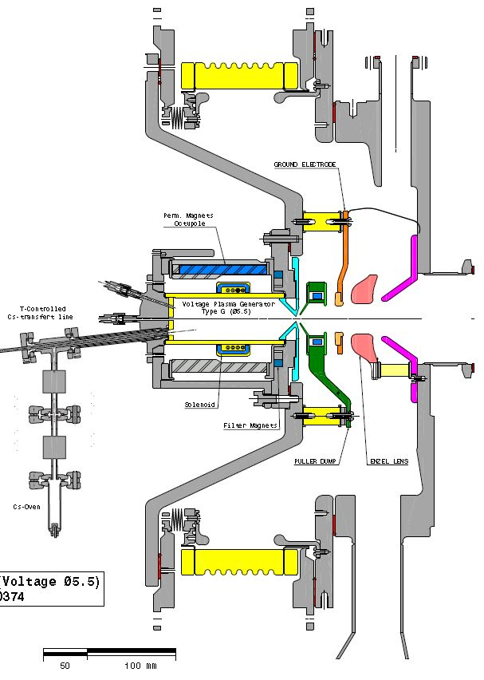


The 3 MeV pre-injector
45 keV H- ion source – Cesiated
Delivering stably a 50 mA beam (27 mA within RFQ acceptance).
Further optimisation on-going in a dedicated test stand.
352.2 MHz RFQ
3 m long structure.
Designed and manufactured at CERN.
Reliable operation since 2013.
MEBT with fast beam chopper
3.5 m long matching line from RFQ to DTL
Fast and efficient beam chopping:
Risetime < 10ns
Extinguish factor 100%

Slide 30





The accelerating structures
Drift Tube Linac – 3 - 50 MeV
PMQs in vacuum – FFDD focusing scheme
Designed for > 30 years reliable operation at 10% duty cycle
Adjust and Assemble philosophy: Tight tolerance aluminium girder
Cell-Coupled DTL – 50 - 102 MeV
Construction by BINP and VNIITF in Russia.
7 modules x 3 cavities x 3 gaps.
PMQs located in between cavities.
First-ever CCDTL in a working machine !
Π Mode Structure – 102 - 160 MeV
Collaboration with NCBJ and FZ-Jülich.
Discs and rings were tuned and electron-beam welded at CERN.
Long qualification period for series production:10-20 μm on 500 mm diameter pieces
First low-beta PIMS on an operational machine.

Slide 31



Setting the RF cavities: time-of-flight
Most of the RF cavities settings are found with Time of Flight
17 Beam position monitors from 12 to 160 MeV ( for 22 cavities)
DTL tank 3
PIMS cavity 1
Average energy vs cavity phase
ToF sufficiently precise to allow setting each RF cavity to:
± 0.5 % in amplitude
± 0.5° for the phase
CCDTL module4
Increasing β & Decreasing number of gaps per cavity

