Slide 1
China initiative Accelerator Driven System (CiADS)
Yuan He, Hushan Xu, Bin Zhang
Institute of Modern Physics

Slide 2
Outlines
Motivation and Project Introduction
Design and Progress
  Accelerator
  Target
  Reactor
Summary

Slide 3

Nuclear Power Development in China
Nuclear energy is an inevitable strategic option to meet China energy demand in the future
  China is the largest energy consumer in the world and coal is the major resource for electricity production (79% in 2011)
  China claims that the CO₂ emissions will reach a peak around 2030 while Paris Climate Agreement.
Current status of China nuclear power
  37 nuclear power reactors in operation, 20 reactors under construction
  Produced electricity: 591TW.h, 3.56% share in 2016
The planned NP development in China (-2020)
  By 2020, the installed nuclear capacity will be increased to 58GWe (~7%), and 30GWe are under construction
  By 2050, 350~400GWe (~20% ), comparable with the total NP capacity in the world (391GWe, 447 reactors in 2017).
Notes:
almost same scale of the total capacity in the world todays!

Slide 4

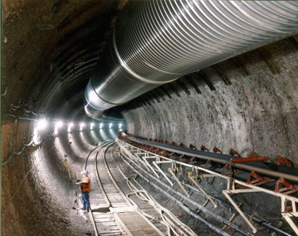
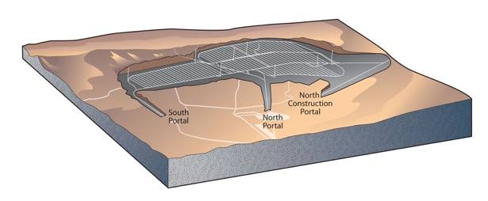
Issues for Sustainable NP
Management and safe disposal of nuclear waste
  1GWe PWR ~25 ton/year;
  ~2200 ton/year in 2030 in China; ~10000 ton/year now in the world
  Total capacity of Yucca Mountain ~ 70000 ton;
“The ADS has the advantage that it can burn pure minor actinides while avoiding a deterioration of the core safety characteristics.”
⎯ ADS and FR in Advanced Nuclear Fuel Cycles – A Comparative Study, NEA/OECD, 2002
Accelerator Driven Sub-critical Reactor and Accelerator Driven Recycle of Used Fuel are promising path to resolve the problems.

Slide 5
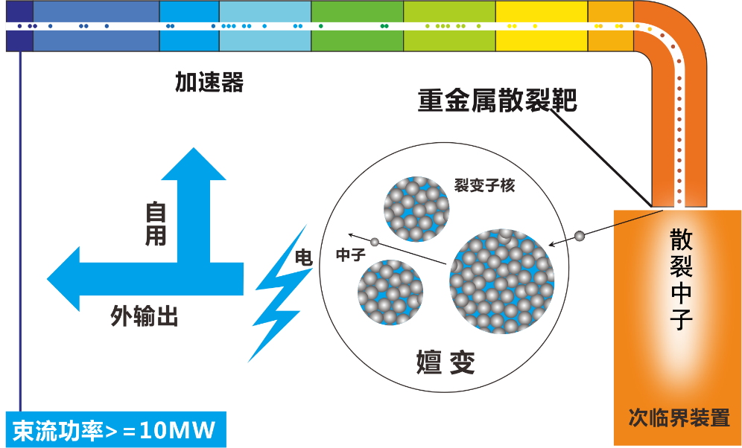
Basic Principle of ADS
Accelerator
Spallation target
neutron
Output power
Transmu-tation
Sub-FR

Slide 6




ADS Roadmap in China
￥1.78 B
Phase I
2011--2016
Phase IV
Phase II
2017--2024
Phase III
Inject I
Inject II
10 MeV
10 MW_{t}
>500 MW_{t}
≥1 GW_{t}
2014
~2.5 MeV
&10mA
2016
~25 MeV
&~10mA
2024
~500 MeV
&~10mA
<2030
~1.0 GeV
&<15mA
~203x
~1.0 GeV
&>15mA
Key Tech. R&D : Acc., Target, Blanket… Prototypes
Initial Facility
Demo. Facility
Indust. Facility
“strategic Priority Research Program” of the Chinese Academy of Sciences
CiADS

Slide 7



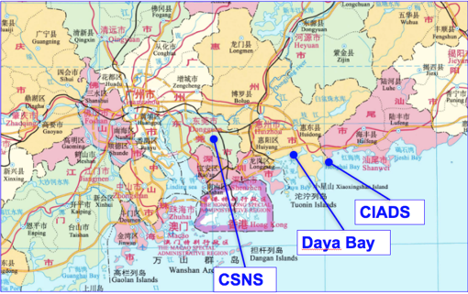
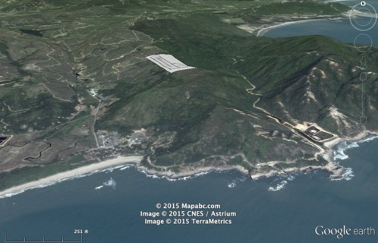
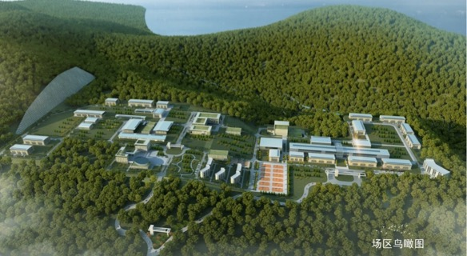
CIADS Project (2017-2024)
China initiative Accelerator Driven System (CiADS)
Approved in Dec. 2015
Leading institute: IMP
Budget: >1.8B CNY (Gov. and Corp.)
Location: Huizhou, Guangdong Prov.
Contribution Partners:
CIAE, CGN, IHEP, CASHIPS, etc.
Location is in Huizhou city, Guangdong Province, 73 km away from Huizhou and 140 km away from Shenzhen. The site is on the top of hill, latitude is around 150m, facing the South See and backing on the mountain. The High Intensity Heavy Ion Accelerator Facility (HIAF) is in the same campus.

Slide 8
Technical routes of CiADS
ADS
CiADS
Acc
Superconducting linac, >2.5MW
HE
proton
Current limit >100mA, CW
Target
Granular W solid, >2.5MW
spallation
neutron
Heat exchange out of reactor
Thermal shock free
Reactor
Sub-reactor, LBE, 10MW
fission
energy
Liquid metal, high conductivity
Good natural circulation ability

Slide 9
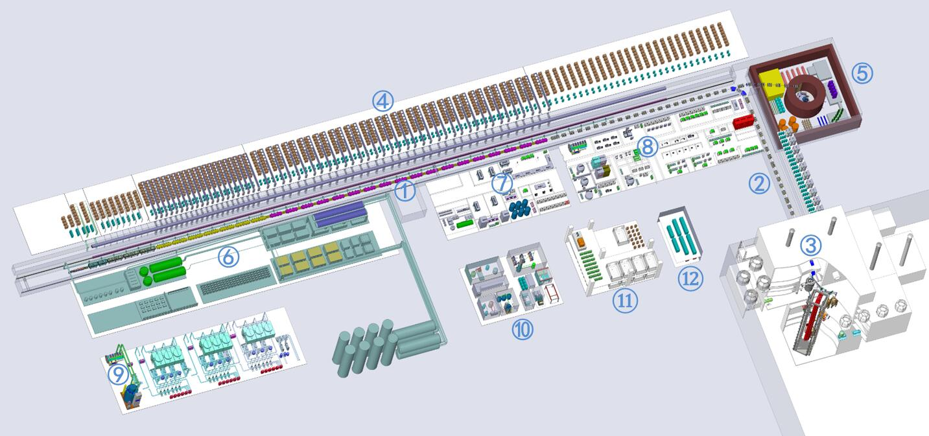
Overall Arrangement of CiADS
① SC linear accelerator
② Coupling beam line
③ Reactor Hall
④ RF High power station
⑤ Beam dump and target exp.
⑥ Cryogenic station
⑦ Accelerator assembly Hall
⑧ SC resonator conditioning hall
⑨ Cooling water station
⑩ Target assembly and exp. hall
⑪ Hot cell building
⑫ Electric transform station

Slide 10
Top Level Specifications of CiADS
ADS
Heat Power of ADS | 10 MW
Superconducting Linac
Species | Proton
Beam Energy | 500 MeV
Beam Power | ~2.5 MW
Operation mode | CW/pulse
High Power Target
Materials | Tungsten, granular flow
Neutron Flux | 10^{16~17} /s
Heat Power | ~2.5 MW
Subcritical Reactor
Heat Power driven by beam | ~7.7MW
Fuel and enrichment | 19.75% UO₂
Keff | 0.73

Slide 11
Outlines
Motivation and Project Introduction
Design and Progress
  Accelerator
  Target
  Reactor
Summary

Slide 12
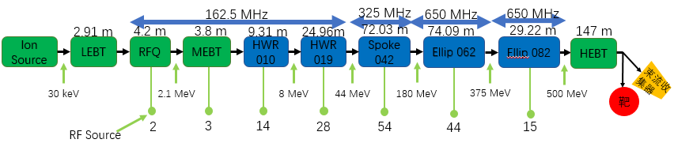
General design of CiADS linac
CIADS sc-lianc design concept：
RAMI dependent design
Beam loss ＜0.1 W/m
Optimization overall
Beam dynamic configuration
ion | proton
energy | 500 | MeV
current | 5 | mA
frequency | 162.5/325/650 | MHz
operation | CW&pulse
Beam loss | ＜0.1 | W/m
length | 367.52 | m
Specials at transport sessions:
Rt front end: beam quality control and re-built
Sc-linac: high redundancy, compensation
Beam on target: homogenies scanning

Slide 13
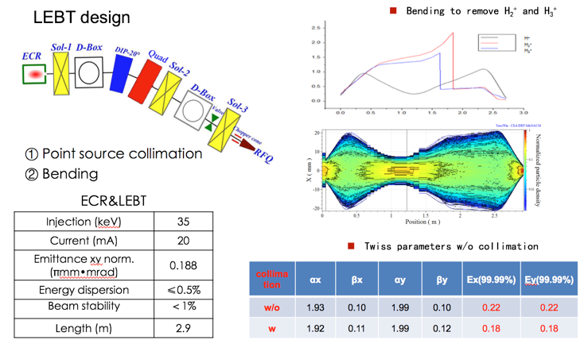
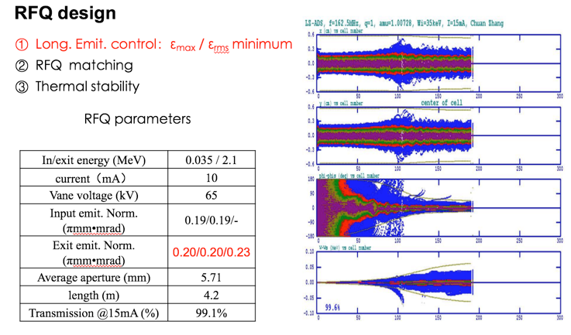
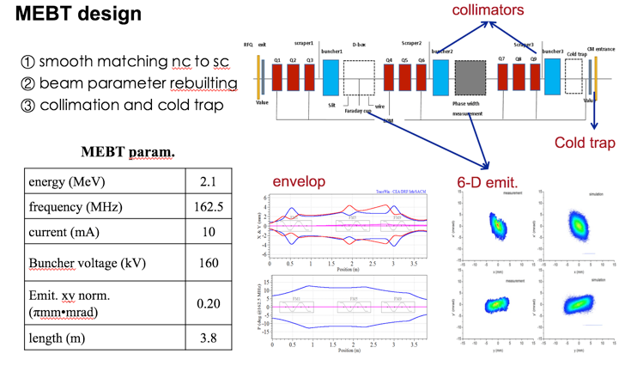
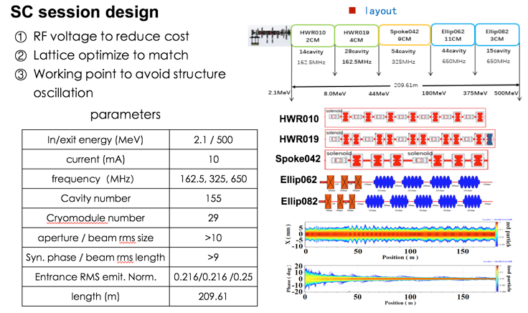
Session design of linac

Slide 14
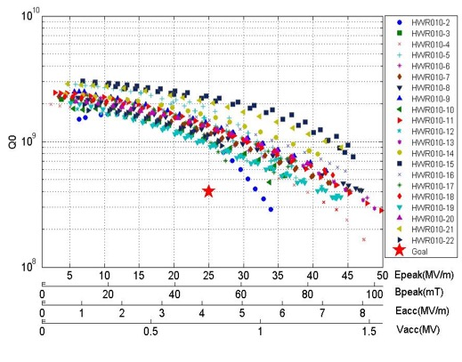
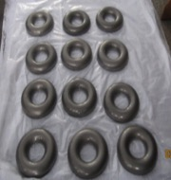
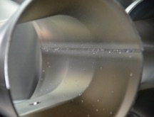
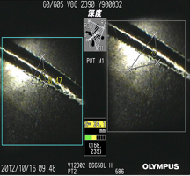
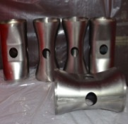
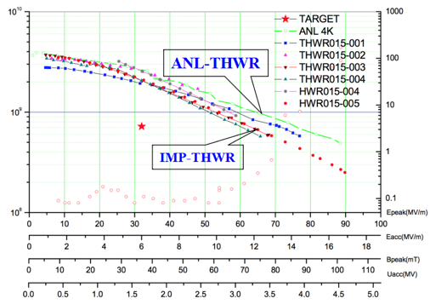
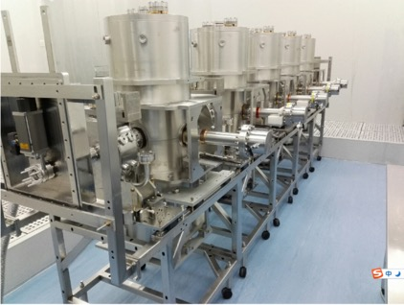
SC resonators of CiADS
f (MHz) | 162.5
β_{opt} | 0.101
Epeak / Eacc | 5.9
Bpeak / Eacc | 12.1
G = Rs×Q0 (Ω) | 28.4
R / Q0 | 153
Q0 (4.4K, Rs=71.4 nΩ) | 4E8
Vacc (MV) | 0.78
Epeak (MV/m) | 25
Bpeak (mT) | 50
Pdiss(W) (4.4K, Rs=71.4nΩ) | 10
HWR010
VTA results of HWR010
fabrication
f(MHz) | 162.5
Vacc(MV) | 1.8
Bpeak(mT) | 40
Epeak(MV/m) | 32
R/Q(Ω) | 292
G（Ω） | 51
Eacc(MV/m) | 6.6
P(W)(Rs=70nΩ) | 16
βopt | 0.15
Q0 | 7.2E+08
HWR015
VTA results of HWR015
String assembly in cleanroom

Slide 15
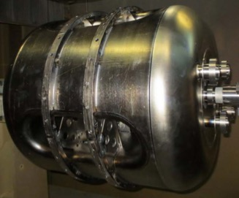
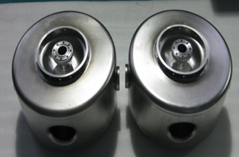
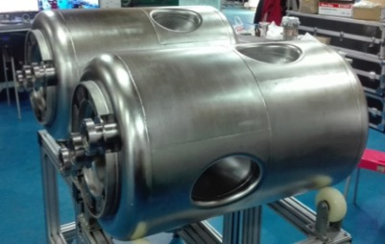
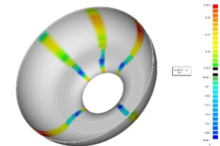
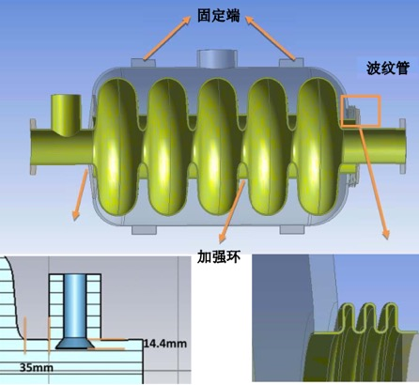
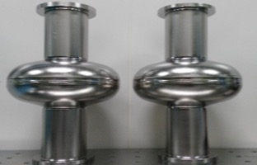
SC resonators of CiADS
f (MHz) | 325
β_{opt} | 0.42
Epeak / Eacc | 3.78
Bpeak / Eacc | 7.09
G = Rs×Q0 (Ω) | 108.5
R / Q0 | 420.8
Q0 (2K, Rs=20 nΩ) | 5.4E9
Vacc (MV) | 5.4
Epeak (MV/m) | 35
Bpeak (mT) | 70
Pdiss(W) (2K, Rs=20nΩ) | 12.8
DSR042
Single Spoke
CH
Double Spoke
Operating Frequency (MHz) | 650
Operating Temperature （K） | 2
Geometrical beta β_{g} | 0.63
Optimal beta β_{opt} | 0.67
Number of cells | 5
E_{acc} at β_{opt} (MV/m) | 15.6
Epeak / Eacc (β_{opt}) | 2.25
Bpeak / Eacc (β_{opt}) | 4.79
G (Ω) | 192.7
R / Q0 | 360
Q0 | 1E10
Vacc at β_{opt} (MV) | 11.39
Cavity Length (m) | 1.09
Elliptical 063

Slide 16
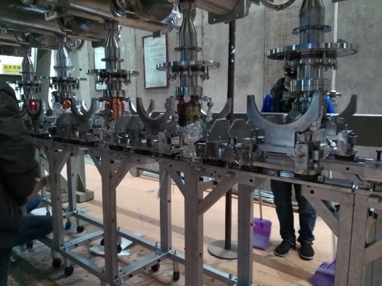
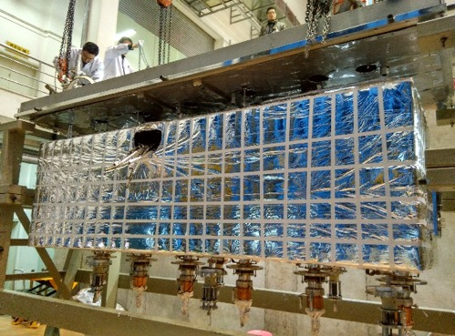
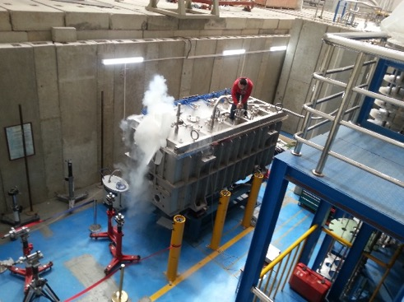
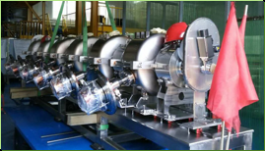
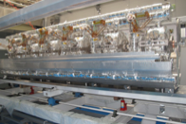
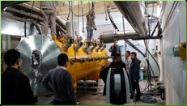
Prototypes of Cryomodules
HWR
Spoke

Slide 17
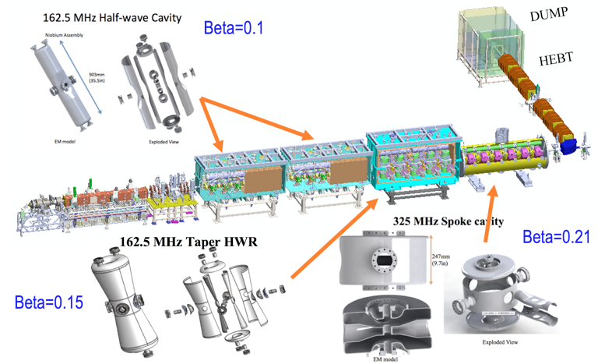
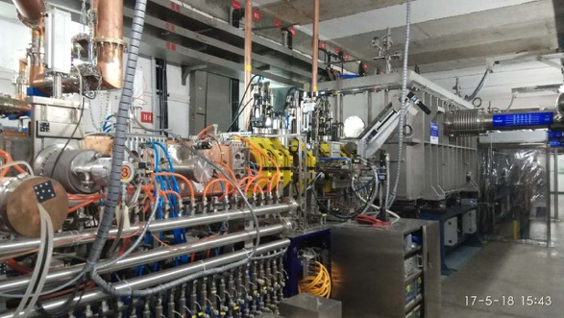
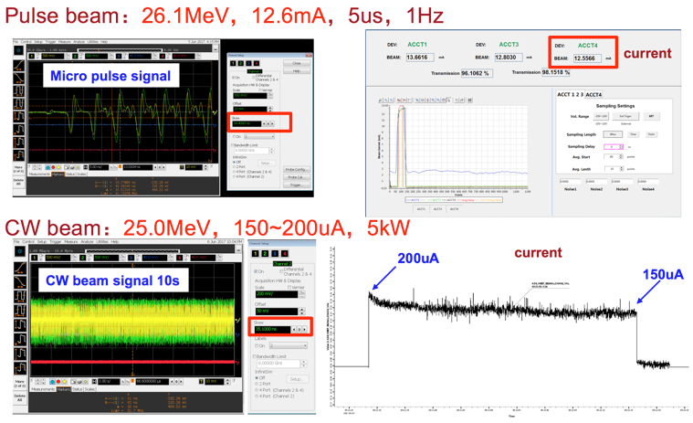
Prototype of ADS sc-linac
25 MeV
10 mA
25 MeV ADS Front-end Demo sc-Linac
World first ADS front-end demo lianc.
First 25 MeV CW beam of 170 uA, and pulse beam of 12.6 mA in 2017.
The beam of 10 MeV@2 mA, the most powerful CW proton from sc-linac, were demonstrated in 2016.

Slide 18
Outlines
Motivation and Project Introduction
Design and Progress
  Accelerator
  Target
  Reactor
  Material
Summary

Slide 19
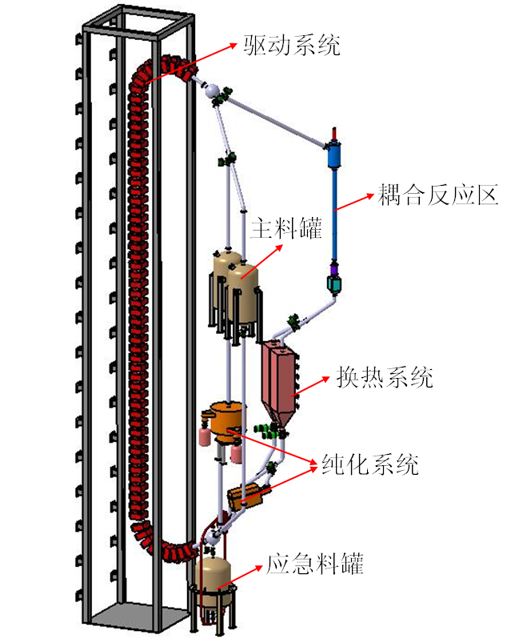
General design of granular target
item | value
Beam energy | 250~500 MeV
Beam current | 5~10 mA
Neutron flux | 10^{16~17}/s
Effective Neutron | 2~6.2 n/p
Exchange power | ~2.5 MW
Granular flow | <72 m³/h
Lifter hight | ~40 m
Lifter
Coupling area
Cont-ainer
Heat exchanger
function
Remove beam heat
Yield neutron
Coupling A & R
Purifier
Emergency container
Notes:
靶系统回路循环运行，在靶段耦合发挥功能，在其他功能段从热工、材料等角度冗余支持运行。

Slide 20
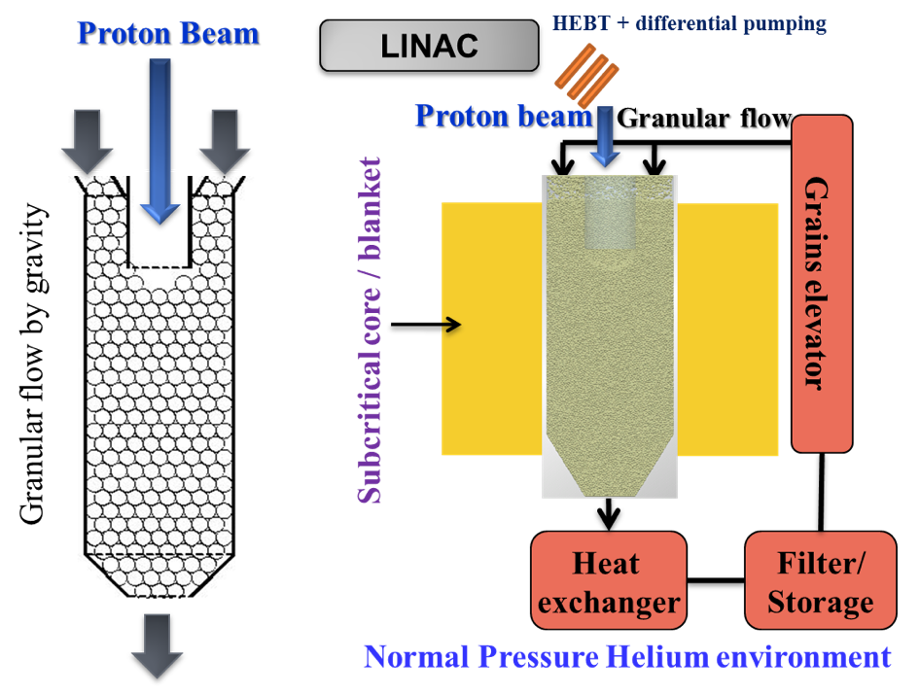

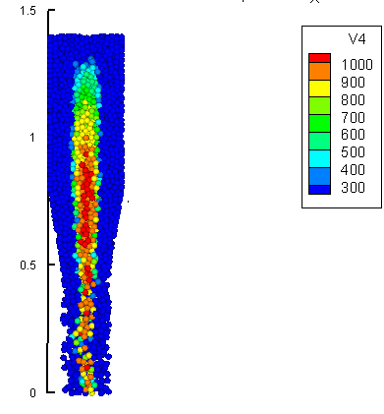
Granular Target Conception
Sand Clock
Granular flow
Beam heating
Science China
Tech. Sci. 58(10)
July 2015
Spallation
neutron
Merits:
Heat exchange outside
No Stress due to beam trip
No thermal shock due to beam pulse
Drawbacks：
Dusty due to abrasion
It can stands for tens of MW beam power
Increasing flexibility to use other target materials to increase the neutron yields

Slide 21
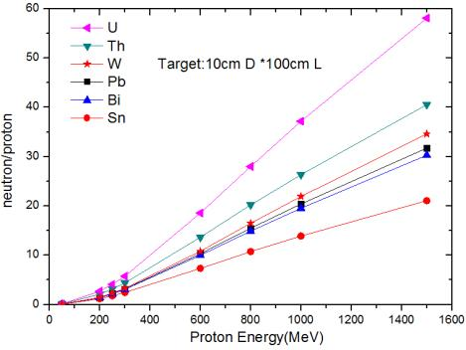
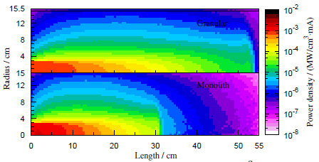
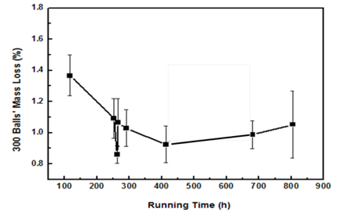
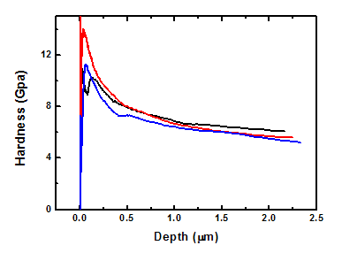
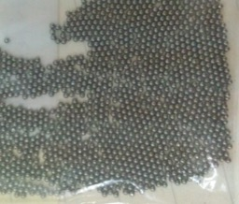
Granular Target Materials
Alloy W/Ni/Fe has high neutron yield, mechanical performance, high thermal conductivity, low thermal expansion, low cost, etc.
 | value
gradients | 93W-4.5Ni-2.5Fe
diameter | 1.0±0.1mm
density | 17.6g/cm³
impurity | ≤0.1%
ductility | ≥10%
Neutron yield
Heat deposition
Abrasion line
hardness
Produce 13 tons

Slide 22
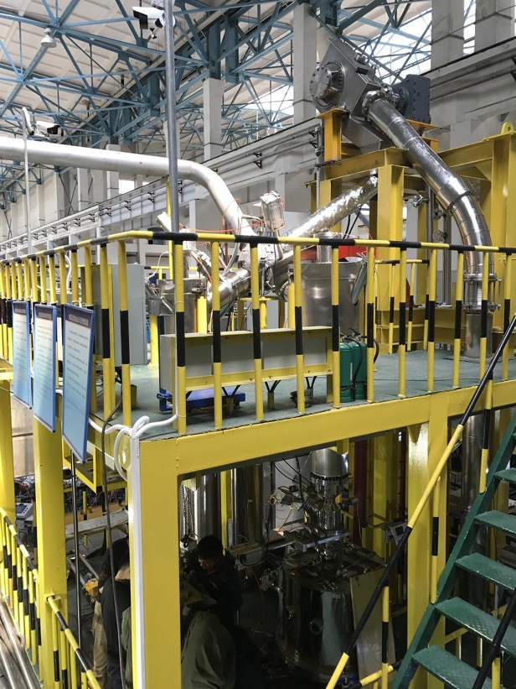
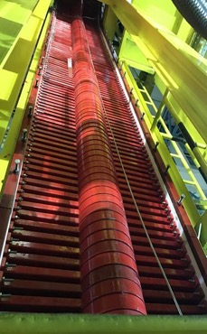
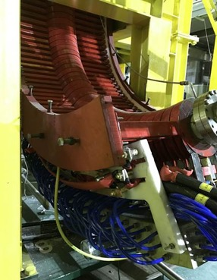
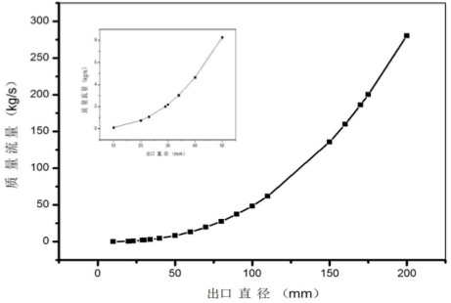
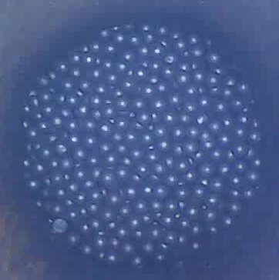
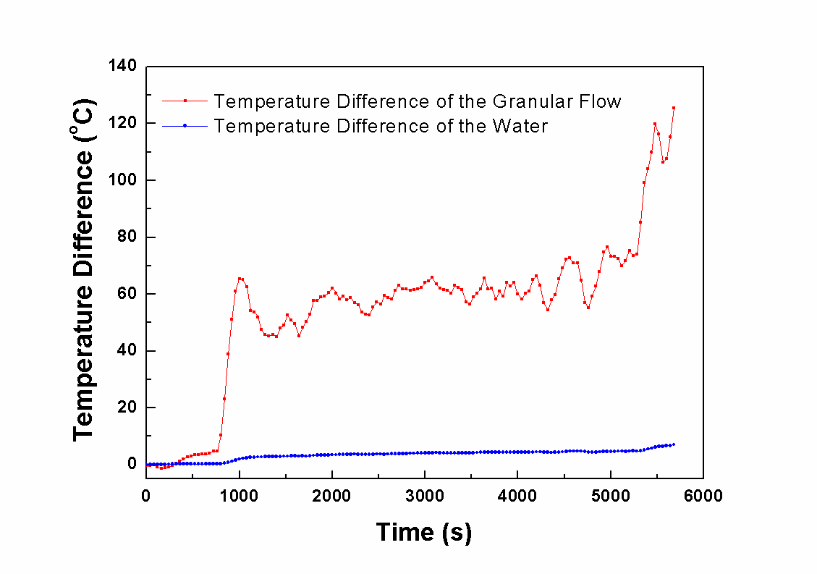
Prototype of granular target
Flux with aperture
Electro-magnetic lifter
Granular temp.
Water temp.
Heat exchange exp.
Granular flow
Integral target setup, verify granular flow, heat exchanger, electro-magnetic lifter, purifier, and so on

Slide 23
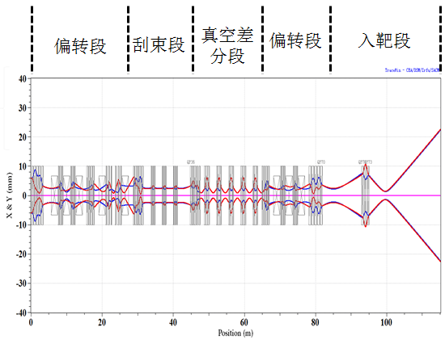
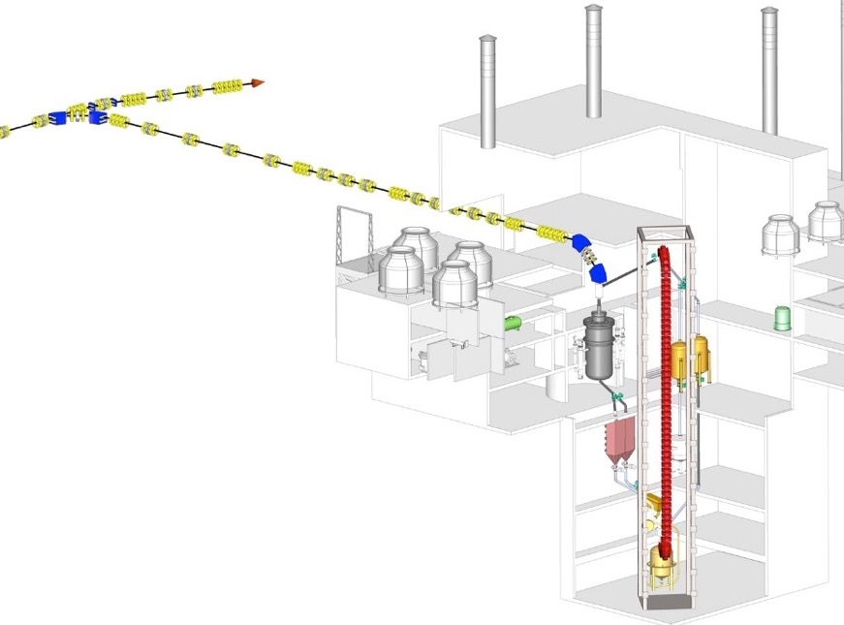

Design of A. & T. coupling
collimation
differential
bending
bending
scanning
 | value | unit
Emit. RMS norm. (x/y/z) | 0.28/0.28/0.33 | π mm.mrad
Entrance αx/αy/αz | 1/1/-1 | ——
Entrance βx/βy/βz | 20/20/20 | mm/π.mrad
Beam profile on target | round
homogenity | ±10 | %
99.99% beam diameter | <110 | mm

Slide 24




Design of A. T. R. coupling
Vacuum differential session
FR with central tube
Thermal insulation between target and reactor
Non hard connection and touch between target and reactor container
High Vacuum
10⁻⁵ Pa
Low Vacuum
0.1 atm
Scanning
Windowless from Acc to Target
Donna type scanning to uniform temperature rising
Monitoring beam on target
A T R coupling
Physical de-coupling and neutron coupling

Slide 25




Exp. of E-Beam on W Granular Target
2014.7, e-beam tungsten target coupling setup
Identify Target Power Density of proton beam 1.0GeV@10~20mA on W
Long-term operation stably
Granular flow and heat simulation agree with experiment

Slide 26
Outlines
Motivation and Project Introduction
Design and Progress
  Accelerator
  Target
  Reactor
Summary

Slide 27



General Design of FR
 | Top level spec.
type | LBE sub- FR
Power | 10MWt (incl. beam)
fuel | UO₂ (19.75%)
Main coolant Configuration | Pool-loop
Main coolant driven mode | Forced circulation
Coolant | LBE
Main coolant pressure | Normal
Main coolant temp | 280-380℃
main coolant exchanger | Main exchanger×2 Auxiliary exchanger×4
Main pump | Mechanical pump×2
Secondary Loop coolant | Pressure water
Secondary Loop pressure | 1.4MPa
Secondary Loop Temp | 225-260℃

Slide 28

Neutronics design
Parameters | Unit | Value
 |  | BOL | EOL
Reactor Power | MW | 7.74 | 7.66
Target Power | MW | 2.26 | 2.34
Proton Energy | MeV | 500
Beam Intensity | mA | 4.51 | 4.67
Neutron Yeild | n/p | 8.81
Uranium Load | t | 1.7217
EOL Burnup | MWd/tU | 4902
Keff | - | 0.73457 | 0.72687
Ks | - | 0.76922 | 0.76450
UO₂ Enrichment 19.75% Fuel；
Lifetime 3 years

Slide 29
Thermo-Hydraulic Design
Name | Value
Power | 7.74 MW
Number of Assembly | 30
Inlet Temp | 280℃
Out Temp | 380℃
Core total flow rate | 541 kg/s
Coolant Velocity | 0.32 m/s
Highest Temp of Coolant | 456℃
Core Pressure Drop | 0.0030 MPa
Coolant flow distribution of 7 rods bundle
Limitation：
The highest temperature of cladding is 460℃< limitation 550℃
The highest coolant velocity is 0.36m/s< limitation 2m/s
The highest temperature of fuel is 534℃

Slide 30

CiADS Safety Analysis
Accident Choose
Typical LBE reactor accidents：
Loss of flow
Blockage
Typical ADS accidents：
Beam trip
Beam overpower
Tools
RELAP5mod4.0
Replace original pressure-drop and heat relationships
Import external source driven model
Reactor System Node Diagram
It is convinced that this reactor design has great safety margin under all of the accident conditions.

Slide 31




Typical accident safety analysis
Loss of flow
Blockage
The highest temperature of cladding is 746 K while all of the coolant flow have been lost without any safety protection system response in the reactor.
The highest temperature of cladding is 905 K while 90% reactor has been blocked.
Beam trip
Beam overpower
If 1.0E8 times beam trips had been occurred during the lifetime of the reactor, cladding fatigue would happen.
Great heat transfer margin has been considered in this design

Slide 32








Nuclear Assembly Design
To guarantee the stability of the assembly in the reactor, locking machine and balance weight have been chosen in this design.
The structure of the nuclear assemble has been included Locking Machine, balance weight, bottom nozzle, under support lattice etc.
Name | Unit | value
Bundle number | 60
Configuration | Triangle
Assemble length | mm | 3310
Rod length | mm | 1340
Locate mode | wire
Wire diameter | mm | 1.4
Assemble gap | mm | 4
Balance weight
outer sleeve
Locking
Machine
Bottom nozzle
Undersupport lattice
Fuel bundle
Upsupport lattice
Top nozzle
Handling head

Slide 33




Coolant System Design

Slide 34





Neutron Verifications
Independent Development Reactor operation monitoring system
Online dual fiber detector and Solid track detectors
For critical mass,
theoretical value and experimental value differ 0.3%
Target material | Period method/mk | MCNPX/mk | Relative error/mk
Tungsten particles | -0.932 | -0.99 | -0.058
Tungsten | -1.144 | -1.162 | -0.018
Lead | 1.322 | 1.562 | 0.24
Built at the end of 2016（ CIAE+IMP）
Experiments verified The accuracy of target-reactor coupling calculation and core design

Slide 35





LBE Loop & Oxygen Control System
Built several LBE circuit research loops, achieved the precise control of oxygen concentration.
Oxygen control setups
LBE Loop

Slide 36
Outlines
Motivation and Project Introduction
Design and Progress
  Accelerator
  Target
  Reactor
Summary

Slide 37
Summary
CiADS is worldwide first facility of Accelerator Driven System. It has been approved and breaking ground in this year.
CiADS will demonstrate the technologies on high power linac, granular target, LBE sub-critical FR, and the high power coupling among them.
The prototypes of ADS key tech. such as front-end of sc-linac, granular test stand, and large-scale LBE loop have been built and operated. The feasibilities are verified.

Slide 38
Thanks！

