Slide 1
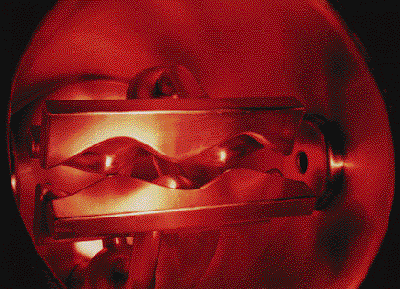
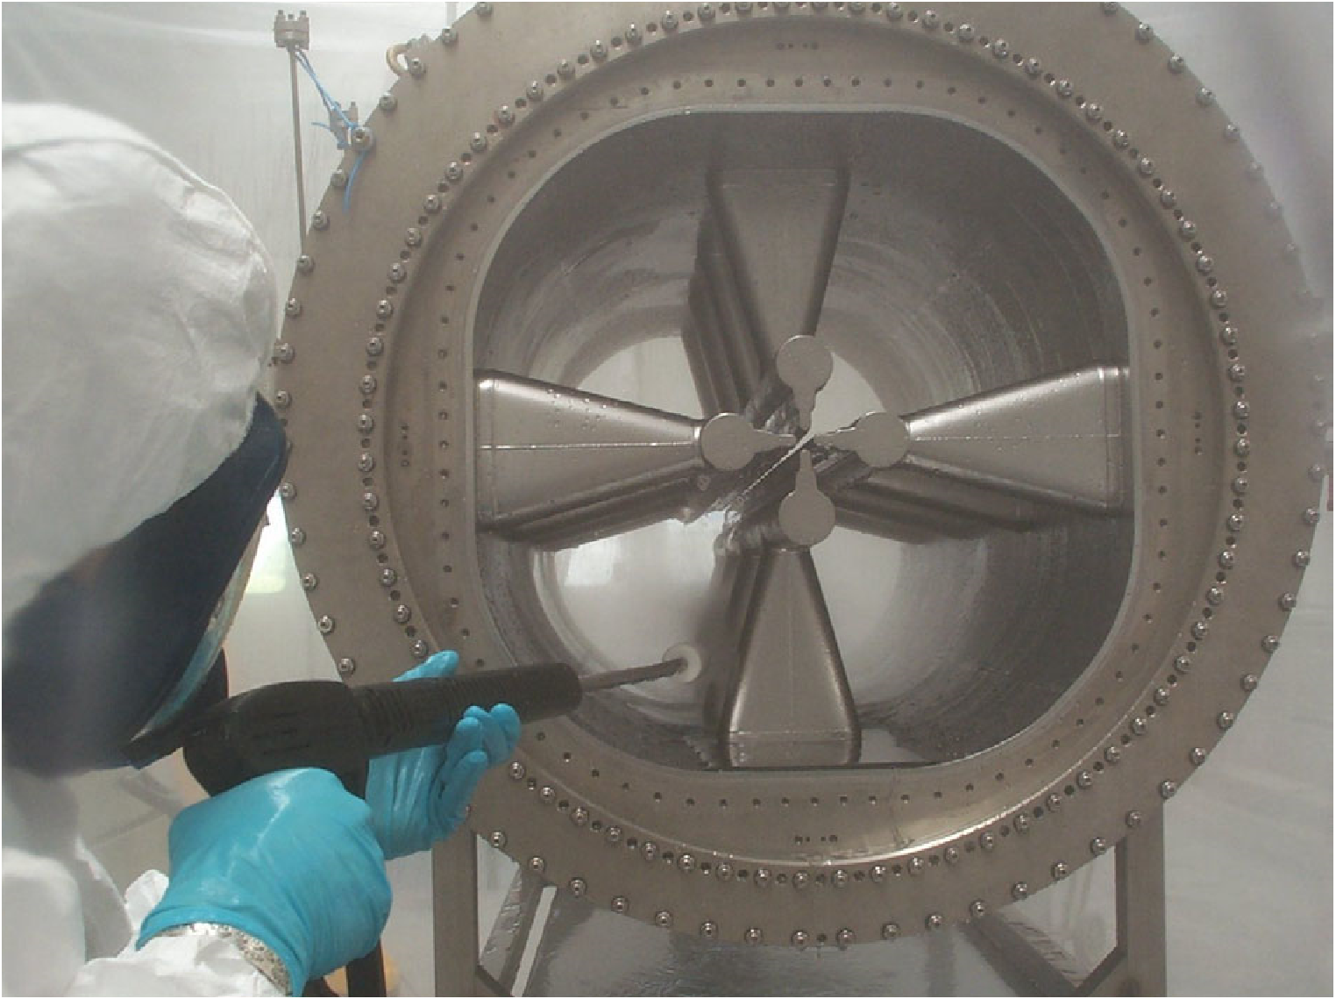
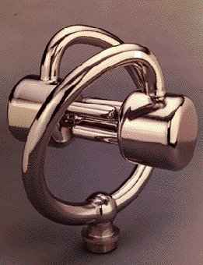
SC-RFQs: towards CW high power proton linacs
G. Bisoffi (replacing A. Pisent) for the INFN-LNL Team

Slide 2
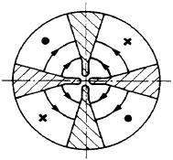
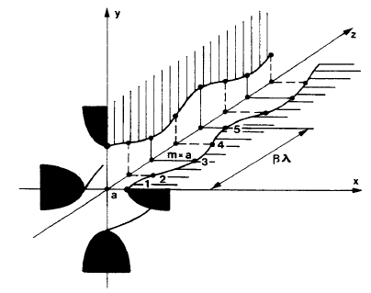
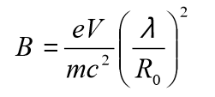
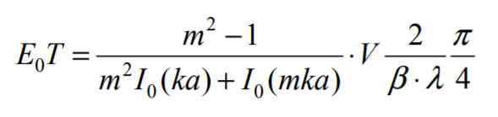
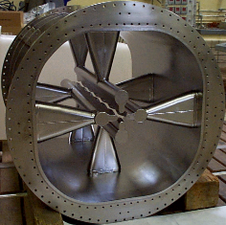
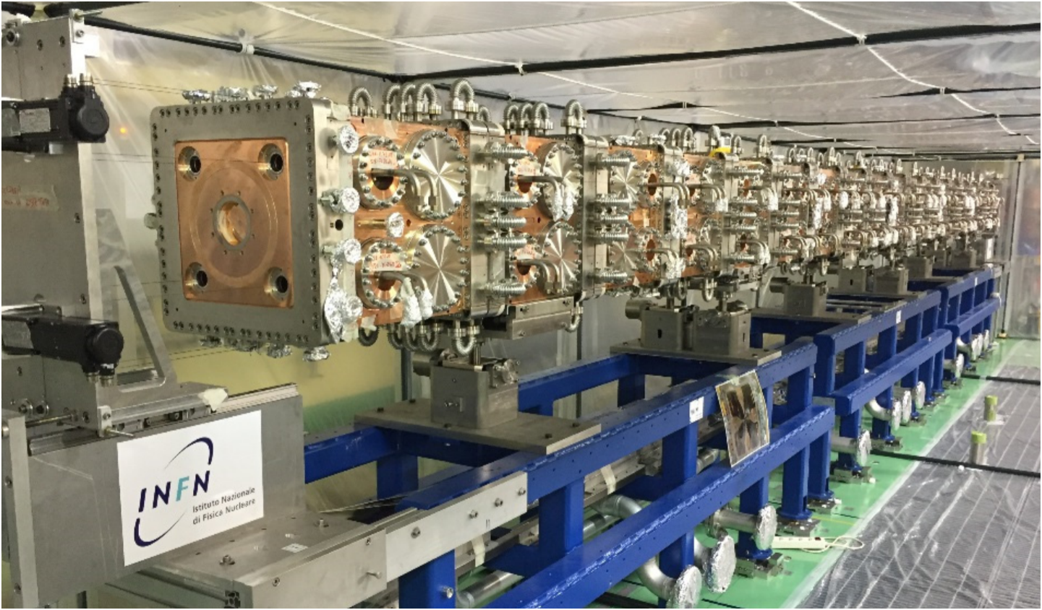
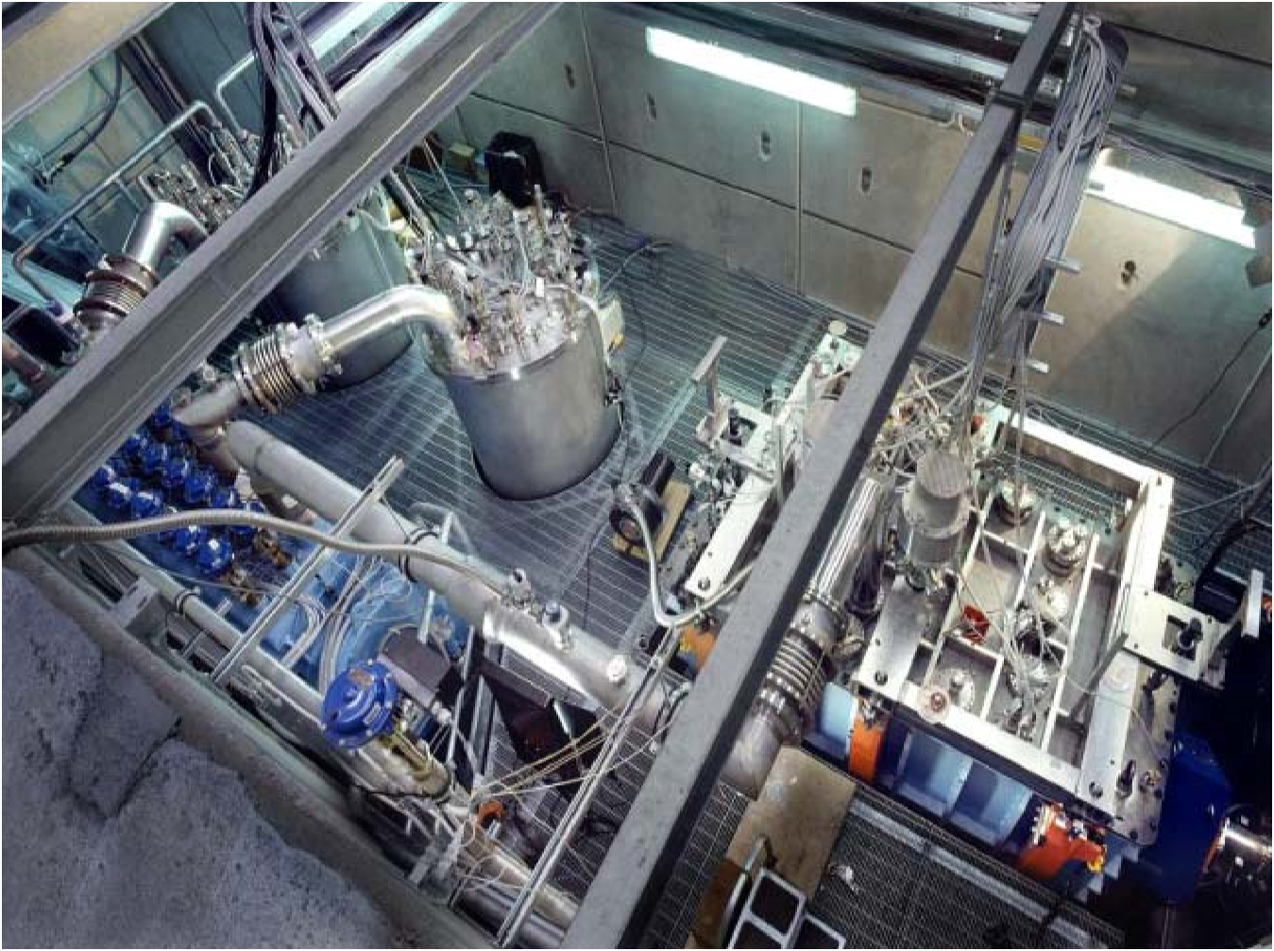
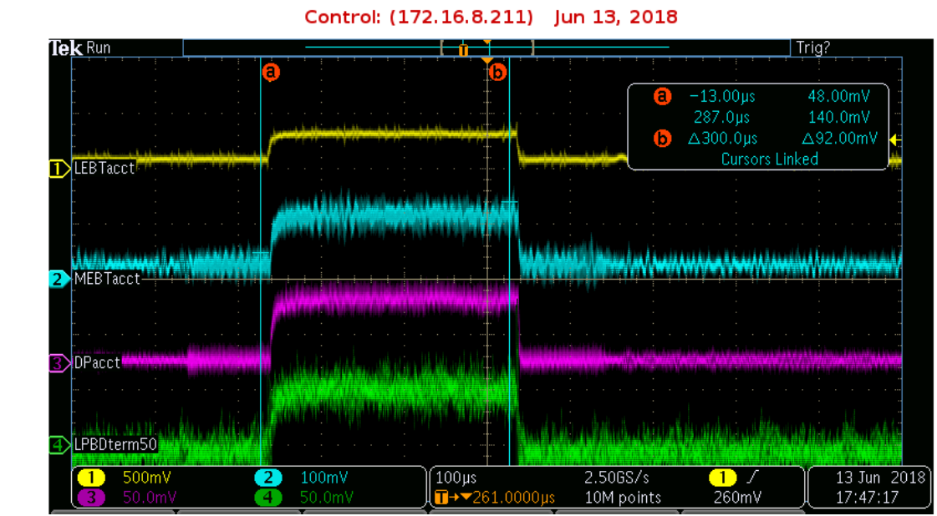
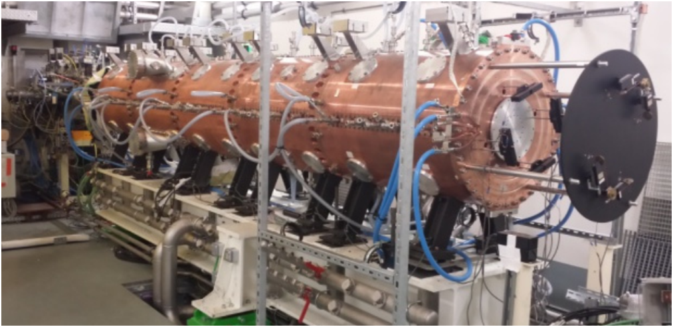
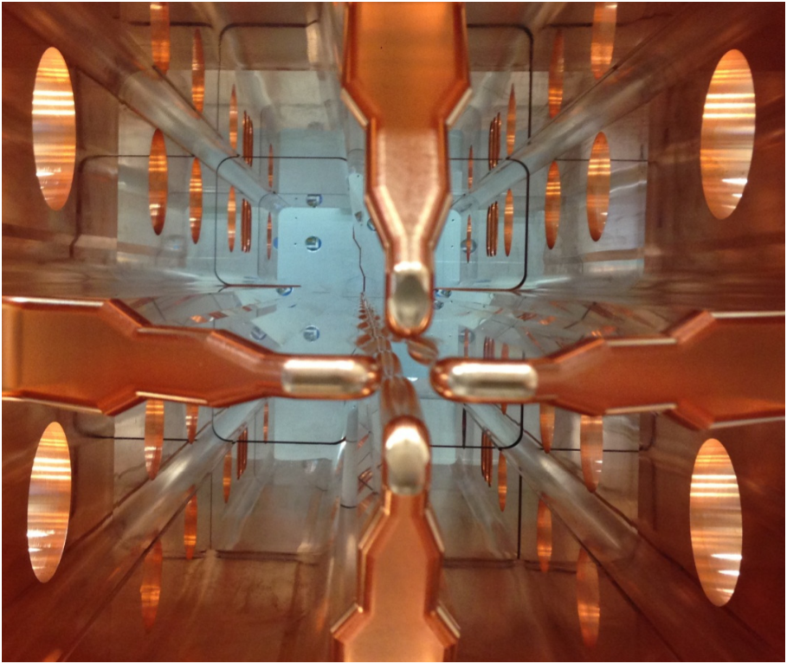
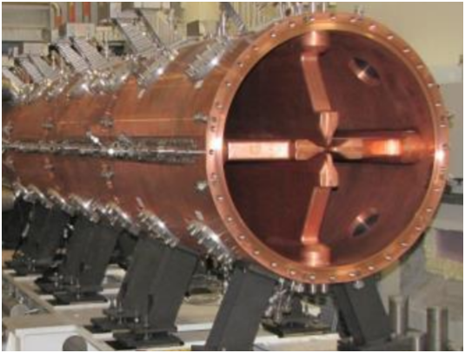
CW RFQs
Focusing ⇐ main quadrupolar E⊥
Acceleration ⇐ small but effective E‖
modulation of 4 vanes (synchronous with
beam bunches) one modulation period = βλ
IFMIF (NC)
d, 5 MeV, 130 mA, 175 MHz
10 m, 80-130 kV, 450 kW
PIAVE (SC)
HI, 0,6 MeV/A, 5 μA, 80 MHz, 2 m, 280 kV, 0,5 kW
SPIRAL2 (NC)
d, 3 MeV, 5 mA, 88 MHz
5 m, 110 kV, 180 kW
First beam today - 4:45 pm local time! 13 mA, 300us, 1 s

Slide 3
Outline
The PIAVE S-RFQs and precursors
Design and construction highlights
Q-curves, alignment, f&A locking
Recent upgrades of PIAVE S-RFQs
S-RFQs vs N-RFQs for high-I linacs

Slide 4
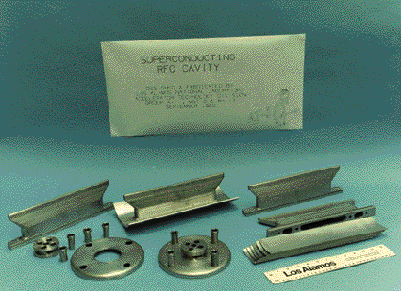
Precursors
ANL-1990: 64 MHz, full Nb device
LANL: 194 MHz 4-vane, full Nb
model (for high-I beams)
Not completed…
E_{s,p}=128 MV/m CW!
Stony Brook: 6 indep.-phased 50 MHz sc RFQ-lets (Pb/Cu model)
ANL: 194 MHz full Nb
model, not tested
E_{s,p}~10 MV/m global thermal breakdown

Slide 5
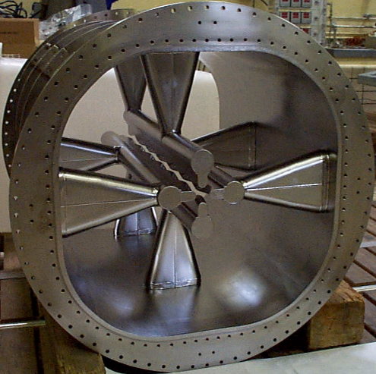
PIAVE, Bunching+2 S-RFQ’s (80 MHz)+8 sc QWR’s
Full Nb, E_{s,p}~ 25,5 MV/m, Limit: field emission
Operational
since 2006
From ECRIS on 350 kV HV platform up to β = 0.05

Slide 6
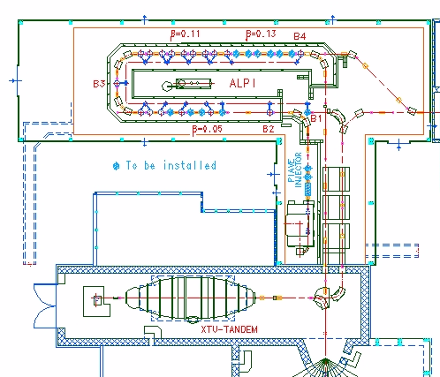
A positive ion injector for a HI SC linac
SC
Booster
ALPI
Positive Ion Injector
PIAVE
XTU-Tandem
It injects a CW SC-linac with CW beams of higher A and I_{b} (A~100 is Tandem VdG stripper limits)

Slide 7
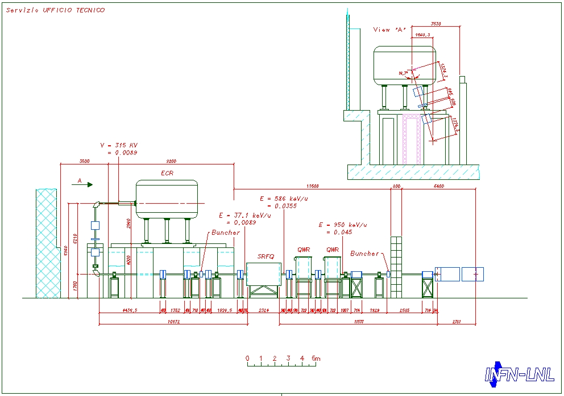
PIAVE Injector Layout
Two S-RFQs
ECR + LEBT
n.8
QWRs
to ALPI

Slide 8
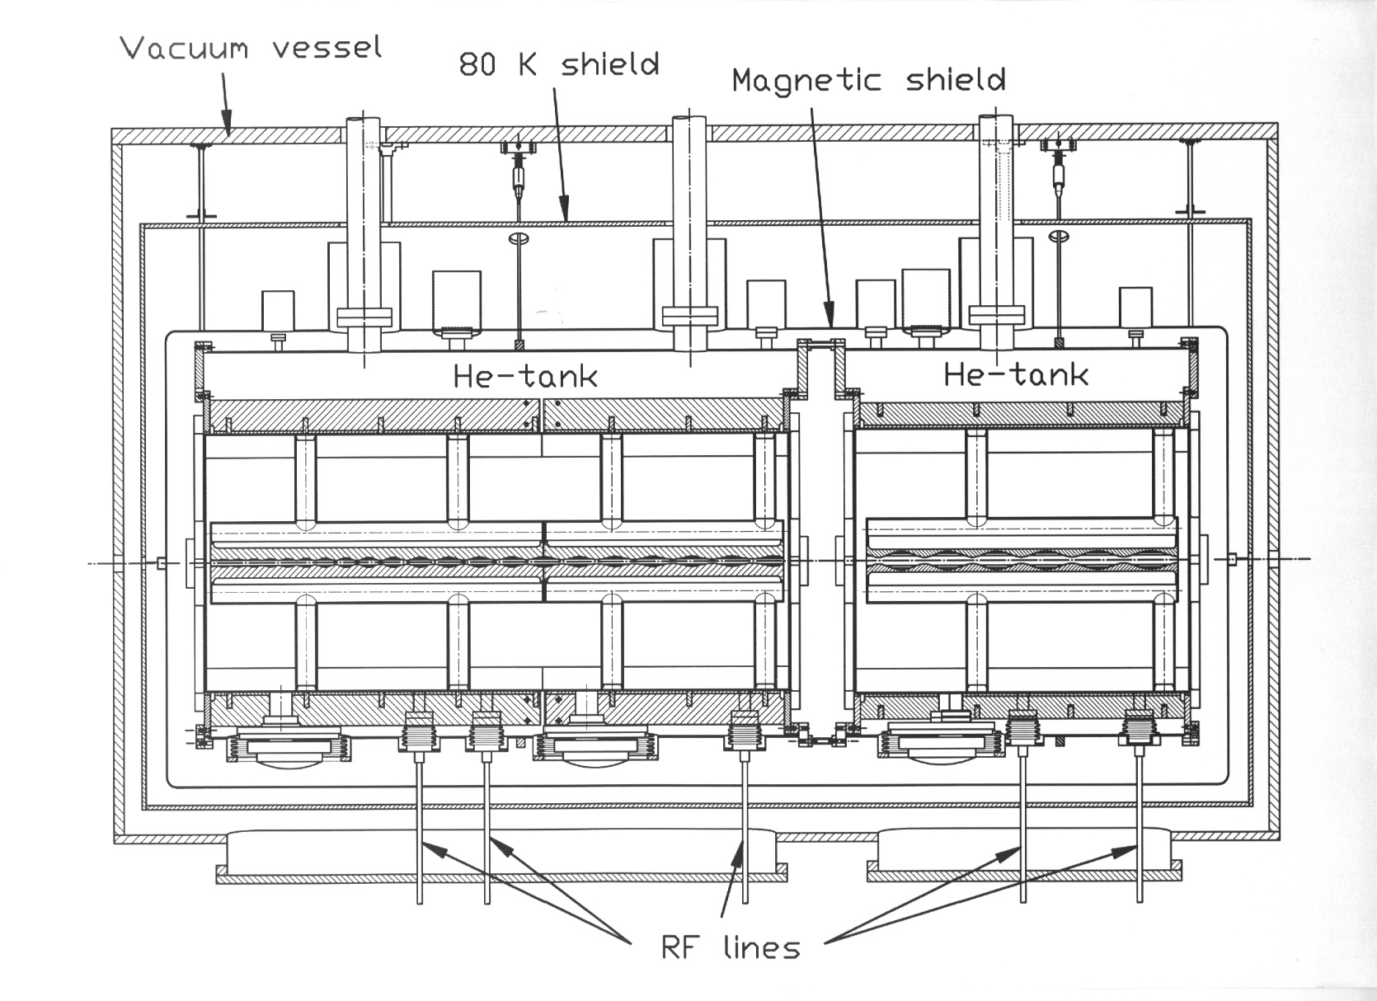
Two S-RFQs in a cryostat
SRFQ1
SRFQ2
beam
line
1.38 m
0.74 m

Slide 9
PIAVE RFQ design values
Designed for A/q=8,5 from an ECR on a 315 kV platform
Acceptance (norm) = 0.8 mm mrad
Output long. Emittance = 0.7 ns keV/u

Slide 10
S-RFQs: setup for beam acceleration
After extensive source+LEBT setup…
Si
Lens
Lens
B
SRFQ1
SRFQ2
FC

Slide 11
ϕ_{SRFQ2} is scanned, while ϕ_{SRFQ1} = k
Δφ = 137°
(theoretical 0°)
T ~ 30 %, as expected from the theory
T ~ 30 → 68% (expected : 70%) after switching on the 3H-buncher

Slide 12
Outline
The PIAVE S-RFQs and precursors
Design and construction highlights
Q-curves, alignment, f&A locking
Recent upgrades of PIAVE S-RFQs
S-RFQs vs N-RFQs for high-I linacs

Slide 13
Design and technical choices
Design compromises between requirements
of N-RFQs and sc resonators
Vane shaped electrodes: 4-pole field distortion reduced
Four rod type (-50% in volume ⇐ cryostat size)
Inductance ⇔ Stems (simple and smooth) H_{max} ~ H_{C}/3 at E_{acc,nom}
90°-apart-stems : H/2 on thicker vanes
0.8 m
EB-welded full Nb (E_{s,m}=25 MV/m)
low ρ_{th} (∼75 W/mK) ⇒ 3 mm thick Nb sheets, filled with He
Not Nb/Cu sputtering (further R&D)

Slide 14
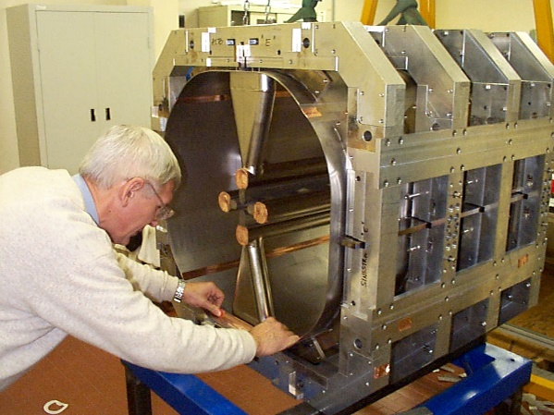
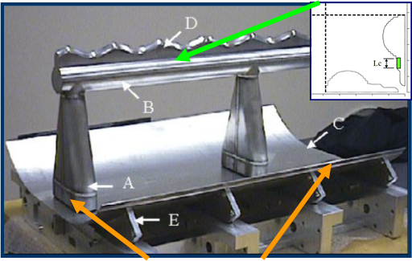
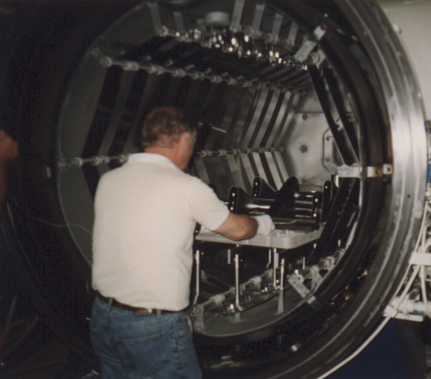
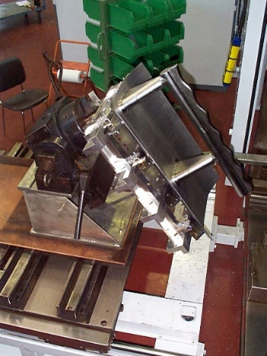
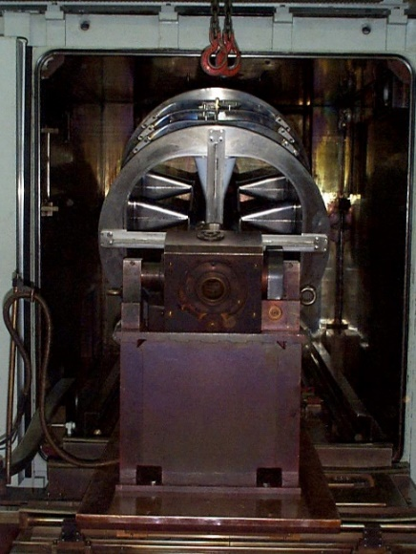
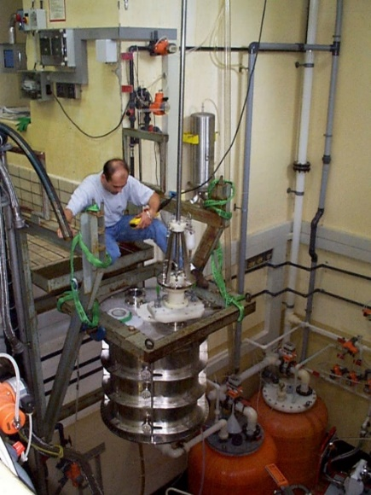
Construction and tuning process
ΔL and ΔC-tuning
Annealing (DESY)
EB Welding (Zanon SpA)
HPWR (INFN)
BCP (CERN)
f_{300K} to f_{4K}: need to predict vacuum, cooldown, BCP Δf ! Full-scale SS technological prototype developed

Slide 15
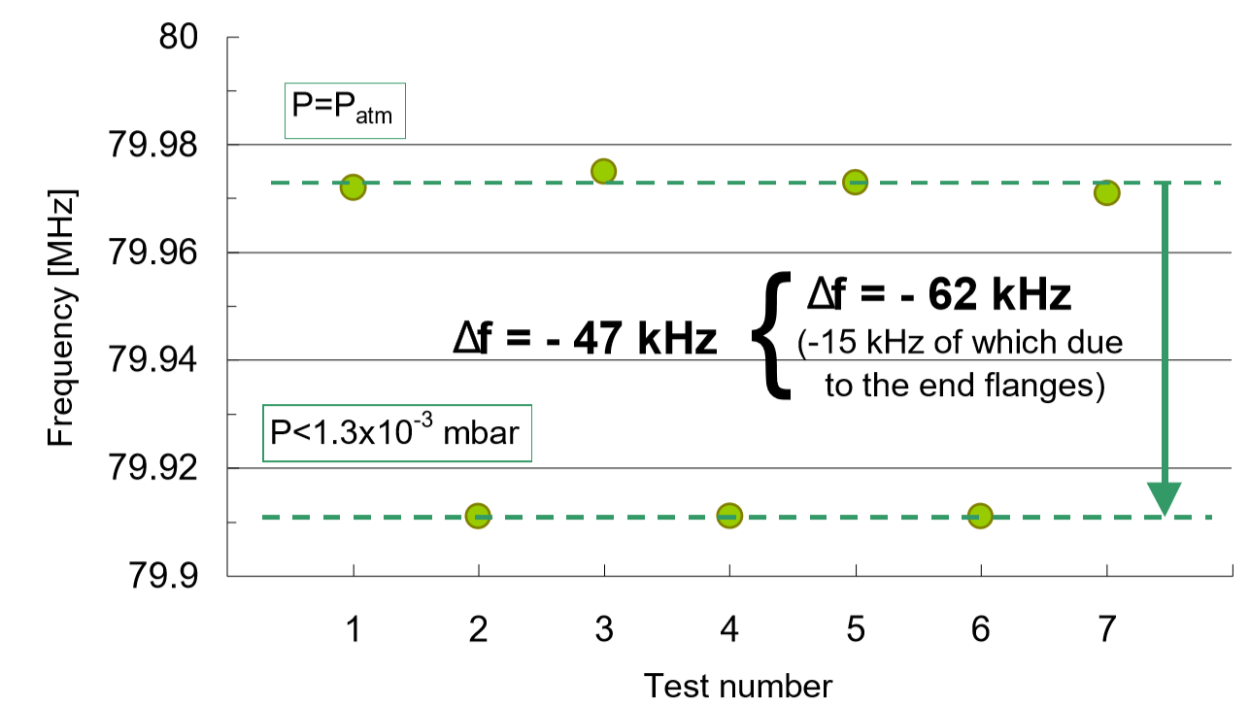
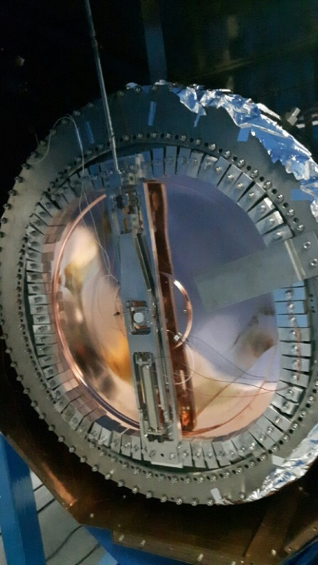
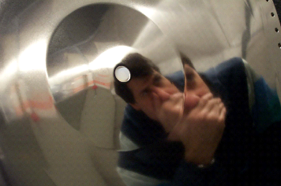
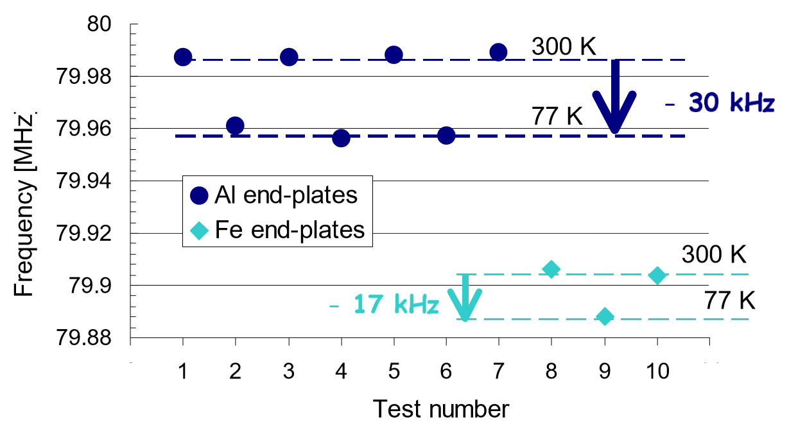
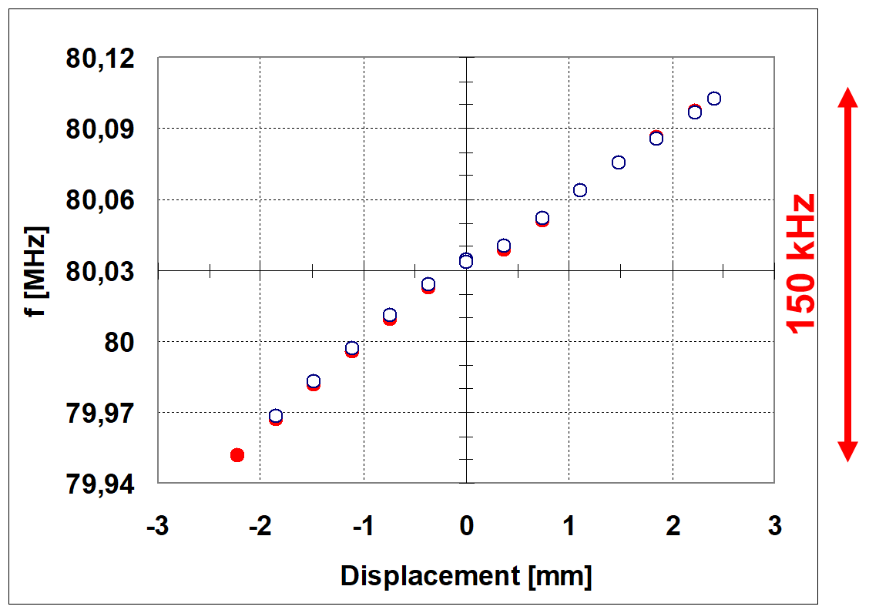
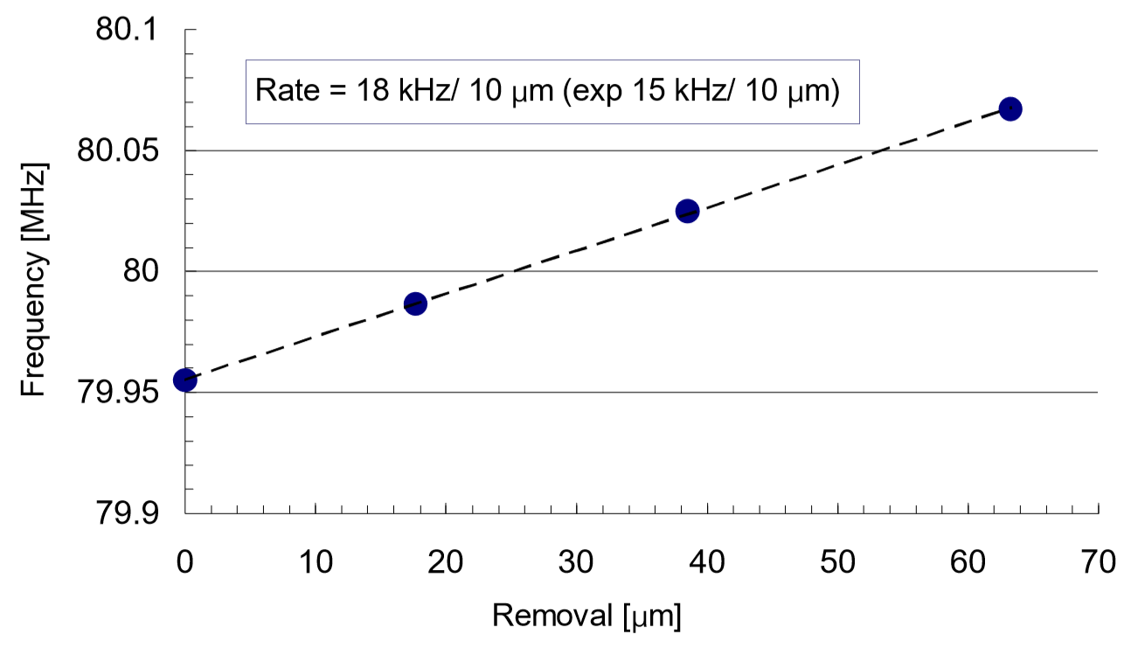
f-sensitivity to vacuum, cooldown, BCP
Vacuum
End plates in Nb/Cu
Cooldown
Slow f-tuning from
in/out deformation
of 2 Nb/Cu sputtered
end plates (RF joint
tighness is crucial
H=3÷6 mT)
BCP
Slow tuner range at 4K,
Δz=± 2,5 mm

Slide 16
Outline
The PIAVE S-RFQs and precursors
Design and construction highlights
Q-curves, alignment, f&A locking
Recent upgrades of PIAVE S-RFQs
S-RFQs vs N-RFQs for high-I linacs

Slide 17
The main issues of S-RFQs, besides getting the right f_{res}…
Q curve specs: E_{s,p}=25,5 MV/m @ P_{cav} ≤ 10 W
Alignment: among the vanes and and between RFQ and beam axis (better than ± 0.2 mm for good beam transmission)
Keep frequency locking to M.O. vs slow volume changes (drifts of the liquid He P) and fast vibrations (and Lorenz detuning)

Slide 18
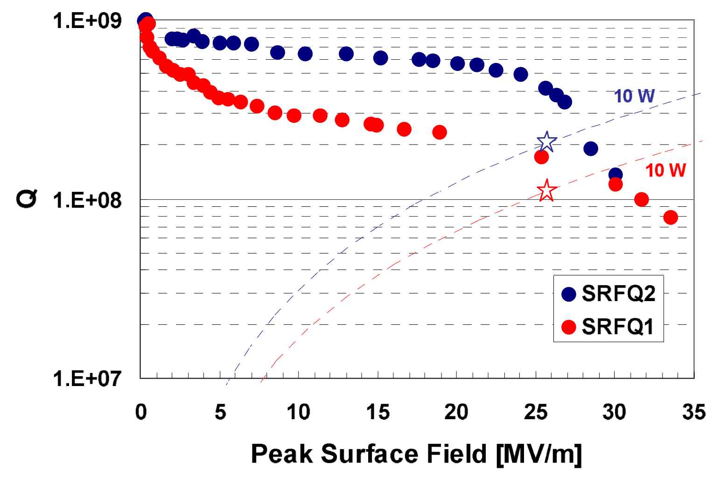

Unloaded Q curve: nominal E_{a} @ P_{cav} ≤ 10 W achieved

Slide 19
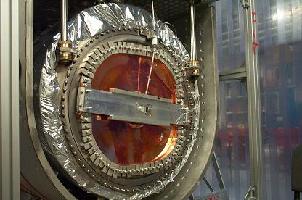
Q₀-limit: rf contact at end-plate joints
B_{s} at the joint between Nb-sputtered end-plate and Nb cavity: 3÷6 mT
Tight contact + differential contraction: Nb/Cu plate and Nb cavity get pasted together (no gasket!)
Any looser or imperfect contact lead to substantial Q₀ drops
E.g.: machining of the end-plate had to compensate for the 100 μm step on the Nb cavity due to BCP
(Q_{BCS} = 1.5x10¹⁰)

Slide 20
Conditioning Field Emission

Slide 21
4K-Conditioning of last multipacting levels

Slide 22
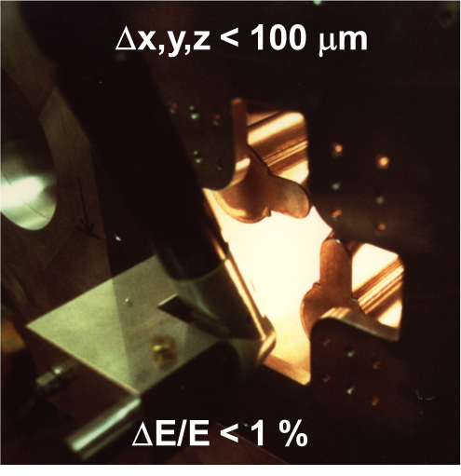
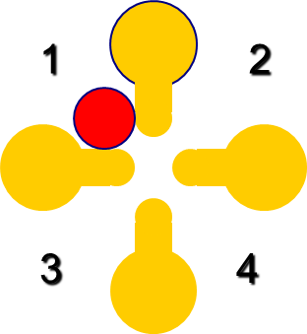
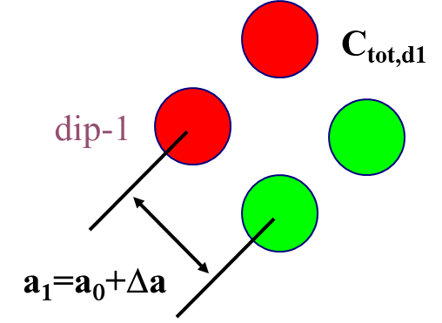
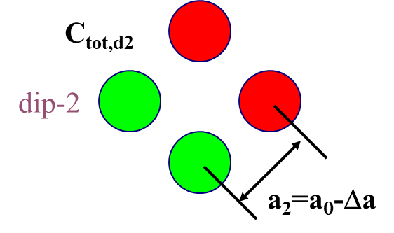
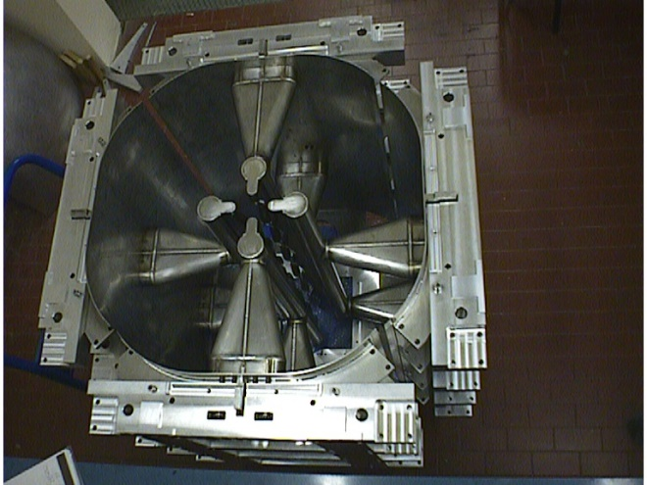
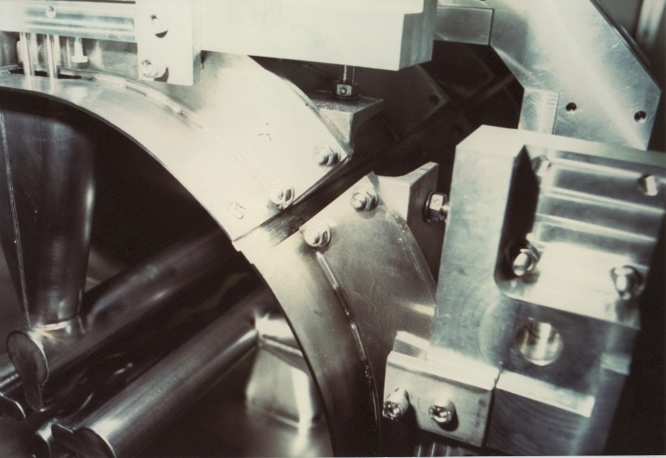
Alignment among the vanes
Bead-pulling - ΔE/E < 0.4 %
f_{d,1} = 100.6933 MHz
f_{d,2} = 100.9633 MHz
Δa ~ 75 μm
After EBW of the 4 quadrants, TIG welding of the Ti ribs is the very last crucial f-tuning / fine alignment step.

Slide 23
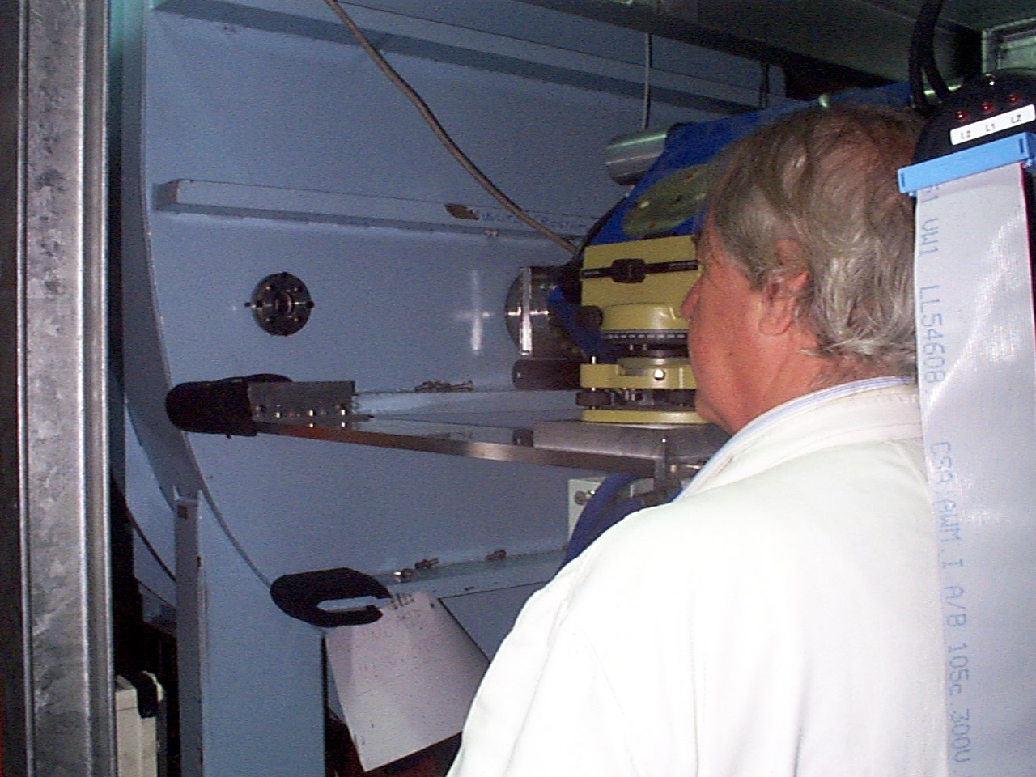
Alignment between RFQ and
beam axis (better than 0,2 mm)
Specs: ± 0.2 mm between SRFQ1
and SRFQ2 and between SRFQs
and injection line for good T
The quad in front of SRFQs
is moved vertically and
horizontally around the
SRFQs’ axis

Slide 24
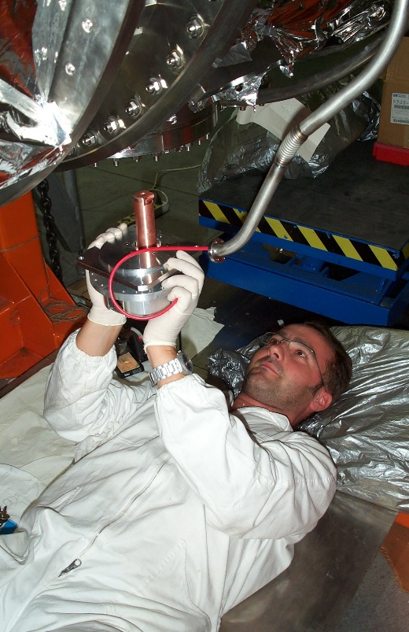
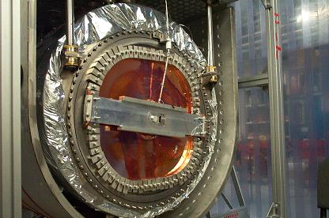
f-locking vs slow (drifts of the liq-He P) and fast (vibrations) events
SLOW P_{He} DRIFTS
MICROPHONICS EXCITATIONS
Mechanical tuner coping with the Δf/Δt,
induced by ΔP_{He}/Δt
Cryo-plant operation minimizes ΔP_{He}/Δt
Rigid mechanical design
Use of VCX fast tuners (ANL)
Gentle cryo-plant operation

Slide 25
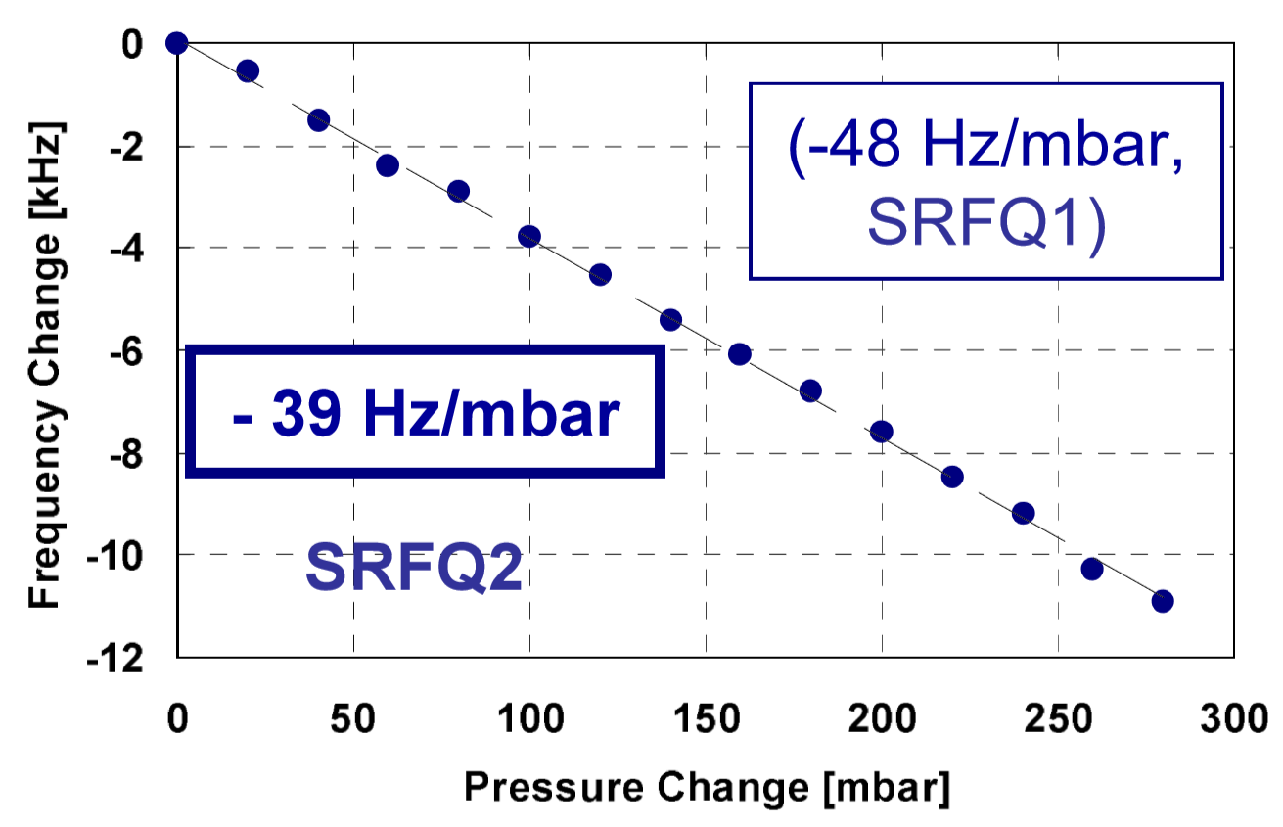
Sensitivity to He bath P variations -48 and -39 Hz/mbar
ΔP/Δt ≤ 5 mbar/min is required

Slide 26
up to30 mb/min

Slide 27
P changes smaller in range and speed
after optimizing the cryo-plant parameters
< 1÷2 mb/min
Cryogenic-Plant Specs: 1.2 ±0.05 bar;
ΔP/Δt < 2 mbar/min → 1.33 Hz/s
Careful setup of the P.I.D. parameters controlling cryostat valves opening (continuous filling mode). Control of additional heating or increased production rate of liquid He vs cavity rf power.
Cryo-Plant Specs met: 1.2 ±0.05 bar; ΔP/Δt < 2 mbar/min → 1.33 Hz/s

Slide 28
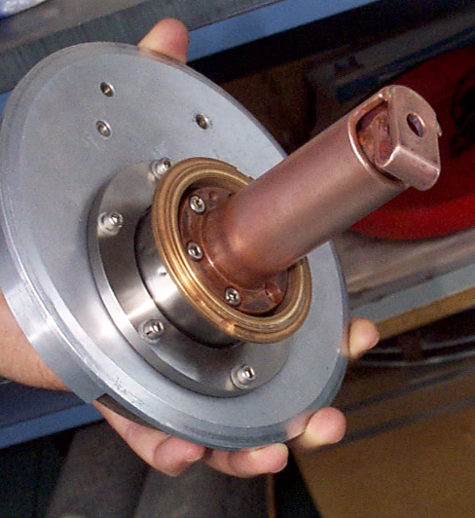
EM frequency Locking versus Mechanical Vibrations
During accelerator operation, synchronicity with beam bunches is required, hence f₀ - jitters need to be controlled (Q₀=8x10⁸ & f₀ = 80 MHz ➔ Δf = (f/Q₀) = 0.1 Hz - sensitive to mechanical vibrations !)
Design: Ti stiffening cage (lowest mechanical mode > 120 Hz)
Operation: use of VCX fast tuners (collaboration with ANL)
Overcoupling with a 1 kW RF amplifier gives Δf = 20 Hz;
VCX fast tuners can control a Δf = 100 Hz range
Frequency range = ±50 Hz
Loop voltage = 300 V
Loop current = 30 A
P_{react} = 9 kVA
P_{diss} ~ 20 W
(1)
(2)

Slide 29
On-line Q-curves (loaded by VCX)

Slide 30
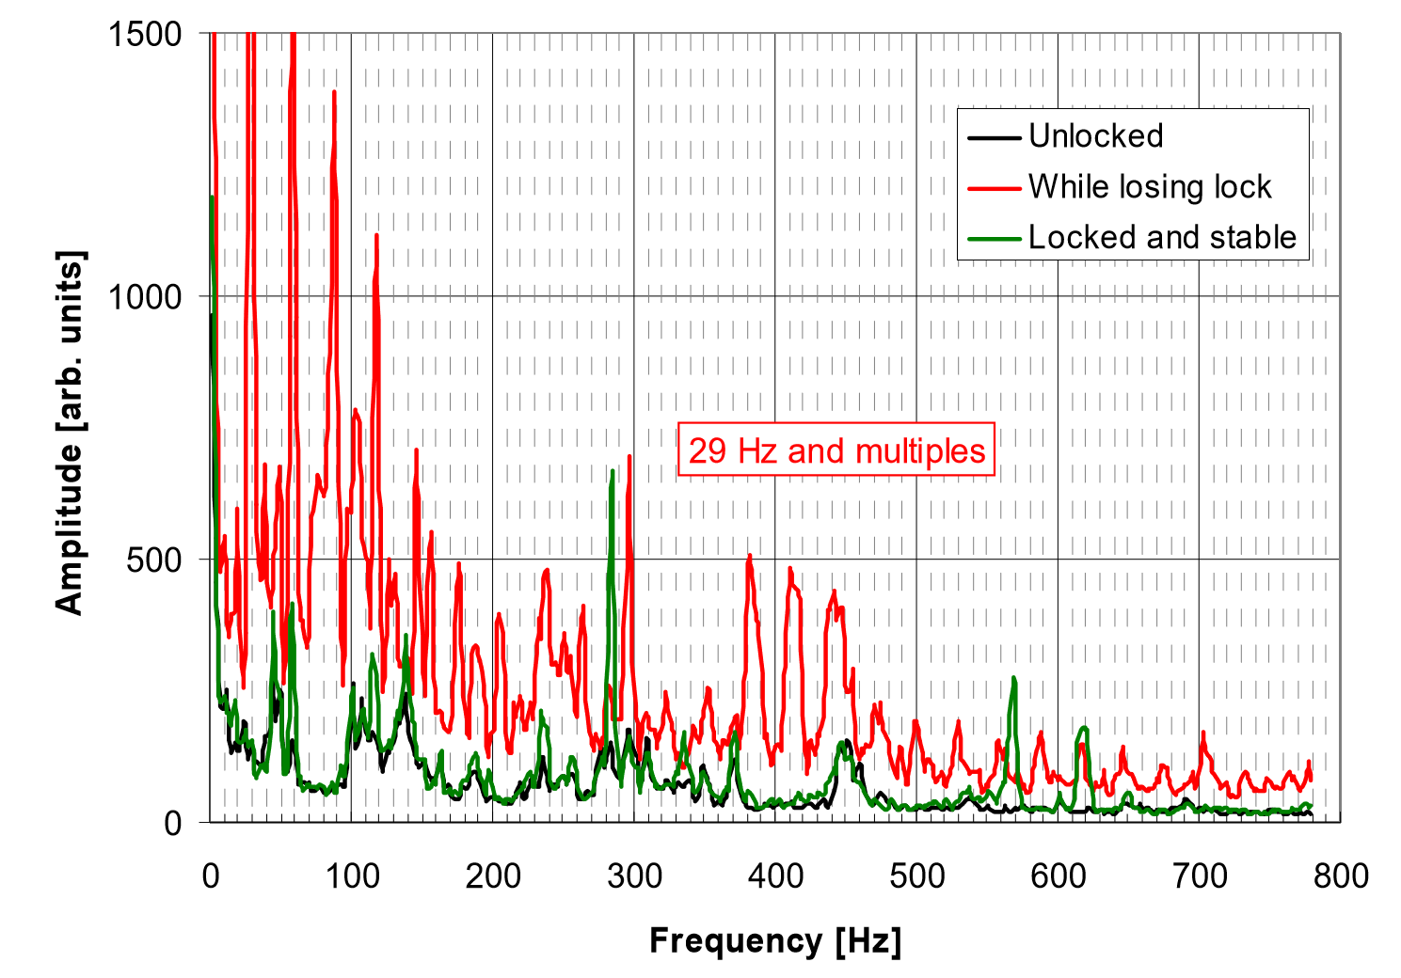
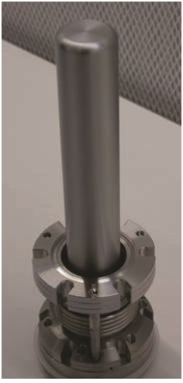
Piezo detection of vibration during unlocking events
Spectra were taken on SRFQ2 (at 4K) support bars: stable locked (green); out-of-lock (black); while losing lock (red). Spectrum of a 29 [Hz] and multiples: plate vibration modes.
Room for improvement for future SRFQs: from tuning on the «drum-like» end-plates to SC plunger tuner (D. Longuevergne et al., Proc of IPAC13, 884-888)

Slide 31
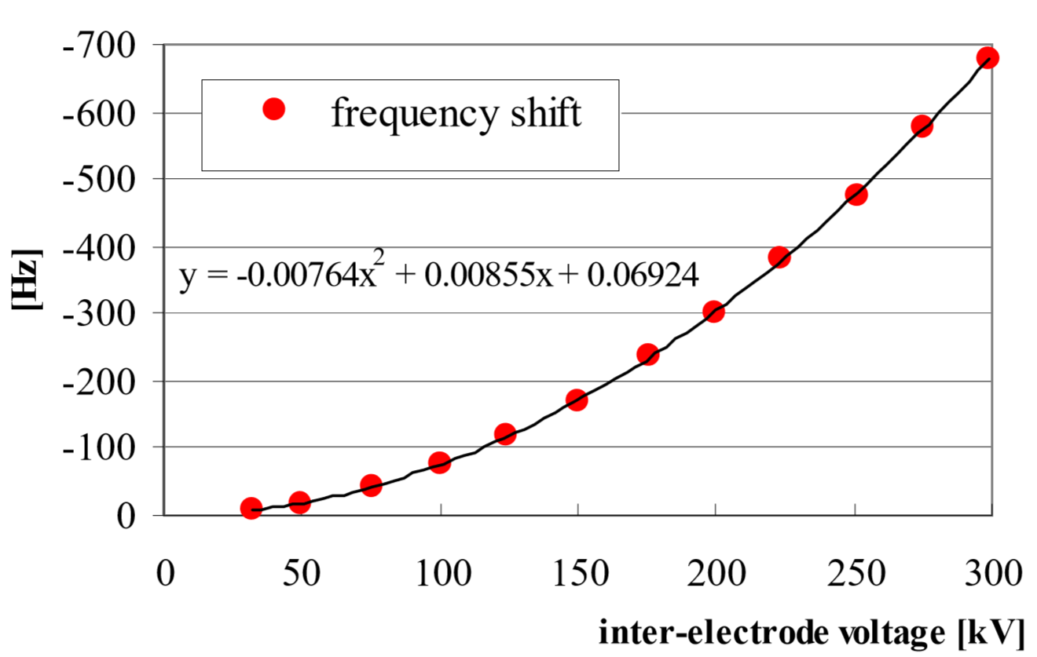
Lorenz force detuning
Δf=-0,9 E_{s,p}²

Slide 32
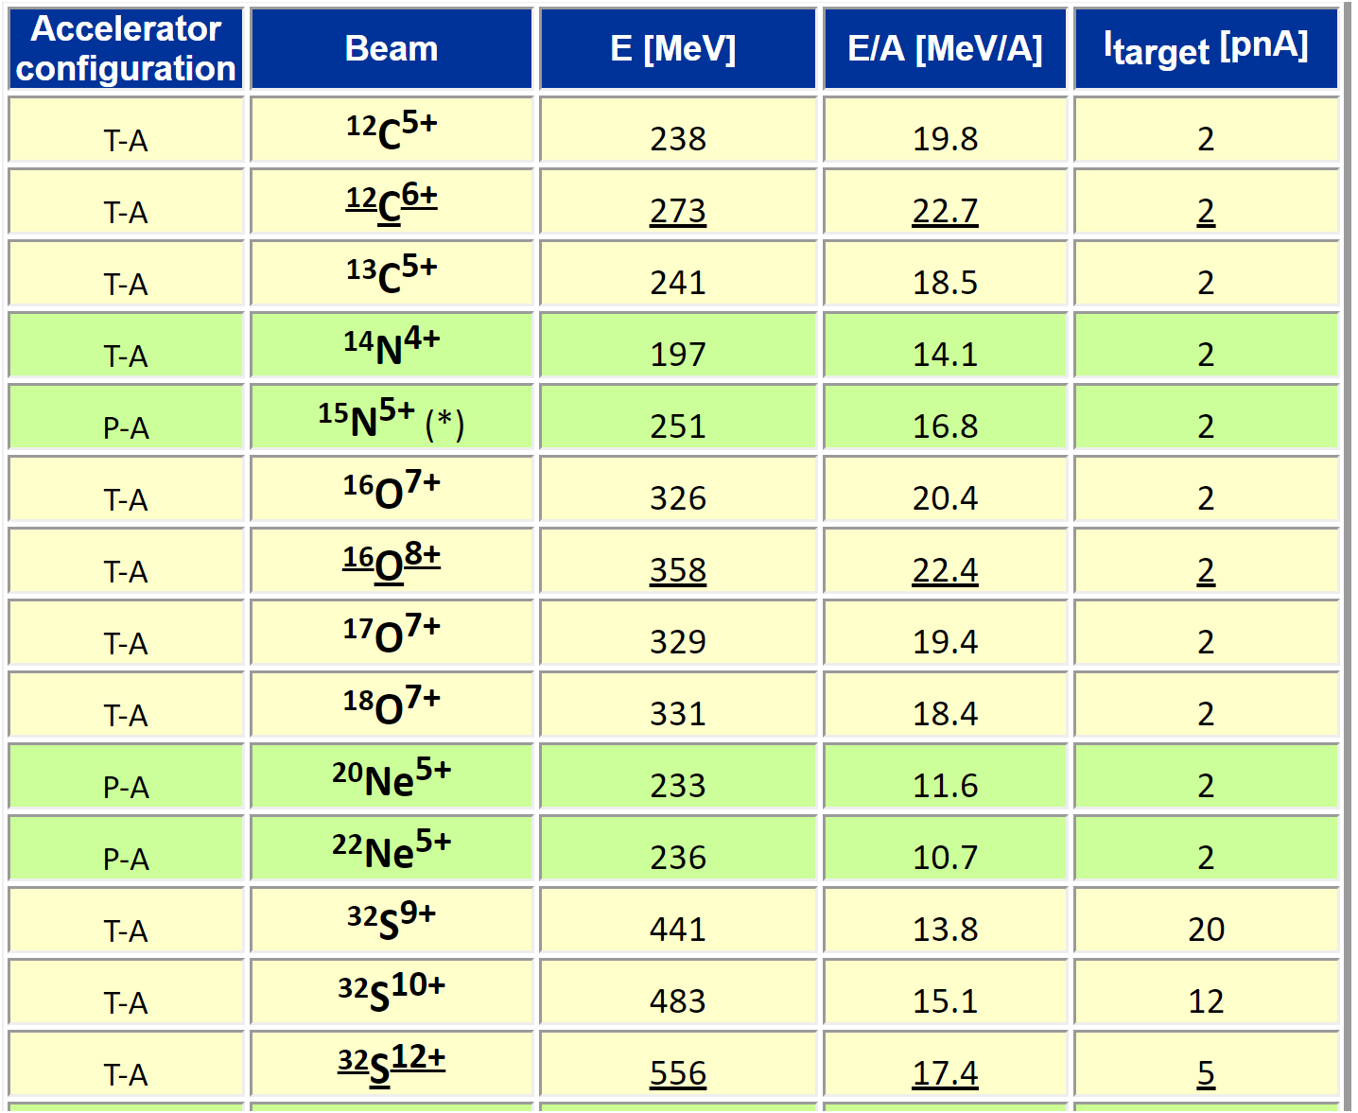
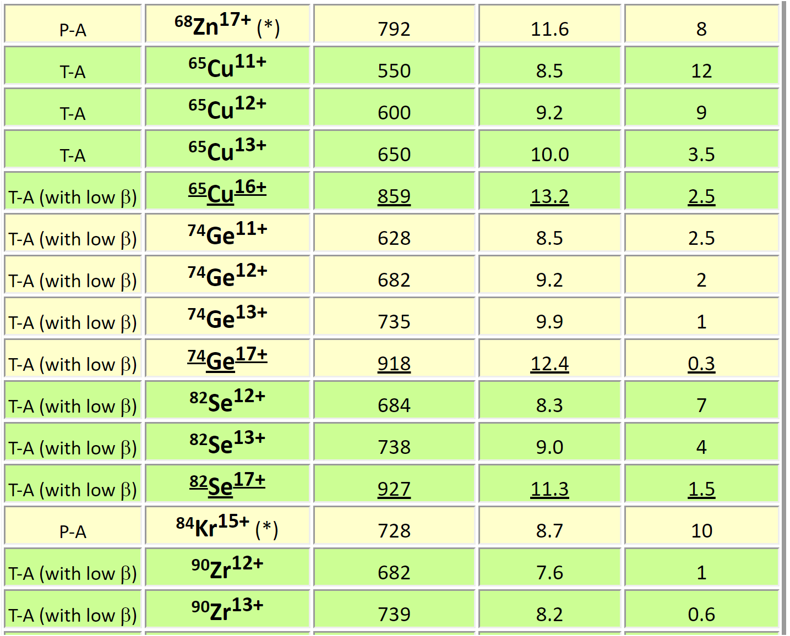
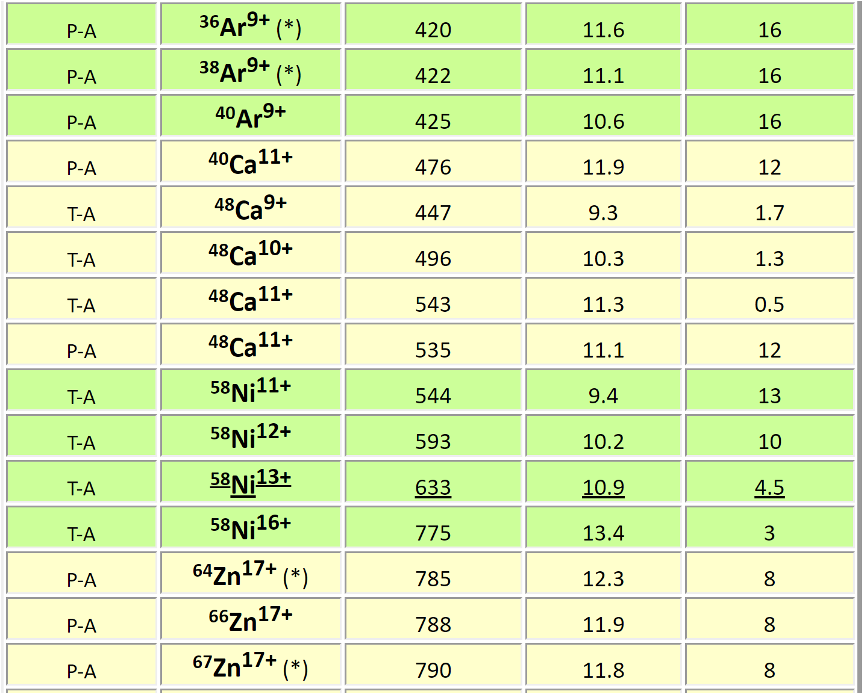

In operation for 10 years: typical beams for users
However: SRFQs’ reliability
and performance had to be improved

Slide 33
Outline
The PIAVE S-RFQs and precursors
Design and construction highlights
Q-curves, alignment, f&A locking
Recent upgrades of PIAVE S-RFQs
S-RFQs vs N-RFQs for high-I linacs

Slide 34
Scope of the 2016-2017 Upgrade
IMPROVED TUNING SYSTEM - Slow tuners with non linear zones; fast tuner with perishable elements and … vanishing know-how
HIGHER FIELDS - SRFQ2 limited to 80% of the field specs (E_{s,p}=21 vs. 25,5 MV/m) → achieve 100% of E_{s,p} to accelerate larger A/q beams
IMPROVED ALIGNMENT - LASER tracking alignment of SRFQs on beam line, to improve beam transmission;
BETTER GAS He DRAINING - Increase the He gas flow, to make RF conditioning more efficient;
REPLACE DAMAGED COMPONENTS - heating resistors, T sensors, He and N level meters (damaged in 10 years)

Slide 35


Combined slow+fast tuning scheme
Parallelogram (4-arm linkage):
- a long bar bound to the cavity frame;
the other long bar to the tuning plate beam port.
a short arm hosts a PT actuator
Room T slow tuning curves: linear and
repeatable, with acceptable backlash.
(shown f-offsets compensate cool down
frequency-shifts)
Notes:
Four-arm linkage (parallelogram) with a long bar bound to the main cavity frame, the other one to the tuning plate beam port. A short arms hosts a PT actuator (length varied depending on f_{res}). The opposite one is moved by an endless screw, actuated by a stepper motor. The tuning plate can be deformed by the stepper motor for coarse/slow movements and the PT-actuator for fine/fast ones.

Slide 36



Piezotuning…
PT static tests done at 300 and 4K
VCX FT kept operational, after
Replacing broken capacitors, diodes, fuses, …
Dynamic f_{res} response vs actuator voltage needed to design the PT control loop (soon…)
SRFQ2 VCX Tuning window between on and off statuses of the PDS.

Slide 37

Smoother VCX loaded Q-curves
Light BCP done at CERN (13 and 16 um). Δf=+45 kHz (SRFQ1), +24 kHz (SRFQ2), well within the 150 kHz slow tuning range (else Q₀~1x10⁹). Smoother curves, better He gas draining!
Stably locked at 120% of nominal E_{s,p}; beam operation at 0,95 * nominal E_{s,p} , very stably on a 3-days long shift. Then regular and reliable operation started again.

Slide 38
Outline
The PIAVE S-RFQs and precursors
Design and construction highlights
Q-curves, alignment, f&A locking
Recent upgrades of PIAVE S-RFQs
S-RFQs vs N-RFQs for high-I linacs

Slide 39
Are SRFQs applicable to high-I linacs?
Pisent, G. Bisoffi et al.,
Proc. Linac06,
227-231
An example: a SRFQ for a d-SC linac
Beam losses
For a d-beam, they must be kept well below 1% for RP reasons.
In a SRFQ they are even more severely limited by the heat deposition allowed in the cryostat.
Fortunately the large transverse acceptance of SRFQs allows to design a beam dynamics with very small losses.
Notes:
As a second possible application we considered an SRFQ as first element of a 3-5 mA deuteron cw superconducting linac. Accelerators of this kind (final energy ~40MeV), for the production of neutrons and RIBs, are under construction in at least two laboratories. They require a cw RFQ that, being nowadays normal conducting, has a power consumption comparable with the rest of the linac for a rather modest beam power. An SRFQ in this case, operating in a system where a cryogenic system is anyway present, beside reducing the power consumption, allows to decrease substantially the beam losses and to increase the linac input energy (allowing a more robust beam dynamics).
Indeed for a deuteron RFQ beam losses should be kept well below 1% for radiation protection reasons. At the same time in a SRFQ the beam losses are even more severely limited by the heat deposition allowed in the cryostat (~20W). But fortunately the large transverse acceptance of SRFQs allows to design a beam dynamics with very small losses. In Tab. 5 a possible set of parameters is shown. The beam losses are <10-3 ; in Fig. 9 the PARMTEQM simulation is shown, where the very large space between beam envelope and structure aperture can be appreciated.

Slide 40

Beam dynamics
x (cm)
y (cm)
φ-φ_{s} (deg)
w-w_{s} (deg)
Cell number

Slide 41

RF design of a 4 m long S-RFQ in 3 modules
HFSS Results:
  Quadrupole frequency f_{q} = 88.061 MHz
  Next quadrupole f = 95.6 MHz
  Dipole frequency f_{d} = 94.191 MHz
  Surface electric field E_{s} = 18.1 MV/m
  Maximum B field B_{max} = 213 Gauss
  Voltage flatness = ± 0.8 %
  B field at joint location: <3 Gauss
  for a +10 mm strip

Slide 42

Lower P: 5 mA and 2,6 MeV → P_{b,m}=13 kW P_{RF,N-RFQ}~313 kW at mains;
P_{RF,S-RFQ}~13,5 kW at mains.
T= 99,9% (strong focusing,
large acceptance,
far vanes).
H_{s,p} is modest.
Conversely, N-RFQs
are limited in H_{s,p} (R_{sh} is limited).
Higher modes are far away.
In N-RFQs, large tuning windows, needed to move the dipole mode away, create several areas of large consumption.
Pros
of S-RFQs
Notes:
These cw RFQs, being nowadays normal conducting, have a power consumption comparable with the rest of the linac for a rather modest beam power.
Particles close to the separatrix may be lost but tend to go straight due to the transeverse focusing channel, so they are lost after exiting the SRFQ!

Slide 43
In RFQs, for p and d, to achieve the nominal E_{s,p} field is mandatory.
P_{RF} is large: a quench may couple more
power into the cavity (sharp
transition to NC state).
Provide early quench
detection.
Cares to
be taken
Beam power loss.
3. Liquid He boiloff →
global heating and transition to NC state.
With 5 mA-2,6 MeV ( ≥ * 2 margin) P_{b,m}=13 kW
and T_{b} = 99,8% (≥ * 2 margin vs. simulations),
P_{b,lost}~26 W (=cryogenic load) – Up to 40 W OK in PIAVE ! likely more.
Option: use pressurized He-II (transfer P_{diss} beyond the lambda plate)
Notes:
These cw RFQs, being nowadays normal conducting, have a power consumption comparable with the rest of the linac for a rather modest beam power.
Particles close to the separatrix may be lost but tend to go straight due to the transeverse focusing channel, so they are lost after exiting the SRFQ!
Quando viene raffreddato sotto i 2,189 K a pressione normale, il cosiddetto punto lambda, diventa un superfluido conosciuto come elio liquido II
Pengo: bisognerebbe usare He-II a 1 bar, non come quello di LHC che è a 50 mbar ed è un misto delle due fasi liquida e gassosa, idealmente a 1,9K dove ha il massimo di conducibilità. Si ottiene mettendo elio nella doppia parete, in contatto con lambda plate e He-I bifasico superiore. Basta 1 litro (=?). La conducibilità termica è 10^6 volte superiore e il problema della dissipazione è trasferito all’He bifasico, con lo stesso consumo. Così sparisce il problema del gas, rimane quello della potenza criogenica associata a quanta potenza di fascio si perde.
Meglio con compressori freddi (Linde ne fa a 4K) che con pompe, più affidabile anche se più costoso. Il tutto può costare 0,5 M€, da aggiungere al coasto dell’RFQ SC.

Slide 44
Further comments
Construction challenges, different (EBW vs. brazing; cryogenic vs. high P_{RF} issues…), not in severity
Construction tolerances (0,05 mm, for f_{res} tuning) and alignment tolerances (0,2 mm) are achievable in both.
Develop a well cooled coupler. Locking issues due to low intrinsic bandwidth are no longer a problem; a 13 kW beam (Δf=600 Hz) solves the problem with marginal increase of P_{loss} at 4K. A good coupler is required.
3. Cost: N-RFQ (SPES case, 80 MHz)=2,5 M€; for PIAVE S-RFQ (in 2018-€)=2 M€, no RM and bunching sections.
4. Other technologies could be considered: Nb/Cu (complex geometry, but much better mechanical stability); Pb/Cu (H_{p} ok, high enough E_{acc} possible?)
Notes:
alignment tolerances=0,2 mm, achievable in both, determined predominantly by f_{res} tuning; moreover 0,05 mm precision on 0,8 or 1,4 m weighs more than 0,1 mm on 4 m, so it is more relaxed than PIAVE SRFQs).
Cost: NC: 1M€ vanes, 0,5M€ tanks, 0,5M€ ancillaries, 0,5M€ RF = 2,5 M€ SC=?
f=80 MHz; at 2f, 4f worse field flatness, quadratically worse transverse focusing, Ea does not scale with f as it does with NC RFQ – Kilpatrick)
Errore di allineamento dovrebbe essere meno severo su una cavità più corta.

Slide 45
Outlook
PIAVE S-RFQs at INFN-Legnaro have been working since 2006 for user operation
Further BCP, a better tuning system, LT alignment, improved gas He draining have improved their performance and reliability
A slightly modified design seems suitable for high-I beam acceleration, whether in full-Nb or Cu-based

Slide 46


A dedication

