Slide 1



ESS Spoke cryomodule testing: cryogenic experience
…on the past year
Patxi DUTHIL
Guillaume OLRY

Slide 2
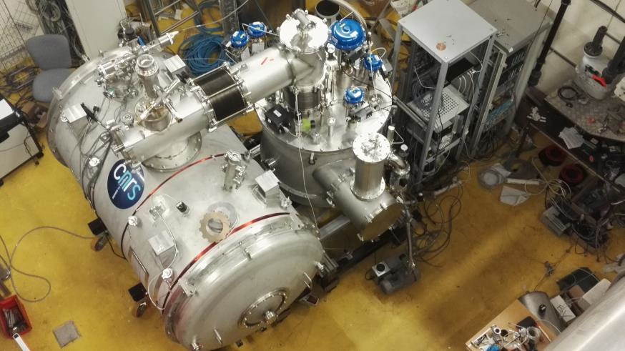
Outline
  From June 2017 to now: one year of ups and downs
  Status of today
  Future work
  Few comments
JUMPER
VALVE BOX
CRYOMODULE

Slide 3
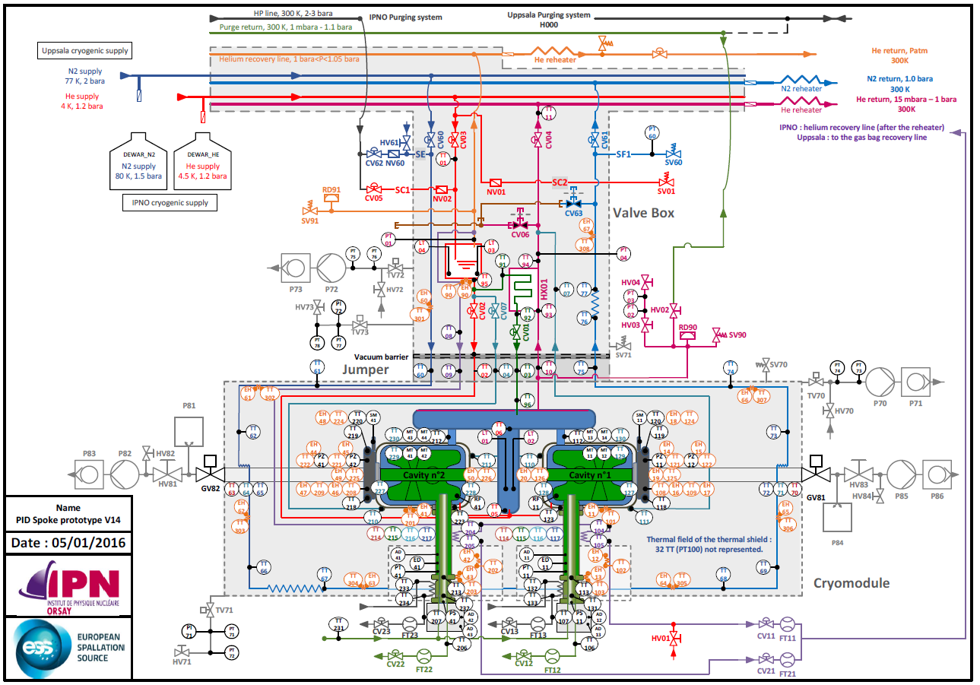
Setting of the experiment [1]
Main differences wrt the machine configuration:
Thermal shield cooled with saturated LN₂ (no pressurized He)
Supply with saturated LHe (not pressurized)
Heat intercept along the RF double wall coupler is done by use of cold saturated vapours instead of Supercritical He
A lot of instrumentation (T° sensors: 60 CX + 110 PT100; 69 heaters, etc)

Slide 4
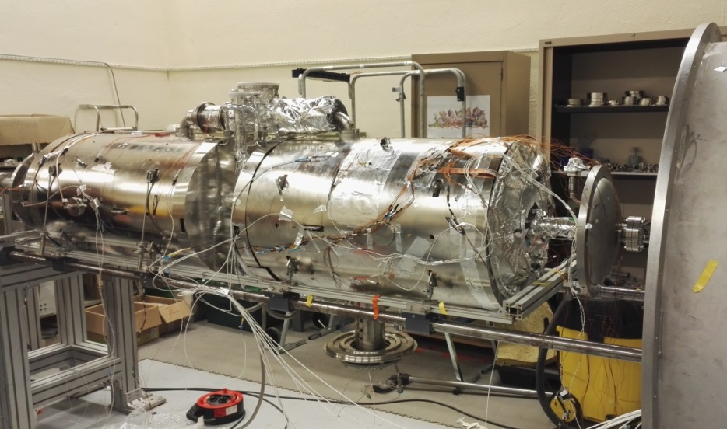
Setting of the experiment [2]
Main differences wrt the series cryomodule configuration:
  Cav1: Giulietta + tuner + magnetic shield + 2 antennas
  Test the tuner.
  Get the Qo value of the cavity to evaluate the efficiency of the magnetic shield
  Cav2: Dummy cav + magnetic shield + double-wall tube
  Direct measurement of the magnetic field inside the cavity
  Test the cooling of the DW tube
GIULIETTA
DUMMY CAV

Slide 5
June 2017
    Valve box
    . Ready for cryo tests after several repair operations
    Cryomodule
    . Assembly of the cryomodule was under progress (all components repaired)
    . Repairing action on the VLP branch line of the cryogenic jumper of the cryomodule repaired by the manufacturer and delivered on June 14th; integration done by IPNO.
    Helium production facility
    . Not (fully) available due to supervision defects
    ⇒ valve box cryo tests was postponed to July

Slide 6
July 2017
    Valve box
    . Cryogenic tests performed = cool-down and 4 K mode:
    C&C tested (PLC controls such as regulation loops, etc.) + cryofluids consumption
    ⇒ Good results @4K i.e. the valve box was operated and works as expected;
    Cryomodule
    . Cryomodule assembled and leak tested;
    . Cryomodule installed in the Supratech experimental platform;
    . Repaired VLP line of the cryogenic jumper was too long prevented the cryomodule from its connection to the valve box
    Helium production facility
    . Supervision temporally repaired (new server and OS environment needed)

Slide 7
August 2017
    Valve box
    . Standby (waiting for the cryomodule)
    Cryomodule
    . VLP line of the cryogenic jumper was shortened (internal action);
    . Cryomodule was connected to the valve box → A lot of He leak tests of this connection (multichannel cryogenic line) were carried out
    Helium production facility
    . New server and OS environment installed
    . Re-qualification process of the He high pressure storage started (Pressure Equipment Directive): storage sectors have been successively removed from service for qualification tests.
    ⇒ Temporary shutdowns will affect the experiment

Slide 8
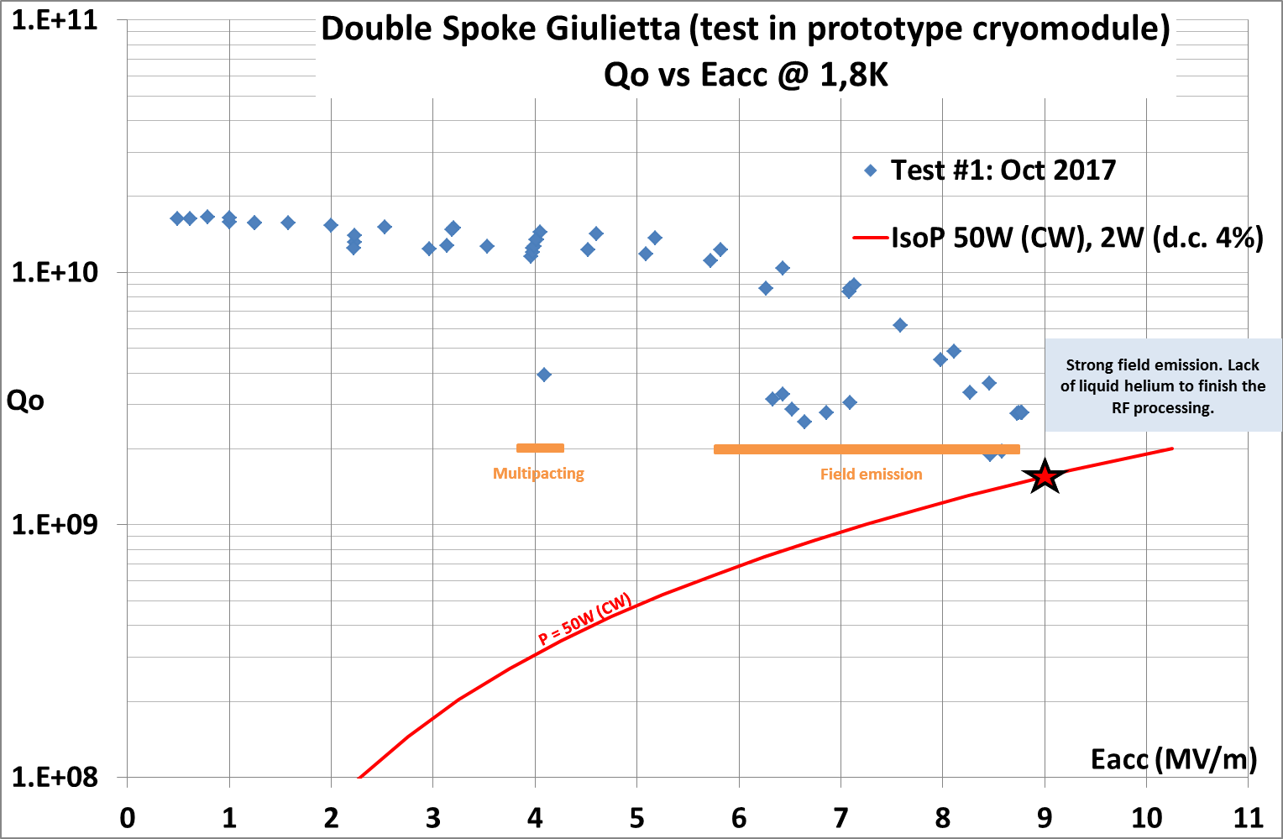
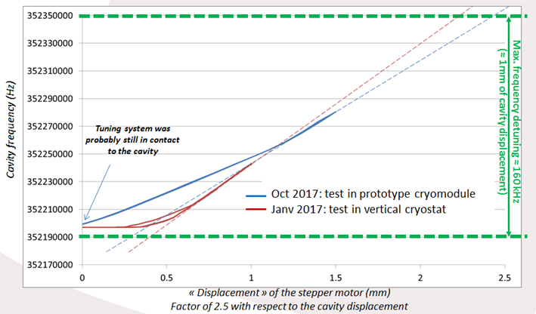
September 2017
    Finally, first cool-down of the valve box and the cryomodule happened!
    Operation at 4 K
    ⇒ C&C tests: diagnostic debugging (T° sensors), tuning of the regulation parameters
    Operation at 2 K (18-22/09)
    cavities operated at 2 K during some hours
    continuous and regulated transfer of superfluid from the valve box into the cryomodule operated during 1.5 h
    cooling of the double wall of the coupler with saturated helium operated during 1 day (but no usable data)
    RF test of Giulietta cavity ⇒ (@low field) Q₀ of 1.8 10¹⁰ , Eacc max =8.8 MV/m (limited by field emission)
    Tuner tested without any hysteresis
    erroneous indication of some temperature sensors within the valve box (due to bad thermal contacts)

Slide 9
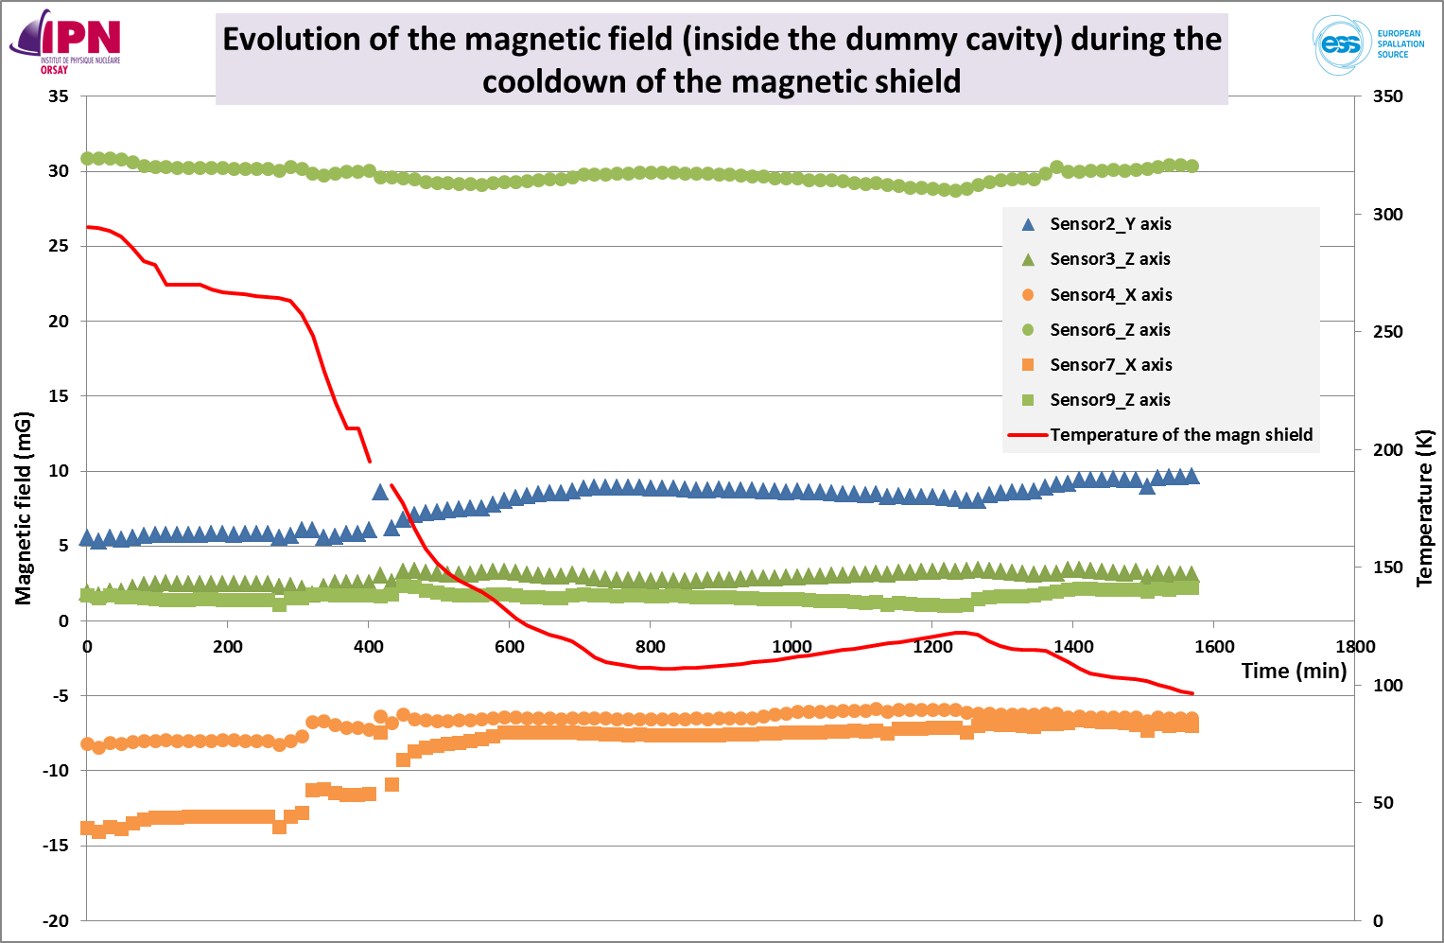
October to mid-November 2017
    Helium infrastructures
    (25/09-16/10) 3 weeks of shutdown: re-qualification of the He high pressure storage and helium gas buffer
    In the meanwhile…
    Valve box
    was opened & accessible temperature sensors were disassembled
    thermal supports of the T° sensors were cleaned and properly greased
    T° sensors were mounted properly and VB closed again, ready for new tests
    → Then.. second cool-down
    (16/10-10/11) Operation at 2 K
    good regulation of the superfluid level in the cryomodule was achieved:
    He level of 62.5 cm: cavities completely filled up;
    no significant change of the magnetic shield efficiency during the cooling down to 100K);
    Again…temperatures measured at some locations within the valve box and cryomodule are not as expected = discrepancy with our estimations was observed;

Slide 10
Mid-November 2017 to Feb 2018
  WINTER BREAK…LONG PERIOD OF DISASSEMBLY, REPAIR, INSPECTION, CONTROL, UPGRADE, MAINTENANCE, REASSEMBLY…
    Endoscopy in the cryogenic jumpers of the cryomodule and the valve box → contacts between the cryogenic branch lines and parts of the thermal shield.
    Cryomodule and jumpers disassembly
    Reroutine of some cryolines
    MLI corrections
    Improvements of the thermal contacts between the magnetic shield and the cooling circuit
    Control of the 156 internal sensors (including heaters and RF)
    Opening if the valve box
    Detection (endoscopy) and correction of thermal contacts at the vacuum barrier
    Repair of a leak in the thermal shield circuit
    Reassembly of the cryomodule, the jumper and the valve box.
    …

Slide 11
Feb to end of March 2018
    06/02 → Cryomodule was connected to the valve box in the experimental areas and ready for cryo (under vacuum)
    But …
    Stand-by for 4 weeks because of co-workers absences and resignation
      the cooldown was postponed to the end of March
      05/03: restart of the activities to finish the modifications of the supervision and PLC program

Slide 12
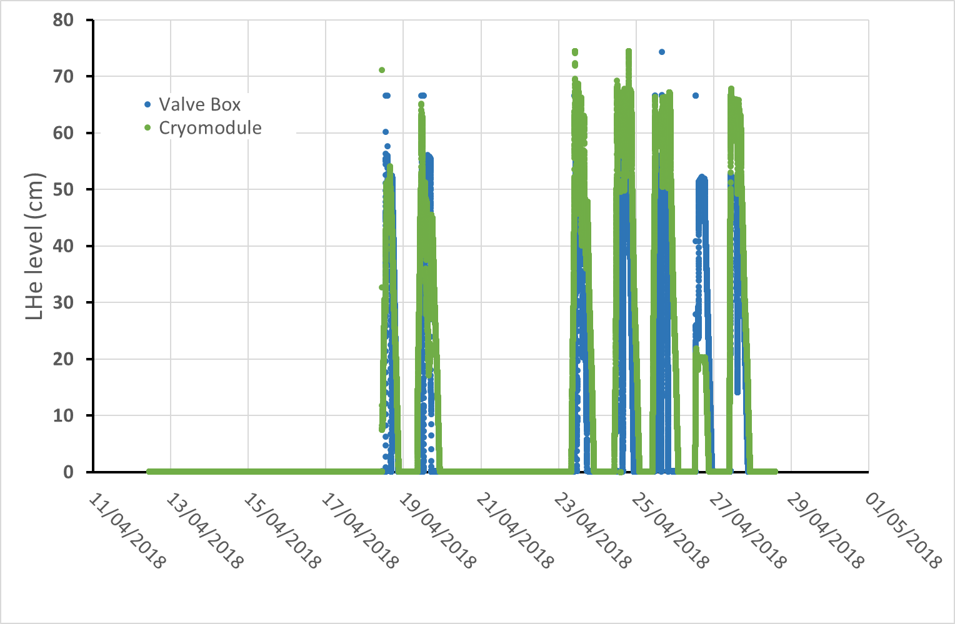
April 2018 [1]
    → Third cool-down
Timeline:
4 K op
2 K op
2 K op
4 K op
2 K op
Coupler cooling circuit and RF cavity tests
4 K op
4 K op
Std-by mode
(20-60 K)
Slow cool-down
+
Std-by mode
(20-66 K)
Weekend
Weekend
Weekend
Compressed air failure

Slide 13
April 2018 [2]
Some constraints
Limited liquefier capability
LHe production~70 L/h
Transfer efficiency to fill in the dewars from the liquefier: 60% ⇒ 42 L/h
Short operating time @ 2K of about 1 hour max per run
  Space configuration: from the dewar into the cryomodule ~ 10 m long flexible line → ~7 W losses (measured)
  Use of “small” 500L dewars: 2 (to 3) per day + small volume of LHe in the cryomodule: ~150 L
  No long cycles with LHe regulations
  Limited time for RF test of the cavity

Slide 14
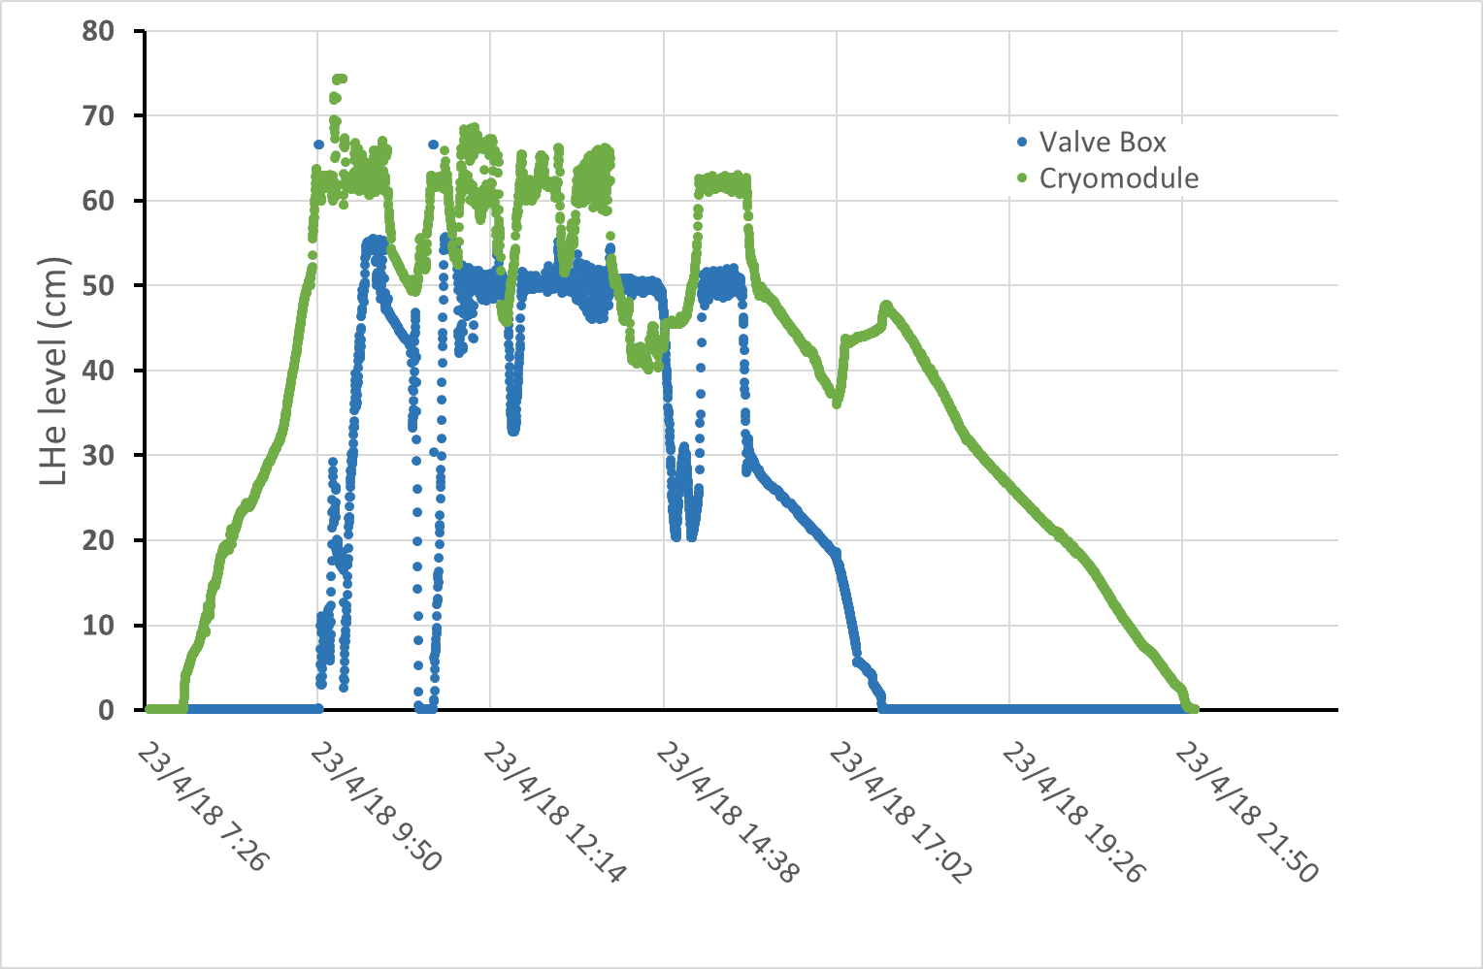
April 2018 [3]
Typical run over a day
4 K regul
Filling up the CM
4 K to 2 K
2 K regul
Nominal CM LHe level
Small cool down
Dewar 2 empty
→replacement
Dewar 1 empty
→replacement
Filling up the VB
7h
1h

Slide 15
April 2018 [4]
1st cryogenic results (data are being processed)
  Some indicated temperatures not physical
    Investigation is under progress: control of the sensors + thermal test of the sensor anchoring
  Cryogenics at 2 K
    +35 % of He consumption at 2 K (TBC)
    Efficiency of the JT is thought to be not enough efficient
    → Investigation is under progress (loads on the CM jumper, thermal contacts)
  Coupler double wall cooling
    Reduction of the heat loads by conduction of about 15 W as calculated
    Heating power at the coupler warm flange: ~70 W as calculated

Slide 16
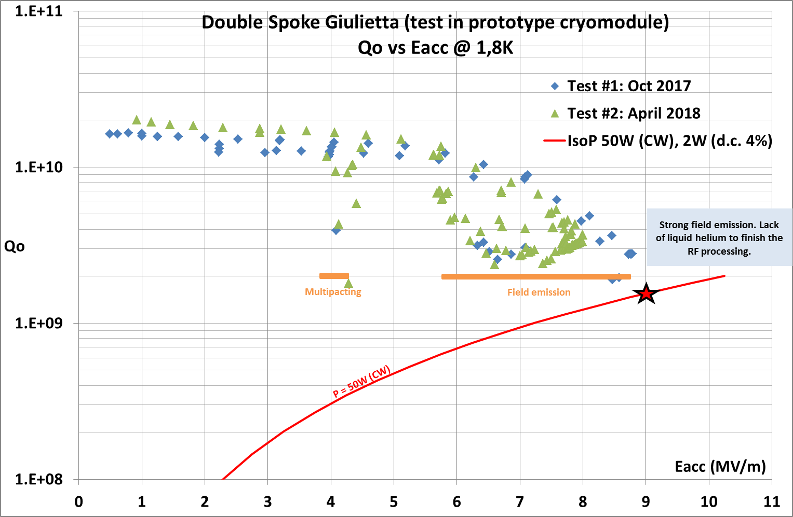
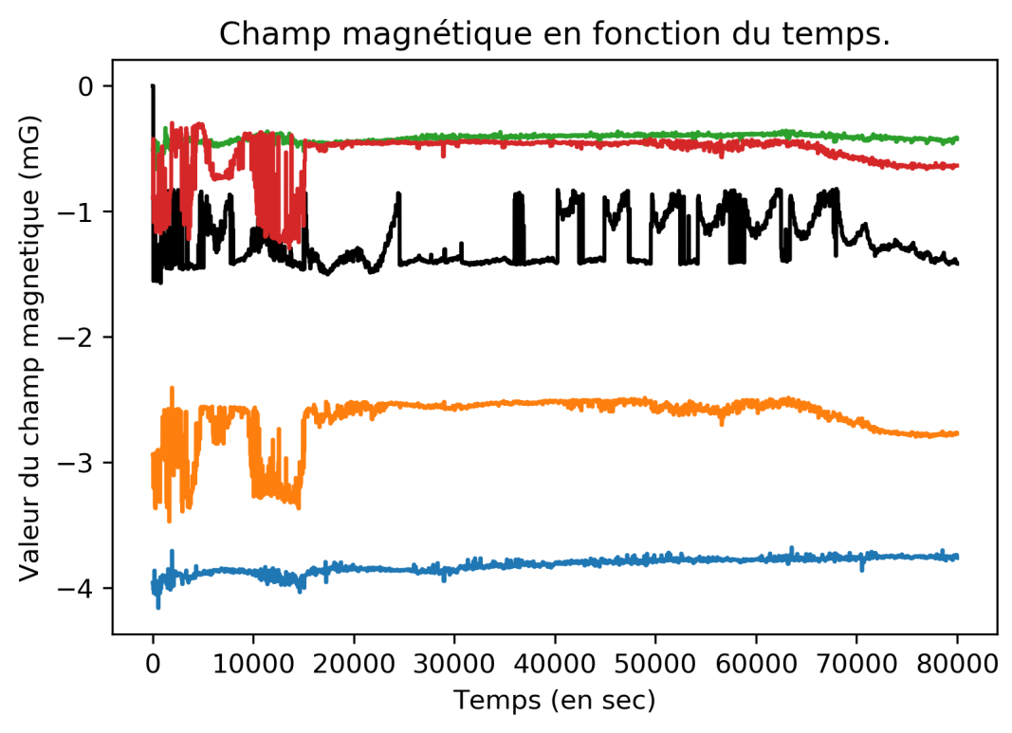

April 2018 [5]
    RF test of Giulietta cavity → (@low field) Q₀ > 2 10¹⁰ , Eacc max =8 MV/m (limited by field emission, no quench)
    Magnetic shield temperature cooled down to 30K: the residual magnetic field is unchanged → no need of active cooling
0
0
0
0

Slide 17
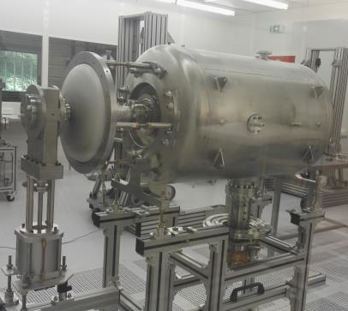
Status of today & future work
    Valve box
    Has been open again.
    Accessible Temp sensors will be controlled again, especially those of the heat exchanger.
    The cryo line, formerly dedicated to the magnetic shield, will be removed
    VB is planned be tested again in July before shipment to UU in August
    Cryomodule
    The cavity string assembly has started in clean room and should be finished end of June
      Problem of seizure (tooling)
      Bad orientation of the couplers / DW tubes
      Pollution (Particles size > 10µm) of one gate valve
    Final assembly outside the clean room is planned in July
    Shipment to UU is also scheduled in August

Slide 18
Few comments…
    Manufacturing issues had (and still have) big impacts on the initial test plan
    → internal resources reallocation to fix most of the problems
    → non visible defects which make the measurements barely understandable
    Staff resignation and turnover
    The complexity of the experiment and overall time needed for the cryogenic testing were obviously underestimated
    Same people taking care of the prototypes experiments and the time consuming “activities” of the series (call for tender, production follow-up, reporting, meetings…)

Slide 19
Thank you for your attention

