Slide 1




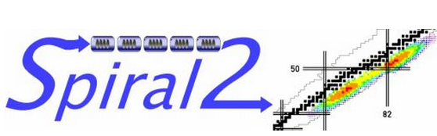


FLUX TRAPPING STUDIES ON LOW BETA CAVITIES
SLHIPP-8, Uppsala, 12-13 June 2018
D. Longuevergne, P. Duchesne
IPN Orsay

Slide 2
OUTLINE
FACILITIES AND EQUIPMENT @ IPNO
  The cryostat and magnetic configurations
  The 3 types of cavities
MAGNETIC SENSITIVITY MEASUREMENTS
  On SPIRAL2 Quarter-Wave Resonator
  On MYRRHA Spoke Resonnator
  On ESS Spoke Resonnator
ANALYSIS
  Cooling conditions
  Geometrical effects
  Field dependence
  Temperature dependence

Slide 3
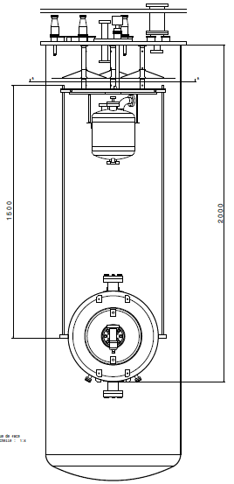
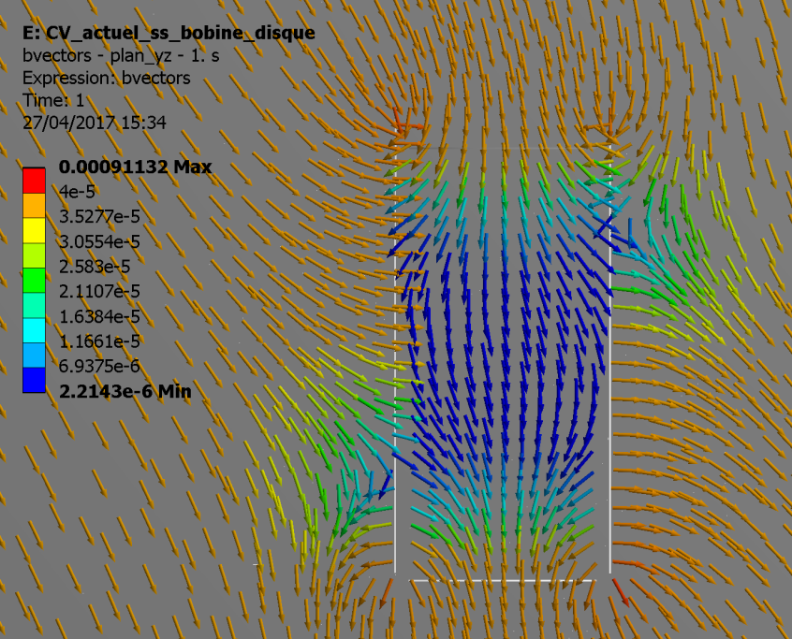
The cryostat and magnetic configurations
The vertical cryostat
Magnetic shielding
  Passive : 0.6 mm mu-metal all around the cryostat : B < 25 mG
  Active : 3 coils inside mu-metal sheets
Residual field simulation with no compensation coils
P. Duchesne

Slide 4
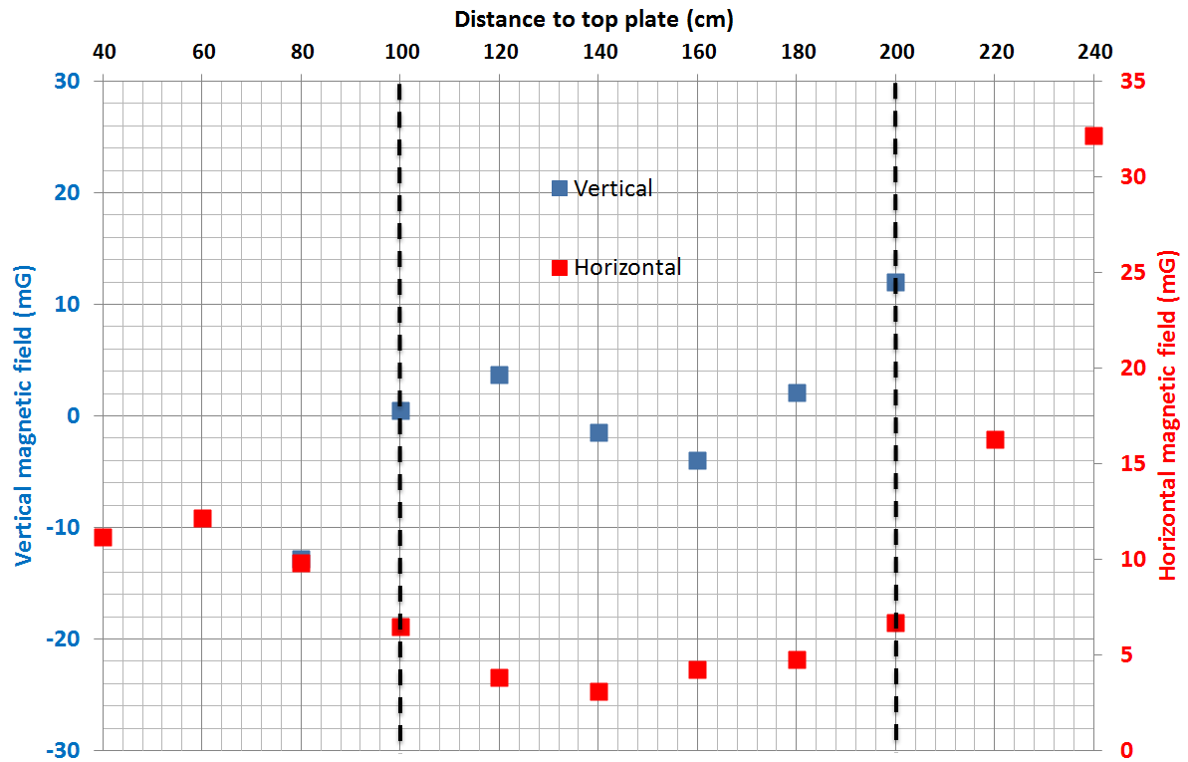
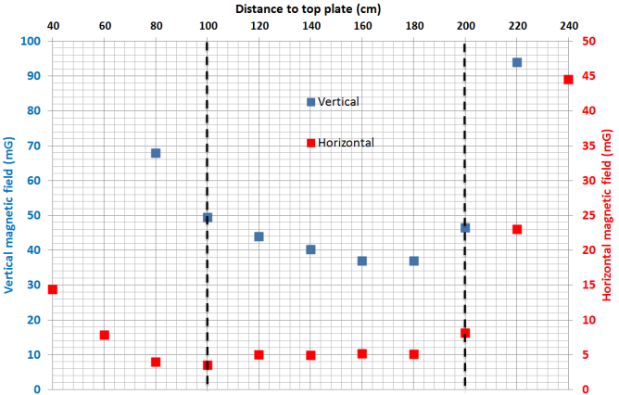
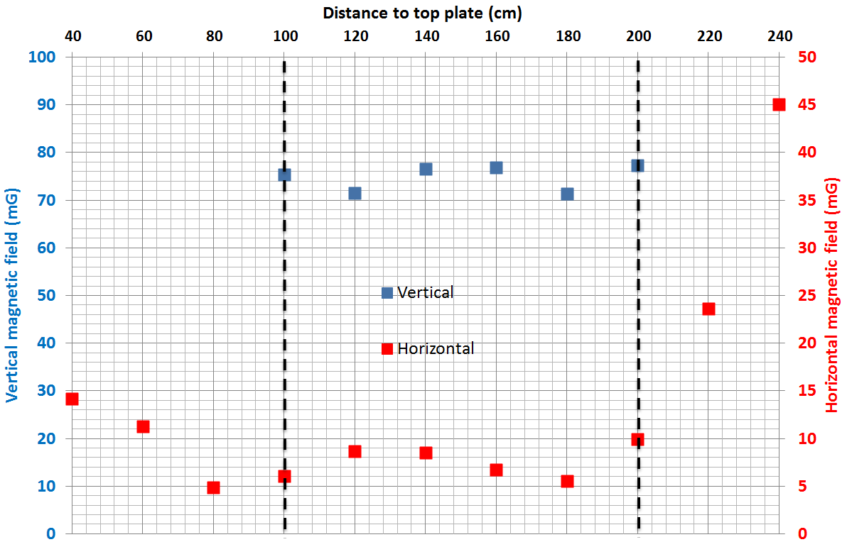
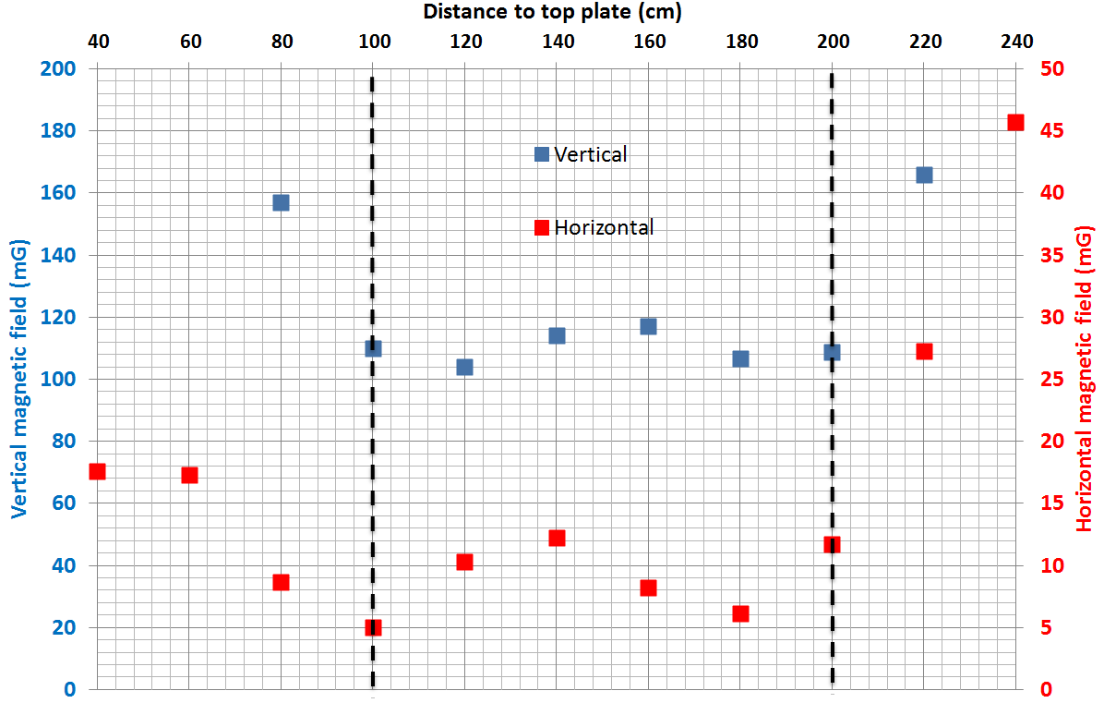
The cryostat and magnetic configurations
Magnetic configurations
OPTIMAL :
Bv < 10 mG
Bh < 10 mG
40 mG :
Bv ~ 40 mG
Bh < 10 mG
75 mG :
Bv ~ 75 mG
Bh < 10 mG
110 mG :
Bv ~ 110 mG
Bh < 10 mG

Slide 5
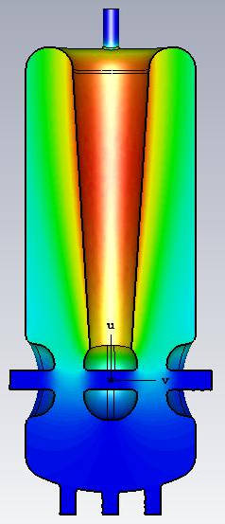
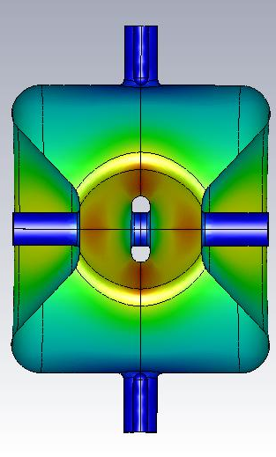
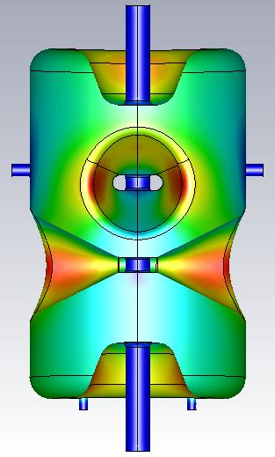
The 3 types of cavities
QWR for SPIRAL2
SPIRAL2 QWR
F₀ = 88 MHz
Bpk/Eacc = 10.5 mT/MV/m
r/Q = 515 Ω
G = 33 Ω
MYRRHA Spoke
F₀ = 352 MHz
Bpk/Eacc = 7.3 mT/MV/m
r/Q = 217 Ω
G = 109 Ω
ESS Spoke
F₀ = 352 MHz
Bpk/Eacc = 6.9 mT/MV/m
r/Q = 426 Ω
G = 130 Ω

Slide 6
OUTLINE
FACILITIES AND EQUIPMENT AT IPNO
  The cryostat and magnetic configurations
  The 3 types of cavities
MAGNETIC SENSITIVITY RESULTS
  On SPIRAL2 Quarter-Wave Resonator
  On MYRRHA Spoke Resonnator
  On ESS Spoke Resonnator
ANALYSIS
  Cooling conditions
  Geometrical effects
  Field dependence
  Temperature dependence

Slide 7
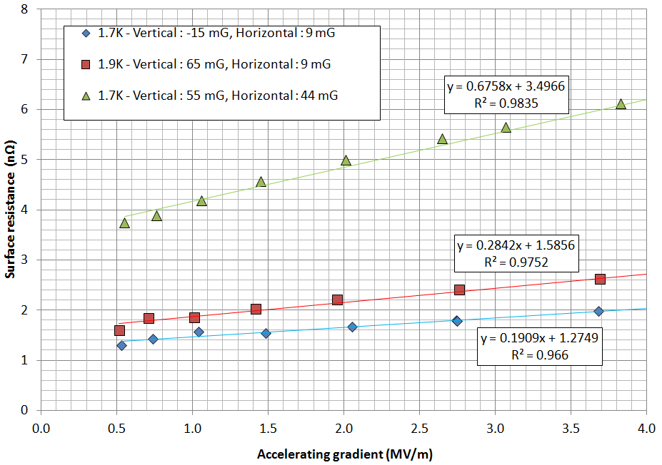
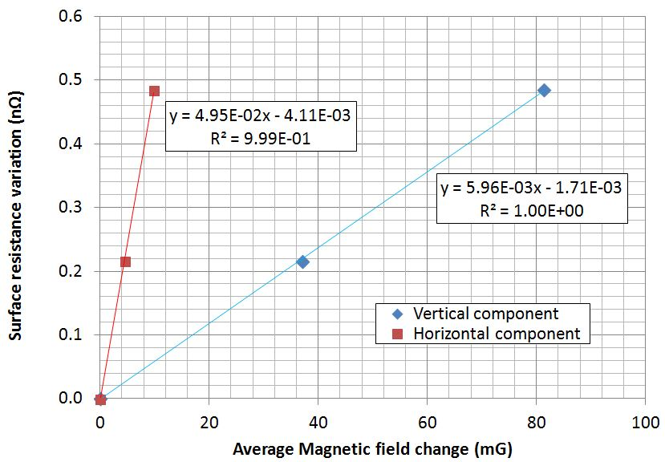
Magnetic sensitivity
SPIRAL2 QWR
@ 88 MHz, @ 1.7K, S_{mag}= 0.056 nΩ/mG
OBSERVATIONS :
  Very low sensitivity to vertical field (~ 0.006 nΩ/mG)
  Sensitivity to horizontal field (~ 0.05 nΩ/mG)
  Geometrical dependence of magnetic sensitivity
  Linear dependence of surface resistance coming from flux trapping

Slide 8
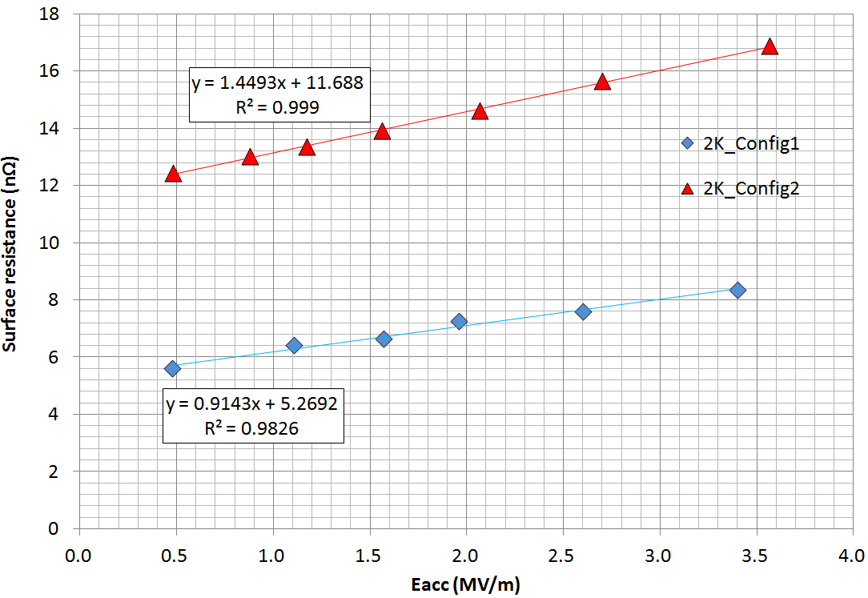
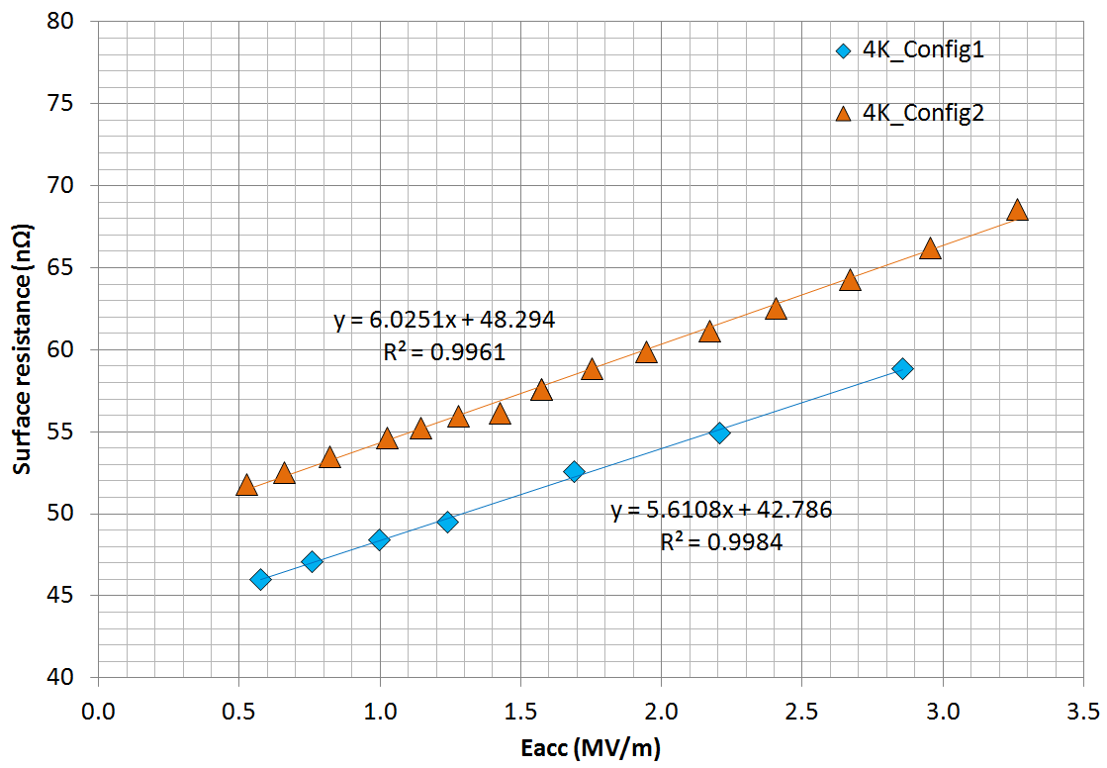
Magnetic sensitivity
MYRRHA Spoke
@ 352 MHz, S_{mag}= 0.12 nΩ/mG @ 2K
S_{mag}= 0.16 nΩ/mG @ 4.2K
OBSERVATIONS :
  Low sensitivity to vertical field ~ 0.06 nΩ/mG @ 2K ~ 0.054 nΩ/mG @ 4.2K!
  Linear dependence of surface resistance coming from flux trapping

Slide 9
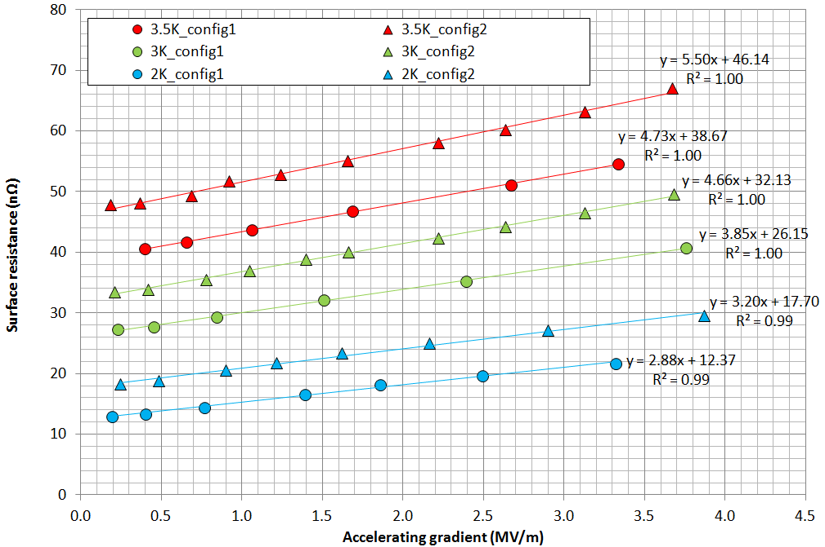
Magnetic sensitivity
ESS Spoke
3.5K
@ 352 MHz, S_{mag}= 0.12 nΩ/mG @ 2K
S_{mag}= 0.16 nΩ/mG @ 4.2K
3K
2K
OBSERVATIONS :
  Low sensitivity to horizontal field
  ~ 0.09 nΩ/mG @ 2K
  ~ 0.075 nΩ/mG @ 4.2K!
  Temperature dependence of magnetic sensitivity
  Linear dependence of surface resistance coming from flux trapping

Slide 10
OUTLINE
FACILITIES AND EQUIPMENT AT IPNO
  The cryostat and magnetic configurations
  The 3 types of cavities
MAGNETIC SENSITIVITY RESULTS
  On SPIRAL2 Quarter-Wave Resonator
  On MYRRHA Spoke Resonnator
  On ESS Spoke Resonnator
ANALYSIS
  Cooling conditions
  Geometrical effects
  Field dependence
  Temperature dependence

Slide 11
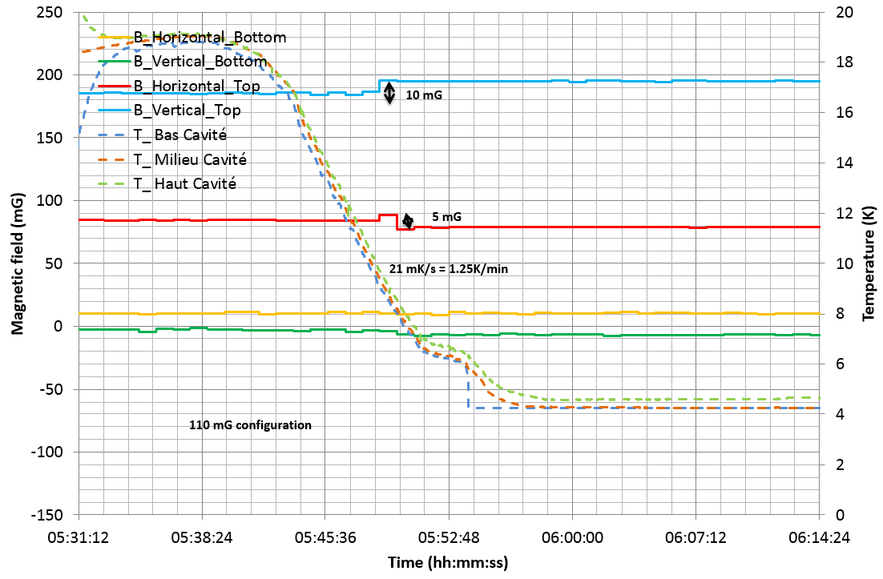
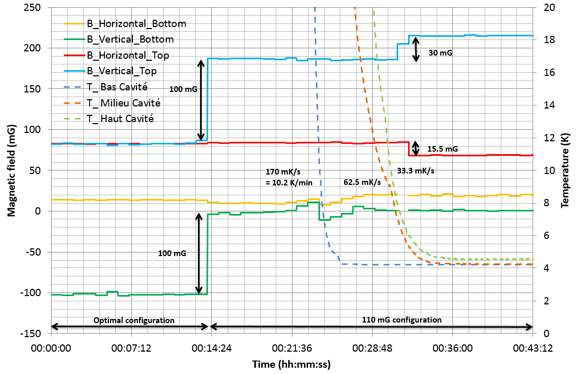
ANALYSIS
On MYRRHA Spoke :
  SLOW COOL-DOWN (ΔT ~ 0.5K) FAST COOL-DOWN (ΔT ~ 4K)
  With fast cool down, magnetic field difference before/after transition is 3 times bigger!
  Expect a significant change in surface resistance ?
Cooling conditions

Slide 12
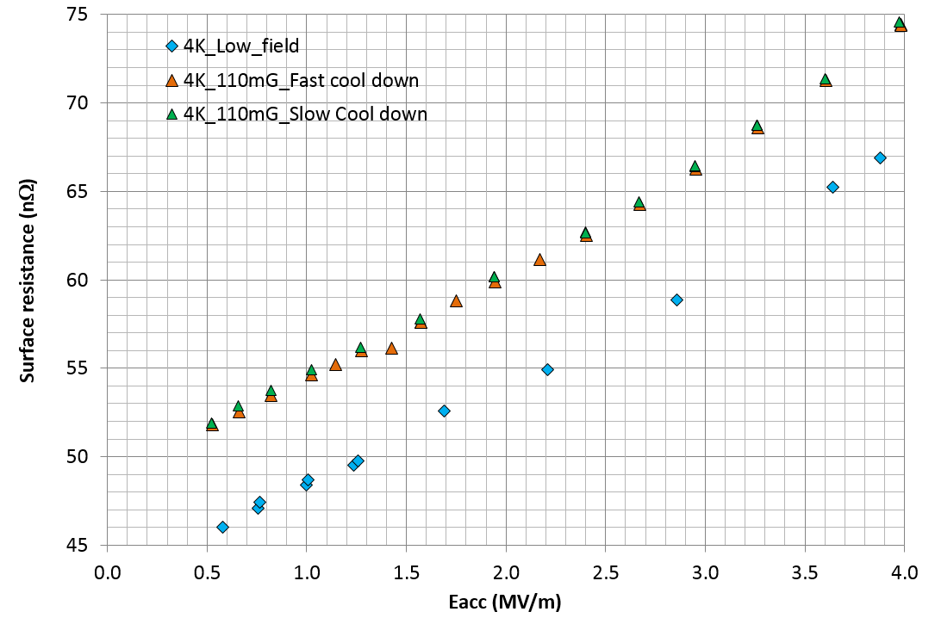
ANALYSIS
On MYRRHA Spoke :
  Between slow and fast cool-down, a difference of 0.2 nΩ measured over 6 nΩ.
  No flux expulsion is observed but field re-distribution after transition
Cooling conditions

Slide 13
ANALYSIS
Geometrical effect
Flux trapping :
Only normal component to the surface is trapped (SP2 QWR is a good example).
How to predict magnetic sensitivity of a structure with simulation code :
  Need to know normal vector of each mesh => mapping of trapped flux
Sensitivity is measured experimentally from Qo measurement : power measurement
  Trapped flux induces dissipations only in RF magnetic field regions

Slide 14
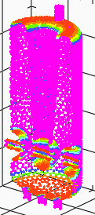
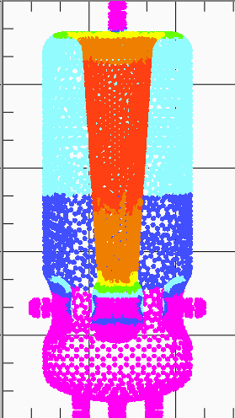
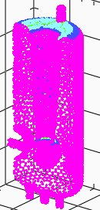
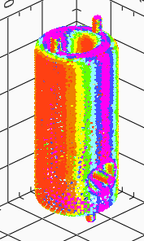
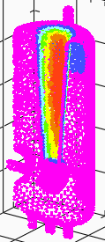
ANALYSIS
Geometrical effect
 | Trapped flux | RF surface currents | Sensitivity to magnetic field
SPIRAL2 QWR – vertical field
SPIRAL2 QWR – horizontal field

Slide 15
ANALYSIS
Geometrical effect
nΩ/mG |  | Transverse sensitivity | Beam axis sensitivity | Vertical sensitivity
SPIRAL2 QWR @4.2K @ 88 MHz | Calculated | 0.048 | 0.048 | 0.011
 | Measured | 0.05 |  | 0.006
 | Error (%) | 4 |  | -50
MYRRHA SPOKE @4.2K @352 MHz | Calculated | 0.088 | 0.076 | 0.069
 | Measured |  |  | 0.05
 | Error (%) |  |  | 20
ESS SPOKE @4.2K @352 MHz | Calculated | 0.078 | 0.066 | 0.084
 | Measured |  | 0.075
 | Error (%) |  | 9.5
Theoretical
0.08 nΩ/mG
Theoretical
0.16 nΩ/mG
Theoretical
0.16 nΩ/mG

Slide 16
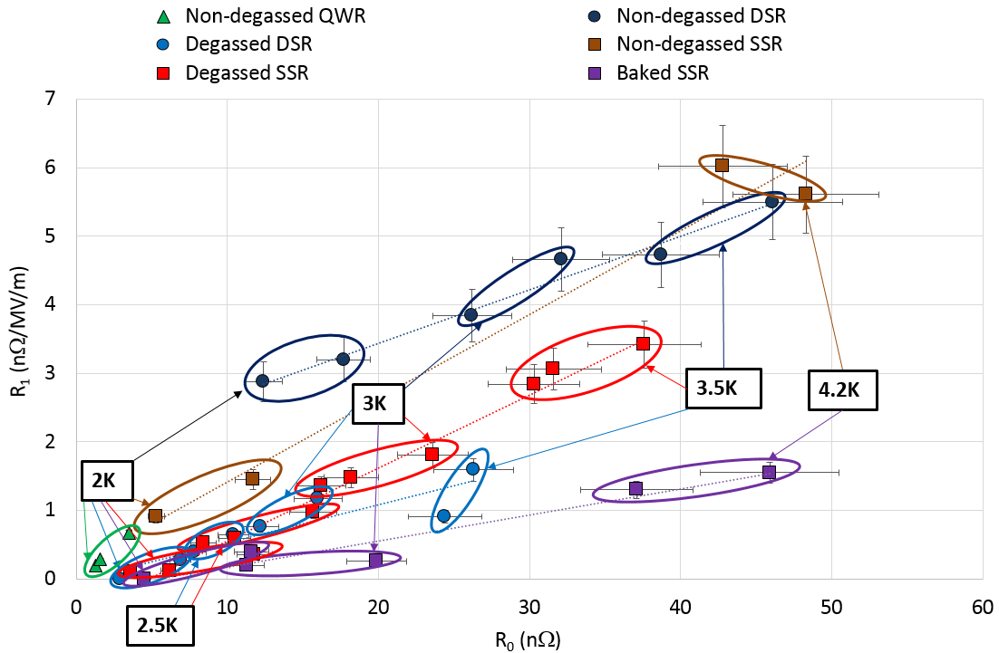
ANALYSIS
Field dependence
R_{s} = R₀ + R₁*E_{acc}
R₀ = R_{res} + R_{BCS}

Slide 17
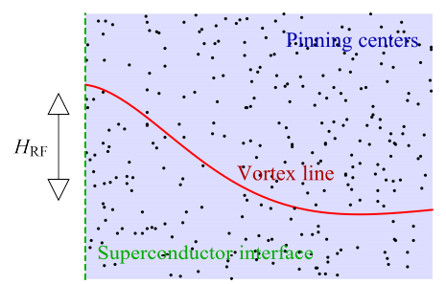
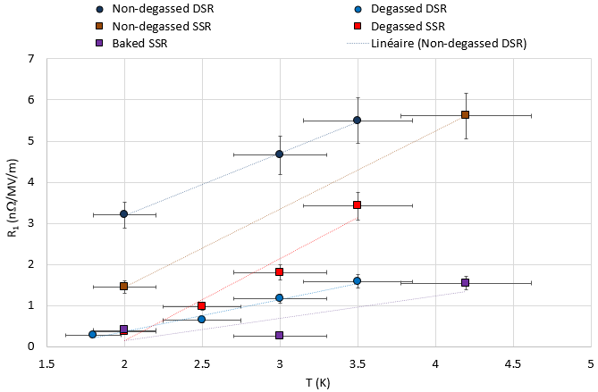
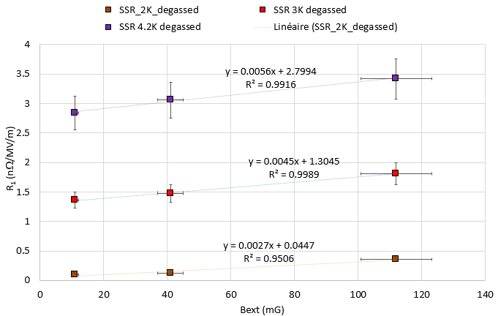
ANALYSIS
Field dependence
Possible explanation : collective weak pinning
  Cornell’s analytical approximation (D. Liarte) :
  R₁ decreases « linearly » with temperature
  R₁ decreases « linearly » with external field
  R₁ affected by heat treatment
D. Liarte, CORNELL

Slide 18
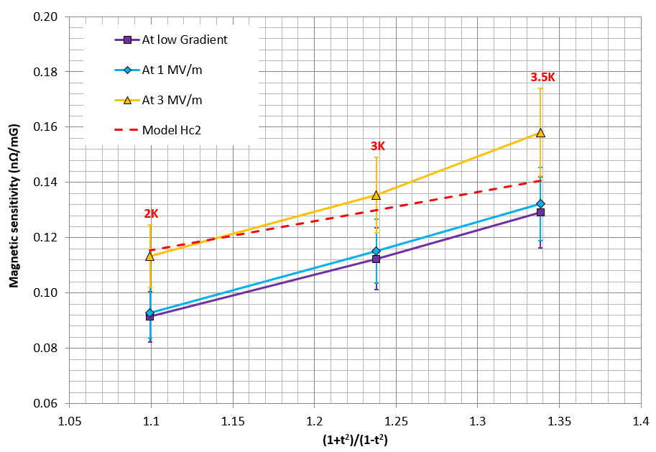
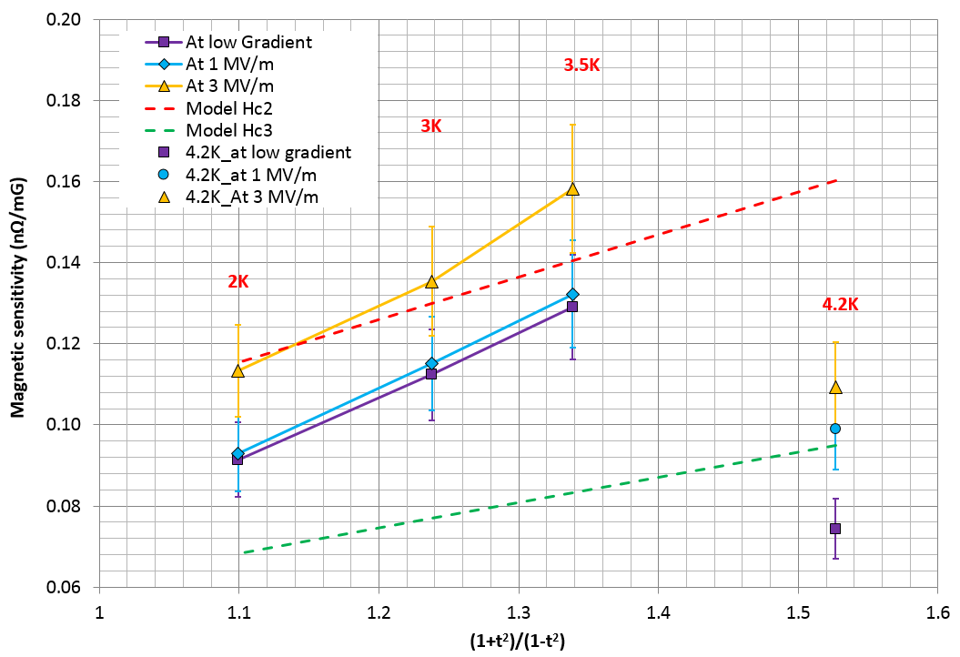
ANALYSIS
Temperature dependence

Slide 19
CONCLUSION
Cooling conditions
  Magnetic field variation during transition is measured
  The variation depends significantly on cooling speed (T gradient)
  But no significant change of magnetic sensitivity
Geometrical effect
  As only the normal component of magnetic field is trapped, the geometry should have a significant impact on sensitivity
  A good prediction of sensitivity is calculated by the model presented here
Field dependence
  The linear dependence of the surface resistance due to trapped flux looks correlated to Rbcs+Rres and not only Rres!
Temperature dependence
  The residual resistance caused by flux trapping is temperature dependent!

Slide 20
THANKS FOR YOUR ATTENTION

Slide 21
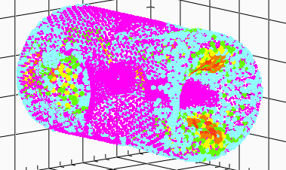
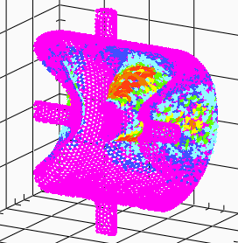

Slide 22
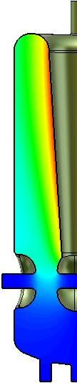
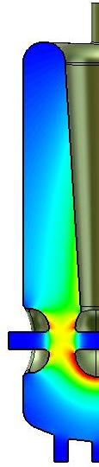
Quarter-Wave Resonnator
QWR for SPIRAL2
Material : Bulk Niobium
β = 0.12
F₀ = 88 MHz
T : 4.2K
Eacc : 6.5 MV/m
Bpk/Eacc = 10.5 mT/MV/m
Epk/Eacc = 4.9
r/Q = 515 Ω
G = 33 Ω
Designed at IPNO
1 spare cavity fabricated by RI
Helium tank in titanium

Slide 23
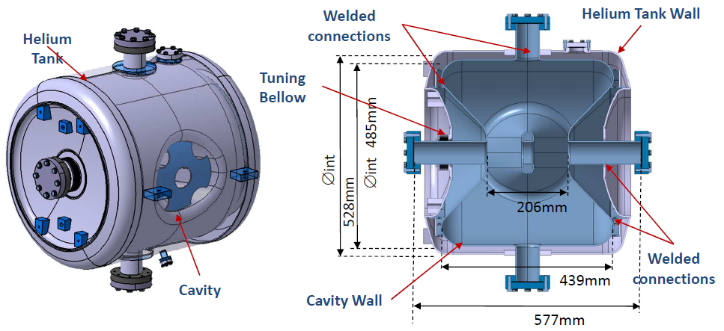
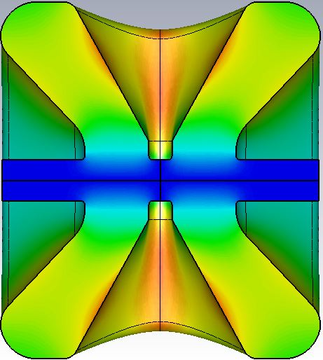
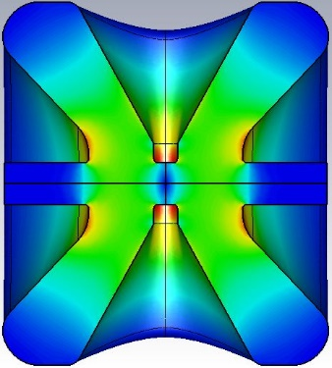
Spoke Resonator
SSR for MYRRHA
Material : Bulk Niobium
β = 0.37
F₀ = 352 MHz
T : 2K
Eacc : 6.4 MV/m
Bpk/Eacc = 7.3 mT/MV/m
Epk/Eacc = 4.3
r/Q = 217
G = 109
Designed at IPNO
2 prototypes fabricated by E. Z. Zanon Spa
Received in december 2015
Helium tank in titanium

Slide 24
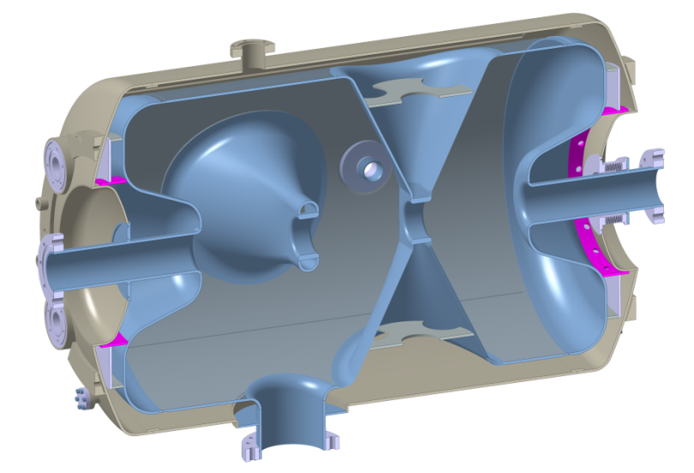
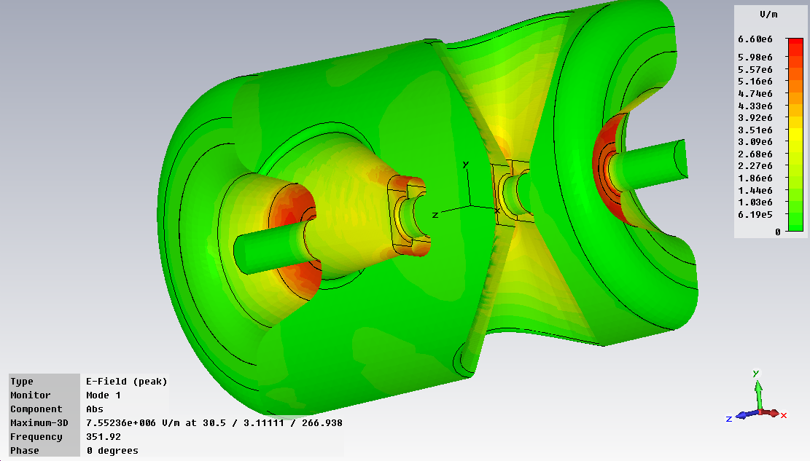
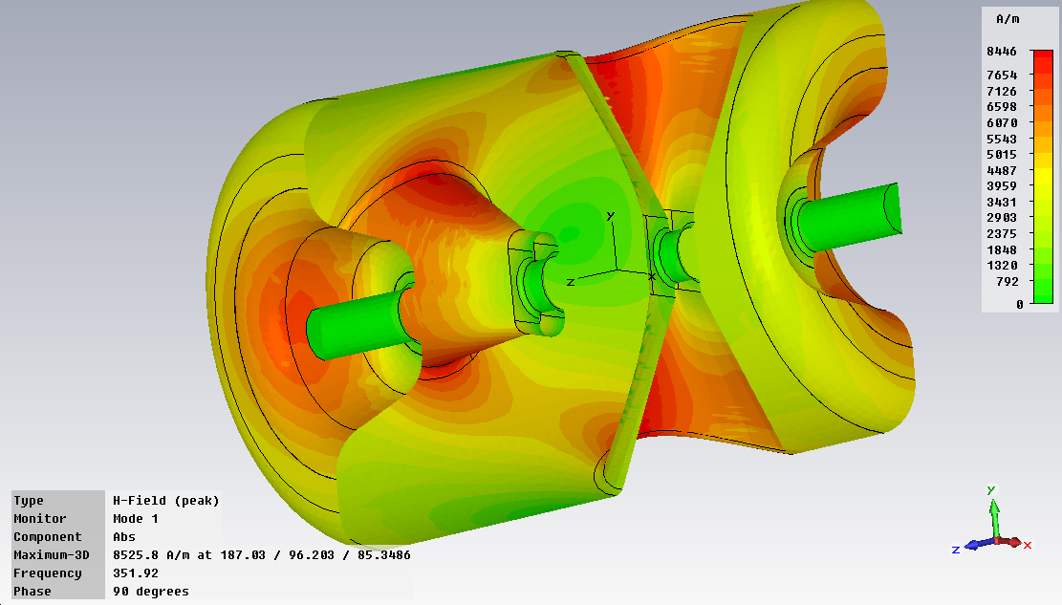
Spoke Resonator
DSR for ESS
Designed at IPNO
2 prototypes fabricated by E. Z. Zanon Spa. 1fabricated by SDMS
Received early 2015
Helium tank in titanium
Material : Bulk Niobium
β = 0.5
F₀ = 352 MHz
T : 2K
Eacc : 9 MV/m
Bpk/Eacc = 6.9 mT/MV/m
Epk/Eacc = 4.3
r/Q = 426
G = 130
4 HPR Ports
Pick-up Port
E field
Bellows
H field
Coupler port

Slide 25
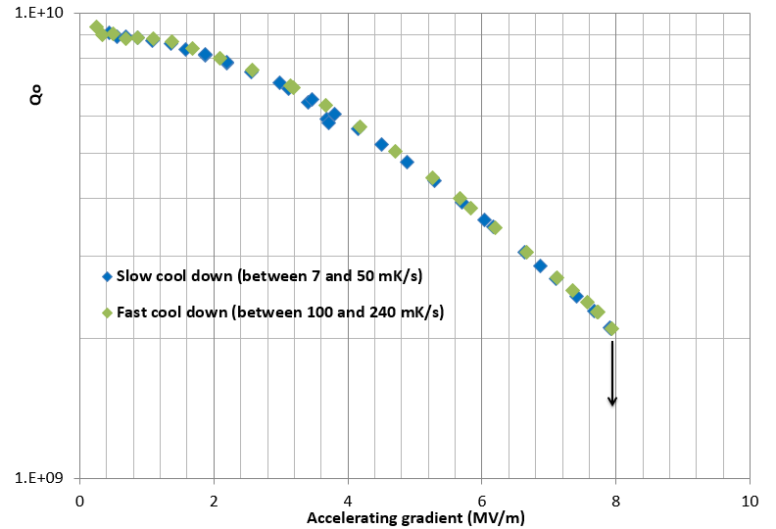
ANALYSIS
On Spiral2 QWR :
Cooling conditions

