Slide 1
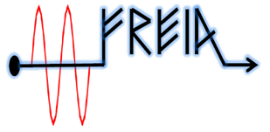


ESS Elliptical high-beta cavity package test results
-
Thibault Hamelin
Han LI
-
SLHiPP-8
Notes:
Bonjour.
Franck Peauger.
Je suis Ingénieur RF accélérateurs au SACM
Je suis au CEA depuis janvier 2006

Slide 2

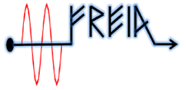


Introduction and motivation of the test
First test of ESS elliptical cavity equipped with a power coupler
  Collaboration between :
  High beta Cavity. coupler and Cold Tuning System (CTS)
        Test stand (cryostat. control system…)
        RF source (modulator and klystron)
The test of HB elliptical cavity has the goals of verifying:
  the cooling procedures.
  the power coupler conditioning and performance with the cavity.
  the cavity performance with the coupler.
  the cold tuning system (CTS) ability and performance.
  the LLRF ability and performance.
  the high power RF amplifier ability and performance in combination with the cavity and LLRF.
SLHiPP-8 - T.Hamelin & H.Li

Slide 3
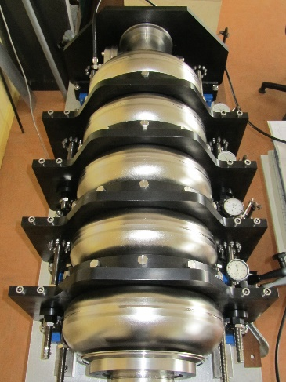
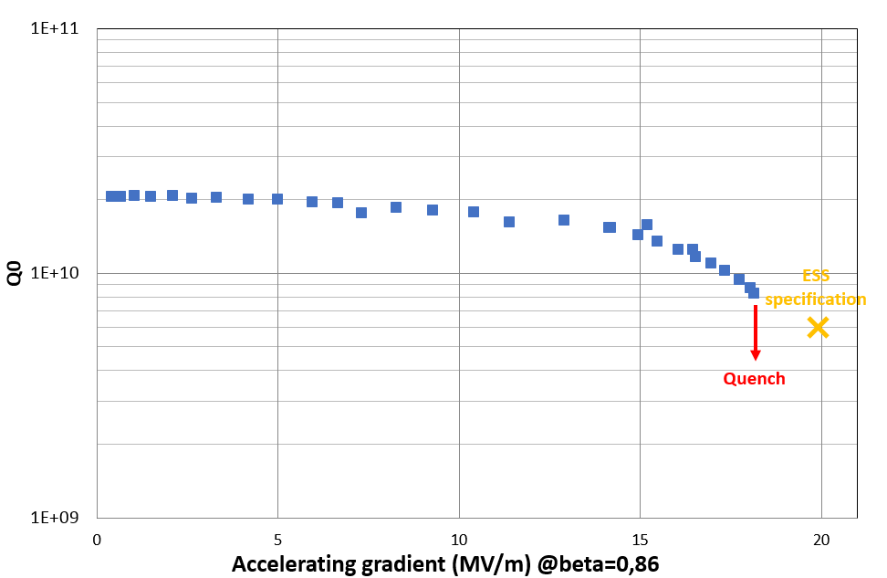
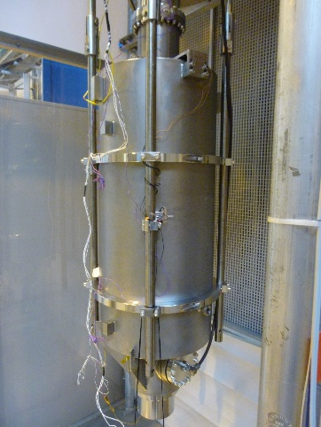
Preparation of cavity at CEA
Field flatness tuning → chemical treatment → clean room assembly → test in cryostat vertical (CV) at CEA
Degradation of the cavity performance during a baking
  adequate for this test (find the same performance with coupler)
Field flatness tuning stand
Cavity preparation for CV test
SLHiPP-8 - T.Hamelin & H.Li

Slide 4
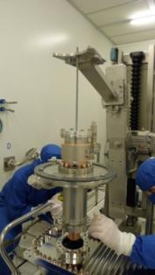
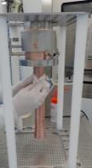
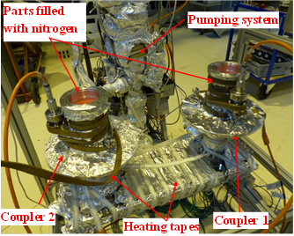
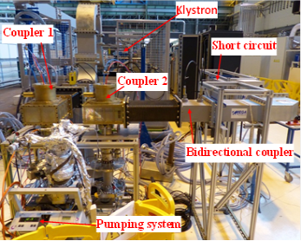
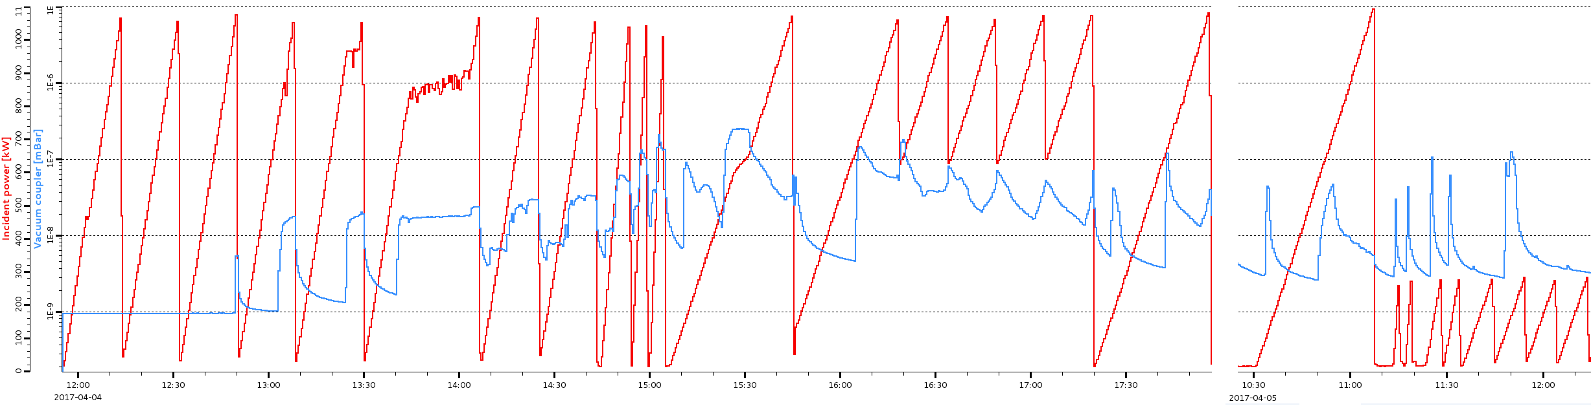
Preparation of power coupler at CEA
Coupler cleaning ❶ → clean room assembly of 1 pair of coupler on coupling box ❷ → baking at 170°C during ~100h ❸ → RF conditioning ❹
Conditioning sequence | Traveling wave(TW) | Standing wave (SW)
RF power ramps | From 15 kW to 1100 kW | From 15 kW to 300 kW to 1100 kW
RF pulse repeat rate | From 1 Hz to 14 Hz | From 1 Hz to 14 Hz
RF pulse length | From 50 μs to 3600 μs | From 50 μs to 3600 μs to 500 μs
Configuration | On load 50 Ω | On short circuit: 2 positions to have an electric field on ceramics at maximum and minimum levels
❶
❷
❸
❹
SLHiPP-8 - T.Hamelin & H.Li

Slide 5
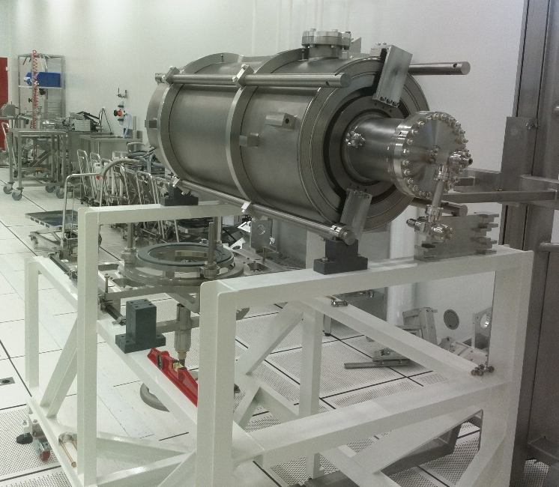
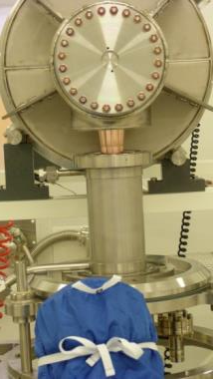
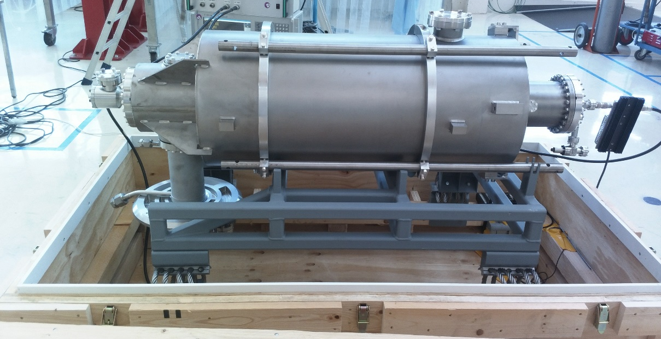
Cavity and coupler assembly at CEA
Coupler assembly on the cavity in clean room
Coupler-cavity assembly stand
Packaging of the coupler-cavity for Uppsala
Coupler assembly on the cavity
SLHiPP-8 - T.Hamelin & H.Li

Slide 6
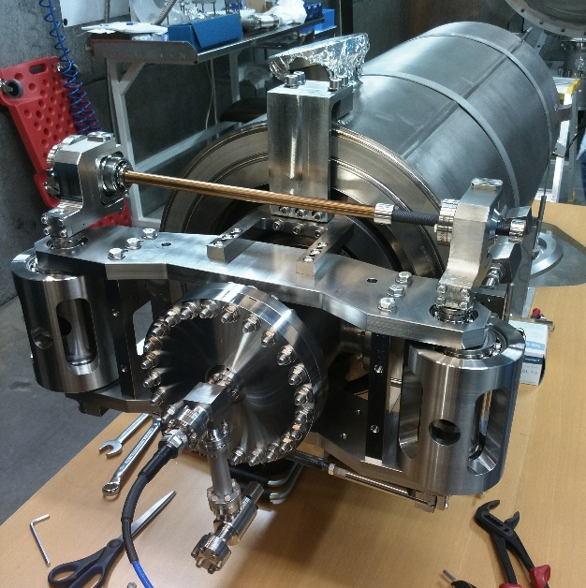
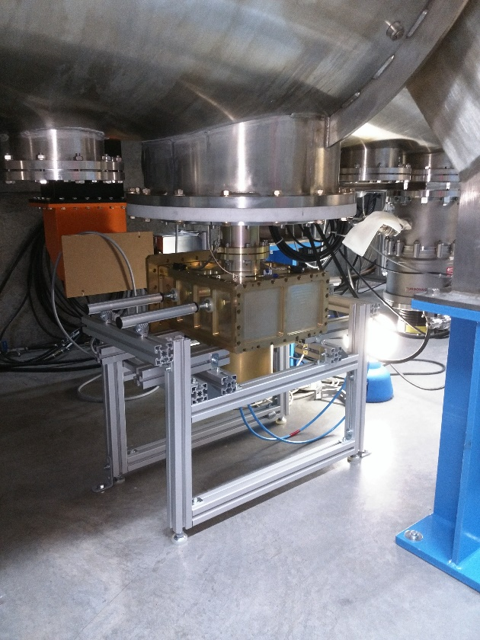
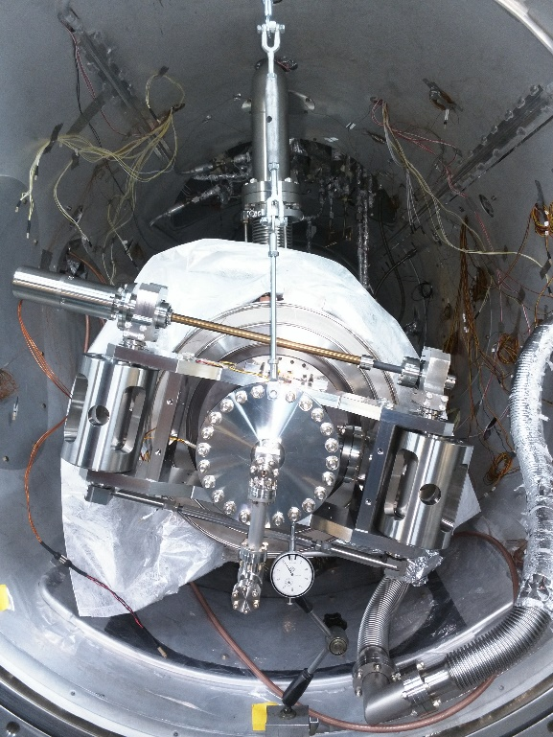
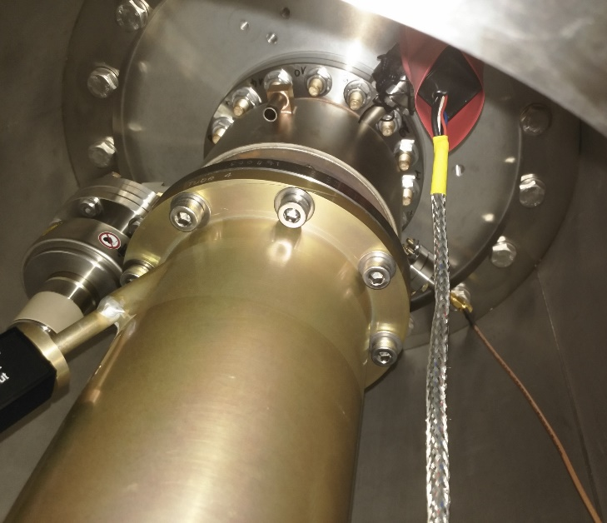
CTS and doorknob assembly at FREIA
Assembly and adjustment of the CTS
Assembly of the doorknob
Vacuum Photomultiplier
Vacuum gauge
Implementation of the cavity and the coupler in the cryostat
Implementation of the coupler security signals
Air Photomultiplier
Electron pick up
SLHiPP-8 - T.Hamelin & H.Li

Slide 7
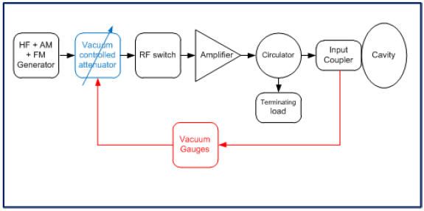
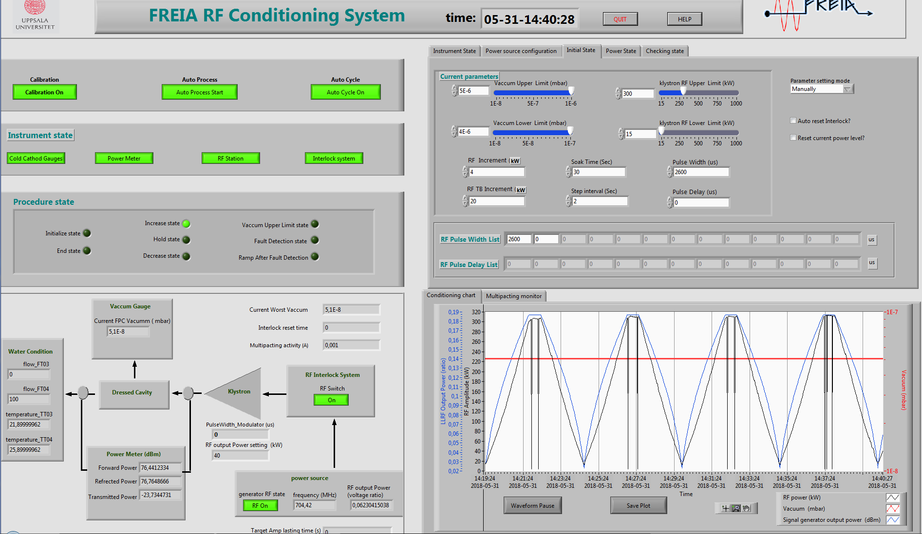
FPC conditioning
FREIA conditioning program
  Conditioning software has been tested with ESS spoke cavity
  Several repetition rates has been implemented
  (1Hz, 2Hz, 3.5Hz, 7Hz, 14Hz)
  Key paremeters setting are following CEA’s suggestion,like interlock thresholds and vacuum thresholds.
Parameter | value
Loop control time (s) | 1
Pulse repeat rate (Hz) | 1,2,3.5,7,14
Vacuum upper limit (mbar) | 5e-6
Vacuum lower limit (mbar) | 2e-6
RF upper limit (KW) | 1000 (for pulse less then 500us) 300 (for pulse less then 500us)
RF lower limit (KW) | 1
Initial pulse length (µs) | 50
pulse length step | 50 µs. 100µs,. 200 µs,. 300µs,. 400 µs,. 500µs,. 800 µs,. 1,.5 ms,. 2 ms,. 2.6 ms
SLHiPP-8 - T.Hamelin & H.Li

Slide 8
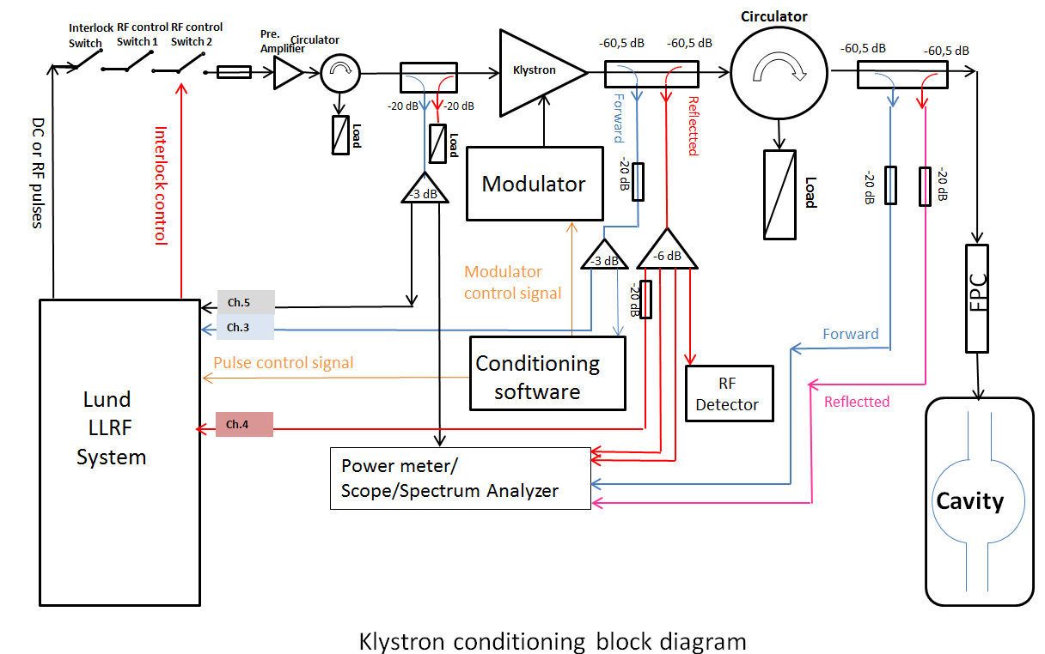
FPC conditioning block diagram
SLHiPP-8 - T.Hamelin & H.Li

Slide 9
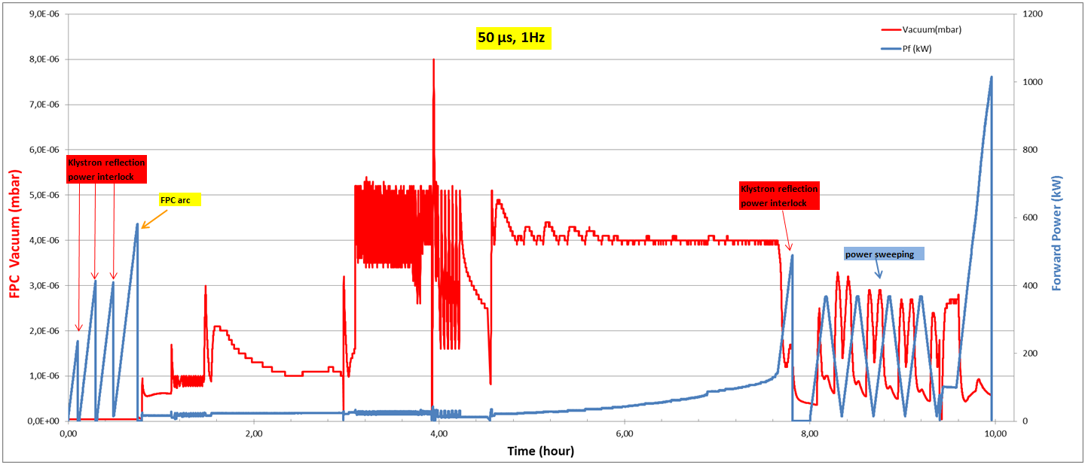
FPC warm conditioning
Warm conditioning of FPC took 20 hours in total (effective conditionig time)
  A lot of outgassing happend at low power with short pulses, 10 hours was spend at 50us phase
  Several repetition rates has been implemented for 500 us pulses (1Hz, 2Hz, 3.5Hz, 7Hz, 14Hz)
  300kW power with 2.6 ms pulses is reached
SLHiPP-8 - T.Hamelin & H.Li

Slide 10
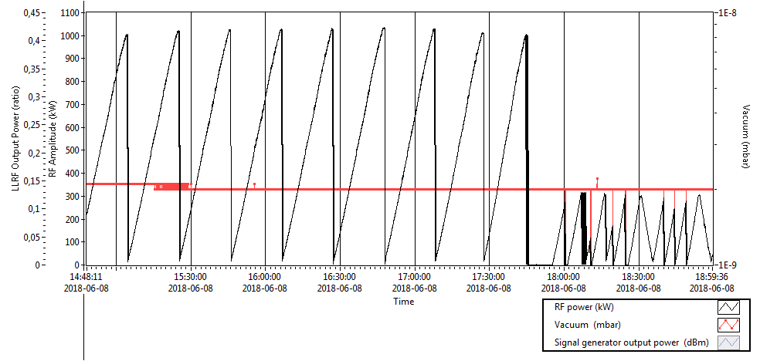
FPC cold conditioning
Cold conditioning of FPC took 9 hours in total (effective conditionig time)
  Cold conditioning was complected at 2K
  Same procedure as warm conditioning was adopted
  Two frequencies were used for the cold conditioning
  (slightly lower and higher frequency than the resonant frequency)
  300kW power with 2.6 ms pulses is reached
SLHiPP-8 - T.Hamelin & H.Li

Slide 11
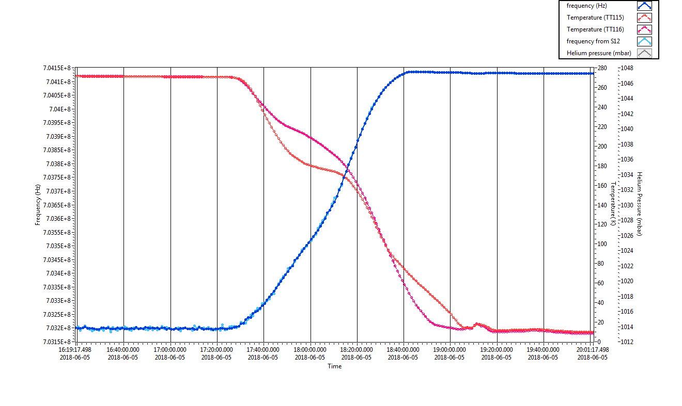
Frequency checking
Frequency checking during cool down to study the cavity behavior
  Key frequencies at certain temperature
  Frequency shift
Parameter | Frequency (MHz)
 | 300K | 4K | 2K
Π mode | 702.991 | 704.120 | 704.081
Frequency shift (compare to 300K) | 0 | 1.129 | 1.09
SLHiPP-8 - T.Hamelin & H.Li

Slide 12
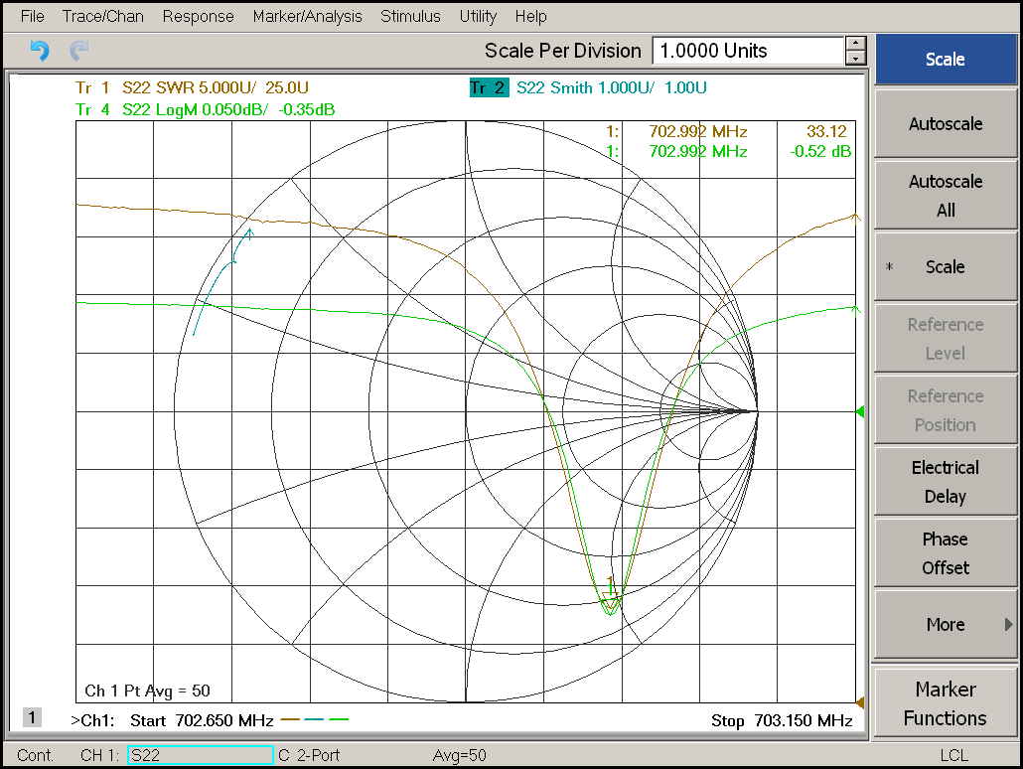
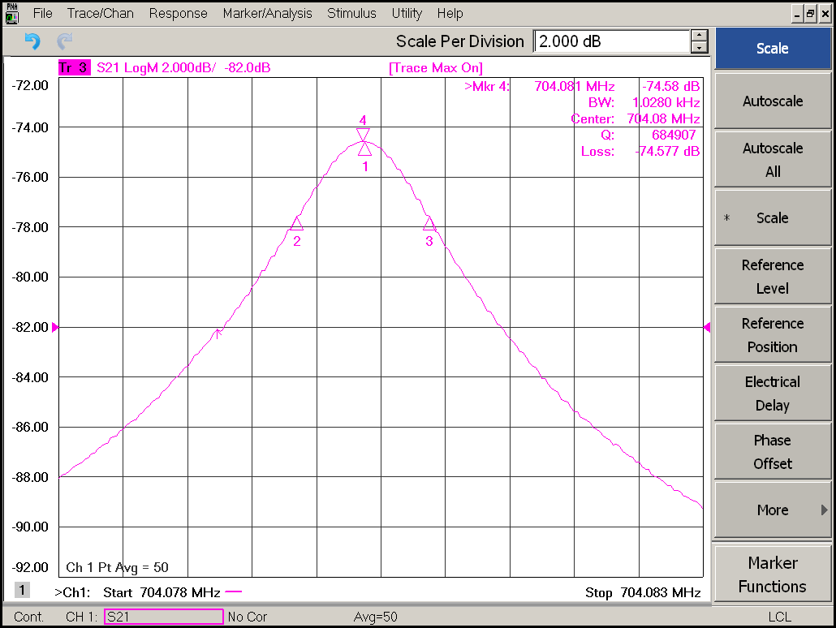
Qext for FPC
The Qext for FPC has been studied both at room temperature and cold with different medthod.
  Good agreement of result is found
  Qext of FPC is close to the expectation
SWR measurement at 300K
The external quality factor of the port of input power can be calculated by the standing wave ratio (SWR).
Qe=(1+SWR)QL
Test run | SWR | Qe
1 | 29.1 | 5.7*10⁵
2 | 32.3 | 6.3*10⁵
3 | 35.6 | 7*10⁵
4 | 33.1 | 6.5*10⁵
5 | 26.5 | 5.2*10⁵
6 | 28.4 | 5.6*10⁵
Qext = 6.8e5
S21 measurement at 2K
SLHiPP-8 - T.Hamelin & H.Li

Slide 13
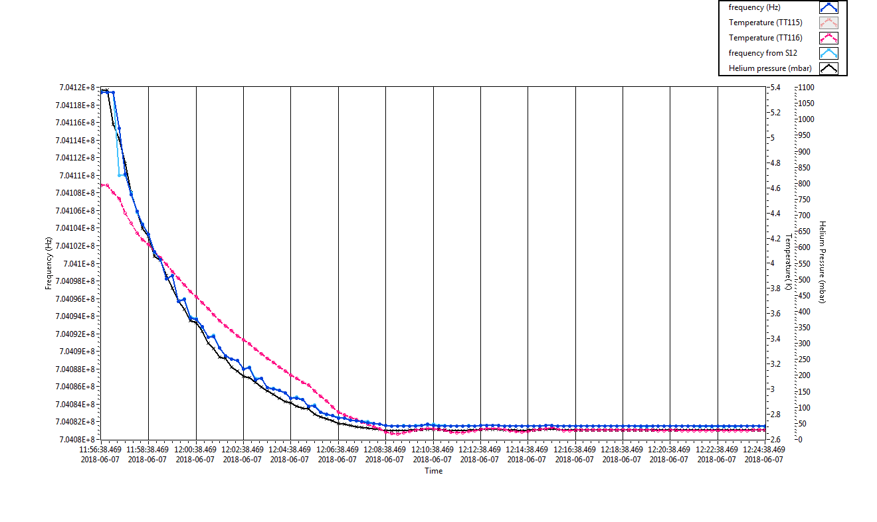
Frequency Sensitivity to Pressure
Checking the cavity frequency shift as a function of helium pressure during cool down from 4.2 K (~1080mbar) to 2 K (~30mbar)
Frequensy sensitivity test rerult of HB elliptical package
Frequency sensitivity to Pressure= 37 Hz/mbar
SLHiPP-8 - T.Hamelin & H.Li

Slide 14
Passband measurement
Frequency of fiest passband was studed at different temperature
Parameter | Frequency (MHz)
 | 300K | 4K | 2K
Π mode | 702.991 | 704.120 | 704.081
4Π/ 5 mode | 701.761 | 702.889 | 702.848
3Π/ 5 mode | 698.464 | 699.592 | 699.551
2Π/ 5 mode | 694.370 | 695.494 | 695.454
Π/ 5 mode | 691.104 | 692.227 | 692.187
Frequency distance between nearest HOM and the nominal frequency is
>1.2 MHz
SLHiPP-8 - T.Hamelin & H.Li

Slide 15
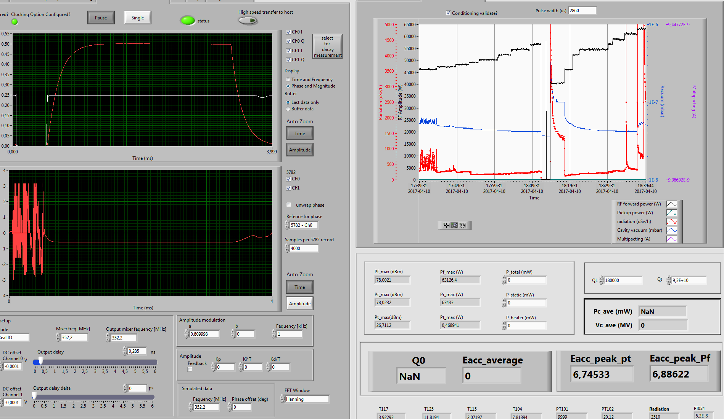
Cavity conditioning and Test
Cavity package conditioning and test will use FREIA pulse SEL.
Test program base on Labview will be applied. which has successfully implemented on the spoke packege.
2.6 ms pulse with 14Hz repetition rate will be used.
Major multipacting regions and FE regions will be found
Contorl screem of pulse SEL at FREIA
SLHiPP-8 - T.Hamelin & H.Li

Slide 16
Conclution
Test stand and software for HB elliptical cavity test are tested and ready.
Conditioning of FPC has successfully finished.
RF test of the HB elliptical cavity is under going.
SLHiPP-8 - T.Hamelin & H.Li

Slide 17
Annex
Commissariat à l’énergie atomique et aux énergies alternatives
Centre de Saclay | 91191 Gif-sur-Yvette Cedex
T. +33 (0)1 69 08 76 11 | F. +33 (0)1 69 08 30 24
Etablissement public à caractère industriel et commercial | RCS Paris B 775 685 019
SLHiPP-8 - T.Hamelin & H.Li

Slide 18
RF Conditioning
Security Signals
Conditioning test stany is instrumented to to ensure the safety of couplers
5 arc detectors (photomultiplier PM): 2 by couplers (1 PM on the vacuum side (PMV1 and PMV2) and 1 PM on the air side (PMA1 and PMA2) and 1 for the conditioning box (PMB)
2 pick up electrons (current measurement) (1 per coupler) (PUE1. PUE2)
3 vacuum gauges (IKR070): 1 per coupler (VAC1. VAC2) and 1 for the conditioning box (VACB)
5 temperature sensors (PT100): 2 for the hydraulic cooling circuit (1 per coupler). 1 on each coupler closest to the ceramic and 1 for the conditioning box
10 RF measurements: 8 measuring the incident and reflected powers by bidirectional couplers (PKREV. PKDIR. PIREV. PIDIR. PTREV. PTDIR) and 2 measuring the power on the electron pickup of each coupler (PuRF1. PuRF2)
Fast signals: response time < 10μs
Power supply for the ferrite
Flow meter D1
Flow meter D2
Bi-directional Coupler 60dB
Bi-directional coupler 60dB
VAC1
VAC2
Bi-directional Coupler 60dB
50Ω load or short circuit
Coupler 2
klysron
PMA1
Coupler 1
PMA2
PC_loadREV
PMV1
PMV2
PuRF1
PuRF2
PUE1
PUE2
PtDIR
PKDIR
PMB
PtREV
PKREV
PIREV
PC_loadDIR
PIDIR
Test box
50Ω load
VACB
Pumping system
SLHiPP-8 - T.Hamelin & H.Li

Slide 19
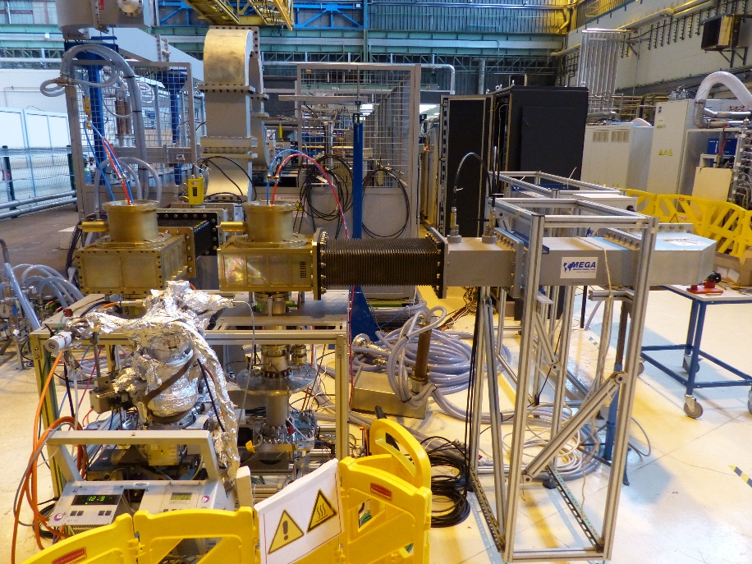
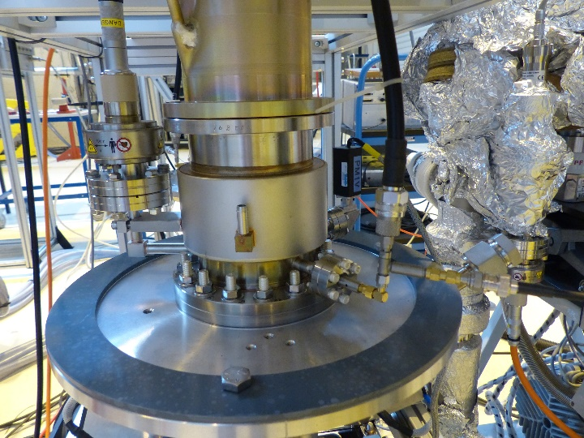
RF Conditioning
Views of the conditioning stand
Klystron
inlet / outlet of hydraulic cooling system
Short circuit
Coupler 1
Coupler 2
Conditioning box
Pumping system
Photomultiplier
Vacuum gauge
RF measurement
Electron pick up
SLHiPP-8 - T.Hamelin & H.Li
Current measurement

Slide 20
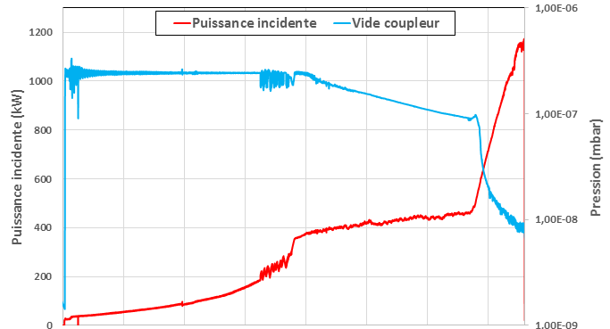
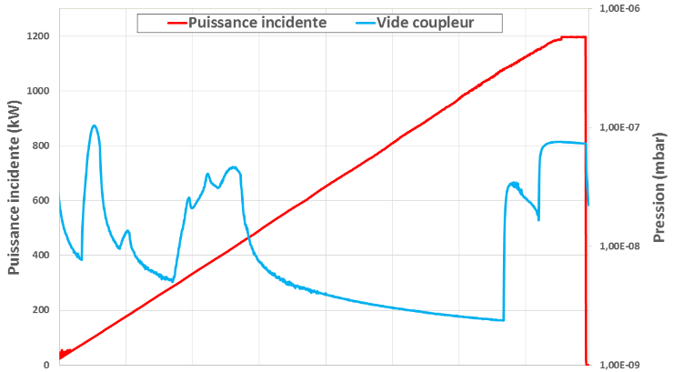
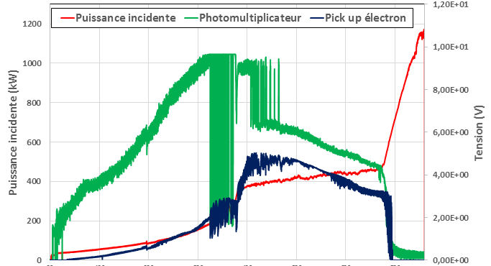
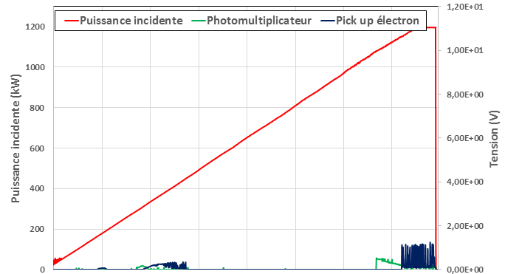
RF Conditioning
Conditioning results
First ramp
N ramp
Incident power (kW)
Vacuum (mbar)
Vacuum (mbar)
Incident power (kW)
~ 5h00
~ 20 min
Incident power (kW)
Voltage (V)
Voltage (V)
Incident power (kW)
~ 5h00
SLHiPP-8 - T.Hamelin & H.Li
~ 20 min

Slide 21
The list of tests
Warm test | Cool down | Cold test | Warm up
Central cavity frequency and spectrum of HOM Qe | Frequency shift due to cool down | Coupler cold conditioning | Frequency shift vs. T
 |  | Cavity conditioning
 |  | Central frequency Loaded Q and Qe
Coupler warm conditioning
 |  | Cavity level profile: let the LHe evaporate to low levels Effect of CV105 in heat load Cavity's power limit Effect of different FPC cooling temperatures in heat load Max load on the 2K pumps
 |  | Q0 Dynamic heat load Max gradient Dynamic Lorentz force detuning
 |  | Stabilization of the cavity field with LLRF using only RF compensation Dynamic Lorentz force detuning Tuning range of the slow step tuner
 |  | Tuner related testing
CRYO
VNA
SGD
signal
generator driven
SEL
Lund system
Lund university

