Slide 1
Prototyping activities for medium & high beta ESS cryomodules in CEA Saclay
Pierre Bosland – on behalf of the ESSI team (ESS Irfu)
SLHIPP8 - Uppsala

Slide 2

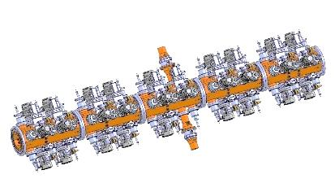
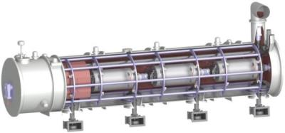

General view of the CEA/Irfu in kind contributions to the ESS accelerator
DTL
Spokes
Medium β
High β
HEBT & Contingency
HEBT & Contingency
Target
    Collaboration with IPN Orsay for the design of the cryostat of the elliptical cryomodules
RFQ
2 prototype cryomodules medium & high beta (+ RF power tests at Saclay)
30 Cryomodules of the series (elliptical cavities provided by INFN & STFC)
    Presentation: Han Li with Thibault Hamelin
    This presentation
    Presentation: Thierry Trublet
    Diagnostics (EMU & Doppler sur la LEBT + NIPM + nBLM)
    Parts of Control System (Source, LEBT, RFQ, nBLM)
    Presentation: Jacques Marroncle

Slide 3
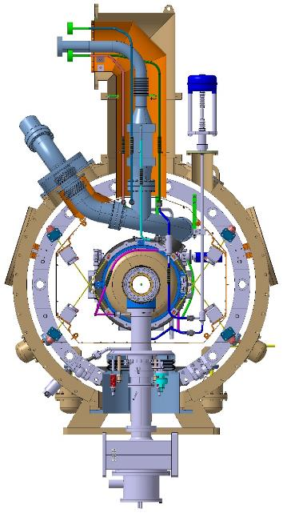
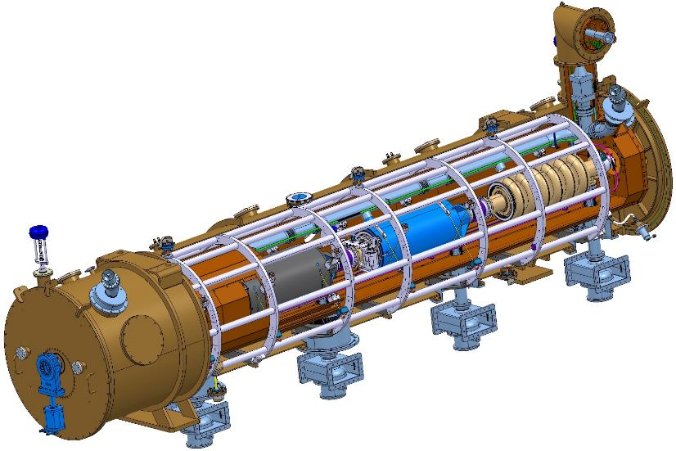
The main caracteristics of the ellipical cryomodules
4 cavities supported by a spaceframe
Same cryomodules design for medium and high beta
704 MHz, 3.6 ms RF pulse at 14 Hz (beam pulse 2.86ms)
T = 2 K
Eacc = 16.7 MV/m (Mβ) and 19.9 MV/m (Hβ) (Epeak = 40/44 MV/m)
Power coupler : 1.1 MW peak (mean power 55 kW)
Frequency tuning system equiped with piezo stacks for Lorentz force detuning compensation
6.6 m long

Slide 4
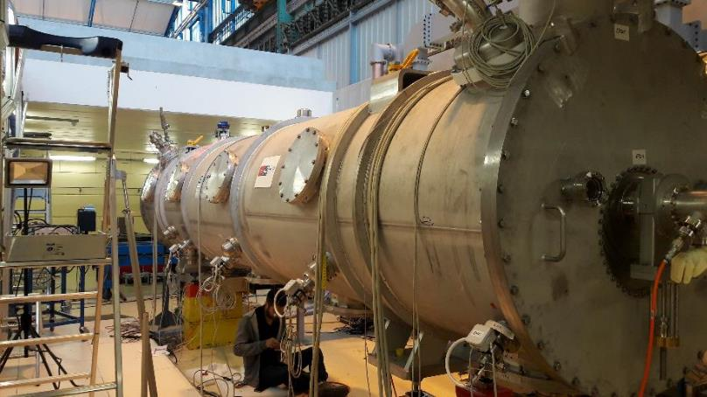
The prototype cryomodule with medium beta cavities M-ECCTD
    Two periods:
    2017: assembly and tests at 2K and low level RF power (a power coupler mechanically broken by bad handling and cavities polluted by a violent leak)
    2018: refurbished cryomodule – tests at high RF power July 2018 .

Slide 5
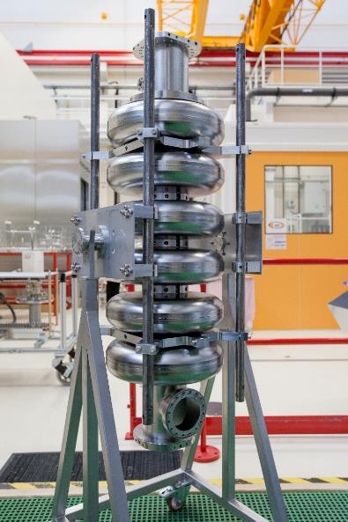

Performances of the 4 Cavities tested in vertical cryostat before assembly inside the cryomodule
M-ECCTD – first assembly
3 “CEA” cavities: CEA design, complete preparation and tests in CEA lab (BCP, HPR, etc.) except HT in industry
1 INFN LASA cavity: INFN design, complete preparation in industry and tests in LASA

Slide 6
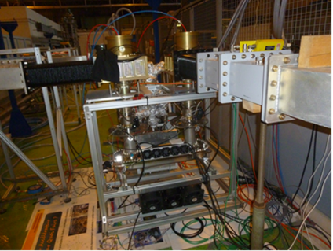

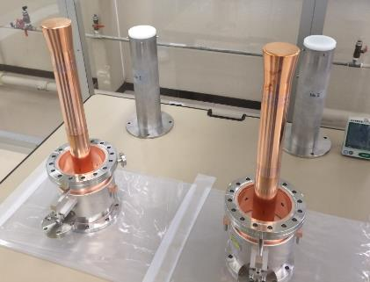
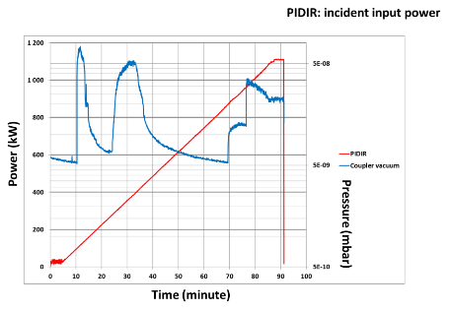
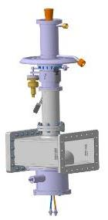
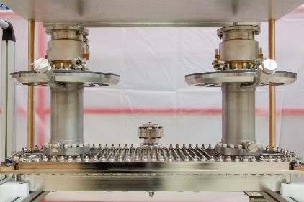
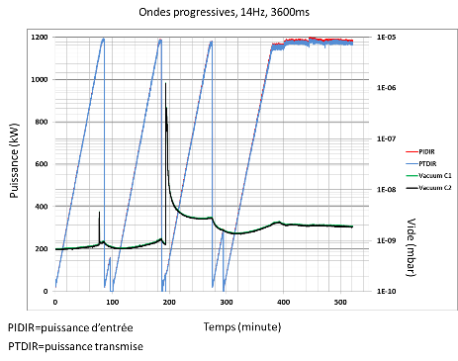
Conditionning of the RF power couplers
M-ECCTD power couplers
5 prototype coupler pairs successfully conditioned up to
1.1 MW peak
in travelling waves
and in reflected power
1.1 MW peak
Door-knob equipped with a antenna bias system (10kV max)
4 couplers could be mounted in the M-ECCTD

Slide 7
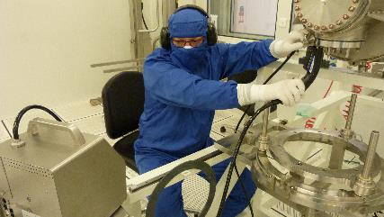
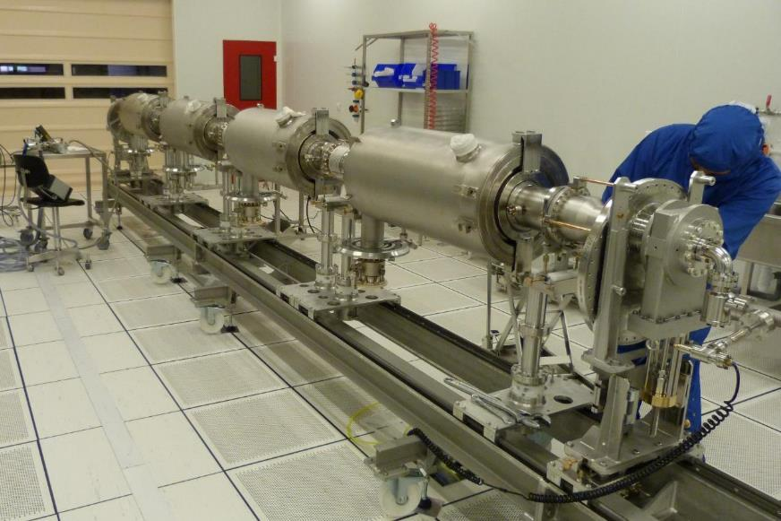
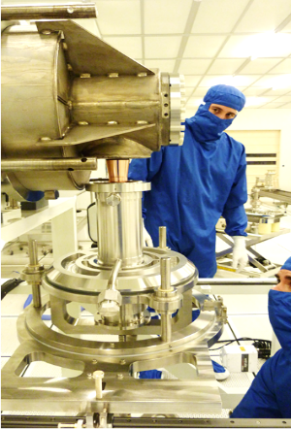
Assembly of the cavity string in ISO 4 clean room
M-ECCTD first assembly
March 2017
Jan. 2017

Slide 8
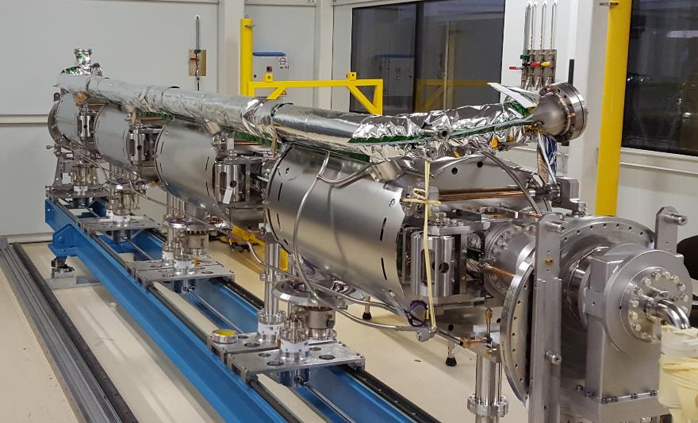
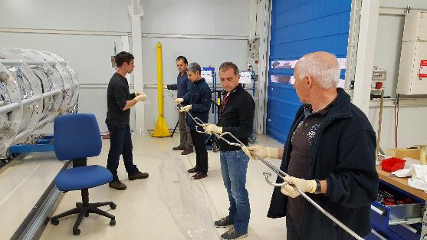
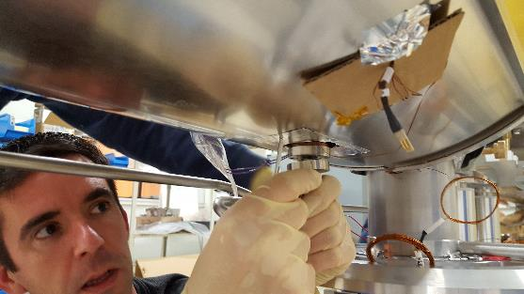
Cryomodule Assembly outside the clean room
M-ECCTD first assembly
April 2017
Welding the titanium diphasique pipe
MLI, magnetic shields, tuning systems, cryo-pipes etc.

Slide 9
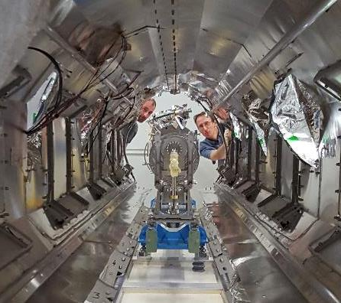
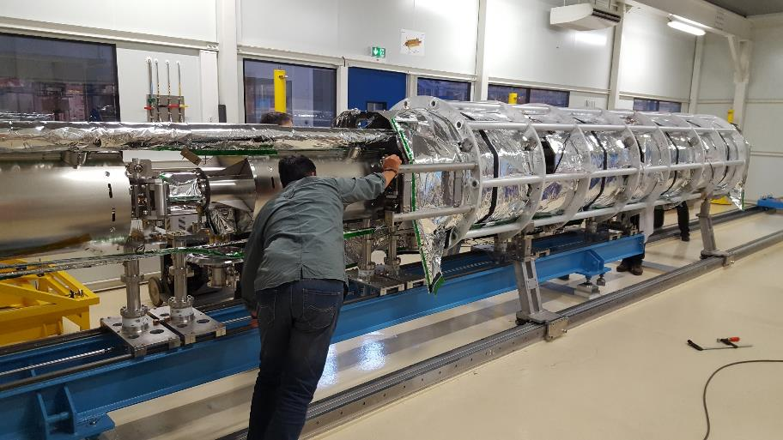
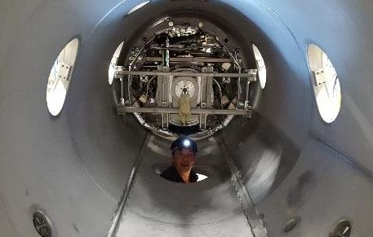

insertion inside the spaceframe and thermal shield
M-ECCTD first assembly
May 2017

Slide 10
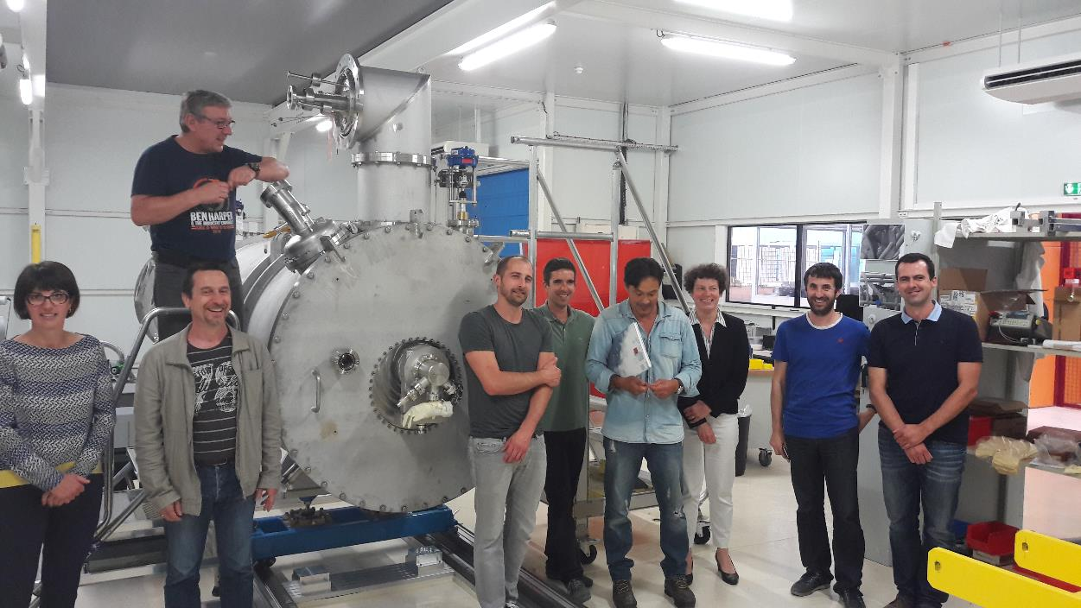
The M-ECCTD vacuum tank is closed

Slide 11
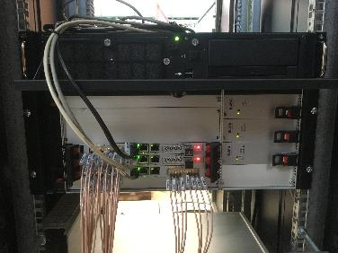
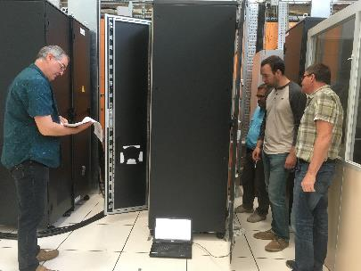
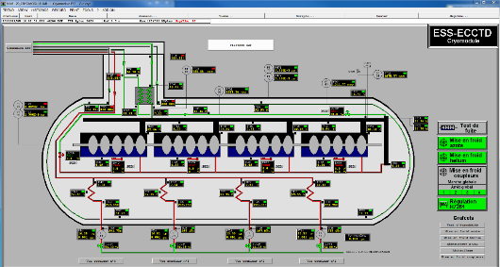
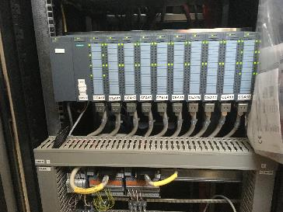
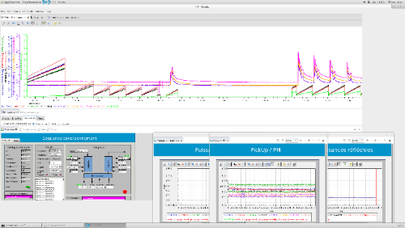
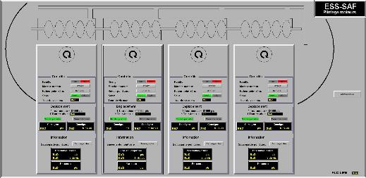
Acquisition, Control racks, software for the RF power test stand in CEA
Muscade: control system for cryogenics, vacuum …
EPICS: control system for RF

Slide 12
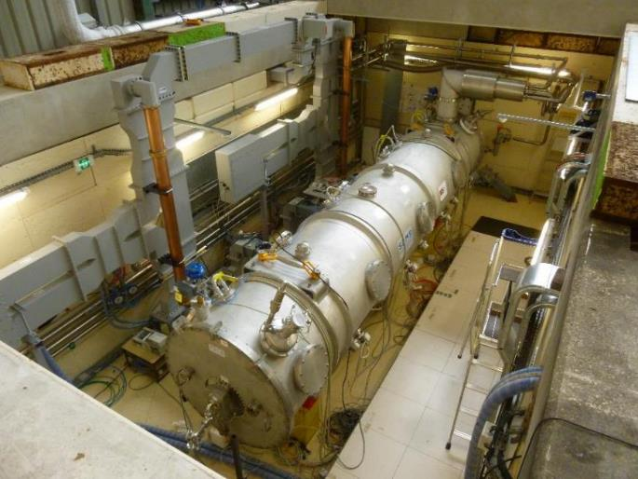
Installation inside the tests stand in July 2017
1rst cool down at 4.2 K and 2K: Aug/Sept. 2017
One ceramic coupler broke while mounting the doorknob:
=> fast cavity refilling up to atmospheric pressure
=> pollution of the cavity string and RF power tests cancelled
The broken coupler was dismounted and replaced by a blank flange to close the cavity string and allow performing cryogenic and low level RF measurements.

Slide 13
Chronology of the Tests of the M-ECCTD

Slide 14
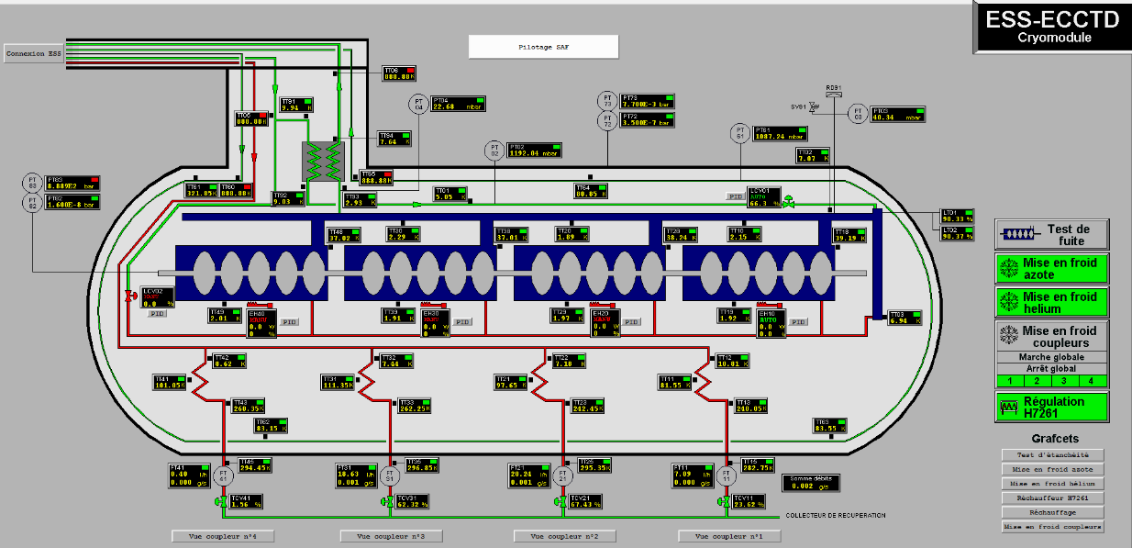
M-ECCTD first test
Cryomodule maintained several hours at 2 K with a stable Lhe level
1^{rst} cryogenic load measurements at 2K: ~ 23W (estimations = 17W)
Without any optimization of the cooling conditions
Satisfying values

Slide 15
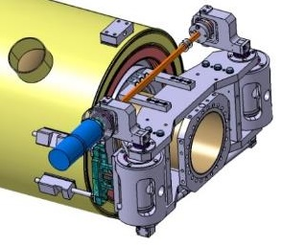
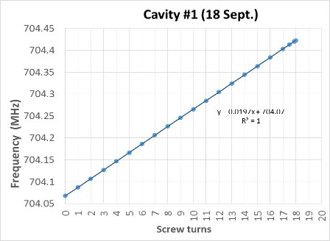
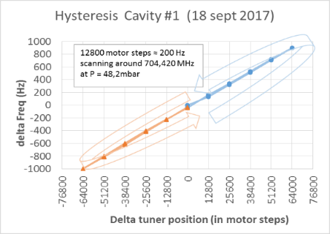
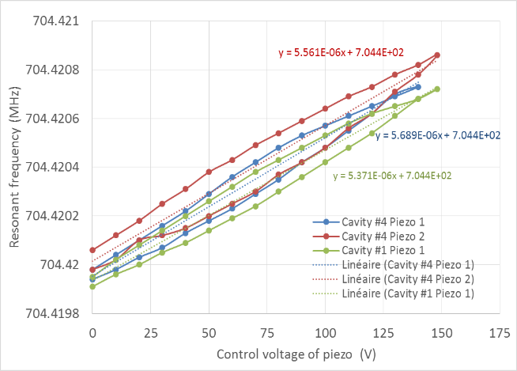
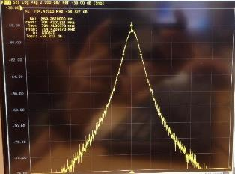
M-ECCTD frequency tuners
RF measurement at low power:
Frequency tuning of the cavities at 704.42 MHz and at 4.2 K and at 2 K with the tuners.
Very low hysteresis
Check of the piezo stacks running (Their real efficiency for Lorentz force detuning compensation can only be checked at high power)
Estimation of the hysteresis level by frequency cycling around the machine frequency
(GHe pressure could not be well controlled)
Frequency as a function of the voltage applied to the piezo stacks.
Max range obtained for 148V: 880 Hz
Measured hysteresis: 130Hz to 190Hz

Slide 16
Refurbished M-ECCTD Cryomodule assembly
The second assembly is an opportunity to test and validate the assembly procedure before the arrival of the industrial team.
The main changes in the assembly procedures from 1^{rst} assembly to the 2nd assembly:
In clean room:
  Reversed orientation of the cavity string inside the clean room
  Some new tools (cavity supports, slow pumping systems, …)
Outside the clean room:
  The cavity string still under vacuum during the roll out of the clean room
  Welding the diphasic titanium pipe with cavities under vacuum
  Cavity slow refilling outside the clean room
  Completion of the assembly with cavity at atmospheric pressure.
Some modifications have been done for decreasing the thermal losses on the thermal shield and on the cold mass at 2K.

Slide 17
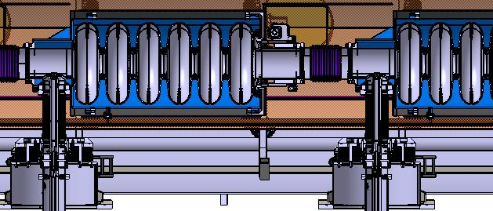
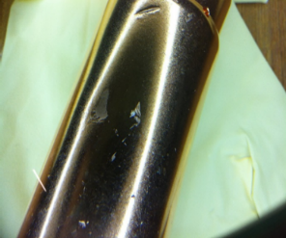
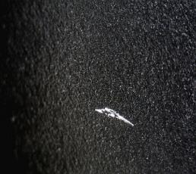
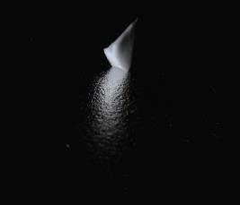
Pictures of mp01 (cav3) and broken coupler antenna
Some ceramic particles were stick in the Nb surface
recipe to cure the damaged cavities and remove all ceramic particles?

Slide 18
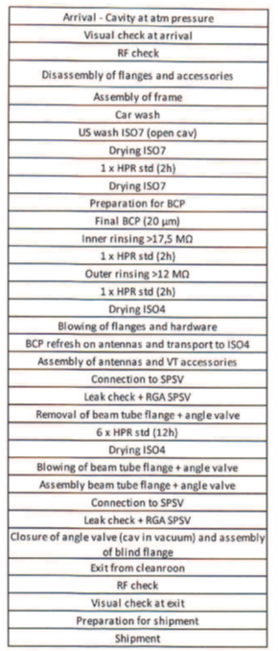
RECIPE PROPOSED to zanon
Basic idea: HPR→BCP→HPR
2 hours HPR → 25-30µm BCP →16 hours HPR

Slide 19
Q-curves of reprocessed cavities for the refurbished M-ECCTD
MB01:
Prepared in ZANON
Transport ZANON to LASA
Test in VC in LASA
Transport to Saclay
MP04:
Prepared and tested in Saclay
MP01 and MP02:
Prepared in ZANON
Transport ZANON to CEA
Test in VC in CEA
  Eacc max was limited 18 & 22MV/m to avoid breakdown due to possible alumina still stick inside.
  It will be possible to push to higher field in the cryomodule.
Conclusions:
  4 cavities for the refurbished M-ECCTD
  ZANON processing is very efficient (5 preparations => 5 good results)
  Transport boxes and shipment: no degradation for 3 cavities

Slide 20
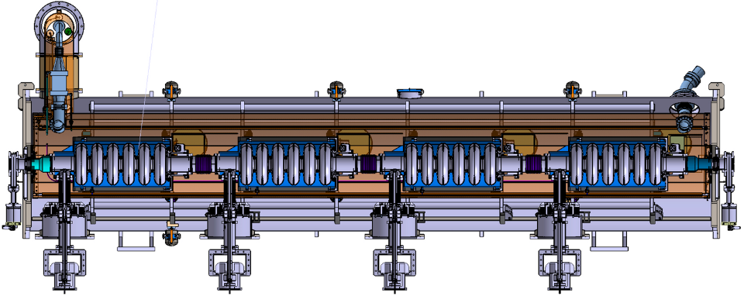
Configuration of the
Refurbished mecctd
Recovered
MP01
Recovered
MP02
Recovered
LASA
MP04

Slide 21
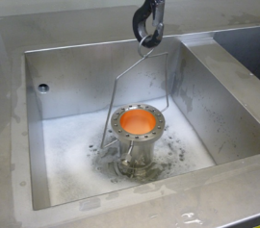
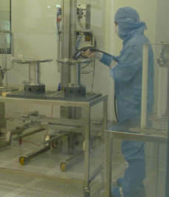
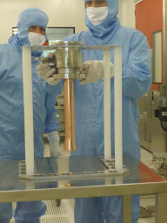
Couplers reprocessing
Examination of the couplers: some scratches on the antennas and some ceramic parts found in the chocks)
Standard cleaning:
  External conductor: degreasing in US bath,
  Antenna & ceramic window: manual cleaning
  Particle counting in clean room
RF power conditioning:
  Duration of RF processing: ~40 h of RF.
  Usual duration of RF processing for unprocessed components: 50 to 100 h.

Slide 22
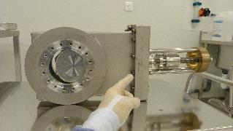
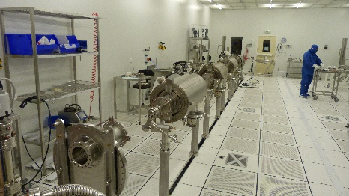
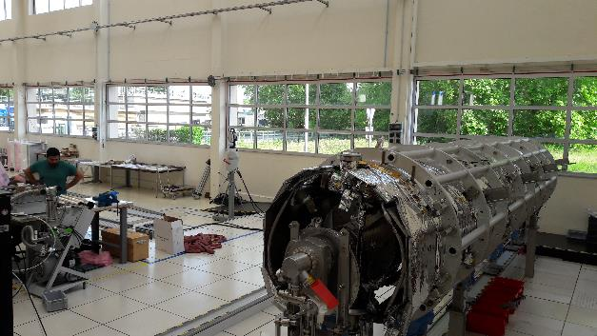
Refurbished M-ECCTD Cryomodule assembly
All the cavities are equipped with a coupler and placed on the feet.
The assembly is starting at the back of the room (right side of the string).
The gate valves have been dismounted, repaired, cleaned and checked in the lab.
(One had been damaged by the ceramic particle wind and was leaky)
The cavity string is presently inside the spaceframe and the thermal shield. The alignment of the cavities is closely followed and readjusted during the transfer of the cavities mass from the feet to the spaceframe.
M-ECCTD assembly performed in the infrastructure dedicated to the series cryomodules assembly

Slide 23
Conclusions
The first tests of the M-ECCTD allowed to validate part of the cryomodule design even though the coupler incident didn’t allow us to preform the high RF power tests. The general cryogenic behavior is good. Some extra losses have been identified and corrected in the second assembly. The tuner has a very good linearity, low hysteresis and the piezo stacks response is as expected.
The second assembly is an opportunity to test and validate the assembly procedure before the arrival of the industrial team (in September).
The cavities could be cured with a standard recipe, and the power couplers could also be reprocessed before the second assembly in the cryomodule.
The assembly of the refurbished M-ECCTD is presently on going and should be complete in few weeks before the start of the RF power tests in July.

Slide 24















































































































Thank you for your attention
Notes:
Project d’envergure avec une équipe de plus de 80 personnes qu’il faut organiser le travail

