Slide 1
Cavity Failures and Beam Dynamics in the ESS Linac
Ciprian Plostinar on behalf of
Mamad Eshraqi, Yngve Levinsen, Ryoichi Miyamoto and Renato De Prisco
SLHiPP-8, 12-13 June 2018
Ångström Laboratory, Uppsala

Slide 2
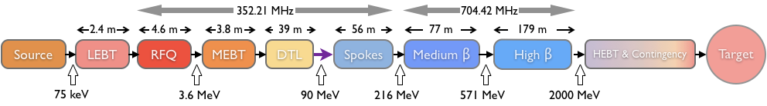
The ESS Linac
Ion Species | Protons
Output Energy | 2 | GeV
Frequency | 352.21/704.42 | MHz
Pulse Length | 2.86 | Ms
Peak Current | 62.5 | mA
Protons per Pulse | 1.1 x 10¹⁵
Repetition Rate | 14 | Hz
Duty Cycle | 4 | %
Average Beam Power | 5 | MW
Accelerating Structures | RFQ, DTL, SC Spokes/Elliptical
Accelerator Length | ~365 | m

Slide 3
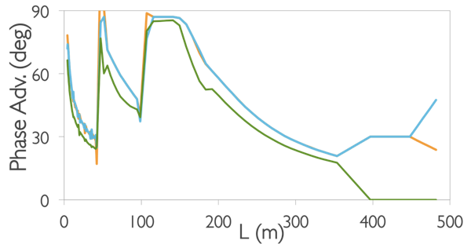
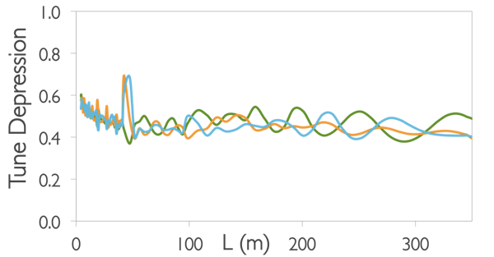
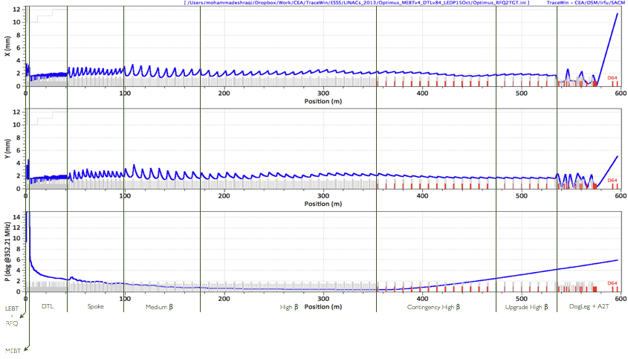
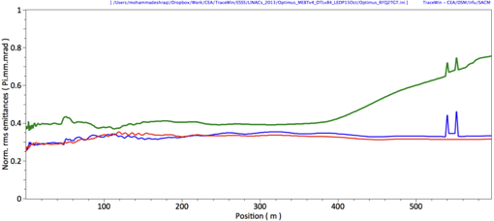
The ESS Linac - Baseline Beam Dynamics
End-to-end Envelopes
RMS Emittance Evolution

Slide 4
Cavity Failure Cases
Loss of field:
  Failure in the chain of high power RF
  Failure in cavity/environment
  Failure in control system
End-to-end muti-particle beam dynamics error studies (MEBT to A2T):
  Using beam distribution from RFQ simulation
  TraceWin/Partran
  Note the loss pattern rather than magnitude

Slide 5
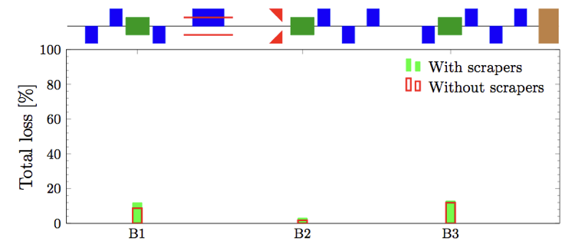
MEBT Cavities
Total losses in the whole linac in number of particles due to a complete failure of each MEBT lattice element, comparing the cases with and without the three MEBT scrapers.

Slide 6
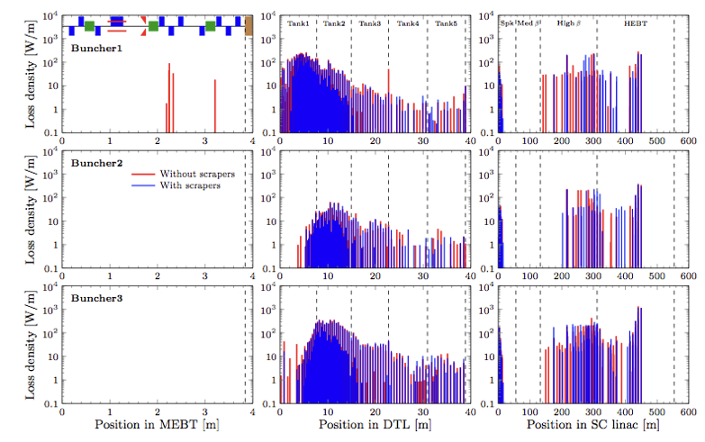
MEBT Cavities
Losses in linac due to complete failure of MEBT Bunchers. Losses into the three MEBT scrapers are not shown.

Slide 7
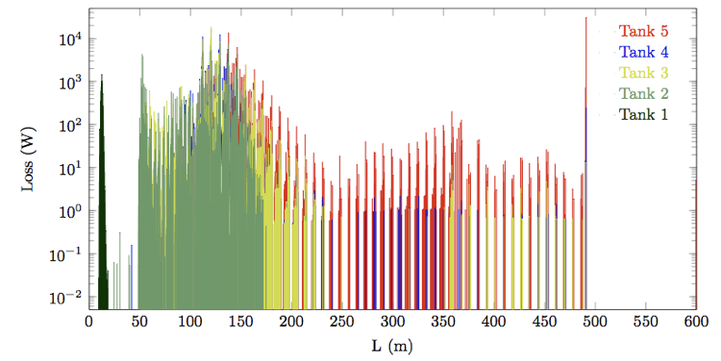
DTL Tanks
Losses due to individual DTL tank RF failure

Slide 8
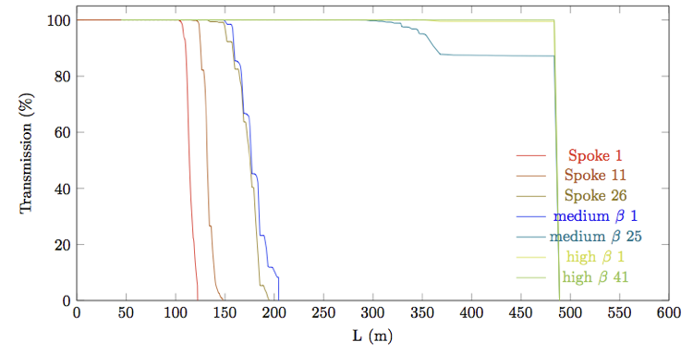
SCL Cavities
Transmission for different cavity failure scenarios.

Slide 9
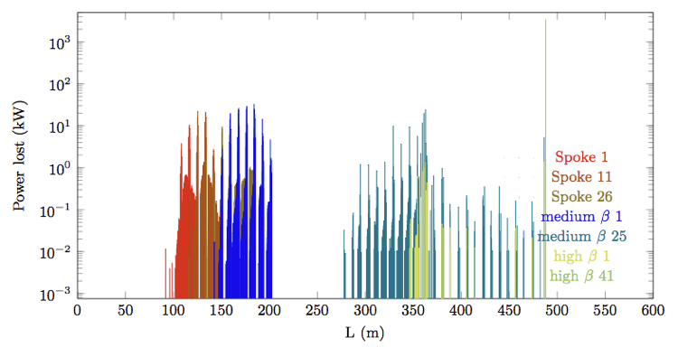
SCL Cavities
Power lost for different cavity failure scenarios.

Slide 10
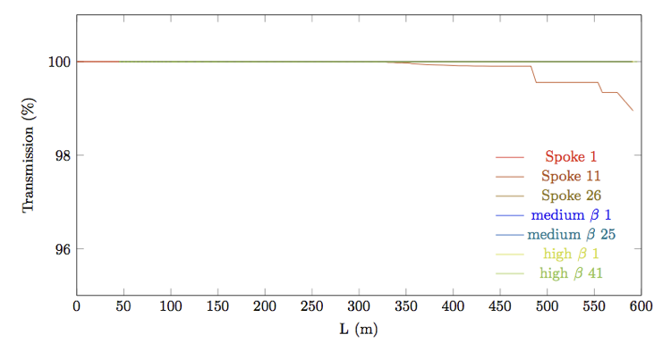
SCL Cavities – with correction
Transmission after correction for the failed cavities. The reason Spoke 1 is not fully recovered is the “procedure used” for the correction. Using more cavities one can recover the beam in that case too.

Slide 11
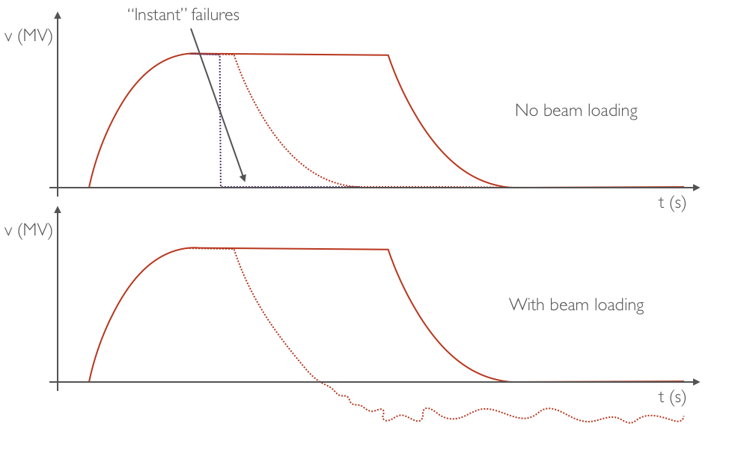
Transient Effects

Slide 12
Assumptions
Sync phase stays constant
  valid for close to nominal field in the failing cavity
Cavity gets loaded by the beam at -50% of its operating voltage
  valid for cavities operating at the maximum of range, for lower voltages a value above |-50%| is closer to reality
The LLRF of the downstream cavities does not correct for delayed arrival
Losses are per microsecond, depending on the Q of the cavity and beam current, they should be scaled.

Slide 13
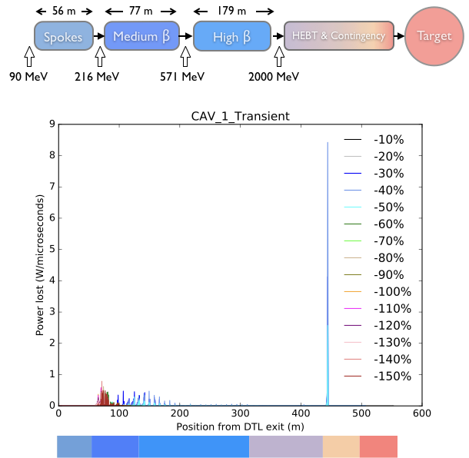
Losses
SPK Cavity 1

Slide 14
More Losses
SPK Cavity 1
SPK Cavity 11
SPK Cavity 26
MBL Cavity 1
MBL Cavity 36
HBL Cavity 1
HBL Cavity 40
HBL Cavity 84

Slide 15
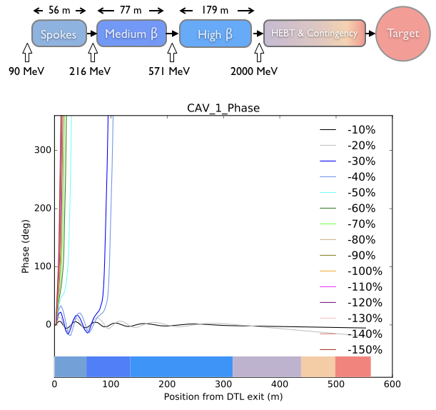
Predicting the loss – Minority Report
SPK Cavity 1
By looking at the amplitude and phase signal of the BPMs, beam loss/RF failure could be anticipated!

Slide 16
Predicting the loss
SPK Cavity 1
SPK Cavity 11
SPK Cavity 26
MBL Cavity 1
MBL Cavity 36
HBL Cavity 1
HBL Cavity 40
HBL Cavity 84

Slide 17
Is it detectable?
It depends on the modulation depth of the density required by the BPMs.
For 10% modulation, bunches with ~150 deg rms can be detected.
1% corresponds to ~200 deg RMS.

Slide 18
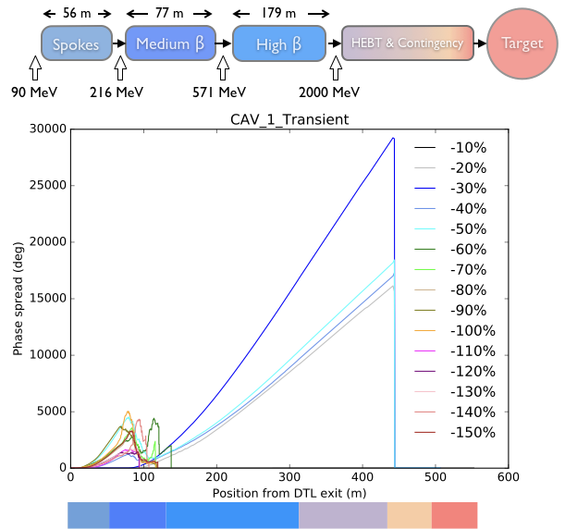
Bunch length
SPK Cavity 1

Slide 19
Bunch length
SPK Cavity 1
SPK Cavity 11
SPK Cavity 26
MBL Cavity 1
MBL Cavity 36
HBL Cavity 1
HBL Cavity 40
HBL Cavity 84

Slide 20
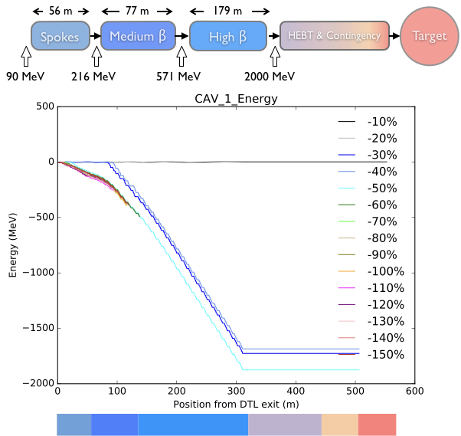
Energy
SPK Cavity 1

Slide 21
Energy
SPK Cavity 1
SPK Cavity 11
SPK Cavity 26
MBL Cavity 1
MBL Cavity 36
HBL Cavity 1
HBL Cavity 40
HBL Cavity 84

Slide 22
Summary
Instant Failures
  MEBT:
    Bunchers: A large fraction of the beam actually reaches the target.
      MEBT scrapers largely ineffective for longitudinal losses.
  DTL:
    Considerable amount of losses inside Tanks 1 and 2 if Tank 1 is not at its nominal voltage.
  SCL:
    Depending on the energy at the failed cavity, the unaccelerated particles will be either lost locally or in the DogLeg.
Transient Effects
  Beam loss/RF failures could be predicted/detected before noticeable losses occur by looking at the amplitude and phase signal of the BPMs!
    Potential supplementary diagnostic information

