Slide 1
OVERVIEW OF THE
ESS BEAM DIAGNOSTICS
Tom Shea
and the ESS Beam Diagnostics Team
Input from: C. Thomas, J. Norin, B. Cheymol, S. Molloy, R. Baron, H. Hassanzdegan, I. Kittelmann, T. Grandsaert, V. Grishin, H. Kocevor, C. Derrez,, M. Eshraqi, E. Adli, M. Poggi, M. Ferianis, I. Bustinduy, P. Aden, T. Papaevangenlou, J. Marroncle, L. Segui, S. Vilcins, A J. Johannson, and staff from virtually all partner and collaborating institutes.

Slide 2
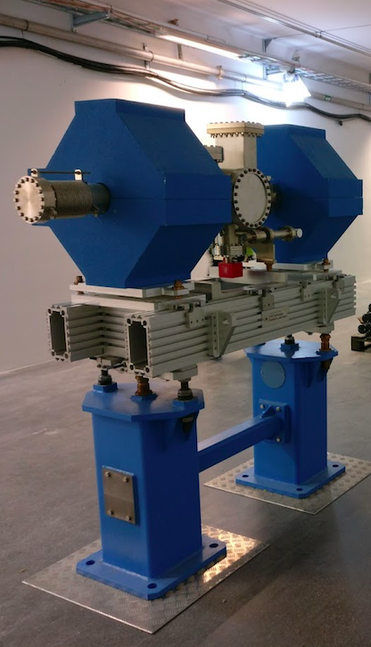
Outline
Overview
  Diagnostics Team Organization
  Beam Diagnostics Suite: Quantities and Scale
Systems Organized by Measurement Capability
(highlighting only those in the superconducting linac)
  Beam Accounting
  Measurement of Beam Centroid
  Measurement of Beam Distribution
Protection
Outlook

Slide 3
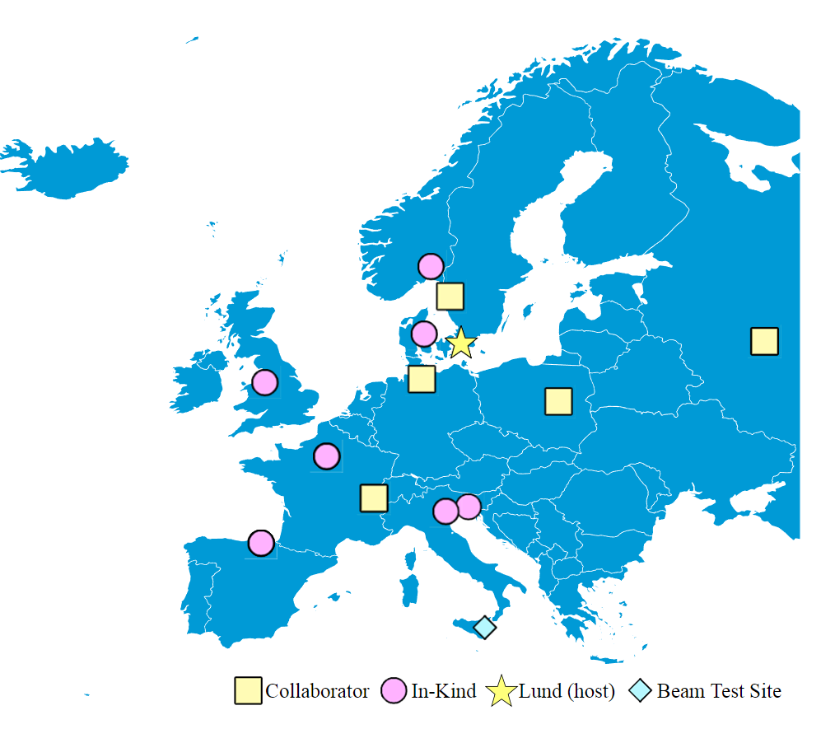
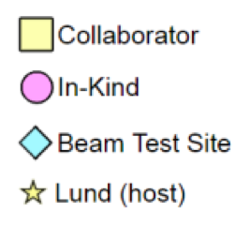
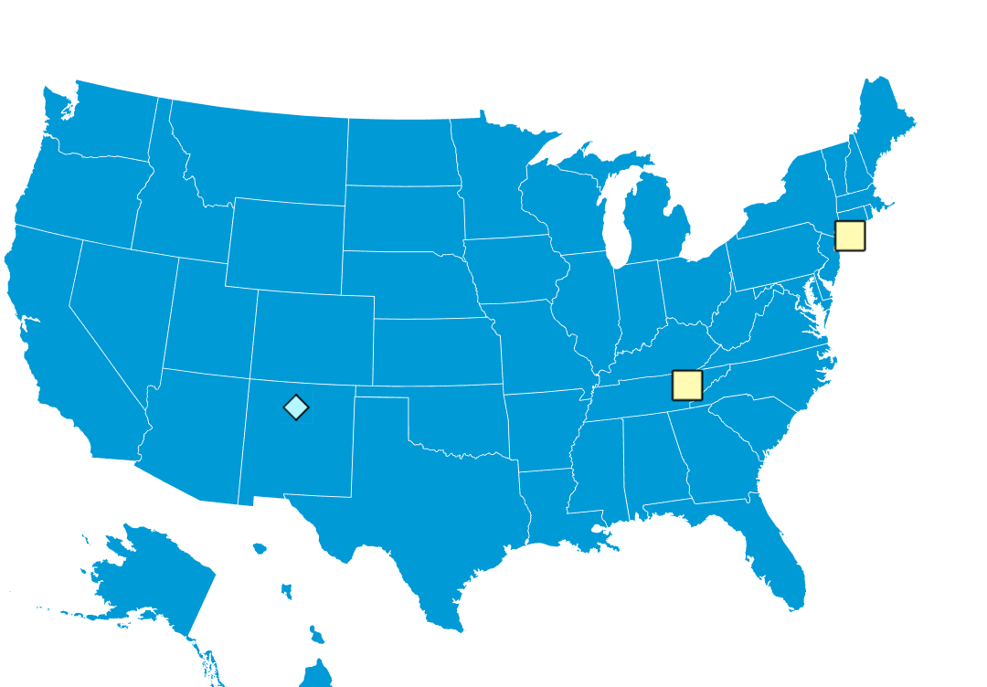
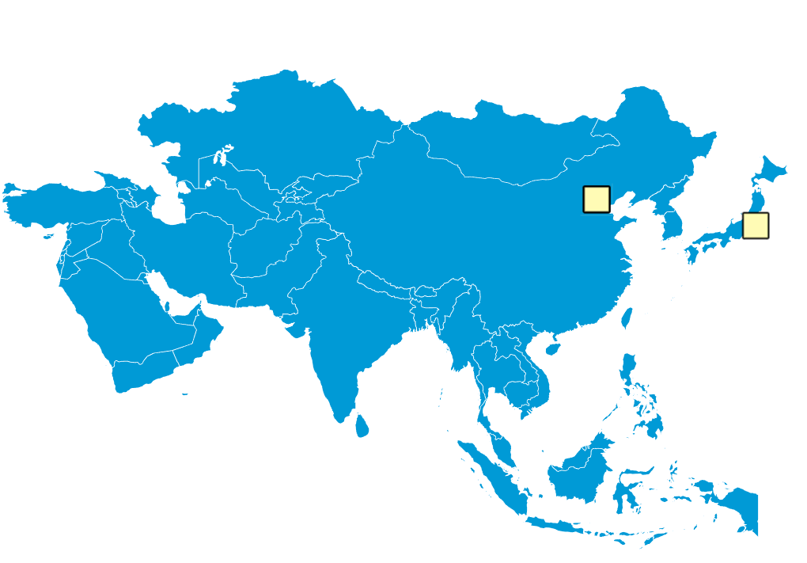

ESS Diagnostics:
22 Partners and Collaborators
Aarhus University
CEA Saclay, Paris
CERN, Geneva
Cockcroft Institute, Daresbury
DESY, Hamburg
Elettra – Sincrotrone Trieste
ESS Bilbao
INFN, Catania
INFN, Legnaro
Lund University
University of Oslo
Technical University of Denmark
Science and Technology Facilities Council, Daresbury
Warsaw University of Technology
IMP, China
J-PARC, Japan
Oak Ridge National Laboratory
Los Alamos National Laboratory
INR, Moscow
Högskola Väst, Trollhättan
Stony Brook U., New York
BNL, New York

Slide 4
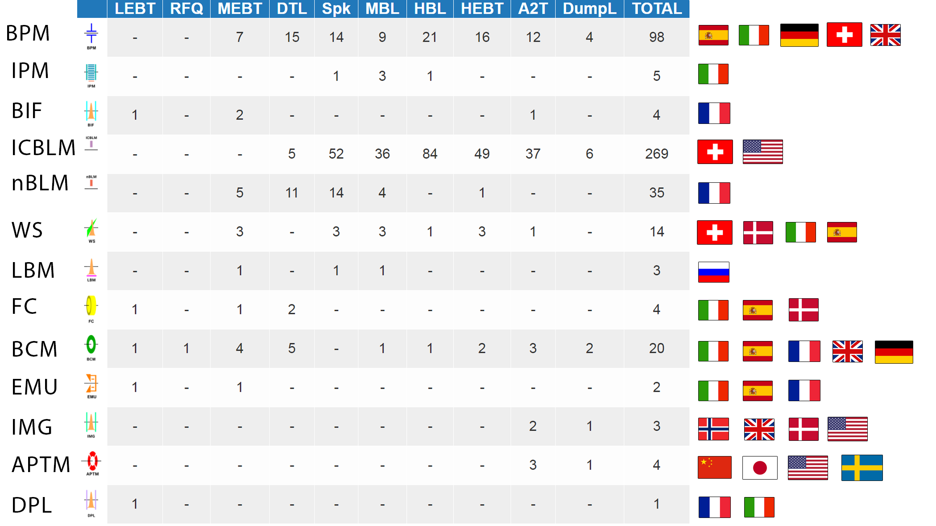






Slide 5
Scale
22 types of beam diagnostic systems
466 diagnostic systems with ~µs protection capability
>10000 tracked assets
~ 50 equipment racks in gallery
Tunnel: 514 diagnostic systems in the baselined lattice and shown in synoptic display
Stubs: 1740 long-haul cable runs (ion chamber BLM cables highlighted)
Gallery: 2260 named devices (rack-mounted electronic devices for ion chamber BLM highlighted

Slide 6
Beam Accounting
Measuring beam current and where it is lost
  Constituents of beam extracted from ion source
  Losses that damage or activate accelerator
  Energy delivered to beam destinations
  Beam leaving aperture and overheating target/dump components
Systems
  Doppler
  Faraday Cups
  Beam Current Monitors
  Beam Loss Monitors
    Neutron detectors
    Ion chambers
  Aperture Monitors
From cradle
To grave

Slide 7
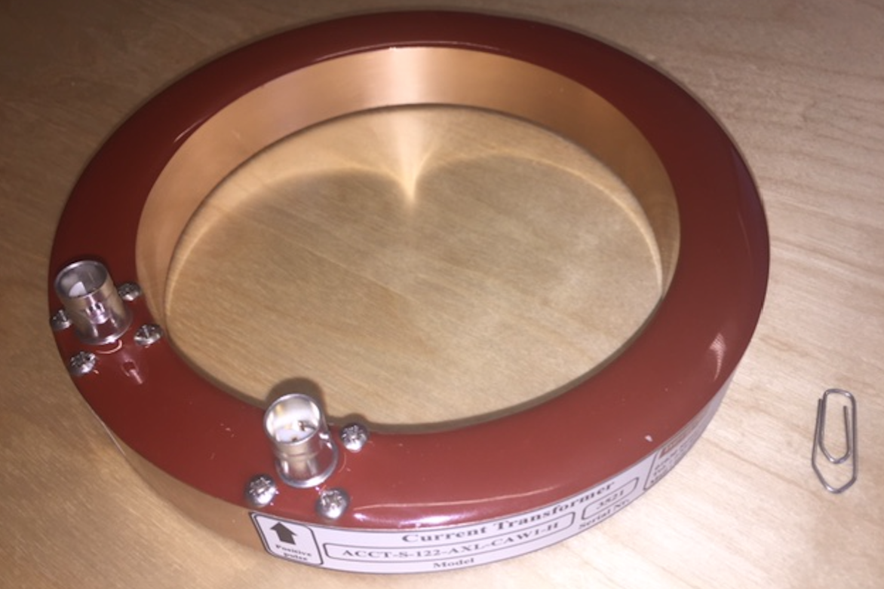
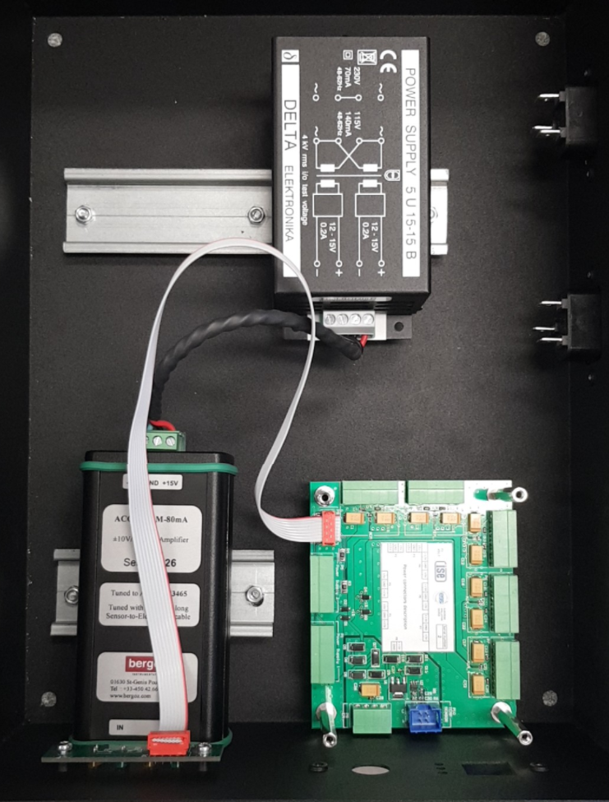
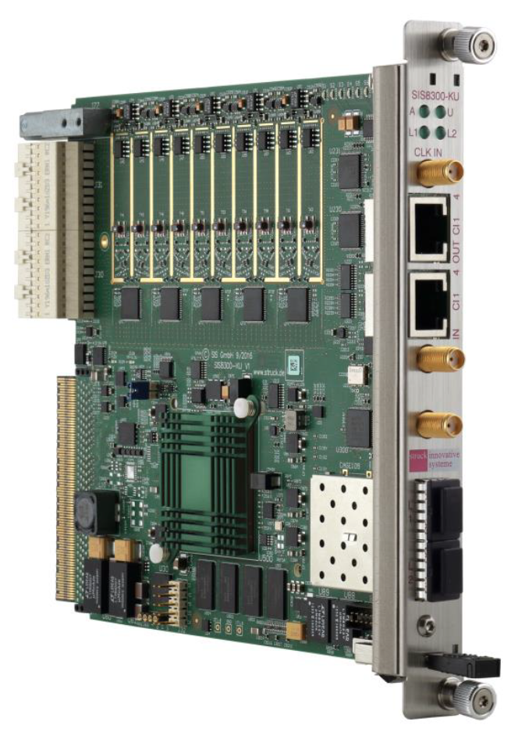
Beam Accounting: Current Monitors
AC Current transformers in superconducting section
Integrated into vacuum flanged assembly
Signal handled by front end electronics before transmission to MTCA-based acquisition system.
~ mA accuracy, µs response

Slide 8
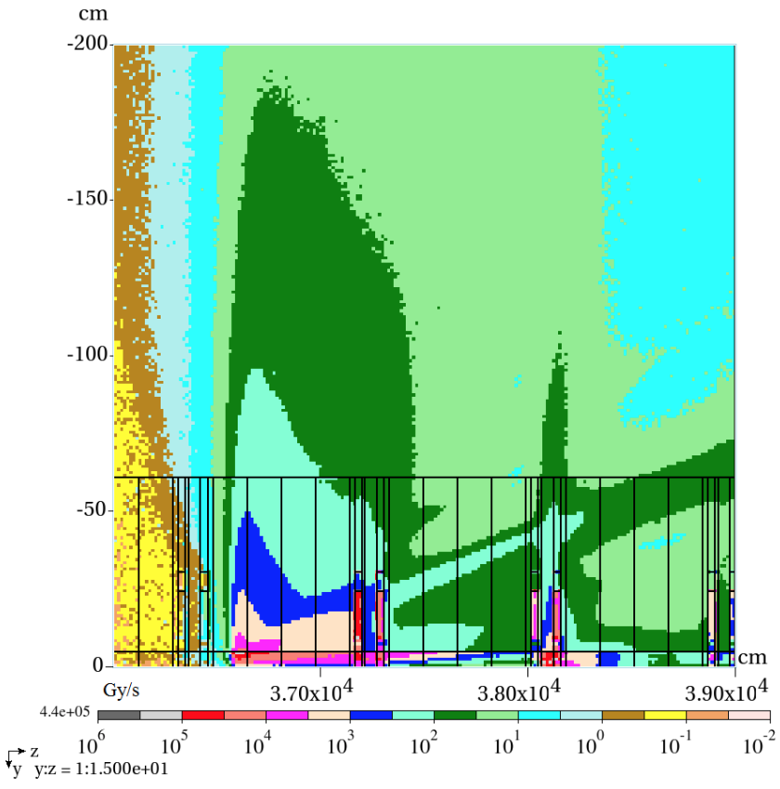
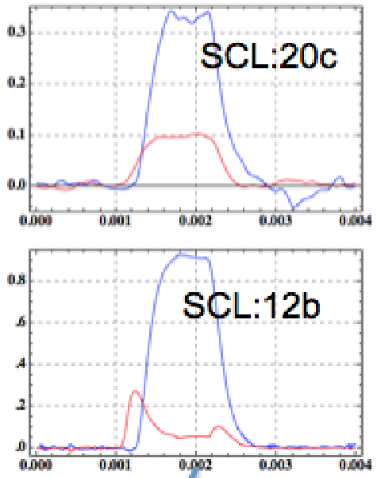
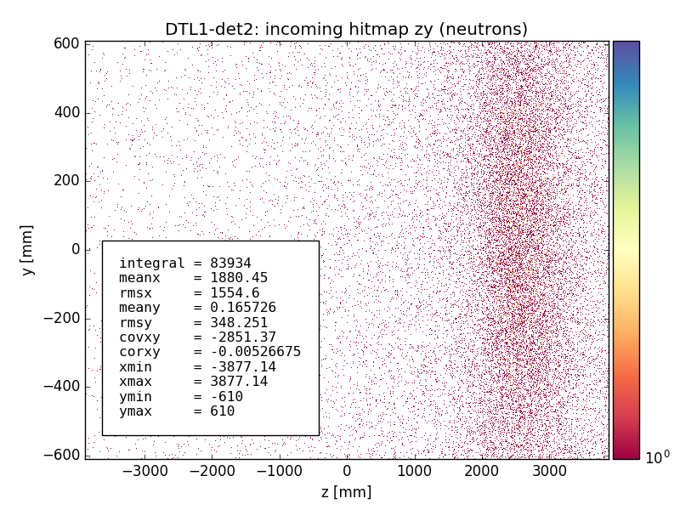
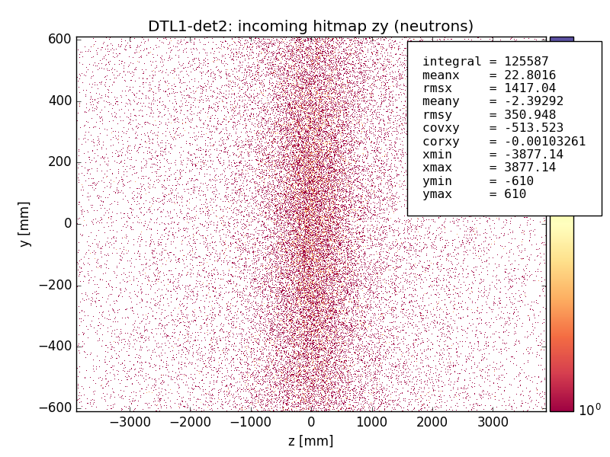
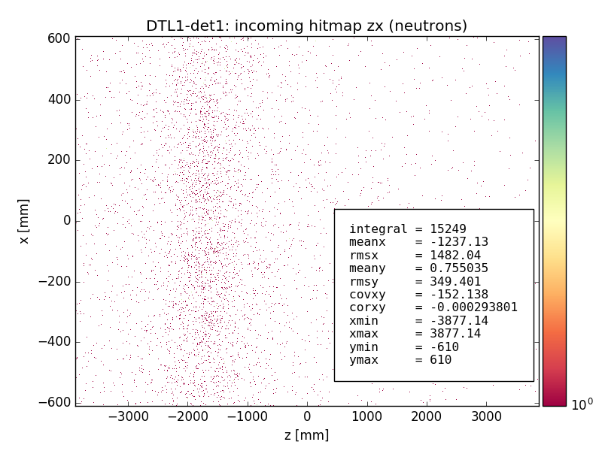
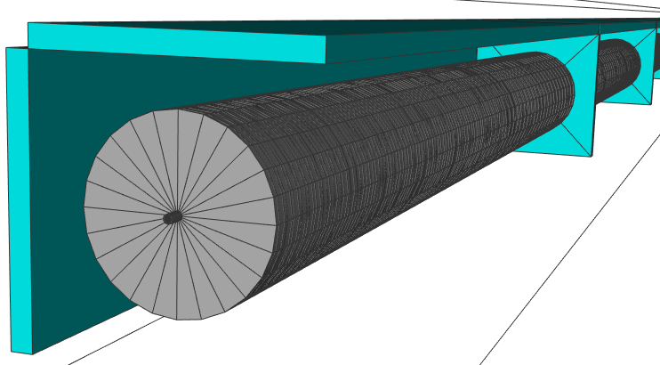
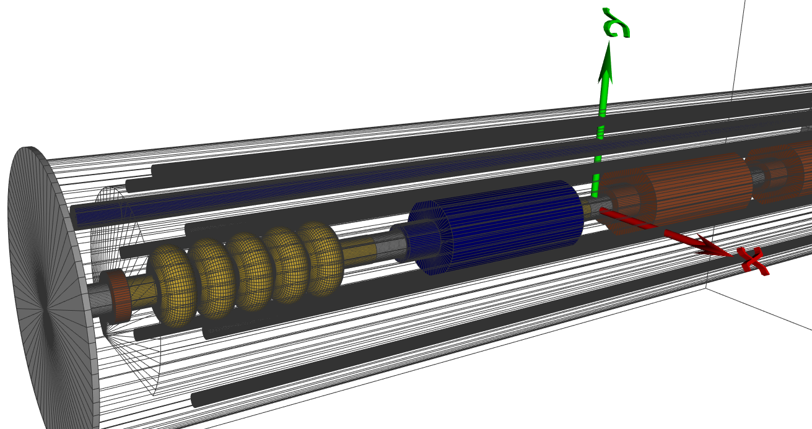
Beam Accounting:
Beam Loss
Photon background
X-Ray spectroscopy
Real-time background subtract
Particle discrimination
In SCL: MARS simulation.
dose from point loss @ 2 GeV
Neutron hit maps from GEANT4 for 3 different localized loss locations along the DTL tank1: possible correlation of the distribution peak position with the loss location
(SNS example)
M. Jarosz
SCL GEANT4 simulations commencing with more detailed model
y
z
x
I. Kittelmann

Slide 9
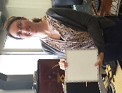
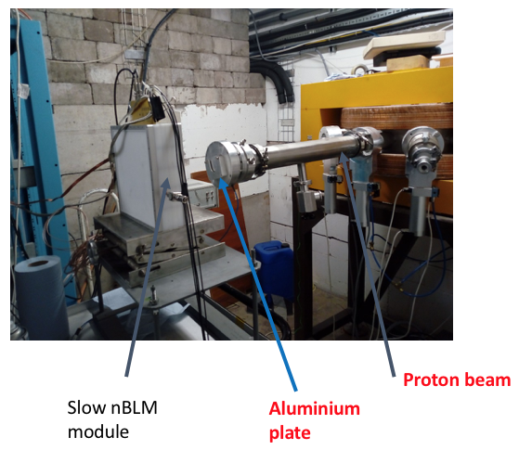
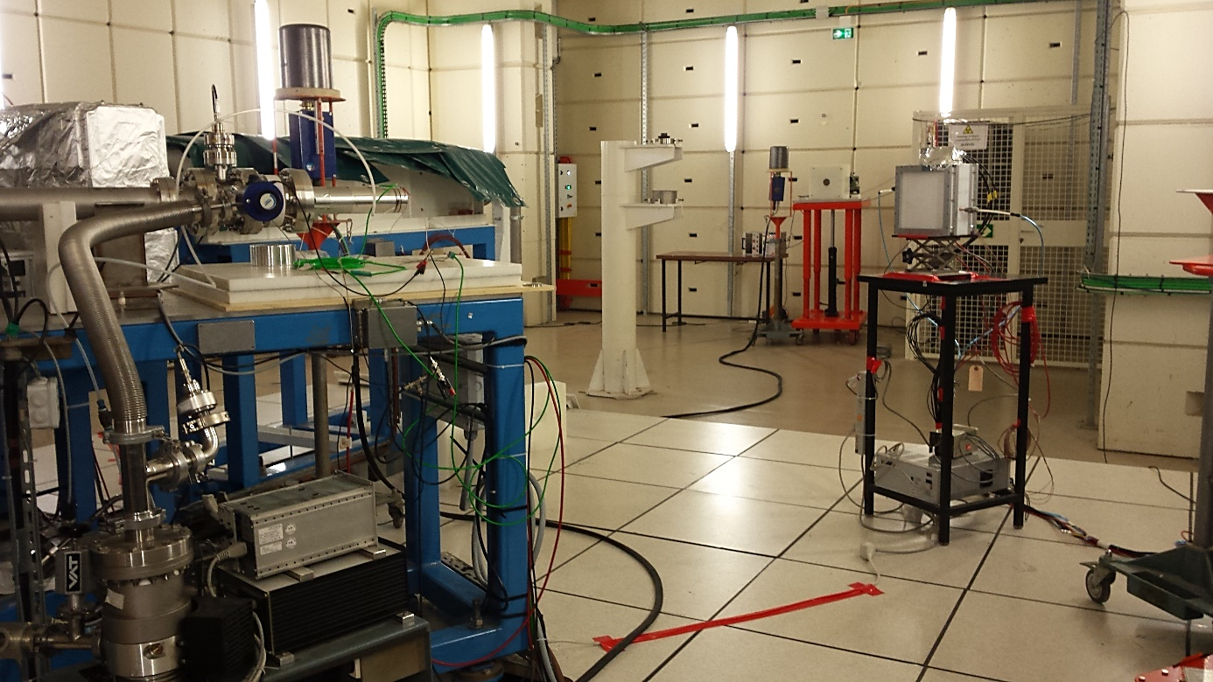
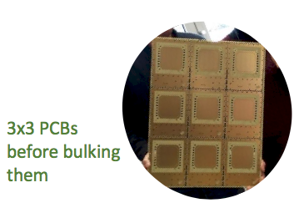
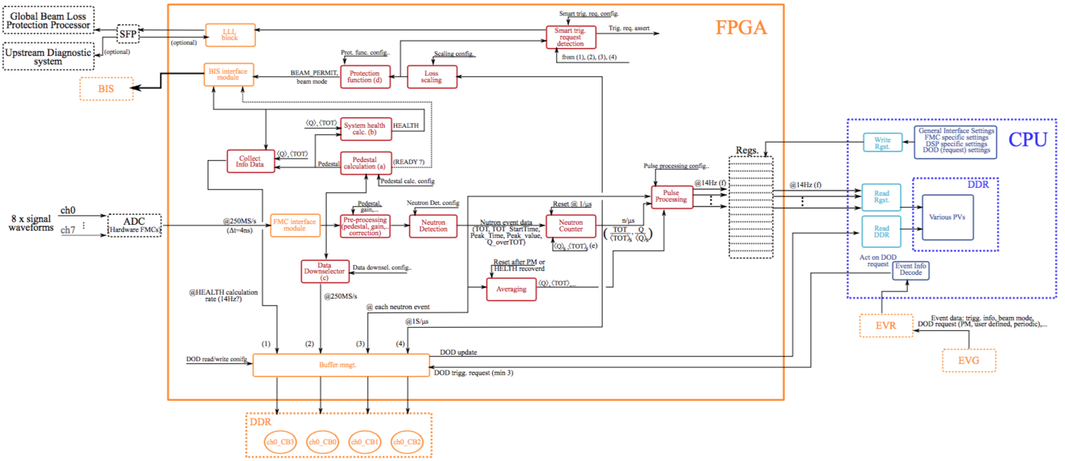
Beam Accounting: Neutron Detectors
Birmingham 40 MeV protons on Al
IPHI 3 MeV protons on Be
Draft of FPGA architecture
Neutron event detection
Handle pile-up and transition to current readout mode
Continuously buffered data acquisition with trigger system
(Data on Demand – feature shared with other systems)
CEA, ESS-Lund, Łodz

Slide 10
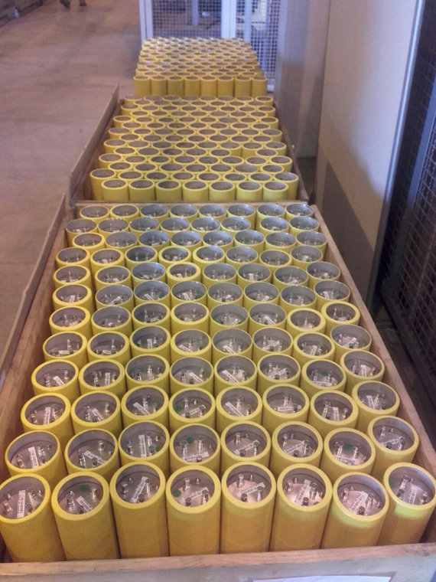
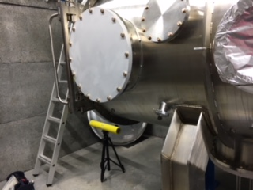
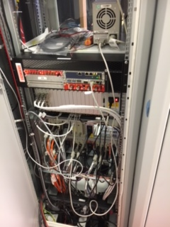
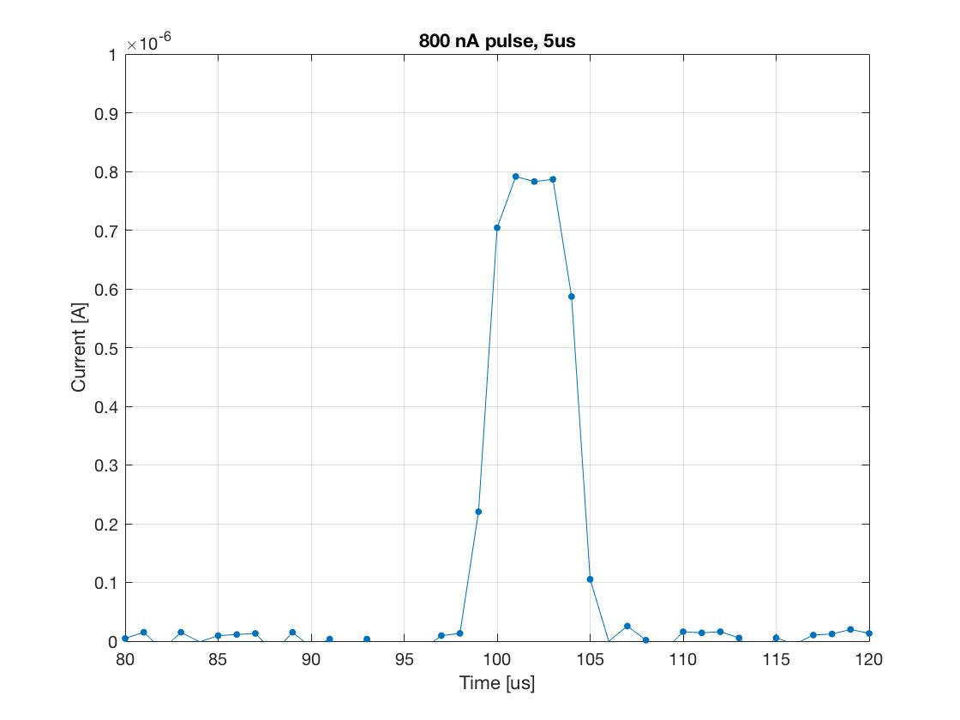
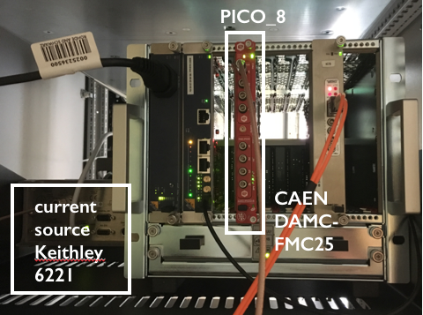
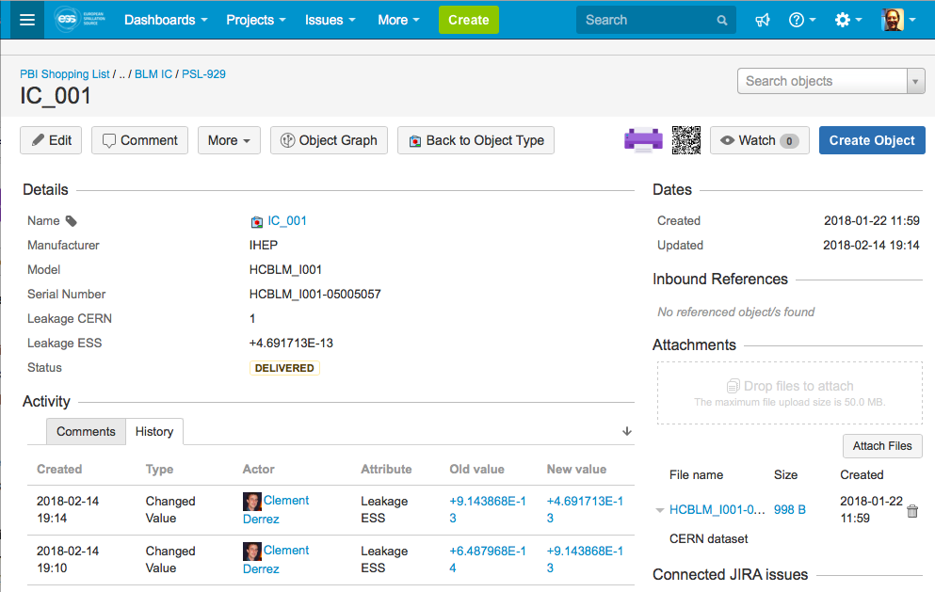
Beam Accounting: Ion Chamber Loss Monitors
Installed here in Uppsala for photon and EMI testing
All 285 detectors received summer 2017
Proton beam tests at CERN,
Gamma at LTH
Data transfer via API (in testing)
Short pulse (5 us):
→ 1% of 1 W/m
Data (HDF5), Device status in asset management system

Slide 11
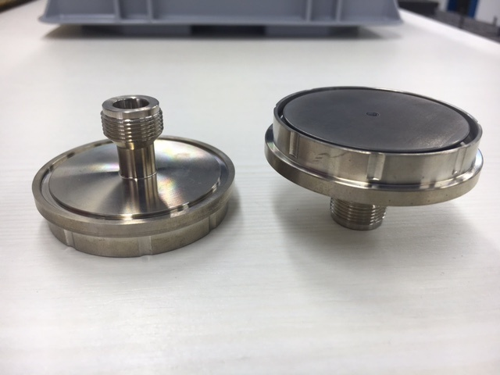
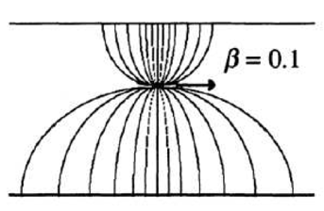
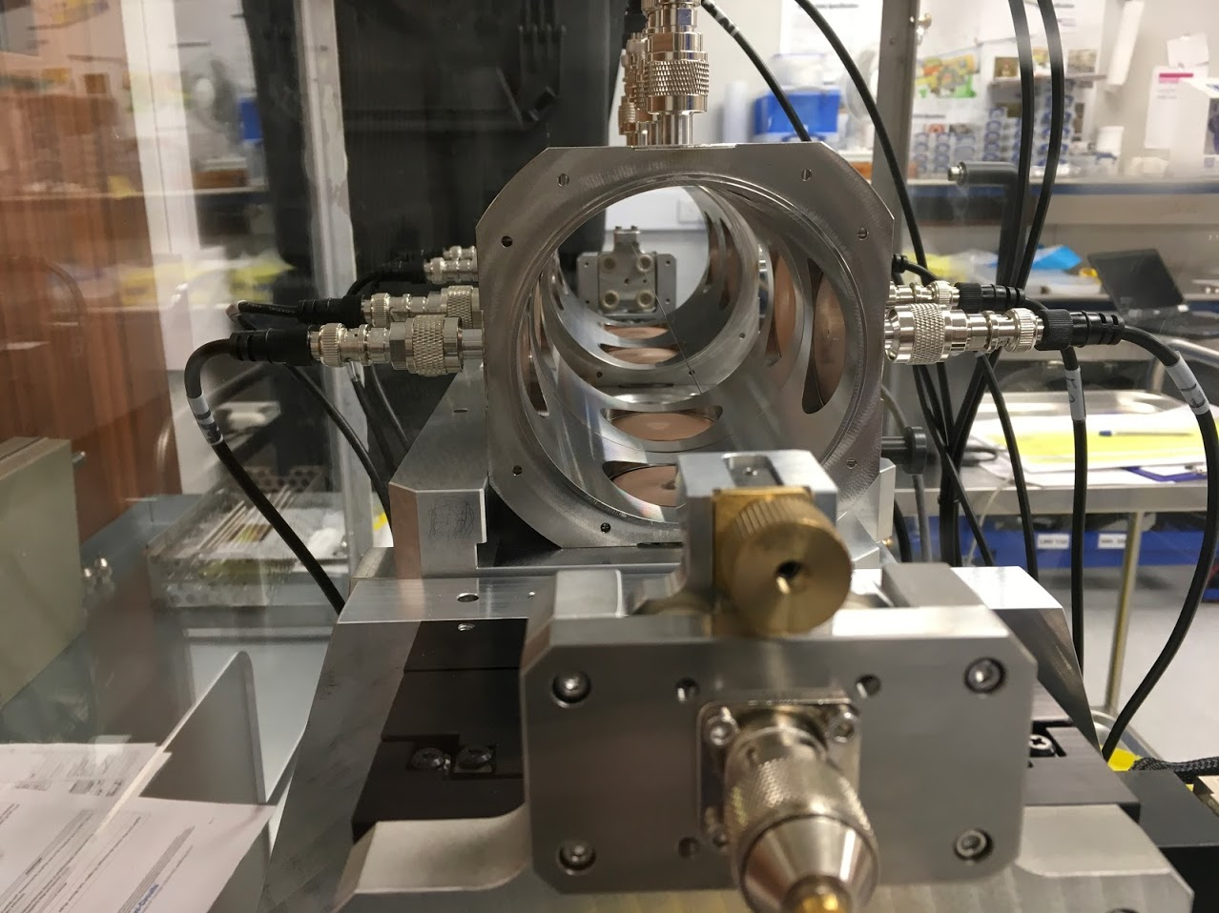
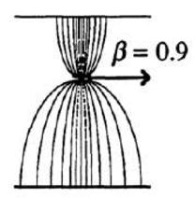
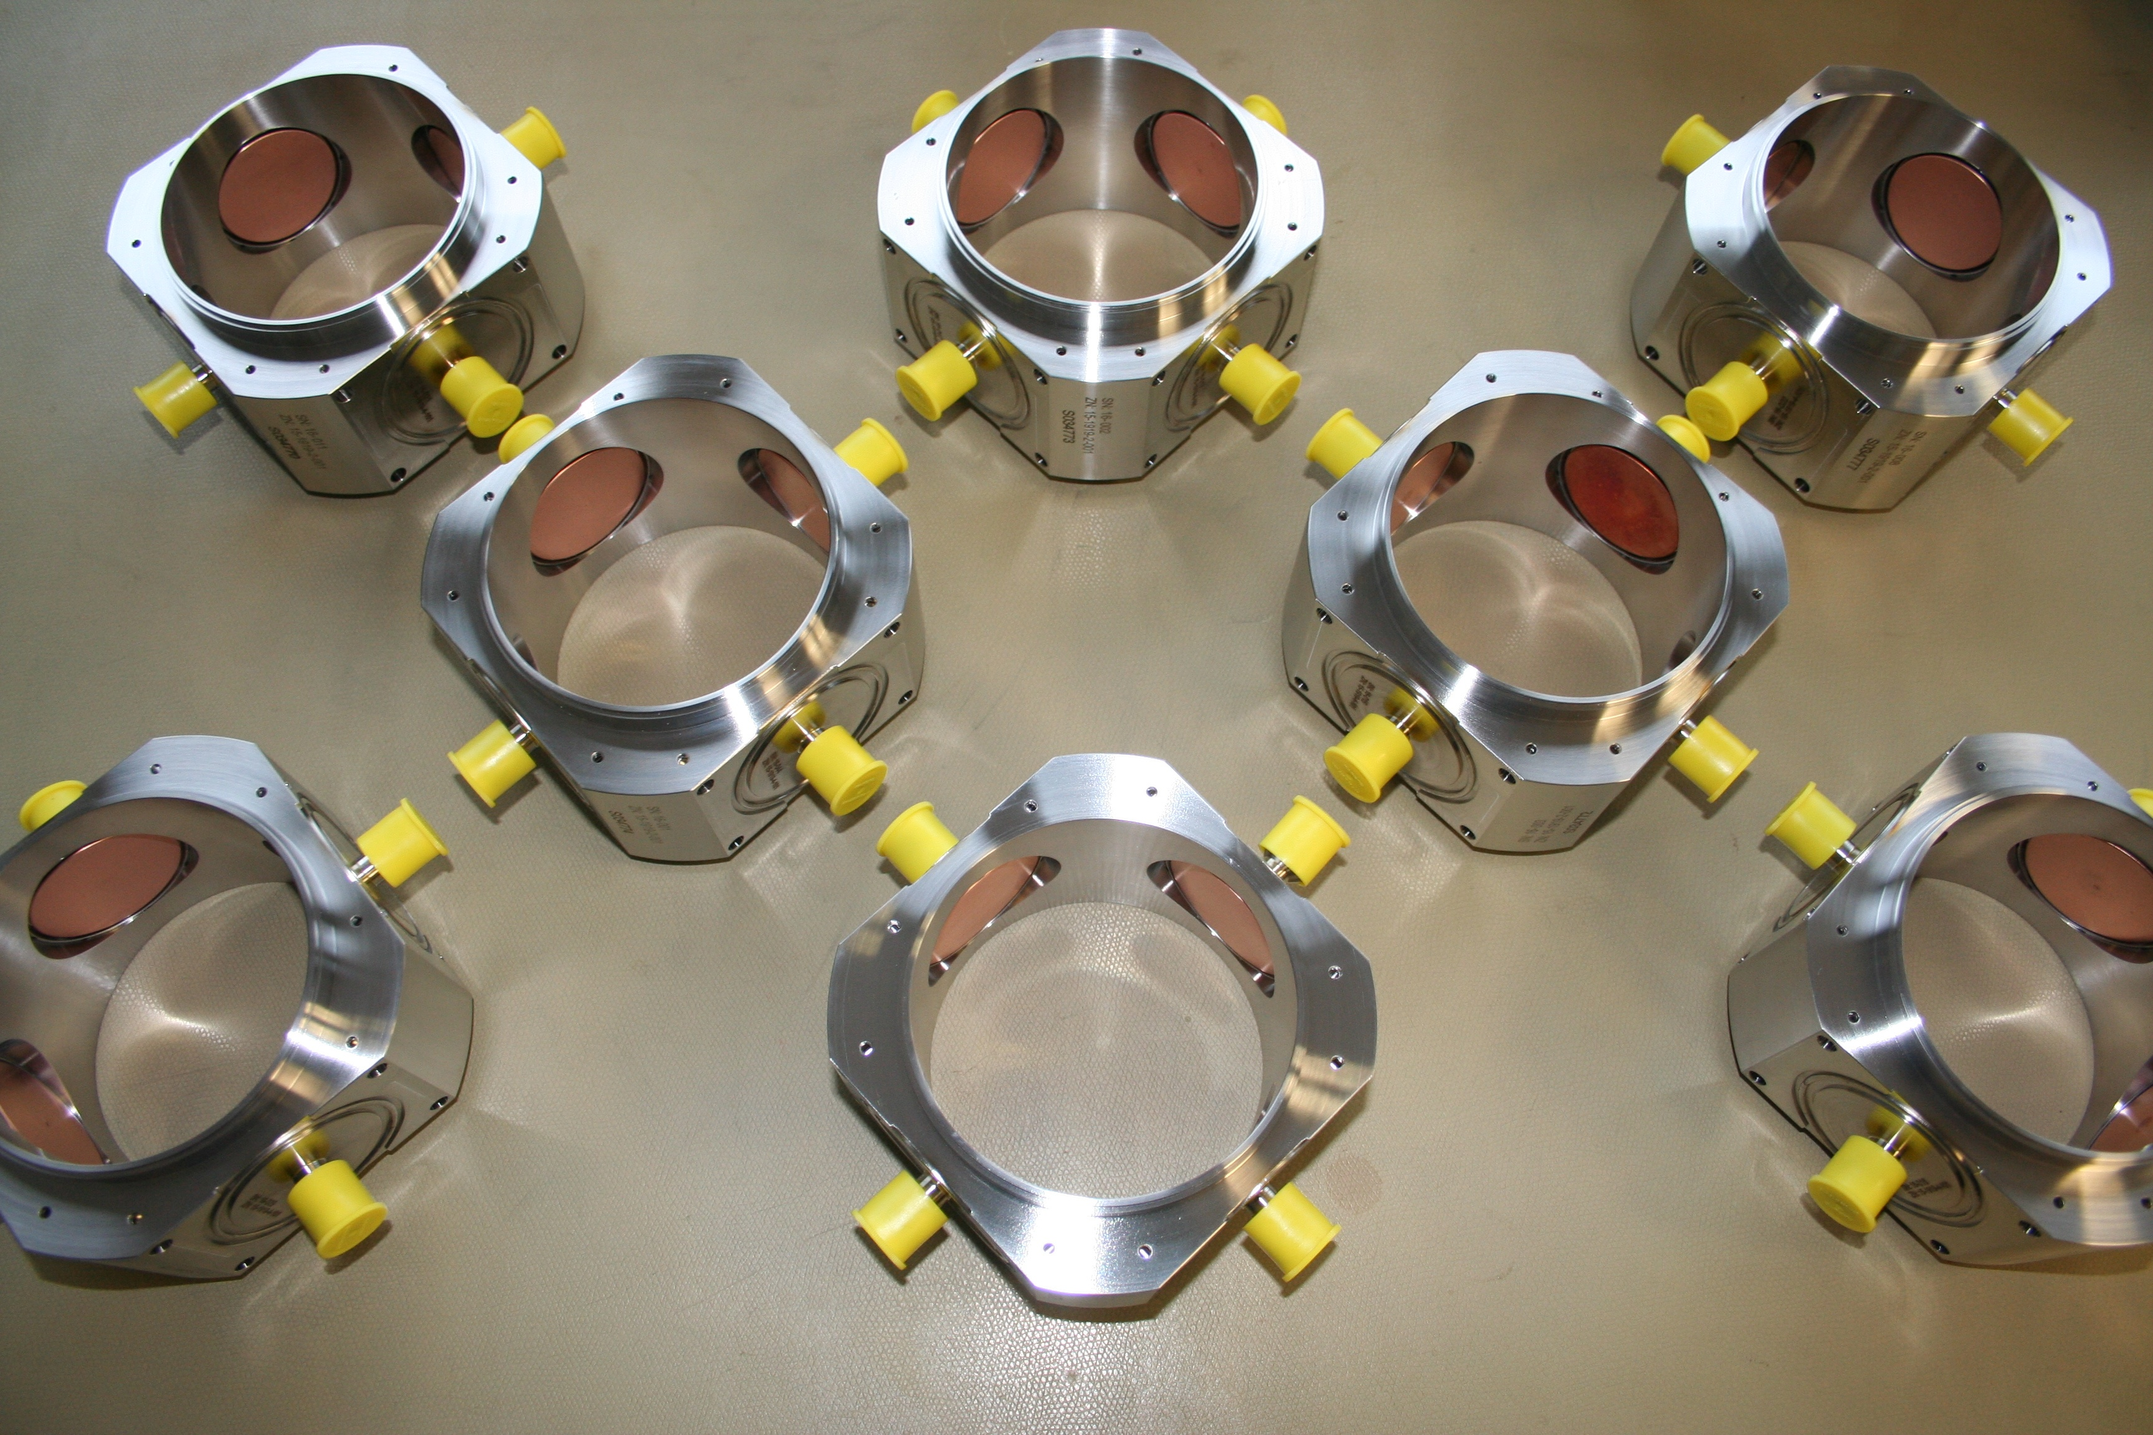
Centroid Measurements:
Beam Position and Phase
Button assembly manufacturing: DESY
Characterized and embedded in LWU at Daresbury

Slide 12
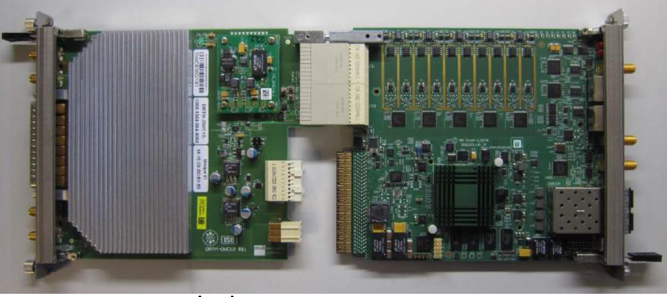
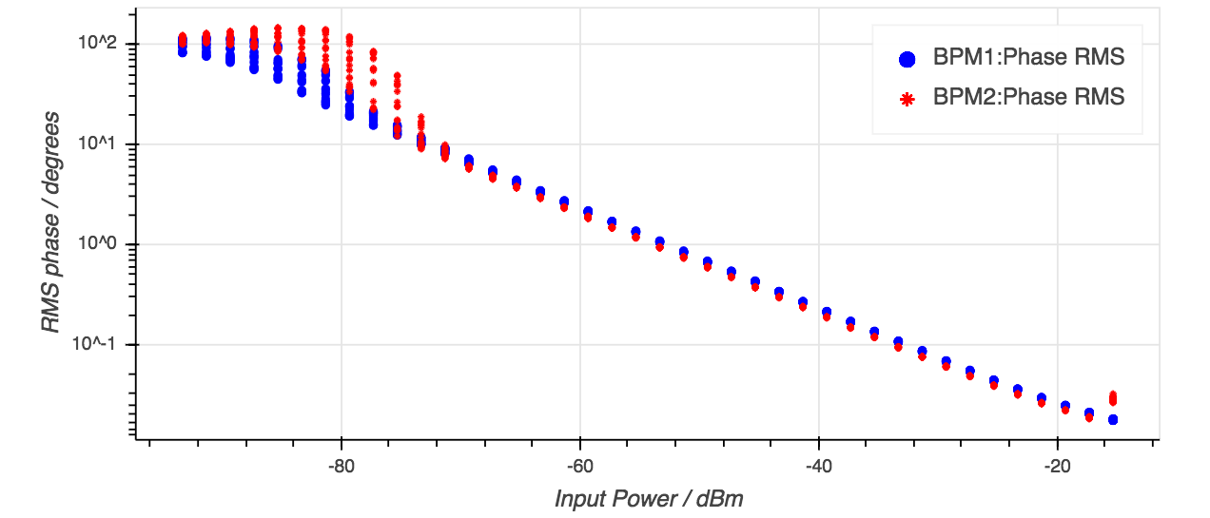
Centroid Measurements:
Beam Position and Phase
Focus on phase performance
Electronics, FPGA framework, non-IQ receiver design coordinated with LLRF team
Struck transition module, Digitizer w/Xilinx KU in MTCA
Also, custom RF front end
Approximately 1 mA of beam
Approximately 0.1 mA of beam
S. Molloy, R. Baron, ESS Lund

Slide 13
Beam Distribution Measurements
Emittance Measurement Units
Wire Scanners
Bunch Shape Monitors
Non-invasive profile
Grid
Imaging

Slide 14
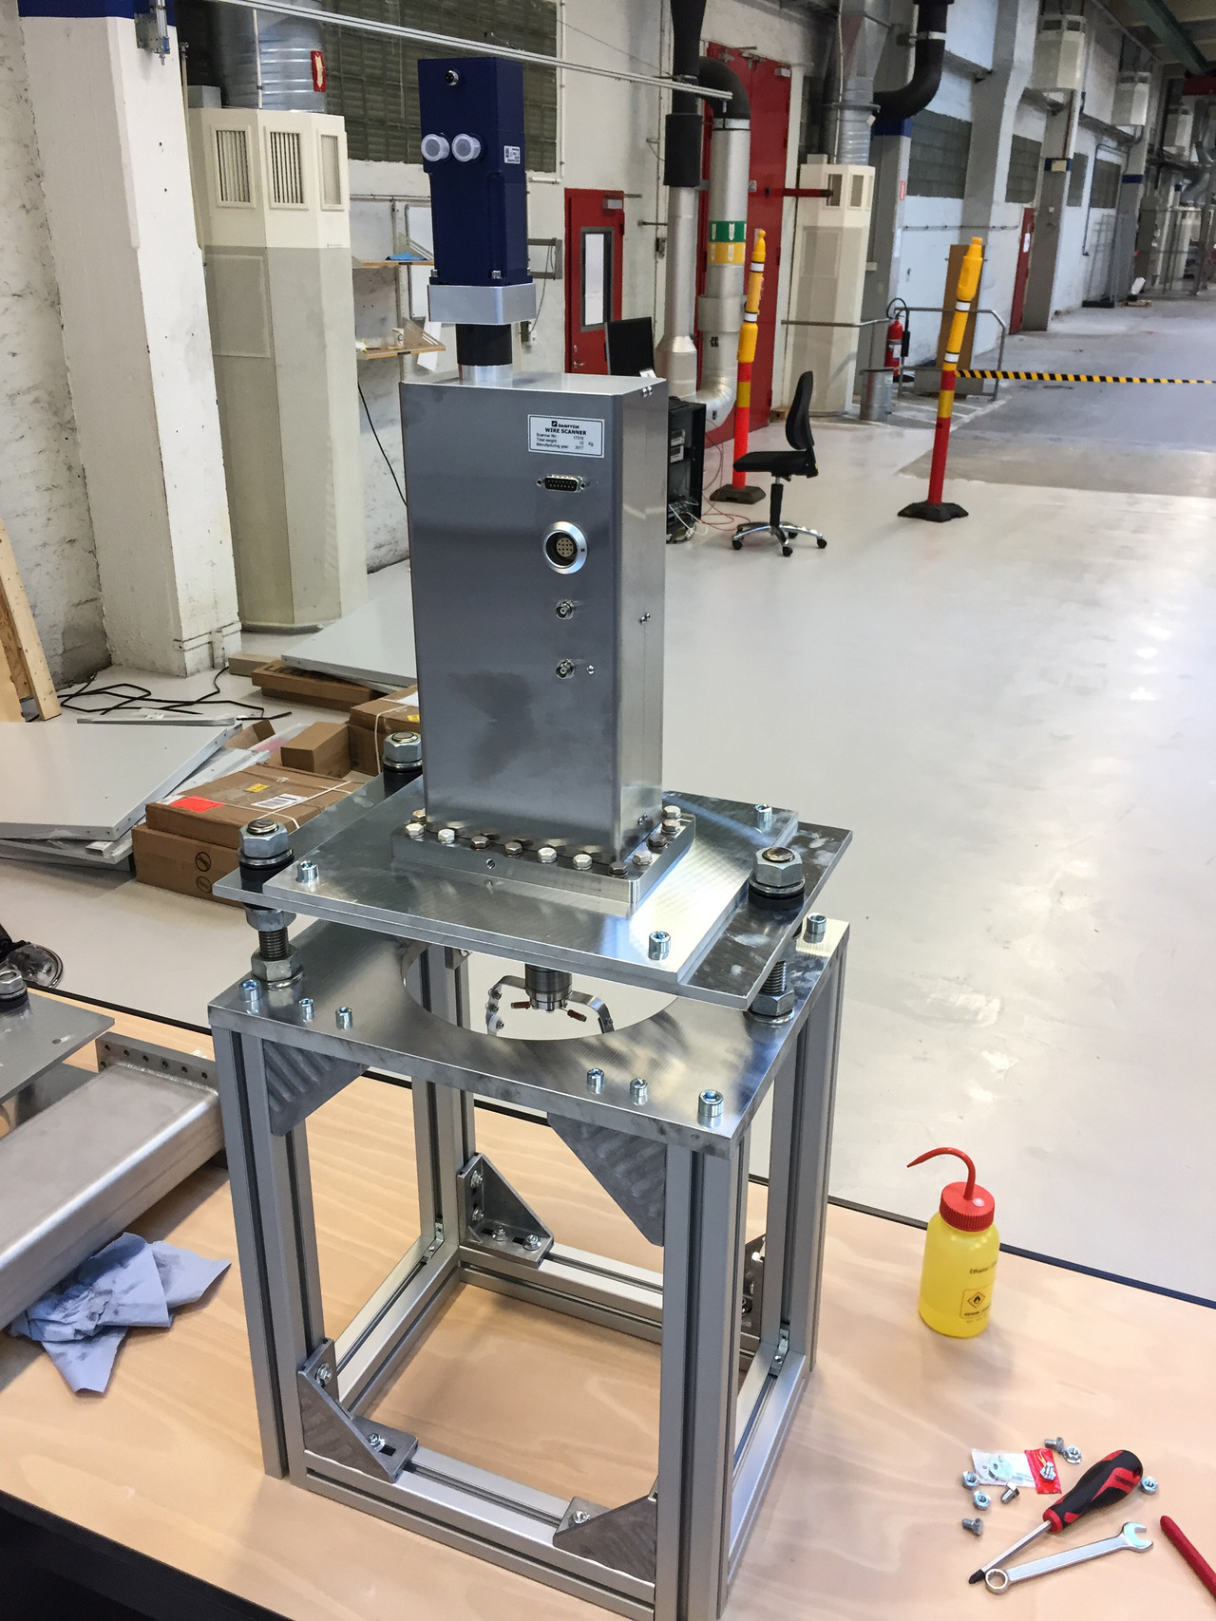
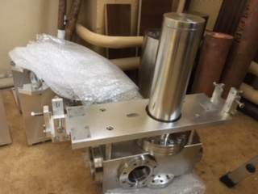
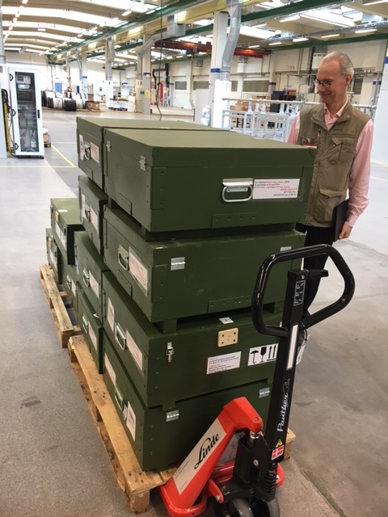
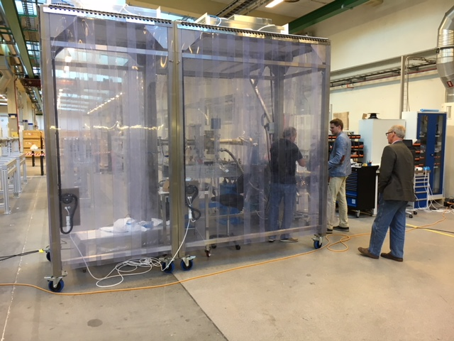
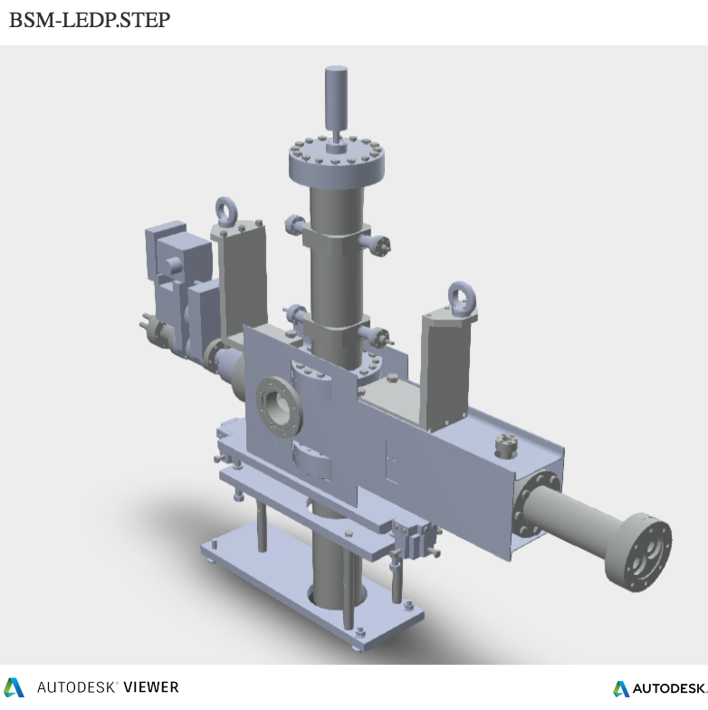
Distribution Measurements:
Invasive Profile: Wire Scanners, BSM
Linac wire scanner actuator: Århus; acceptance testing in RATS
Bunch Shape Monitors: delivery complete from INR.
A few ps resolution.
Clean room in Lund
Wire Scanner Electronics: Trieste
Grid Electronics: LTH

Slide 15
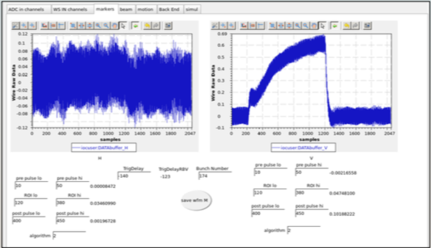
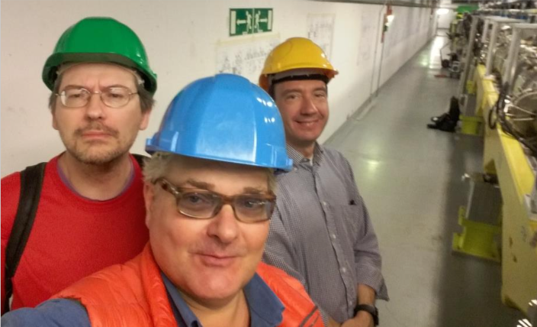
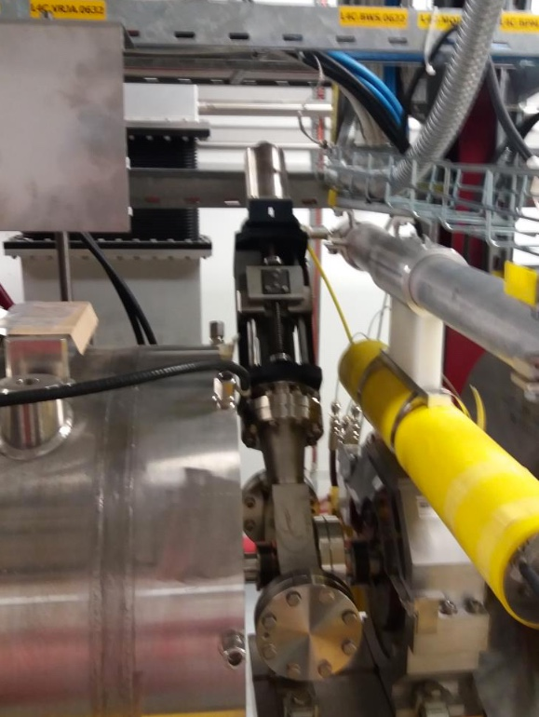
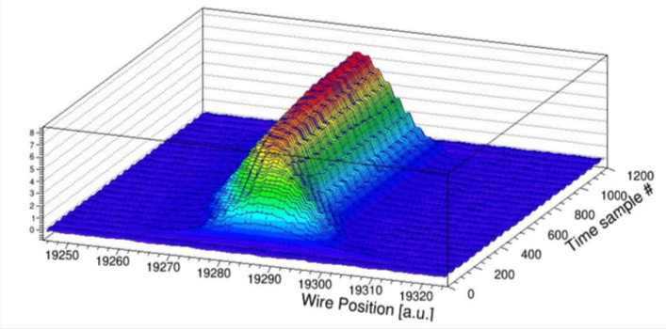
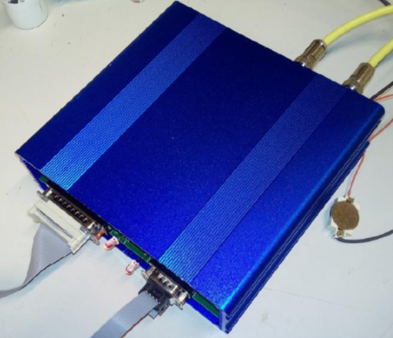
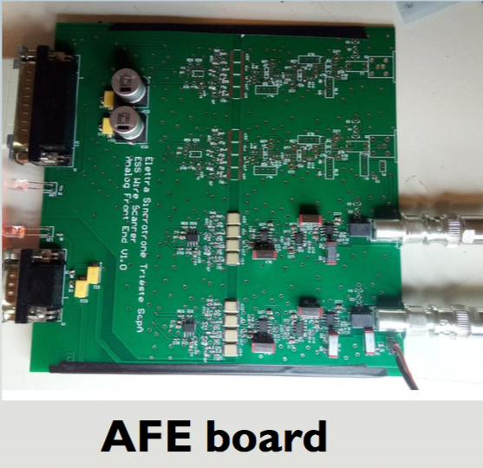
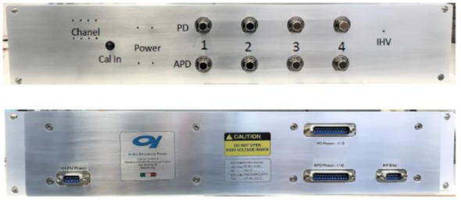
Distribution Measurements:
Wire Scanner Electronics
EPICS and MTCA system integration
Clement on WS (particle free, and test)
Time resolved profile of Linac4 proton beam measured with ESS electronics and software
Analog electronics
Optical front end
Trieste

Slide 16
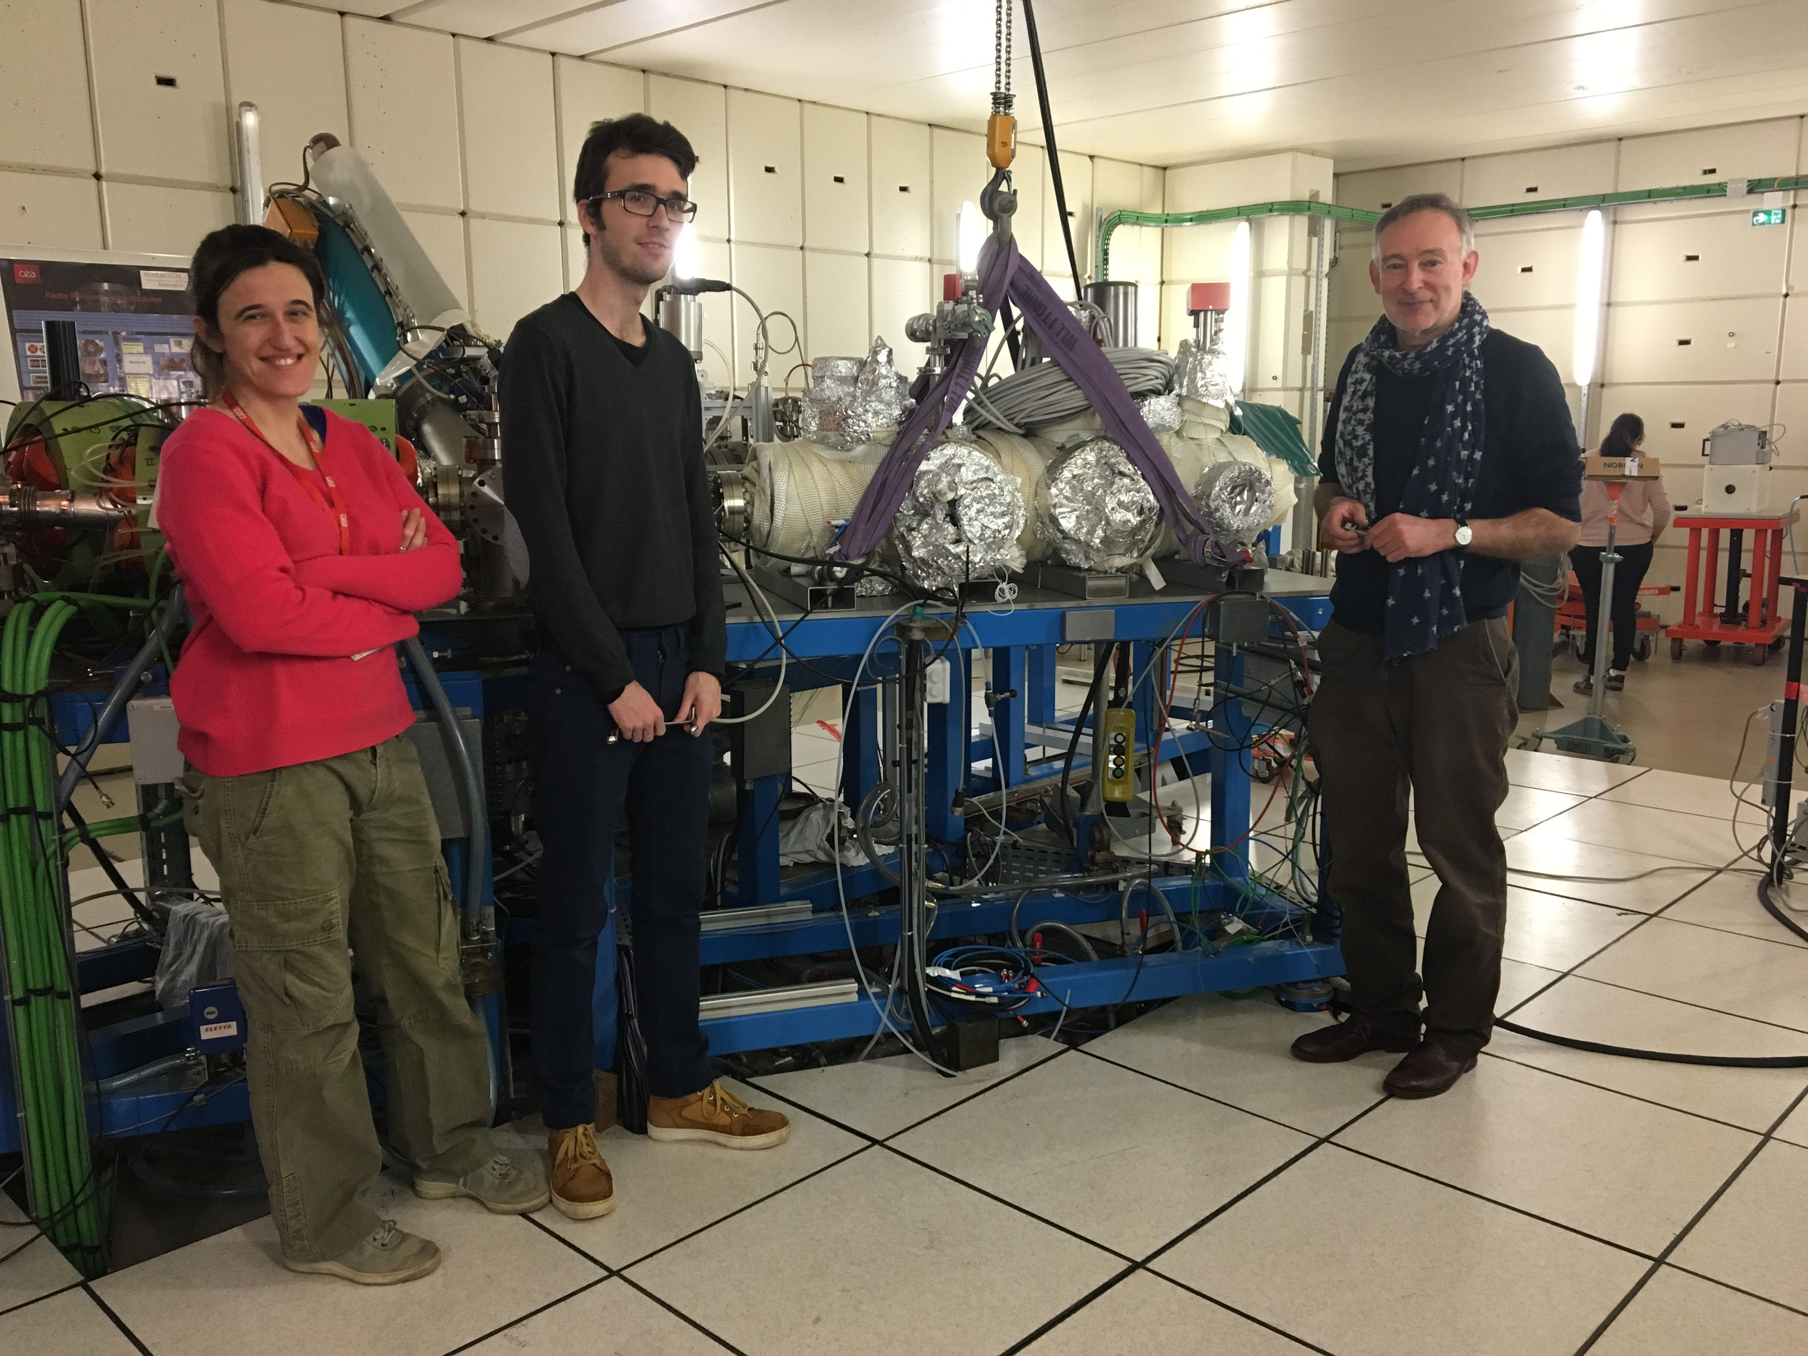
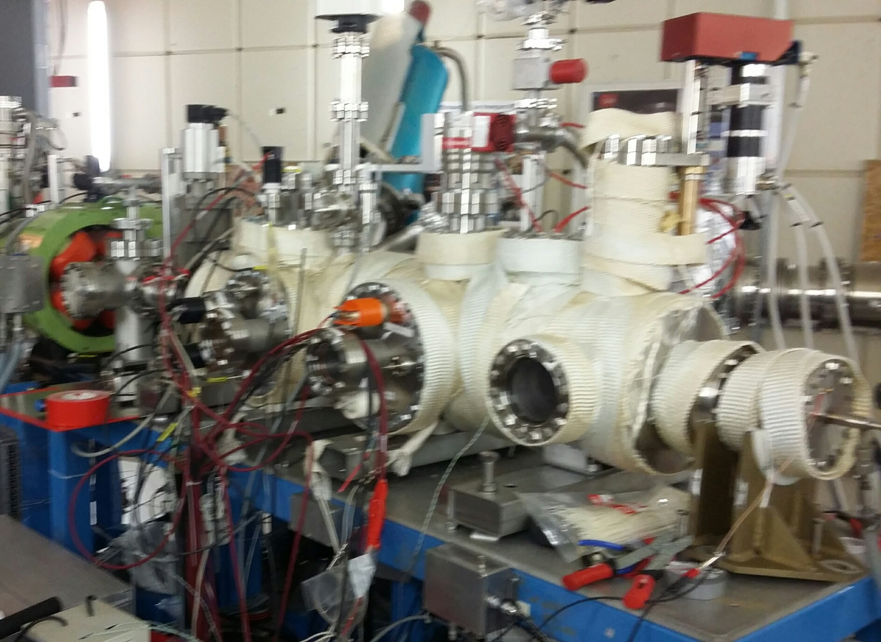
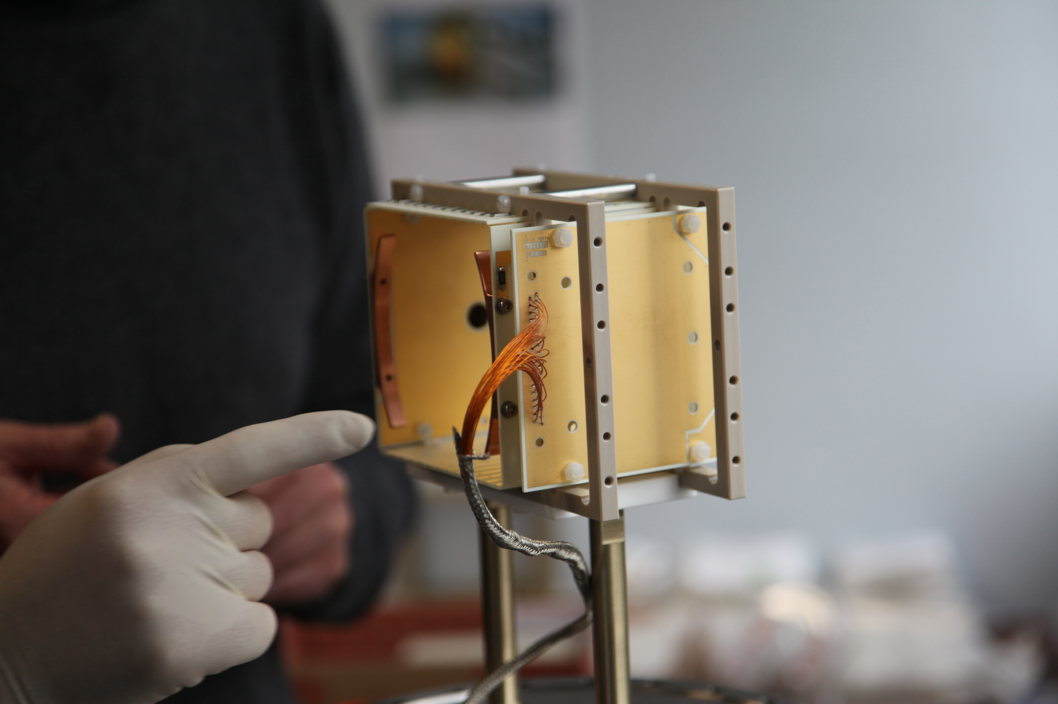
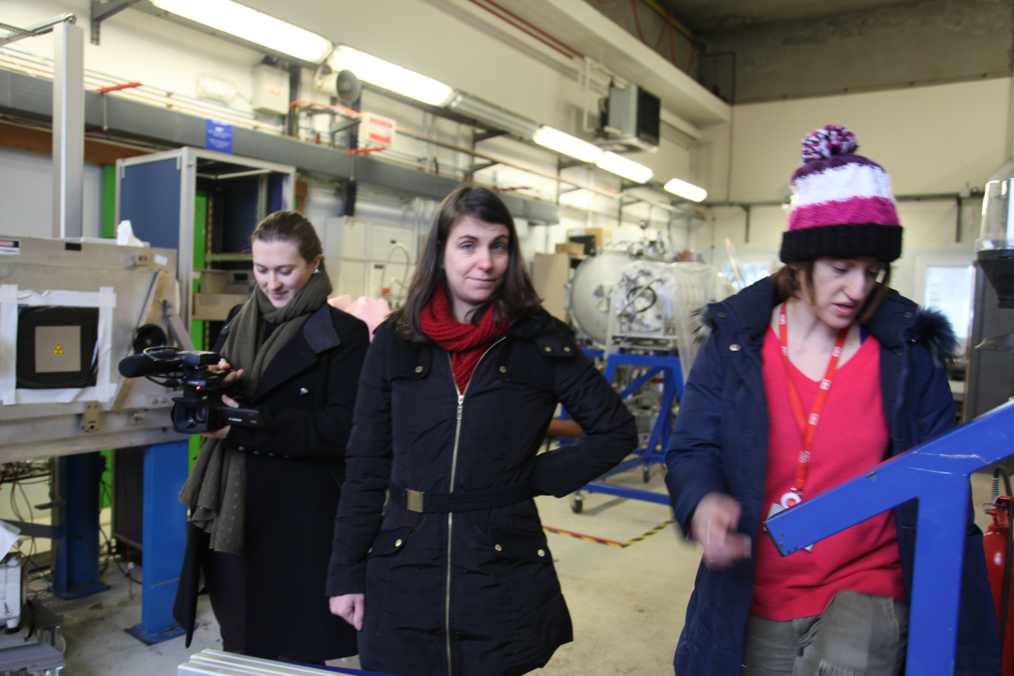
Distribution Measurement: Measure Long Beam Pulses with Non-invasive Profile Monitors
NPM prototypes in beam at CEA
Ionization Profile Monitor
Saclay, ESS-Lund

Slide 17




Protection from Beam Loss
Damage model:
  Total beam loss, ~µs latency required for protection
  BCM, icBLM (saturation), nBLM (current mode) -> Interlock
> 1.6 milliamp lost for up to 200 µs
  BCM, icBLM, nBLM -> Interlock
~ microCoulomb lost over 200 µs to diffusion time
  icBLM, nBLM -> Interlock
~ “1 Watt/meter” loss, dose management
  icBLM, nBLM -> alarm based on dose/activation plan
Before beam loss occurs, RF fault within pulse
  BPM -> Interlock before loss, based on change of energy
FLUKA
ANSYS
Response of components to energy deposition by beam
Position Monitors, and sparse coverage by Current Monitors
coverage by Ion Chambers
Neutron Detectors

Slide 18



Differential Measurements
3.125 Gb/s low latency link:
Developed for Beam Current Monitor
Capable of providing real-time communication between diagnostics, LLRF, neutron instruments, …
Current
Phase
Bit error rate < 10**-15
Simulations by ESS Beam Physics

Slide 19
Outlook
Putting it all together
Data analysis Machine learning
Adaptation
Analysis
Updates to analysis layer managed by trigger system
Gigabit/s
Terabit/s
Low latency processing
Real-time Control and
Protection functions
trig
trig
Continuous Buffering
Low latency data transmission
Acquisition
Acquisition
Acquisition
Actuators
Machine

Slide 20
Thank you

