Slide 1
In-Kind and the ERIC Framework
WPs 2 & 3.1
Allen Weeks
June 22, 2018

Slide 2

An Opportunity to Learn
Time to reflect on our thinking at the beginning
The connection between In-Kind and BrightnESS
Aspects of the ERIC ‘framework’ from an organisational perspective in relation to VAT

Slide 3
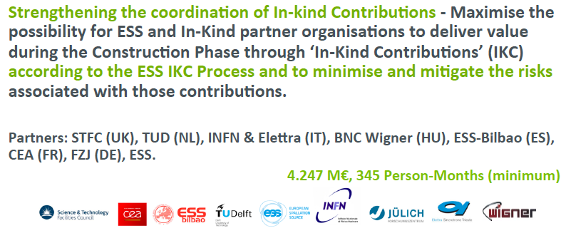
How Does BrightnESS WP 2 Support
In-Kind Contributions (IKC)?
An IKC is a non-cash contribution provided by a Member to ESS and including Technical components, personnel, installation and/or integration of components; can also be R&D work as well as personnel needed to perform the R&D work or - other products or services relevant for the completion of the ESS facility.

Slide 4
In-Kind @ ESS
Sweden and Denmark
Construction 47.5%
Cash 100%
Non-Host Members
Construction 52.5%
In-kind ~ 70%
Cash ~ 30%
In-Kind Potential
= 37%
or
€685 million
A budget of about
€3 million was allocated for ESS with almost no allowance for IKC Partners to ‘manage’
4

Slide 5

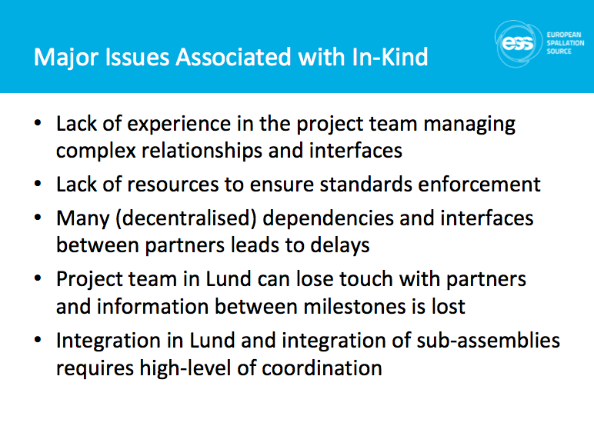

Slide 6













More than 40 IKC Partners in 13 Countries
€500 million!
Rutherford-Appleton Laboratory, Oxford(ISIS)
Kopenhagen University
Laboratoire Léon Brilouin (LLB)
Lund University
Nuclear Physics Institute of the ASCR
Oslo University
Paul Scherrer Institute (PSI)
Polska Grupa Energetyczna - PGE
Roskilde University
Tallinn Technical University
Technical University of Denmark
Technical University Munich
Science and Technology Facilities Council
University of Tartu
Uppsala University
WIGNER Research Centre for Physics
Wroclaw University of technology
Warsaw University of Technology
Zurich University of Applied Sciences (ZHAW)
Aarhus University
Atomki - Institute for Nuclear Research
Bergen University
CEA Saclay, Paris
Centre for Energy Research, Budapest
Centre for Nuclear Research, Poland, (NCBJ)
CNR, Rome
CNRS Orsay, Paris
Cockcroft Institute, Daresbury
Elettra – Sincrotrone Trieste
ESS Bilbao
Forschungszentrum Jülich
Helmholtz-Zentrum Geesthacht
Huddersfield University
IFJ PAN, Krakow
INFN, Catania
INFN, Legnaro
INFN, Milan
Institute for Energy
Research (IFE)
6

Slide 7
The Collaboration Landscape
ESS
ERIC
agreement
Industrial Partner
In-kind Partner
Not all IKC Partners are VAT Exempt
Not all IKC Partners are Rep. Entities
In-kind Review Committee
(or AFC)
Research Ministry or Funding Agency
Council or General Assembly

Slide 8

In-Kind Process
BrightnESS
PHASE 1
CONTRACTING
PHASE 2
IMPLEMENTATION
PHASE 3
ACCEPTANCE
ERIC Plan
WPs/WU 1
WPs/WU 2
WPs/WU 3
WPs/WU 4
EOI Response
ESS+ Partner discussion
Contract proposal
IKC frame contract + technical annex
Design, Production
Delivery
IKRC + Council approval
Transfer of ownership
IKRC + Council Approval
ERIC + Partner follow up and review
ERIC + Partner final acceptance
IKC value crediting to member country

Slide 9
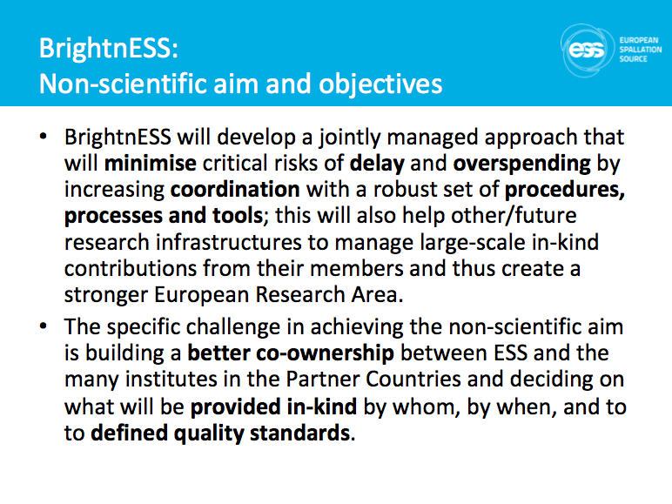

Slide 10
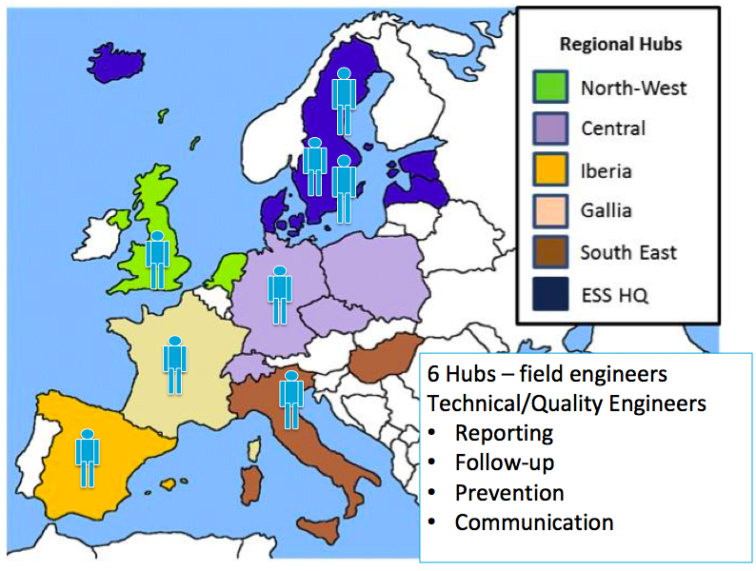
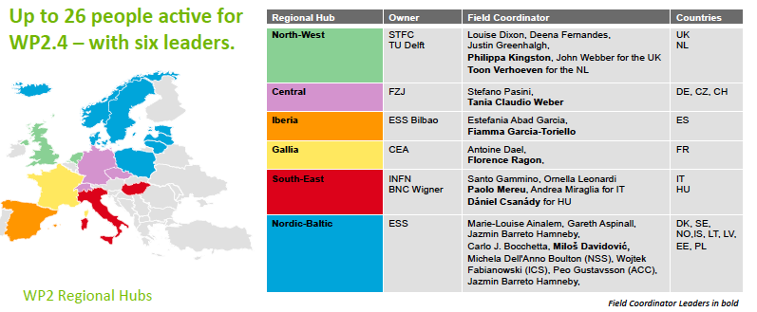
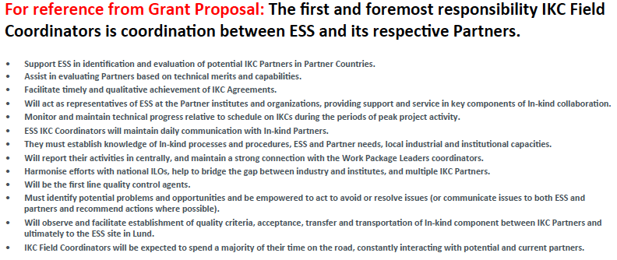
IKC Regional Hubs

Slide 11
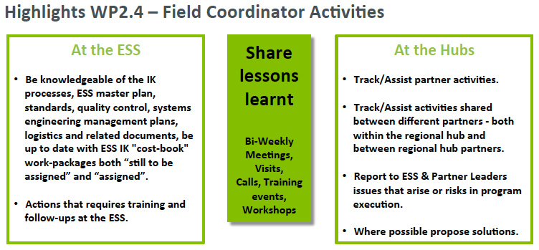

Slide 12
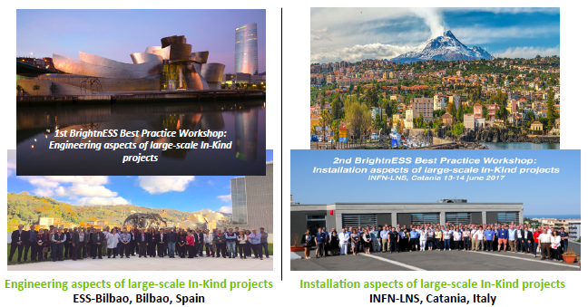
In-Kind ‘Best Practices’ System and Meetings
Critical approach to establish a ‘common language’
Between ESS and IKC Partners
Between IKC Partners
In ESS (!)

Slide 13
Accounting for IKC
How to keep track of €500M when it doesn’t go in the system?
Adapting local accounting rules led to lack of clarity how to treat IKC in accounting terms. This leads to a number of questions:
Are IKC a capital contribution (asset)? Or Income?
What is the value of an IKC?
  Due to the above described IKC principles, it is not obvious what their cost and their value for the organisation are;
  The ‘Cost Book’ is a valuable tool to get all parties on the same page;
When does an IKC have to be accounted?
  Day of delivery/hand-over?
  Approval by IKRC/AFC/Council?
  Where do we book in the system?

Slide 14
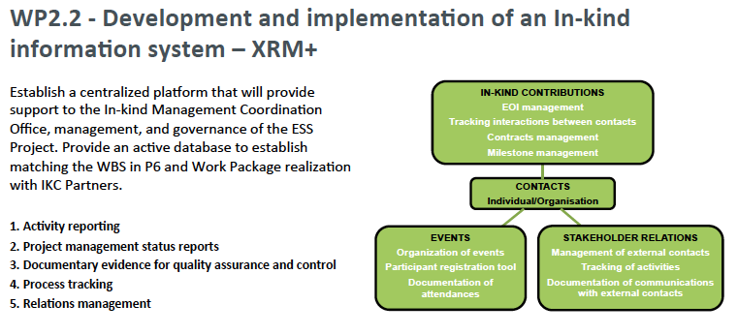

Slide 15
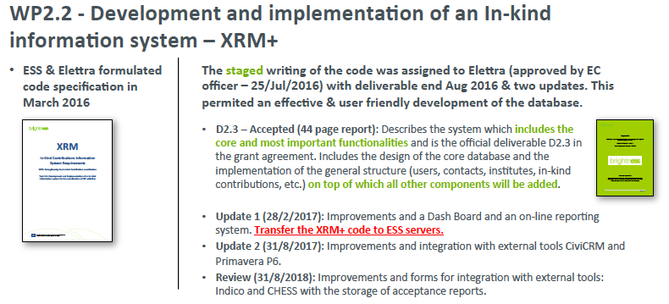

Slide 16
Value-Added Tax on IKC
Council Regulation (EC) No 723/2009 gives ERICs broad flexibility in treatment of taxation and VAT, but does not provide guidance for IKC partner institutions
Payment of VAT by national institutes to industrial suppliers was not included in the ERIC Cost Book. This was due to the fact that the governing bodies foresaw the future ERIC as being exempt from paying VAT as an international organization
Several institutes have notified ERIC that the fact that there is no certainty on VAT the result might either be:
Reduction of the IKC scope to compensate for the VAT costs
A request by the institutes, via the Council, that ERIC pays the VAT

Slide 17
Learning How VAT Applies to IKC
From previous meetings/documents of the VAT Advisory Committee, the following guidelines were understood:
Only members (and not representing entities) may enjoy the same VAT exemptions as the ERIC itself;
A representing entity may act as an intermediary in the name and on behalf of the ERIC;
Members may use a 15.10-certificate, provided that it is specified that it is for the sole purpose of the ERIC.
No ‘silver bullets’ were found – and it wasn’t really the goal to ‘solve’ the problem.
The aim was to ‘mitigate the risk’ and keep the ESS Project moving …

Slide 18
Value-Added Tax by Country
 | ESS ERIC Recognized as an International Organisation
 | Direct Exemption | Representing Entity | Representing Entity with supporting documents | Cash Contribution
Belgium
Czech Republic
Denmark
France
Germany
Hungary
Italy
Netherlands
Norway
Poland
Spain
Host
Switzerland
United Kingdom
 | Being Explored
 | Achievable
 | Not Possible

Slide 19
VAT Decision Tree On IKC In Each Country
Recovery

Slide 20
There are VAT risks in the Host Country for IKC
Just when you think it’s safe to go back in the water…
Possible risks include:
Local Host Country VAT being charged or
In-Kind partner obliged to register for VAT in Host Country
Various VAT situations and VAT consequences are precisely described in the VAT legislation. A minor change in the circumstances and facts may have a significant impact on the conclusion how VAT should be handled.

Slide 21
Background
Definition
Transaction means the supply of goods or services for the use at ERIC in Host Country.
It involves purchases from subcontractors which are invoiced to the In-Kind partner and delivered either to the In-Kind partner or directly to ERIC.
Assumptions
It is not possible to apply the 15(10) VAT and Excise Duty Exemption Certificate.
The In-Kind partner does not have a fixed establishment in Host Country. (In case the In-Kind partner has a fixed establishment in Host Country a specific analysis is required in order to assess the VAT consequences.)
In Kind Partner
Out of scope in kind contribution
ERIC
Contractual relationship from a VAT perspective
Services or goods
Supplier/
Subcontractor

Slide 22
Key Questions:
In-Kind partner VAT registered in Host Country and/or other EU-country?
Supplier VAT registered in Host Country and/or other EU-country?
Supplier having fixed establishment in Host Country?
What is the transaction object? i.e.
  Goods only
  Goods which are installed or assembled in Host Country
  Services connected to real estate, installation in real estate in Host Country
  Other Services

Slide 23
STEP 1 - Identify subject of transaction procured from supplier
Services connected to real estate, installation in real estate
Go to STEP 2A
Other services (Main rule services according to VAT Directive)
Go to STEP 2B
Goods, shipment from other EU-country to ERIC in Host
Go to STEP 2C
Goods,
shipment within Host
Goods assembled, installation in Host Country (shipment from outside Host)
Go to STEP 2D
Go to STEP 2E
Subject of transaction procured from supplier
STEP 1

Slide 24
Next Steps…
Services connected to real estate, installation in real estate
STEP 2A
Other services (Main rule services according to VAT Directive)
STEP 2B
Goods, shipment from other EU-country to ERIC in Host
STEP 2C
Goods,
shipment within Host
Goods assembled, installation in Host Country (shipment from outside Host)
STEP 2D
STEP 2E
Subject of transaction procured from supplier
Does subcontractor have fixed establishment in Host?
Host VAT in invoice to IKP
Does IKP have VAT registration is Host?
Reverse charge. IKP accounts for VAT in Host
Subcontractor to register for VAT in Host Country and charge Host VAT in invoice to IKP
Does IKP have VAT registration in EU (not Host)?
Reverse charge VAT in IKP’s VAT return
Is the subcontractor Host or have fixed establishment in Host?
Subcontractor should charge Host VAT in invoice to IKP
Probably VAT in invoice but from subcontractor’s home country
STEP 1
Does IKP have VAT registration in Host?
Reverse charge. IKP accounts for VAT in Host Country
Subcontractor has to charge VAT in home country
Subcontractor should charge Host VAT in invoice to IKP
Probably VAT in invoice but from subcontractor’s home country
Does the subcontractor have fixed establishment in Host?
Subcontractor should charge Host VAT in invoice to IKP
Does the IKP have VAT registration in Host?
Reverse charge. IKP accounts for VAT in Host Country
Subcontractor to register for VAT in Host Country and charge Host VAT in invoice to IKP
Does IKP have VAT registration in Host?
Reverse charge. IKP accounts for VAT in Host Country
Subcontractor should charge Host VAT in invoice to IKP
Subcontractor should charge Host VAT in invoice to IKP
Probably VAT in invoice but from subcontractor’s home country
Probably VAT in invoice but from subcontractor’s home country

Slide 25
IKC and VAT: Lessons Learned
ERICs are non-economic actors – do not get engaged with being a ‘taxable person’ more than necessary.
Direct exemption is preferable to reimbursement
The VAT treatment relative to IKC from ERIC Members must be approached strategically and globally
Representing Entities play an important role in the establishment, construction and operation of ERICs

Slide 26
In-Kind Process
BrightnESS
PHASE 1
CONTRACTING
PHASE 2
IMPLEMENTATION
PHASE 3
ACCEPTANCE
ERIC Plan
WPs/WU 1
WPs/WU 2
WPs/WU 3
WPs/WU 4
EOI Response
ESS+ Partner discussion
Contract proposal
IKC frame contract + technical annex
Design, Production
Delivery
IKRC + Council approval
Transfer of ownership
IKRC + Council Approval
ERIC + Partner follow up and review
ERIC + Partner final acceptance
IKC value crediting to member country

Slide 27
Conclusions
Recognised a key risk and put resources into the project at a critical time
Strengthened the collaboration by providing IKC interactions outside of the normal project scope
Allowed certain issues to be handled systematically, with a global perspective - not only in project ‘crisis’ mode
Captured best practices from both sides of the collaboration
In-Kind Collaborations are a balanced relationship and should be viewed as a ‘partnership’ not a ‘supplier’ relationship
BrightnESS stimulated (usually) people to be solution oriented and not get overwhelmed by VAT and other ‘legal’ administrative

Slide 28
Thank You

Slide 29
Thank you!

