Slide 1





S2.2 – Direct contact
Txema de la Fuente (JEMA)
www.europeanspallationsource.se
Critical Design Review on 660kVA klystron modulators for RFQ/DTL and MBeta

Slide 2
Direct contact
Risks
Direct contact risk:
  Accidents due to direct contact of live parts in the modulator;
  This is a general electrical safety risk (not specific to the modulator), and will be treated on a similar way as any industrial electrical equipment following the usual standards and safety practices.
Mitigation measures:
  Common good engineering practice will be applied.
  The first level of protection is the modulator enclosure:
    All High Voltage parts are sealed inside the HV oil tank, which will be grounded (explained in a other presentation).
    All Low Voltage parts will be inside an enclosure with index IP 32 or higher.
  Inside the Low Voltage cabinet (accessible through doors and pannels):
    Door opening are protected with door switches, which automatically de-energise the system in case of any attempt to open. Panels mounted with screws requiring a tool.
    Some power cable terminations will be covered.
    Some plexiglass shields with appropriate marking signs will be placed on the most exposed parts of the cabinet.
    Automatic capacitor discharge systems (explained in a other presentation).
    Manual grounding switches (explained in a other presentation).
    Equipment and procedures for verification of absence of voltage before accessing.

Slide 3
Direct contact
Mitigation
All Low Voltage parts will be inside an enclosure with index IP 32 or higher
Roof
Panels

Slide 4
Direct contact
Mitigation
Door opening are protected with door switches, which automatically de-energise the system in case of any attempt to open. Panels mounted with screws requiring a tool.
Panels with screws

Slide 5
Direct contact
Mitigation
Some power cable terminations will be covered.
Cable termination cover

Slide 6
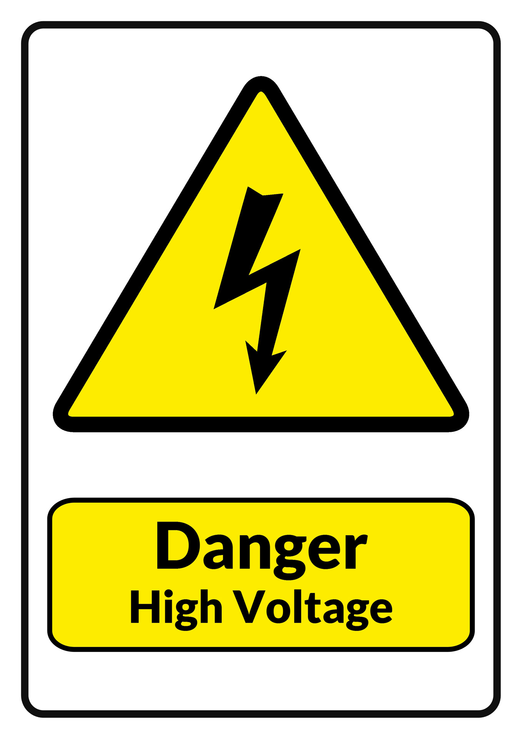
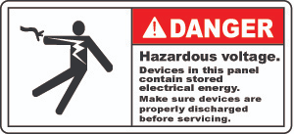


Direct contact
Mitigation
Some plexiglass shields with appropriate marking signs will be placed on the most exposed parts of the cabinet.
Equipment and procedures for verification of absence of voltage before accessing.

