Slide 1



S2.5b – Protection against explosion and arcs
Carlos A. Martins, ESS
Safety Review on 660kVA klystron modulators for RFQ/DTL and MBeta

Slide 2
Possible reasons for explosions and arcs in the LV power conversion stage
Arcs
Like in any other large power converter, the modulators will have large copper busbars which could accidentally be short circuited (i.e. metallic piece left over adjacent busbars);
Mitigation is typically made by two ways:
  Right selection and adjustment of the Main Circuit Breaker and auxiliary breakers;
  Mechanical barrier formed by the cabinet enclosure;
Explosions
Each modulator will have 3 independent main capacitor banks, each bank storing 50kJ;
This represents a much higher risk than the risk associated to arcs, mentioned above. Therefore a dedicated study and experimental verification were carried out.

Slide 3
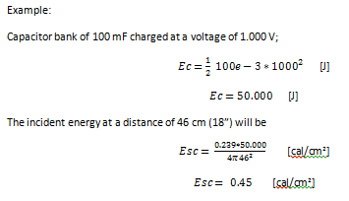
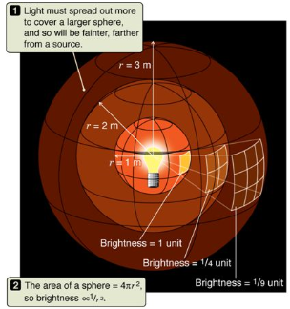

Electrical flashovers in open air exposure
$$Ec=\frac{1}{2} Ceq {Vc}^{2}$$
No fuses added
Extracted from: “Personnel Safety Aspects and Protection of Systems with Power Electronic Converters”, ESS, P. Torri

Slide 4
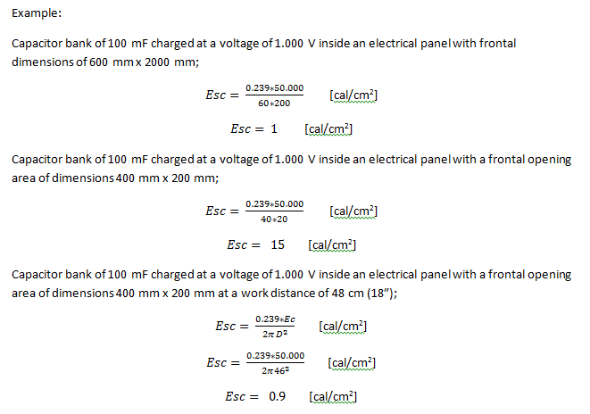
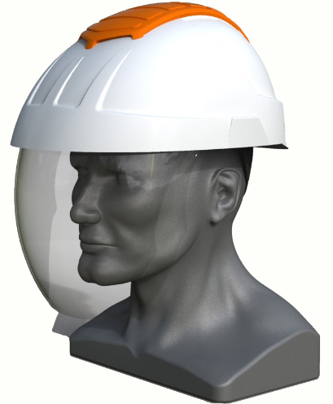

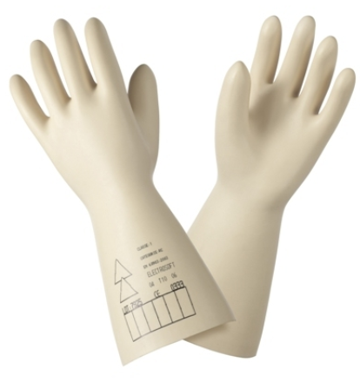

Electrical flashovers in closed cabinet with window exposure
$$Ec=\frac{1}{2} Ceq {Vc}^{2}$$
Worst case scenario
- Standard PE required, for electrical installations
No fuses added
No fuses added
No fuses added
Extracted from: “Personnel Safety Aspects and Protection of Systems with Power Electronic Converters”, ESS, P. Torri

Slide 5
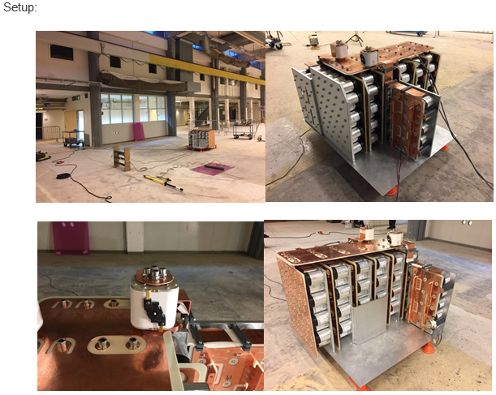
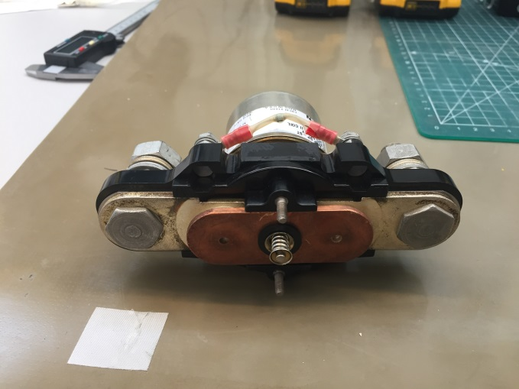
Experimental setup for capacitor short circuit evaluation
Test 1: IGBT failure, with fuse
Setup: Short circuit in F1 (busbar A) with relay
Short circuiting relay, simulating IGBT
fuse
Extracted from: “ESS SML modulator Capacitor Bank Short-Circuit Protection – Prototype design, assembly and test report”, ESS, P. Torri – ESS-0101797

Slide 6
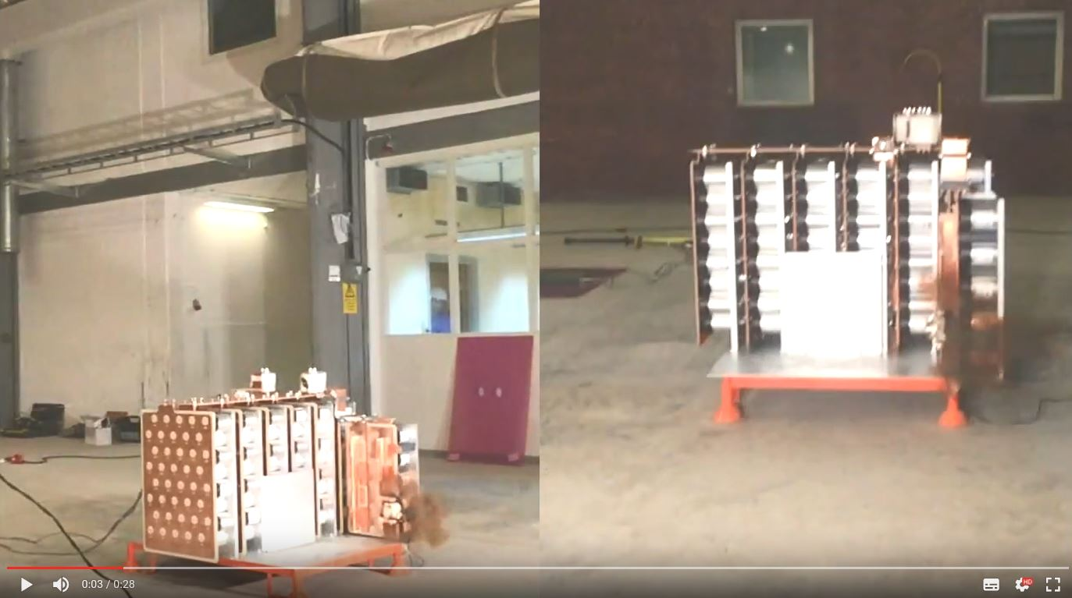
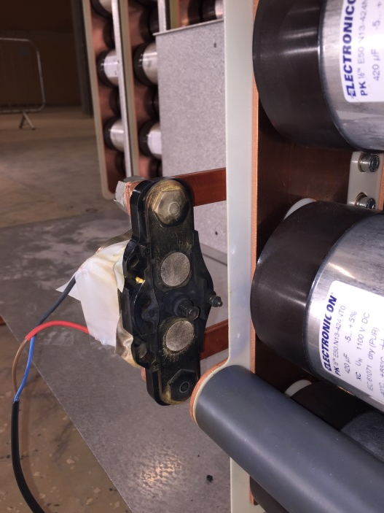
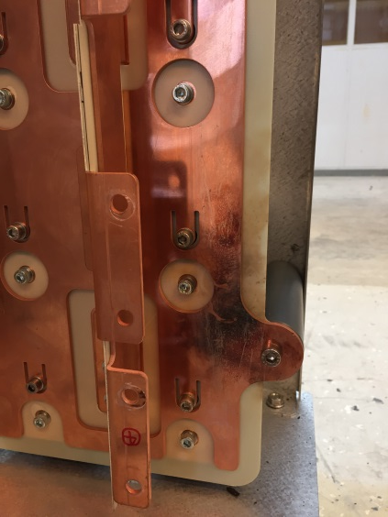
Experimental setup for capacitor short circuit evaluation
Test 1: IGBT failure, with fuse
Results: Short circuit in F1 (busbar A) with relay
- No damage in the busbars
- Only the relay was damaged
Extracted from: “ESS SML modulator Capacitor Bank Short-Circuit Protection – Prototype design, assembly and test report”, ESS, P. Torri – ESS-0101797

Slide 7
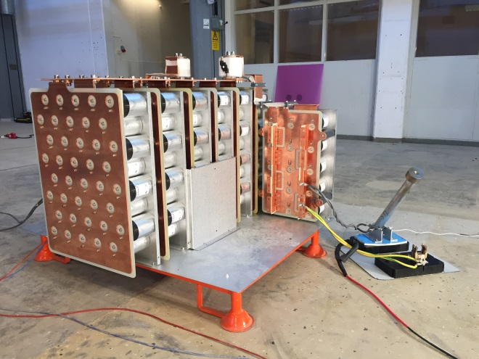
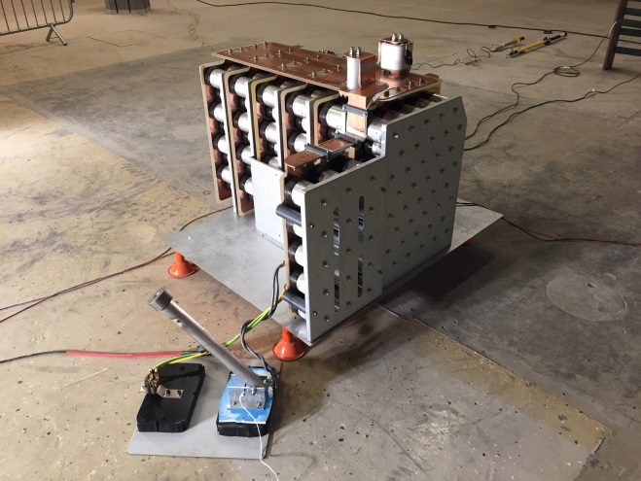
Experimental setup for capacitor short circuit evaluation
Test 3: Busbar short-circuit with heavy bar, with fuse
Setup: Short circuit in F1 (busbar A) with bar
Short circuiting gravity bar
Extracted from: “ESS SML modulator Capacitor Bank Short-Circuit Protection – Prototype design, assembly and test report”, ESS, P. Torri – ESS-0101797

Slide 8
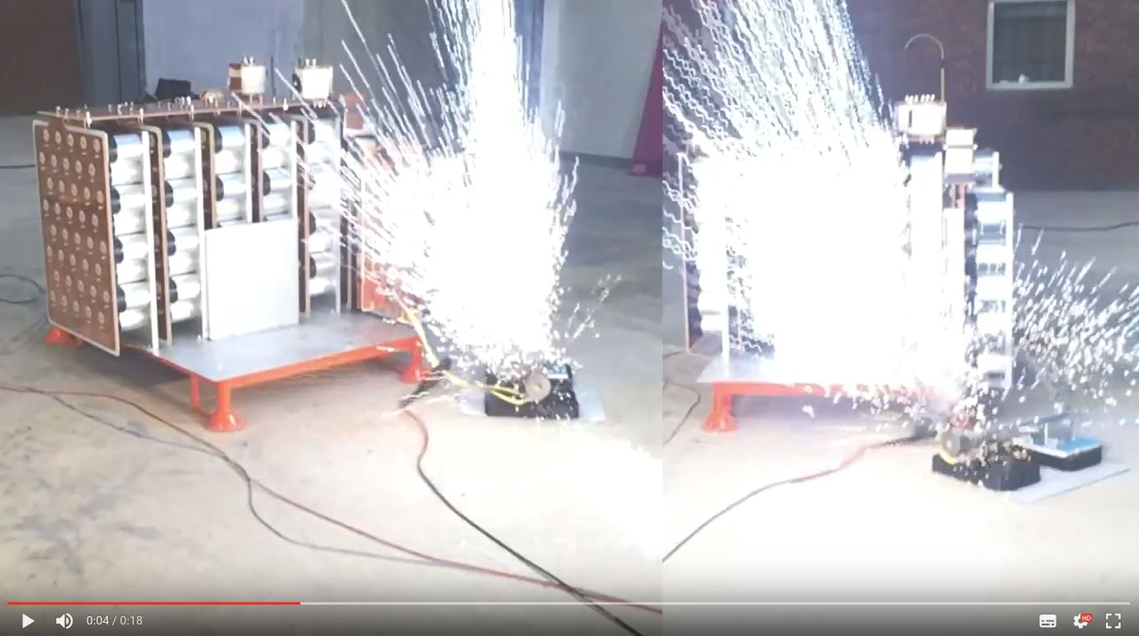
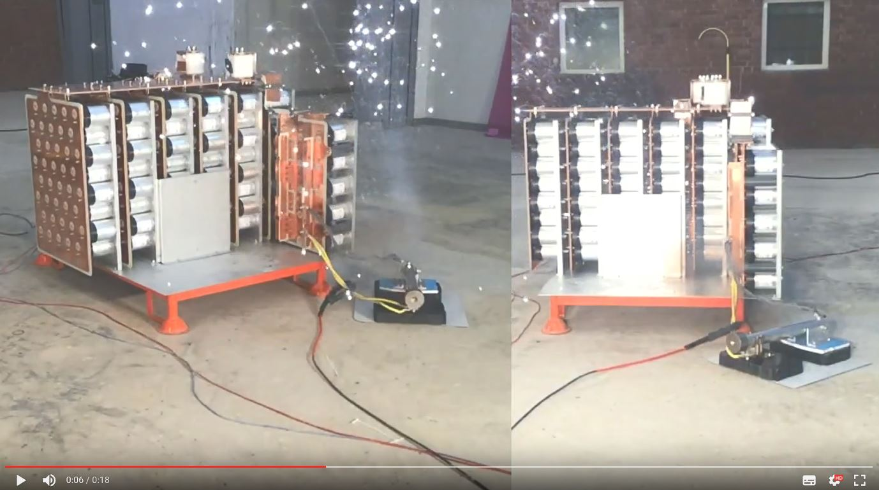
Experimental setup for capacitor short circuit evaluation
Test 3: Busbar short-circuit with heavy bar, with fuse
Results: Short circuit in F1 (busbar A) with bar
- No damage in the busbars
- Only the short circuiting bar was damaged
Extracted from: “ESS SML modulator Capacitor Bank Short-Circuit Protection – Prototype design, assembly and test report”, ESS, P. Torri – ESS-0101797

Slide 9
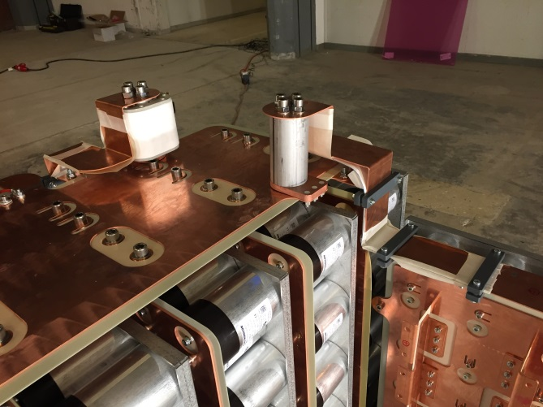
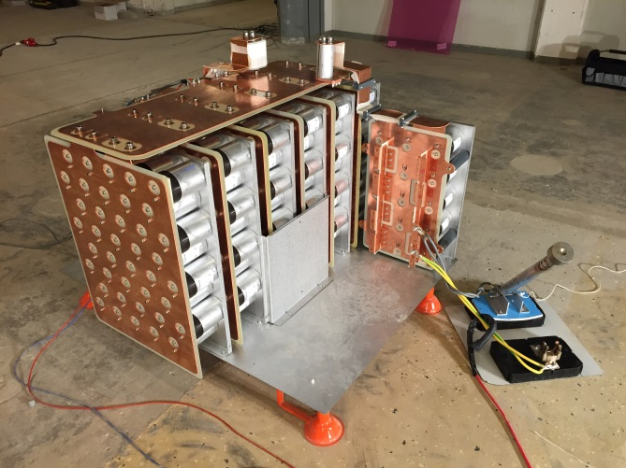
Experimental setup for capacitor short circuit evaluation
Test 4: Busbar short-circuit with heavy bar, without fuse
Setup: Short circuit in F1 (busbar A) with bar
Shunt replacing the fuse
Short circuiting gravity bar
Extracted from: “ESS SML modulator Capacitor Bank Short-Circuit Protection – Prototype design, assembly and test report”, ESS, P. Torri – ESS-0101797

Slide 10
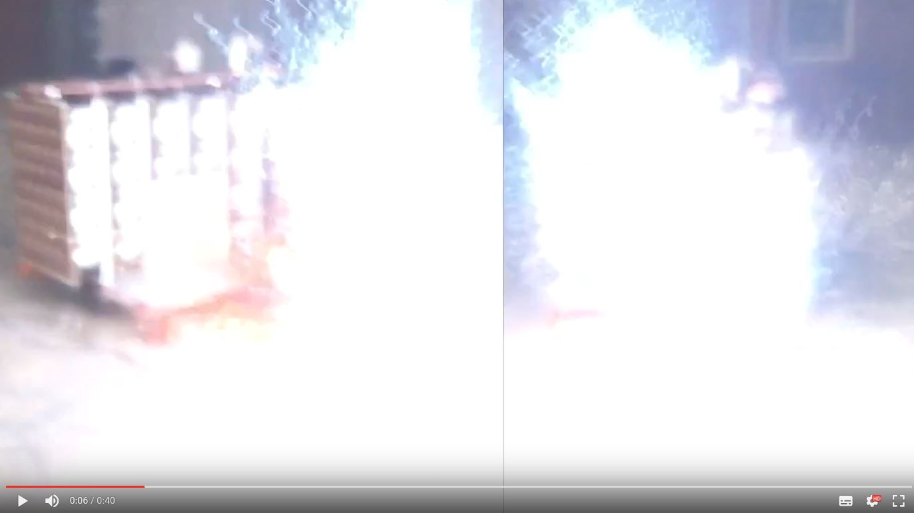
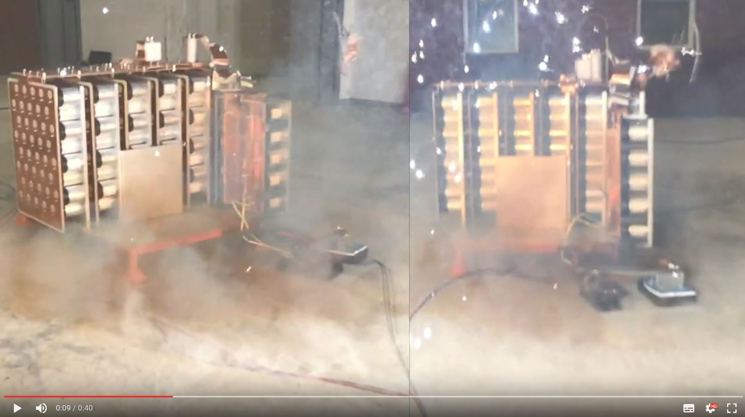
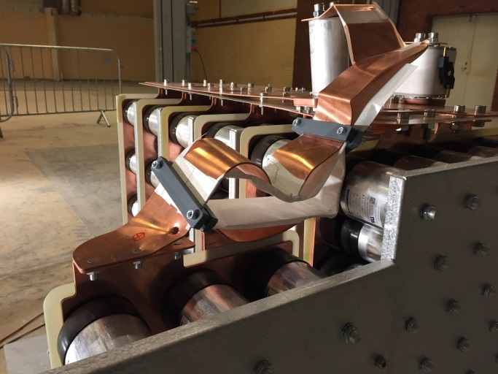
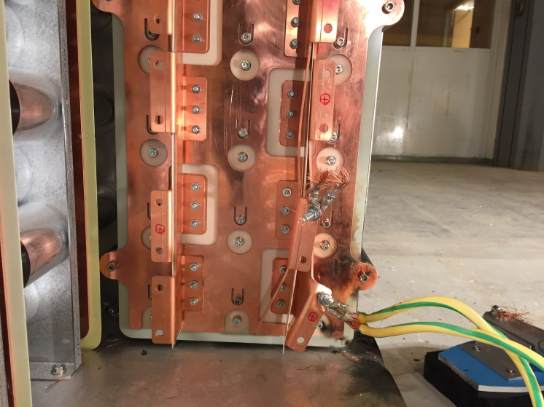
Experimental setup for capacitor short circuit evaluation
Test 4: Busbar short-circuit with heavy bar, without fuse
Results: Short circuit in F1 (busbar A) with bar
- Busbar B damaged (works like a fuse)
- Busbar A damaged;
- Still, no projection of large metal pieces
Extracted from: “ESS SML modulator Capacitor Bank Short-Circuit Protection – Prototype design, assembly and test report”, ESS, P. Torri – ESS-0101797

Slide 11
Conclusion
Fuses will be used, at the input of each H-bridge;
  No damage of parts, except the one creating the short-circuit (most likely the IGBT’s);
  Very limited released energy, wrt the total stored energy:
    < 5kJ, in case of IGBT (i.e. < 10%);
    < 15kJ, in case of heavy bar (i.e. < 30%);
If Fuses would not be used;
  Serious material damages on the busbars A, B and C;
  Almost full stored energy will be released:
    48kJ, in case of heavy bar (i.e. ~96%);
  Still, if doors of cabinet closed:
    No deformation of the cabinet enclosure;
    No projection of parts outside;
    However, huge blasting noise;

