Slide 1

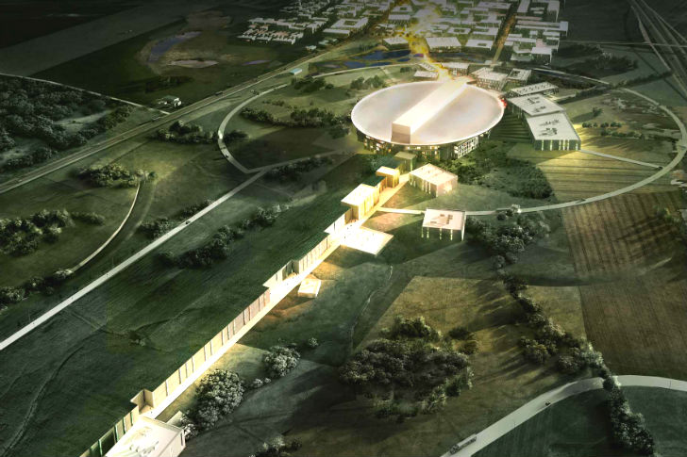



S3.1 – Risk of fire in LV cabinet and prevention
Txema de la Fuente (JEMA)
www.europeanspallationsource.se
Critical Design Review on 660kVA klystron modulators for RFQ/DTL and MBeta

Slide 2
Risk of fire in LV
Ignition could be due to cable overheating, electrical short circuits, electrical arcs in modulators, etc.
Common good engineering practice will be applied.
Special care will be taken with the materials, so that inflammable materials will not be used.
The following components can show a reduced risk of flammability:
  Halogen-free cables.
  Polypropylene in the main DC capacitors.
  Rubber coating in HV cables.
  Fibre glass in insulation structures.
  MIDEL 7131 oil: fire ignition temperature >300°C, inside a closed tank with very little quantity of oxygen.
Apart from the cables, no many things that can burn.
In case of fire, it should probably extinguish by itself once all materials have been consumed and therefore, the walls of the cabinet should be enough to avoid big propagation of fire outside the enclosure.
Similar practice have been done in the past in JEMA power supplies with good results and no complicate things than usual.

