Slide 1
ESS Wire Scanner CDR
Requirements
Clement Derrez
www.europeanspallationsource.se
1 March, 2018

Slide 2
Wire Scanner: principle
A thin wire is scanned through the particle beam while the secondary emission current, the signal from a calorimeter downstream, and the signal of the motor encoder are acquired simultaneously. Plotting either of the SEM or SCINT signals against the encoder gives the beam profile.

Slide 3
Wire Scanner in ESS LINAC
3 WS dual axis
SEM mode
1 WS dual axis (A2T)
SEM + SCINT mode
3 WS single axis
SEM mode
4 WS dual axis
SEM + SCINT mode
In total:
19 motion axes
44 SEM mode channels
40 SCINT channels

Slide 4
System specifications
The RMS beam size in both horizontal and vertical planes shall be measured with an accuracy of better than ± 0.100 mm
WS measurement shall cover the full beam pipe aperture
Time resolution shall be 1 μs
WS dynamic range shall be at least 10³

Slide 5
ESS wire scanner operation
Scan performed at constant speed (100 μm.s-1 to few mm.s-1) and in step by step mode
  A slow tuning mode (i.e. 50 μs, up to 62.5 mA, 1 Hz).
  A fast tuning mode (i.e. 10 μs, up to 62.5 mA, 14 Hz).
Vertical and horizontal measurement separated to avoid cross talk

Slide 6
Warm LINAC Wire Scanner
Design ESS Bilbao
Single movement, 45 degrees
33 um carbon wire
Linac4 wire scanner in the MEBT

Slide 7
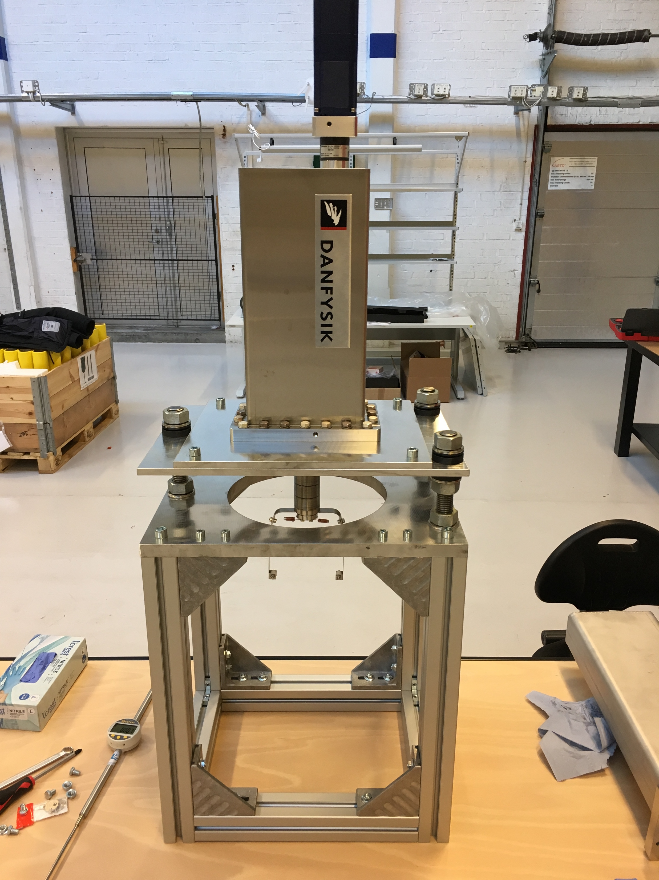
Cold LINAC Wire Scanner
Dual movement, particle free actuators
40 um Tungsten Wire
  Higher signal than carbon wire
  No pollution of cavities
First Danfysik prototype in RATS

Slide 8
Secondary emission
The signal generated on the wire can be divided in two main components:
  The emission of secondary electron emitted when the protons are crossing the boundary between vacuum and the wire
  The charge deposition due to protons stopped in the wire.

Slide 9
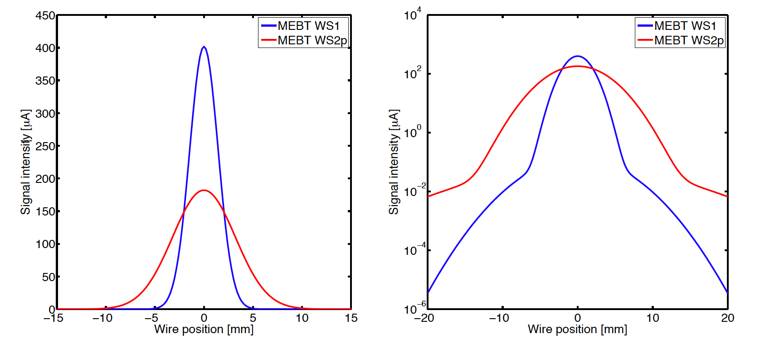
MEBT: Signal estimation
33 μm Carbon wire
  Maximum expected signal in MEBT (for Ibeam=62.5 mA): 180 μA to 400 μA depending on the beam sizes

Slide 10
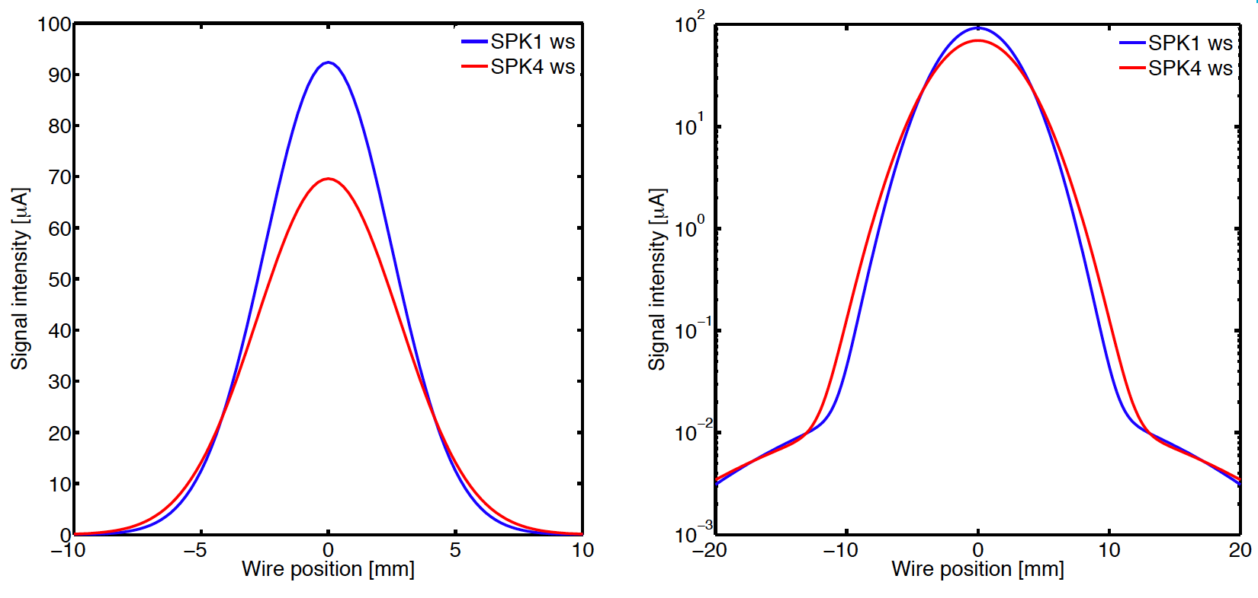
Spoke: Signal estimation
40 μm Tungsten wire
  Peak current: 60 to 90 μA (SEM mode)

Slide 11
SEM mode specifications
Vertical/horizontal separated
Sensitivity 10 nA to 1 mA
Wire polarization up to ±100 Volt
Sampling rate up to 2 MHz
Minimum dynamic range: 10³
1 Hz or 14 Hz trigger
Repeatability of the movement: ± 25 μm

Slide 12
SEM mode specifications
SEM acquisition: MEBT and spoke
Current readout: both wire extremities
AFE: two separated channels’ gains H/L
Elliptical sections and downstream: profile primarily reconstructed in shower mode. Expected SEM signal is ~50% lower in the worst case compared to the spoke section

Slide 13
SCINT mode specifications
LWU preliminary design (Daresbury)
ESS Detectors assembly
Profile reconstructed with 4 scintillators installed in the LINAC Warm Unit (LWU)
Distance wire-detector is set to 400 mm.

Slide 14
SCINT mode specifications
OFE: similar concept as for AFE, high and low gain channels
  PD and APD to increase dynamic range
Wavelength shifting fiber candidates
  Diameter equal to 1 mm
  Single cladding (NA 0:55)
and Scintillators to be tested vs MC simulations, radiation damage to be assessed
  BC-408 (Saint Gobain)v
  SC-301 (IHEP)
  EJ-200

