Slide 1
ICS (Technical) Overview
Timo Korhonen
ICS Chief Engineer
www.europeanspallationsource.se
14 February 2018

Slide 2
Outline
ICS Mission and Technical Scope
ICS Technologies
  Hardware standards
  Software at I/O level
  Overview of EPICS
      The Parts of EPICS
  User level software and services
  Timing system overview
Integrated Control System
  What is the meaning of I in ICS?

Slide 3
ICS Mission and Technical Scope
ICS mission is to prove an integrated control system that
  Covers Accelerator, Target, Neutron Instruments (partly) and Conventional Facilities
  Enables operation of the ESS as a Neutron Factory
    To enable science with neutrons
    Operation by a single crew in the Main Control Room
    Optimization and maintenance of the facility by the technical groups
  Has high performance and high reliability
  Includes machine (Accelerator, Target) protection
    To increase machine availability, ultimately.
  Includes also Personnel Safety System
    But PSS is not handled in today’s presentations. It is less “integrated” than the other systems.

Slide 4
Technical Scope Components
I/O Controller hardware
  MTCA systems, PLCs, EtherCAT
  CPUs for running EPICS IOCs: on MTCA, industrial PCs and virtual machines on a high-availability server cluster.
    Use-case dependent.
I/O Control software
  EPICS, PLC programs, system integration, services configuration
Application software and frameworks (Susanne’s talk)
  GUI tools, data archiving, alarm systems, control room applications,…
Information infrastructure for the “machine” (Remy’s talk)
  Technical (computer) network, Servers, Consoles, Storage,..
Configuration management tools
  Databases for configuration capture, naming convention,…
Some top-level systems
  Timing, machine protection, PSS

Slide 5


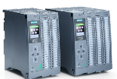
I/O controller hardware platforms at ESS
Signal speed
A custom made microTCA board with a powerful FPGA and a CPU. A FPGA framework constitutes the development environment. The CPU runs EPICS
ICS has adopted a three layer strategy for implementing the control system based on signal speed
  A custom made platform based on microTCA for applications with data acquisition exceeding 100 kHz
  The CPU will run EPICS and the FPGA will have a complete application development environment
  For slower signals, EtherCAT will be used as a real-time fieldbus with good price/performance ratio
  Synchronization and event information are key for applications where the high-end platform solution would be too costly
  Low speed signals are handled with commercially available PLC systems from Siemens
  This is a cost-effective solution that addresses ESS reliability and maintainability requirements
  The PLC:s will be connected to EPICS for further integration into the control system
10 MHz
1 MHz
100 kHz
Digital controls platform
10 kHz
1 kHz
EtherCAT I/O modules that are connected to commercial or open-source EtherCAT master controllers which are in turn connected to the EPICS based control system
100 Hz
EtherCAT
10 Hz
Slower signals are handled by industrial automation (PLC) for reliability and cost reasons. The standardized platform for ESS applications comes from Siemens
1 Hz
0.1 Hz
Industrial automation (PLC)

Slide 6
I/O Control Software
Software that runs on the ICS computers that connect to physical I/O
  MTCA.4 systems, Industrial PCs, PLCs
Unifying layer: EPICS (next slides)
  Sometimes EPICS reads/writes I/O directly (MTCA, etc.)
  Sometimes EPICS is a “translator”
    PLC case: (most) logic handled in PLC, EPICS provides remote access.
    EPICS is a toolbox, not a “control system”.
    EPICS can also be a powerful programming tool
  All control data in ESS Control Room and in control system services is handled via EPICS

Slide 7
What is EPICS?
EPICS is an abbreviation for:
Experimental Physics and Industrial Control System
EPICS is:
A collaboration
A software tool kit
A control system architecture
EPICS:
  supports distributed control systems for large research facilities like accelerators, fusion facilities (e.g. ITER), telescopes, etc.
  Scalable from very small systems to millions of control points (PVs)
  uses Client/Server and Publish/Subscribe methods over computer network

Slide 8
The Architecture of EPICS
Network-based Client/Server Model
Process Variables communicated over computer network using PVAccess protocol
A Server provides information and service
A Client uses the service or asks for the information
PVA
PVA
Client
Client
PVA
PVA
Server
Server
For EPICS, client and server refer to their PVAccess role: i.e. PVAccess Client and PVAccess Server (PV = Process Variable)
This standard control system architecture is often called 3-tier architecture
  Client – Server – I/O

Slide 9
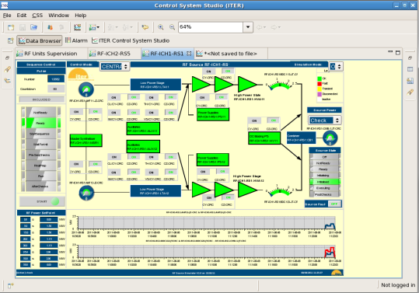
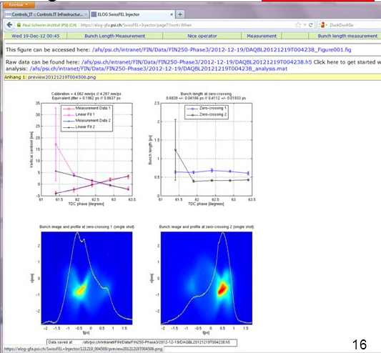
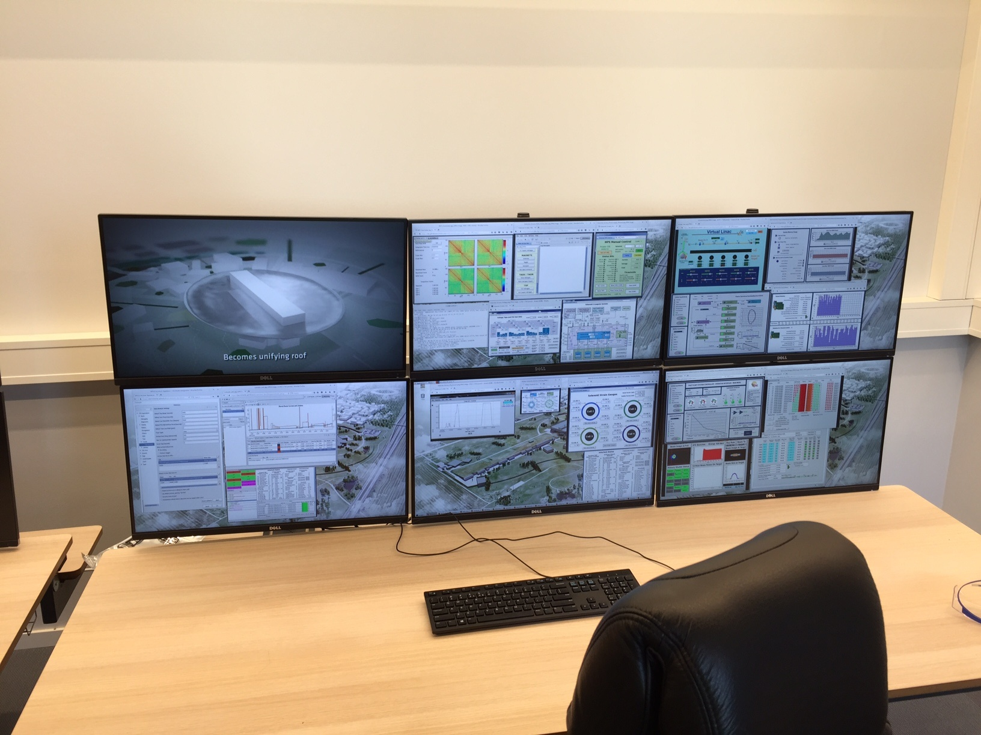
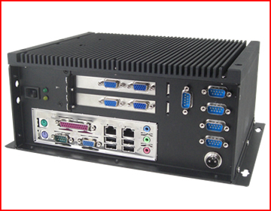
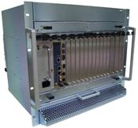
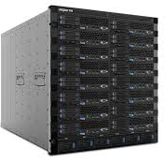
Servers and Clients at ESS
PVA
PVA
PVA
Client
Client
Client(s)
PVA
Server
PVA
PVA
Server
Server
Industrial automation (PLC)
100 MHz
10 MHz
1 MHz
100 kHz
10 kHz
1 kHz
100 Hz
10 Hz
1 Hz
0.1 Hz

Slide 10

EPICS Records and Process Variables (PV)
A Process Variable (PV) is a named piece of data associated with the machine (e.g. status, readback, setpoint, parameter)
In EPICS, PVs are defined by records in the EPICS Database. Records:
  Manipulate the raw data
    Conversion to engineering units (linear, breakpoint tables)
    Check for alarms and errors
    Averaging, min-max,…
  Help clients (GUI screens etc.) to configure themselves (display limits, floating point precision, update hysteresis etc.)
  Can define database links to:
    Exchange data among each other
    Implement closed loop control
CS-Studio
Probe
CS-Studio
Display Builder
Process
Variables
Process
Variables
PVAS
PVAS
PVAC
PVAC
Notes:
10
Copied the contents from the page 6 of 01-Intro.odp.

Slide 11



Example Record
IOC
Database
Process
Temperature Sensor
Analog to Digital Converter
record (ai, “MTRT1-TEMP:READ”)
{
field (EGU, “deg C”)
field (EGUL, “0”)
field (EGUF, “100”)
field (HSV, “MAJOR”)
field (HIGH, “51”)
field (SCAN, “.1 second”)
field (DTYP, “Hy8401”)
field (INP, “#C3 S0 @”)
}
Normal Operation
5 - 50°C
0 – 100°C
0 – 10V
8 bit ADC
0 – 10V
0 – 255 bits

Slide 12



Connecting EPICS records
IOC
ADC
Database
Analog In
MTTR1-LI-COOL:TEMP1
Binary
I/O
INP
VAL
Problem:
In the LINAC we have a water chiller that must be turned ON whenever the average temperature of two temperature sensors rises above a set point. The set point is nominally 10 degrees centigrade.
Calculation
Binary out
EGU: deg C
MTRT1-LI-COOL:CALC
Sensor
INPA
MTRT1-LI-COOL:SW
T1
INPB
VAL
DOL
OUT
ADC
C: 10
Analog In
CALC: ( (A+B)/2 ) > C
Chiller
MTRT1-LI-COOL:TEMP2
SCAN: 10 second
INP
VAL
Sensor
EGU: deg C
T2

Slide 13

Process Variable naming
PV (EPICS record) names must be unique in ESS
Examples of possible PV names and values:
  CWS-PHTS-DLHT:MT2-TT.VAL 26 degC
  (TT: Temperature transmitter)
  CWS-PHTS-DLHT:VC1-FCVZ.VAL ‘OPEN’, ‘CLOSE’, …
  (FCVZ: Flow Control Valve command)
Basic concept: <device name>:<property>
See “ESS Naming Convention”
(ESS-0000757) for more details.
  EPICS has a few restrictions on names (allowed characters)
  There is also a “naming committee” with representatives of all divisions (has not been very active until recently).
Notes:
13
Copied the contents from the page 7 of 01-Intro.odp and mostly modified to fit CODAC Core System.

Slide 14
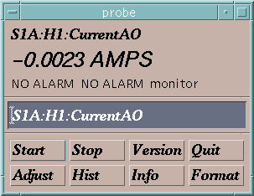
Process Variable Communication
“connection request” or “search request”
“get”
or
“pvget”
“put” or
“pvput”
“set a monitor”
Change its value to 30.5
Notify me when the value changes
Who has a PV named “S1A:H1:CurrentAO”?
What is its value?
Channel Access Client
PVA Client
PVA Server
I do.
25.5 AMPS
OK, it is now 30.5
It is now 20.5 AMPS
It is now 10.5 AMPS
It is now 0.0023 AMPS
Channel Access Server
Process Variables:
“put complete”
S1A:H1:CurrentAO
S1:P1:x
S1:P1:y
S1:G1:vacuum
30.5 is too high. It is now set to the maximum value of 27.5.
“post an event”
or
“post a monitor”
or
You are not authorized to change this value
or

Slide 15
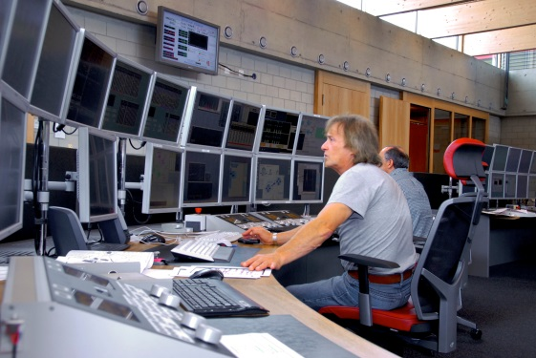
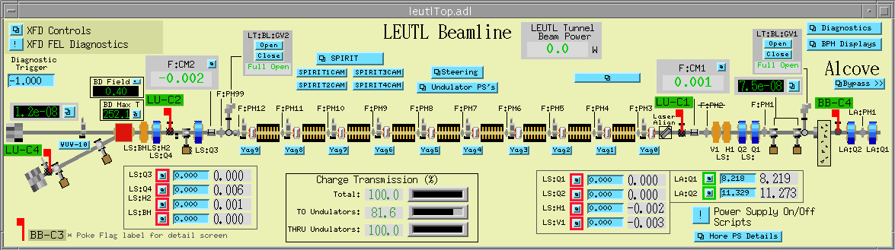
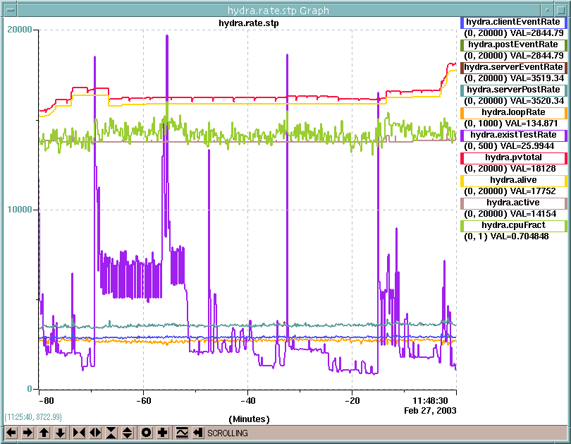
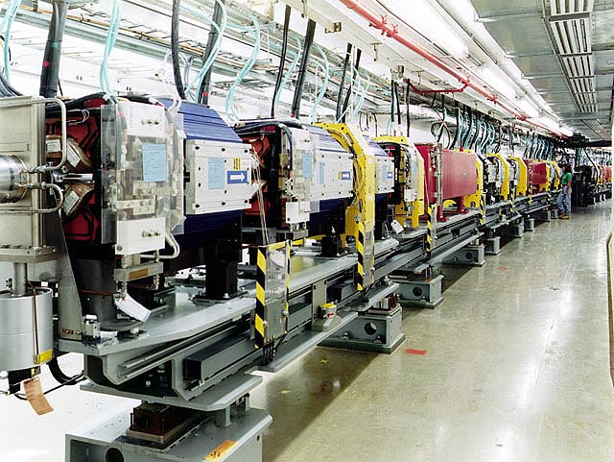
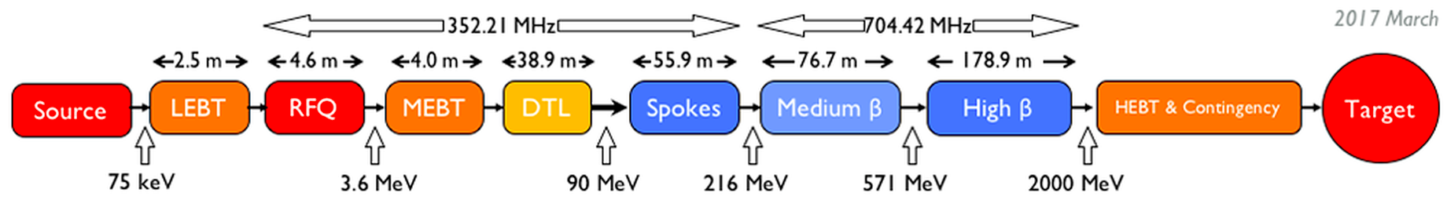
From “Machine” to control room
PVAccess Client
Operator
PVAccess Client
PVAccess Client
Network (PVAccess Protocol)
PVAccess Server
Process Variables:
Computer Interface
Power Supply
S1A:H1:CurrentAO
S1:P1:x
S1:P1:y
S1:G1:vacuum
Beam Position Monitor
Computer Interface
Computer Interface
Vacuum Gauge
Machine

Slide 16
ESS Software services (EPICS Clients)
Archiver Appliance: EPICS data archiver
  Stores process variable values to files, in timestamp order (remember: timing system)
  Different frequencies and volumes depending on subsystem requirements
  Tool for analyzing system performance (what happened on Friday at 15:30?)
Control System Studio (aka CS-Studio)
  Toolset for operators, subsystem engineers, developers, etc.
  Display Builder: HMI/GUI tool (Create GUIs without programming)
  Data Browser: Archiver data visualization tool
MASAR: MAchine (State) Save, Archive and Restore
  Save Machine (Accelerator, Target) setpoints (EPICS PVs) depending on operating (=beam) conditions
  Restore machine to a desired state (e.g., beam mode, beam power)
Scripting tools (Python)
  Access to EPICS PVs (pvaPy), Archived data, numerical libraries (numpy)
and many more … (Susanne’s talk)

Slide 17
Timing System
One of the global systems in ESS
  almost all systems have a relation to timing
Timing system task: Synchronize machine operation by:
  Sending trigger signals
    Start the RF pulse; Extract protons from source; raster the beam
  Sending clock signals
    14 Hz clock to target wheel; 420 Hz to neutron chopper; 88 MHz to LLRF,BI; etc. All have to be phase-synchronous.
  Distributing global time (11 ns resolution)
    Enable (time) correlation of events: what happened at a proton pulse?
      Which target sector received the beam? How much current was lost? Etc.
    EPICS handles time stamping of data/actions.
  Distributing beam parameters
    Timing system can guarantee synchronous delivery
    Beam destination, beam mode (probe, tuning, production,…)
  Synchronizing software actions
    Data collection, post-mortem analysis, etc.
Notes:
Remember: eye pattern
14 Hz will be generated internally in the EVG. De facto decision.

Slide 18

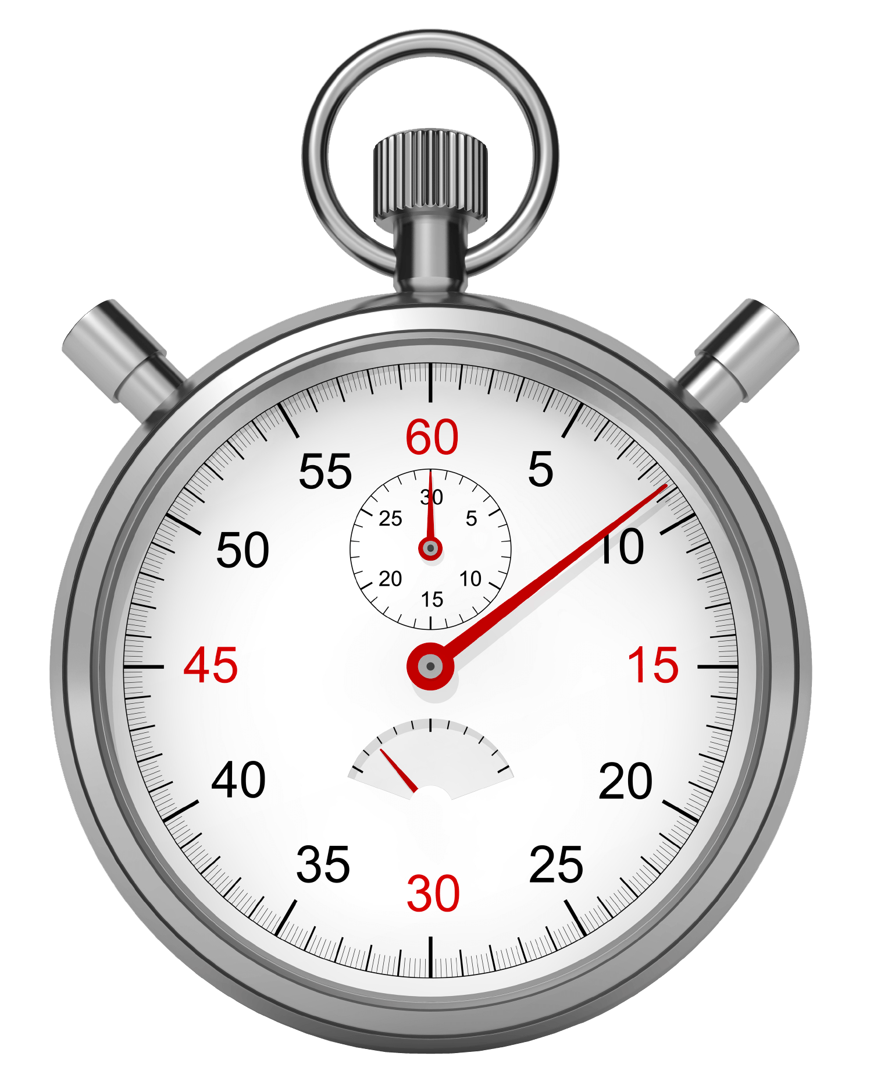
Timing System
RF Master Oscillator
88 MHz
Master Event Generator
fanout
GPS
Event
receiver
Event
receiver
fanout
Event
receiver
Event
receiver
Event
receiver
Event
receiver
Event
receiver
Event
receiver
The frequency of (88 MHz) is used as the system clock. Event receivers synchronize to that clock.
The 14 Hz frequency is generated by dividing 88.0525 MHz by 6289464 to get 14.00000064 Hz
All receivers get the same (wall-clock) time and can time-stamp acquired data and actions
Notes:
Remember: eye pattern
14 Hz will be generated internally in the EVG. De facto decision.

Slide 19
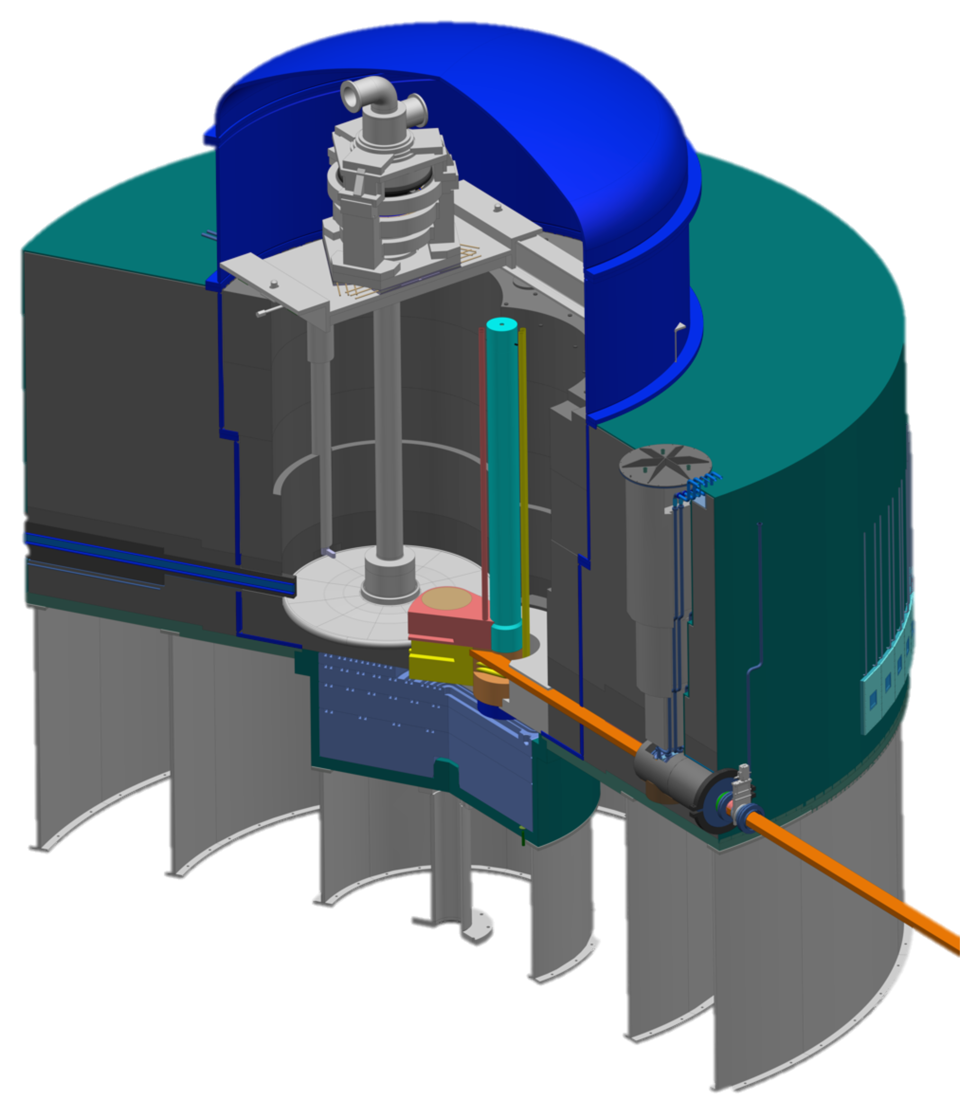
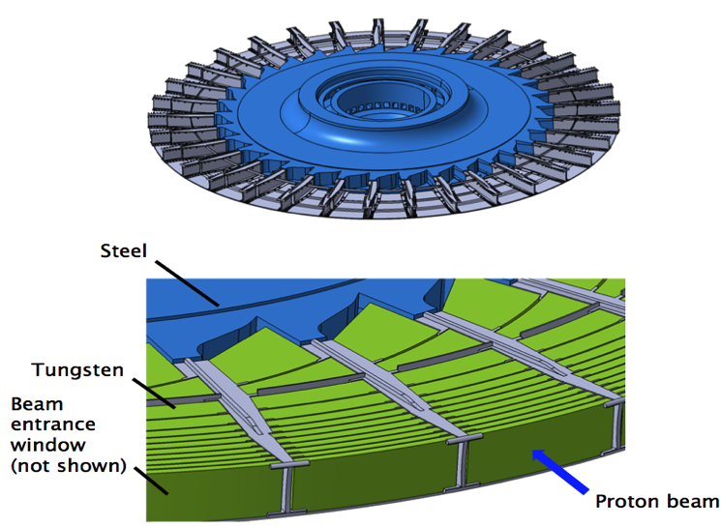
Timing Example - Target
n
p
p
Target motion must be precisely synchronized with the 14 Hz operation of the accelerator to ensure proton pulses are ‘painted’ in the middle of each sector.
No beam to target before:
  Rotation speed is correct and wheel phase and 14 Hz clock match
  Beam Rastering System is ready, etc.
  Beam destination is set ”To Target”(mode data via timing system)

Slide 20
Timing system
  Timing receiver available form factors: MTCA.4 and PCIe (to be used in a PC/Server with PCI Express expansion slots)
Practical issue to solve: communication between Target and Accelerator systems.
Timing runs on MTCA and PC platforms, a solution for EtherCAT is also underway
For EtherCAT a solution is in development. Motion control should be covered.
No direct connection to Siemens PLCs foreseen/possible.
Beam-related data could be exchanged over EPICS

Slide 21
Integrated Control System
Why are these standards important?
  Integrated upper layer: see the whole facility in coherent format
    Operation by a single crew: similar things done in a similar way makes operations easier, reduces probability of errors
    Operational data can be analyzed using same tools for every system
  Hardware standards
    Suitability to each task, cost efficiency, maintenance, personnel skills
  Timing:
    Accelerator, target, Neutron instruments are heavily dependent on each other working in sync
  EPICS: well-proven, scalable, made for scientific facilities
    Integration of different technologies
  Naming: uniform standard in the whole facility
    All operational data will be using these names – live & archived
    Operators, developers, engineers are all familiar with the names

Slide 22
Development processes
Standard development processes
  Quality control
    difficult if all systems are developed differently (we cannot expect full uniformity but should at least try to minimize differences)
  Skillset and available resources
    People (in ICS) should be able to help each other; avoid reliance on “single hero experts” whenever possible
  Diversity of developers
    Internal, in-kind, commercial, consultant
    All this has to be eventually maintained by ESS staff

