Slide 1
ESS Main Control Room
&
ICS Infrastructure
Remy Mudingay
www.europeanspallationsource.se
16 March, 2018

Slide 2
Overview
Technical Network
ESS Main Control Room

Slide 3
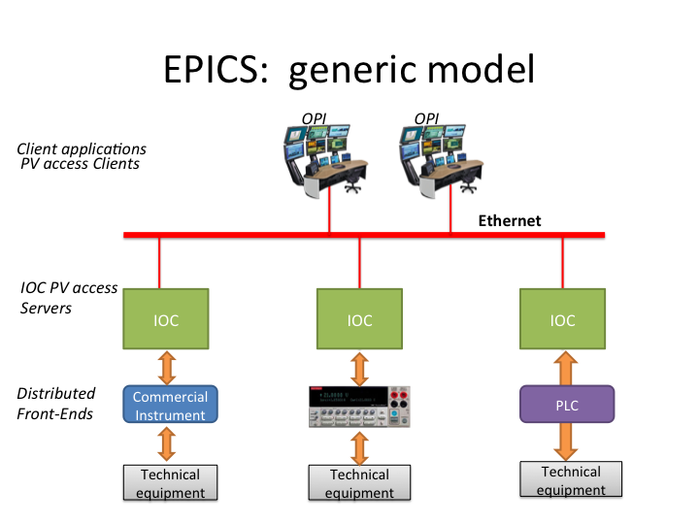
EPICS Control System
Conceptual model
Distributed
Process variable
Input Output Controller
Internet of Things
SCADA system

Slide 4
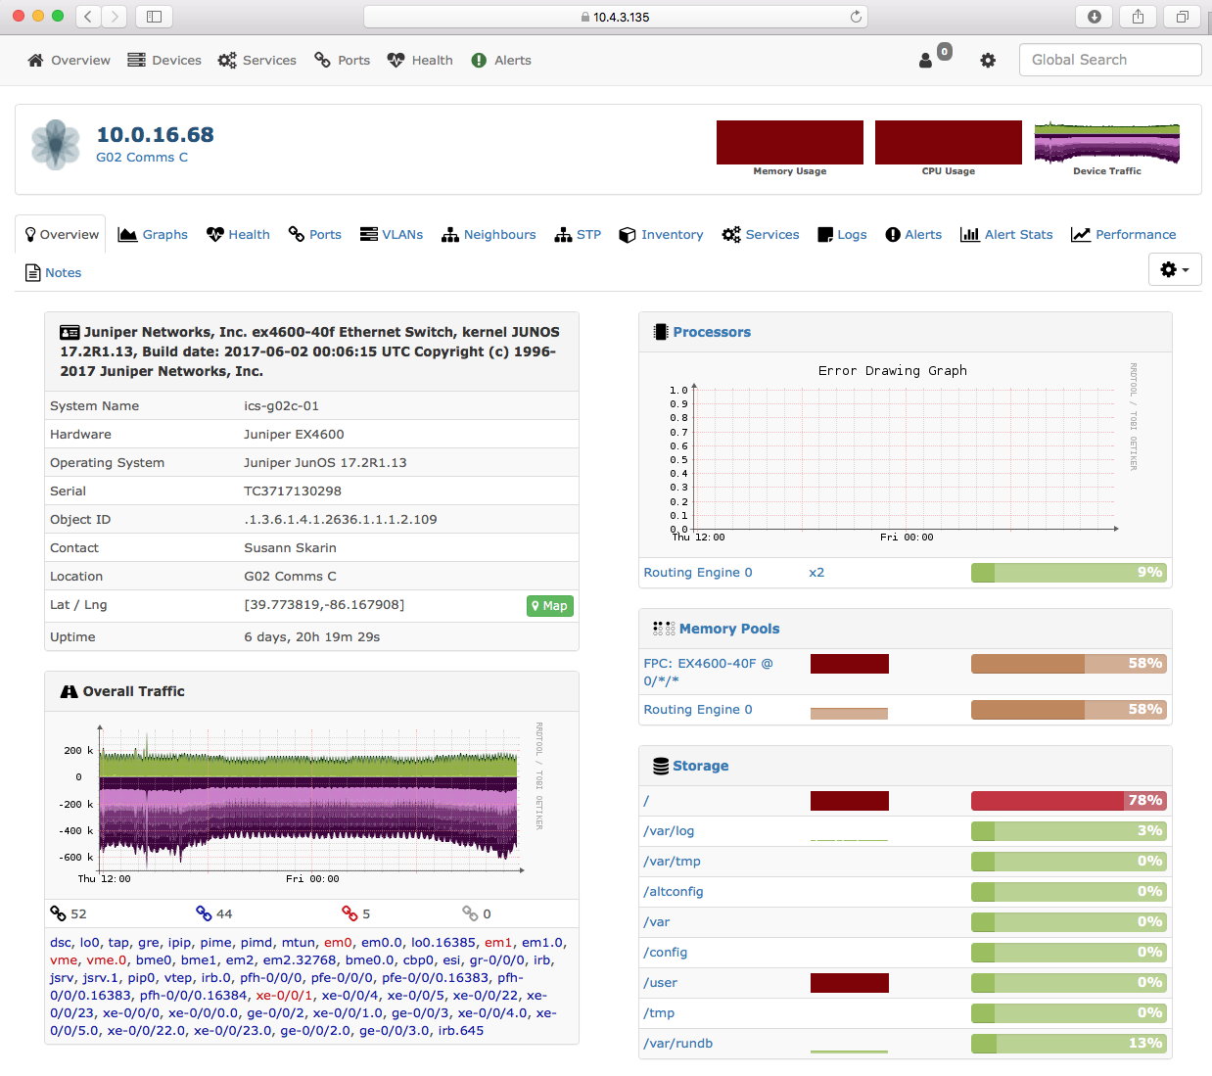
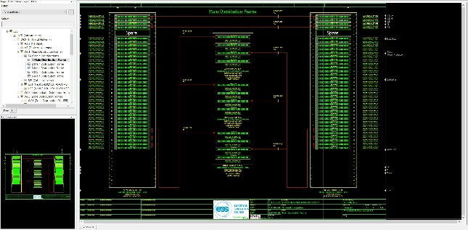
Technical Network what is it?
Technical Network?
A group of private networks that interconnect machine systems and sub-systems:
  Accelerator
  Cryogenics
  Each Neutron Instrument
  Target
  Utilities (electrical substations and HVAC)
  consoles located in Control rooms.
Physical Network
  Cables (copper and optical fibre)
    Timing system
  Telecommunication rooms (COMMS room)
  Standards, architecture and topology
  Switches
  Firewalls
Data & Communication Network
  Addressing, naming (identification and assignment) and configuration
  Baseline Monitoring, logging and incident response
Devices
  mTCA
  Scalance switches
  PLCs
  Power supply monitoring
  Industrial PCs
ESS-0057773 ICS Technical Network IP address plan
CSEntry: https://csentry.esss.lu.se

Slide 5
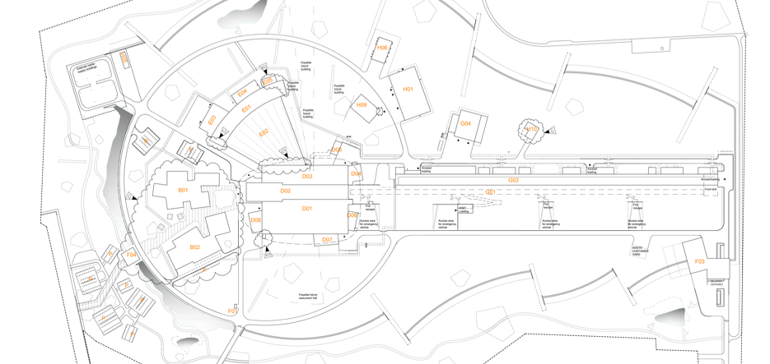
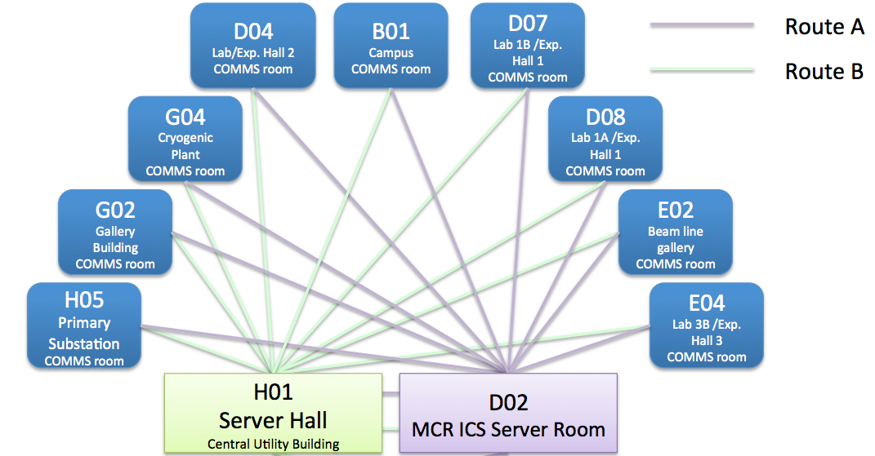
Technical Network Architecture
H01 Server room
D02 Server room
Server room
COMMS room
Fibre route A
Fibre route B

Slide 6
Technical Network
Logical Application Connectivity
GPN
Machine directorate Engineer/Technician
EPICS Archive
Storage
Control System Web application
services
EPICS
PV
Gateways
EPICS configuration services
Diagnostics
Diagnostics network
OPI
Computer infrastructure network
MCR operator
Computer infrastructure network
pvAccess network
OPI
MCR operator
Technical Network
EPICS IOC
EPICS IOC
EPICS IOC
Controllers
Power Supply
Sensors
PLC
Vacuum
pump
Magnet
Voltage
System

Slide 7
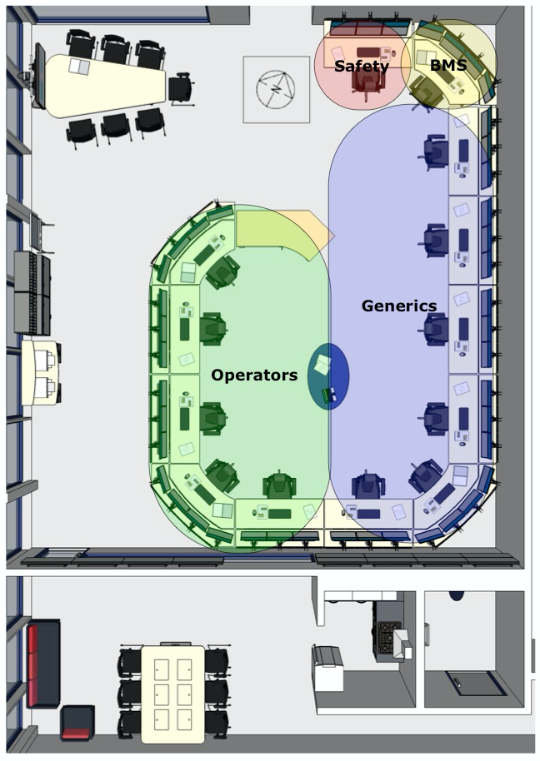
ESS Main Control Room
Local Control Room (G02)
Main Control Room (D02)
  Human factors analysis and ergonomic design according to ISO 11064 standard - design of control centres of both ESS Local & Main Control Rooms.
Requirements
  SSM
  Operators – User Reference Group ESS (URGE)
  Stakeholders
In-Kind partner IFE (Institute for Energy Technology)
IK deliveries:
  ESS-0052323 ESS MCR stage 1 – Conceptual design
  ESS-0065576 control room equipment specification
  ESS-0153747 Design of the ESS local control room
  ESS-0196596 ESS MCR environment design
  ESS-0109943 Detailed Design of ESS MCR
  MCR - stage 3 Implementation (TODO)
Main control
  Location - D02 (1st Floor)
    MCR proper 129m²
    Total 208m²
  Delivery – 2019 TBD

