Slide 1
Control System
EPICS Client Software
Susanne Regnell
ESS/ICS
Date: 2018-02-16

Slide 2
Control System Studio
... is an Eclipse-based collection of tools to monitor and operate a large scale control system (EPICS)
  Display Builder
  Data Browser (live or archived data)
  Data Probe (to look at a specific value)
  Alarms Viewer (BEAST)
  Archiver Appliance
  Directory Service (also called Channel Finder)
  Save & Restore (Process Variable settings)
Official homepage: http://controlsystemstudio.org/

Slide 3
The Architecture of EPICS
Network-based Client/Server Model
Process Variables communicated over computer network using PVAccess protocol
A Server provides information and service
A Client uses the service or asks for the information
PVA
PVA
Client
Client
PVA
PVA
Server
Server
For EPICS, client and server refer to their PVAccess role: i.e. PVAccess Client and PVAccess Server (PV = Process Variable)
This standard control system architecture is often called 3-tier architecture
  Client – Server – I/O
[Slide from Timo]

Slide 4
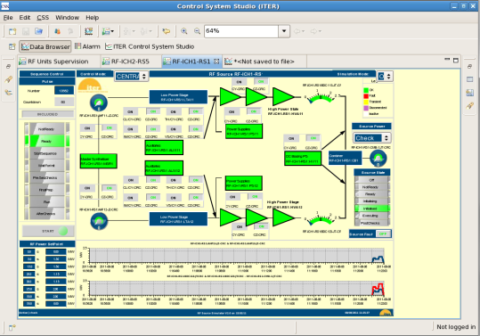
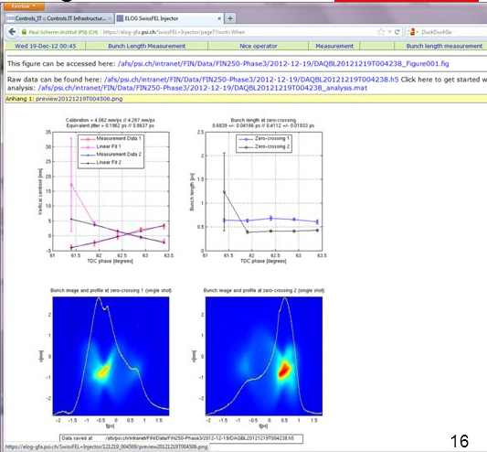
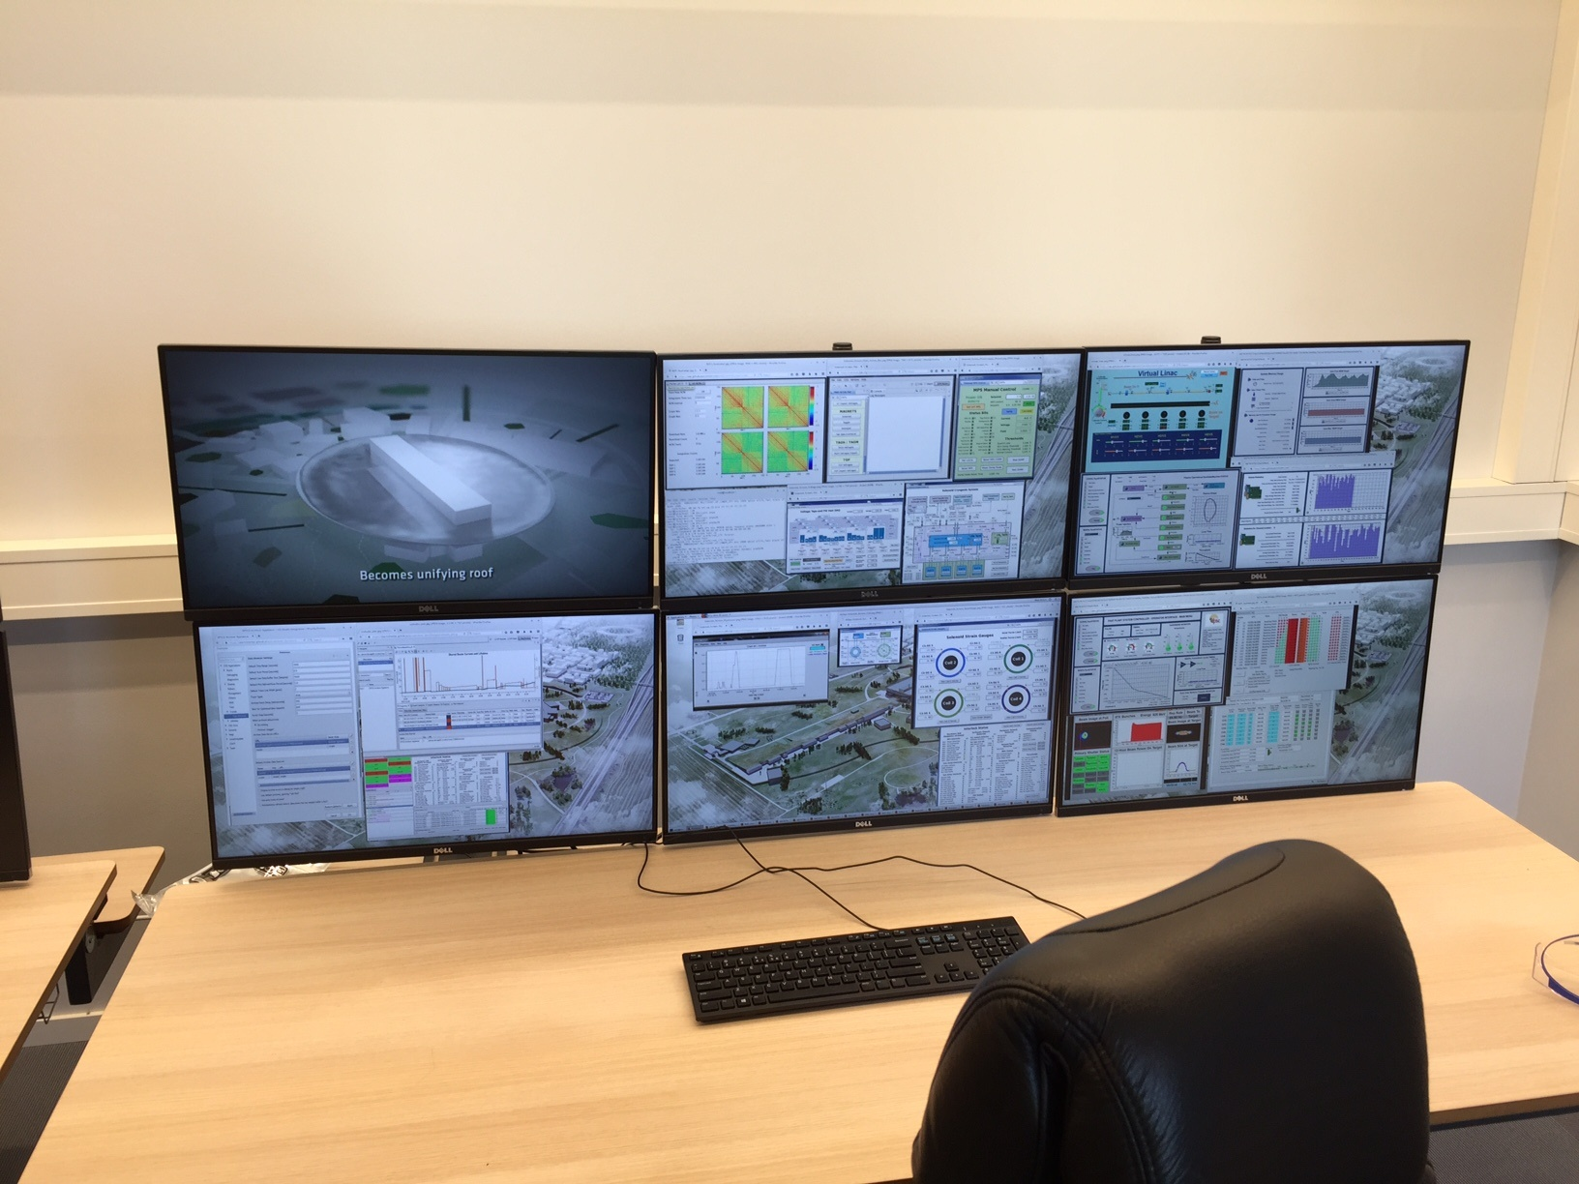
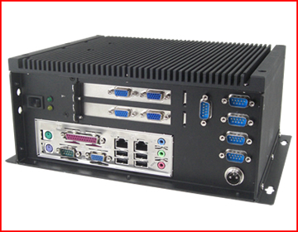
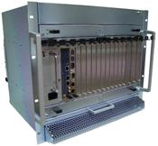
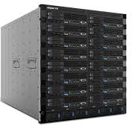


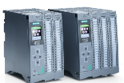
Servers and Clients at ESS
PVA
PVA
PVA
Client
Client
Client(s)
PVA
Server
PVA
PVA
Server
Server
Industrial automation (PLC)
100 MHz
10 MHz
1 MHz
100 kHz
10 kHz
1 kHz
100 Hz
10 Hz
1 Hz
0.1 Hz
[Slide from Timo]

Slide 5
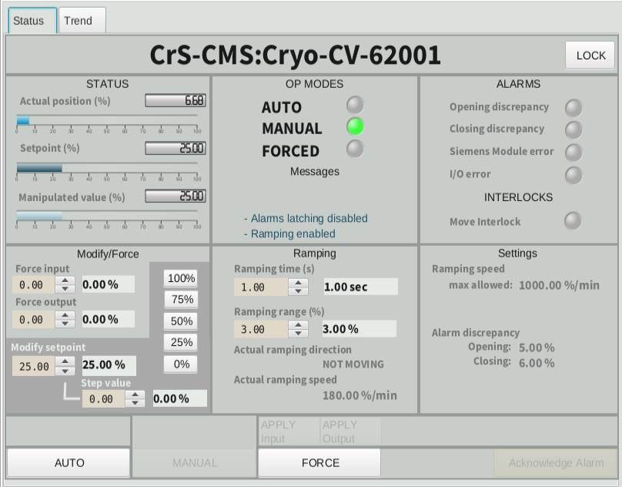
CS-Studio (Display Builder)
Operator Interface screens (OPIs) – EPICS Clients
Example of an OPI

Slide 6
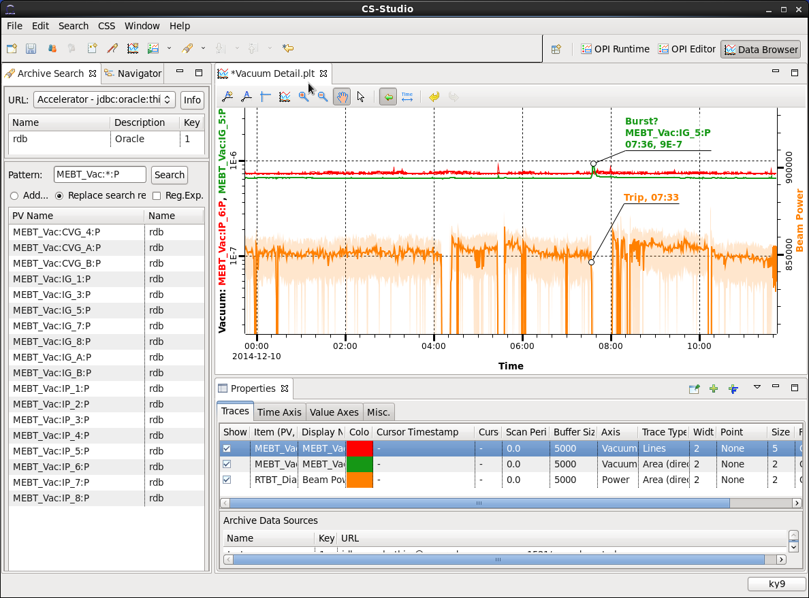
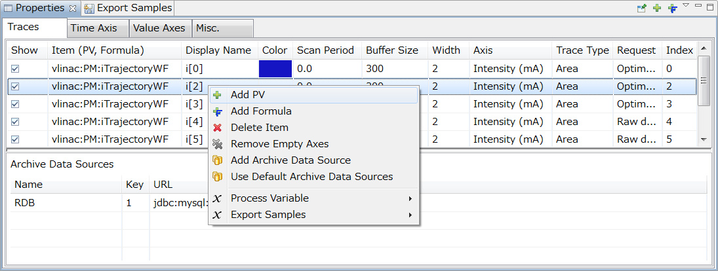
CS-Studio (Data Browser)
EPICS Client

Slide 7
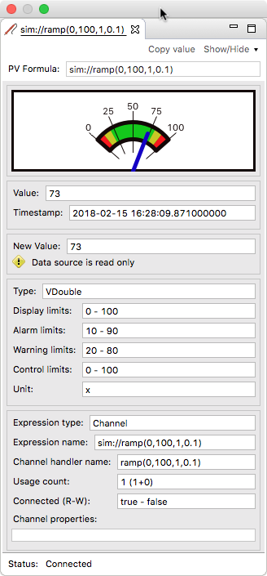
CS-Studio (Data Probe)
(EPICS Client)
Used to look at live values from
a single PV

Slide 8
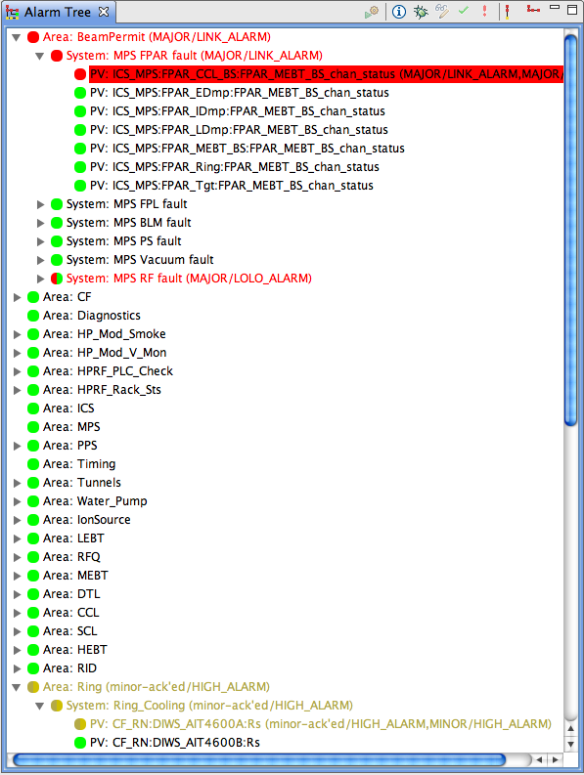
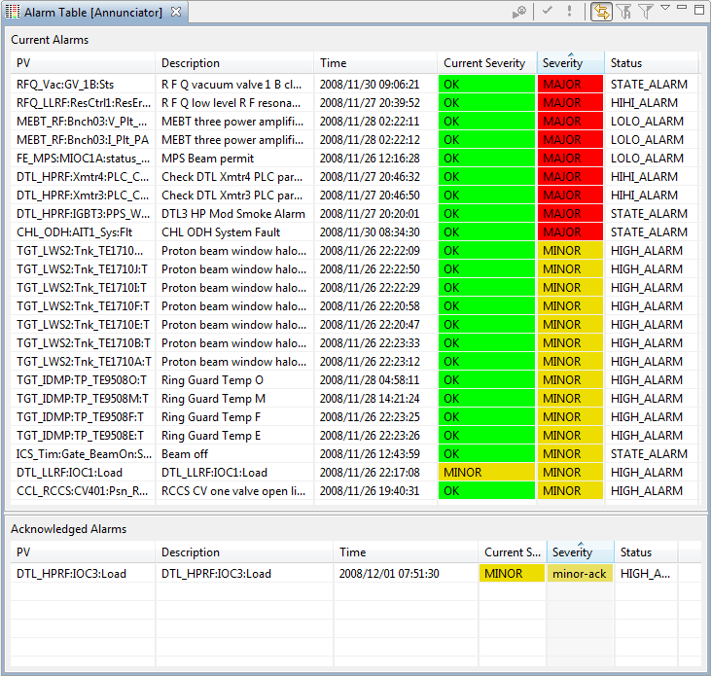
CS-Studio (Alarms Viewer)
EPICS Client

Slide 9
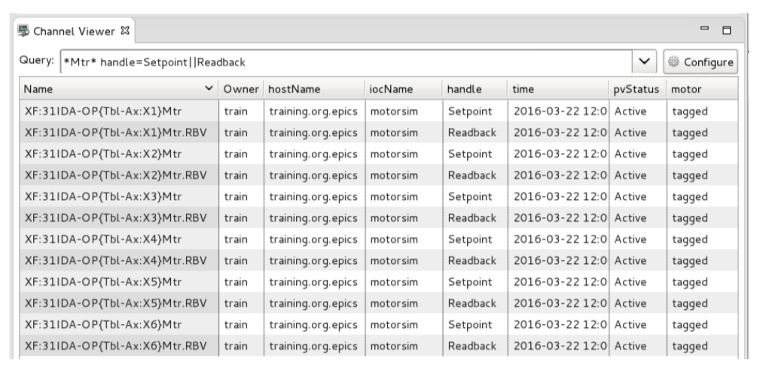
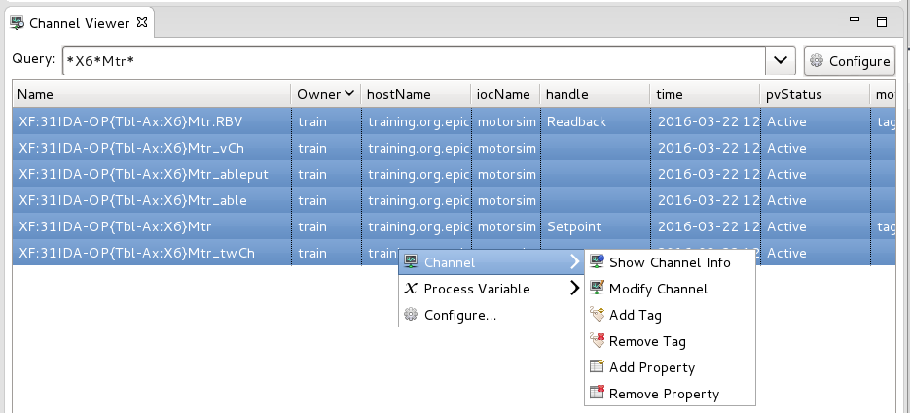
CS-Studio Channel Finder
Directory service for EPICS Channels
EPICS Client
Problem: EPICS has a flat name space
Solution: Generic Directory Service (Channel Finder)
EPICS clients need to know with which channel to communicate
Query for name, property value and tags associated with channels

Slide 10
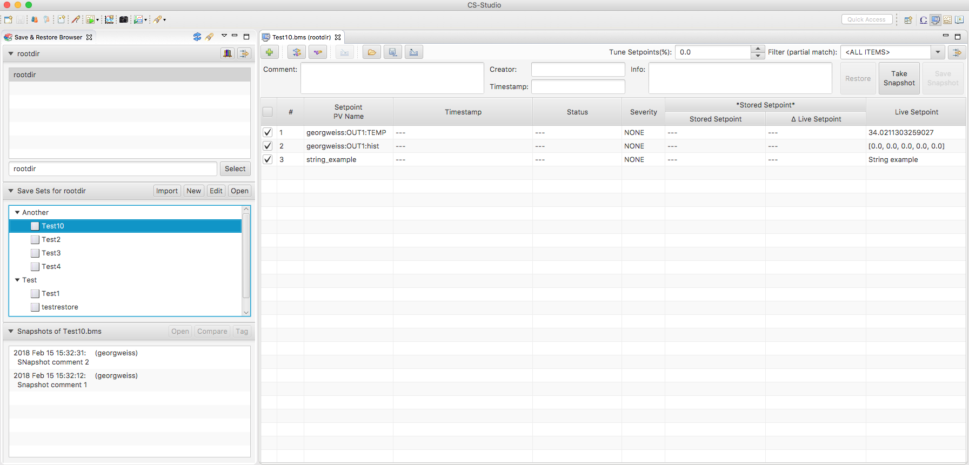
CS-Studio Save & Restore (EPICS Client)
”Save Sets” organised in folder structure.
Users maintain Save Sets, each defining an arbitrary number of PVs (channels).

Slide 11
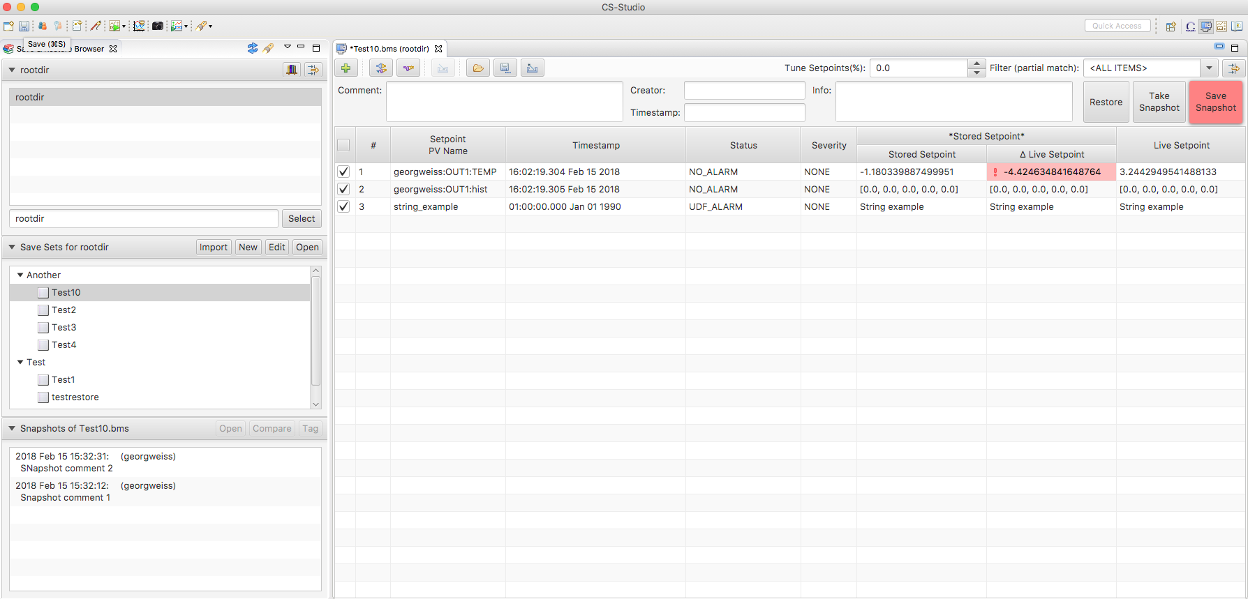
CS Studio Save & Restore
User presses ”Take snapshot”, current values from PVs in the Save Set are retrieved.
User presses ”Save snapshot” to commit the snapshot to the repository.
User presses ”Restore” to write values from snapshot to PVs.

Slide 12
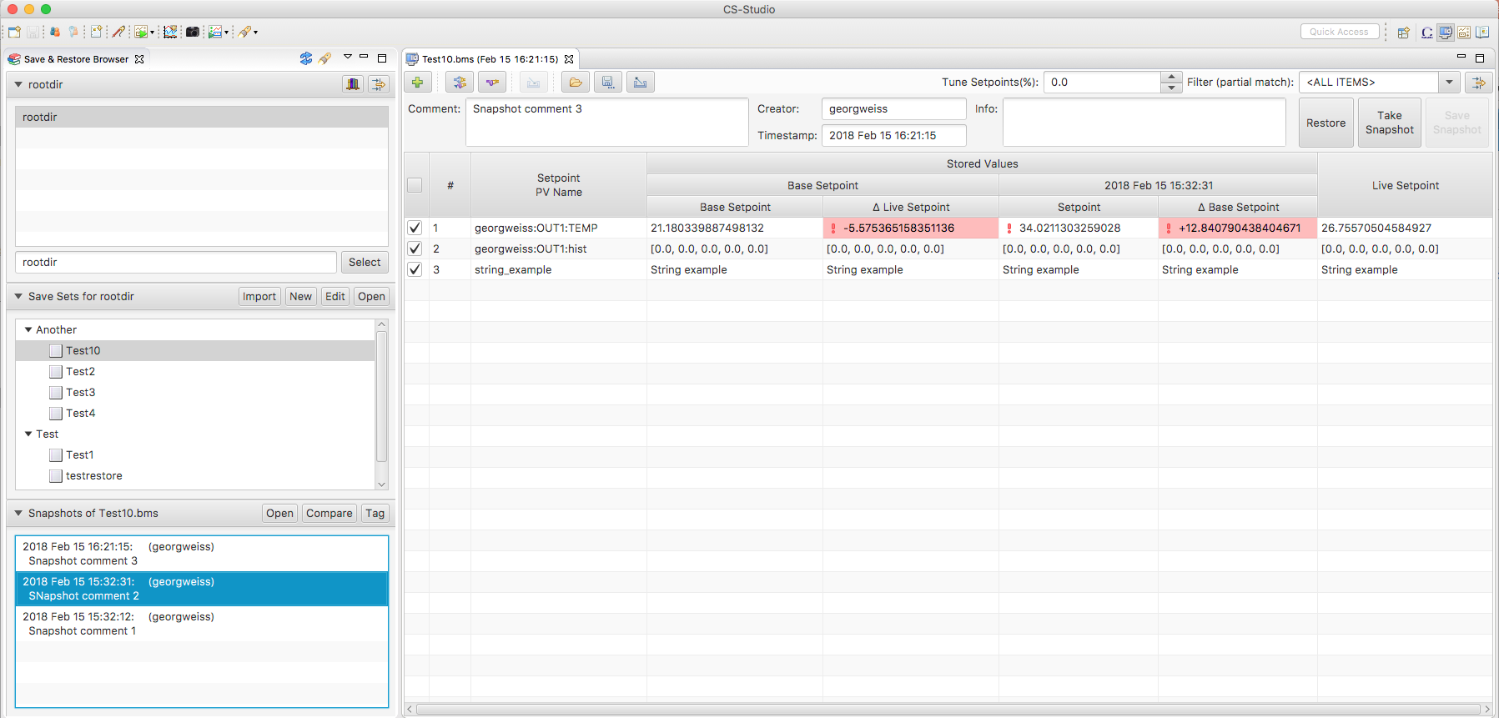
CS Studio Save & Restore
Two (or more) snapshots can be compared.

Slide 13
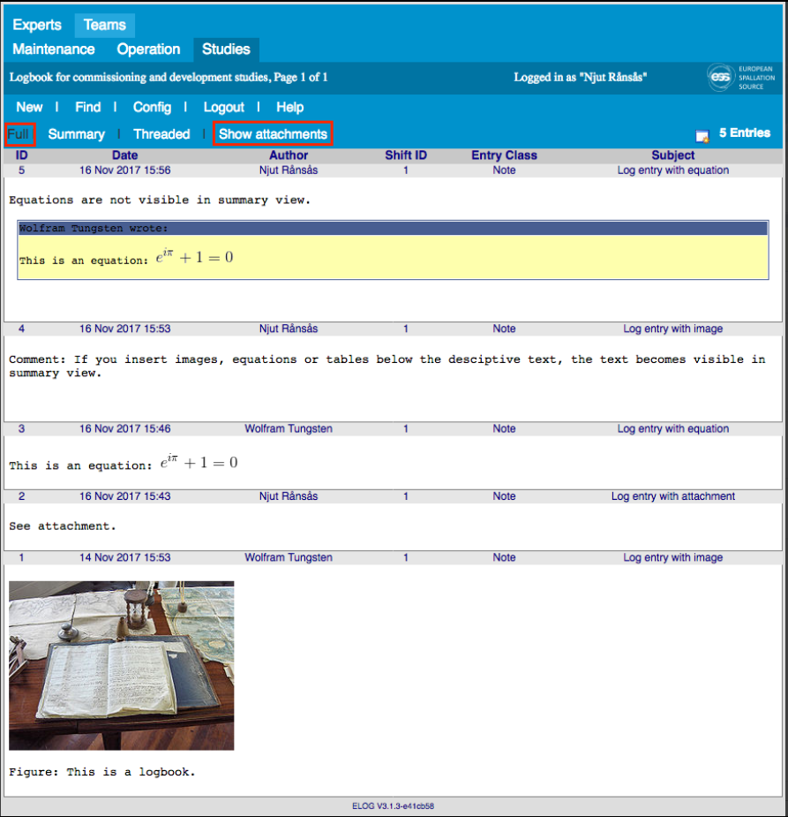
Electronic Logbook
Logbook (Confluence pages)

Slide 14
Other software
Open XAL framework for High level Physics applications (in production)
Post Mortem system (not started)
Operation Sequencer (not started)
Naming Service (Naming Convention) (in production)
Controls Configuration Database (in production)
Cable Database (in production)
IOC Factory (in production)
Calibration Service (under implementation)

